Slide 1

The use of PPAs for Energy Security planning proposals
17 October 2023
www.pas.gov.uk

Slide 2
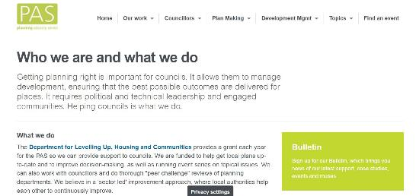
Planning Advisory Service (PAS)
Team of 15
Part of Local Government Association
Funded by DLUHC and Defra to support English planning authorities
“PAS exists to support local planning authorities in providing effective and efficient planning services and to support the implementation of changes in the planning system”
Notes:
Poll (Zoom): have you worked with PAS before?

Slide 3
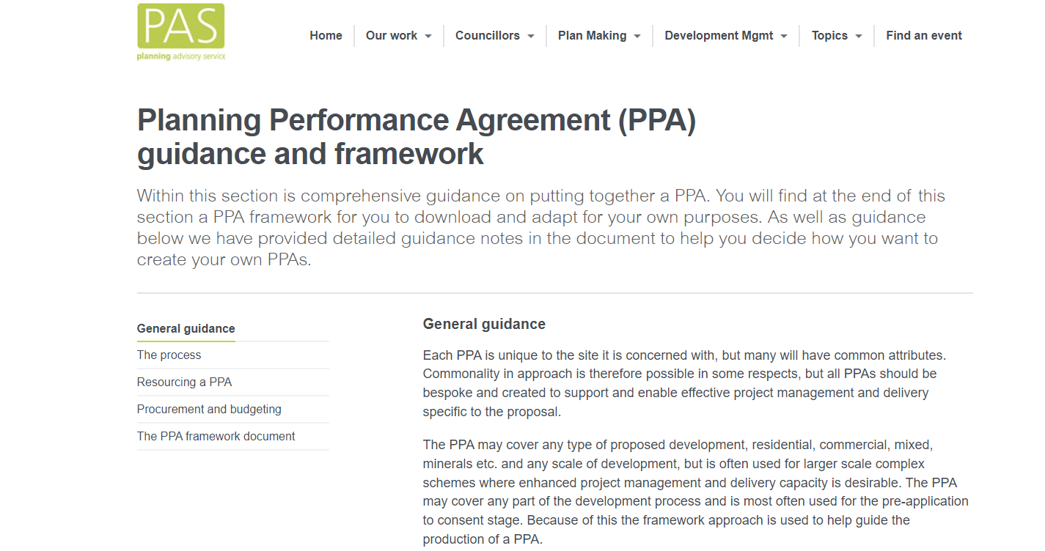


Best practice in pre apps and PPAs
Notes:
ATLAS

Slide 4
What is a Planning Performance Agreement (PPA)?
A project management tool used for planning applications, which enable all parties to be clear about what is required of them at all stages of the planning application process.

Slide 5
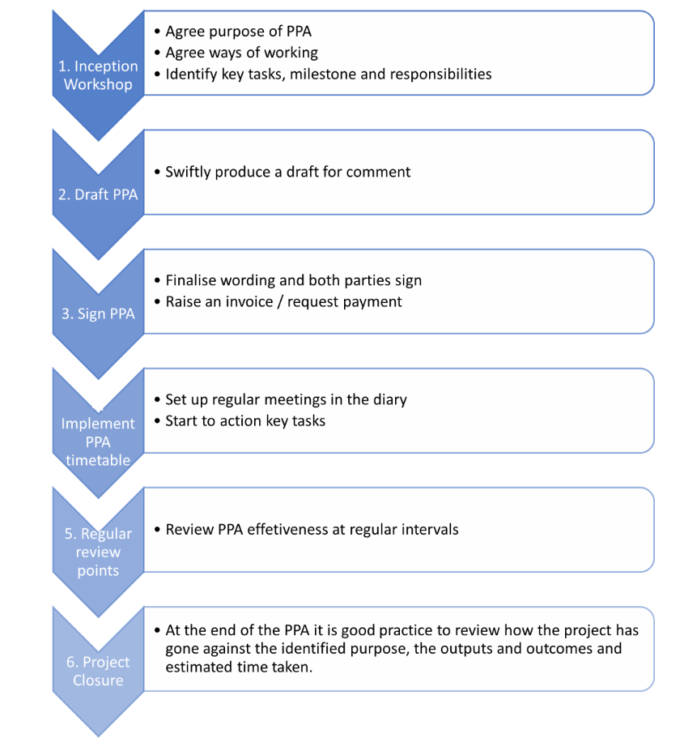
The process
Notes:
All parties – LPA, applicant, consultees and other stakeholders

Slide 6
Key principles
Good to take a common approach as long as each PPA is bespoke to the proposal
Can cover any development proposal, but is usually used for large-scale and complex applications
Can cover any stage of the development process, but works best if it covers the whole lifecycle of a planning application
They are a project management tool and don’t have to be complicated
Everyone involved needs to agree to the PPA
Notes:
Lifecycle ideally to include post decision matters

Slide 7
Stage 1 - Inception
What is the purpose of the PPA?
Who are the signatories to the PPA?
What are the issues to be addressed?
Who are the individuals who are running the show?
Who’s on the project team?
Notes:
Purpose – complex, contentious, time dependent, involve many parties, strategic,
Signatories – applicant, LPA, funders, outside bodies
Issues – 1 key issue, many layered and interdependent, politics
Individuals – usually case officer and applicant project manager
Project team – key people who are critical to delivery

Slide 8
Stage 1 - Inception
Who are the other stakeholders?
Key dates and milestones
Performance standards
What are the risks?
Who’s paying?
Does this stage need a whole day workshop, exchange of emails or a chat with a few key people?
Notes:
Stakeholders – consultees, Members, community organisations, Govt departments, funders
Milestones – Applicant over optimistic
Performance standards – agree lead in times for info, response times, formal consultation responses, attendance at meetings
Risks – funding deadlines, critical infrastructure to be delivered, planning committee, other council decisions

Slide 9
Stage 2 – draft the PPA
Use the PAS framework
Base it on inception workshop
Normally LPA to lead on getting it agreed and signed
Don’t overcomplicate matters and avoid lawyers if you can
Do it quickly and don’t expect it to be perfect

Slide 10
Stage 3 – sign the PPA
Ensure it is signed by the organisations that matter
For LPA this should be chief Planner / Head of Service
Who are the accountable individuals?
Has everyone in the project team “signed up” to the PPA
Are you making it public – better if you do?
Notes:
Organisations that matter – LPA, applicant, other key signatories
Public – if not why not

Slide 11
Stage 4 – implement the PPA
Arrange meetings linked to key milestones and diarise the project, including the PPA project review meetings
Raise invoices if payments are to be made
Procure consultants if needed
Put resources in place
Set up working groups as necessary
Monitoring arrangements
Notes:
People on holiday?
Resources – dedicated case officer?

Slide 12
Stage 5 – project review
Is collaboration going as intended?
Are you having review meetings at the right intervals?
Are you meeting key milestones? If not what are you doing about it?
Are the right resources going into the work? If not what are you going to do about it?
Are you achieving the right outcomes? If not what are you going to do about it?

Slide 13
Stage 5 – project review
Do you need to change the PPA? How are you going to agree changes?
Is the PPA doing what you thought it would do? Is it working for everyone?

Slide 14
Stage 6 – project closure
Review the outcomes and outputs – are they the same as in the inception meeting?
What worked well and what didn’t work well?
Has it been value for money?
Will all parties do it again? If not, why?

Slide 15
Resourcing a PPA
Can it be resourced without additional staff?
Do you backfill or bring in new people?
How long do you need the additional resources?
What are the training needs?
Can you use more junior staff as a development opportunity to assist lead?
Do you need a separate project manager?

Slide 16
Resourcing a PPA
How will you cost the work and recharge time? pre-app fees calculator
Who is paying for external support and specialists?
How will you manage changes in costs?

Slide 17
Procurement and budgeting
Understand your procurement rules and leave yourself enough time for procurement
Do you need to set up a call-off contract with a number of suppliers and what does Finance think about that?
Alternatively a procurement framework?
Upfront fees or staged payments?
Where does the income go? Governance?

