Slide 1
DM cribsheet
Richard Crawley, Programme Manager
Leadership academy Oct 15
www.pas.gov.uk

Slide 2
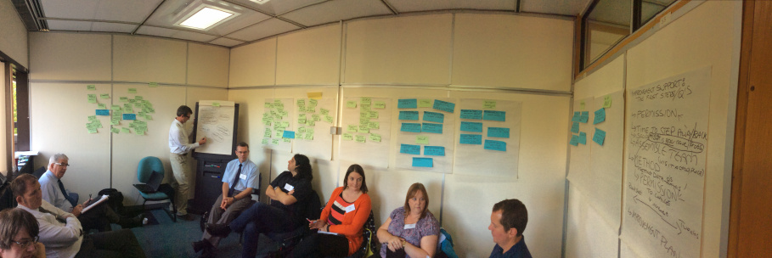
My secret cribsheet
In preparation for non-majors designation
How do the top councils help the bottom councils?
We asked our top 10 for their help and these councils answered our call:
  Bolton, Bournemouth, Bury, Hastings, Notts, Rotherham, Wolverhampton

Slide 3
Top 10 councils
Have quick end-to-end times
And low waste (withdrawns)

Slide 4
Is there one way to do things ?
Common approaches / behaviours
  Prepared to learn
  Share and work with colleagues
  Dig into things and challenge
Cribsheet = observations and good prompts
PS Useful on peer challenges (become a peer! See the world !)

Slide 5
Cribsheet structure
Culture and ‘enablers’
Process cribsheet
Your view
  Check culture
  Check first process
  Find something you don’t agree with ? Something missing ?
Do ‘councillors’ or ‘leadership’ need their own page ? Is it useful ?

