Slide 1
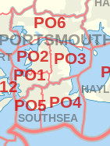
Geographic spread
postcode | count
PO1 | 551
PO2 | 163
PO3 | 31
PO4 | 1464
PO5 | 1553
PO6 | 34

Slide 2
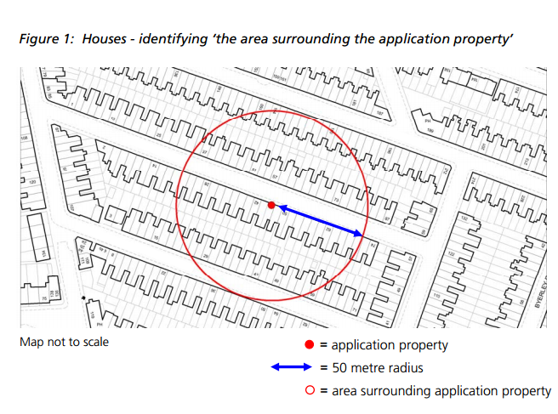
50m rule

Slide 3
Other approaches
Bath and NE Somerset: If 25% of properties in census output area are HMOs and 25% within 100m then refuse
York: neighbourhood area concentration under 20% and proportion within 100m under 10% then pass
Oxford: proportion within 100m of street length under 20% then pass
Southampton: proportion within 40m under 20% then pass

Slide 4
Number of applications

