Slide 1
Expedited Written Representations

Slide 2


Housekeeping
Please keep mic on mute unless invited to speak
Use SLIDO to ask questions and answer polls: https://app.sli.do/event/4RGtNAxpzE68QpxmFo4B13
It is impossible to cover everything today - but we are collecting questions and issues to share with PINS
Notes:
Anna

Slide 3
First poll
About you…..
What is your role?
Notes:
Anna with Garreth monitoring Slido

Slide 4
Background
The Part 1 written representations process was introduced in 2009 to provide a simpler, quicker method for certain appeals (Householder and Minor Commercial).
Following consultation in March 2024 and Ministerial approval in November 2024, the revised legislation expands the scope of Part 1 appeals to include the majority of written representation appeals.
Notes:
Lauren from here onwards
As many of you will recall...the part 1 written reps process came into effect in 2009 in relation to householder apps, and expanded in 2013 to include minor commercial apps and advertisement consents. It provided for a simpler, quicker process, and faster determination of these appeals by the Planning Inspectorate, known as PINS. PINS administer the planning appeals system and determine appeals, on behalf of the Sec of State.
The amendment to the written reps procedure regulations means that the part 1 expedited procedure becomes the default appeal procedure for all appeals under section 78(1) of the TCPA. A list of appeals which will follow the part 1 procedure is found at para 9.1.3 in the amended procedural guide for appeals. Importantly these regulations also clarify that under this route, no new material can be submitted by appellants when they appeal. They come into force on 1st April and therefore affect planning applications submitted on or after 1 April (note – explanatory memorandum states "applications made".
The vast majority of appeals are written representations, 95% in fact at the latest count.
Only 4% of appeals are hearings (this is where the planning inspector needs to ask questions about the evidence)
and only 1% of appeals are inquiries and this is when it is necessary to test evidence under cross examination.

Slide 5
Why?
To speed up decision-making and reduce uncertainty for communities and developers
Encourages complete, high-quality submissions at the application stage (“submit once, submit right”)
To address delays caused by late evidence and unnecessary duplication
Keep decisions local
Notes:
The current expedited procedure for householders allows for the quicker determination of appeals as there is no opportunity for any party to submit further reps. All reps submitted during the application form part of the appeal and so in effect, the appeal is determined on the same basis as the original app.
However, the standard written reps procedure allows appellants and LPAs to submit further information and evidence and to comment on each others reps. 3rd parties can also submit further reps and comment on the appellant's case. All together, this causes additional delay.
MHCLG stats show that in the year ending March 24, PINS determined almost 14K appeals, of which almost 9K were through the standard written reps procedure. Such appeal types take on average 29 weeks to determine, compared to h/hs through the expedited procedure took an average of 11 weeks less.
For these reasons, expanding the expedited procedure will allow more appeals to be decided more quickly.
It will reduce some of the pressure and time spent by LPAs by removing the need to submit a statement of case.
And it will remove the need to process and publish reps from interested parties.
Because no new or amended information can be submitted, The changes will encourage applicants to submit high quality, complete submissions at the outset and potentially reduce the number of appeals as a result – thereby keeping decisions local.

Slide 6
For Local Planning Authorities
Evidence will be based on the Decision Notice, Officer or Committee Report and information contained within the Questionnaire (no opportunity to send an additional statement)
Officer and committee reports should contain thorough reasoning
By choosing to list all plans and documents in the decision notice, the LPA may find that this speeds up and simplifies the process at appeal stage
Will need to provide copies of all documents and plans determined as part of the original application at appeal
Responsible for ensuring parties are aware that should the application be determined at appeal, there will be no further opportunity to comment or submit evidence
Train staff, update templates (e.g. notification letters, site notices, press adverts etc.), guidance and webpages, and inform Members
Model Notification letter templates for Appeals to be updated by PINS
Notes:
This slide summarises the main implications for yourselves as local planning authorities:
Evidence will be based on the Decision Notice, Officer or Committee Report, committee minutes and information contained within the Questionnaire. There is no submission of additional statements.
For this reason you will need to ensure that your reports are robust, with sound justification of refusal reasons. for cttee overturns, members must state their reasons and Meeting minutes need to accurately capture these
As is best practice, decision notices should list all plans and documents that the application has been determined against.
With reference to the list on the decision notice, you will submit all application docs and plans to PINS, including the appeal questionnaire and officer report, committee report and minutes.
The publicity obligations on LPAs has changed, meaning you have the responsibility of ensuring that all parties know that if the application is determined by the expedited written reps procedure, their comments will be forwarded to PINS and there is no opportunity to comment or submit evidence during the appeal, therefore they must submit them before the application is determined.
The onus is on you to train staff, update your templates and webpages, and inform your members
We recognise that there will be a famiiarisation process to be gone through and PINS are due to publish updated model notification letters to help you, and in the meantime they have provided draft wording which I will come to on another slide shortly. The updated procedural guide for appeals is available now so you can start to prepare.

Slide 7
For Applicants
Must submit all relevant documentation at application stage
No opportunity to submit new evidence at appeal
Appeals should not be used as an opportunity to evolve the scheme
Engage in proactive dialogue with the LPA to resolve potential disputes during the application process
A simpler, more streamlined appeals process, with no need to submit a statement or final comments
Statutory deadlines for lodging an appeal remain the same
Completed planning obligation to be submitted at time of making appeal
The Planning Inspectorate will continue to apply the Criteria for Determining the procedure
Notes:
We will now consider the changes from the perspective of the applicant:
They must submit the necessary information at application stage as there is no opportunity to submit anything more at appeal stage BUT do take note of para 9.2.2.1 in the procedural guide which sets out an exception to this – where there has been a material change of circumstance since the LPA issued the decision – the applicant can make this claim on the appeal form.
Appeals can no longer be used to amend or evolve schemes
As such this reinforces the importance of applicants engaging with you early, ideally at the pre-app stage. If issues come to light at application stage, applicants or their agents should engage with you and seek to address issues if possible within the appropriate timescales.
Applicants will benefit from a simpler, streamlined process which should result in faster appeal decisions
If relevant, Applicants must submit their completed planning obligations with their appeals at the outset, alongside the appeal form, application form, decision notice, and lists of all documents submitted to the LPA when the application was made, as well as list of any other documents submitted at a later date e.g. amended plans.
Important to note that PINS will continue to apply their criteria for determining the appropriate procedure. Most appeals will follow the part 1 written reps procedure but the inspector has the right to transfer an appeal to a diferent prcedure if appropriate.

Slide 8
For Interested Parties
Important that interested parties make full comment at application stage as no further opportunity to comment during a part 1 appeal
Comments made at the application stage will remain relevant at the appeal stage, as Part 1 appeals will not introduce any new information
Interested parties can be assured that a scheme will not evolve through Part 1 appeal process
Less burden on interested parties to resubmit comments
Have 4 weeks from the start date of the appeal to withdraw any earlier comments
Notes:
Interested parties must make all of their comments before the application is determined because they will not have any further chance once the appeal has been submitted. This links back to the obligations on yourselves as LPA to ensure they are aware of this.
Their comments will remain relevant at appeal stage, as the development will not have been amended or further info submitted at appeal.
There is less burden on interested parties as a result of the changes but it is important that the changes are communicated, including to members who residents are likely to contact.
If they wish for their comments to be withdrawn, they can do so within 4 weeks of the start date of the appeal.

Slide 9
Useful Resources
The Planning Inspectorate have updated their Procedure Guide to reflect how the changes will be administered
New ‘Appeal a planning decision’ journey from mid-May 2026
Suggested wording for Notification Letters:
‘ Any person wishing to make representations about this application, can submit comments XXX by XXX. Please be aware that should this application result in an appeal deemed suitable for the Part 1 Written Representations procedure, this may be the only opportunity for interested parties to submit their representations. Should an interested parties wish to withdraw their original comment at appeal stage, they can do so within 4 weeks of the start date of the appeal'
Notes:
Now I will move on to show you the useful resources available from PINS, which I have already made reference to:
The PINS procedural guide to appeals has been updated and so you are encouraged to read and digest this now.
From around mid may PINS are producing an "appeal a planning decision" journey which is an updated online submission route. It will streamline how appeals are submitted, similar to the simplified approach already used for Householder Appeals. As a result, appellants will see fewer steps and a more intuitive process when submitting their appeal.
PINS have provided us with suggested wording for your notification letters which you take from this slide – we will be sharing the slides after the webinar.

Slide 10
PAS's initial take on this...
We expect most LPAs to welcome the changes – let us know
We think the changes reinforce the need for:
  effective pre-application services
  up-to-date local lists for validation
  good committee chairing and minute-taking
  effective communication with no surprise refusal reasons and conditions
  robust (but not excessive) report writing
  clear information for your teams, members and customers
Notes:
We understand that you may have many different thoughts and questions on the effect of the changes to the Part 1 procedure. Here in the PAS team we have reflected on the changes and we wanted to share these initial observations with you:
Firstly we expect that most of you will welcome the changes, certainly in principle, and particularly preventing the submission of amendments or further information at appeal stage. That said, we know how busy you are and we recognise there will be a familiaration process to go through and additional work to update guidance and notices for example.
2. We think that the changes reinforce the need for a number of key points – which relate back to the principles of best practice in planning.
Effective pre-app services – the general thrust of the changes is putting the emphasis on the applicant to submit higher quality applications so early and effective engagement is key.
Local lists need to be up to date and easily accessible on your websites
In regards to committee overturns in particular, chairs need to be well-trained and strong, and they must ensure that members explain their reasons for refusing applications contrary to officer recommendation> This must be captured in the minutes of the committee meeting, as this forms a key part of the council’s case at appeal.
Case officers having the time and space to communicate effectively with applicants and agents before applications are decided. Reasons for refusal should not come as a surprise and opportunities to reduce these should be taken.
As there is no opportunity to submit a statement of case, your only chance is the officer report. As such they must robustly justify reasons for refusal but should remain concise
An appropriate team member to take the lead on training all relevant officers on the part 1 changes and implementing the necessary changes to your procedures, letters, websites etc. It is really important that the changes are communicated to your members and customers also.

Slide 11
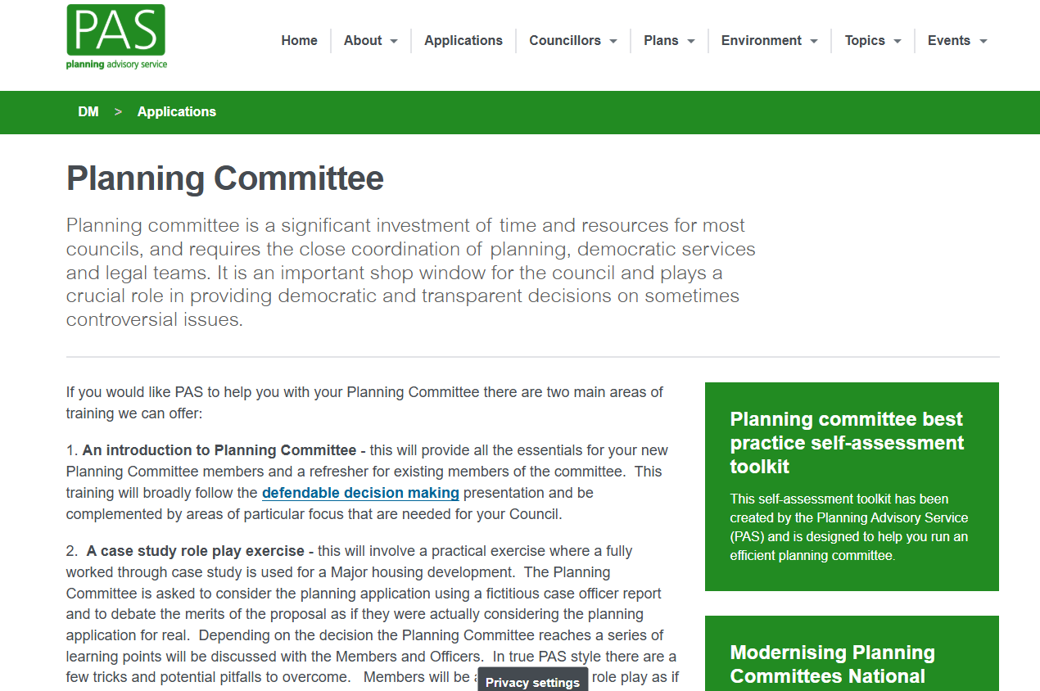
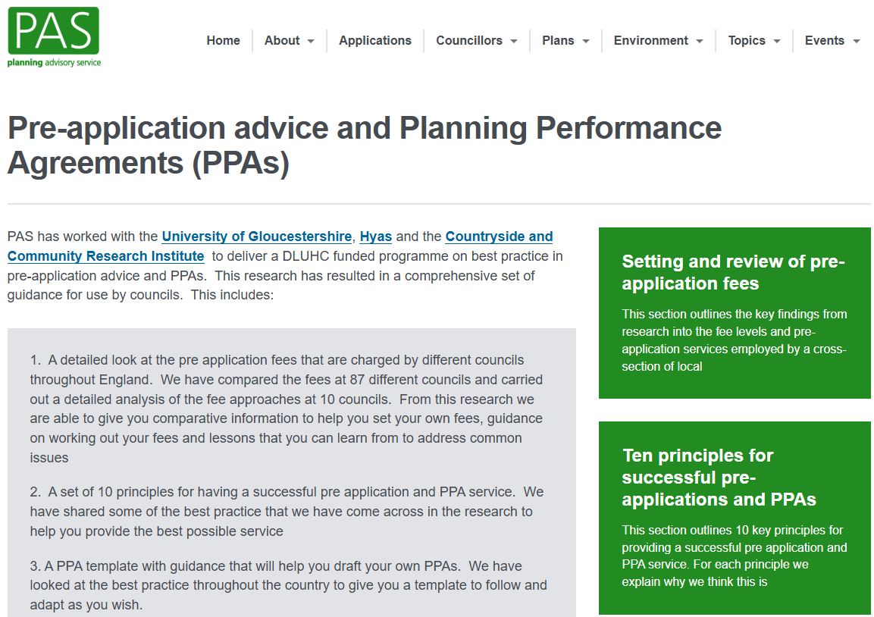

How PAS can support you
Planning Committee
Pre-application advice and Planning Performance Agreements
Development Management Challenge Toolkit
Notes:
Here at PAS we have lots of support available for you in development management, in the form of online resources and toolkits.
We really do recommend following the links in the slides to see what is available.
For example on the development management pages we have best practice from high perfomring councils on writing robust officer reports.
We have a set of 10 key principles for running successful pre-application and PPA services.
And we have a section dedicated to planning committee including a toolkit with a wealth of best practice from chairing skills, to officer presentations.
Please do utilise these resources, and we hope they will assist you in realising the intended benefits of the changes to the appeals procedure.
thank you very much for listening and I hope this has been a useful overview and reflection. I will now hand back to Anna and Garreth for a discussion on the slido feedback.

Slide 12
Finally….thank you for joining
Please fill out feedback polls in Slido…..
Have you found today’s event helpful?
To what extent has it improved your understanding of the changes?
How positive are you about these changes to the appeals regs?
What is your main take-away from what you have heard?
Anything you need more information about?

