Slide 1
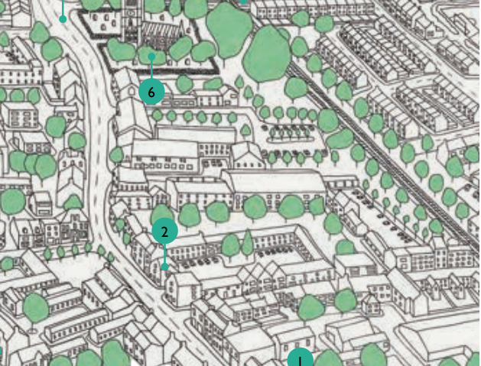
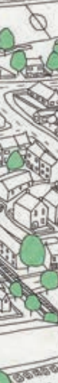

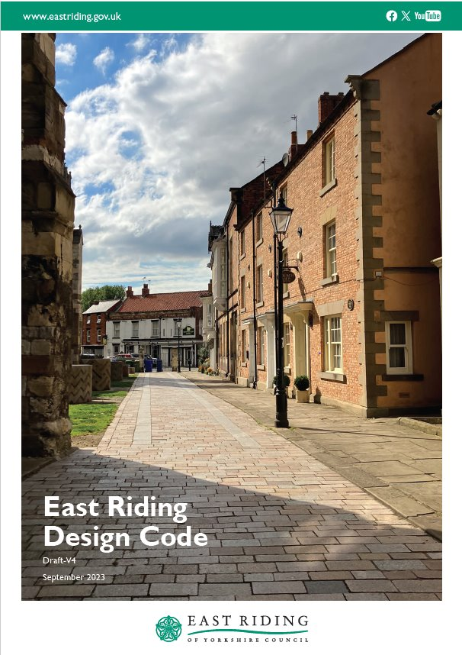
Design Code Practitioners Network for Local Authorities
26TH March 2024
planningdesign@eastriding.gov.uk

Slide 2
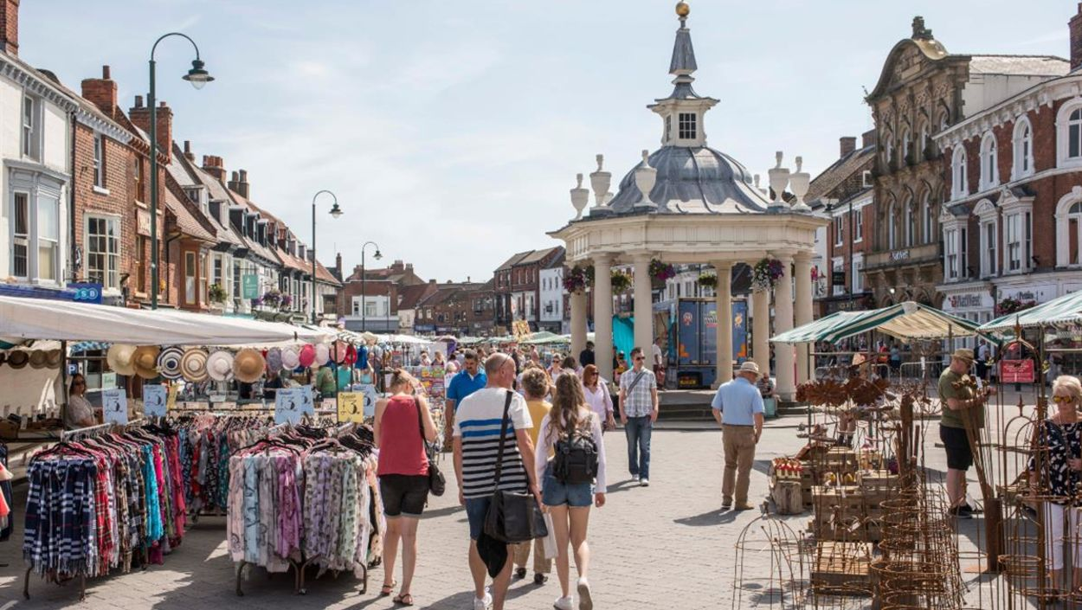
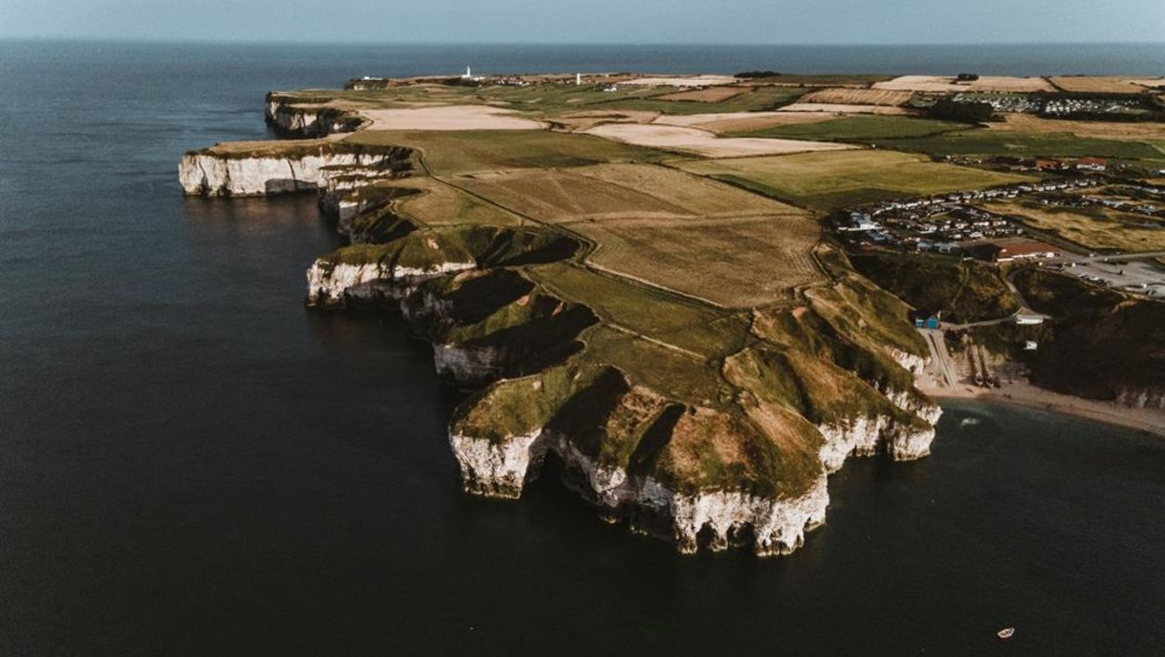
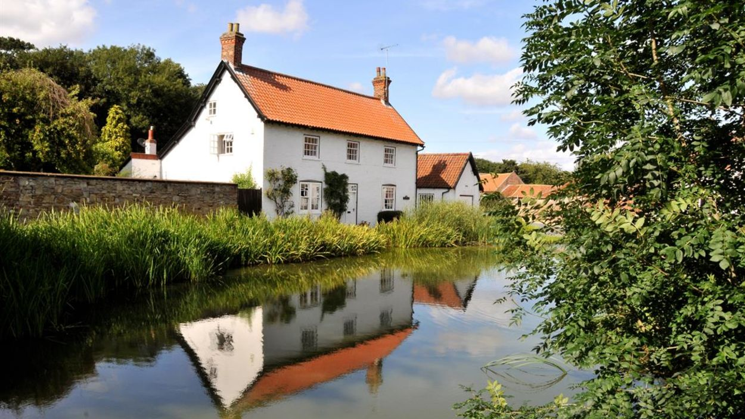
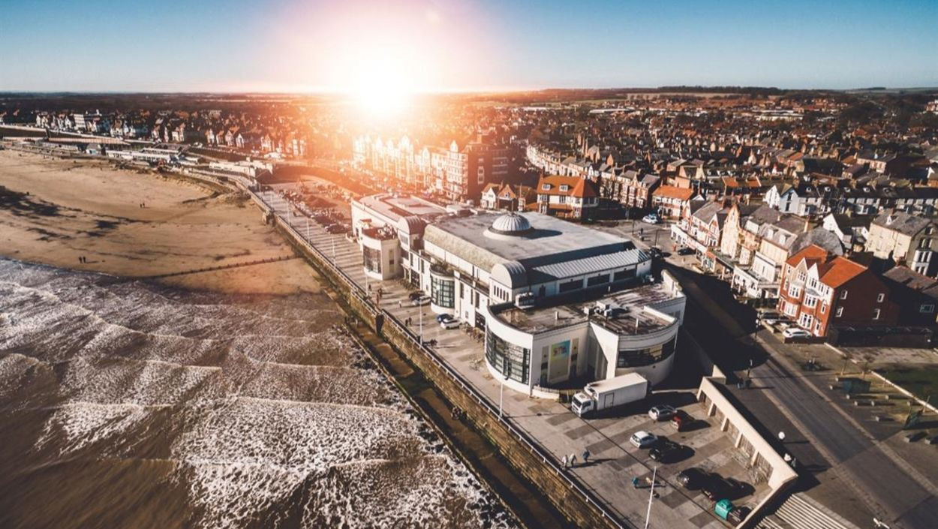
A background to the East Riding
One of the largest authorities in the country
A population of over 340,000 with a low density (142 per square km compared to England’s average of 434 per square km)
A mix of coastal, rural and more ‘urban’ communities and geography and contrasting economic and social wealth and deprivation

Slide 3



The team
PRINCIPAL PLANNING OFFICER
PLANNING OFFICER
Initially, the project was led solely by a Principal Planning Office; team subsequently expanded over following 18 months
Regular liaison with Forward Planning and key DM specialist teams
Don't underestimate the size of task ahead – the input of DM Officers will be essential in producing the code!
ASSISTANT PLANNING OFFICER
URBAN DESIGN OFFICER
CONSULTANTS
ILLUSTRATORS

Slide 4

Public Consultation and ENGAGEMENT
Public Consultation
March 2022 – aspects of design important to residents
A series of stakeholder engagements
September and October 2023 – public consultation on draft Design Code
Notes:
Second bullet point: a great opportunity to get varied feedback and identify what issues are important to different stakeholders
Second to last: to find where the code worked, and where it needs refining and improving
Final bullet point: to identify where codes can be best used, and where drafts can be improved . You are going to be the ones who are using it every day and needing to apply it! Also think of it as a training and upskilling exercise, this is likely something very different to what you do, or have done, so enjoy it and take a role in shaping the future of the authority you work in. Speaking from experience it has been a real learning curve, but a worthwhile one

Slide 5
Notes:
Second bullet point: a great opportunity to get varied feedback and identify what issues are important to different stakeholders
Second to last: to find where the code worked, and where it needs refining and improving
Final bullet point: to identify where codes can be best used, and where drafts can be improved . You are going to be the ones who are using it every day and needing to apply it! Also think of it as a training and upskilling exercise, this is likely something very different to what you do, or have done, so enjoy it and take a role in shaping the future of the authority you work in. Speaking from experience it has been a real learning curve, but a worthwhile one

Slide 6
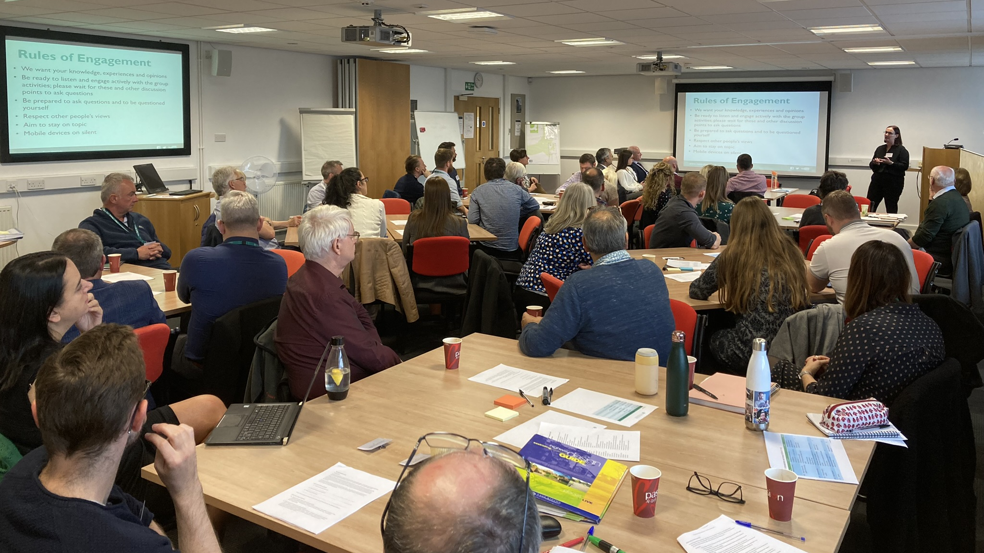
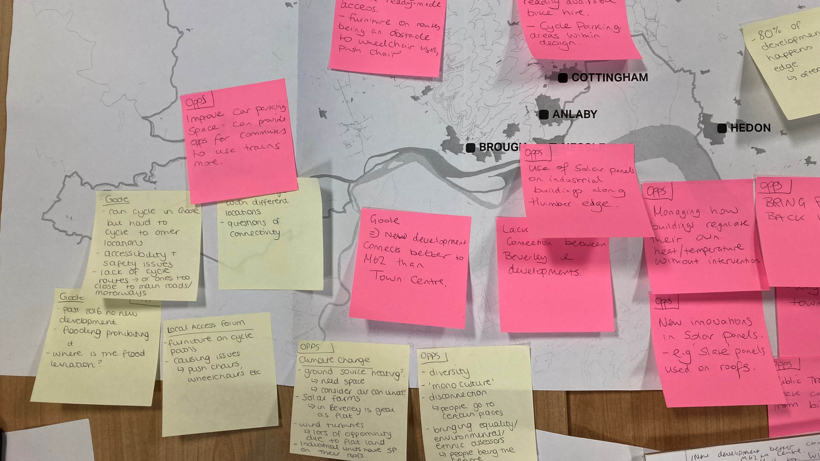
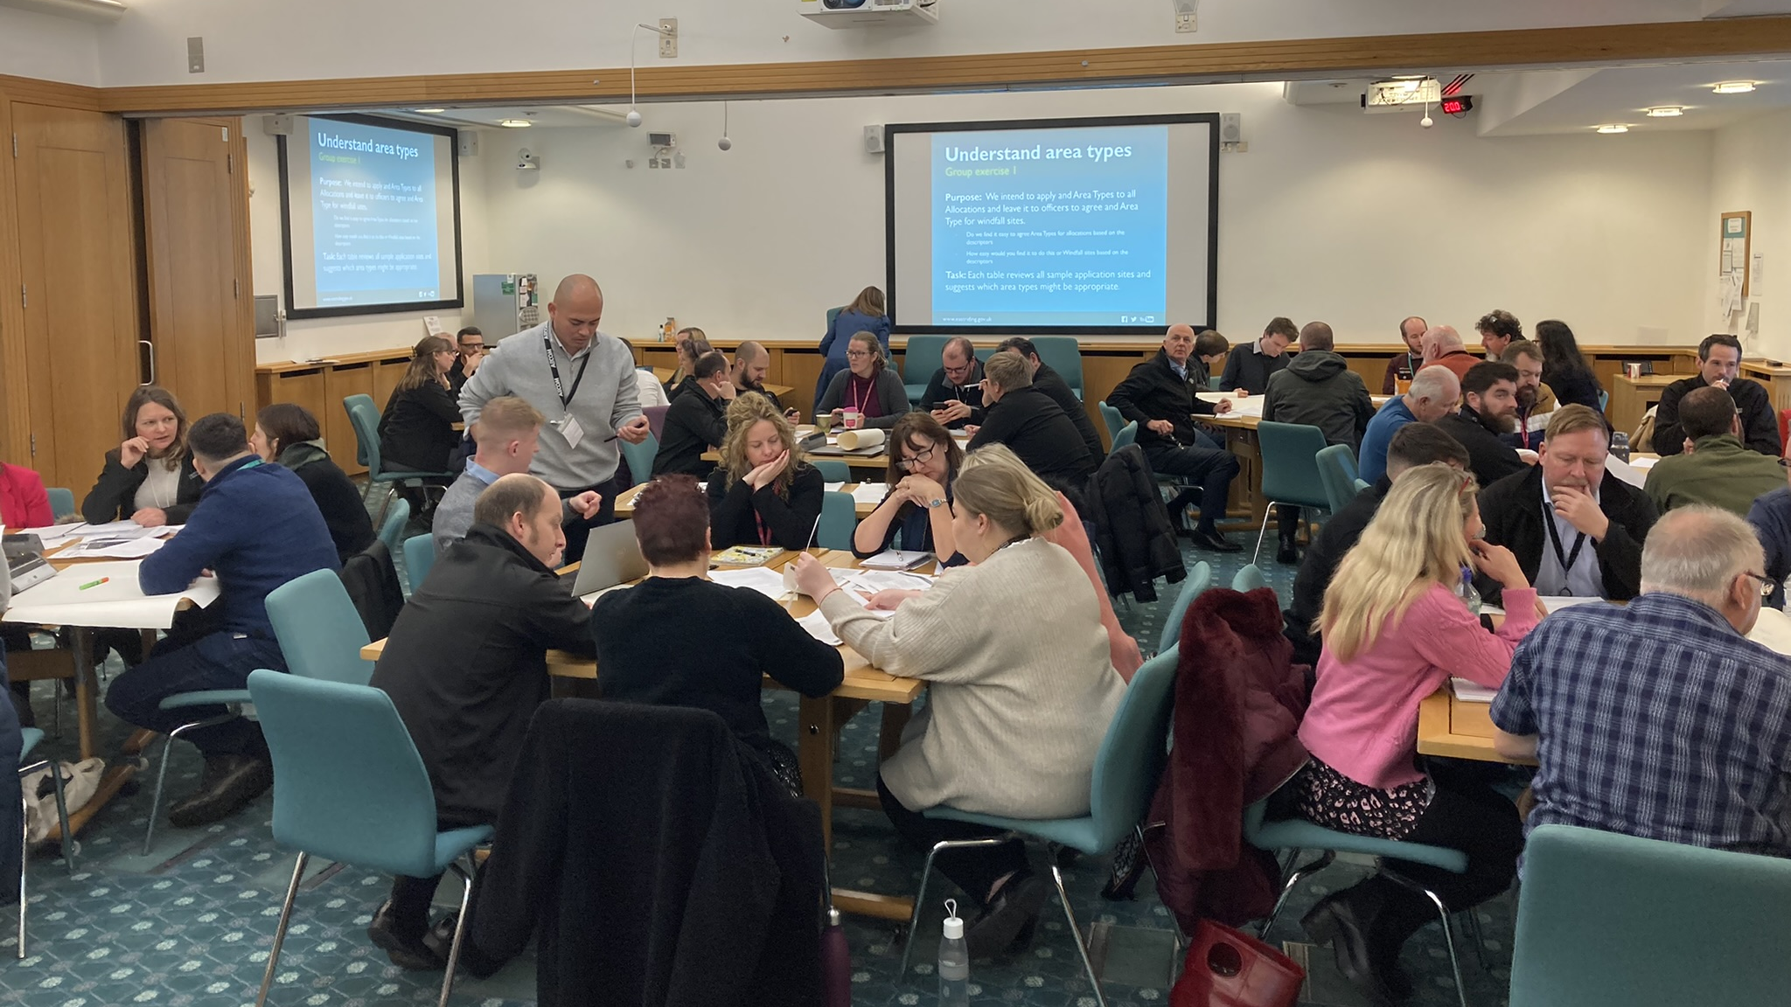
Internal Consultation and Workshops
Internal Consultation
With Planning Officers of all levels (area teams and Strategic Officers)
Specialist teams (Highways, Conservation, Trees and Landscape) and Forward Planning
Sessions focused on how the code would work with applications
Imperative DM and Policy Officers are involved throughout
Notes:
Second bullet point: a great opportunity to get varied feedback and identify what issues are important to different stakeholders
Second to last: to find where the code worked, and where it needs refining and improving
Final bullet point: to identify where codes can be best used, and where drafts can be improved . You are going to be the ones who are using it every day and needing to apply it! Also think of it as a training and upskilling exercise, this is likely something very different to what you do, or have done, so enjoy it and take a role in shaping the future of the authority you work in. Speaking from experience it has been a real learning curve, but a worthwhile one

Slide 7





East Riding Design Vision and Values
CONNECTED
INCLUSIVE AND SAFE
Informed by public consultation in March 2022, with the Design Values being reflected throughout the code in Key Information boxes at the end of each code, which reference other relevant local and national planning policy and guidance
LANDSCAPE LED
DISTINCTIVE AND CONTEXTUAL
SUSTAINABLE
Notes:
Cover quickly

Slide 8
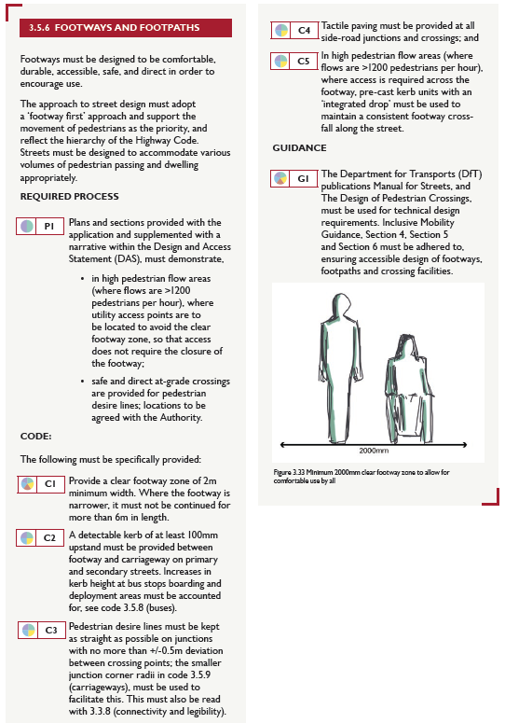
The different types of 'Code'
Codes: Design requirements (mainly quantifiable) that the applicant/designer will need to implement within their development
Required Process: Requirements that are not a design outcome, but steps that an applicant will need to take to evidence e.g. supplying specific information in a Design and Access Statement or specific plan
Guidance: Design desirables and preferences which the authority would like to see
Notes:
Required Process: This will make Officers role easier as the information *should* be easy to find if Required Process is followed

Slide 9
Coding for a large geographic area
ENVIRONMENT
LAYOUT
Authority wide codes and design considerations, each with their own sub-sections – aimed at developing a holistic, top-down approach to design:
PUBLIC OPEN SPACE
BLOCK
STREET DESIGN
PLOT
BUILDING
Notes:
Cover quickly

Slide 10

TOWN CENTRE
Coding for a large geographic area
INNER NEIGHBOURHOOD
In addition to the seven authority wide design considerations, we currently have seven different place types to allow for place specific coding: ​
OUTER NEIGHBOURHOOD
NEIGHOURHOOD CENTRE
VILLAGE
COUNTRYSIDE
BUSINESS, NON-CENTRAL RETAIL AND INDUSTRIAL

Slide 11
Some key advice and things to consider and how DM Officers must be involved
What do you want to achieve?
Think about the key design issues within your area, are there specific priorities to address?​
Where can you make the small changes, which make the biggest differences quickest?​ Perhaps start 'small' and then build up?
Who do you want to engage with, and how are you going to do so?
Early engagement with Officers and internal specialist teams and maintain regular dialogue to ensure any specialist requirements align with your placemaking objectives Early engagement with external stakeholders
How to 'simplify' or 'refine' the code
Where appropriate refer to/rely on National Guidance and Policy e.g. BNG or Building Regs
What can't be coded for should be referred to as Guidance or preferences
Clear and concise coding should enable a straightforward 'yes' or 'no' in terms of compliance
Use good quality imagery!
Notes:
You as Officers are in a great position to contribute to this...think about reasons why applications get refused, could some of these issues be easily rectified with stronger and clearer design coding and guidance?
Who do you want to engage with, and how are you going to do so?

Slide 12
key advice, things to consider; INVOLVING DM Officers
Wider processes:
Think about how the code will work alongside assessing all types of applications​ - design codes are aimed at improving both decision making, and design outcomes
How will Officers need to refer to the design code in reports?
Work with digitising the code in mind (if not working on a digital basis already) ​​
Think about this being the first version of your code – you want to ensure as much 'buy-in' for future versions as possible​ - it is never going to be a perfect document and will require adjustments like all policy and guidance documents!
How are applicants going to demonstrate compliance or non-compliance (and justification), and how are Officers going to consider and determine diversions from the code? ​

