Slide 1

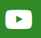

Nature Recovery Toolkit 1 day Workshop
North Northamptonshire
youtube.com/@paswebmaster
Linkedin.com/in/pas-team-4935556128
pas@local.gov.uk

Slide 2
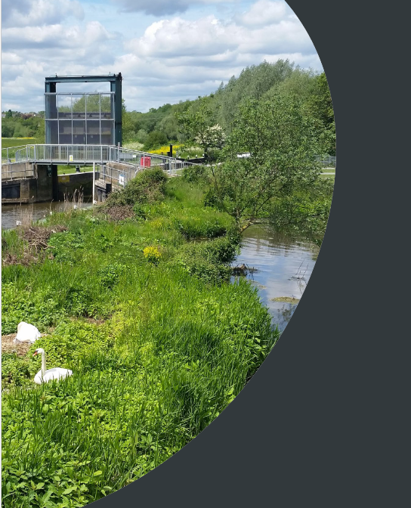
What we’ll cover in the next few mins
What the Toolkit is
Why here & why now?
What we are offering
What we are asking of you

Slide 3
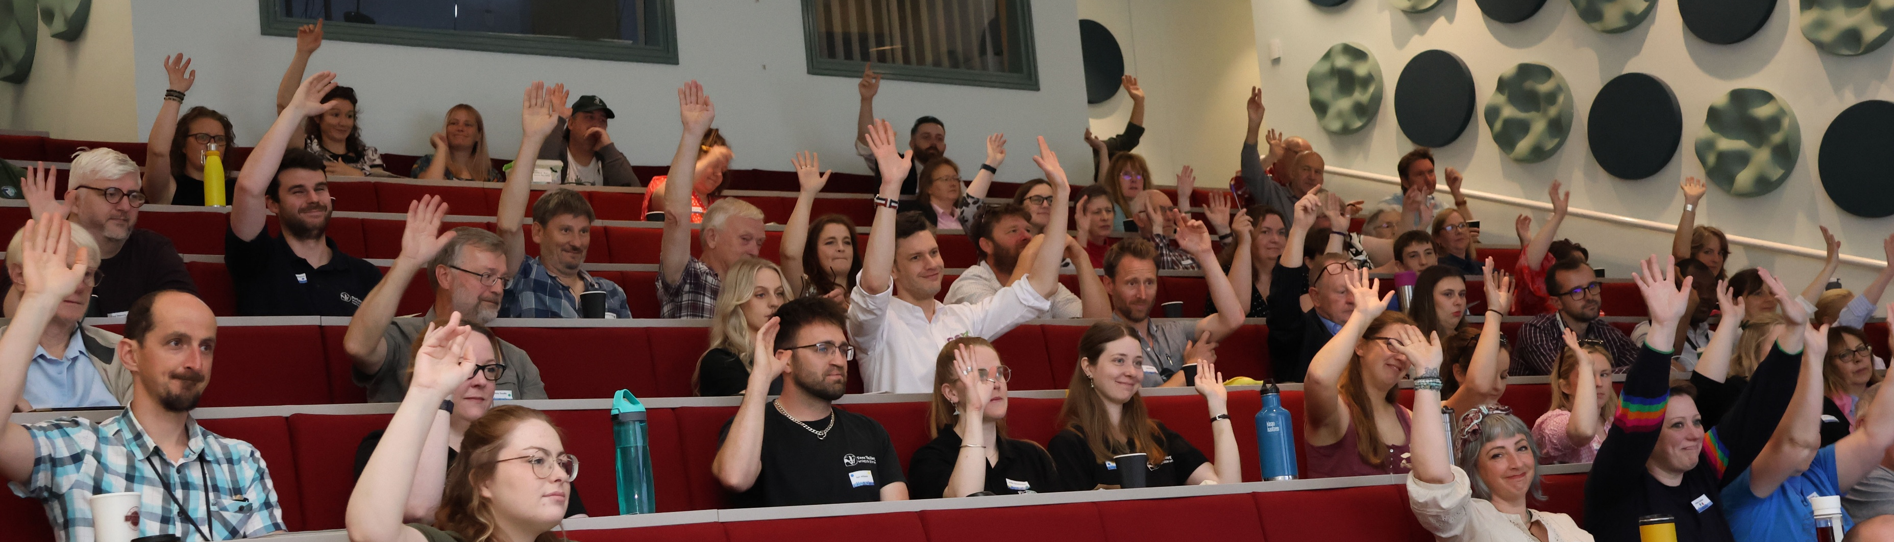
North Northamptonshire has been selected as one of a handful of authorities to ‘pilot’ the tailoring & delivery of the PAS Nature Recovery Toolkit for Local Authorities. In turn many other authorities will be afforded the confidence to use it as a self-service toolkit.
PHOTO CREDIT: Barron Media - Tees Nature Conference 2024

Slide 4

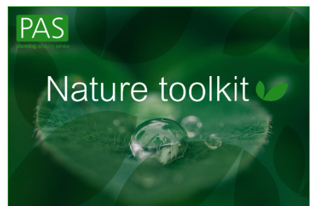
“Nature Recovery Toolkit”
What it does:
Aligns nature recovery with council priorities
Helps councils meet statutory nature and environment duties
Engages with colleagues across the council to inspire & support them to identify how their services can contribute to nature recovery
Identifies the best delivery method to support these commitment.
WE NEED YOUR SUPPORT
Notes:
NOTES FOR WORKSHOP LEADS:
You have priorities corporate …have to deliver, nice to deliver..
Other LA priorities nature can help deliver
To deliver these priorities all your service areas have a part to play & they will benefit their services
We’ve got a process!
Quickly & simply brings your service areas together to agree on their priorities & how they are going to deliver & could fund them
Bring each service area along as a whole council
Here we are:
Delivering a 1 day workshop
We want you to commit to sending someone to workshop
PAS & NNH will deliver
So now take you through in a little more detail…
Helps to make sense of the changing and complex world of policy and action for nature and take advantage of the opportunities
turning statutory ‘must do’ requirements into opportunities for the whole council to support delivery of their strategic and corporate priorities on health, air quality, climate change, adaptation etc.
The toolkit focusses on council priorities, the land that they hold, the services they deliver and explores how nature can act as an enabler for these and the quick wins that can be made.
Why should local authorities use the toolkit?
There are a number of advantages that can be delivered as a result of using toolkit including:
Across the council / political buy-in and joining up work across departments.
Read-across into other plans and strategies and streamlining benefits.
A clearer understanding of how to deliver change, saving costs and securing additional funding.
Readiness for Local Nature Recovery Strategy delivery – what can the council do
A shortlist of priority activities and interventions that can start to be delivered.
Our approach is rooted in establishing a strong governance process as a means of demonstrating to the wider council how a strategic approach to nature can help address wider corporate issues.

Slide 5
Why here and why now?
PEOPLE
The natural environment provides health benefits worth £14.3million annually
COMMUNITY
Flood alleviation, air quality, noise, local climate regulation and accessible nature
COUNCIL
Help deliver our wider policies & services…housing, transport, economic regeneration…
Planning
Highways & transport
Estates
Education
Housing
Assets & Environment
Finance
Adult & children’s services
Public health
Notes:
NOTES FOR WORKSHOP LEADS:
North Northamptonshire has a Natural Capital Investment Plan, combined with West Northants and Peterborough, this completed in 2023 and considers various aspects of the natural environment. It has provided a detailed habitat basemap using the best available data. This data show (as slide says) the value of the natural environment – some big numbers.
Designated sites are SSSI (includes the SPA), Local wildlife site, country Wildlife site and local nature reserves. If we include priority habitats and ancient woodland tis increased to 11.45%
A small number considering the benefits secured.
The study reviewed different ecosystem services – for example, water quality, air quality, carbon storage, water flow, food production, timber, accessible nature.
The supply and demand of specific services in different areas and has given us a lot of detailed information. This means that we have lots of opportunities to enhance and secure more benefits and savings to not only enhance the natural environment but to support social and economic aspects as well.
NOTES: physical health benefits determined by the number of people predicted to meet the recommended activity guidelines and the quality adjusted life years that will result.
Recreational benefits calculated by the outdoor recreation valuation on estimated number of visits made to accessible greenspaces and the welfare value of those visits.

Slide 6
Our community cares
In developing the LNRS, through the consultation we had 93% agree that we were focussing on the right priorities.
Nature means happiness because nature is just like us, its amazing (Phoebe aged 9)
Children are missing out on the wildlife and nature (Margaret aged 89)
How we value nature has changed (Jane aged 80)
I really like going on walks through the woodland areas (Iris aged 11)
Parks, pride and place: The role green spaces can play in building pride in place More in Common 2025 research finds that two-fifths of Britons say the mental health benefits of green spaces are the most important benefit to them
Annual loss to economy with mental health absence from est. £70 - £100bn.
Data from 2018 show 17.7% of the UK population are suffering from mental health issues
Notes:
NOTES TO WORKSHOP LEADS:
Can we get a figure on volunteer hours – across our area just in the country parks? Ill ask Rebecca
Quotes from children and older people consulted as part of the LNRS work.

Slide 7
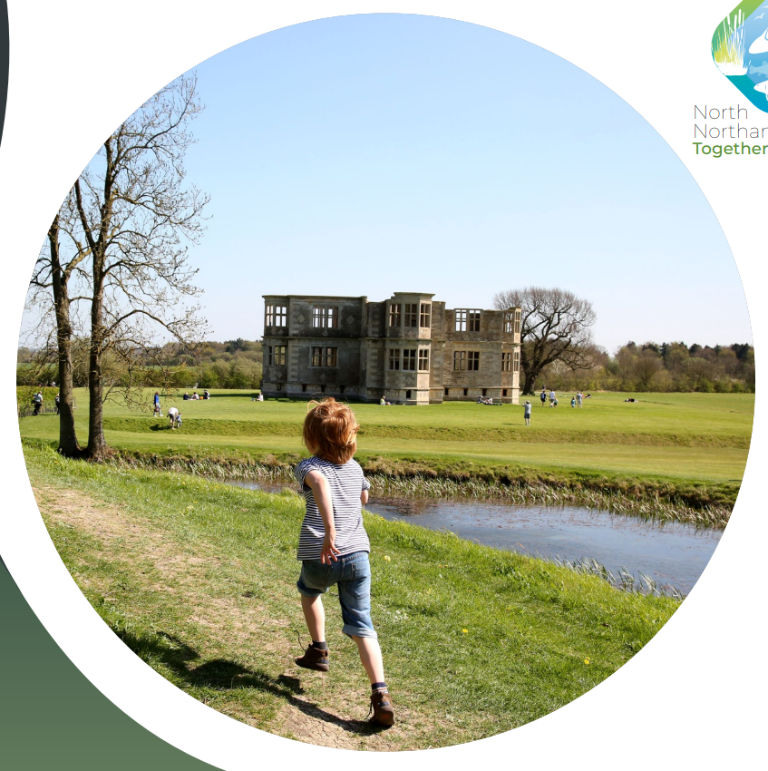
North Northamptonshire colleagues have identified the key take-aways:
Increased awareness of nature recovery opportunities how we can work together for wider benefits
Understand your role and that of your service to support nature recovery
Action alongside service plans tailored to your service area to include nature this could include economic considerations, health and well being and nature-based solutions (NbS)
Local Nature Recovery Strategy | North Northamptonshire Council

Slide 8
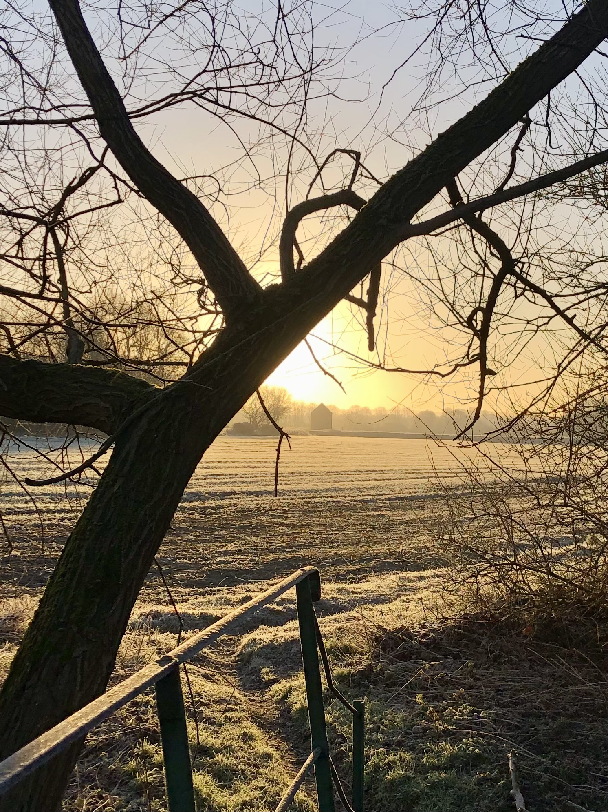
Our offer:
PAS has been working with council colleagues to tailor the toolkit to your needs
A 1 day in-person workshop is planned for the 15th January at Stanwick Lakes. Two Principal Consultants from PAS and One Principal Officer from Natural England will be in attendance to assist with the event.
PAS will follow up to offer further support if needed
PAS will develop a National case-study to help inspire and inform more councils
PHOTO CREDIT: R Murtagh frosty view to dovecot

Slide 9
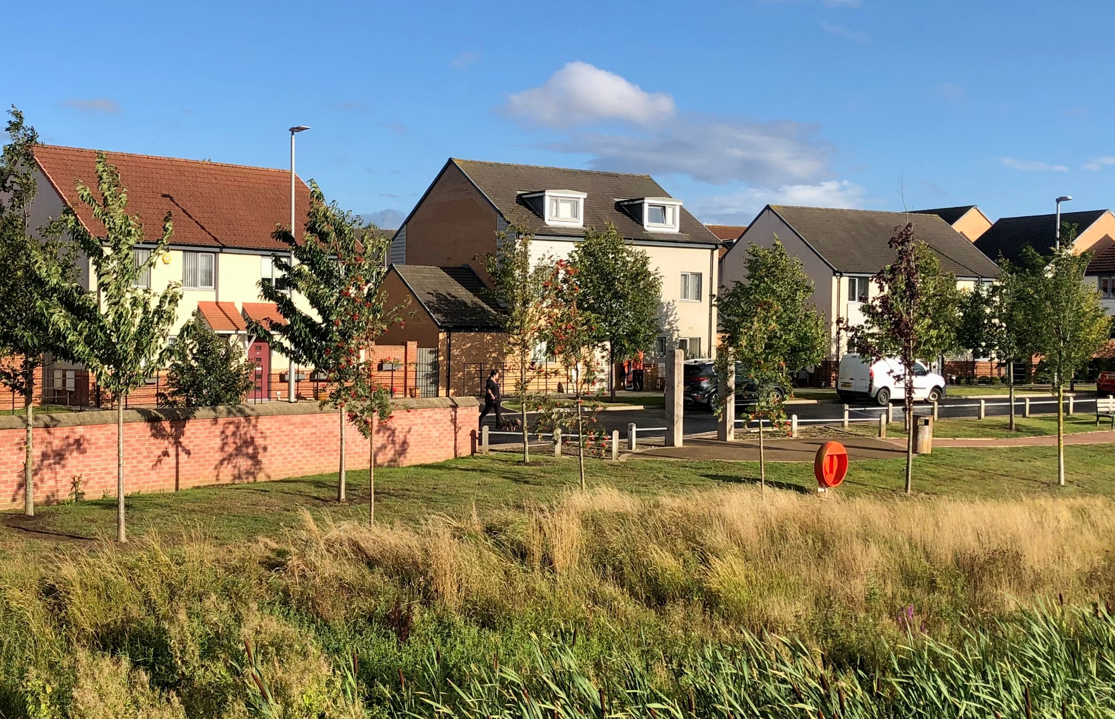
Our asks of you…
Nominate staff within your service to attend the in-person workshop on the 15th January
  Ensure they have some authority (e.g. budget holders)
  Encourage & enable them to attend.
  Support the governance & reporting mechanism that will be agreed at the workshop.
Follow up from: Andra.Stopforth@northnorthants.gov.uk

