Slide 1


Statutory Consultee reforms workshop
13th February 2026
London

Slide 2



What is PAS?
PAS exists to support local planning authorities to provide efficient and effective planning services, drive improvement and respond to and deliver changes in the planning system.
Notes:
PAS is a MHCLG and DEFRA grant-funded programme
PAS is part of the Local Government Association (LGA)
This is primarily an information slide that only needs to be shown if PAS is running the session

Slide 3
Agenda
  09:30 - 10:00 Registration and Coffee
  10:00 - 10:10 Welcome and Introductions
  10:10 - 10:45 Presentation by MHCLG followed by Q&A
  10:45 - 11:25 Presentation by Natural England followed by Q&A
  11:25 - 11:40 Coffee break
  11:40 - 12:20 Presentation by Environment Agency followed by Q&A
  12:20 - 13:00 Lunch
  13:00 - 14:00 Workshop 1 – statutory consultee process and feedback
  14:00 - 14:10 Break
  14:10 - 15:10 Workshop 2 – Statutory consultee engagement and feedback
  15:10 - 15:30 Summary of the day and next steps

Slide 4
MHCLG Presentation:
Statutory consultation planning application process

Slide 5
Statutory Consultees
Key role & challenges
Statutory consultees play a vital role in the TCPA planning system.
Key challenges & considerations:
Delays/uncertainty
Capacity constraints
Delivering HMG growth objectives & planning reforms
Diverse challenges facing each statutory consultee

Slide 6
Timeline of our progress so far
with statutory consultation reforms
January 2025
Moratorium announced
On new statutory consultees.
March 2025
Written ministerial statement
On a system wide review.
November 2025
Public consultation
On reforms to the statutory consultation system (TCPA regime).

Slide 7



Reforming planning fees
Three key areas of reform
National default planning fees
To better reflect local planning authority costs.
Local variation of planning fees
To enable local authorities the ability to vary from the national default fee to better reflect the costs of their local area.
Surcharge levy
To support statutory consultees.

Slide 8
Next Steps
With statutory consultee and planning fee reforms
Reforms to statutory consultation system
New national default fee
Responding to consultation on reforms to statutory consultee system & following this, taking forward regulations.
Consulting on new national default fee, prior to laying regulations.
Surcharge levy
Local fee setting
Consulting on surcharge proposals & rolling out regulations.
Following the default fee schedule.

Slide 9
Our aims for today
Positive outputs
Gain variety of views/perspectives on working together.
To understand what is working well.
Identify areas for improvement.
To provide us with ideas for best practice.

Slide 10
MHCLG Q&A:
On statutory consultation planning process

Slide 11
Planning Advisor Service Event:
Statutory consultee engagement in decision making
Natural England
John Dixon – Principal Officer for Planning Casework Reform
John.Dixon@naturalengland.org.uk

Slide 12

Our Statutory Role
Natural England’s general purpose is set out in the Natural Environment and Rural Communities Act (NERC) 2006:
Natural England general purpose is to ensure that the nature environment is conserved, enhanced and managed for the benefit of present and future generations, thereby contributing to sustainable development.
This includes:
Promoting nature conservation and protecting biodiversity
Conserving and enhancing landscape
Promoting access to the countryside

Slide 13
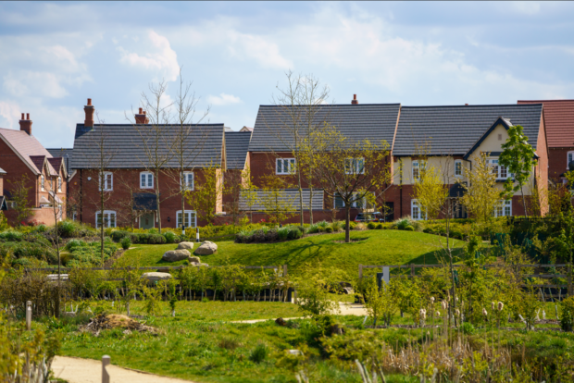
Our Planning Remit
We provide advice on new legislation, policy, decision making and guidance. Our remit covers landscape, biodiversity, soils, access to nature and green infrastructure and spans terrestrial and marine environments.
We are statutory consultee on:
Development plans
Nationally Significant Infrastructure Projects (NSIPs)
Certain planning applications outlined in the Development Management Procedure Order (impacting on Sites of Special Scientific Interest and best and most versatile agricultural land)
Environmental assessments (Habitats Regulations Assessment, Strategic Environmental Assessment and Environmental Impact Assessment).

Slide 14
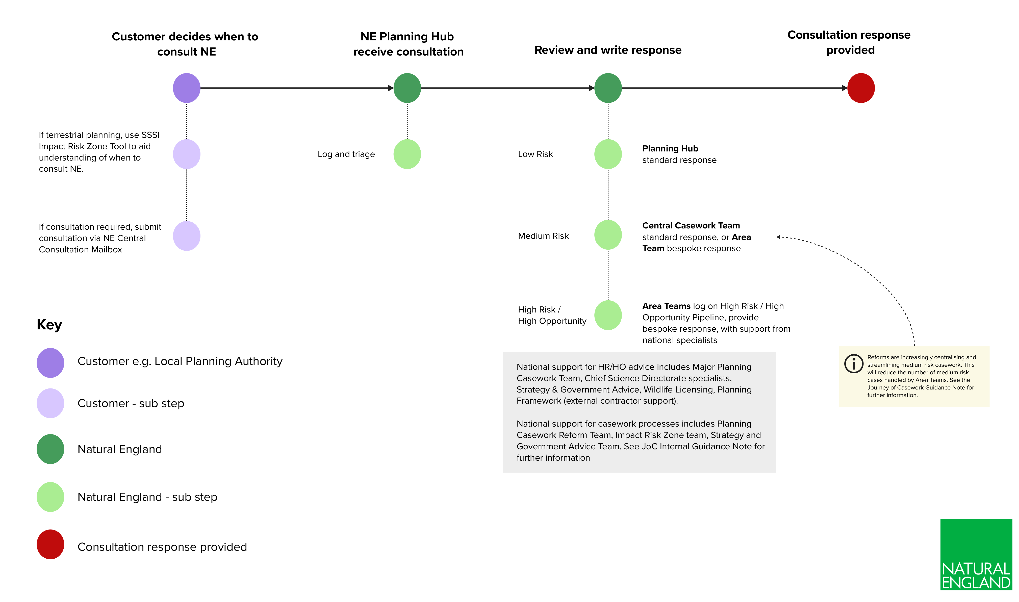
Our Service

Slide 15
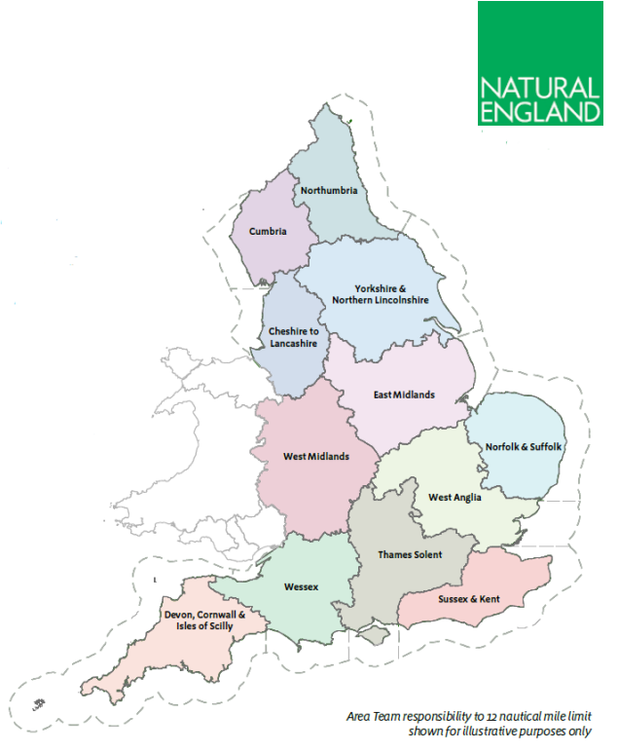
Our Service

Slide 16
What works well?
We receive 30,000 consultations every year and respond within our statutory 21 day period 90% of the time.
Upfront guidance and tools such as Standing Advice and the Impact Risk Zones help LPAs avoid unnecessarily consulting us.
We are resolving environmental issues strategically and streamlining planning consultations e.g. strategic solutions, biodiversity net gain, nature restoration fund, standing advice.
We collaborate with our partners locally and nationally to support them resolve issues and maximise opportunities.

Slide 17
What isn’t working well?
30% of consultations we receive are unnecessary.
The quality of consultations is inconsistent. We require further information 12% of the time.
Manual internal processes and poor data sharing across organisations creates delays and duplication.
Loss of ecological expertise in LPAs is creating more reliance on NE and over-consultation.
We don’t always know the impact of our advice.

Slide 18
What could be improved?
Modernised and integrated digital infrastructure: A single front door, integrated with LPA systems and maximising automation for unnecessary and low risk consultations.
Improved use of Impact Risk Zones to decrease unnecessary consultation and improve quality of consultations.
Expand Standing Advice to more issues, giving LPAs better guidance early on.
Better training and capacity for LPAs e.g. through PAS, increase ecological expertise, shared-service models.
Expanded performance measures about environmental outcomes.
Earlier and more consistent engagement in Local Plans, integrating them with Local Nature Recovery Strategies.
Improved validation and upfront guidance to improve consultation completeness

Slide 19
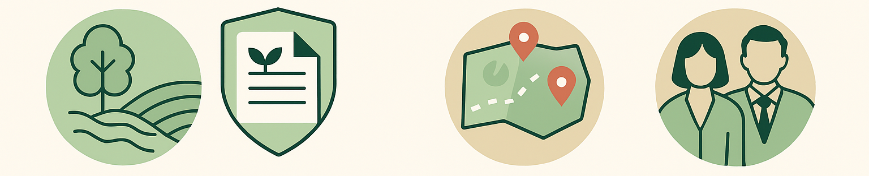
Our top reform priorities
Use more standing advice
Use standing advice/upfront guidance for common issues e.g. air quality/soils/
landscape
Digital transformation
Improve the Impact Risk Zone tool, create a single automated entry point, modernise our casework management processes.
Maximise strategic approaches
Invest more into strategic approaches via plans and strategies for pre-agreed solutions
Work proactively with LPAs
Support building environmental skills and capacity within LPAs including via our work with PAS

Slide 20
Our top reform priorities
Collectively these reforms will help us to:
Reduce time spent on low risk planning consultations and focus our efforts where they have the biggest impact.
Streamline the planning system consultee process for faster results.
Provide a better, quicker and more consistent service to LPAs and help grow their environmental skills.
Resolve more issues at a strategic scale.

Slide 21
Wider planning activities
Amending the NERC Act so we can prioritise our input into the highest risk and highest opportunity cases.
Establishing Environmental Development Plans and the Nature Restoration Fund

Slide 22
How are we engaging with LPAs?
Prioritising development plan making and spatial development strategies.
Integrating Local Nature Recovery Strategies with plans.
Developing environmental skills via toolkits and training e.g. PAS Housing Toolkit, EXPLORE Framework.
Addressing environmental issues that effect LPAs strategically via ADEPT.
Conducting digital user research to understand LPA needs.

Slide 23


Slide 24

The NERC Act amendment
The NERC Act was amended via the Planning & Infrastructure Act 2025
Clarifies NE’s advisory role so we can focus on high impact work which offer more for nature recovery and help unlocks issues to support growth
Introduces a prioritisation framework (set out in an operational statement to be agreed with Defra)
Brings NE in line with other statutory consultees.
Does not alter our role under the DMPO
Notes:
Amendment in the Planning & Infrastructure Act clarifies Natural England’s advisory role under the Natural Environment and Rural Communities Act 2006 so that it can focus on high risk and high opportunity cases, allowing it to make a greater contribution to nature recovery.
Currently, Natural England must provide advice to public authorities on any requests relating to its general purpose. Following this change Natural England will instead follow a prioritisation framework set out in an operational statement, which would be agreed with the Defra Secretary of State.
Unlike other statutory consultees, Natural England’s blanket duty to provide advice is unique and this change brings it more in line with other consultees. The approach to developer advice is unaffected.

Slide 25
The existing legislative framework
✅ Development Management Procedure Order (DMPO) requires consultation with NE if:
If development in or likely to affect and SSSI
If development would result in the loss of >20ha of BMV land.
Substantive response required – no comment/agree we are content/refer to standing advice/provide advice/decide not to engage at all
Focused role and we have discretion in terms of response types
⚖️ Natural Environment & Rural Communities Act (s.4) duties:
NE must provide advice when asked by a public body (incudes the Local Planning Authority)
Affects advice on HRA and EIA
Lack of discretion
⚠️ Challenges for NE:
The push to strategic advice is needed but practically difficult
Legislation for planning is not always compatible

Slide 26







Why do we need the NRF?
The current planning system has struggled to halt the overall decline of nature and to deliver the homes and infrastructure the country needs.
Developers spend money on costly surveys and administration, rather than conservation measures that drive nature recovery.
By creating a scheme which looks at targeted, landscape-scale nature recovery, we can deliver:
​
Better outcomes for nature
Streamlined, digital processes for developers
NRF
Homes and infrastructure we need

Slide 27


How the NRF works
Developer identifies site for development
Developer chooses to use existing site regulations and/or the NRF*
Use of existing regulations
All environmental obligations not covered in an EDP, such as Habitat Regulations, would still apply
Natural England develop EDPs that support landscape-scale nature recovery and sustainable growth
The developer pays into the NRF, providing the funding to deliver the conservation measures in the EDP
*in certain cases, an Environmental Delivery Plan may be mandatory.

Slide 28

What is an Environmental Delivery Plan?
EDPs enable certain environmental obligations for development to be discharged via a levy payment to Natural England.​
EDP
An EDP will set out the measures needed to outweigh the impacts of development.
EDPs will detail costed conservation measures and a charging schedule.​
EDPs will initially focus on local or regional areas of England, depending on the scale needed to address environmental challenges.
An EDP will be put in place for up to 10 years.
Natural England will need to ensure the measures in an EDP are met through an Overall Improvement Test (OIT)
Safeguards will be written into an EDP, which can be deployed if measures are not achieving their goals.

Slide 29




The EXPLORE Framework
OUTCOMES
Helping local authority users have creative, integrated conversations and build positive outcomes for people and nature into their plans and visions.
Health
Wellbeing
Nature
Sustainability
Strategic planning toolkit, co-developed with pilot local authorities and the University of Exeter, hosted online by Local Partnerships.
Users bring the four outcomes (health, wellbeing, nature, and sustainability) together, test intervention ideas, and work through trade-offs in an applied, collaborative way.
Bridges the gap between technical information and practical solutions, supports join up across the authority and stakeholders.
Framework components: Outcome Measures Dashboards, Horizon Scanning cards and Factor Maps, Facilitation Package & support.
10th March: ADEPT/Natural England launch webinar
Notes:
Local authorities face increasingly complex challenges: improving health and wellbeing, protecting nature and driving sustainability, all while making decisions under pressure and with limited resources.
The EXPLORE Framework is an practical, evidence-based toolkit for creative and integrated planning. It’s designed to help local authority users bring the four outcomes of Health and Wellbeing, Nature and Sustainability together, test intervention ideas, and work through trade-offs in an applied, collaborative way.
It bridges the gap between technical information and practical solutions, supports join up across the authority and stakeholders.
EXPLORE is hosted on the Local Partnerships website. It has 4 components, which have been co-developed with pilot local authorities including Surrey, Norfolk and Liverpool County Councils:
Data dashboards present high-level strategic data on Health and Wellbeing, Nature and Sustainable outcomes for each local authority, in an easy-to-understand format.
‘Factor maps’ - diagrams that show what matters for improving the outcomes in a common and accessible format, which supports cross-departmental conversations.
Plain English ‘horizon scanning cards’, to provoke conversations about future proofing.
A Facilitation Package, which underpins these components, including process guides and workshopping templates to support creative conversations across disciplines, professions and sectors, and enable users to step above process to focus on shared goals.
EXPLORE is going live on the 10th of March. Register for the launch webinar, co-hosted with ADEPT, to find out more: ADEPT/Natural England webinar.

Slide 31
PAS Statutory Consultee Event:
Role of the Environment Agency
Andrew Mozley, Manager, Planning & Place
13 February 2026

Slide 32
Purpose of the planning system
To guide and regulate the way land is used and developed to achieve sustainable development
Role of Environment Agency in planning
To provide authoritative environmental / flood risk evidence and advice so that planning for a place can be based on an understanding of its relationship with the environment.
We do this in line with our core duties to protect and improve the environment, and to contribute to sustainable development.
We believe protecting the environment and delivering sustainable development can go hand in hand. Nature is in decline and our economy is not growing – something must change, and we are ready to play a part in improving both.
Notes:
To summarise:
We are a statutory consultee providing expert environmental advice.
We support sustainable, resilient development.
We work with LPAs and partners to protect people, nature and place.

Slide 33

Key legislation
Town & Country Planning Act 1990
Planning & Compulsory Purchase Act 2004
Strategic Environmental Assessment Regulations 2004
Planning Act 2008
Localism Act 2011
Local Planning Regulations 2012
Development Management Procedure Order 2015
Environmental Impact Assessment Regulations 2017
Levelling Up and Regeneration Act 2023
Planning and Infrastructure Bill

Slide 34
Environment Agency consultee role
  Spatial Development Strategies
  Local Plans, including evidence base:
    Sustainability Appraisal (Strategic Environment Assessment)
    Strategic Flood Risk Assessment
    Water Cycle Studies
  Minerals and Waste Plans
  Neighbourhood Plans
  Marine Plans
Plans
Triggers for consultation with EA:
Environmental Impact Assessment
Flood Zones 2 and 3
Direct impacts on a watercourse
Land potentially impacted by contamination
Control of Major Accident Hazards
Hazardous Substances Consent
Minerals or Waste Development
Non-Mains Drainage
Coastal Change Management Areas
Potentially polluting land uses – cemeteries, intensive farming, oil and fuels
  Planning applications
  Nationally Significant Infrastructure Projects
  Local Development Orders
  Marine Licences
  And more (Transport and Works Act Orders, Electricity Act Consent Variations, …)
Projects

Slide 35

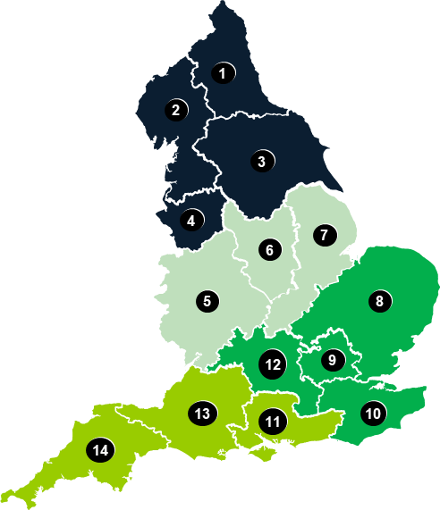
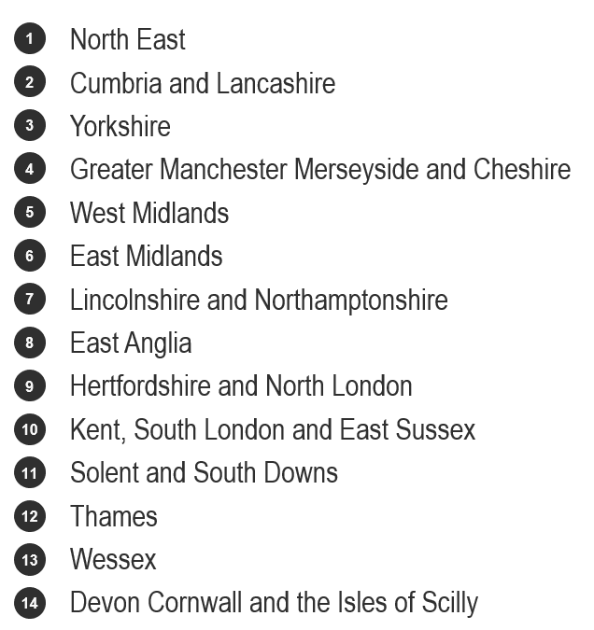
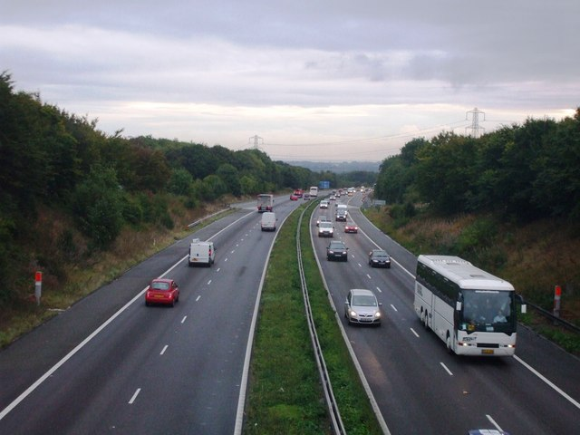

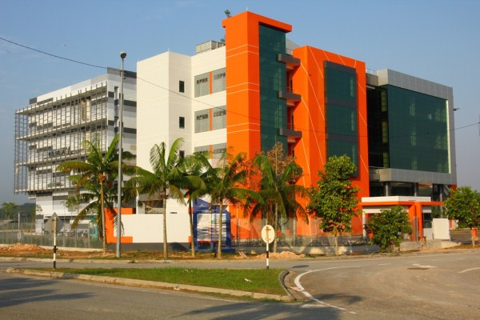
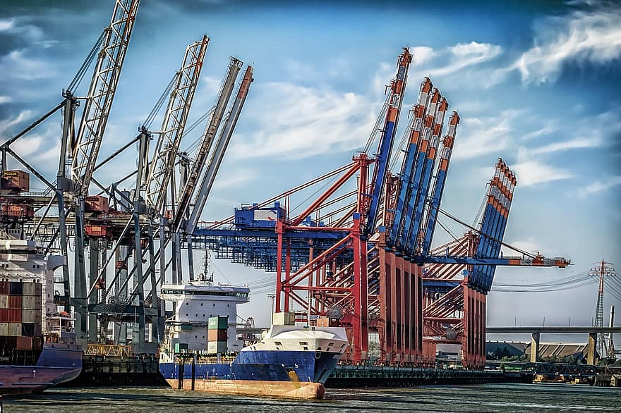
Central Government
National Planning Policy and Guidance
Planning & Place
NSIP Application
National Infrastructure
Local Government
Sustainable Places
Local Plan
Planning Application
Homes, industry, infrastructure, etc
This Photo and This Photo by Unknown Author is licensed under CC BY-SA
Notes:
Planning & Place – provides national engagement and advice to government and the sector
National Infrastructure Team – manages consultations on Nationally Significant Infrastructure Projects
14 Area Sustainable Places (SP) teams – lead providing advice to Local Planning Authorities
Area Function teams – provide expert advice to SP teams (as part of wider duties).

Slide 36
What the Environment Agency's consultee role considers
🌊Flood risk advice
Review Flood Risk Assessments
Detailed assessment of flood risk models
Advise on safety and resilience
💧Water environment advice
Assess impacts on rivers, estuaries and wetlands
Prevent deterioration and support environmental improvements
🌍Groundwater & contaminated land
Protect aquifers and drinking water sources
Review contamination assessments and remediation
Prevent new pollution pathways
🍃Nature, habitats & biodiversity
Advise on water‑dependent habitats and species
Support nature recovery and ecological resilience
Highlight opportunities for environmental enhancement
🚰Infrastructure capacity (water & wastewater)
Assess risks linked to limited water/wastewater capacity
Support Water Cycle Studies
Help ensure growth is environmentally sustainable
🏭NSIP & major growth advice
Provide early, strategic advice on large projects
Assess environmental risks at scale
Support sustainable national and regional growth

Slide 37
Current Planning Application Process
Post-Permission
Developer
Local Planning Authority
Pre-application
Submission
Consultation
Determination
Decision
Appeal
EA Sustainable Places
Advice to developer
Screen
Internal consultation
Advice to LPA
Installations
Integrated Environment Planning
Fisheries, Biodiversity & Morphology
Flood & Coastal Risk Management
Groundwater & Contaminated Land
Land & Water
Waste

Slide 38
Delivery numbers
In an average year:
  We receive circa 25,000 consultations a year from Local Planning Authorities
  We respond substantively to circa 10,000 planning applications each year
  The rest are either re-consultations on the same consultation or mis-consultations
In 24/25 we:
  Responded to 12,324 consultations (21 days) on 9635 development proposals.
  Of these 9117 were planning applications, 518 were pre-application enquiries under our preliminary opinion service
  88.3% of these were responded to within 21 days or in an alternative agreed time-period
  We agreed 836 separate cost recovery pre-application enquiries with developers, enabling us to recover £672,000 of our costs
  Made 570 EIA consultation response and 350 scoping opinion consultations
  Responded to 438 consultations under the NSIP regime
  Responded to 299 Marine Licence consultations
25/26 to date:
  We have met our target of 95% of responses made in 21 days KPI since June
  We have done this by introducing new tools and ways of working across the business
  We are improving our old and outdated IT workflow system which causes delays. This is due to launch in 2026
  We are in discovery phase of a service transformation project to improve our planning service and align to government service delivery and priorities
  Responded to various reviews and recommendations, improved internal governance and assurance for spatial planning and engaging with planning reform

Slide 39

Key successes of the Environment Agency
High volume of consultations handled each year
Improved performance against the 21‑day KPI
Nationally respected specialist expertise
Early engagement services that help developers
Trusted evidence and environmental insight

Slide 40
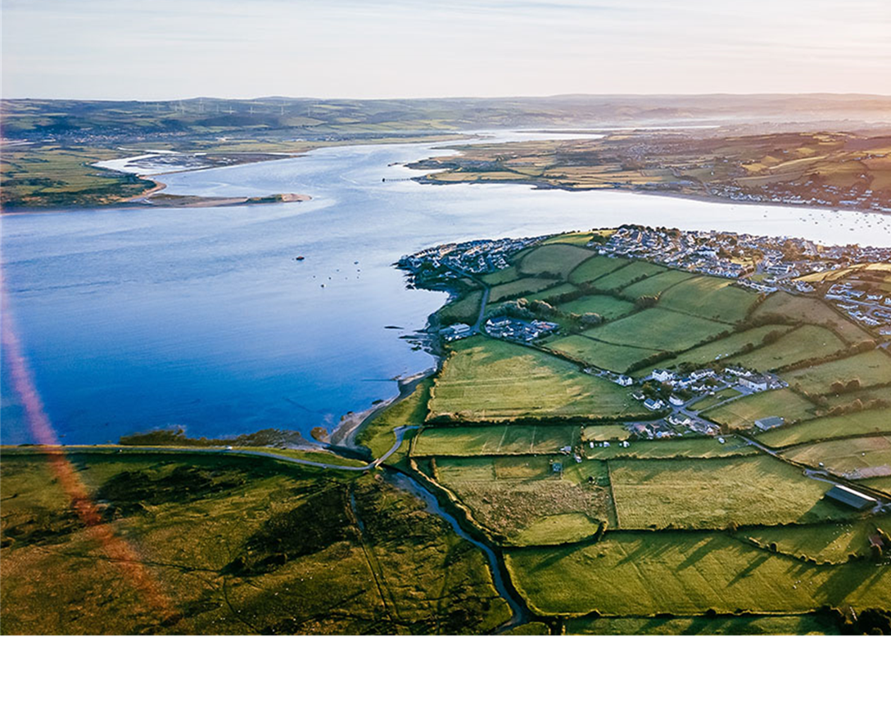
Issues experienced by the Environment Agency
High number of mis consultations – some activity we are unable to / don't need to advise on as it is not within our remit or standing advice applies.
Incomplete applications – information missing / insufficient for us to provide our advice
We are keen to work with Local Planning Authorities to resolve these issues. We are aware that this work involves a lot of time and resource and we would like to give the best service possible.

Slide 41
Reform of Statutory Consultees:
What we are already doing to improve our service
21 days performance – we are:
  clarifying and streamlining existing processes
  reviewing response approaches, including the potential for more standing advice/standard comments in responses
  focusing planning application advice on protection of life, human health and prevention of serious environmental harm
  moving advice on environmental improvement to more strategic interventions
  reframing responses, removing use of objections where directions do not apply
  reviewing and updating all online guidance to ensure it meets the needs of customers
  looking to work with developers and Local Planning Authorities to better understand how we can improve our service.
Our current performance sits at 99% against this target

Slide 42
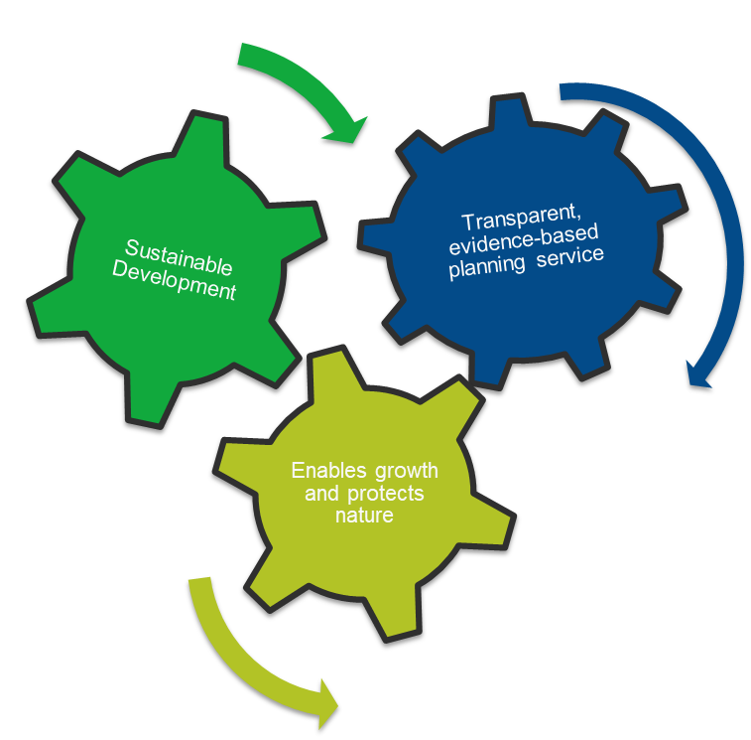
Improving our role as a consultee
Outdated workflow IT causing delays
Increasing environmental complexity (e.g., water, flood risk, infrastructure)
Variability in customer experience
Opportunities to engage earlier with LPAs and developers
How we are improving our service- Our Service Transformation
A long‑term programme to modernise our planning service
Creating a more consistent, digital, user‑centred experience
Aligning with government service standards
Improving data, guidance and customer interaction
Ensuring our service can meet future environmental challenges
Notes:
Currently the EA recognises it has:
Outdated workflow IT causing delays
Capacity pressures in specialist technical areas
Increasing environmental complexity (e.g., water, flood risk, infrastructure)
Variability in customer experience
Opportunities to engage earlier with LPAs and developers
The Spatial Planning Transformation Programme is a strategic initiative by the Environment Agency. Its purpose is to redesign and modernise how spatial planning services are delivered across England.
Why is this important?
It ensures sustainable development that supports both the economy and the environment.
It creates a predictable, transparent, and evidence-informed planning service, making processes clearer and more efficient.
The Programme also aligns with the Government’s growth mission: Enable growth while protecting natural systems.
Ultimately, this transformation will help us work smarter, provide better outcomes for communities, and strengthen environmental resilience.

Slide 43
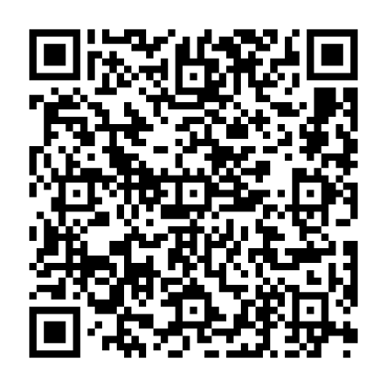
Your expertise matters – Join us to co-design a better planning service.
We need to understand what you need:
We need to understand what you need from this service.
What your previous experience was- the good and the bad.
Understanding your needs will help us shape a service that is clearer, more useful and easier to engage with.
Benefits to you:
Give your voice in shaping tools, guidance, or policy by sharing what actually works on the ground.
You can highlight real challenges and help reduce future friction
Provide evidence of LPA needs at a national level
What the interviews will cover:
What about EA planning advice works well for LPAs and what doesn’t
What impacts you are seeing as a result of how we work with you
Your hopes for how EA might work together with LPAs in the future on planning matters.
Ways to get involved:
Scan the QR code to book an interview or email: spatial_planning_transformation@environment-agency.gov.uk
Notes:
The programme is conducting stakeholder interviews. These interviews will help us understand how the Spatial Planning Transformation Programme could shape planning governance in the future.
We need to understand what you need:
We need to understand what you need from this service.
Your experiences previously- the good and the bad.
Your input will highlight what really matters and where change would have the biggest impact.
Understanding your needs will help us shape a service that is clearer, more useful and easier to engage with.
Benefits to you:
Early insight into changes, shape a new planning service.
You have a say early, not when decisions are already made.
Your input shapes direction before changes are designed or implemented.
What the interviews will cover:
What about EA planning advice works well for LPAs and what doesn’t
Your hopes for how EA might work together with LPAs in the future on planning matters.
Ways to get involved:
Scan the QR code to book an interview.

Slide 44

Thank you for your time. Are there any Questions ?

Slide 45
Workshop 1 – the process
The purpose of the first workshop is to discuss the statutory consultation planning application process (TCPA regime).
We are keen to fully understand who does what in that process and when.
Please draw upon when a planning application comes in, who in the statutory consultee’s organisation does it go to, who in the local planning authority makes the assessment of who it should go to, what monitoring is done, and what does that look like in terms of the process, including monitoring of the 21 day statutory timescales.
We would like to understand how the planning regs are considered in that process and how much is internal guidance or standing advice drawn upon in the process and how useful are they.
We also wish to understand any best practice or tools (such as IT systems, geo-mapping, no objection letters etc) you find really help speed up the process.
If you have views on how the process could be improved in terms of inefficiencies or particular pressure points, we are keen to hear those views too.

Slide 46
Workshop 2 – engagement
The purpose of this session is to cover your views on the quality of your engagement with statutory consultees on the TCPA planning application process, how that engagement looks, what is working well and perhaps what is not.
We would like your views on how to get the best impacts and input out of the system in order to make everything work as smoothly as possible in terms of your engagement with statutory consultees.
You may have views on the role of standing advice and how easy that is to understand in terms of what needs to be done to make an application acceptable.
We would like your views on whether you thought there were particular thorny issues or technical planning reforms that new standing advice could help with, potentially to improve your engagement with statutory consultees by reducing the burden on them/LPAs, freeing up capacity for more impactful applications, possibly.
You may wish to draw upon how technology supports your engagement and/or how digital technology may improve that collaboration in the future.

Slide 47
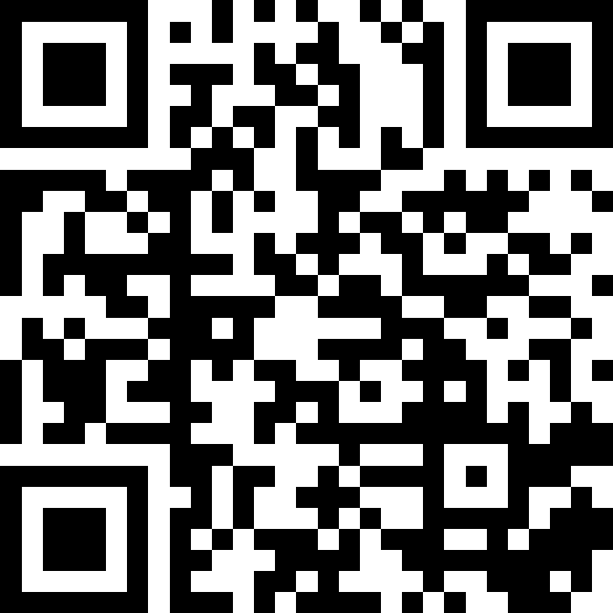
Feedback
  Please scan the QR code
  to provide Feedback on
  today’s event.
https://app.sli.do/event/vkcW9TrZ73eqdpsdSp19A8
Join at www.slido.com using the code 2914149

