Slide 1
Agenda
  0930 – 1000 Registration and coffee
  1000– 1010 Welcome and Introductions
  1010 – 1045 Presentation by MHCLG followed by Q and A
  1045 – 1120 Presentation by Historic England followed by Q and A
  1120 – 1135 Coffee break
  1135 – 1210 Presentation by National Highways followed by Q and A
  1210 - 1245 Presentation by Active Travel followed by Q and A
  1245 – 1345 Lunch
  1345 - 1445 Workshop 1 – statutory consultee process and feedback
  1445 – 1545 Workshop 2 – Statutory consultee engagement and feedback
  1545 – 1600 Summary of the day and next steps

Slide 2
MHCLG Presentation:
Statutory consultation planning application process

Slide 3
Statutory Consultees
Key role & challenges
Statutory consultees play a vital role in the TCPA planning system.
Key challenges & considerations:
Delays/uncertainty
Capacity constraints
Delivering HMG growth objectives & planning reforms
Diverse challenges facing each statutory consultee

Slide 4
Timeline of our progress so far
with statutory consultation reforms
January 2025
Moratorium announced
On new statutory consultees.
March 2025
Written ministerial statement
On a system wide review.
November 2025
Public consultation
On reforms to the statutory consultation system (TCPA regime).

Slide 5



Reforming planning fees
Three key areas of reform
National default planning fees
To better reflect local planning authority costs.
Local variation of planning fees
To enable local authorities the ability to set their own fees to better reflect the costs of their local area.
Surcharge levy
To support statutory consultees.

Slide 6
Next Steps
With statutory consultee and planning fee reforms
Reforms to statutory consultation system
New national default fee
Responding to consultation on reforms to statutory consultee system & following this, taking forward regulations.
Consulting on new national default fee, prior to laying regulations.
Surcharge levy
Local fee setting
Consulting on surcharge proposals & rolling out regulations.
Following the default fee schedule.

Slide 7
Our aims for today
Positive outputs
Gain variety of views/perspectives on working together.
To understand what is working well.
Identify areas for improvement.
To provide us with ideas for best practice.

Slide 8
MHCLG Q&A:
On statutory consultation planning process

Slide 9

Planning Advisory Service
Statutory Consultees
Charles Smith
Policy Director
16 January 2026

Slide 10

How are we performing?
Responded to over 99% of consultations on planning applications within 21 days or an agreed deadline, each year since 2015/16.
Extended fewer than 4% of planning consultations, each year since 2021/22.
Taken average 11.6 days to respond to all planning consultations since 2021/22.

Slide 11

How do we decide when to engage?
We triage cases to:
prioritise cases where our advice is most needed to support local planning authorities’ decisions;
identify where we can direct local planning authorities to standing guidance;
ensure, for other cases, we send a timely response indicating no comment.
We provide bespoke advice in c.25% of cases.

Slide 12

What is the nature of our advice?
For 2024/25:
33% of bespoke advice on planning applications was supportive;
62% of bespoke advice set out points which could either be allayed by revision or were to be weighed by the decision-maker in the balancing exercise;
5% of bespoke advice took the form of objections (1% of all consultations overall) – advice that on heritage grounds the proposals were inappropriate, again to be weighed against other considerations.

Slide 13

What is the impact of our engagement?
i) proportion of applications where our pre-application advice was followed by positive amendments in line with our advice was 85.2%
(ii) proportion of cases in which amendments we received in response to our substantive advice positively reflected that advice was 75%
(iii) proportion of applications to which we have objected which were refused on heritage grounds or withdrawn was 71%.

Slide 14

When are we consulted?
Listed building consent applications for works to a Grade I or II* building, or relevant demolition works to a Grade II building.
Applications for planning permission for development affecting a Grade I or II* listed building or its setting, a Grade I or II* registered park or garden, a scheduled monument or a registered battlefield.
Development affecting the character or appearance of a Conservation Area and involves new build or extension affecting land more than 1,000 square metres.
Local planning authorities’ own applications for planning permission for relevant demolition in Conservation Areas.

Slide 15
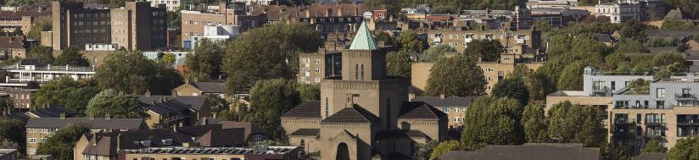
What changes are proposed to HE’s role?
Restriction of consultation on Grade II listed buildings unless for total demolition.
Raising the threshold for consultations on proposals affecting conservation areas from a site area of 1,000 to one of 2,000 square metres.
Abolishing our power of direction for London listed building consent applications.
Net impact: 20% consultation reduction

Slide 16

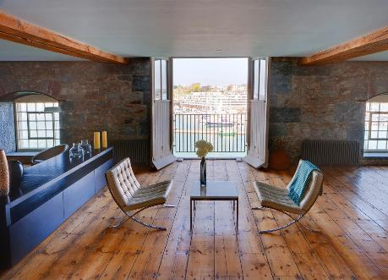


Royal William Yard
Plymouth

Slide 17
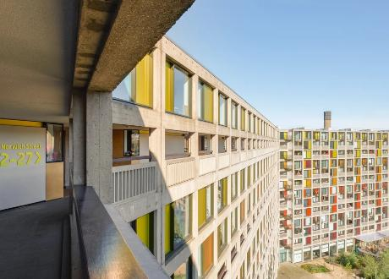



Park Hill
Sheffield

Slide 18


Slide 19
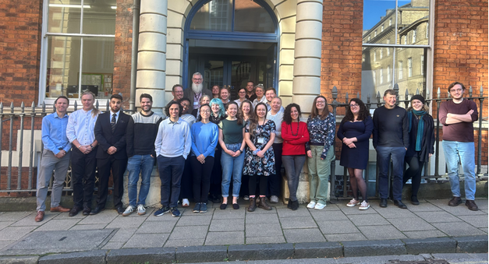
Develop a personal relationship

Slide 20

Do not consult unnecessarily

Slide 21

Ensure applicants provide sufficient information

Slide 22

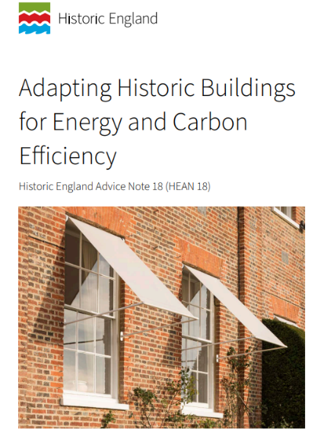
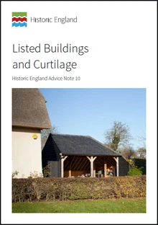
Use our advice and guidance

Slide 23


Take part in our training programmes

Slide 24



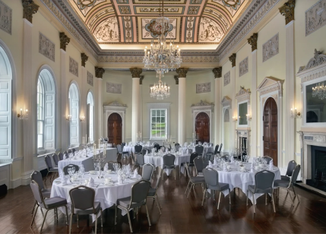
Encourage early consultation for high profile and/or contentious cases

Slide 25
Thank you
From the extraordinary, to the everyday, our historic places and spaces matter to us all.
That’s why at Historic England we work together with people across England, to discover, protect and bring new life to our shared historic environment – so the heritage that surrounds us all, lives on and is loved for longer.
Historic England

Slide 26
Liz Garlinge
Peter Fisher
PAS statutory consultee event
January 2026

Slide 27

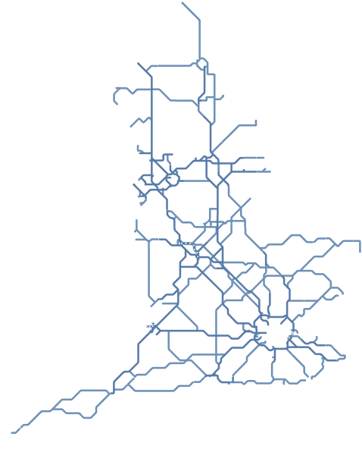




National Highways
over
24,000
bridges and other structures
National Highways manages and improves England’s 4,300 miles of motorways and major A-roads that make up the strategic road network.​
This network plays a vital role in everyday life and is crucial to the UK economy. It connects regions, families and friends. It supports local and regional growth, and it enables businesses to deliver goods nationally and globally. ​
We’re an arms-length government body, receiving our strategic direction and funding from the Department for Transport. We deliver the government’s road investment strategies over multi-year funding periods. ​
Everything we do, from designing our roads to clearing incidents, helps keep traffic moving safely 24 hours a day, 365 days a year.
over
100,000
street lights
over
150,000
signs
over 3,500
electronic messaging signs
30,000ha
soft estate area
4,300
miles of motorways and major A-roads

Slide 28

NH Spatial Planning in numbers
In the last year, NH has received 4435 formal consultations
In the same period, NH also received 107 appeal consultations, and 588 requests for pre application advice.
Substantial requests relating to development of 337 local plans.
24 DCO applications submitted in the
last 12 months

Slide 29
What does planning reform mean for National Highways?
Stricter focus on statutory remit
Stat consultee review
Removal of duty to consult
Cost recovery
£11.9bn
£868m
Operations, maintenance and renewals
Designated funds
.
Removal of requirement to produce a PIER
£9.3bn

Slide 30
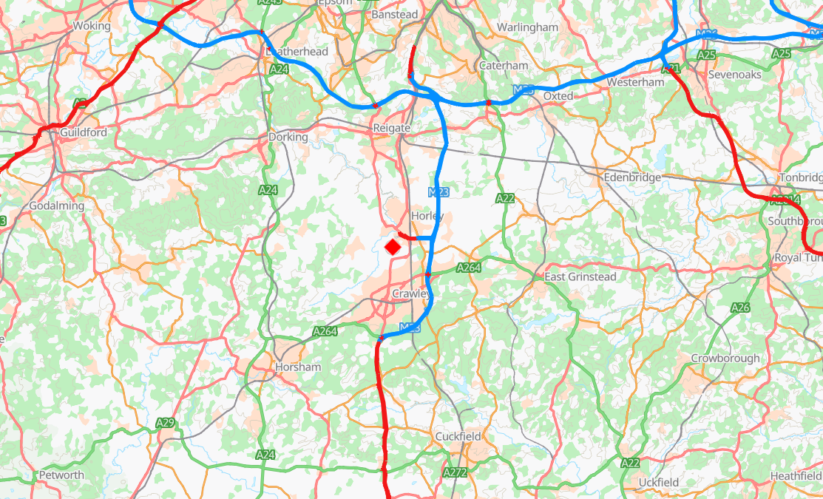

Working with developers – a case study
Existing main runway
Northern runway
M25
Gatwick Airport
M23

Slide 31







National Highways' role in planning is changing
 | An enabler, not a blocker In line with the government's planning agenda, we need to become an enabler for growth, collaborating with developers and promoters and ensuring we do not become a blocker to sustainable development.
 | More development requires more support The government's economic and planning agenda is already leading to an increase in development in areas such as housing, transport and energy. This is affecting our workload across National Highways, requiring us to rethink of spatial planning delivery.
 | Opportunities to recover costs Consultees like National Highways are now able to recharge developers and promoters for the planning advice they provide. This is a great opportunity for us to generate revenue for National Highways but will require changes to deliver effectively.
 | Less applications to submit, more to review We are anticipating a reduction in workload for planning applications for our own schemes due to the reduction in enhancements. However, there will likely be an increase in applications for National Highways to review
 | Smoother, quicker processes In the past, our processes to review planning applications have led to some delays and gaps. With volumes increasing and with opportunities for revenue, we need smoother and more efficient spatial planning delivery across National Highways.

Slide 32
The current spatial planning ecosystem
Multiple teams across National Highways provide a spatial planning service. They regularly engage with each other, but there are few consistent processes across them all, resulting in some inefficiencies and an inconsistent experience for our customers.
OD Yorkshire & North East
OD North West
Legal Services
Strategic Planning Division
OD Midlands
Major Projects
OD East
OD South West
Third Party NSIPs Team
OD South East

Slide 33





NH’s ambition for Spatial planning- Road Period 3 (2026-31)
Better prioritise our efforts to provide a responsive high quality, consistent planning service for developers and promoters which acts as an enabler for sustainable development
Ensure National Highways can respond to the government's ambitious planning agenda
Provide greater support, recognition and career pathways for the spatial planning community​ across National Highways
Recover costs for National Highways by establishing and delivering new cost recovery processes for DCOs
Bring spatial planning operations in line with the new National Highways structure and ambitions to be a customer focused organisation
Spatial planning defined in this context as all NH engagement in the planning system both as an applicant and as a consultee. This includes Local Plans, Development Consent Orders, TCPA and Highways Act as well as other bespoke planning routes as was used for HS2 and Universal Studios.

Slide 34


How ATE engages as a statutory consultee
Mark Knighting
Head of Development Management
12:10 – 12:45

Slide 35

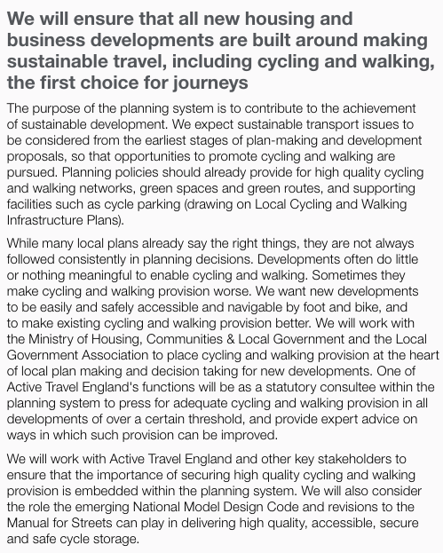
Genesis of Active Travel England

Slide 36
Current statutory consultation thresholds
Since June 2023, local planning authorities have been required to consult ATE on planning applications where developments meet at least one of the following thresholds:
≥ 150 homes
≥ 7,500m² floorspace
≥ 5ha site area
    ATE discharges this function with 9 caseworkers, soon to be 11. However, there is scope to increase team size further over the next 12-18 months.
    Due to relatively low staffing levels, ATE offers a limited pre-application service currently.
    ATE doesn’t have a statutory role for NSIPs.

Slide 37








ATE planning application assessment toolkit
    Highlights key assessment criteria and common shortfalls to address
    Brings together and auto-references relevant national policy & guidance
    Easy to use although web-version now in development

Slide 38
Toolkit criteria
1. Trip generation and assignment
Does the application appropriately forecast all day trips to, from and within the site by walking, wheeling and cycling?
2. Active travel route audit
Has an appropriate assessment on the design and accessibility of existing active travel routes in the locality of the site been presented?
3. Pedestrian access to local amenities
Are most buildings within 800m from a range of amenities (such as primary schools, parks, play areas, food shops, cafes and community buildings) using well-designed routes?
4. Cycling accessibility
Are a range of local amenities, and town centres, railway stations, employment areas and the National Cycle Network as appropriate, accessible for cyclists using well-designed routes?
5. Access to public transport
Are all buildings within 400m of a high-frequency bus stop or 800m of a rail/light rail station or tram stop, with appropriate facilities, using well-designed routes?
6. Off-site transport infrastructure
Does the application include proposals to enhance local active travel and public transport infrastructure?
7. Site permeability
Does the development prioritise pedestrian and cycle movements within the site?
8. Placemaking
Does the development establish a strong sense of place, with well-designed streets, public spaces that feel safe and key amenities provided?
9. Cycle parking and trip-end facilities
Does the application provide the requisite amount and quality of cycle parking and trip-end facilities?
10. Travel planning
Does the travel plan outline ambitious mode share targets and measures to embed active travel, alongside appropriate monitoring and remedial strategies?

Slide 39

Proposed statutory consultation thresholds
≥ 250 homes
≥ 750m² floorspace for school or college development
Highway authority development requiring planning permission
    Forecast 40% reduction in consultations.
    Focus on key strategic developments where ATE can have greatest influence.

Slide 40
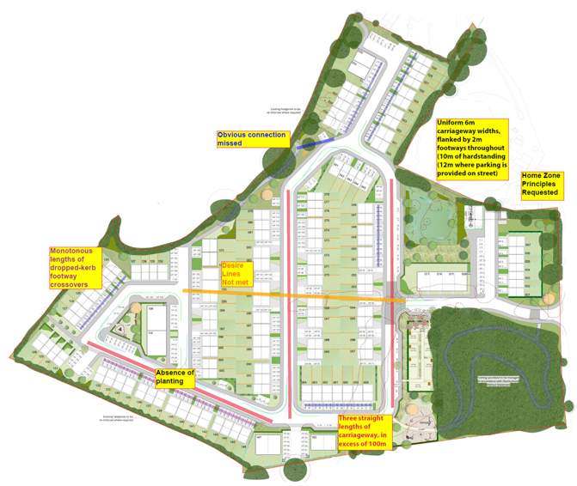
Case study – Hambrook, 158 homes (original plans)
Desire lines not met
Long lengths of dropped kerb
Speed-inducing carriageways (wide & straight)
Absence of planting
Connections missed
Isolated play area

Slide 41
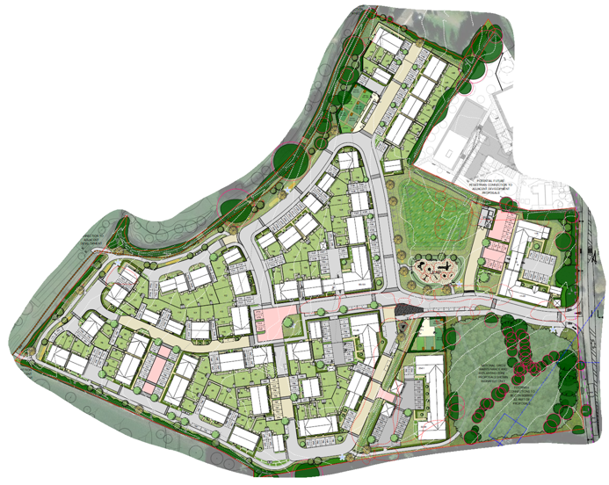
Case study – Hambrook, 158 homes (revised plans)
Legible, direct routes
Streets that calm traffic by design, not by ‘retrospective’ measures
Central square
Street trees
Areas of shared space
Play area central

Slide 42
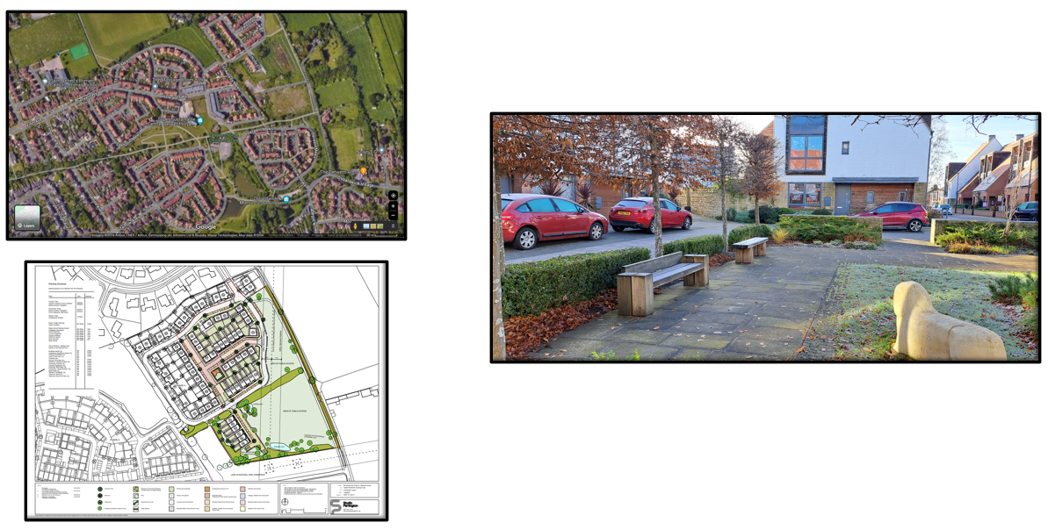
Case study – Derwenthorpe, 481 homes (built)

Slide 43
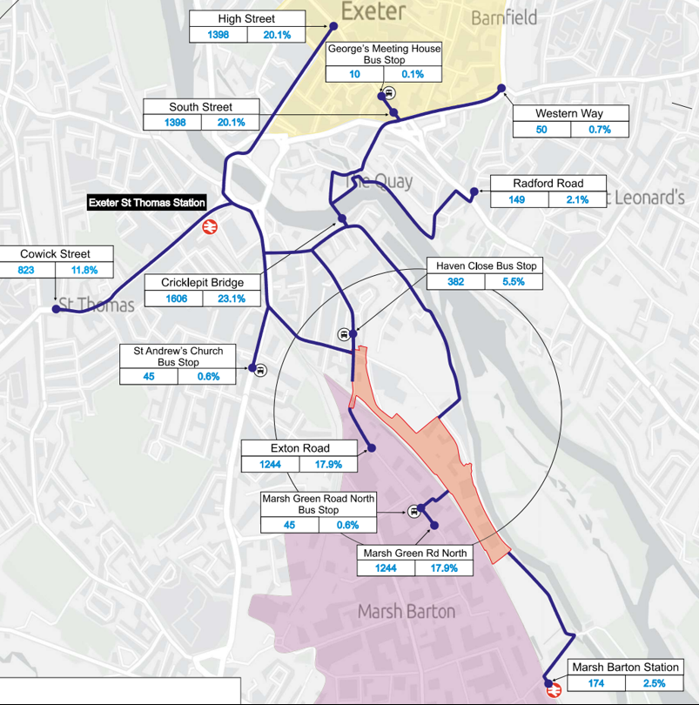
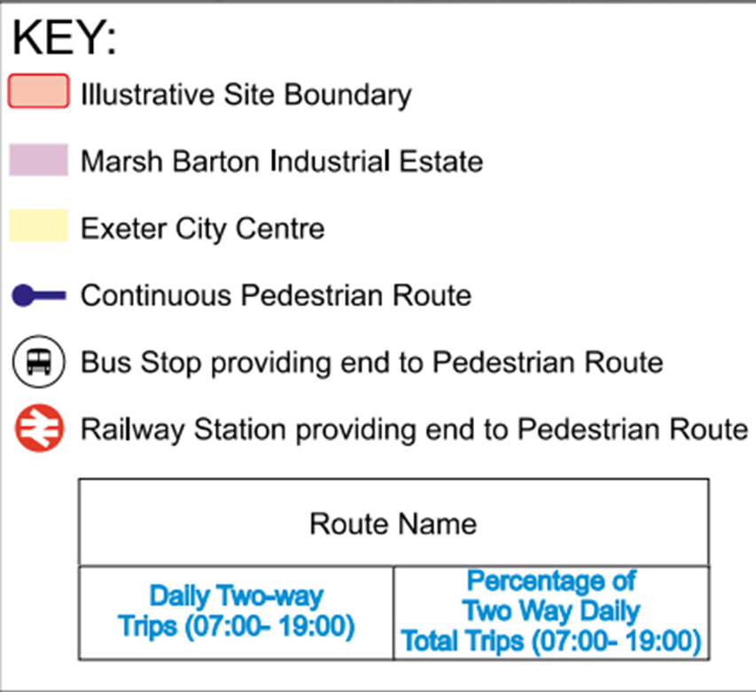
Case study – Exeter, 1,100 homes
TA identified the key places people want to visit from the site – schools, centres, health, stations etc.
This showed the modal share and number of walking/wheeling trips.
Distance and importance of the facility used to forecast.
This assessment informed routes to be audited and supported the case for additional infrastructure to support active journeys.

Slide 44
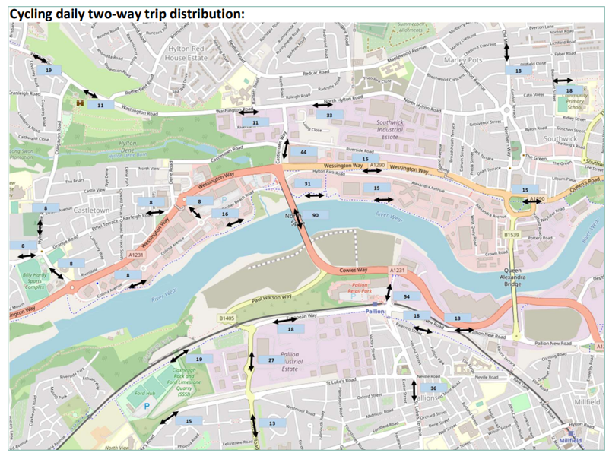
Case study – Crown Works Film Studios, Sunderland

Slide 45
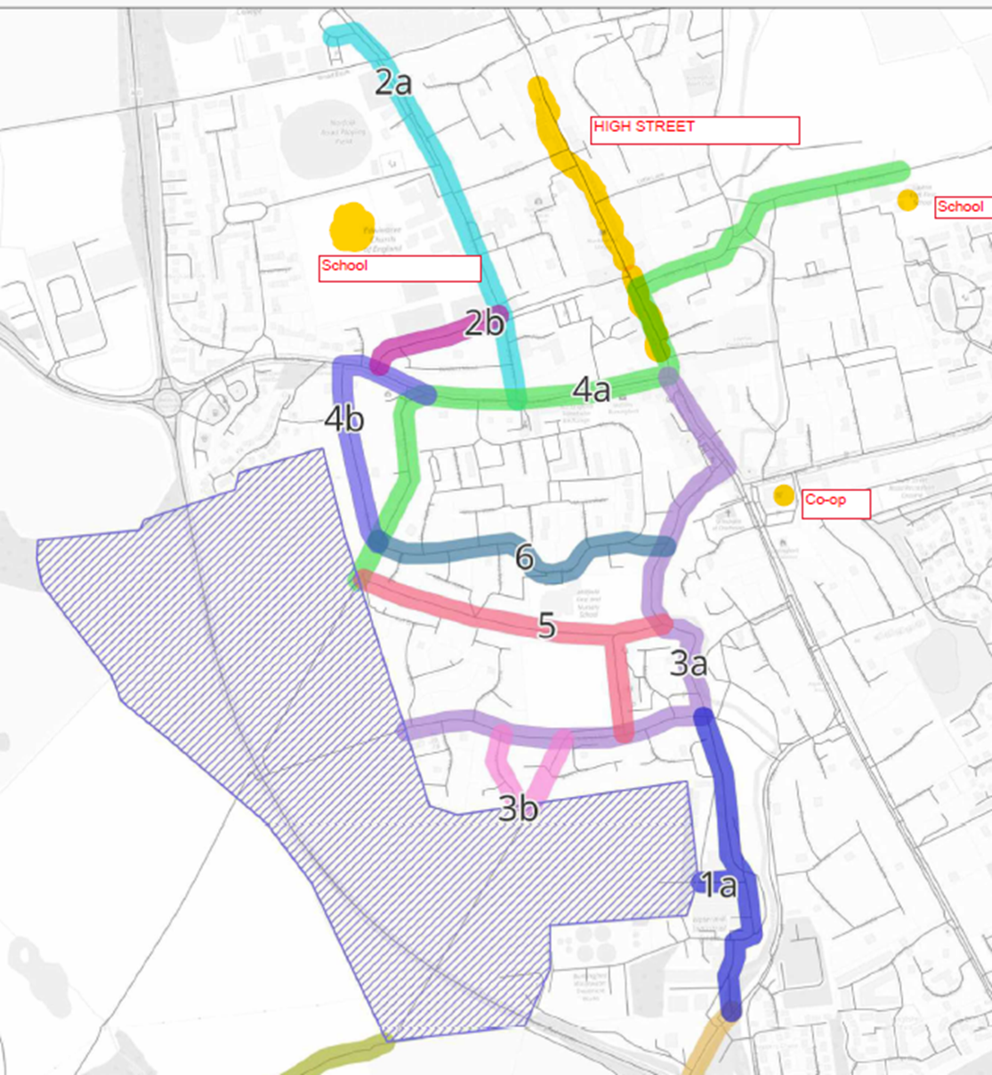
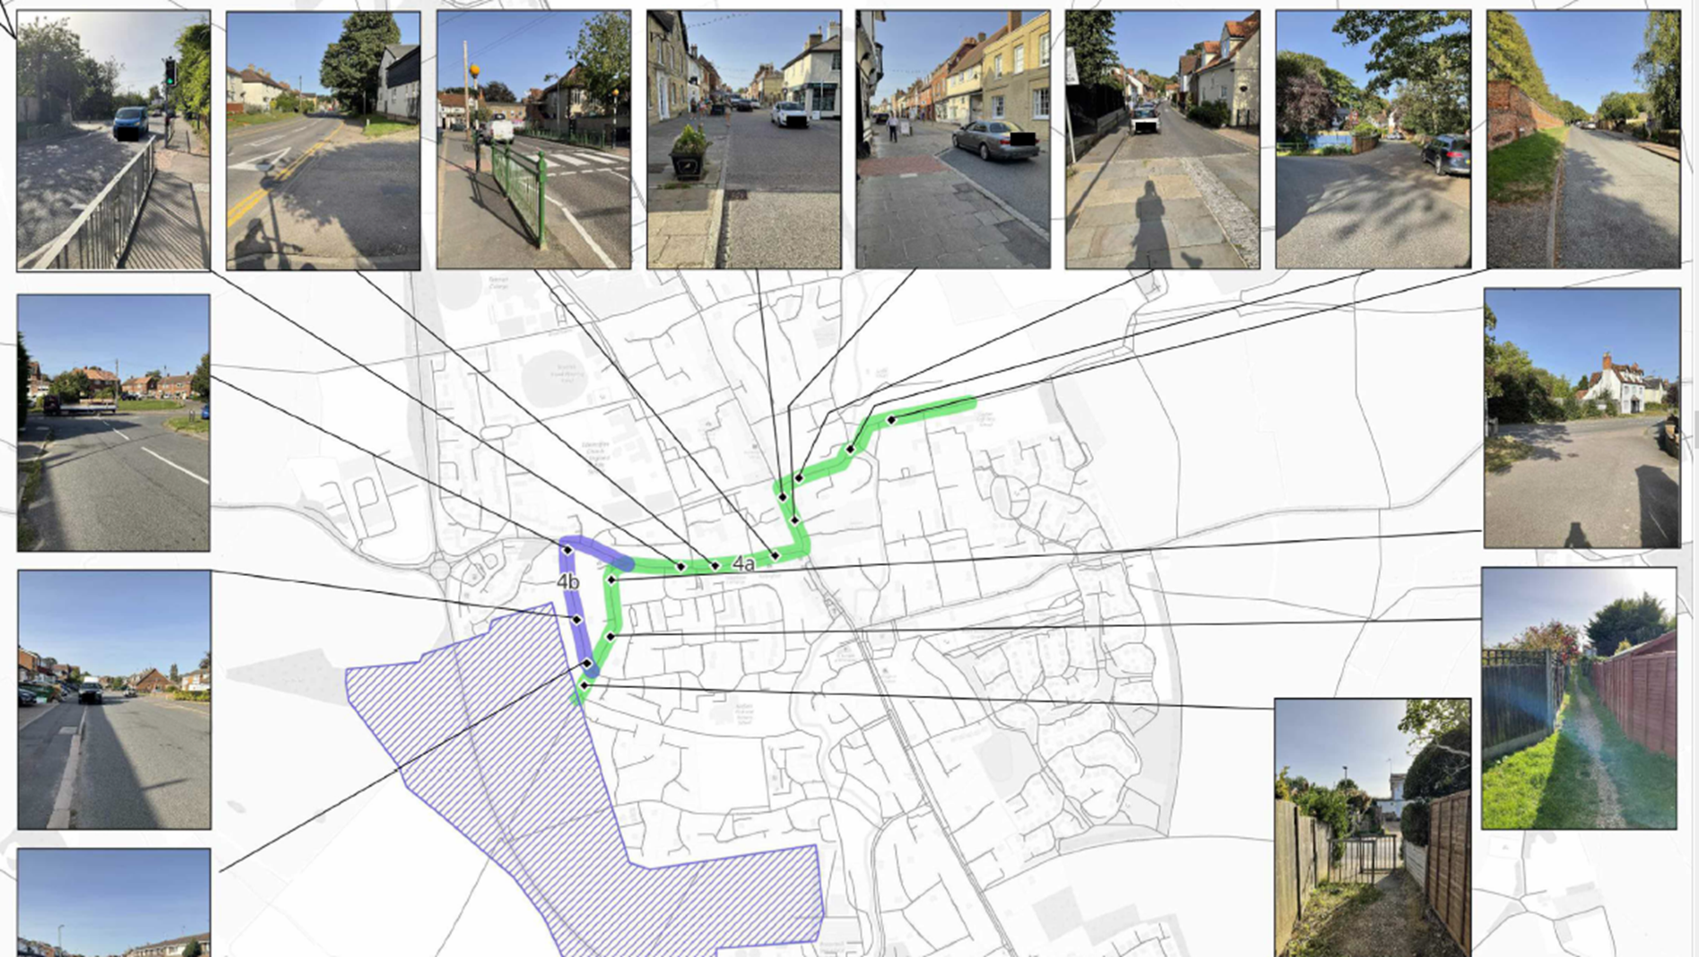
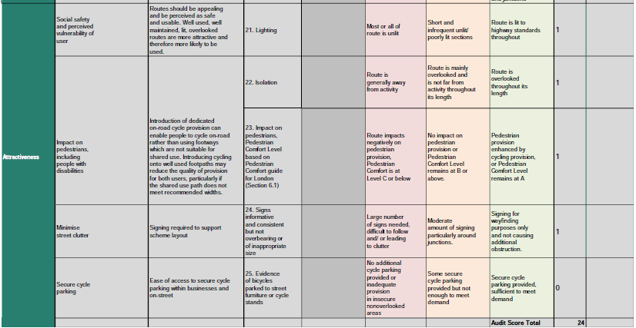
Case study – Hertfordshire, 350 homes
ATE asked transport consultant to undertake a local route audit.
They assessed walking/wheeling routes and scored cycling routes using LTN 1/20’s Level of Service Tool, with accompanying plans, photos and description provided.
This identified need for speed reductions, widening of sections of footways, side road treatment and further improvements planned in the LCWIP.
We worked closely with the LHA to prioritise schemes and understand what would work.

Slide 46
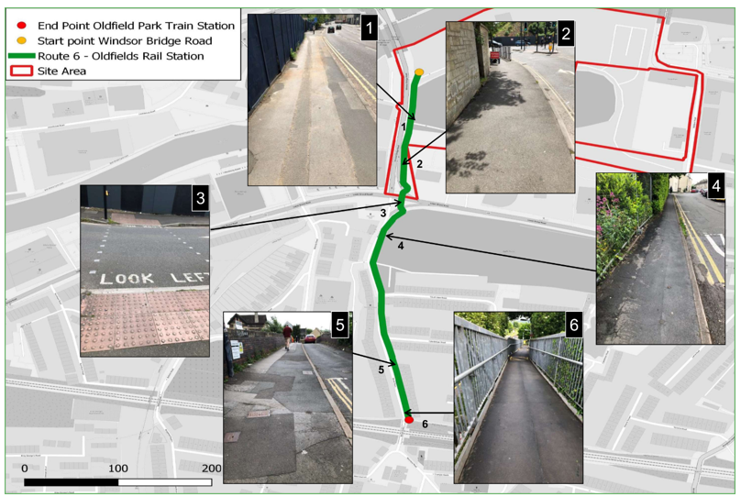
Case study – Western Riverside, Bath

Slide 47
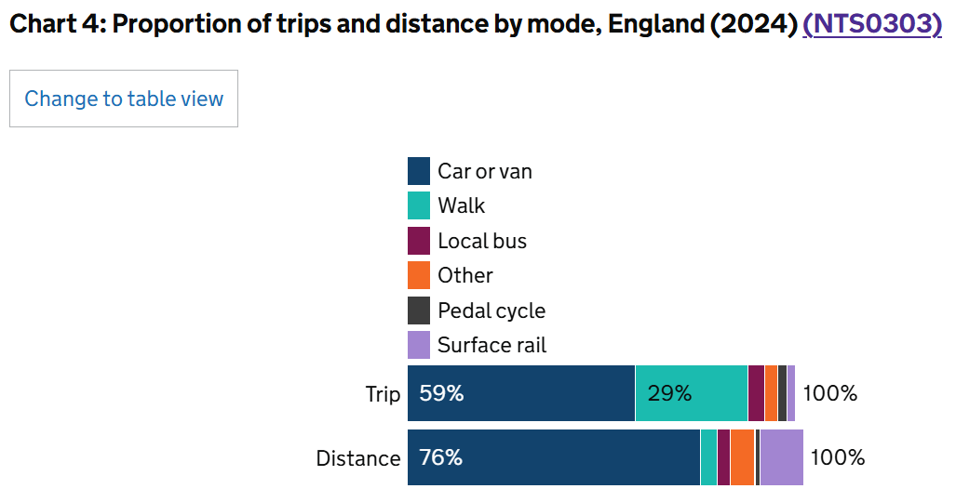
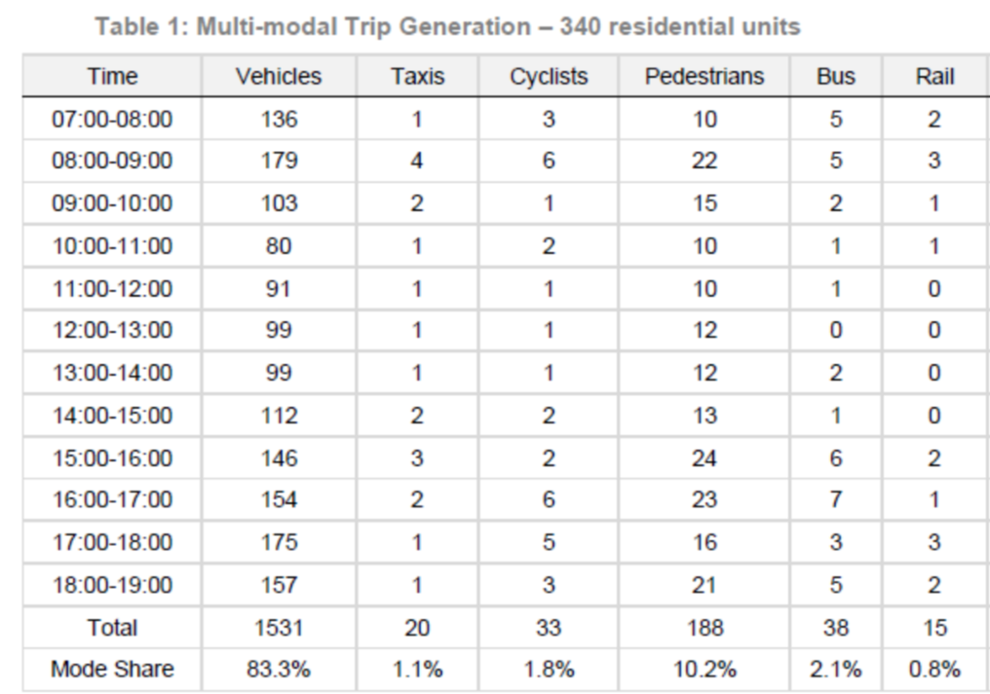
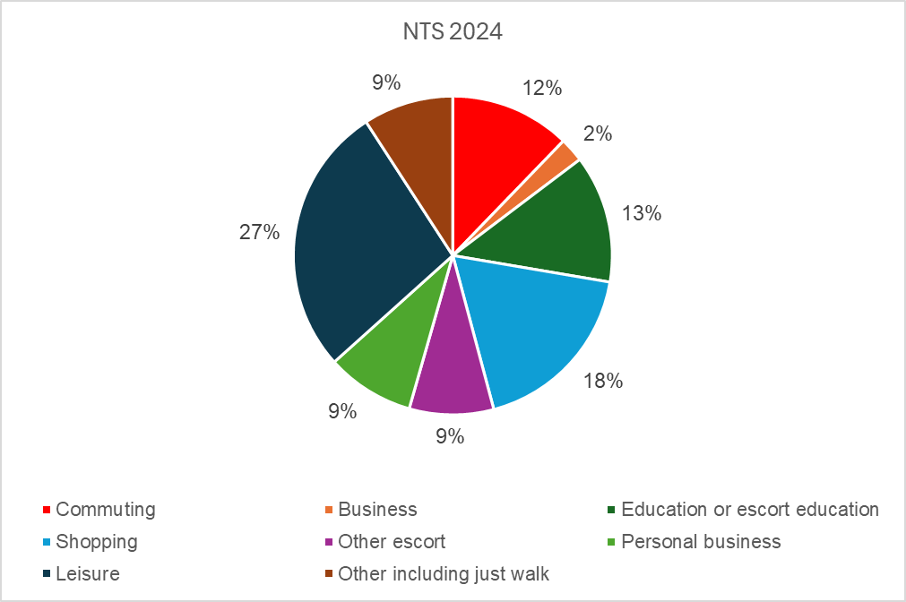
Challenges – rubbish in, rubbish out

Slide 48
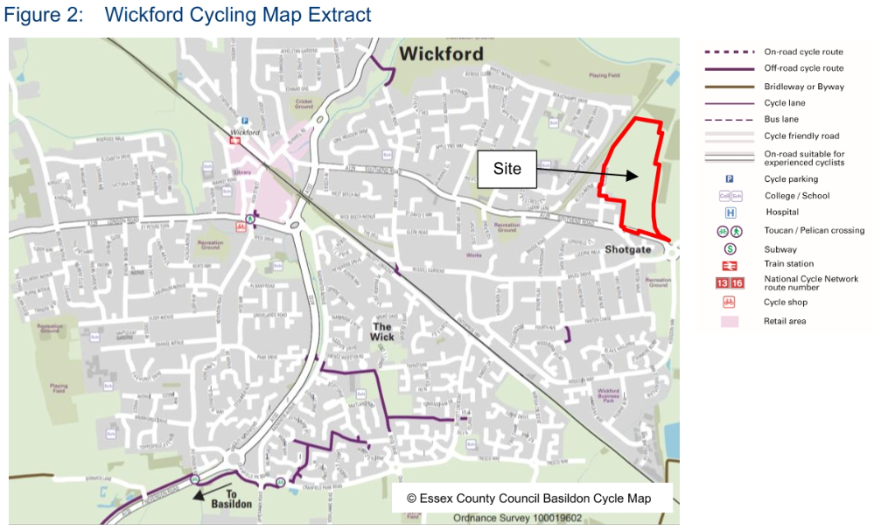
Challenges – desktop assessments of route quality
“Although [there are] no formal cycle routes… the relatively wide carriageways and 30mph speed limits ensure an excellent opportunity for safe cycling to and from the site”

Slide 49
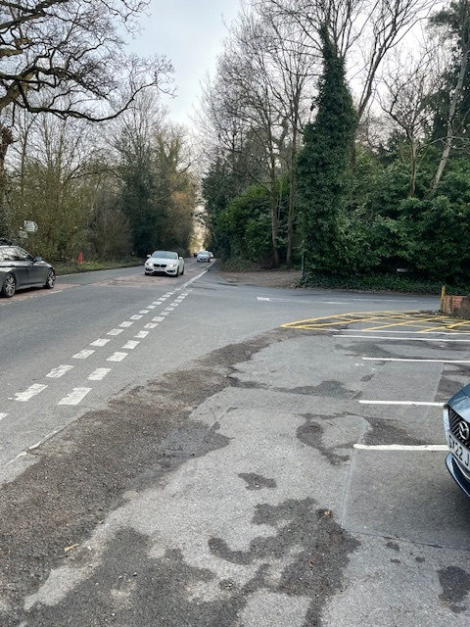
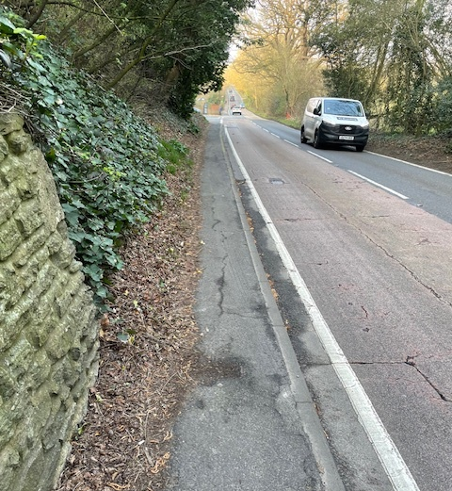
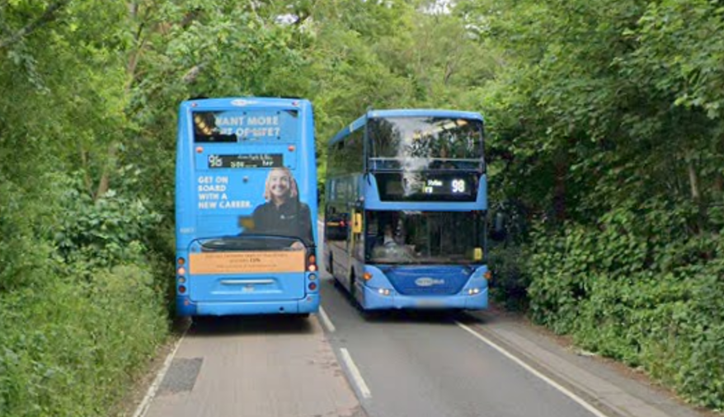
Challenges – not everyone agrees with you
Inspector: “…I do not consider the level of pedestrian provision along Worthing Road, post-improvement, would be so substandard as to discourage normally fit and active people from using it.”
Note: None of the deficiencies shown in these photographs will be improved.

Slide 50
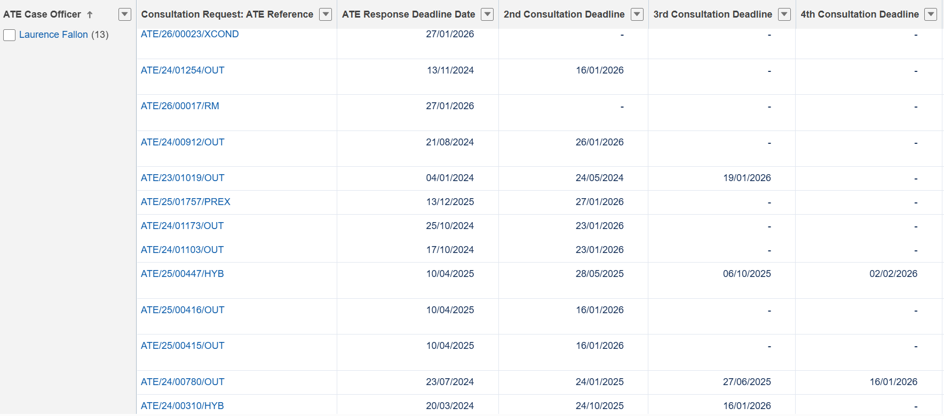
Challenges – re-consultations

Slide 51
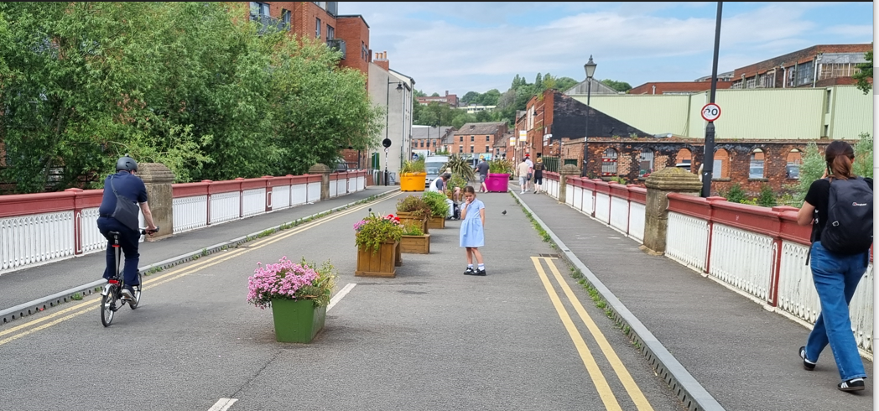
Possible areas for improvement
    Earlier engagement
    ATE responses – more succinct / focus on key issues only?
    Fewer re-consultations or written responses to re-consultations?
    Enhanced training offer and improved products?

Slide 52

Active Travel England
West Offices, Station Rise, York, YO1 6GA
gov.uk/government/organisations/active-travel-england

Slide 53
Workshop 1 – the process
The purpose of the first workshop is to discuss the statutory consultation planning application process (TCPA regime).
We are keen to fully understand who does what in that process and when.
Please draw upon when a planning application comes in, who in the statutory consultee’s organisation does it go to, who in the local planning authority makes the assessment of who it should go to, what monitoring is done, and what does that look like in terms of the process, including monitoring of the 21 day statutory timescales.
We would like to understand how the planning regs are considered in that process and how much is internal guidance or standing advice drawn upon in the process and how useful are they.
We also wish to understand any best practice or tools (such as IT systems, geo-mapping, no objection letters etc) you find really help speed up the process.
If you have views on how the process could be improved in terms of inefficiencies or particular pressure points, we are keen to hear those views too.

Slide 54
Workshop 2 – engagement
The purpose of this session is to cover your views on the quality of your engagement with statutory consultees on the TCPA planning application process, how that engagement looks, what is working well and perhaps what is not.
We would like your views on how to get the best impacts and input out of the system in order to make everything work as smoothly as possible in terms of your engagement with statutory consultees.
You may have views on the role of standing advice and how easy that is to understand in terms of what needs to be done to make an application acceptable.
We would like your views on whether you thought there were particular thorny issues or technical planning reforms that new standing advice could help with, potentially to improve your engagement with statutory consultees by reducing the burden on them/LPAs, freeing up capacity for more impactful applications, possibly.
You may wish to draw upon how technology supports your engagement and/or how digital technology may improve that collaboration in the future.

