Slide 1

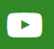
Nature Recovery Toolkit Workshop
Council
youtube.com/@paswebmaster
Linkedin.com/in/pas-team-4935556128
pas@local.gov.uk
Notes:
NOTES FOR WORKSHOP LEADS:
Welcome – brief (go through the agenda in a moment)
Housekeeping – practical i.e. toilets, refreshments, fire alarms
Introductions to presenters & roles/who:
Chair i.e. Timekeeping, introduction and review - Shaun
Notetaking and reporting back on key issues – use post notes for actions
Anyone else? – Ann, PBH, Matt, & Shaun to lead group exercises

Slide 2
Welcome & Introductions
PAS Consultants
Council co-ordinators

Slide 3
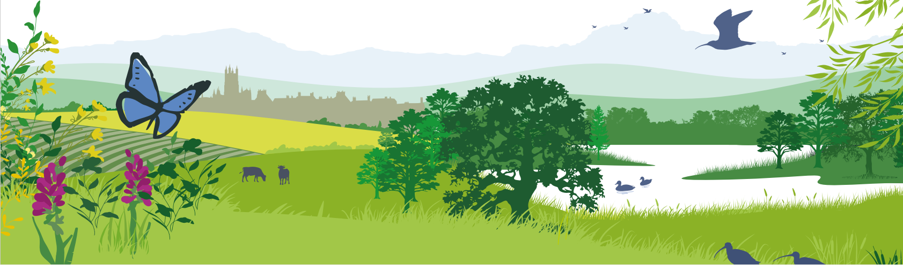
The Purpose Of Todays Workshop
AIM: To consider how nature recovery measures can be delivered throughout the council’s services & operations
KEY OBJECTIVE: Identify opportunities and actions the council can take forward to achieve this aim
Notes:
2 min
NOTES TO FACILITATORS:
MW
TAKEN FROM YOUR NATURE RECOVERY TOOLKIT CHECK-LIST:
Purpose of the workshop (the why):
Aim (the what, your desired outcome):
Key objectives (the how – specific actions to create your process):

Slide 4
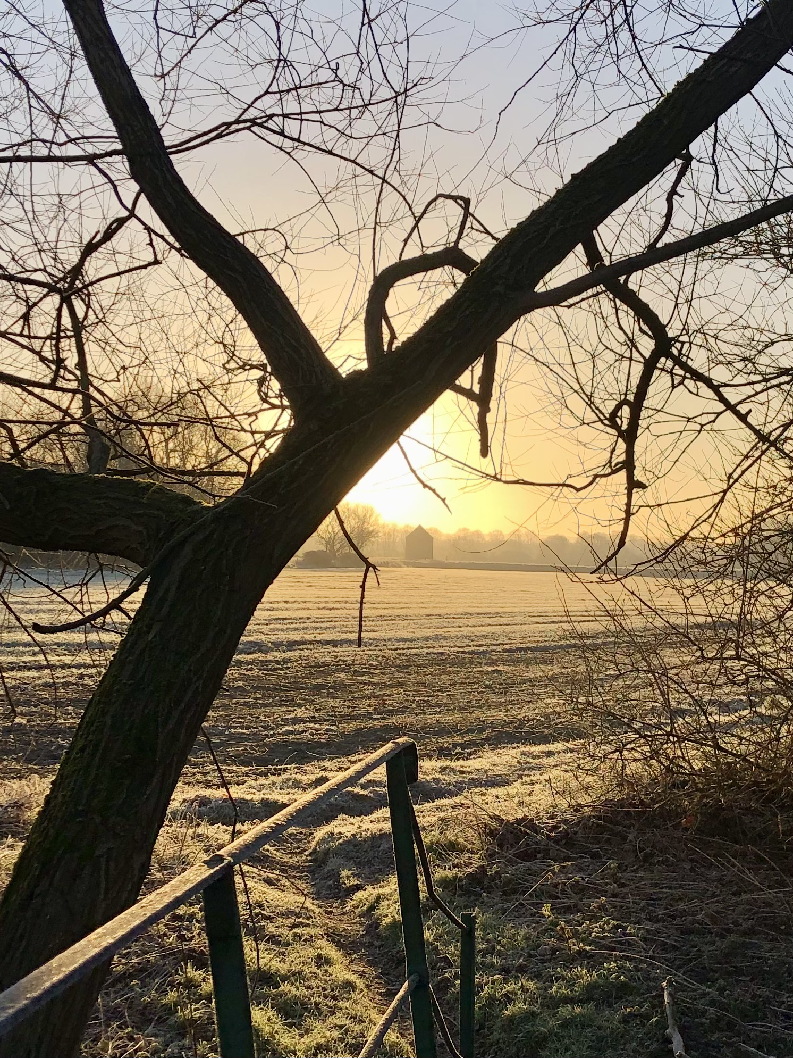
Key take-aways for attendees
Realise what actions are already being undertaken and what we can all do to help the Council improve
Increased awareness of the delivery options for nature recovery & knowing where to find support and who to work with
Understand your role and that of your service area for nature recovery
PHOTO CREDIT: R Murtagh frosty view to dovecot
Notes:
NOTES TO FACILITATORS:
TAKEN FROM YOUR NATURE RECOVERY TOOLKIT CHECK-LIST:

Slide 5
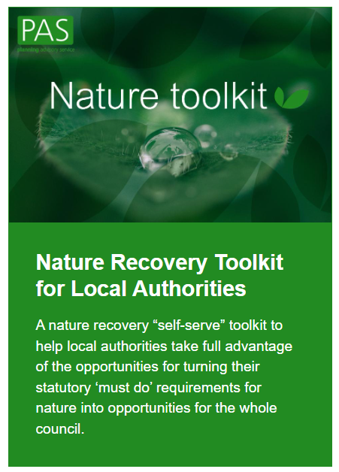
“Nature Recovery Toolkit”
Help councils understand a complex world by providing:
A framework for:
Supporting corporate objectives through duties including BNG, biodiversity reporting, and LNRS
Understanding the statutory (must do’s) and opportunities (could/should dos)
Deciding what to do (who contributes, objectives, the evidence base, funding, making it happen etc)
A process:
Engaging the right stakeholders
Working with stakeholders to decide what to do - workshop
Understanding the oversight and governance requirements for your chosen priorities
Notes:
NOTES FOR WORKSHOP LEADS: RM
Helps to make sense of the changing and complex world of policy and action for nature and take advantage of the opportunities
turning statutory ‘must do’ requirements into opportunities for the whole council to support delivery of their strategic and corporate priorities on health, air quality, climate change, adaptation etc.
The toolkit focusses on council priorities, the land that they hold, the services they deliver and explores how nature can act as an enabler for these and the quick wins that can be made.
Why should local authorities use the toolkit?
There are a number of advantages that can be delivered as a result of using toolkit including:
Across the council / political buy-in and joining up work across departments.
Read-across into other plans and strategies and streamlining benefits.
A clearer understanding of how to deliver change, saving costs and securing additional funding.
Readiness for Local Nature Recovery Strategy delivery – what can the council do
A shortlist of priority activities and interventions that can start to be delivered.
Our approach is rooted in establishing a strong governance process as a means of demonstrating to the wider council how a strategic approach to nature can help address wider corporate issues.

Slide 6
Workshop Agenda
Time | WORKSHOP AGENDA | Timing
10:00 | Welcome, housekeeping, introductions | 10 mins.
10:10 | Introduction to the toolkit and this session | 25 mins.
10:35 | REQUIRMENTS & RESPONSIBILITES Scene setting Exercise - mandatory requirements and existing work | 20 mins.
11:00 | BREAK | 15 mins.
11:15 | PRIORITIES & OPPORTUNITIES Scene setting Exercise – How can nature help address our corporate & service priorities | 45 mins.
12:00 | LUNCH | 60 mins.
13:00 | BARRIERS, GAPS & SOLUTIONS D Exercise – How can nature help address your service priorities | 30 mins.
13:30 | ACTION & DELIVERY E Exercise – Action and delivery group exercise F Exercise - Data monitoring & support | 30 mins
14:00 | Next Steps – Feedback & Close | 15 mins
Notes:
RJ
NOTES FOR WORKSHOP LEADS:
It’s a busy day – start on time, time your sessions
Keep a copy of the agenda on display so participants can see it at all times

Slide 7
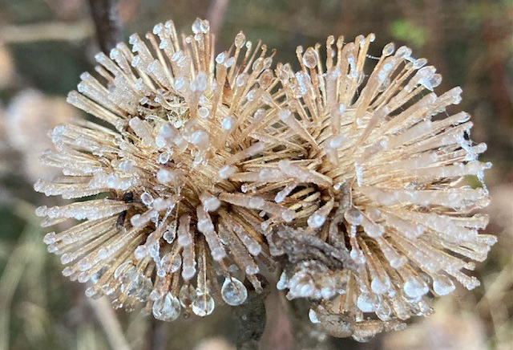
What nature means to you
In pairs, decide on who is A and who is B
Take turns to speak – one at a time this is not a conversation
Introduce yourself (name, role)
Think of a place in nature you know/visit
Briefly where is it? What is it?
    What do you value about it? Why is it special?
PHOTO CREDIT: R Murtagh
5-minute exercise. 2 minutes each (timed)
Notes:
NOTES FOR WORKSHOP LEAD:
It is essential to start with gratitude. It gets people connected, relaxed and motivated

Slide 8

INTRODUCTION – why bother?
Notes:
NOTES TO FACILITATORS:
Complying with the biodiversity duty - GOV.UK
Yorkshire Wildlife Trust State of Nature
Intro to LNRS
Relate to day job – why is this important
Longer journey – how can nature help you meet your existing priorities
Already doing a lot just not capturing in one place and celebrating etc

Slide 9

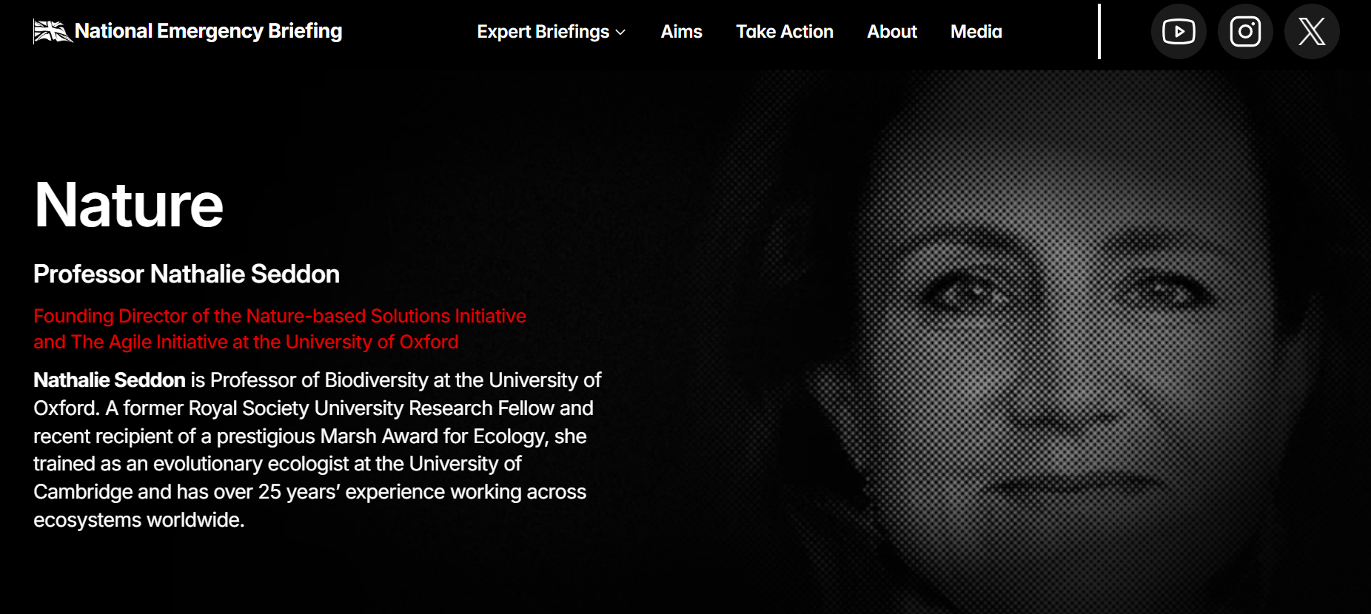
“Nature is not a ‘nice to have’; it is critical national infrastructure.”
National Emergency Briefing
Notes:
RM
CLICK ON IMAGE TO PLAY 10 MINUTE VIDEO​
Key points from the briefing​
Nature is critical national infrastructure. When we destroy it, we increase floods, heat deaths, food insecurity and economic instability. When we restore it, we reduce risk, save lives and strengthen the economy.​
The UK is one of the most nature-depleted countries on Earth. Only about 53% of our biodiversity remains; one in six species faces extinction. This is a loss of vital functions — pollination, clean water, flood regulation - not just wildlife.​
Nature loss is a national security and economic risk. Continued degradation could cause a major economic shock - while leaving millions of homes exposed to flooding and heat.​
Restoring nature is one of the highest-return investments available. Wetlands, peatlands, hedgerows and urban trees cut flood risk, prevent heat deaths, protect food supplies, store carbon and create skilled jobs — at far lower cost than rebuilding after disasters.​
We are still paying to destroy our own life-support system. Public money and finance continue to subsidise pollution and ecosystem damage, actively increasing long-term risk.​
The public is ahead of the Government. Most people want stronger action to protect and restore nature - and the science shows we know exactly what works.​
​

Slide 10
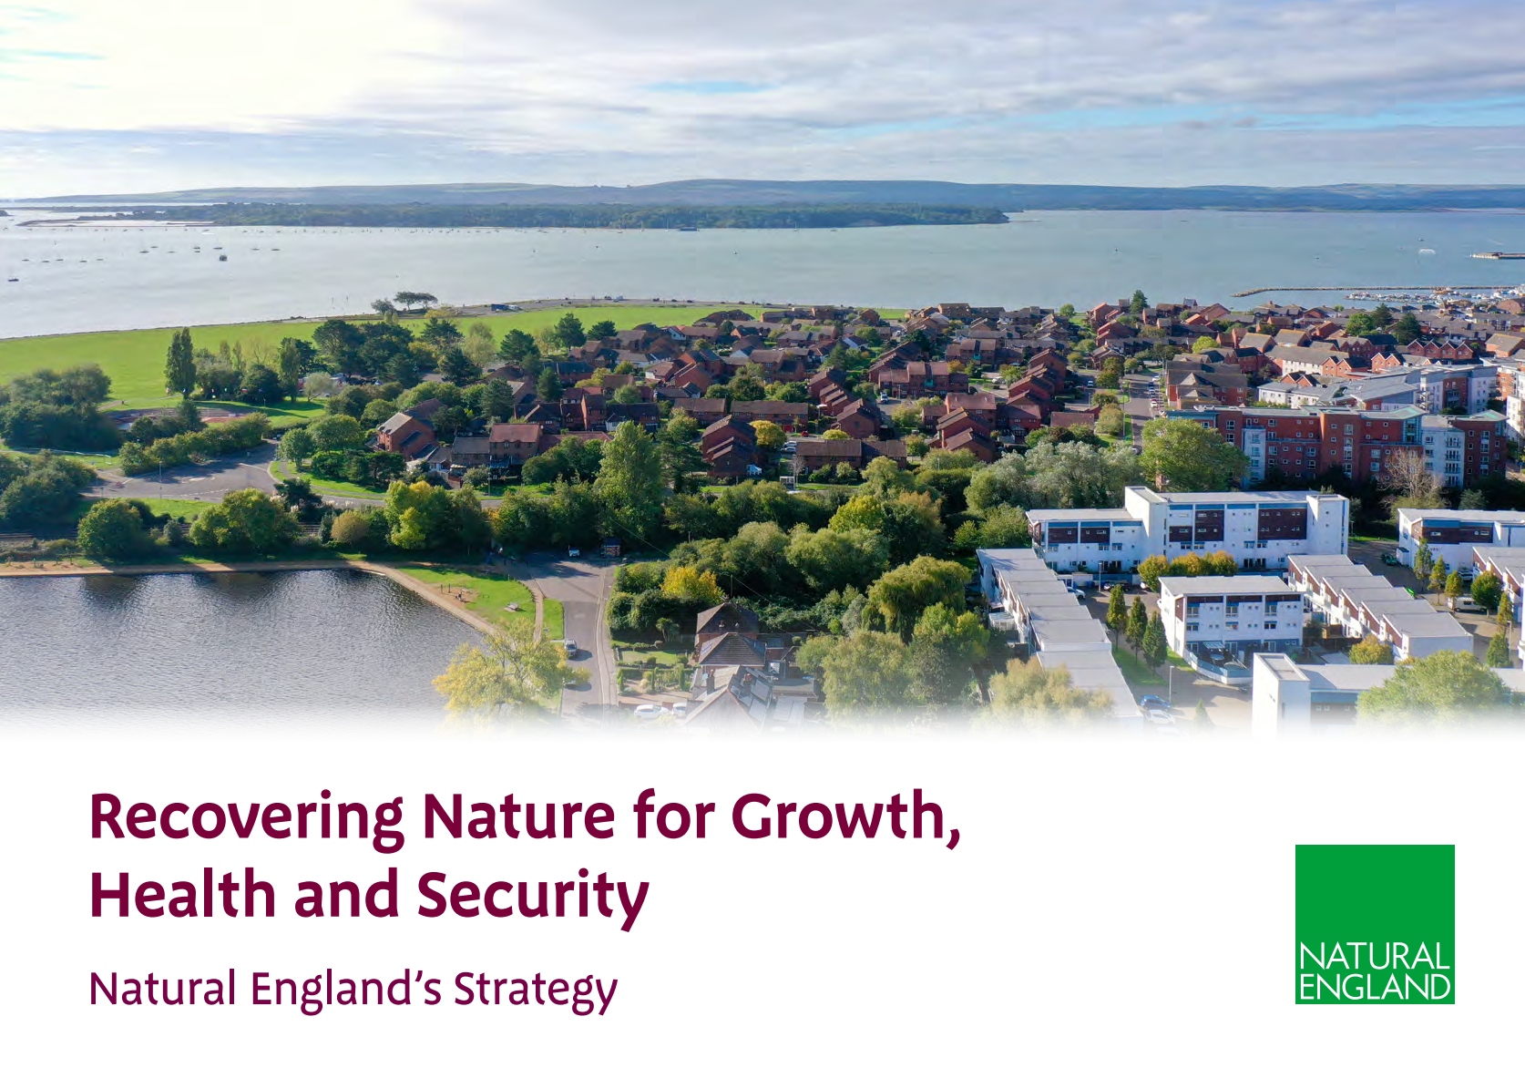



Notes:
MW
Up to 5min intro here from NE colleagues:​
Local context, NE new strategy and what they want to see in BCP, strength of various partnerships/platforms etc for delivery (LNRS, Habs regs)

Slide 11


Purpose of this section:
To understand the session objectives in the context of the councils' priorities and explore what action can be taken.
Output:
Set of short-, medium- and long-term opportunities including quick wins and projects that need developing.
Actions
Requirements & Responsibilities
Notes:
NOTES TO FACILITATORS:

Slide 12
Scene setting – REQUIRMENTS & RESPONSIBILITES
What are the council’s key priorities and challenges?
How can nature and the powers for nature help address these?
Notes:
NOTES TO FACILITATORS:
List:
General priorities & challenges e.g. North Northants Corporate Plan: Family, Community, Prosperity, and delivering Smarter, Faster and Fairer public services.
LNRS, BNG, Biodiversity Duty FYI not too much technical detail needed here. You could:
Quote residents input into the LNRS
Spot-light some key local success stories that attendees will relate to & be proud of

Slide 13
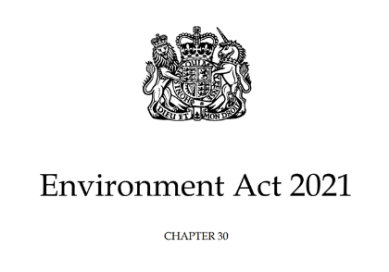
Environment Act 2021 Summary
Responsible authorities appointed by the Secretary of State (S105) to lead the Local Nature Recovery Strategy (LNRS), working with a broad range of stakeholders.
Enhanced duty for LAs to conserve and enhance biodiversity (S102) and report on their actions (S103) aka Biodiversity Duty Complying with the biodiversity duty - GOV.UK
LPAs will need to comply with the above duty and have regard to the Local Nature Recovery Strategy in local planning policy and decisions (S102).
All planning permissions granted in England (with a few exemptions) will have to deliver at least 10% biodiversity net gain from Nov 2023 (S98-101)
Notes:
RJ
NOTES TO WORKSHOP LEADS:
The Environment Act 2021 introduced a number of new duties for local authorities which are of relevance to nature recovery and biodiversity including:
Responsible authorities appointed by the Secretary of State (S105) to lead the Local Nature Recovery Strategy (LNRS), working with a broad range of stakeholders.
Enhanced duty for LAs to conserve and enhance biodiversity (S102) and report on their actions (S103)
LPAs will need to comply with the above duty and have regard to the Local Nature Recovery Strategy in local planning policy and decisions (S102).
All planning permissions granted in England (with a few exemptions) will have to deliver at least 10% biodiversity net gain from Nov 2023 (S98-101)
An amendment to the Levelling Up & Regeneration Act changed the need for plan makers to 'have regard' to LNRS to 'take account’ of LNRS. This duty applies generally, and to specific elements of the LNRS, including the mapped proposals. This hasn't come into force yet but its important to flag.

Slide 14
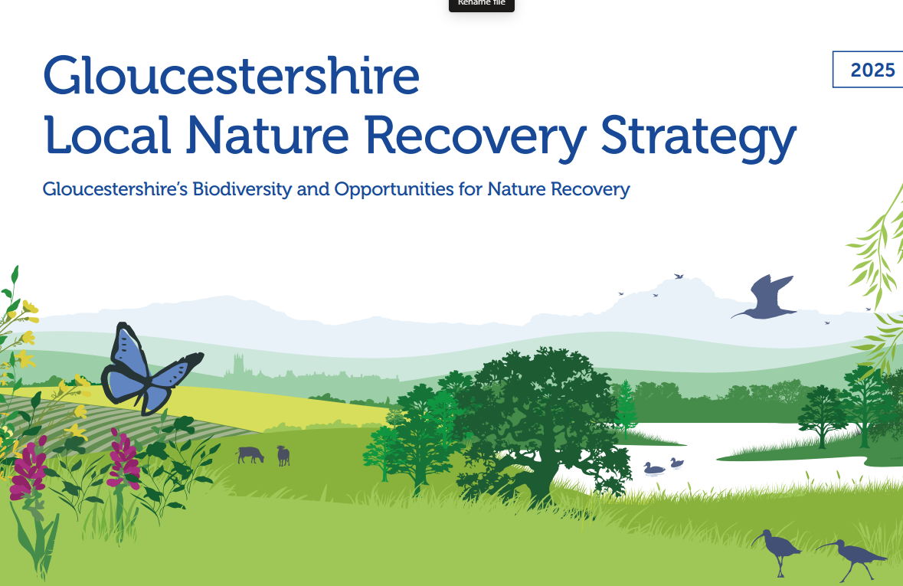
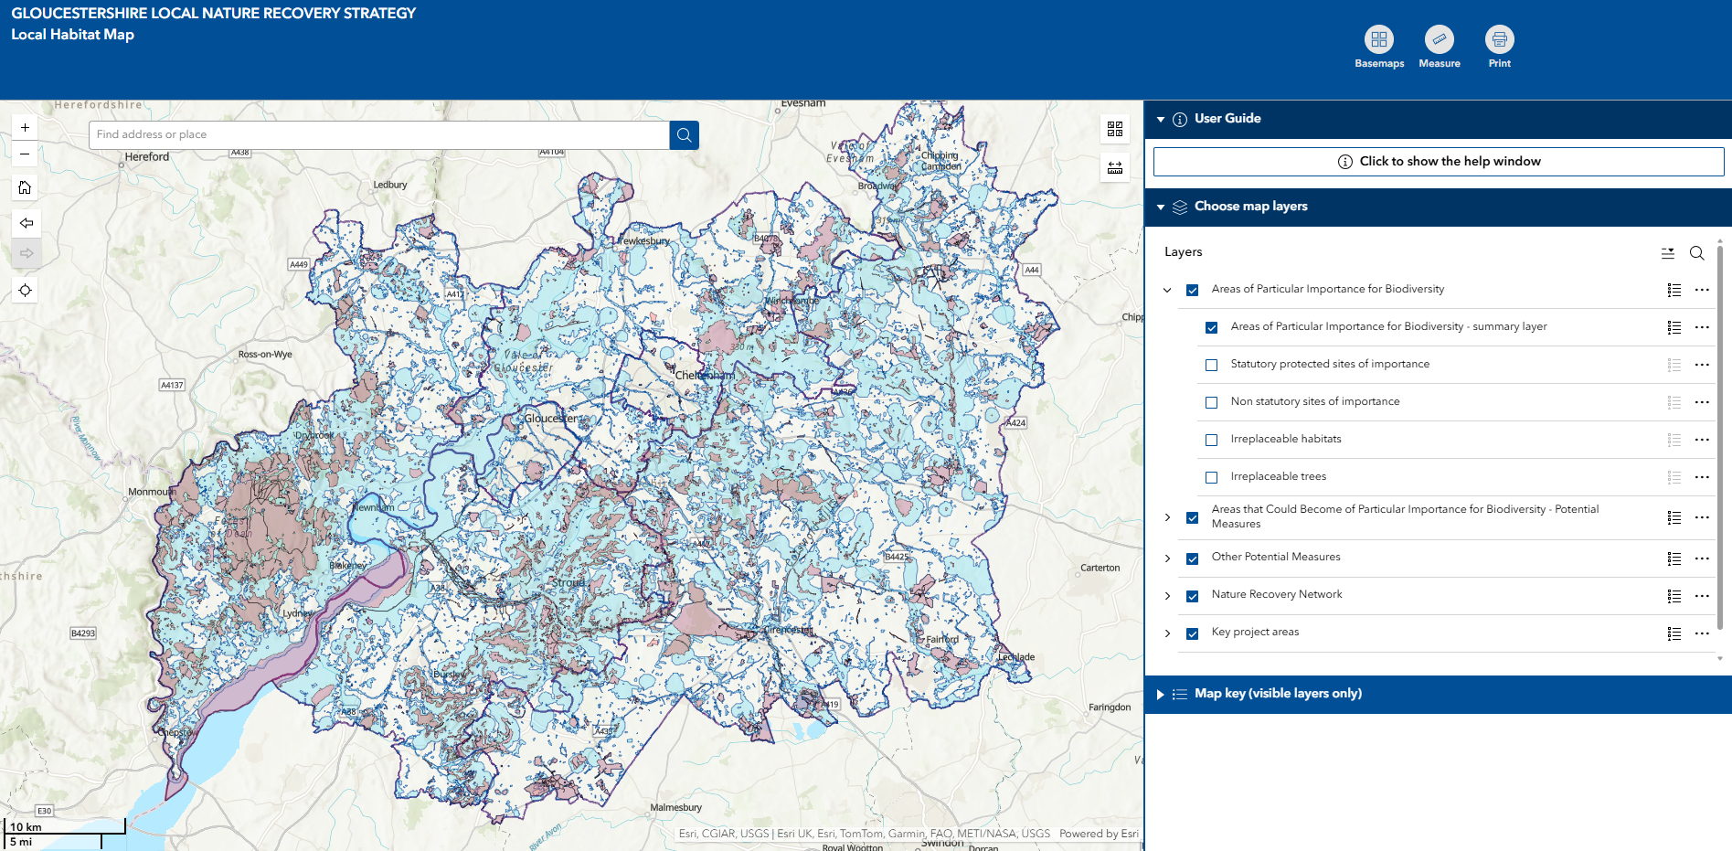
Local Nature Recovery Strategy
The LNRS is a statutory requirement under the 2021 Environment Act.
It sets out a plan to restore and enhance nature across Gloucestershire, highlighting existing areas of value for nature, and mapping where we should focus nature recovery, by expanding and connecting, or restoring habitats

Slide 15
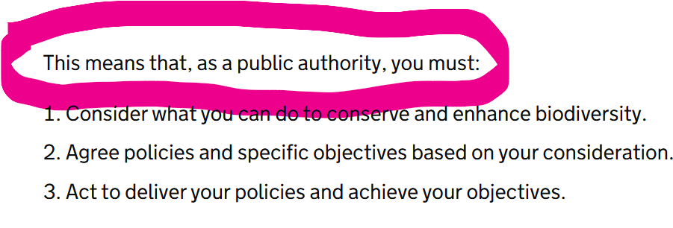
Biodiversity Duty

Slide 16
Biodiversity Duty reporting
When completing your consideration, you could review your policies and documents to look for opportunities to make changes to better conserve and enhance biodiversity….
transport – support sustainable travel to reduce carbon emissions and improve air quality
waste – review waste management and recycling processes to reduce water pollution and air pollution from waste transport and landfill
water – improve water efficiency to reduce the effect water abstraction can have on sensitive habitats and species
procurement – buy sustainable materials and supplies to reduce the demand on natural resources
light – make sure the design of artificial lighting minimises effects on nature
human resources – promote and educate staff on biodiversity issues
estate – improve the management of your land for biodiversity
sustainability – make sure biodiversity forms a part of sustainability considerations

Slide 17
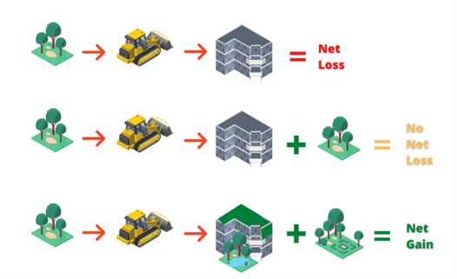
Mandatory Biodiversity Net Gain
https://www.local.gov.uk/pas/environment/biodiversity-net-gain-bng-local-planning-authorities
Notes:
NOTES TO WORKSHOP LEADS:
International first! It’s a game changer – why…
England only and covers all (bar exempted) development under the Town & Country Planning Act (TCPA) – majors now, non-majors from 2 April - and (from 2025) 2008 Planning Act, i.e. NSIPs
Minimum 10% gain required and post-planning approval of biodiversity gain plan
Significant on-site and off-site habitat secured for at least 30 years
BNG hierarchy: on-site, off-site and last resort statutory biodiversity credits
Baseline and post-intervention unit values calculated using standardised biodiversity metric
National register for off-site net gain sites

Slide 18
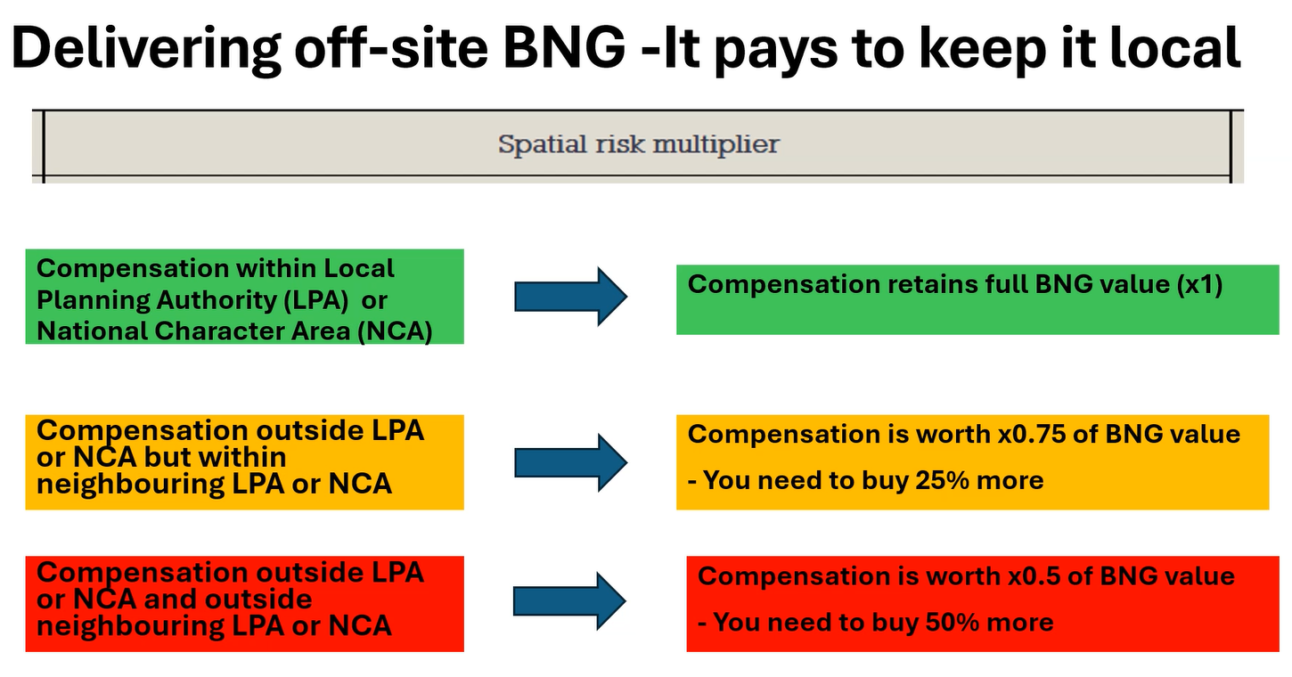
Mandatory Biodiversity Net Gain
Notes:
NOTES TO WORKSHOP LEADS:
International first! It’s a game changer – why…
England only and covers all (bar exempted) development under the Town & Country Planning Act (TCPA) – majors now, non-majors from 2 April - and (from 2025) 2008 Planning Act, i.e. NSIPs
Minimum 10% gain required and post-planning approval of biodiversity gain plan
Significant on-site and off-site habitat secured for at least 30 years
BNG hierarchy: on-site, off-site and last resort statutory biodiversity credits
Baseline and post-intervention unit values calculated using standardised biodiversity metric
National register for off-site net gain sites

Slide 19
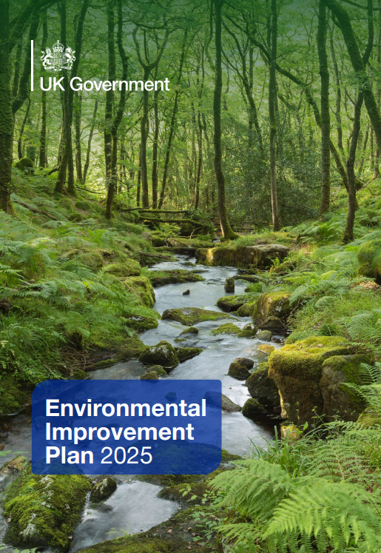
Environmental Improvement Plan 2025
The new EIP 2025 comes with delivery plans and an Environmental Indicator Framework (EIF) across 10 Goals.
Whilst the Government has a key role, many of the goals are shared responsibilities with local authorities. Together with other obligations, these cascade down to local level and are relevant to the councils plans and operations.
As well as duties and obligations under the law
  New duties
  We have a desire to engage, work together and include the natural environment throughout all that we do.
Key message – Nature Delivery is service delivery and is best delivered through collaboration
Environmental Improvement Plan (EIP) 2025 - GOV.UK
Environmental Improvement Plan: monitoring plan - GOV.UK
Notes:
RJ

Slide 20
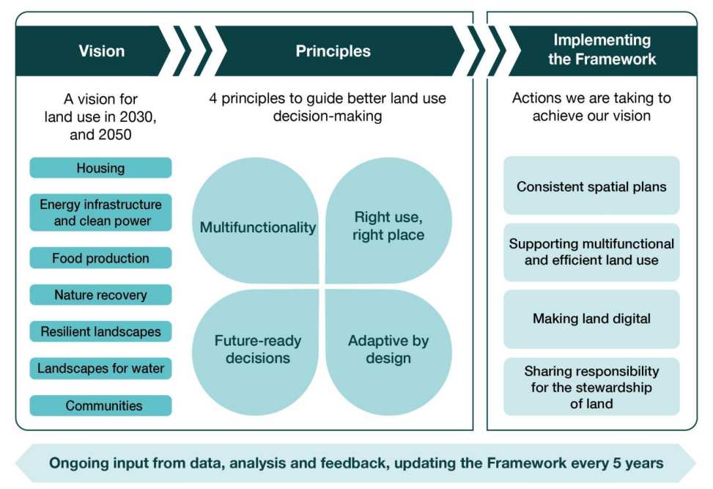
The Land Use Framework for England
https://www.gov.uk/government/publications/land-use-framework
Notes:
See PAS notes

Slide 21
QUIZ – LA Powers & Duties
DUTY
INFLUENCE
POWER
‘local government has 170 statutory duties across a wide
range of interrelated areas concerning rural land.’ Savills/LGA 2011

Slide 22
Who is responsible for action?
Sphere of influence
F. Involving, Engaging & Communicating
E. Partnership
D. Showcasing
C. Place shaping
A. Direct Control
B. Procurement, commissioning & commercialisation
Influence
Power
Duty
Graphic adapted from GMCA
Notes:
NOTES TO FACILITATORS:
This slide is here as its important at the outset to get attendees contemplating where they/their role/service sits within this. It’s a system too we can all contribute and no one service is fully responsible.
Where does your service sit on this sphere?
Where does your team/role sit?
Does your role sit in different parts of the sphere?
FIRST THE COUNCIL AS A WHOLE:
What is within the control of the council?
What isn’t within control?
Who owns the process?
THEN CONSIDER YOUR AREA OF RESPONSIBILITY:
Open discussion?
Discussion on table?
Pair sharing?

Slide 23
Who is responsible for action?
Sphere of influence
F. Involving, Engaging & Communicating
E. Partnership
D. Showcasing
C. Place shaping
A. Direct Control
B. Procurement, commissioning & commercialisation
F. Involving, Engaging & Communicating: Translating global & national policy & targets for local relevance, raising awareness with stakeholders & supporting communities
E. Partnership: Leading, bringing people & organisations together, coordinating, supporting others & joining partnerships
D. Showcasing: innovating, piloting, demonstrating & sharing practice, scaling & replicating.
C. Place shaping: using powers to control development & transport
B. Procurement, commissioning & commercialisation
A. Direct Control: land management, buildings, operations
Graphic adapted from GMCA
Notes:
NOTES TO FACILITATORS:
This slide is here as its important at the outset to get attendees contemplating where they/their role/service sits within this. It’s a system too we can all contribute and no one service is fully responsible.
Where does your service sit on this sphere?
Where does your team/role sit?
Does your role sit in different parts of the sphere?
FIRST THE COUNCIL AS A WHOLE:
What is within the control of the council?
What isn’t within control?
Who owns the process?
THEN CONSIDER YOUR AREA OF RESPONSIBILITY:
Open discussion?
Discussion on table?
Pair sharing?

Slide 24
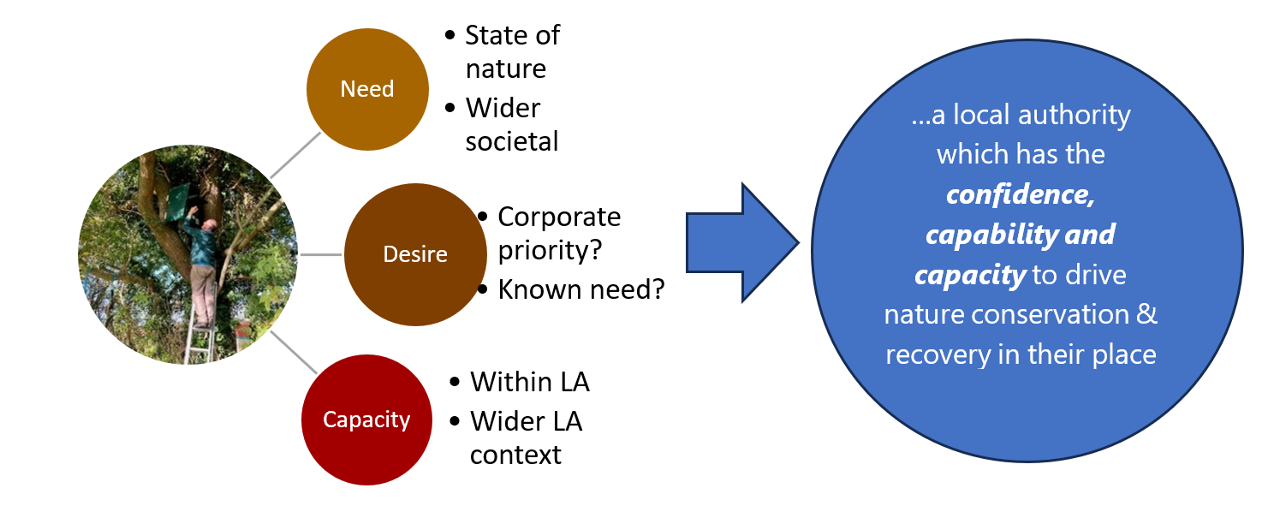
Optimum delivery of nature recovery by local authorities
Insights on Local Government Delivery of Nature Recovery | Local Government Association
Notes:
Graphic from Insights report
Ranking or similar exercise to determine current position
Check external sources
Also scene setting:
Corporate commitments (list and reference)
Existing/planned corporate resources (identify not necessarily to use detail)

Slide 25
BREAK
Notes:
NOTES TO FACILITATORS:

Slide 26
Purpose of this section:
To understand the session objectives in the context of the councils' priorities and explore how nature can help deliver these.
Output:
Discover the connections with your service and define opportunities for delivery.
Notes:
NOTES TO FACILITATORS:

Slide 27
Councils Corporate Plan

Slide 28
Exercise - how can nature help our corporate priorities?
CORPORATE PLAN | How can nature help deliver these priorities?
Children and young people thrive
Strong, healthy communities that care
A place to be proud of
An open, fair sustainable council

Slide 29
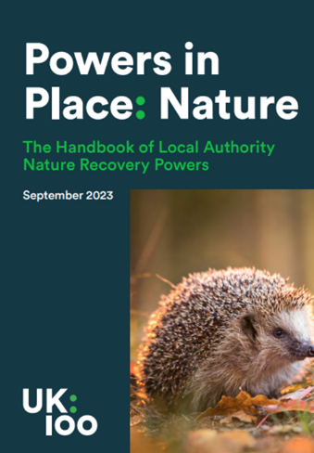
We are also facing a twin crises!
“We are facing twin crises - an ecological crisis that is exacerbated by, and exacerbates, the climate crisis.
Along with the transformative changes needed to tackle climate change and deliver Net Zero, transformative change is also needed to deliver Nature Recovery, and this requires a mind-set shift for national government and local authorities.”
Addressing both together is a win win!
Source: UK100
Notes:
NOTES TO WORKSHOP LEADS:
What is the link between climate and nature - addressing both together is a win win!
We are in the middle of a climate and nature emergency, and the two are inextricably linked. Climate change is driving nature’s decline, and the loss of wildlife and wild places leaves us ill-equipped to reduce carbon emissions and adapt to change.
One cannot be solved without the other.
When healthy, our natural habitats can reduce the risk of flooding, help prevent coastal erosion, improve people’s health and wellbeing, as well as maintain healthy soils, clean water and the pollinators needed for our crops – and therefore sustain us.

Slide 30
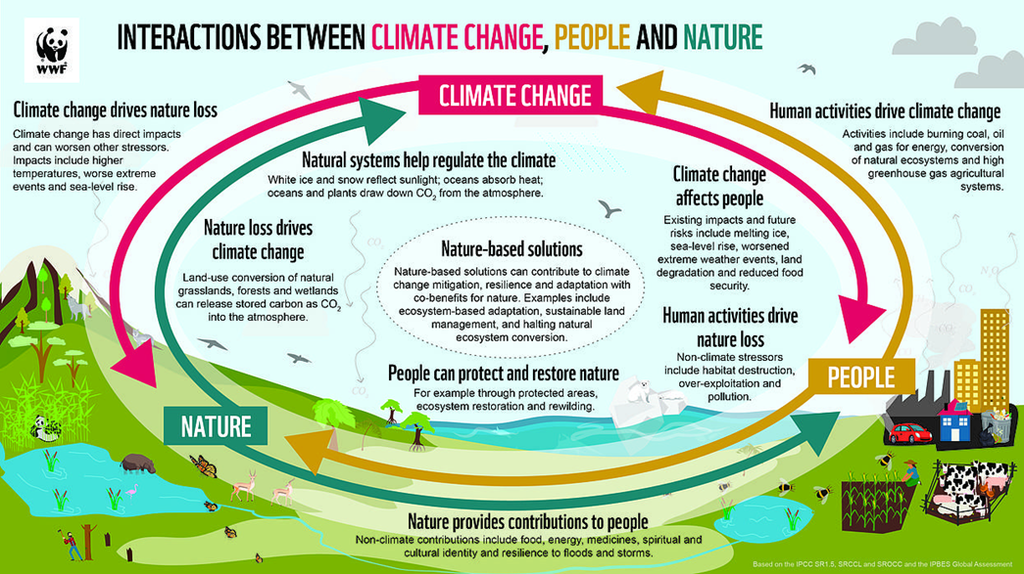
What is the link between climate & nature?
“We are facing twin crises - an ecological crisis that is exacerbated by, and exacerbates, the climate crisis.
Along with the transformative changes needed to tackle climate change and deliver Net Zero, transformative change is also needed to deliver Nature Recovery, and this requires a mind-set shift for national government and local authorities.” UK100
Source: WWF
Addressing both together is a win win!
Notes:
NOTES FOR WORKSHOP LEADS:
What is the link between climate and nature - addressing both together is a win win!
We are in the middle of a climate and nature emergency, and the two are inextricably linked. Climate change is driving nature’s decline, and the loss of wildlife and wild places leaves us ill-equipped to reduce carbon emissions and adapt to change.
One cannot be solved without the other.
When healthy, our natural habitats can reduce the risk of flooding, help prevent coastal erosion, improve people’s health and wellbeing, as well as maintain healthy soils, clean water and the pollinators needed for our crops – and therefore sustain us.

Slide 31
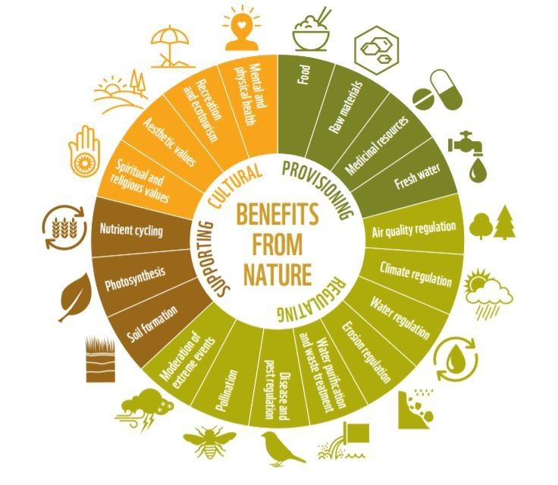
Valuing The Benefits From Nature
Health benefits associated with outdoor recreation in the UK was estimated to be between £6.2 billion and £8.4 billion in 2020
UK natural capital has an estimated value of £1.2 trillion (2019)
Restoring half of peatlands could have a value of
£45 -51 billion
The extent of UK urban areas increased 30% between 1990 and 2019, while enclosed farmland fell 5%.
82% of people agree that being in nature makes them happy!
Notes:
NOTES TO WORKSHOP LEADS:
Nature and its component parts like soil, water, air is sometimes referred to as natural capital which provides us with services, and these can be valued! The stock of UK natural capital we are currently able to value is estimated at £1.2 trillion (2019)
•A few examples of these individual services – so restoring around half of our peatlands to near natural condition would return between £45 to 51 billion (2019)
•The health benefits of outdoor recreation in the UK are estimated to be between £6.2 and £8.4 billion in 2020, with 82% of people agree that being in nature makes them happy!
•There are big land use changes going on - between 1990 and 2019 urban areas in UK increased 30% enclosed farmland fell 5% and I’ll pick up on that in my next slide..
These are big figures! What we really need is a consistent way to gather this information for individual projects so that we can start to develop the markets for these services.

Slide 32
The benefits of nature for people
Good access to green space in England could save £2.1bn per
year in health costs
for every £1 invested in TWT specialised health or social needs projects which connect people to nature, there is a £7 social return
Urban nature provides over £15 billion of benefits to the economy every year
The annual value of air pollution removal services by urban vegetation was around £800 million in avoided negative health impacts in 2021.
In 2015, 2.1m
active visitors to urban blue and green spaces
Creating 74,000
adjusted life yrs.
Notes:
NOTES TO WORKSHOP LEADS:
Benefits for people from nature in urban areas is of growing importance with 80% of people living in urban areas. A few examples starting from the right of the slide:
Stat 5:The Wildlife Trusts report for every £1 invested in health or social needs projects that connect people to nature, there is a £7 social return https://www.wildlifetrusts.org/sites/default/files/2019-09/SROI%20Report%20FINAL%20-%20DIGITAL.pdf
Stat 4:Urban nature provides over £15 billion of benefits to the economy every year
Stat 3: The annual value of air pollution removal services by urban vegetation was around £800 million in avoided negative health impacts in 2021.
Urban natural capital accounts, UK - Office for National Statistics (ons.gov.uk).
Stats 1 and 2: Its estimated there were 2.1 million active visitors to green and blue spaces in urban areas in 2015, providing 74,000 additional quality adjusted life years to society.
£2.1 billion per year could be saved in health costs if everyone in England had good access to greenspace, due to increased physical activity in those spaces

Slide 33
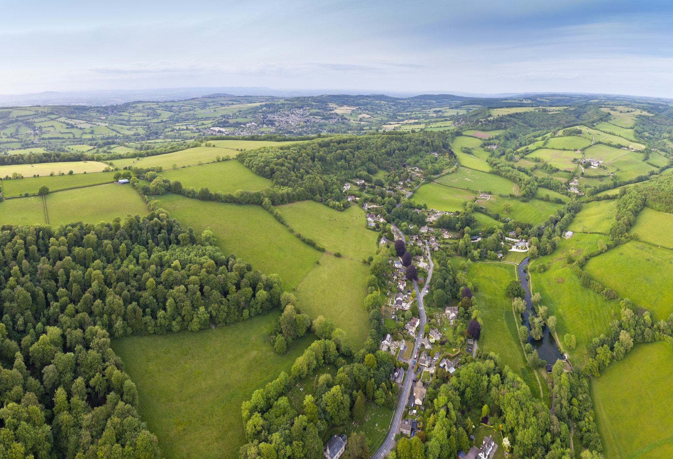
LUNCH BREAK
Notes:
NOTES TO FACILITATORS:
During lunch find case study examples from the resources deck

Slide 34
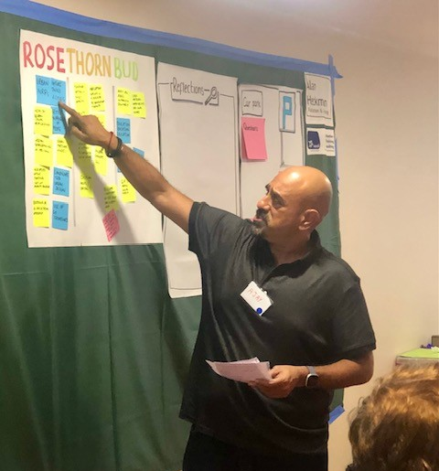
Exercise – Priorities, Opportunities
Rose – what's being done/what's planned/what’s working/has worked already, strengths
Bud – what’s the potential - would you like to see?
15 -minute exercise. Feedback after next section
PHOTO CREDIT: R Murtagh 2025
Notes:
NYC Responsible, Accountable, Consulted, and Informed
NOTES FOR WORKSHOP LEAD:
Max of 2-minute feedback per group – so adjust time accordingly
You MUST time it!
Activity: (we would like a sense of what people are doing that can currently be recorded on the action plan, and what additional things they are doing that we can adapt the action plan with).
Have a copy of our biodiversity duty action plan and the 12 targeting operating model points on each table. Ask attendees to write on different sticky notes (including service area) for rose and bud ideas for the action plan.
Johns Idea:
Step 1 — Explore the 12 Priorities Through a Nature Lens (20 minutes)
Work in small groups.
For each of the 12 priorities (provided on your table):
A. How can nature recovery support this priority?
Write 2–3 ideas.
Think about quality of place, wellbeing, climate resilience, cost reduction, community involvement, etc.
B. How can our service contribute to nature recovery?
Write 2–3 ideas.
Think about land, assets, policies, engagement, data, operations, budgets, partnerships.
Capture ideas on post‑its or directly onto the template provided.
Step 2 — Identify Barriers (10 minutes)
For the same priority areas:
What challenges or blockers might stop us delivering these opportunities?
E.g., funding, skills, policy constraints, staff capacity, competing priorities, data gaps, risk appetite.
Write barriers clearly — one per post‑it.
Step 3 — Generate Solutions (10 minutes)
For the barriers identified:
What could overcome this barrier?
E.g., partnership working, external funding, training, new processes, pilots, co‑design with communities, better data, behaviour change, governance support.
Aim for 1–2 practical solutions per barrier.
Step 4 — Prioritise (10 minutes)
As a group:
Choose 2 opportunities that offer the greatest benefit.
Choose 2 solutions that are most achievable in the next 12 months.

Slide 35
Rose - Strengths
Capture what's worked well:
What projects and programmes already delivering for nature
How is nature already supporting your service delivery?
Bud – Aspirations
Capture the outcomes you want:
This is the place for ‘blue sky thinking – the detail is coming later!
If money & resourcing were no object, what would you like to see?
Notes:
PRINT
NOTES TO FACILITATORS:
Use the checklists and template to help inform the process.
From the discussions what are the ‘immediate’ opportunities you would like to consider further as part 2?

Slide 36

Purpose of this section:
To understand the barriers to action, then explore the types of solutions that could help address these barriers.
Output:
Develop a set of outline short-, medium- and long-term ideas/opportunities that can be progressed in more detail.
Notes:
NOTES TO FACILITATORS:

Slide 37
Scene setting – barriers & solutions
What are the principal gaps?
Are there technical barriers to delivery?
What resource gaps are there?
Are there any common issues affecting delivery?
Are there opportunities or possible solutions?
Notes:
NOTES FOR WORKSHOP LEADS:
See resources slide deck – do you want to include any slides on these subjects to set the scene? Are any particularly relevant to you? Think about how useful it would be to your audience. It's one thing to acknowledge barriers but another to set encourage a mindset in attendees of its all too hard and complex.

Slide 38
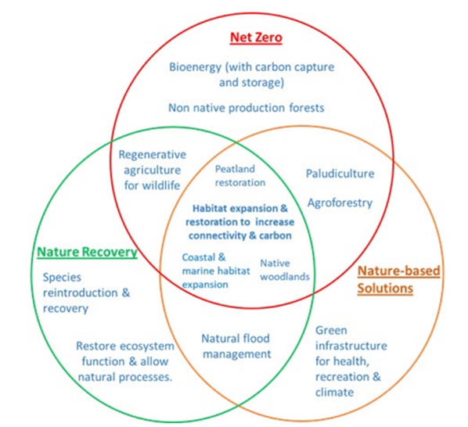
Linking policy agendas & delivering multifunctional benefits simultaneously
Supporting housing development
Sustainable transport
Better health and well being
Ensuring climate change adaptation and mitigation
Reducing flood risk
Improving air and water quality
Thriving biodiversity – including the pollinators on which we all depend on
Source: UK100
Notes:
NOTES FOR WORKSHOP LEADS:
Although the nature and climate crises are inextricably linked the decline of nature can still be somewhat divorced from climate change and there is not enough to tie into wider priorities – environment, care, health, economy, housing
So how you pitch it is key so its about:
- Supporting housing development – Embedding Green Infrastructure in new and existing housing will ensure high levels of quality of life and quality of place.
- Enabling sustainable transport - Integration of green and grey transport infrastructure will be an essential element to facilitate truly sustainable growth
- Better health & wellbeing - People enjoy access to natural green spaces for recreation, leisure, relaxation, inspiration and improved health and wellbeing.
- Addressing the climate and biodiversity emergencies - Green Infrastructure will be part of our contribution to global efforts to reduce carbon emissions towards a zero-carbon future. This will include tree planting, habitat restoration and people walking and cycling instead of using fossil-fuel-based modes of transport
- Reducing flood risk - Green Infrastructure will help to reduce the risk of both river and surface water flooding..
- Improving air quality - Green Infrastructure will provide a cost-effective, adaptable and small-scale solution to improving air quality. This will improve people’s health and overall quality of life.
- Thriving biodiversity - Networks of Green Infrastructure will provide great spaces for wildlife. They will contribute to a healthy natural environment.

Slide 39
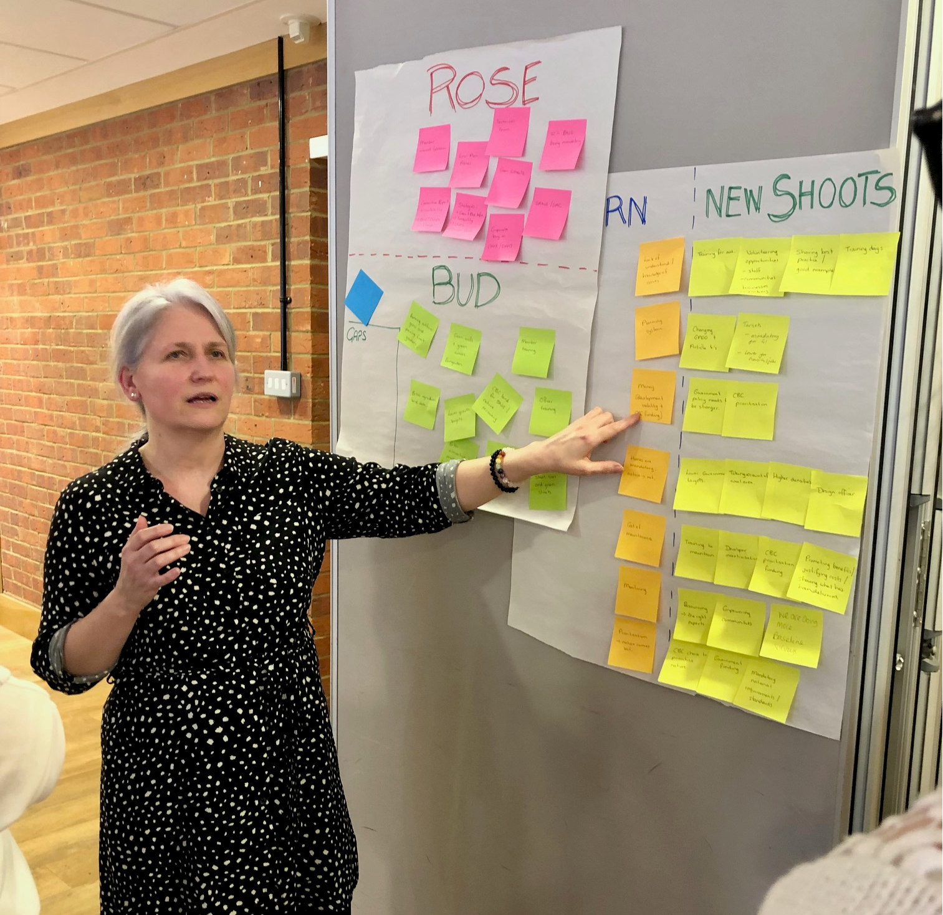
Exercise – Barriers, Gaps & Solutions – For You And For Nature
Thorn – gaps & barriers
New shoots - solutions
PHOTO CREDIT: R Murtagh 2026 Central Bedfordshire
Notes:
NYC
Gaps and barriers
Shared issues
Internal resources implications
NOTES FOR WORKSHOP LEAD:
Shared issues in thorn
Max of 2-minute feedback per group – so adjust time accordingly
You MUST time it!
Activity: (we would like to explore what barriers people currently have for delivering these existing/new actions and what solutions they can think of to mitigate these).
Have a copy of our biodiversity duty action plan and the 12 targeting operating model points on each table. Ask attendees to write on different sticky notes (including service area) for thorn and new shoots for the action plan.
Johns Idea:
Step 1 — Explore the 12 Priorities Through a Nature Lens (20 minutes)
Work in small groups.
For each of the 12 priorities (provided on your table):
A. How can nature recovery support this priority?
Write 2–3 ideas.
Think about quality of place, wellbeing, climate resilience, cost reduction, community involvement, etc.
B. How can our service contribute to nature recovery?
Write 2–3 ideas.
Think about land, assets, policies, engagement, data, operations, budgets, partnerships.
Capture ideas on post‑its or directly onto the template provided.
Step 2 — Identify Barriers (10 minutes)
For the same priority areas:
What challenges or blockers might stop us delivering these opportunities?
E.g., funding, skills, policy constraints, staff capacity, competing priorities, data gaps, risk appetite.
Write barriers clearly — one per post‑it.
Step 3 — Generate Solutions (10 minutes)
For the barriers identified:
What could overcome this barrier?
E.g., partnership working, external funding, training, new processes, pilots, co‑design with communities, better data, behaviour change, governance support.
Aim for 1–2 practical solutions per barrier.
Step 4 — Prioritise (10 minutes)
As a group:
Choose 2 opportunities that offer the greatest benefit.
Choose 2 solutions that are most achievable in the next 12 months.

Slide 40
New shoots - solutions
For each orange note capture what could be improved and/or what more could you do:
  What is within the council's discretion?
  How can you reduce the risk?
  What could government do to help?
  What can you do better?
  What can you stop doing?
  Solutions to fill existing gaps in processes.
  Focus on incremental benefits
  Reinventing the wheel is OK.
  RACI
Thorn - Weaknesses
  What currently challenges the “Now”?
  What risks are there to achieving the ambitions?
  What practice is currently impossible to implement (what are we waiting for and need to know?)
Notes:
NOTES TO FACILITATORS:
NYC Responsible, Accountable, Consulted, and Informed
Use the checklists and template to help inform the process.
From the discussions what are the ‘immediate’ opportunities you would like to consider further as part 2?

Slide 41

Purpose:
To understand how the opportunities are going to be delivered. How might you make the whole thing work financially, who else needs to be involved including potential partnerships both internally and externally.
Output:
Set of short-, medium- and long-term opportunities including quick wins and projects that need developing.
ACTION
Funding and delivery
Notes:
NOTES TO FACILITATORS:

Slide 42
Scene setting – PRIORITIES & ACTIONS
Notes:
NOTES FOR WORKSHOP LEADS:
See resources slide deck – do you want to include any slides on these subjects to set the scene? Are any particularly relevant to you? Think about how useful it would be to your audience.
From original
What are the funding needs, pressures and cost of doing nothing?
How can local authorities make savings, secure funding, investment and generate revenue?
What are the delivery models being used by local authorities?
What are the challenges, opportunities and risks for your authority?

Slide 43
Strategic approaches to unlock development & deliver nature recovery
Direct impacts:
1. Biodiversity Net Gain:
Move to nature positive development is providing clarity and level playing field for developers, and mechanism for ongoing greenspace management.
Indirect impacts on protected sites and species:
2. Alternative Greenspace to address recreational disturbance - Thames Basin Heaths SPA:
Strategic approach delivering nature recovery and access to nature at scale and avoiding delays to 50,000+ homes by delivering 2,000 hectares of new green space and increased bird populations.
3. District Level Licensing - Great Crested Newts:
Strategic approach that streamlined assessment and reduced cost to developers (estimated to be around £45m), with £40M+ generated for nature conservation on the ground.
Advisory Standards:
4. Green Infrastructure Standards:
Strategic approach setting national standards for green infrastructure that are embedded through local plans and local design codes, providing clarity for developers.
SOURCE: Natural England 2025

Slide 44
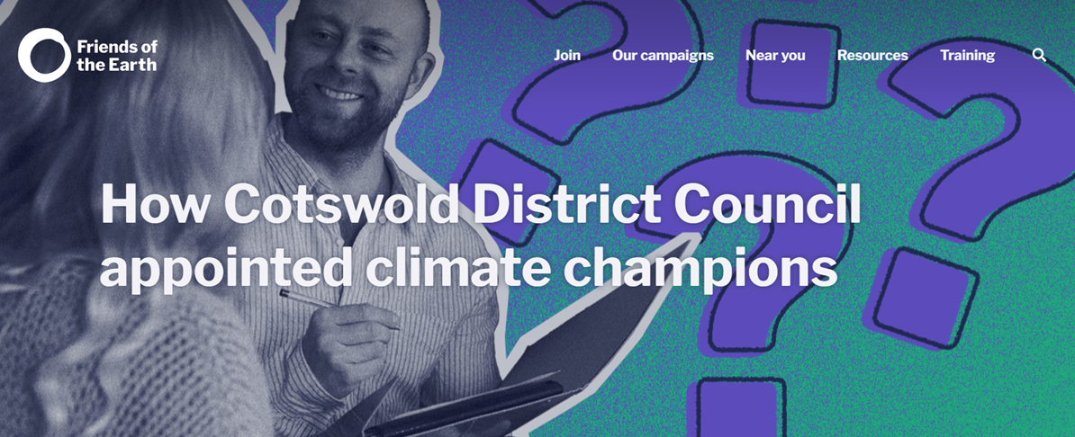
Do you have the right people to champion nature?
Do you need to find a senior sponsor in the council such as a Chief Executive, deputy leader or portfolio holder to allow people to spend time on this.
Who do you need to speak to?
Are you pushing at open door?
Is it an environment lead or another portfolio holder?
Do you also need an officer?
“Introducing climate champions at councillor and officer level has created a distinct change of culture at the council, with climate change and ecological impacts now considered in every report, in a similar manner to impacts on equality and finances.”
Source: Friends of the Earth
Notes:
NOTES FOR WORKSHOP LEADS:
Often where activities cross over multiple services and priorities, they need champions and teeth, and this needs to be politically framed. But they also need revenue and the lack of this can often be the driver.
An example of a council Cotswold District Council appointed climate champions to make more progress on climate goals.
When declaring a climate emergency in 2019, Cotswold District Council created a new councillor role: Cabinet Member for Climate Change and Forward Planning. Having this leadership role has boosted the authority’s efforts to meet its climate goals, which include an 80% reduction in carbon emissions by 2030, to be achieved without offsetting or use of carbon credits. This means a real cut in emissions in the local area, rather than paying into (potentially distant) schemes to remove carbon from the atmosphere.
https://groups.friendsoftheearth.uk/climate-action/how-cotswold-district-council-appointed-climate-champions

Slide 45
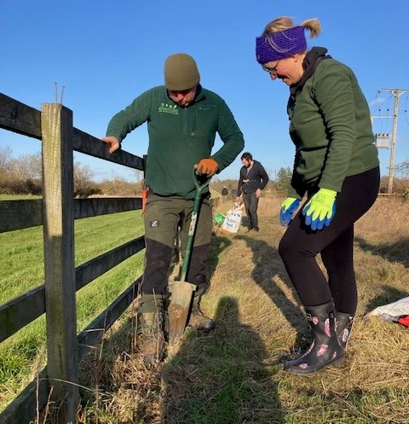
Exercise – Priorities and Actions
Harvest: Immediate gains you can collect now,
Cultivate: Work in progress requiring active development,
Plant: Strategic bets for the future
PHOTO CREDIT: R Murtagh 2022
20 -minute exercise. 5-minute feedback (timed)
Notes:
NOTES FOR WORKSHOP LEADS:
NYC Responsible, Accountable, Consulted, and Informed
Opportunities – gaps to meet aspirational goals
Gold/silver/bronze – scale of ambition
How to celebrate good work
Easy wins
Actions
How to improve communication between teams
Split into same or different groups and use the third part of the “action” template to understand what the short-, medium- and long-term opportunities look like in more detail including:
Quick wins
Project’s that need developing and could be delivered in a timeframe and
More aspirational future schemes.
Use the risk analysis 4 box risk analysis template and the impact-effort matrix to inform the process.
Max of 2-minute feedback per group – so adjust time accordingly
You MUST time it!

Slide 46
Group exercise – Actions and delivery
Harvest – Quick wins
Practice that is low risk, high acceptability and easy to implement.
Plant – More aspirational future schemes
  Innovative breakthrough ideas.
  Practice that has high impact.
  Link to your new shoots
Cultivate - Projects that need developing and could be delivered in a timeframe
  Practice that is low risk, high acceptability and easy to implement.
  ‘Wow’ ideas are those with potential for significant change and possible to implement within current reality.
Remember each opportunity however big or small adds to the understanding of what is possible.
Notes:
NOTES TO FACILITATORS:
Carousel feedback – rotate around tables
Use the checklists and template to help inform the process.
From the discussions what are the ‘immediate’ opportunities you would like to consider further as part 2?

Slide 47
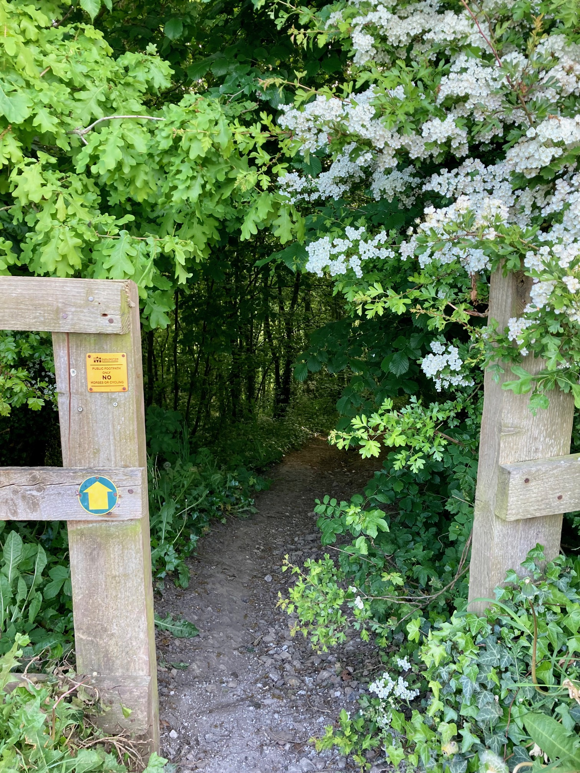
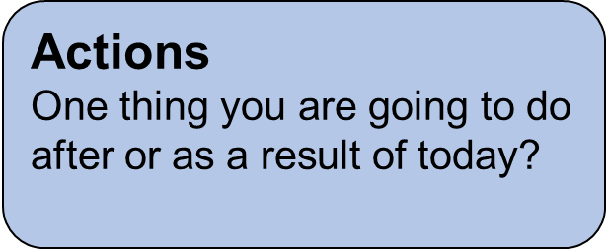
Next Steps
Council – Take the output of today & report to SLT with recommendations of next steps
PHOTO CREDIT: R Murtagh Spring gateway
Notes:
Notes to facilitators:
Think about destination for these actions. E.g. Council service plans, separate biodiversity duty action plan etc.
20 minutes – how are we going to agree the action plan? Dot sticker votes on flipchart?

Slide 48
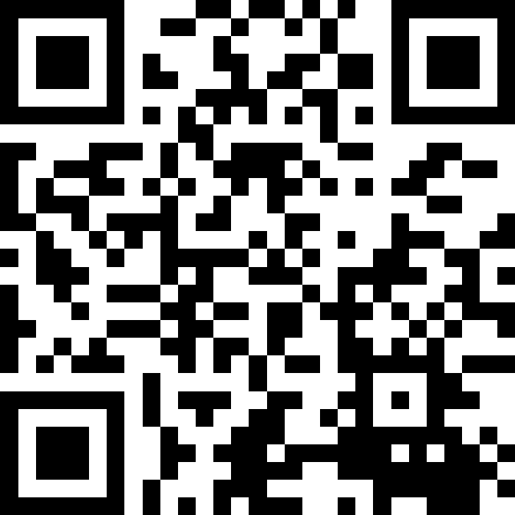
FEEDBACK - SLIDO
Nature Recovery Toolkit
Workshop
Link
Notes:
Rachel

