Slide 1
Air Pollution Casework Reform
Webinar for Local Planning Authorities
Planning Advisory Service (PAS) on behalf of Natural England

Slide 2
Background
Legal Framework
Natural England acts an advisory ‘nature conservation body’ under the Habitats Regulations when consulted on planning proposals.
Local Planning Authorities (LPAs) have a legal duty to ensure protected sites are not negatively impacted by development. They seek Natural England’s advice on the impacts and what mitigation measures are required to enable the development to progress without harming protected sites under the Habitat Regulations and Wildlife and Countryside Act
As the decision maker, LPAs can decide if they take into account Natural England’s advice when granting planning permission. But need to give reasons why NE's advice isn't followed.
NE understands that LPAs need NE to provide consistent advice. The new approach should help us to better achieve this.

Slide 3
What we are doing.
Natural England is changing how it responds to planning consultations where air pollution may affect protected sites.
We will now give clear, high quality consistent advice upfront. This advice will be based on our best scientific understanding of how to assess development impacts on air quality.
It should give you what you need to check applicants have provided you with sufficient information to assess air quality impacts on protected sites.
Natural England will provide bespoke advice for the highest risk or complex planning cases .

Slide 4
Why is NE changing the way it responds to consultations relating to air quality?
Air pollution is one of the most significant threats to biodiversity, ecosystems and human health.
The majority of nitrogen sensitive Sites of Special Scientific Interest (SSSIs) and Special Areas of Conservation (SACs) in England receive atmospheric nitrogen deposition above the load considered to have significant harmful effects (critical loads).
Due to the scale of the air pollution problem, it is becoming increasingly challenging for NE to provide advice on a case by case basis and to identify effective solutions.
To better support our customers, we are looking at more effective ways of providing high quality, clear and consistent advice to LPAs which is readily available.
Notes:
98% of SAC’s

Slide 5
What is Standing Advice?
Standing advice is Natural England’s formal advice on a specific issue (i.e. Air Pollution)
It is a ‘material consideration’ in the planning process so must be taken into account when assessing a planning application.
We can use this as a way of providing advice on planning applications
The advice is hosted on GOV.UK -Air pollution and development: advice for local authorities - GOV.UK
It can help you make decisions on planning applications where there could be air quality impacts on protected sites.
This provides up front advice which is available immediately where there is an air pollution impact
However, you should:
Continue to use NE's SSSI IRZ's to determine if you need to consult NE on any planning applications. We will direct you to the new standing advice in our responses where needed.

Slide 6
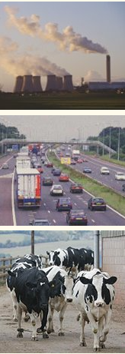
New process - Summary
Standing Advice on GOV.UK – Launched on 16^{h} October 2025
This covers:
All agricultural planning applications (e.g. slurry stores, animal housing and intensive livestock units)
Industrial TCPA developments (including anaerobic digesters, biomass plants*, combined heat and power plants*, combustion plants*, data centres, energy from-waste facilities*, factories (*except where they also include carbon capture and/or the generation or use of hydrogen fuel or are located in an Industrial Cluster
Roads or transport related planning applications

Slide 7
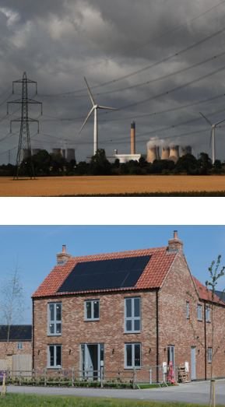
What is Standard Advice?
Standard Advice – Letters and paragraphs – Launched on 16th October 2025
Standard advice sets out Natural England’s advice on more complex or difficult issues for Nationally Significant Infrastructure Projects (NSIPs) or Local Plans.
It can include standard paragraphs or complete letters.
It gives clarity on Natural England’s position to the decision-maker.
It ensures that advice is provided in a consistent way.

Slide 8
Standing Advice
The Standing Advice:
Sets out what you will need to do to undertake a Habitats Regulations Assessment (HRA) for Habitats Sites or a detailed air quality assessment for SSSIs and if the applicant has provided you with the correct information for you to do this.
Explains how to:
  Check if emissions will reach a protected site.
  Check relevant ‘critical loads’ and ‘critical levels'.
  Take account of emission reductions for agricultural developments
  Consider the proposal in combination with other projects.
  Complete an appropriate assessment (habitats sites) or detailed air quality assessment (SSSIs).

Slide 9
Standing Advice – Headlines
The Standing Advice builds on the advice Natural England would have previously provided on air pollution impacts.
The thresholds used to determine if a proposal has a Likely Significant Effect alone or in combination remains at 1% of the critical level or load.
The screening distances for air quality impacts on protected sites are based on NE's existing SSSI Impact Risk Zones and remain unchanged.
In the majority of cases the approach for agricultural developments which are also funded by the Slurry Infrastructure Grant Scheme remain unchanged. For more complex SIG proposals which require additional assessment NE may advise you to use the Standing Advice to do this.

Slide 10
Standing Advice – Headlines
There is standing advice for agricultural and industrial planning applications. Our previous published guidance only covered roads.
There is now advice on how to consider emission reductions for agricultural planning applications.
Signposting for emission reductions for agricultural developments which also requires an Environment Agency permit.
There is a link to the JNCC Decision Making Threshold Guidance which can be used to rule out the need for an in-combination assessment for very small amounts of air pollution.

Slide 11
What Pollutants are covered?
ammonia (NH3)
nitrogen oxides (NO, NO2 or NOx)
nitrogen deposition
acid deposition
sulphur dioxide (SO2)
The AQ Standing Advice doesn't cover:
the impacts of dust on protected sites.
other environmental impacts such as water quality, water resources, landscape or recreational disturbance.

Slide 12
Step 1:check if emissions will reach a protected site
This is part of the screening stage of a Habitats Regulations Assessment (HRA).
To help you check if the applicant has identified the correct protected site likely to be impacted it:
Provides screening distances for different development types
Explains how to use these screening distances in SCAIL for agricultural or industrial development proposals to check which protected sites likely to be affected
Explains how to use MAGIC for road related proposals or proposals which generate traffic to identify protected sites within 200m of a road.
It explains when no further assessment is required

Slide 13
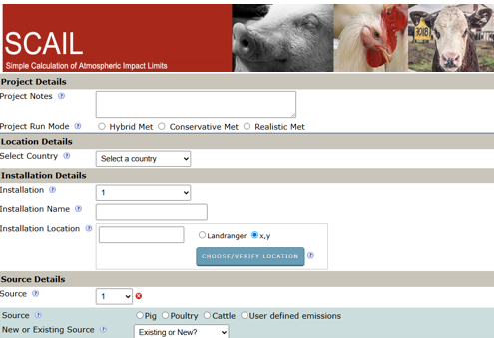
Simple Calculation Assessment of Atmospheric Impact Limits (SCAIL)
What SCAIL Does
Identifies impacts: It screens for potential air quality effects on protected sites and on human health.
Estimates emissions:
It quantifies concentrations of pollutants like ammonia and sulphur, as well as the amount of acidity and nitrogen deposited onto habitats.
Supports risk assessments:
SCAIL results are used as a preliminary step to decide if a site requires a more detailed assessment.
The Two Main SCAIL Models:
SCAIL-Agriculture: Focuses on ammonia emissions from agricultural activities, such as livestock housing and slurry lagoons.
SCAIL-Combustion: Assesses impacts from industrial and medium combustion plants (MCPs
www.scail.ceh.ac.uk/

Slide 14
  Step 2: Check relevant critical loads and critical levels.
This is part of the screening stage of a Habitats Regulations Assessment (HRA).This step explains how to use the Air Pollution Information System (APIS) to check:
Which habitats and features are present on the protected sites the proposal will affect (identified in step 1)
The critical levels and loads of each habitat and feature in relation to each air pollutant
It explains how to calculate the proposal’s Process Contribution (PC)
If the PC is under 1% of all critical levels or loads then an in-combination assessment will be required (Step 4).
Notes:
Critical loads and levels are the points at which air pollutants could cause harm to a protected site. They are either a concentration in the air (levels) or a deposition on the ground (loads).
It explains how to calculate the proposal’s Process Contribution (PC) using SCAIL and LAQM guidance ( for traffic generating proposals).
The final step is to compare the process contribution from the proposed development against the relevant critical levels or loads.

Slide 15
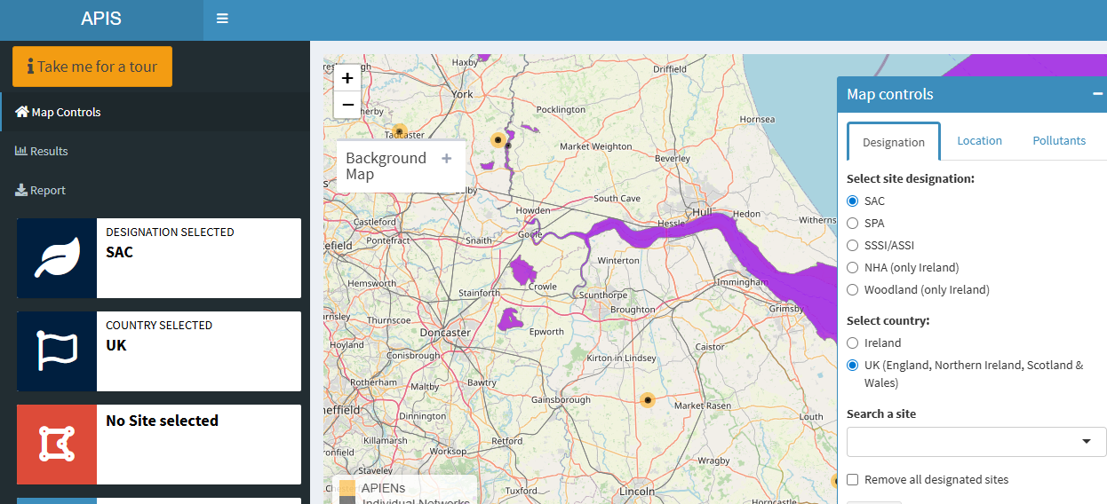
Air Pollution Information System (APIS)
APIS is a comprehensive online resource providing UK-focused information on air pollution and its effects on habitats and species.
It is a searchable database and a GIS mapping tool, offering site-specific details on pollution and deposition levels, critical loads, and source attribution data to support environmental assessments for protected sites and conservation purposes.
https://www.apis.ac.uk

Slide 16
Step 3: Taking account of emission reductions
This step only applies to agricultural developments where applicants have identified the development will result in emission reductions.
Emission reductions are acceptable provided that the following criteria are met.
  The activity causing the pollution would continue even if the proposal was not approved, and
  The proposal site is not considered to be an existing dominant source of air pollution
  Emission reductions are measurable and achievable
The advice sets out a stepwise approach to help you take account of emission reductions in a proposed development.
You will need to ensure emissions reduction measures are secured as part of any approval. For example, they could be secured by a planning condition.
You will need to follow the Environment Agency’s emissions reduction advice if the proposal also needs an Environment Agency permit.
No in-combination assessment is required if an emissions reduction approach is taken.

Slide 17
Emission Reductions – Key Steps
Stage 1
Identify the protected sites impacted using SCAIL
Use APIS to identify designated site features & relevant critical levels and loads
Stage 2
Check the baseline emissions on the proposal site using SCAIL(kg per year)
Stage 3
Screen out dominant sources
A dominant source means it will emit 25% or more of any relevant critical level or load
Stage 4
Review the embedded emission reduction measures.
Check they are measurable, achievable, proportionate and verifiable
Stage 5
Check the emission reduction measures result in an emissions reduction compared to the baseline
Stage 6
Secure commitment to emissions reductions e.g. secured via a planning condition

Slide 18
Step 4: In-Combination
This step is part of the screening stage of a Habitats Regulations Assessment.
If a proposal does not exceed 1% of the critical levels and loads alone, an in-combination assessment with other projects is required. This ensures that the impact of many projects under 1% do not combine together to have a significant effect.
Applicants might use the Joint Nature Conservation Committee (JNCC) ‘decision-making thresholds’ as a reason for not completing an in-combination. If so, you should check they have correctly followed the JNCC guidance on decision-making thresholds.
If an in–combination assessment is required, the types of proposals to include are those in existing HRA guidance. This should not just include the same type of source as the proposed development.
For example, an agricultural development would need to look in combination with other types of development (not just agricultural) where air quality impacts would overlap on a designated site.
If the air pollution caused by all proposals at the protected site combined is above 1% of any critical load or level then an Appropriate Assessment or detailed assessment is required. If it is below 1% in combination with other proposals, no further assessment is required

Slide 19
Step 5:Completing a detailed air quality assessment
This is a more detailed assessment building on the information collected for the screening stage.
Will require more detailed modelling to determine air pollution impacts on protected sites
At the end of the assessment you should be able to:
Conclude no adverse effect on Integrity for Habitats Sites
If there will be an adverse effect on a SSSI
To make your conclusion you will need to consider:
How the proposals emissions effect protected sites
Other factors that could affect the proposals impacts
Consider the impacts alone and in combination
If mitigation is required to address any adverse effects

Slide 20
Factors to consider
Trends in background pollution
Size of impact
Habitat Sites Conservation Objectives
Duration of the impacts
Direct and indirect effects

Slide 21
Mitigation Measures
If there is an Adverse Effect on Integrity you will need to consider mitigation measures to address any harmful effects. You must have certainty that mitigation measures will be effective. Are they:
Achievable
Realistic and based on established good practice
Proportionate
Of a scale which will remove harm
Verifiable
Measurable and quantifiable

Slide 22
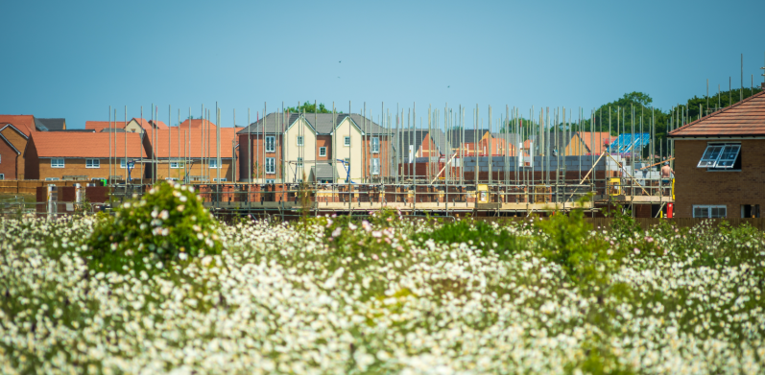
Standard Advice for Local Plans
LPAs should consult NE as usual
NE decides if a standardised response is sufficient to address the impacts of the local plan
If standard advice is appropriate, this will be included as part of the full plan response
It will provide the information you will need to undertake a Habitats Regulations Assessment or SEA for air pollution impacts.
It is a concise version of the stepwise approach to be undertaken and focussed mainly on the impacts of increased road transport.
Includes advice specific to Local Plans and use of the tools for assessing traffic impacts.
Provides advice on possible air quality policy wording
Natural England will engage further should plans need to be considered under derogation.

Slide 23
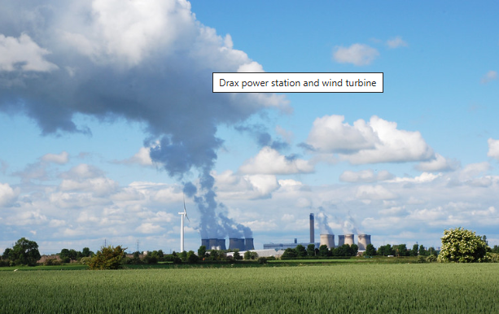
Standard Advice process for Nationally Significant Infrastructure Projects (NSIPs)
NSIP applicant likely to consult NE initially during pre-app stage (DAS).
Area Team staff review application at early stage and consider whether it requires bespoke or standard advice in relation to air pollution.
If not applying bespoke advice, NE submits standard air pollution advice to applicant as part of pre-app stage AND within response to PINS.
It includes a concise version of the stepwise approach for assessment as it is focussed more on industrial and road impacts.
It includes some generic mitigation options that may be used for industrial processes.
Natural England will engage further should proposals need to be considered under derogation.

Slide 24
What will the Standard Advice Cover?
The same air pollutants as for standing advice including ammonia (NH3), nitrogen oxides (NO, NO2 or NOx), nitrogen deposition, acid deposition, sulphur dioxide (SO2)
The advice will cover the key things you will need to undertake for a detailed Air Quality Assessment, including:
Initial screening for credible risk of an effect
Detailed Air Quality Modelling
Applying Screening Thresholds
Detailed Assessments of Ecological impacts
Appropriate Assessments
Optional Local Plan Air Quality Policy

Slide 25
Summary & Benefits
Benefits
Deliver more consistent assessments of air pollution impacts resulting from development as it will be clear from the outset what air quality and ecological information is needed
Ensure NE advice is available up front and immediately
We will now give clear, high quality consistent advice. This advice will be based on our best scientific understanding of how to assess development impacts on air quality.
Summary
Standing advice published on GOV.UK on 16th October - covering advice on agricultural, industrial and road and transport planning applications
Standard advice for local plans also live from 16th October which includes a new suite of letters and paragraphs

Slide 26

Feedback
If you have any further questions or would like to provide us with some feedback, please contact:
LPA-AQStandingAdvicequeries@naturalengland.org.uk.

Slide 27
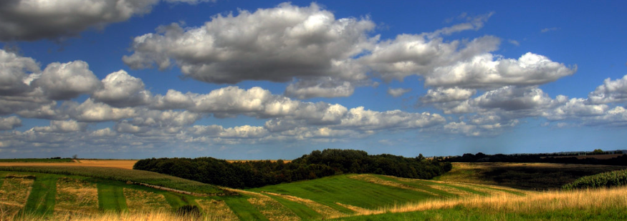
Thank you!

