Slide 1
Planning Committee Training
Planning Enforcement
www.pas.gov.uk
Notes:
The slides in this presentation provide the basis for an introductory training session with local councillors.
Please use, amend or apply the information in this slide pack to meet you own specific needs:
Each time the presentation is used, it should be tailored to address the key issues around Planning Enforcement in your area, following discussions with local planning colleagues and/or members.
Some of the slides are designed to encourage feedback and participation in order to generate discussion, eg about local enforcement cases or challenges.
There are several OPTIONAL SLIDES (eg detailing the legislative and regulatory framework) which may be used or omitted depending on local priorities or the focus of the training session.
Opportunities are identified to highlight local case studies in order to demonstrate how principles and policies can work in practice and the types of cases typically seen in your area
Slides 59 – 64 at the end of the slide pack provide more information on formal enforcement action including a detailed explanation of different enforcement notices. Again, these can be used or ignored to suit local needs.

Slide 2



What is PAS?
PAS exists to support local planning authorities to provide efficient and effective planning services, drive improvement and respond to and deliver changes in the planning system.
Notes:
A couple of introductory matters about PAS to explain what PAS is and why PAS has prepared this training resource.
PAS is a MHCLG and DEFRA grant-funded programme
PAS is part of the Local Government Association (LGA)
PAS aims to support local planning authorities improve local practice and respond to planning reforms.

Slide 3
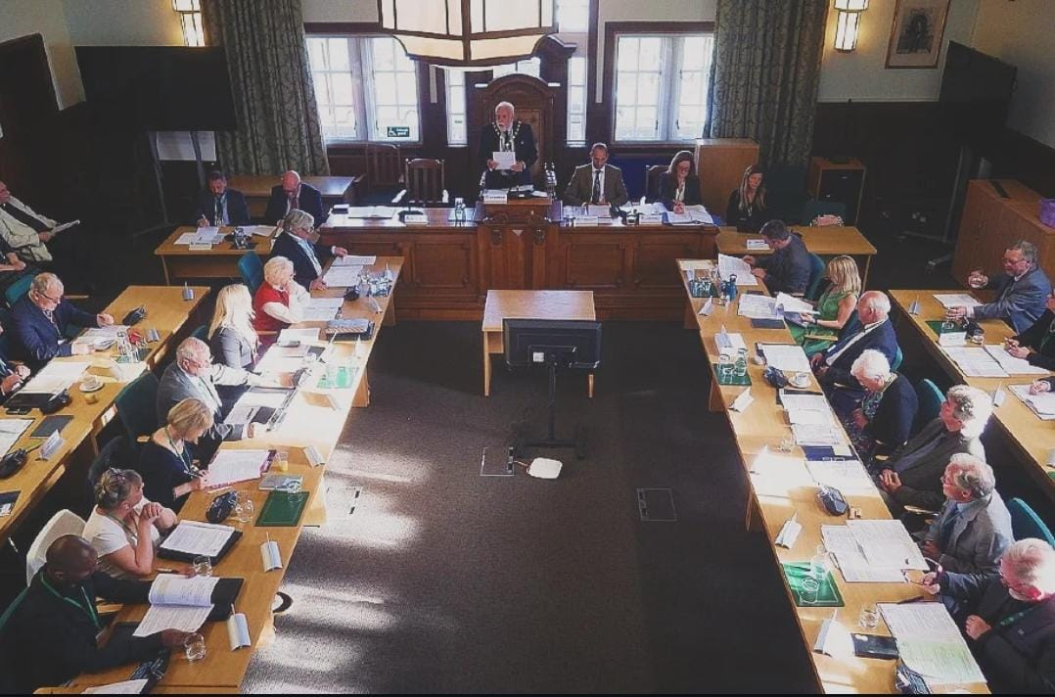
All new or a refresher?
New to planning/committee?
Need a refresh/update?
Pass on your experience!
LinkedIn
Notes:
This session focusses on the Planning Enforcement role of the Council as a LPA.
Some councillors here may have had some previous planning training, but equally there may be some less experienced councillors who would have had no or limited knowledge or experience of the planning system, never mind the focus on planning enforcement.
Many of the principles of the planning system that may have been expressed in planning committee training also apply to planning enforcement – so this training will act as a good reminder/refresher for those that are more experienced.
Just to get a feel of the councillor audience:
- can I ask those who are new to planning to put up your hands? Comment?
- Can I ask those present whether they have had any experience of the planning enforcement system – either directly or indirectly?
Before we start - are there any particular burning issues any councillor would wish to explore during this session?
We will check at the end of the session whether these issues have been covered off.

Slide 4
Learning Outcomes
By the end of this session, you will be able to:
Explain the role of the Local Planning Authority (LPA) in delivering the planning enforcement service.
Demonstrate an understanding of the legislative and policy framework underpinning planning enforcement.
Identify what matters can and cannot be investigated through the planning enforcement service.
Assess expectations regarding case progress, service performance, and the purpose of the Local Planning Enforcement Plan.
Describe the processes involved and the range of potential enforcement actions available to the Council.
Recognize the role and responsibilities of Councillors within the planning enforcement service.
Notes:
READ AND ENSURE ALL PARTICIPANTS UNDERSTAND …..

Slide 5
Structure of the session
A] Background and Key Principles
B] Legislative and Policy Framework including the role of the Local Planning Enforcement Plan
C] Planning Enforcement Processes, Actions and Powers
D] Case Studies – local and further afield
E] The role of the Councillor
F] Discussion and questions
Notes:
Overall, this session should provide you with a good understanding of the key background and principles involved in planning enforcement with a brief overview of the legislative framework lying behind planning enforcement.
I will explain:
What can be and cannot be investigated
The role of the Local Enforcement Plan and how this will guide your Council’s response to alleged planning breaches.
the various powers and actions available to the Council and when they are appropriate to be used
Explain the processes involved
Your officers will then go through XXXXXX local case studies to illustrate the issues they raise and range of work locally [THIS IS OPTIONAL BUT RECOMMENDED]
This will be followed by an overview of your role as a Cllr and a series of Top Tips PAS have developed
And hopefully we should have time at the end to check whether you believe we have covered everything you expected and enter into follow up questions and discussion
Looking at 2 hours max – so finishing by XX PM / Any further issues or questions before we proceed?

Slide 6
A] Background and Key Principles

Slide 7
The Planning Process:
Enforcement
Development Control
Forward Planning
All should be EQUAL
DEVELOPMENT
Notes:
There's often a misguided perception surrounding planning enforcement; with forward planning often thought of as being the most prestigious aspect of planning, and development management improving its status over the years, planning enforcement is regularly viewed as the "poor relative" of the three.
This outlook often results from professional bias of planners, where (and I should add, with good reason) they hold the 'grand vision' of the development plan in high regard, and consider the DM function the "nuts and bolts" of negotiations with developers. But this leaves the hard grind of the enforcement officer overlooked and accorded little importance, with their daily caseload downgraded to dealing with 'minor problems'. However, there is more to enforcement than an unauthorised garden shed or an ill-placed boundary fence!
Any regulatory regime requires an enforcement arm to deal with those situations where the rules have been contravened. In short, forward planning and DM would be pointless activities if land-owners were able to contravene the controls with impunity.
The integrity of the planning system (and of LPAs for that matter) therefore relies on the existence of effective and robust enforcement. The three planning functions, referred to as "The Planning Trinity", should be considered as interrelated and inseparable, for instance:
Forward planning cannot be a realistic activity unless DM decisions (on the ground) reflect the aspirations and the vision of the Local Plan;
DM is potentially and exercise in futility unless it can count on an effective enforcement unit to deal with contraventions;
Enforcement cannot function properly unless DM is carried out conscientiously (for example, appropriately worded and robust planning conditions being attached to permissions) and applies planning policies that will withstand appeal to the SoS; and
Problems with local plan policies and DM decisions will inevitably cause enforcement problems down the line.
It's clear, therefore, that each planning function requires the mutual support of its counterparts and cannot successfully operate exclusively. Hence, it's important for this to be more widely understood by officers and Councilors, so that the enforcement function can be adequately supported and the nuances of the function appreciated.

Slide 8

Effective Planning Enforcement can…
Build public trust in ‘the planning system’
Be a powerful process to ensure compliance with panning policy for the area
Solve a multitude of problems.
Protect the natural and built environment
Notes:
…… The Planning Enforcement function is a critical part of the planning service in being able to:
Build public trust in the planning system and for your authority as the LPA;
Ensure compliance with national and local planning policy for the area; and
Solve a multitude of planning issues, but will not necessarily solve all the problems related to development (which I will highlight in more detail later in the presentation).
And ultimately, it is a service which should be aimed at protecting the natural and built environment.

Slide 9

It can also be considered to be ...
Without doubt, the most difficult part of the planning system to administer
Litigious – Attracts more litigation than the rest of the planning process put together
A legal minefield – the number of instances where local authority notices have to be corrected or quashed for legal inaccuracy is very considerable
Confrontational!!!!
Notes:
However, despite its importance it is often considered to be….

Slide 10
B] Legislative and Policy Framework

Slide 11
The Legislative Framework-
Primary legislation
Town And Country Planning Act 1990
Planning and Compulsory Purchase Act 2004
Planning Act 2008
Localism Act 2011
Planning and
Planning and Infrastructure Act 2025
Secondary legislation
Town and Country Planning (General Permitted Development) (England) Order (GPDO) 2015 (as amended)
Town and Country Planning (Use Classes) Order 1997
Town and Country Planning (Advertisement) Regulations 2007
Guidance
National Planning Policy Framework (NPPF) (Dec 2024)
Planning (Listed Buildings And Conservation Areas) Act 1990
Planning Practice Guidance
Notes:
Here is a list of the various primary and secondary legislation and guidance which LPAs should refer to on a daily basis as part of their determination of cases.
Key Distinctions:
Primary Legislation: Acts of Parliament (e.g., Town & Country Planning Act 1990) that establish the core legal framework for planning.
Secondary Legislation: Detailed rules made under powers granted by primary acts (e.g., Statutory Instruments).
NPPF: A policy document (guidance) that interprets and applies primary/secondary laws, guiding local planning authorities and influencing decisions.
Essentially, planning enforcement follows the same legislative and planning guidance framework as the other planning services, including the DM team and equally deals with an extensive range of issues.
The Government have also introduced new legislation including the Planning and Infrastructure Act 2025 which includes new provision for amending the time limits within which local authorities can take planning enforcement action against breaches of planning control – the immunity period. So as from 25 April, 2024, the enforcement period for unauthorised operational development and changes of use to a single dwelling has been extended to ten years, while the previous four-year limits still apply for breaches completed before this date.

Slide 12
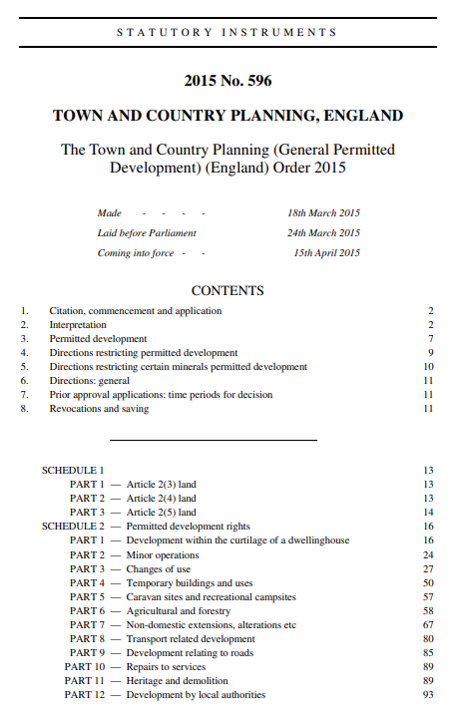
The Enforcement Officer's Everyday 'Bibles'
Secondary legislation:
Town and Country Planning (General Permitted Development) (England) Order (GPDO) 2015 (as amended)
Notes:
OPTIONAL SLIDE FOR DETAIL
GPDO – Schedule 2 – Permitted Development Rights includes:
PART 1 Development within the curtilage of a dwellinghouse
PART 2 Minor operations
PART 3 Changes of use
PART 4 Temporary buildings and uses
PART 5 Caravan sites and recreational campsites
PART 6 Agricultural and forestry
First 6 parts are most likely to be used on a daily basis (depending on the character of the LPA area)
Less frequently used:
PART 7 Non-domestic extensions, alterations etc
PART 8 Transport related development
PART 9 Development relating to roads
PART 10 Repairs to services
PART 11 Heritage and demolition
PART 12 Development by local authorities
… continues up to Part 20
COVERS WHAT CAN AND CANNOT BE DONE UNDER PDR.

Slide 13
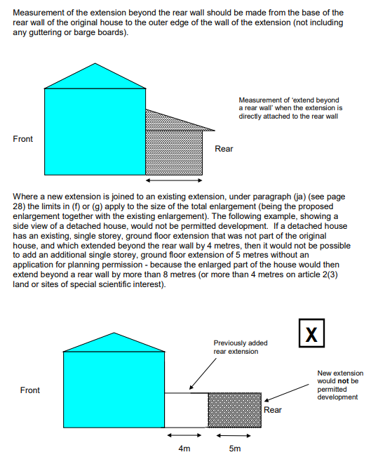
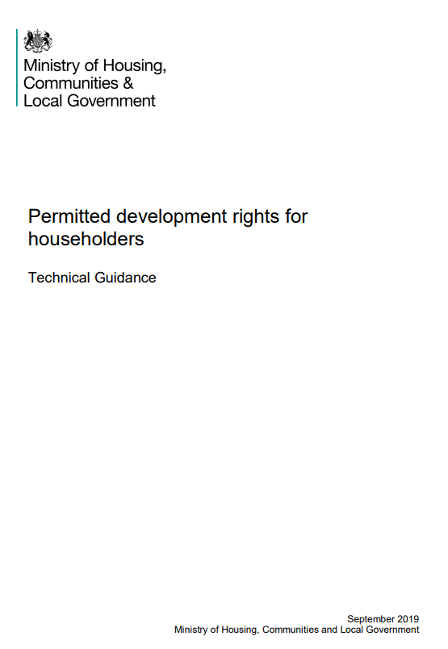
The house- holder's 'Bible'
Permitted development rights for householders: technical guidance
A simplified version of the GPDO
Notes:
OPTIONAL SLIDE FOR DETAIL
Provides the detail of the GPDO, but in simplified language with accompanying diagrams

Slide 14
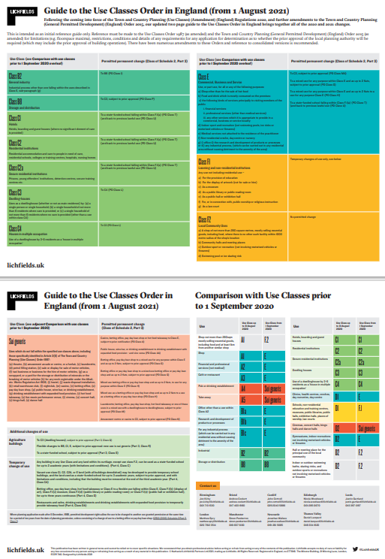
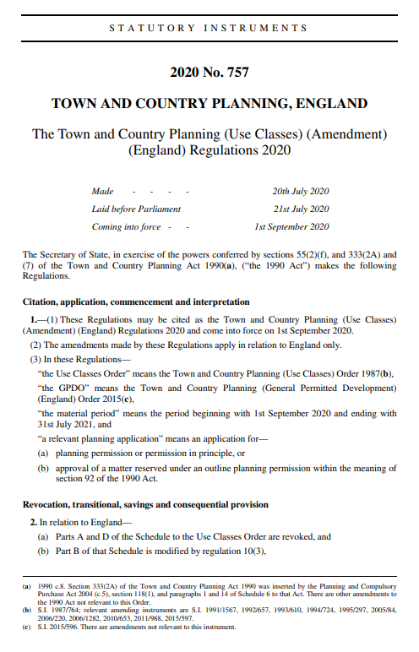
Secondary legislation:
Town and Country Planning (Use Classes) Order 1987 (as amended)
Notes:
OPTIONAL SLIDE FOR DETAIL
Sets out the material changes of use of land and buildings which can be undertaken without the requirement of express planning permission i.e. the change is considered permitted development.
Some helpful guidance provided by Lichfields – a private planning consultancy, but produces helpful guides and explainers for wider use

Slide 15
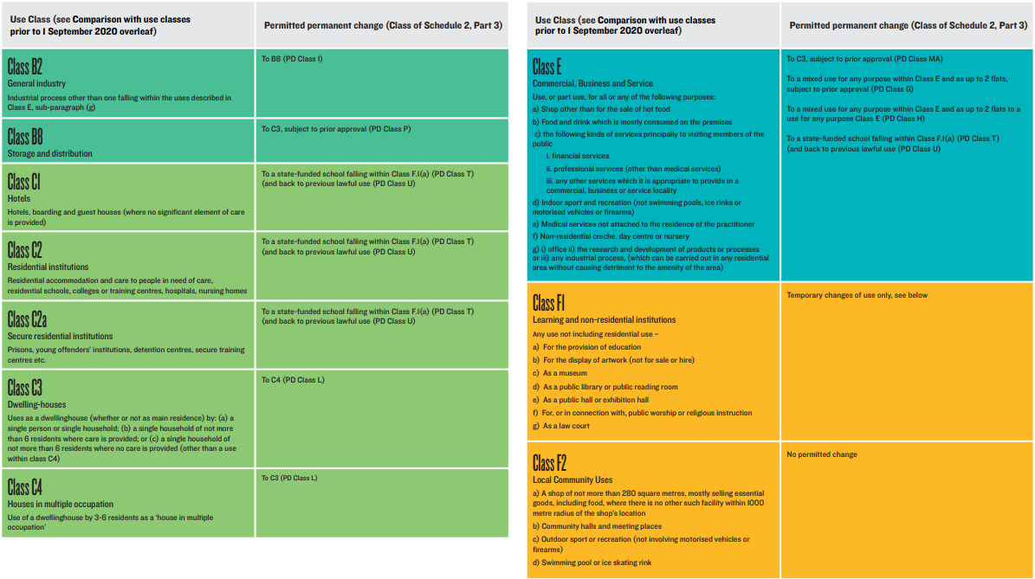
Secondary legislation: Town and Country Planning (Use Classes) Order 1987 (as amended)
Lichfields: England - Use Class Order_March23.indd
Notes:
OPTIONAL SLIDE FOR DETAIL
Sets out the material changes of use of land and buildings which can be undertaken without the requirement of express planning permission i.e. the change is considered permitted development

Slide 16
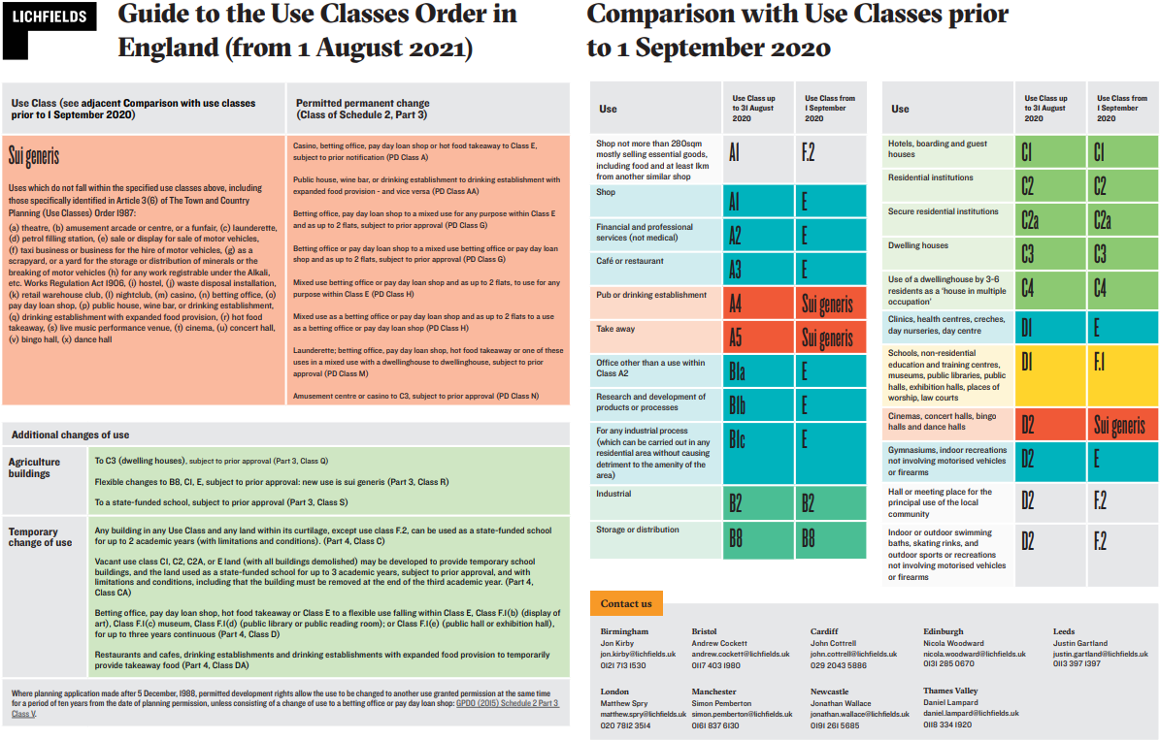
Secondary legislation: Town and Country Planning (Use Classes) Order 1987 (as amended)
Litchfields: England - Use Class Order_March23.indd
Notes:
OPTIONAL SLIDE FOR DETAIL
Sets out the material changes of use of land and buildings which can be undertaken without the requirement of express planning permission i.e. the change is considered permitted development

Slide 17
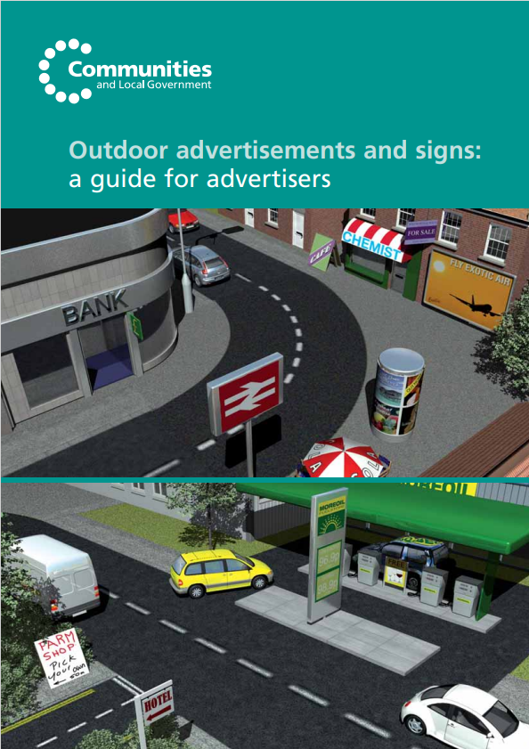
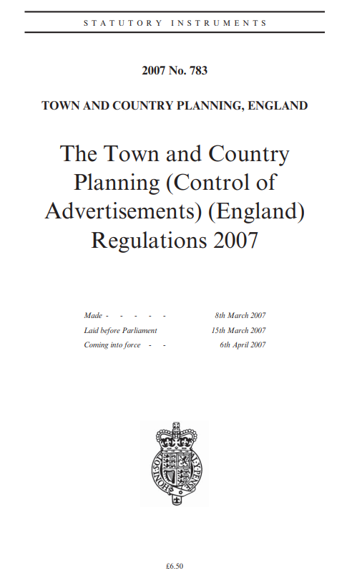
Secondary legislation:
Town and Country Planning (Advertisement) Regulations 2007
Notes:
OPTIONAL SLIDE FOR DETAIL
Schedule 3 most often referred to by planning enforcement officers.
Details the classes of advertisements for which deemed consent is granted and the criteria they must adhere to.
Simplified guidance also published for advertisers to assist them on their compliance with deemed consent.
Alternatively, can submit an application for advertisement consent.

Slide 18
National Planning Policy Framework 2024 (NPPF). Paragraph 60 of The Framework states:
‘Effective enforcement is important to maintain public confidence in the planning system. Enforcement action is discretionary, and local planning authorities should act proportionately in responding to suspected breaches of planning control.'
Notes:
The NPPF – the bible of planning – para 60 sets out the key principles for planning enforcement
The main points to highlight from these particular paragraphs of the National Planning Policy Framework (February 2025) are:
Effective enforcement is important to maintain public confidence – the planning enforcement function exists to ensure that planning decisions are implemented properly and that development is carried out in a manner which adheres to planning law.
And that Enforcement action is discretionary – Enforcement officers cannot, and do not, take action simply because there is a breach. They must act proportionately in responding to suspected breaches of planning control and as a result must consider each and every breach within its own context. Enforcement action should not be punitive; instead Officers should seek to work with transgressors to improve their understanding of the planning system and to seek a compromise where one can be achieved.
And Lastly, the LPA should be seeking to publish a Local Enforcement Plan and I will briefly go through the main components of what should be included in such a document.

Slide 19
What your Enforcement Team can investigate
Unauthorised operational development: unauthorised building works and/or engineering works
Development consisting the change of use of land/buildings without the relevant planning permission
Works to listed buildings without consent
Any activity giving rise to direct or indirect damage to protected trees (TPOs) or qualifying trees in conservation areas
Non-compliance with conditions attached to planning permissions
The display of unlawful advertisements
Failure to properly maintain land so that it affects the amenity of an area
Notes:
The legislative and policy framework set out the principles behind planning enforcement...
So, what kind of breaches can be investigated by the planning enforcement team
READ….

Slide 20
What your Enforcement Team can’t investigate / take action over
Permitted development
Boundary wall disputes and other land ownership issues as these are civil matters outside of the planning legislation
Legal covenants – civil matter
Devaluation of property
Changes of use of land / buildings which don't amount to material changes of use
Obstructions, parking and traffic enforcement*
Graffiti and anti-social behaviour*
Dangerous structures*
Noise nuisance*
* = this is covered by other Council Depts
Notes:
READ…..1 to 5
Works undertaken with the benefit of the Permitted Development Rights of the land (where the PDR remain intact)
Boundary wall disputes and other land ownership issues are civil matters which lie outside of planning legislation
Legal covenants – again a civil matter
Devaluation of property – not a planning matter
Changes of use of land / buildings which don't amount to material changes of use – i.e. operating a business from home (dog grooming / beauty room / music tuition) where the residential use remains the primary use of the building.
No 6 – traffic enforcement – covered by highways authority and/or Police
No 7 – graffiti and anti social behaviour – with other environmental services with the Council or other bodies
No 8 – dangerous structures – through Building Control services or the HSE
No 9 – noise nuisance – dealt with through your env health teams

Slide 21

Planning Enforcement isn’t
Punitive
Designed to catch people out
Always a criminal offence
Able to solve the world's problems
Notes:
Planning enforcement is not a service that should be aimed to punish transgressors, but should try to work with transgressors to overcome unauthorised planning related adverse impacts and only revert to taking formal action when necessary – noting it is not a criminal offence to undertake unauthorised development (unless relating to LBs, TPOs, trees in CAs, and until an enforcement notice is not complied with)
And I will reiterate, it will not necessarily solve all the development related problems arising but should be targeted to address adverse planning related impacts arising from the unauthorised development.

Slide 22
Local Enforcement Plan:
‘[Local planning authorities] should consider publishing a local enforcement plan to manage enforcement proactively, in a way that is appropriate to their area. This should set out how they will monitor the implementation of planning permissions, investigate alleged cases of unauthorised development and take action where it is appropriate to do so.’
National Planning Policy Framework 2024 (NPPF). Paragraph 60
Notes:
The NPPF stipulates that local planning authorities should be seeking to publish a Local Enforcement Plan and I will briefly go through the main components of what should be included in such a document.

Slide 23
Main components of a Planning Enforcement Plan
Prioritisation of cases
Performance Standards
Case Review
Pro Active role
Review process
Celebrate successes
Case Reviews
Every 2/3 years
Involve Councillors
Notes:
A Planning Enforcement Plan in effect should provide the framework in which the Enforcement service will be provided by setting minimum standard time frames for handling cases, with high priority cases being acted upon immediately with site visits and their initial assessment of the complaint taking place within 24hrs – an example of a high priority case may involve listed buildings
With medium priority cases being assessed within typically between 5 and 15 days and setting out the time frame for agreeing way forward in terms of any formal action within a set number of weeks and low priority cases e.g. those cases with limited local impact with extended time frames for investigation and resolution.
Also important to ensure case review is undertaken and lessons learnt where possible and identify whether there is a particular issue within the District which would benefit from a concerted effort to resolve e.g. advert signs on public areas, untidy land etc.
Although the Plan should be drafted taking into account the level of resources available in your team – noting you have a X FTE within the team – and the ability to handle the complaints workload as the base work they have to tackle and the spare resource, if any to undertake any proactive enforcement action.

Slide 24
Enforcement Plan for the local area
Explains the enforcement process – from initial report to conclusion
Details how cases are prioritised
Performance standards e.g. indicative response times
Manages expectations
Notes:
OPPORTUNITY TO INCLUDE A SLIDE ON THE LOCAL ENFORCEMENT PLAN IN YOUR AREA

Slide 25
C] Planning Enforcement Processes, Actions and Powers

Slide 26
Enforcement investigation process (simplified)
Step 1 – Complaint received of potential planning breach
Step 2 – Preliminary checks
Step 3 – Investigation required (yes (case opened) or no)
Step 4 – Investigation underway
Step 5 – Breach identified (yes or no (case closed))
Step 6 – Work to find appropriate outcome - depends on harm being caused by the breach
Step 7 – Successful outcome? (yes or no (case closed))
Step 8 – Consider expediency of formal action
Step 9 – Formal action undertaken
Step 10 – Successful appeal (no or yes (case closed))
Step 11 – Monitor compliance (yes (case closed) or no (back to step 8)
Notes:
Moving onto the process for handling a planning enforcement case by your officers.
This is a simplified flow diagram – which reflects the more detailed typical procedure LPAs follow
Firstly, the receipt and recording of the report/complaint, moving onto the preliminary investigation to ascertain whether the complaint should be investigated or not (as explained previously) – if yes, then undertake further fuller investigation and identify exactly what breach has taken place – undertake discussions with transgressor to find ways of resolving or reducing impact of breach – if not successful, consider the expediency of taking formal action and then take action accordingly – where the transgressor can then decide whether to appeal the action and if successful, close the case or if unsuccessful, monitor compliance with the enforcement notice and if not complied with, consider what further action should be taken –
Pretty straight forward, but in many instances can take time to run through each of the steps and can often involve repeated attempts before coming to any conclusion.
It is not uncommon for some enforcement issues to take several years to resolve depending on the details of the case with respect to the site characteristics, type of breach, and the nature of the actions required to reach a desired outcome.
The HoP / Enf team would usually monitor progress on cases and keep senior officers and cabinet member/ward members updated on the progress on key cases

Slide 27
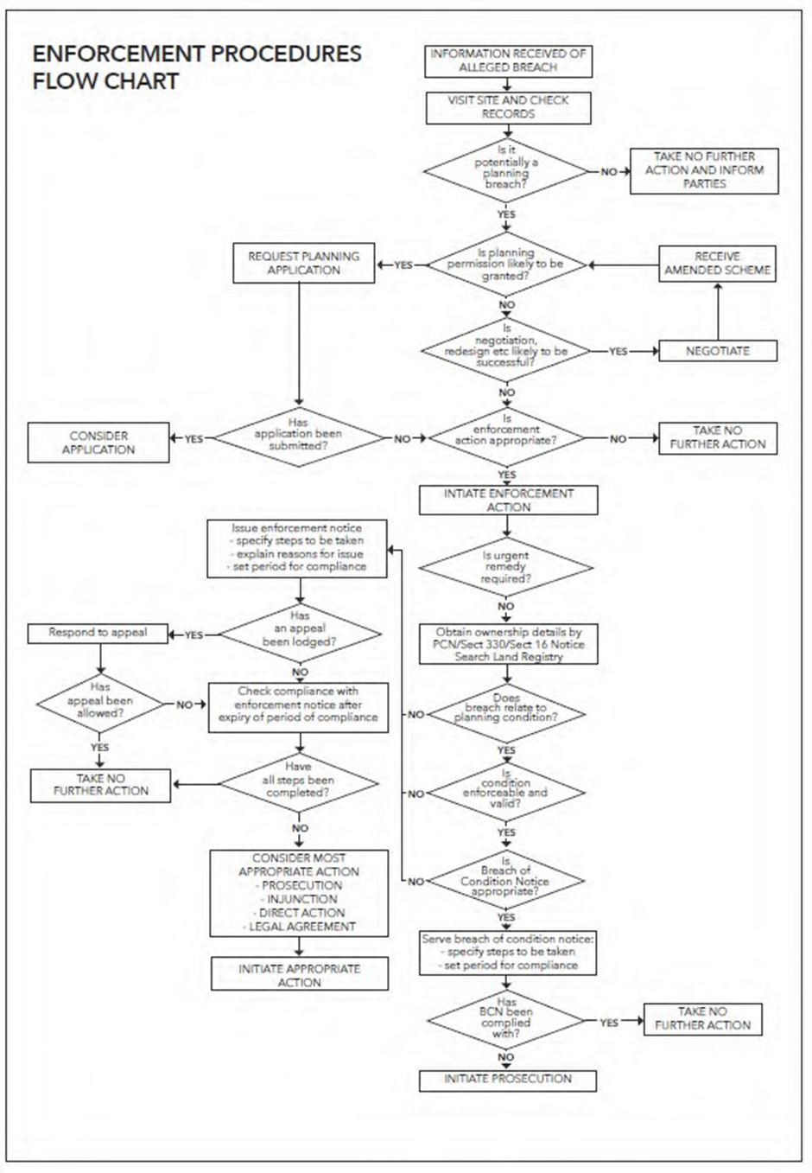
An enforcement investigation can be a lengthy and complex process.
Time taken to determine each case will vary depending on the site, the type of breach, and any actions necessary to reach the desired outcome
Notes:
OPTIONAL SLIDE FOR DETAIL ON PROCESS
It is not uncommon for some enforcement issues to take several years to resolve depending on the details of the case with respect to the site characteristics, type of breach, and the nature of the actions required to reach a desired outcome.
I assume the HoP / Enf team monitor progress on cases and will keep senior officers and cabinet member/ward members updated on the progress on key cases

Slide 28
Step 1: Initial Assessment / Preliminary Checks
Report received - IS IT DEVELOPMENT?
Definition of development...
Primary legislation – Town and Country Planning Act 1990 (as amended)
A definition of two parts – operational development and material change of use:
S55 Meaning of "development" and "new development"
(1) … “development,” means the carrying out of building, engineering, mining or other operations in, on, over or under land,…
… or the making of any material change in the use of any buildings or other land.
Notes:
THE FOLLOWING SLIDES TAKE PARTICIPANTS THROUGH KEY STEPS OF THE ENFORCEMENT PROCESS AND CAN BE AMENDED TO REDUCE DETAIL OR ALLOW A FOCUS ON PARYICULAR ISSUES IN ORDER TO REFLECT LOCAL NEEDS
STEP 1:
Effective enforcement is rooted in the the key principles of development – the starting point for any planning enforcement investigation is to understand whether an alleged breach of planning control constitutes development and whether it is in contravention of PDR, planning permission, LBC etc.
Refer to the definition of development provided at s55 of the TCPA (as amended)
A definition of 2 parts: operational development and a material change of use of land.

Slide 29
Step 1: Initial Assessment / Preliminary Checks (cont'd)
Also...
Primary legislation - Planning (Listed Buildings and Conservation Areas) Act 1990
S.7 Restriction on works affecting listed buildings.
(1) … no person shall execute or cause to be executed any works for the demolition of a listed building or for its alteration or extension in any manner which would affect its character as a building of special architectural or historic interest, unless the works are authorised.
S.9 Offences.
(1) If a person contravenes section 7 he shall be guilty of an offence.
(2) … if a person executing or causing to be executed any works in relation to a listed building under a listed building consent fails to comply with any condition attached to the consent, he shall be guilty of an offence.
Notes:
Different legislation to consider when investigating alleged unauthorised works to a LB
A CRIMINAL OFFENCE! (unlike the planning regime)
Any allegation concerning a LB will more than likely require further investigation.

Slide 30



Step 2: Gathering Facts & Evidence
If the allegation amounts to development...
Initial desk-based assessment
Planning history check (any extant permissions in place?)
Permitted Development Rights (PDR) intact? (in consideration
of secondary legislation - GPDO, Use Class Order and Advert Regs)
Site visit – on the ground assessment
Photos, measurements etc.
Info from reporter / neighbours / alleged transgressor etc.
Notes:
Once the officer has assessed whether the allegation constitutes development, they continue to undertake:
Initial desk-based assessment; and
Undertake site visit.

Slide 31

Step 3: Is it a breach?
Based on:
Info on file (planning history of the site); and
Evidence gathered...
Confirm whether the development is unauthorised.
If development benefits from extant permission / consent or PDR – close case.
If development is unauthorised, assess the expediency to pursue the investigation.
Notes:
Case can be closed if no breach identified – compliance with extant permissions / consent / PDR
Further investigation and an assessment of the expediency to pursue formal enf action required if breach is found.

Slide 32
Step 4: The Expediency Test
Is the development contrary to national and/or local planning policy?
Is the development acceptable in respect of all other material considerations?
If an application was submitted for the development, prior to it being carried out, is it likely to have been supported / permitted?
Is the breach causing harm to public amenity and/or safety?
Would action be proportionate to the level of harm identified?
Is action required now?
Technical breaches of planning control (unauthorised development which does not cause any harm, or such a limited level of harm that mitigation is considered unnecessary) are not expedient to pursue
Notes:
Once a breach of planning control has been identified, officers must assess the expediency of pursuing the case and taking formal enforcement action.
So – how do you assess whether it is expedient to take planning enforcement action or not.
It is important to consider the following points:
Is the development contrary to national and/or local planning policy?
Is the development acceptable in respect of all other material planning considerations? – which if you have undertaken planning committee training you should have covered this off and is a separate training session on its own
If an application was submitted for the development, prior to it being carried out, is it likely to have been supported / permitted?
Is the breach causing harm to public amenity and/or safety?
Would action be proportionate to the level of harm identified?
Is action required now?
And as the final point states: Technical breaches of planning control where unauthorised development does not cause any harm – should not be expedient to pursue and not in the public interest.

Slide 33
Step 4: The Expediency Test (cont'd)
If breach found inexpedient to pursue with formal enforcement action (due to lack of harm) - close case
Case officer is usually required to write up an inexpediency report justifying this decision
If breach found expedient to pursue, a number of options exist to the transgressor:
  Remove / cease identified breach; OR
  Apply for retrospective permission (or in the case of a listed building (LB), apply to regularise the unauthorised works) - this may be contrary to officer advice, unless appropriate mitigation can be secured; OR
  Do nothing and risk formal enforcement action.
Notes:
Breach found inexpedient to pursue – write up inexpediency report – close case
Otherwise, the transgressor has three options...
Any continuation of a breach (i.e. progress made with unauthorised operational development or continuation with MCOU) is done so at the transgressor's own risk

Slide 34
Step 5: Remedy - Retrospective Applications
Only referred to as 'retrospective' in relation to planning regime
When discussing Listed Building Consents (LBCs), it's referred to as an application to 'retain' or 'regularise'
No opportunity to 'regularise' in relation to trees
Planning system permits such applications - no financial penalty
Can often be a remedy to a genuine error…. But sometimes the result of deception!
MUST BE considered the same way
Notes:
I thought it would also be useful to stress that retrospective planning applications are permitted within the planning system and do not incur any financial penalty.
It is not a form of ‘breaking the law’ and can arise through genuine error by the transgressor – although I accept on occasion it can be sometimes an attempt to deceive!
But importantly, such applications should be considered, as with any other planning application, on the planning merits of the case.
Usually, once a retrospective application has been submitted to the LPA, officers await its determination before proceeding with formal enf action.

Slide 35
Step 5: Remedy - Formal Enforcement Action
Planning Contravention Notices (PCN’s)
Enforcement Notices
Planning Enforcement Orders
Breach of Condition Notices
Stop Notices
Temporary Stop Notices
Enforcement Warning Notices
Listed Building Enforcement Notices
Urgent Works and Repair Notices
S215 Notices
Notes:
Should the Enforcement Team determine that there has been a breach and formal enforcement action should be taken, then they will need to consider what action is required – here is a long list of the various Notices that your Enforcement Team have available to them:
Next slide

Slide 36
NOTICE | COMPLIANCE PERIOD | RIGHT TO APPEAL | Notes
Planning Contravention Notices (PCN’s) | 21 days from service | No
Enforcement Notices (EN’s) | Compliance period set within Notice | Yes | Comes into effect 28 days after service.
Breach of Condition Notice | 28 days+ from service | No | Effective immediately.
Stop Notice | Comes into effect 3 to 28 days after service | No (EN appeal) | Requires an accompanying EN
Temporary Stop Notice | Effective immediately | No (EN appeal) | Expires after 56 days
Planning Enforcement Order | Set in Notice | No (EN Appeal) | Notice served within 6 months
Listed Building Enforcement Notices | Compliance period set within Notice | Yes | Comes into effect 28 days after service
Urgent works and Repairs | Set within Notice | Yes
Enforcement Warning Notices | Set within Notice | No
S215 Notices | Set within Notice | Yes | Appeal within 28 days of serving
Notes:
THIS TABLE SUMMARISES THE DIFFERENT NOTICES THAT MAY BE SERVED BY AN LPA AND THE VARYING COMPLIANCE PERIODS AND RIGHTS TO AN APPEAL – ADDITIONAL INFORMATION AND SLIDES COVERING EACH FORM OF NOTICE AERE ALSO AVAILABLE AT THE END OF THIS SLIDE PACK IF FURTHER DETAIL IS REQUIRED (SEE SLIDES 59 – 64)
Planning Contravention Notices (PCN’s)
Are used where there is suspected to be a breach of planning control – used for information gathering – very commonly used by LPAs (holds the same weight as an Affidavit)
Where the recipient has 21 days to respond to the questions to establish what development has taken place and what, if any, breach has taken place e.g. checking permitted development rights etc
And its a Criminal offence to provide false information or to fail to reply (fines up to £1,000)
SIMILAR S330 NOTICE of the TCPA – provides LPAs with the power to require information as to the interest in land.
Enforcement Notices
Are used to require the cessation of unauthorized use or removal of unauthorized structures
An enforcement notice should enable every person who receives a copy to know:
exactly what, in the local planning authority’s view, constitutes the breach of planning control; and
what steps the local planning authority require to be taken, or what activities are required to cease to remedy the breach
Written in plain English – should not use over elaborate language!
There is a Right to Appeal – and once at appeal, time-frames for compliance are frozen until appeal decision received
Breach of Condition Notices
Issued when the conditions of a planning permission are not met
There is no right to appeal because the issues would have been dealt with through the determination of the planning application and the rights of appeal at that stage
Although non-compliance with the notice would revert to LPA taking prosecution action where necessary and then potentially referred through to the courts
Stop Notices
Can be used to stop operations that are causing significant harm (but cannot be used to prohibit the use of a building as a dwelling house)
Should ONLY be used where there would be significant risk to public safety or to the environment
Need to be served in tandem with an enforcement notice – EN first, SN after 3 days have passed
Compliance periods (have to be reasonable) within specified time frames (usually between 3 and 28 days)
If EN is quashed at appeal – the LPA could be subject to compensation costs
Failure to comply with a temporary stop notice is a criminal offense.
Temporary Stop Notice
To stop operations or land use that contravenes planning regulations.
Allows the LPA more time to fully assess the breach of planning control identified and determine the nest course of action.
Failure to comply with a temporary stop notice is a criminal offense.
The notice is typically valid for a maximum of 56 days and should be followed up with the serving of a planning enforcement notice within the 56 day period
Planning Enforcement Orders
Are used to handle cases of concealment and basically removes any immunity from enforcement action
Cases can often involve very high profile cases with much press interest – but not that common
The Notice needs to be served within 6 months of the LPA being made aware of the concealment
Listed Building Enforcement Notices
Are used to address unauthorised works to listed buildings.
The notice specifies the required actions to restore the building or mitigate unauthorised changes.
Unlike general planning breaches, unauthorised works never become immune from enforcement action- NO TIME LIMIT for serving a LBEN
Can be appealed
Urgent Works
Are used to ensure the preservation of listed buildings at risk of decay or damage.
Notices should seek the minimum to make building weather-tight, safe from collapse, and preventing vandalism – cannot ask for full restoration!
Can only be applied to unoccupied buildings or parts of buildings.
After the completion of urgent works, the local authority may recover costs from the building owner.
The owner has 28 days to appeal
Repairs Notice
Served when an LPA considers that a listed building is not being properly preserved
Specify the works which the authority considers reasonably necessary for the proper preservation of the building
These powers are not confined to urgent works or to unoccupied buildings
Enforcement Warning Notices
Used when a violation is not severe enough to warrant immediate enforcement action.
Often aims to regularise minor breaches by inviting the transgressor to apply for retrospective planning permission.
They serve as a preliminary step before issuing formal enforcement notices, allowing for negotiation and compliance.
S215 Notices
Are used to address properties that are in a state of disrepair or neglect and as a consequence give rise to wider amenity issues in the area.
Failure to comply can result in significant consequences, including fines and potential legal action.
Such cases can often involve residents who are elderly or suffering ill health and often not able to adequately maintain their property or garden areas – and often require sensitive handling involving social services and the police where necessary
The wider 'Enforcement Toolkit', however, also includes retrospective planning applications and Lawful Development Certificates.

Slide 37
Tools to Enforce Post Notice
Direct action
Prosecution
Injunction
Notes:
If a planning Enforcement Notice is not complied with within the timescales prescribed in a notice, the LPA has three routes for ensuring conformity
Through Direct Action – where the LPA use contractors to enter a site and physically remove or put right the unauthorized works
Through prosecution - noting the need to satisfy the necessary evidential and public interest tests in the ‘Code for Crown prosectors’ – noting these processes can take a long time particularly if it involves a trial of a complex matter
And in cases of persistent offence against an unauthorized activity, an injunction may be sought as a last resort through the County or High Court.
Your officers will be progressing such cases in tandem with the advice from the Council’s Legal Service.
There are potential cost implications to the Council with all 3 routes, although there are opportunities to seek recovery of costs, possibly in the form of a charge on the land that would be recoverable at the time of sale of the land or property

Slide 38
D] Case study examples
Notes:
THIS SECTION GOES THROUGH SOME HIGH PROFILE CASE STUDIES TO ILLUSTRATE HOW GOOD ENFORCEMENT WORKS IN PRACTICE
LOCAL CASE STUDIES ARE ALSO PROVIDED LATER IN THE PRESENTATION IN ORDER TO ILLUSRATE RECENT ENFORCEMENT EXPERIENCE AND/OR TYPICAL ENFORCEMENT ISSUES

Slide 39
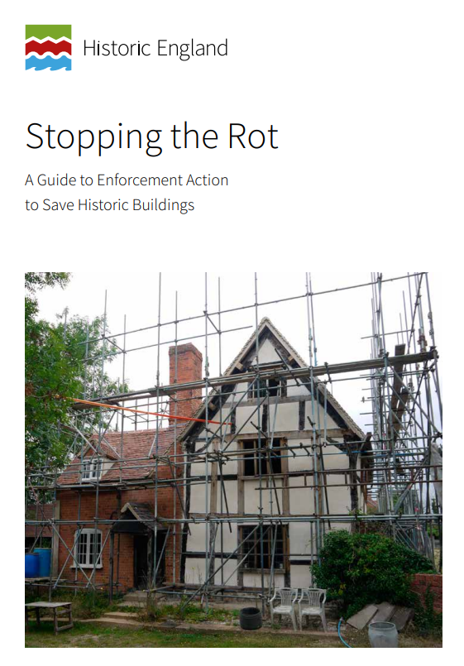
Stopping the Rot -
A Guide to Enforcement Action to Save Historic Buildings
Notes:
SOURCE OF EXAMPLES: THE FOLLOWING EXAMPLES ARE DRAWN FROM “STOPPING THE ROT”
This publication by Historic England contains some successful stories of enforcement that can be used as examples if local cases not available

Slide 40
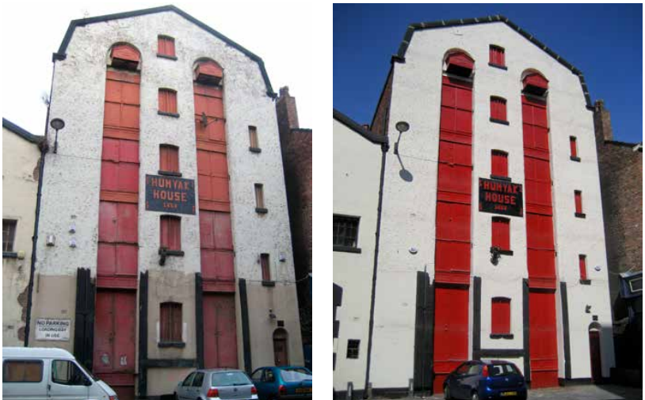
Section 215 Notice:
Liverpool City Council’s Unsightly Buildings Initiative
Relatively inexpensive (no technical survey work required)
Allows the local authority to either undertake works in default of the owner and recover costs as a charge on the property, or in times when funding is unavailable, to seek recourse through the magistrates’ court and rely on punitive fines to encourage work to be done.
Able to address problems with listed and unlisted buildings
Both images © Liverpool City Council.
Notes:
As noted earlier, a Section 215 notice is a power under section 215 of the Town and Country Planning Act 1990 that allows a local planning authority to require the proper maintenance of land where its condition is adversely affecting the amenity of the area.
In 1998 Liverpool City Council first introduced an action programme to deal with historic buildings in a poor state of repair through use of section 215 of the Planning Act. As part of a wider programme of more general environmental improvements, section 215 Notices had the advantages of being relatively inexpensive to draw up (no technical survey work is required). They also allow the local authority to either undertake works in default of the building owner and recover costs as a charge on the property, or in times when funding is unavailable to seek recourse through the magistrates’ court and rely on punitive fines to encourage work to be done. It was seen as an effective and positive mechanism to assist the city’s regeneration.
By 2002 when the programme drew to a halt, roughly half of the 44 targeted buildings had been successfully improved, with partial improvements to the remainder. Because of this early success, a separate programme aimed at the Ropewalks historic merchants’ quarter of the city centre was initiated in 2007 as part of a three-year ‘Creative Ropewalks’ initiative. Underpinned by plans for a ‘creative industry and leisure’ quarter within an area of warehouses, town houses, shops and offices dating from the late-Georgian period, the programme targeted buildings that were in a very poor state of external repair in spite of remaining occupied or in beneficial use. It was able to address problems with listed and unlisted buildings, in the latter case a useful alternative to Urgent Works Notices which require approval from the Secretary of State.
Over the course of two years owners responded positively following the receipt of the first or, more frequently, the second letter. Of 38 buildings that warranted action, 25 were repaired to an acceptable standard. Frequently the action led to full and proper renovation and upper floor space brought back into use. Occasionally it led to owners going beyond the requirements of the draft Notice. It has been estimated that the initiative encouraged investment of more than £1.5 million by private property owners. On the basis of the success in Ropewalks, the Building Conservation Team has taken on the responsibility of the service of section 215 Notices in all the city’s 35 conservation areas, encompassing some 19,000 properties. From a total of 70 informal section 215 enforcement actions since 2009 it has been necessary to serve statutory Notice in only eight instances. The vast majority of problem sites have been dealt with at the informal stage by means of negotiation.

Slide 41
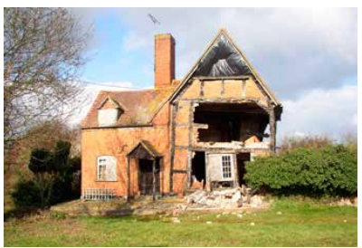
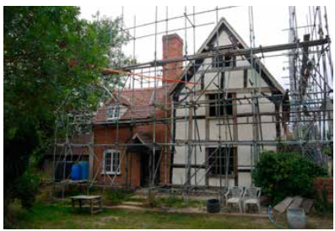
Listed Building Enforcement Notice, Urgent Works Notice and Repairs Notice
A grade II listed timber-framed former farmhouse in Gloucestershire
Grade II listed timber-framed building
Identified by the local authority as being ‘at risk’ in 1998
Took 12 years, a prosecution and the service of a Listed Building Enforcement Notice, Urgent Works Notice and Repairs Notice before repairs were finally completed in 2010.
Collaboration by the local authority’s building control team, enforcement team and conservation officer, which was important in resourcing the action that followed in the ensuing years.
Above (before) © Tewkesbury Borough Council; below (after) © Nick Joyce Associates.
Notes:
This grade II listed timber-framed building was identified by the local authority as being ‘at risk’ in 1998, but it took 12 years, a prosecution and the service of a Listed Building Enforcement Notice, Urgent Works Notice and Repairs Notice before repairs were finally completed in 2010.
Despite approaches by the local authority, offers of grant aid in the late 1990s for repairs to the timber frame and infill panels were not taken up. In 2002 a fire in the attic storey left the building uninhabitable and open to the elements. The local authority’s building control team, enforcement team and conservation officer adopted a team approach to the building, which was important in resourcing the action that followed in the ensuing years.
After the fire, initial letters encouraging repair but advising the owner of the local authority’s enforcement options were issued. These were followed by section 330 Requisition for Information Notices to establish ownership. This was very useful in showing the local authority’s intent to pursue an Urgent Works Notice and eliciting a response.
The owner claimed to have no resources and it became clear that the property had been underinsured so there was no prospect of a full repair. At this stage the conservation officer made contact with the insurance company and worked with them to ensure that temporary repairs to the roof with corrugated plastic sheeting were carried out. This stabilised the building for the next three years, during which time the owner offered the property for sale.
In February 2006, a contractor demolished much of the front and gable elevations of the building. Dangerous Structures procedures under the Building Act were immediately used by the building control team to commission a structural engineer and to enforce the erection of temporary scaffolding support, sheeted and roofed to provide full protection for the building. In March the local authority’s planning committee agreed to prosecute the owner and contractor for carrying out unauthorised demolition and served an injunction to prevent further works. The contractor was later found guilty by magistrates and fined £8,000.
Meanwhile regular monitoring of the building’s condition was carried out by the team while the owner again attempted to sell the property. After eight months the view was taken that a reasonable period had elapsed in which the owner might have organised repairs or in which a sale might have been agreed and the local authority’s executive committee agreed to serve a Listed Building Enforcement Notice to reverse the unauthorised works. The detailed schedule of works included re-forming and tiling the roof which, though not a direct result of the unauthorised works, was considered necessary to allow the reversal of the latter to take place. This, and the timescale for compliance (12 months), had to be considered carefully in order to avoid a challenge on the grounds that the works were unreasonable. The Notice was appealed three months later in March 2007 and only served after a dismissal in January 2008, which extended the compliance period by 15 months to April 2009.
Throughout this time the team had continued to monitor the protection of the building. In 2006 the scaffolding company had threatened to remove their scaffolding due to non-payment by the owner, and was advised by the conservation officer that to do so would render it liable to prosecution. Despite this, in November 2008, the scaffolding was removed. An emergency report was immediately taken to the local authority’s executive committee recommending:
the service of an Urgent Works Notice to re-erect the scaffolding within seven days and the allocation of £35,500 for the local authority to buy, erect, maintain and insure necessary scaffolding protection should the owner not comply
the service of a Repairs Notice relating to the works set out in the extant Listed Building Enforcement Notice and works to put right the fire damage of 2002
obtaining a valuation of the property from the District Valuer preparatory to the service of a Compulsory Purchase Order (CPO)
In drawing up this report the option to rely on the Listed Building Enforcement Notice was considered. Failure to comply is a criminal offence but it was clear that the owner did not have the means to fund repairs and that prosecution would achieve little. The local authority had the option to carry out the repairs listed in the Notice and recover the cost from the owner, but this would not have addressed all the damage resulting from the fire. It was also felt that the Repairs Notice, with its threat of CPO, was important in persuading the owner to dispose of the property at a realistic price informed by the District Valuer’s report.
The estimated cost of the scaffolding was based on a design produced by the structural engineer retained by the building control team and estimates provided by contractors. When the Urgent Works Notice was served, the owner had some new scaffolding erected but not to the required design. The local authority therefore funded its purchase, adaptation and completion in line with the Urgent Works Notice, and within four weeks had secured the building once more. A section 55 Notice was served to secure the local authority’s debt and recover the cost of the scaffolding. The owner launched an appeal against this but did not continue as the property was on the market again and it was anticipated that the sale would be the means of discharging the debt.
In March 2009 the Repairs Notice was served. Copies were also sent to the estate agent and prospective purchasers to ensure anyone buying the building realised that they would be subject to the Listed Building Enforcement Notice and expected to comply with the Repairs Notice. No action was taken and after two months, the conservation officer instructed the District Valuer as the first step on the road to CPO and with a view to informing the asking price. A quantity surveyor’s report on the cost of the works listed in the Repairs Notice was required to inform the valuation, which was finally produced in June 2009 giving a value of £110,000-120,000. With this information the local authority was able to approach the owner and dispel ideas of any higher value and the building was finally sold to a new owner in August 2009. The local authority’s debt was paid and repairs have been completed without the need for further enforcement action.
(p.65 Case Study 6, Stopping the Rot - A Guide to Enforcement Action to Save Historic Buildings)

Slide 42
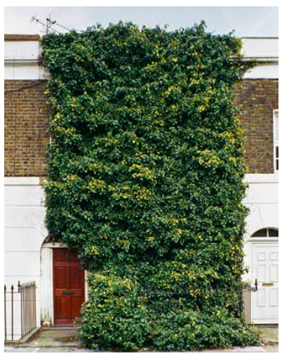
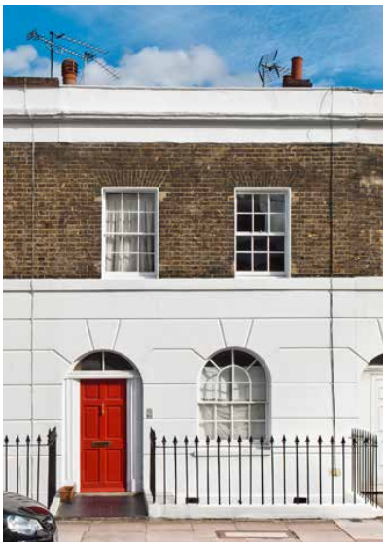
Repairs Notice
A grade II listed Georgian terraced house in London
Listed terraced house within a Conservation Area
Moderately sized three-storey house
Lack of maintenance over a long period: façade (windows, front railings and roof) engulfed by ivy.
Assumed the building was vacant and possibly abandoned
LPA decided to intervene
The owner was at first reluctant to give access to the building, but the LPA decided to treat the case with sensitivity (rather than use powers of entry)
Approach encouraged trust and goodwill
Owner appeared willing to discuss progress but stalled on several occasions.
Repairs Notice was served in order to confirm the local authority’s resolve to act if the owner did not.
The serving of the Notice galvanised the owner, who promptly sold the building to a developer
Both images from Stopping the Rot - A Guide to Enforcement Action to Save Historic Buildings
Notes:
This grade II listed timber-framed building was identified by the local authority as being ‘at risk’ in 1998, but it took 12 years, a prosecution and the service of a Listed Building Enforcement Notice, Urgent Works Notice and Repairs Notice before repairs were finally completed in 2010.
Despite approaches by the local authority, offers of grant aid in the late 1990s for repairs to the timber frame and infill panels were not taken up. In 2002 a fire in the attic storey left the building uninhabitable and open to the elements. The local authority’s building control team, enforcement team and conservation officer adopted a team approach to the building, which was important in resourcing the action that followed in the ensuing years.
After the fire, initial letters encouraging repair but advising the owner of the local authority’s enforcement options were issued. These were followed by section 330 Requisition for Information Notices to establish ownership. This was very useful in showing the local authority’s intent to pursue an Urgent Works Notice and eliciting a response.
The owner claimed to have no resources and it became clear that the property had been underinsured so there was no prospect of a full repair. At this stage the conservation officer made contact with the insurance company and worked with them to ensure that temporary repairs to the roof with corrugated plastic sheeting were carried out. This stabilised the building for the next three years, during which time the owner offered the property for sale.
In February 2006, a contractor demolished much of the front and gable elevations of the building. Dangerous Structures procedures under the Building Act were immediately used by the building control team to commission a structural engineer and to enforce the erection of temporary scaffolding support, sheeted and roofed to provide full protection for the building. In March the local authority’s planning committee agreed to prosecute the owner and contractor for carrying out unauthorised demolition and served an injunction to prevent further works. The contractor was later found guilty by magistrates and fined £8,000.
Meanwhile regular monitoring of the building’s condition was carried out by the team while the owner again attempted to sell the property. After eight months the view was taken that a reasonable period had elapsed in which the owner might have organised repairs or in which a sale might have been agreed and the local authority’s executive committee agreed to serve a Listed Building Enforcement Notice to reverse the unauthorised works. The detailed schedule of works included re-forming and tiling the roof which, though not a direct result of the unauthorised works, was considered necessary to allow the reversal of the latter to take place. This, and the timescale for compliance (12 months), had to be considered carefully in order to avoid a challenge on the grounds that the works were unreasonable. The Notice was appealed three months later in March 2007 and only served after a dismissal in January 2008, which extended the compliance period by 15 months to April 2009.
Throughout this time the team had continued to monitor the protection of the building. In 2006 the scaffolding company had threatened to remove their scaffolding due to non-payment by the owner, and was advised by the conservation officer that to do so would render it liable to prosecution. Despite this, in November 2008, the scaffolding was removed. An emergency report was immediately taken to the local authority’s executive committee recommending:
the service of an Urgent Works Notice to re-erect the scaffolding within seven days and the allocation of £35,500 for the local authority to buy, erect, maintain and insure necessary scaffolding protection should the owner not comply
the service of a Repairs Notice relating to the works set out in the extant Listed Building Enforcement Notice and works to put right the fire damage of 2002
obtaining a valuation of the property from the District Valuer preparatory to the service of a Compulsory Purchase Order (CPO)
In drawing up this report the option to rely on the Listed Building Enforcement Notice was considered. Failure to comply is a criminal offence but it was clear that the owner did not have the means to fund repairs and that prosecution would achieve little. The local authority had the option to carry out the repairs listed in the Notice and recover the cost from the owner, but this would not have addressed all the damage resulting from the fire. It was also felt that the Repairs Notice, with its threat of CPO, was important in persuading the owner to dispose of the property at a realistic price informed by the District Valuer’s report.
The estimated cost of the scaffolding was based on a design produced by the structural engineer retained by the building control team and estimates provided by contractors. When the Urgent Works Notice was served, the owner had some new scaffolding erected but not to the required design. The local authority therefore funded its purchase, adaptation and completion in line with the Urgent Works Notice, and within four weeks had secured the building once more. A section 55 Notice was served to secure the local authority’s debt and recover the cost of the scaffolding. The owner launched an appeal against this but did not continue as the property was on the market again and it was anticipated that the sale would be the means of discharging the debt.
In March 2009 the Repairs Notice was served. Copies were also sent to the estate agent and prospective purchasers to ensure anyone buying the building realised that they would be subject to the Listed Building Enforcement Notice and expected to comply with the Repairs Notice. No action was taken and after two months, the conservation officer instructed the District Valuer as the first step on the road to CPO and with a view to informing the asking price. A quantity surveyor’s report on the cost of the works listed in the Repairs Notice was required to inform the valuation, which was finally produced in June 2009 giving a value of £110,000-120,000. With this information the local authority was able to approach the owner and dispel ideas of any higher value and the building was finally sold to a new owner in August 2009. The local authority’s debt was paid and repairs have been completed without the need for further enforcement action.
(p.65 Case Study 6, Stopping the Rot - A Guide to Enforcement Action to Save Historic Buildings)

Slide 43
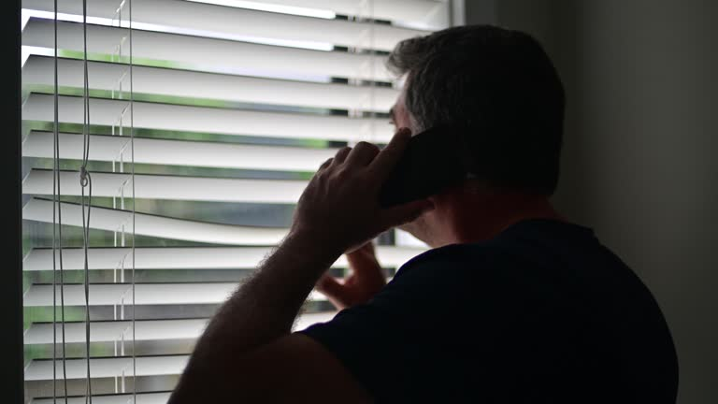
My neighbour doesn’t have planning permission for building work they’re carrying out – can you force them to stop building?
Notes:
THE FOLLOWING SLIDES PRESENT SOME HYPOTHETICAL SCENARIOS SO THAT PARTICIPANTS GET THE CHANCE TO TEST WHAT THEY HAVE LEARBED
READ THE SLIDE AND POSE SOME QUESTIONS TO ENCOURAGE FEEDBACK AND DISCUSSION
Interesting to see what you think
Who thinks the LPA can stop them building?
Who thinks that this is beyond the power of an LPA?
What makes you think this?
What issues do you need to consider?

Slide 44
Expediency of any formal action must be assessed.
Any formal enforcement action must be proportionate to the harm being caused as a result of the identified breach.
Is there irreparable harm being caused as a result?
In the case of unauthorised development at a residential property, such as the construction of a garage /conservatory /outbuilding, although the works may constitute a breach of planning control i.e. no permission obtained, the works may not be considered harmful and may therefore be considered acceptable if a retrospective application were submitted.
However, the owners proceed with undertaking further unauthorised works at their own risk!
In rare circumstances, the LPA has the power to serve a Temporary Stop / Stop Notice requiring the unauthorised development to be halted, but strict criteria e.g. significant harm, including endangering public safety and severe harm to the environment etc. must be met.
Temporary Stop / Stop Notices can only be issued after an Enforcement Notice has been issued.
Notes:
READ THE ANSWER AND TAKE PARTICIPANTS TROUGH EACH POINT
READ 1. and add… should an enforcement notice be issued and not complied with
Only in exceptional circumstances… READ… where the threat is immediate and needs handing immediately e.g. direct pollution impacting the local area, loss of a listed building or the quality of the listed building etc

Slide 45
My neighbour is building an extension that encroaches slightly onto my property – can you do anything about this?
Notes:
Thought it would be useful to run through a few examples to help to take that information supplied in.
READ
Interesting to see what you think – please put your hand up if you think you can stop them building? (what %) ?

Slide 46
LPAs cannot become involved in matters relating to boundary disputes or allegations of trespass onto property.
If an extension is constructed on a neighbours property, but you believe part of it has been built on your land, you should seek legal advice from a solicitor/legal advisor about how to pursue the matter.
Similarly, if a neighbour has erected scaffolding on your property to enable them to construct an extension, the LPA does not have powers to take action – it is a civil matter.
Notes:
READ THE ANSWER AND TAKE PARTICIPANTS TROUGH EACH POINT

Slide 47
Is building an extension/garage/conservatory etc.
without planning permission a breach of planning control?
Notes:
Thought it would be useful to run through a few examples to help to take that information supplied in.
READ THE SLIDE AND POSE SOME QUESTIONS TO ENCOURAGE FEEDBACK AND DISCUSSION
Interesting to see what you think
Who thinks the LPA can stop them building?
Who thinks that this is beyond the power of an LPA?
What makes you think this?
What issues do you need to consider?

Slide 48
Dependent on whether PDR are intact for the property and the dimensions of the extension.
PDR allows for small-scale development to be undertaken without the requirement for express planning permission.
The works still constitute development but will likely benefit from deemed consent, so would not be considered a breach of planning control.
On the other hand, if the property is listed, listed building consent (LBC) is required for any works to extend, alter or demolish.
LBC is required in addition to PDR or planning permission.
It is a criminal offence to carry out unauthorised works to a LB that extend, alter or demolish etc. any part of the building without first obtaining the necessary listed building consent.
It is a criminal offence to fail to comply with the requirements of an enforcement notice within the time given.
Notes:
READ THE ANSWER AND TAKE PARTICIPANTS TROUGH EACH POINT

Slide 49
Local Cases
2 or 3 specific cases – suggest 2 successful and 1 not so successful
Planning enforcement manager to present
Before / after photos
Notes:
THIS SECTION IS OPTIUONAL BUT STONGLY RECOMMENDED – INDVIDUAL LOCAL AUTHORITIES SHOULD PROVIDE SOME LOCAL CASE STUDIES THAT ARE SPECIFIC AND RELEVANT TO THEIR AREA
IT IS AN OPPORTUNITY FOR THE LOCAL ENFORCEMENT TEAM TO SHOW CASE THEIR WORK AND HOW THEY OPERATE

Slide 50
The Most Common Issues
      Adverts -
      Breach of Conditions -
      Change of Use -
      Extensions/Alterations at Dwellings -
      Extensions/Alterations to Non-Domestic Buildings -
      Listed Buildings -
      Not in Accordance with Approved Plans -
      Other -
      Section 215 (Untidy Land) -
      Trees -
      First 50 case o XXXXX
Notes:
THIS SLIDE IS OPTIONAL – IT CAN BE USED TO DETAIL THE NUMBER AND TYPE OF LOCAL ENFORCEMENT CASES BY CATEGORY
For your information, your officers have supplied the following case numbers by category to give you a feel of their workload over a 6 month period

Slide 51
E] The Role of the Councillor

Slide 52
Councilors Role
‘Eyes and Ears’ of the community
Community liaison role
Setting priorities and resources
Awareness of case progress and service performance
Support for enforcement / planning officers
Representing a ‘trusted’ and ‘professional’ LPA service (Planning Code of Conduct)
Notes:
As I have mentioned throughout the presentation, there is a need for the LPA to present a co-ordinated and professional service where officers are able to work collaboratively with Councillors and be trusted by the local community. Therefore, your role as a Councillor is an important one, particularly where the service is handling a complex and/or controversial case within the community.
Firstly, and importantly, you are the ‘eyes and ears’ of your local areas and communities and can bring potential issues to the attention of the planning enforcement team.
Secondly, you have a community liaison role to act as a bridge between officers and the local community, to ensure there is effective and proper communication on the progress of cases to aid understanding and expectations.
Thirdly, the Council is responsible for setting budgets and allocating resources and this will have implications for the ability of the service to not only handle the complaints coming in but also to consider whether the authority would wish to take a more pro-active role in dealing with common adverse issues within the district or locality
Fourthly, it is important for Councillors to have the ability to be able to keep up to date on the progress of key cases in their areas and to have an awareness of how the service is performing – and that includes reviews of cases and how they were handled
Fifthly, as with all the service, there should be support for the officers involved and importantly successes should be acknowledged and fed back to the community which will reinforce trust in the service and the Council as a responsible and professional LPA
And, Lastly, as with the Planning Service as a whole, you are beholden to the councillors ‘code of conduct’ and particularly, issues relating to ‘pre-determination’ and ‘pre-disposition’ still apply.

Slide 53
PAS' Top Tips & Myth Busters
Planning enforcement is contentious – yes, but it doesn’t always have to be! Approaching the matter in a factual, but ‘human’ way, will more often than not result in a better relationship with the transgressor and reporter (however, it’s unlikely you’ll please everyone!)
Clear communication along the lifetime of the case is essential – to keep both the reporter, transgressor, key Members updated.
The use of considered and accurate language is very important:
  ‘alleged breach of planning control’ up to the point a breach has been confirmed;
  ‘transgressor’ rather than ‘violator’ or ‘offender’;
  ‘reporter’ rather than ‘complainant’ etc.
The importance of using the correct terminology: consent (LBs, adverts etc.) vs permission
Planning enforcement doesn’t cover everything despite a lot of people believing it does! (does not cover covenants, civil matters, and parking etc.)

Slide 54
PAS' Top Tips & Myth Busters (Cont'd)
Not all allegations of breaches of planning control amount to actual breaches of planning control; often small scale development can be considered under the permitted development rights of the land.
Planning enforcement is not punitive and formal action should not be taken on a technicality!
Formal enforcement action is discretionary and should be proportionate (NPPF para 59)
Expediency is key!
A breach of planning control is not an offence. However, unauthorised works to a LB or a contravention of the Advert Regs is! As well as unauthorised works relating to TPO or potentially a tree within a Conservation Area.
Retrospective applications hold the same weight and should be considered like any other application – no black mark against the applicant!
Unless a) there is no breach, b) the breach is inexpedient to pursue (in consideration of its low level of harm), or c) compliance is secured quickly, there is no ‘fast-tracking’ and enforcement can be a long process.

Slide 55
In summary
Planning Enforcement can be a simple process…
BUT on occasions, can take an extremely long time (sometimes years) to resolve
Ultimately a legal process and there are no short cuts in the applications of law
Service needs support and co-operation of local councillors and the community
Notes:
So, just to finish off –my quick resume of planning enforcement is
That it can be a simple process but on occasions… can take an extremely long time (sometimes years_ to resolve issues given appeals, court times, changed circumstances and having to start again etc
And as part of that – ultimately, it is a formal legal process with high bars for evidence and process/procedure being carried out appropriately
And as part of that, your Enforcement officers need your support and understanding for them to carry out their business efficiently and effectively .

Slide 56

F] Discussion and Questions
Notes:
I hope that covers the issues you either expected or needed. I’ve checked against the issues you raised at the beginning of the session, and believe these have been covered
List ??
Are there any other matters which you would have expected to have included but appear not to have been covered?
If none, I am happy to open up for questions – noting that your officers are also here to respond to your questions as much as I am.

Slide 57


Stay in touch: we are at local.gov.uk/pas
Planning Advisory Service
Planning Advisory Service

Slide 58
Further information and resources:
RTPI Beginners' guide to planning enforcement (2021) Beginners' guide to planning enforcement
MHCLG, Planning Practice Guidance, Enforcement and post-permission matters

Slide 59
Other additional slides – further information or resources that can be used if required

Slide 60
Formal Enforcement Action
Planning Contravention Notice (PCN’s)
  Suspect breach of planning control – information gathering
  21 days to respond
  Criminal offence to provide false information (fines upto £1,000)
Enforcement Notice
  Requires cessation of unauthorized use or removal of unauthorized structures
  Right to appeal
Breach of Condition Notice
  Issued when the conditions of a planning permission are not met
  No right to appeal
Notes:
I will now go through a long list of the various Notices that your Enforcement Team have available to them:
Planning Contravention Notices (PCN’s)
Are used where there is suspected to be a breach of planning control – used for information gathering – very commonly used by LPAs
Where the recipient has 21 days to respond to the questions to establish what development has taken place and what if any, breach has taken place e.g. checking permitted development rights etc
And its a Criminal offence to provide false information (fines upto £1,000)
Enforcement Notices
Are used to require the cessation of unauthorized use or removal of unauthorized structures
There is a Right to Appeal – and once at appeal time frames are frozen until appeal decision received
Breach of Condition Notices
Issued when the conditions of a planning permission are not met
There is no right to appeal because the issues would have been dealt with through the determination of the planning application and the rights of appeal at that stage
Although non compliance with the notice would revert to LPA taking prosecution action where necessary and then potentially referred through to the courts

Slide 61
Formal Enforcement Action…..(cont)
Stop Notice
  to stop operations that are causing significant harm or are unneighbourly (may not prohibit use as a dwelling house)
  Significant risk to public safety or to the environment
  Served in tandem with enforcement notice
  Compliance within specified time frames (usually between 3 and 28 days)
  If EN quashed – could be subject to LPA compensation costs
Temporary Stop Notice
  To stop operations or land use that contravenes planning regulations.
  Failure to comply with a temporary stop notice is a criminal offense.
  The notice is typically valid for 56 days.
Planning Enforcement Order
  Typically sought when the breach has been deliberately concealed
  Served within 6 months of the LPA being made aware
Notes:
Stop Notices
Can be used to stop operations that are causing significant harm or are unneighbourly (but cannot be used to prohibit the use of a building as a dwelling house)
Only should be used where there would be significant risk to public safety or to the environment
Need to be served in tandem with an enforcement notice
Compliance periods (have to be reasonable) within specified time frames (usually between 3 and 28 days)
If EN is quashed at appeal – the LPA could be subject to compensation costs
Temporary Stop Notice
To stop operations or land use that contravenes planning regulations.
Failure to comply with a temporary stop notice is a criminal offense.
The notice is typically valid for a maximum of 56 days and should be followed up with the serving of a planning enforcement notice within the 56 day period
Planning Enforcement Orders
Are used to handle cases of concealment and basically removes any immunity from enforcement action
Cases can often involve very high profile cases with much press intertest – but not that common
The Notice needs to be served within 6 months of the LPA being made aware of the concealment

Slide 62
Formal Enforcement Action…..(cont)
Listed Building Enforcement Notices
  To address unauthorized alterations to listed buildings.
  The notice specifies the required actions to restore the building or mitigate unauthorized changes.
  Unlike general planning breaches unauthorized works never become immune from enforcement action.
  Can be appealed
Urgent Works and Repairs
  To ensure the preservation of listed buildings at risk of decay or damage.
  The minimum to make building weather-tight, safe from collapse, and preventing vandalism.
  Can only be applied to unoccupied buildings or parts of buildings.
  After the completion of urgent works, the local authority may recover costs from the building owner.
  The owner has 28 days to appeal
Notes:
Listed Building Enforcement Notices
Are used to address unauthorized alterations to listed buildings.
The notice specifies the required actions to restore the building or mitigate unauthorized changes.
Unlike general planning breaches unauthorized works never become immune from enforcement action.
Can be appealed
Urgent Works and Repairs
Are used to ensure the preservation of listed buildings at risk of decay or damage.
Notices should seek the minimum to make building weather-tight, safe from collapse, and preventing vandalism – cannot ask for full restoration!
Can only be applied to unoccupied buildings or parts of buildings.
After the completion of urgent works, the local authority may recover costs from the building owner.
The owner has 28 days to appeal

Slide 63
Formal Enforcement Action…..(cont)
Enforcement Warning Notices
  when a violation is not severe enough to warrant immediate enforcement action.
  Often aims to regularise minor breaches by inviting the violator to apply for planning permission.
  They serve as a preliminary step before issuing formal enforcement notices, allowing for negotiation and compliance.
S215 Notices
  to address properties that are in a state of disrepair or neglect.
  Failure to comply can result in significant consequences, including fines and potential legal action.
Notes:
Enforcement Warning Notices
Used when a violation is not severe enough to warrant immediate enforcement action.
Often aims to regularise minor breaches by inviting the transgressor to apply for planning permission.
They serve as a preliminary step before issuing formal enforcement notices, allowing for negotiation and compliance.
S215 Notices
Are used to address properties that are in a state of disrepair or neglect and as a consequence give rise to wider amenity issues in the area.
Failure to comply can result in significant consequences, including fines and potential legal action.
Such cases can often involve residents who are elderly or suffering ill health and often not able to adequately maintain their property or garden areas – and often require sensitive handling involving social services and the police where necessary

Slide 64
Enforcement Action Against Unlawful Developments by Gypsies
Trespassing on private or public land
Planning Policy – provision of adequate sites to meet needs
Human Rights – Agreed approach from the various public bodies (LPA, County Council, police etc)
Available powers;
  Enforcement Notice
  Stop Notice
  Temporary Stop Notice
  Pre-emptive injunction
  Eviction Injunction
Notes:
OPTIONAL SLIDE _ SUBJECT TO WHETHER IT IS A MAJOR ISSUE IN THE DISTRICT
I understand that unauthorized Gypsy and Traveller development is of concern in the District
It is important to distinguish between those cases where the gypsies do not own/have permission to occupy land – in effect trespassing – and these should be dealt with through eviction powers of landowners (including local authorities) and the Police
Where they do own or have permission and they involve a breach of planning there are several options for taking action depending on the circumstances – which I will refer to
However, it is important to ensure that the LPA have the appropriate planning policies in place including the provision of sufficient land to meet gypsy and traveller needs within the district and that the Council, in conjunction and agreement with other public bodies including County Council and the Police on their approach to handling such cases given the human rights and social services implications involved
In most cases it is expected that given the sensitivies for handling such cases, resolution can be secured without necessarily taking action although this may involve the land being used for a short time scale until resolution occurs (and in some cases where the gypsies only intend to occupy the land temporarily).
PTO
Taking these key matters into account, the LPA has several powers available to take action:
Enforcement Notices
Cannot be pre-emptive – only served once incursion has occurred
Normally 28 days to comply with the notice from date of serving Enforcement notice
Potentially subject to appeal – noting the clock stops on the EN once appeal submitted
Human rights (HR) are a matter the courts take into account
Stop Notice
Again cannot be pre-emptive – but can stop additional pitches once a site has been accessed
Only served in conjunction with EN
Right of appeal – and could pose compensation if Council acted inappropriately
Human rights are taken into account -
Temporary Stop Notice
Prevents any further incursion for upto 56 days within which the Council would be expected to serve an Enforcement Notice– no EN is needed
Prevents further unauthorized development
Some Councils have special ‘out of hours’ (noting that bank holidays can be particularly vulnerable periods for such incursions) out of hours procedures and access to lawyers to draft and serve such notices – although this can be costly service for the Council and may not reap the benefits that many would expect given that significant impact would have already occurred
Pre-emptive injunction
Where action is taken against a named individual or clearly apply to an unknown named individual with evident risk of incursion likely to take place -
No HR issues involved
Eviction Injunction
Need assurance of contempt
Involve HR issues and would be used in the balancing of the acceptance of the injunction use
Important to show LPA has alternative sites – otherwise judges will take into account the likelihood of temporary permission being granted in such circumstances
Highly unlikely to succeed prior to the LPA winning a planning appeal

