Slide 1


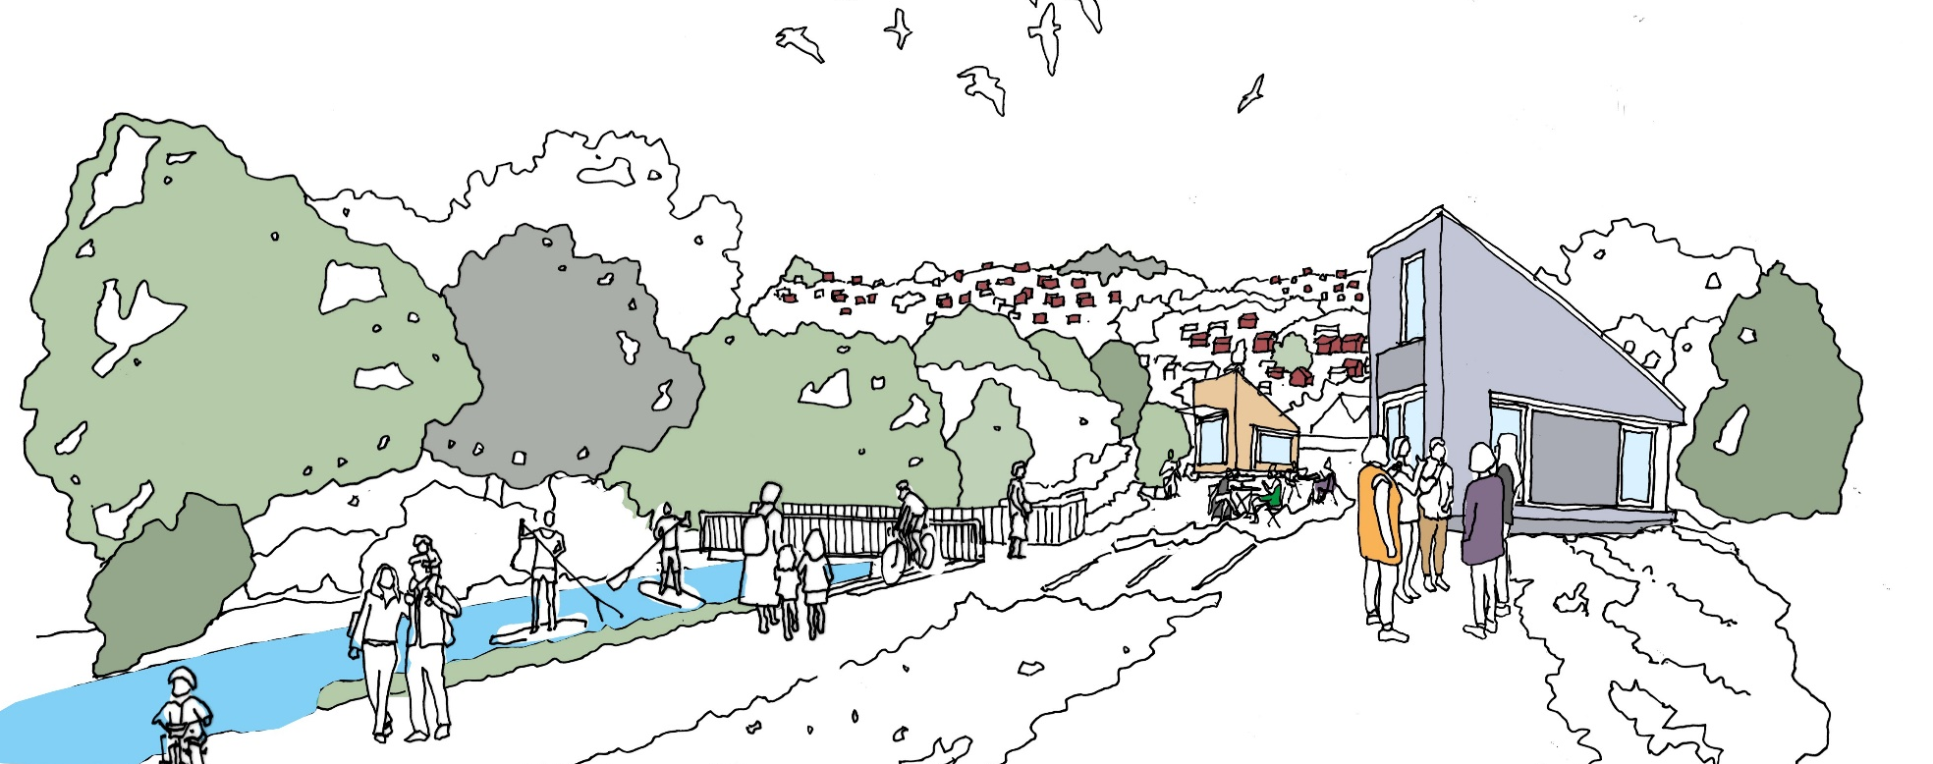

Teignbridge District Design Code
Fergus Pate
26 March 2024

Slide 2
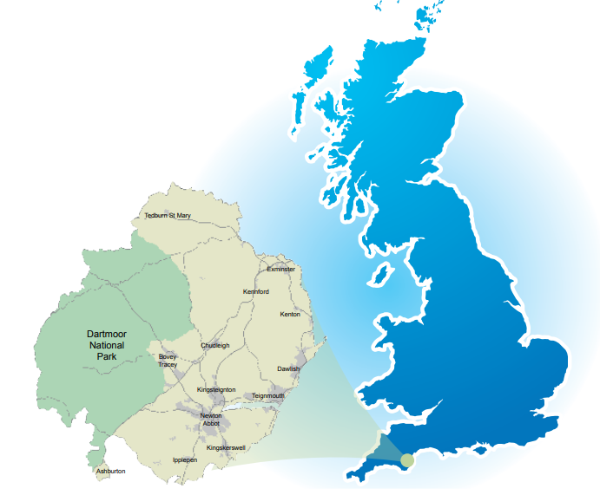
Where are we?
Exeter

Slide 3
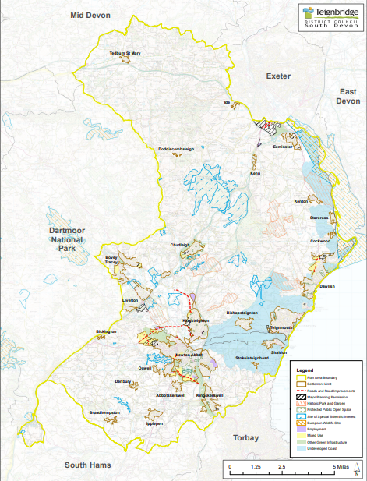
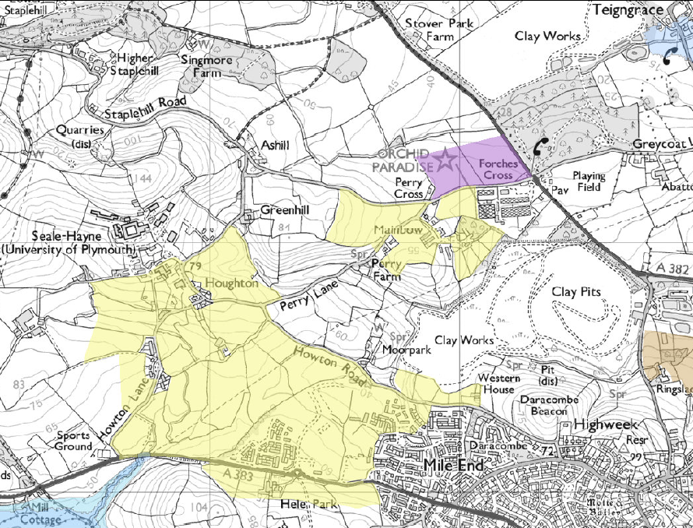
Two Design Codes
Houghton Barton New Neighbourhood
Teignbridge Local Planning Authority area

Slide 4
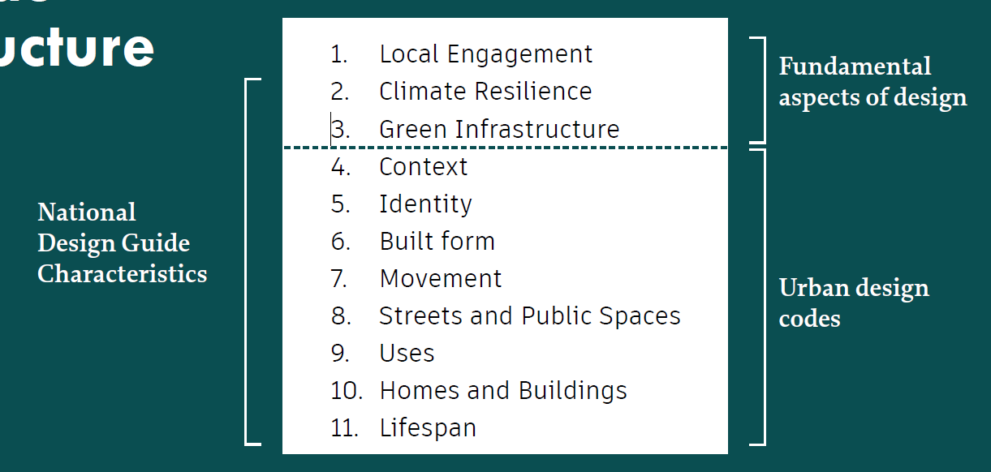
Code Overview

Slide 5
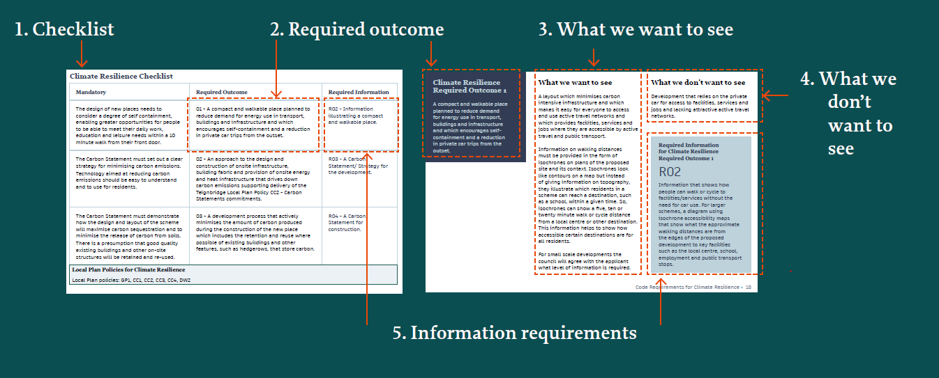
Code Overview

Slide 6


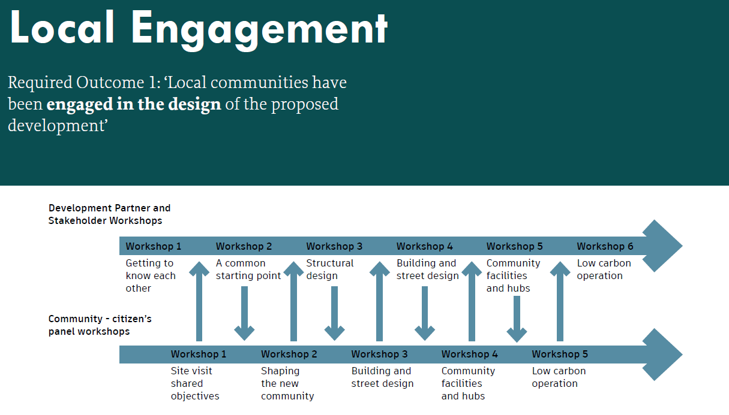
Code Overview

Slide 7
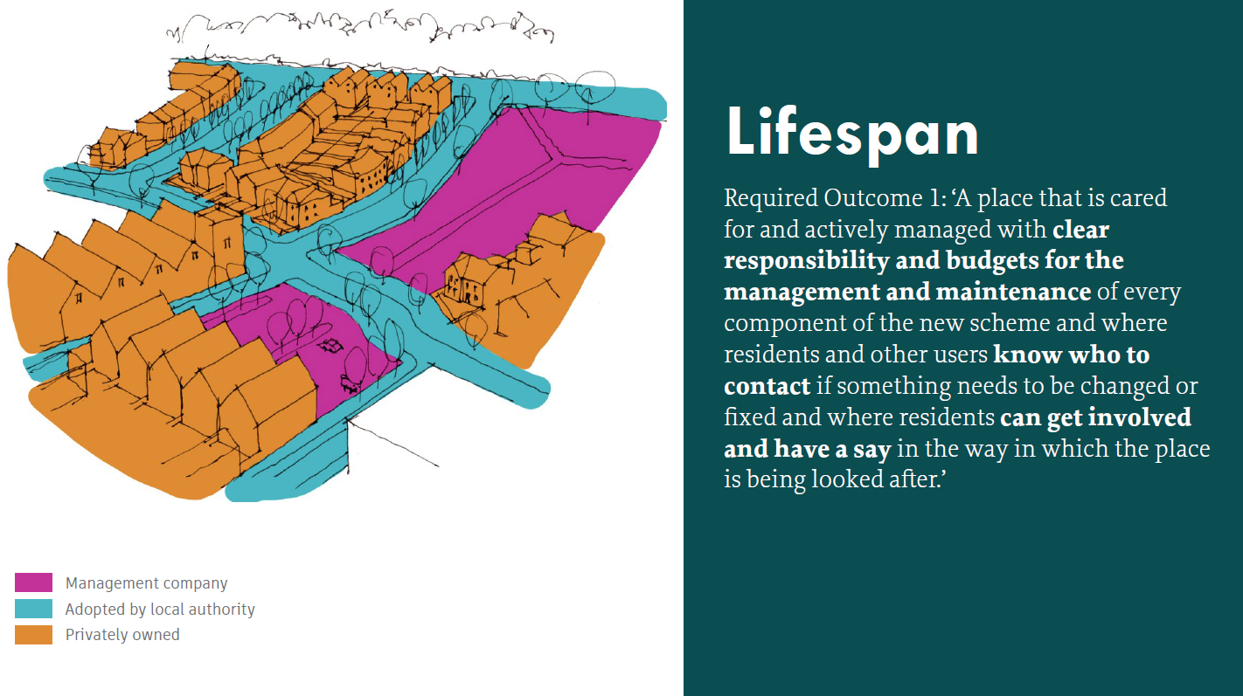
Code Overview

Slide 8


Development Management Opportunity

Slide 9
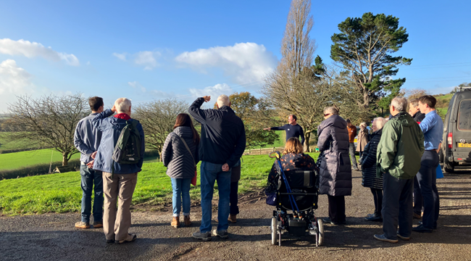
Development Management Collaboration

Slide 10
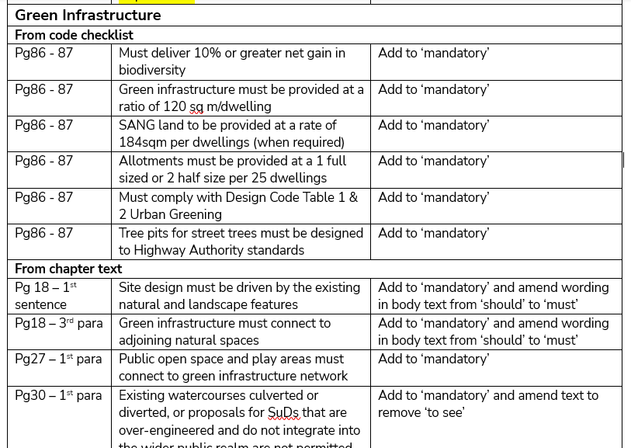

Development Management Collaboration

Slide 11
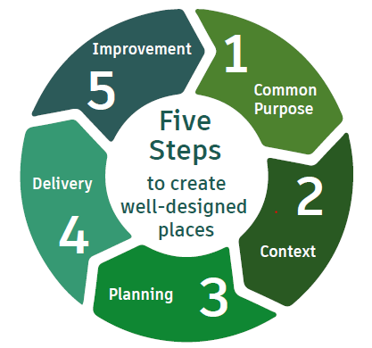
Training and Testing
Development Management
Spatial Planning
Delivery and Economy
Heritage
Ecology
Transport and Highways
Lead Local Flood Authority
Environmental Health

Slide 12
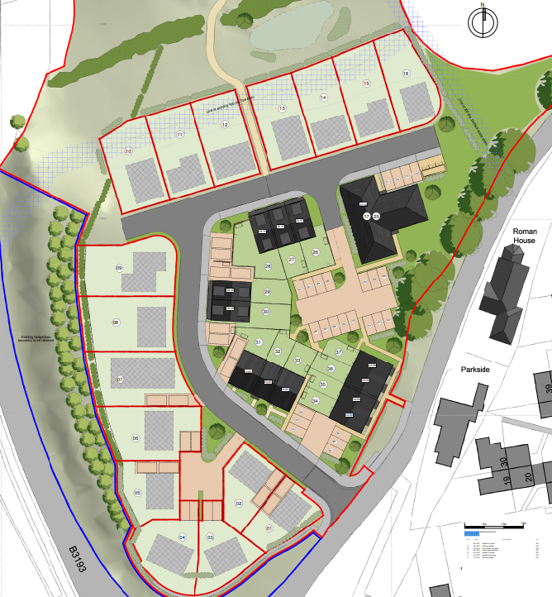
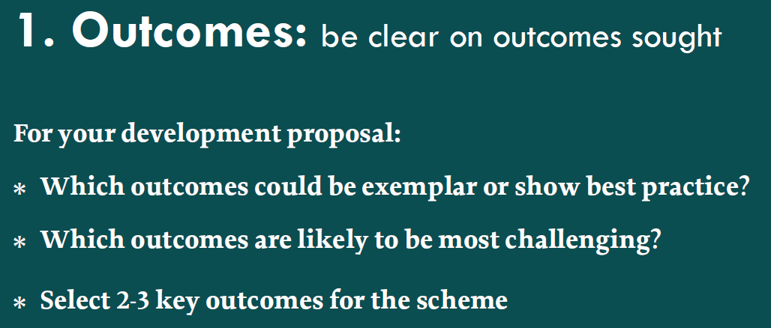
Training and Testing

Slide 13
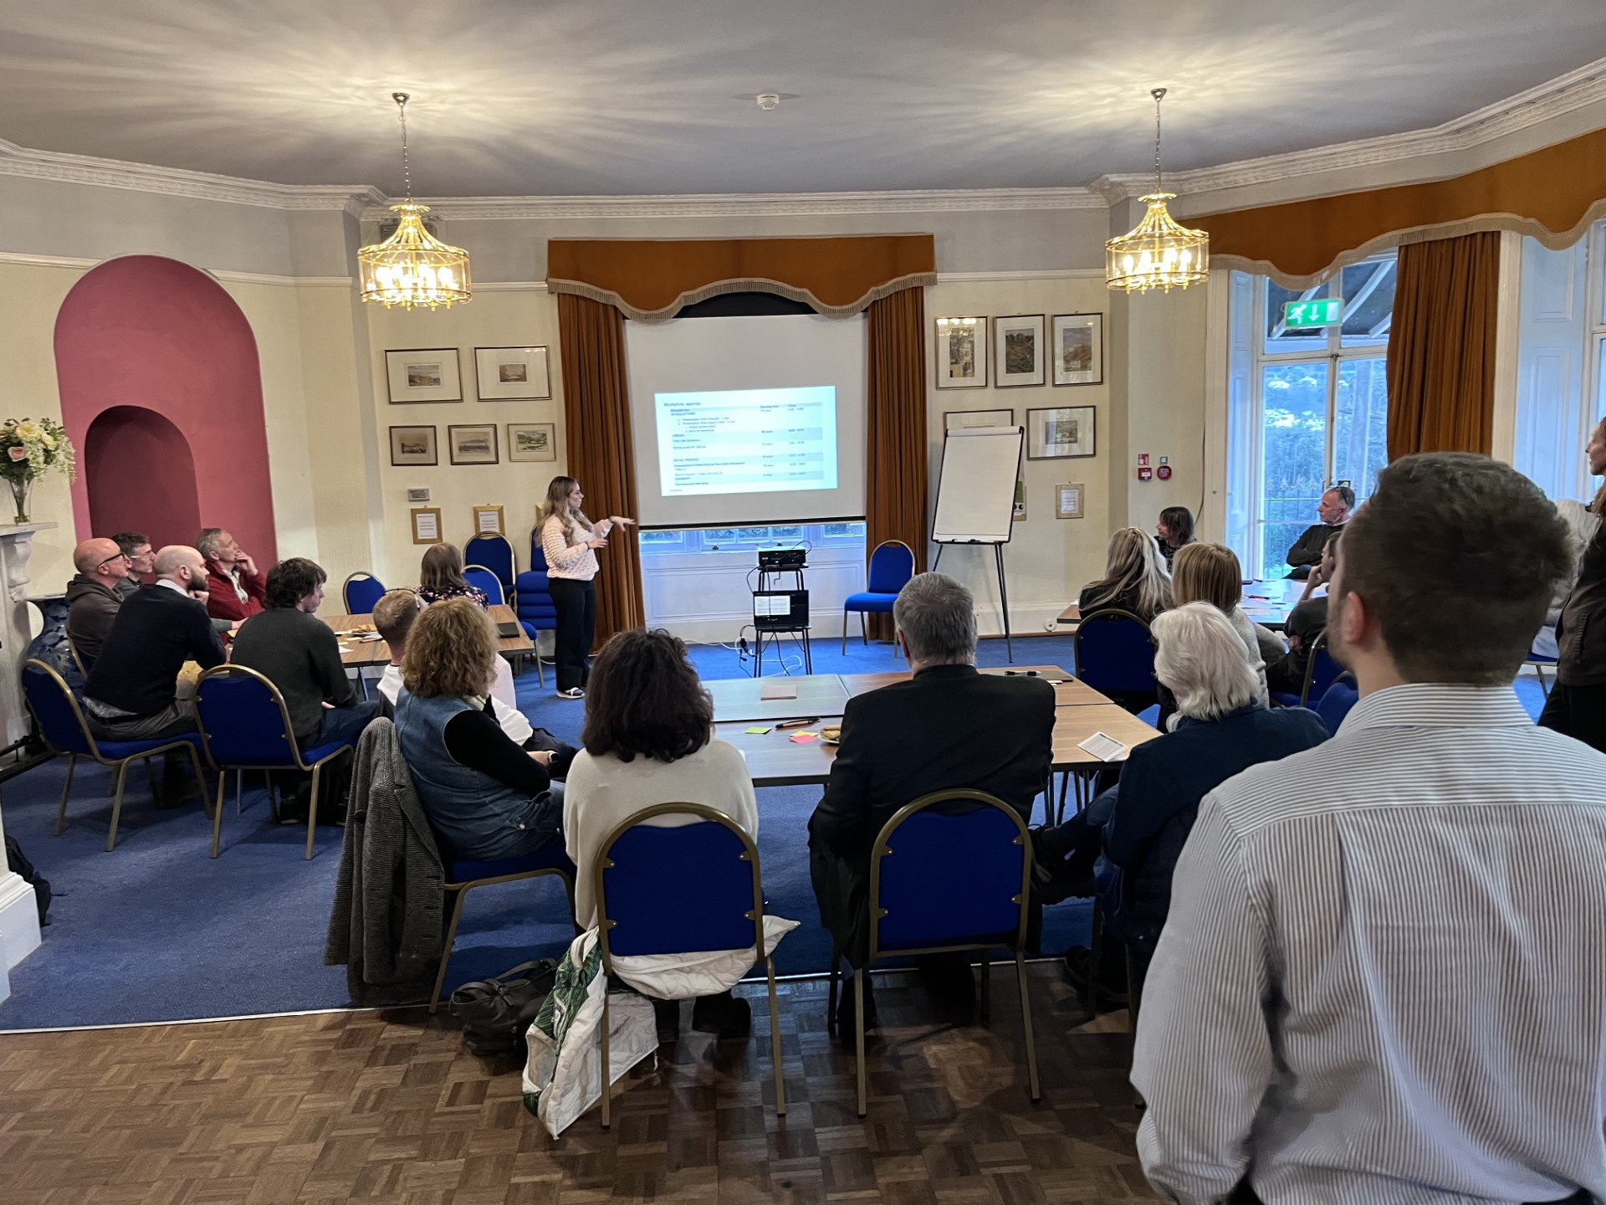
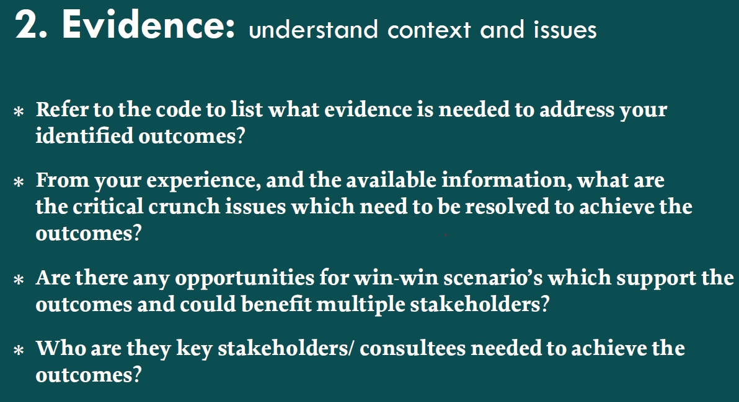
Training and Testing

Slide 14
Training and Testing
What did you like about the workshop? | How could the workshop have been improved? | For a councillor training session, how would the workshop structure need to change? | For a developer and planning agent training session, how would the workshop structure need to change? | How can we summarise the Design Code requirements in a useable format?
The format and structure of the session was good. | As a consultee to the planning process there was an assumption of the level of knowledge I had. | Potentially a clear, why we are here section with a simplified explanation of the code. | One page guide....what you need to do leaflet for them to take away. | Design Code checklist as a local validation requirement;
Looking at the various aspects of the design code | Could have been a bit more interactive on answer the questions posed to each group. | I think it would be fine for councillors | Maybe need to stress the need to keep to good design and ensure they keep to it. Need to ensure schemes with poor design are refused. | More education to developers;
Lots of participation | More handouts and a slightly clearer steer as to what we needed to do | Perhaps site selection would need to be more carefully considered. | Again as above. | Compliance statement as a local validation requirement;
Looking at real applications and the chocolate! | The 2nd speaker very quite, needed a microphone. Otherwise as someone who had nothing to do with design codes it was perfect. |  | Nothing but make sure you have a planner on each table. | Design Code checklist as a local validation requirement;
Using real sites in the district to use the design code. Working with colleagues from different departments. | A few examples of 'smaller' scale sites/ projects. How would you use the Code for a single dwelling? | More explanation of how much weight the DC will have once adopted. A range of scales for examples. | More explanation of how much weight the DC will have once adopted. | Design Code checklist as a local validation requirement;Compliance statement as a local validation requirement

