Slide 1
Workshop #1
Priorities and opportunities

Slide 2
PART 1

Slide 3
Welcome, housekeeping, introductions

Slide 4
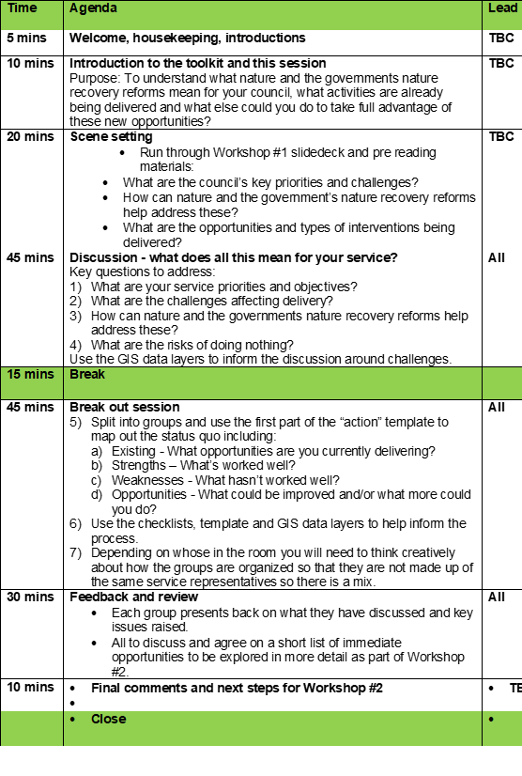
Agenda
Welcome, housekeeping and introductions.
Introduction to the toolkit and the workshop.
Scene setting:
What are the council’s key priorities and challenges?
How can nature and the government’s nature recovery reforms help address these?
What are the opportunities and types of interventions being delivered?
Discussion: What does all this mean for your service and priorities?
Break out session: Identifying what more can you do

Slide 5
Roles…
TBC – Timekeeping, introduction and review
TBC – Workshop deepdives
TBC – Notetaking and reporting back on key issues
TBC – Car park
TBC – Flipchart scribe

Slide 6

…and who are you?
Introduce yourself to the group:
Your name, where are you from and what do you do?
Why are you interested in the toolkit and how could it help support your work?

Slide 7
Introduction
Why are we here and what is this all about?
Toolkit overview
Objectives for the day (go through, then revisit at the end)

Slide 8

“Nature Recovery Toolkit”
Help councils understand a complex world by providing:
A framework for:
Supporting corporate objectives through the new duties including BNG, Biodiversity Reporting and LNRS
Understanding the statutory (must do’s) and opportunities (could/should do’s)
Deciding what to do (who contributes, objectives, the evidence base, funding, making it happen etc)
Getting local authorities interested
Pre work and inception meeting
Useful workshop outputs and relationships
Ideas to take forward
Design and deliver 3 x workshops
Workshop template
Priorities and opportunities
Barriers and solutions
Funding and delivery
Slidedecks and briefing notes
Appendices
Action template - council activities, assets and responsibilities
Useful data layers
Key headlines
Priority steps and checklist
A process:
Engaging the right stakeholders
Working with stakeholders to decide what to do
Understanding the oversight and governance requirements for your chosen priorities
Notes:
So going back to one of my earlier slides theres a lot going on and sometimes it can be difficult for local authorities to make sense of this and take advantage of the opportunities that are coming through the governments nature recovery reforms.
As part of the Natural England funded Nature Recovery Network project PAS are developing a nature recovery “self-serve” toolkit to help local authorities take full advantage of the opportunities for turning their statutory ‘must do’ requirements into opportunities for the whole council to support delivery of their strategic and corporate priorities on health, air quality, climate change, adaptation etc.
The toolkit focusses on council priorities, the land that they hold, the services they deliver and explores how nature can act as a enabler for these and the quick wins that can be made.
Why should local authorities use the toolkit?
There are a number of advantages that can be delivered as a result of using toolkit including:
Across the council / political buy-in and joining up work across departments.
Read-across into other plans and strategies and streamlining benefits.
A clearer understanding of how to deliver change, saving costs and securing additional funding.
Better Local Nature Recovery Strategy production readiness, with a clearer picture of the issues, opportunities and how to tackle them.
A shortlist of priority activities and interventions that can start to be delivered.
Our approach is rooted in establishing a strong governance process as a means of demonstrating to the wider council how a strategic approach to nature can help address wider corporate issues.

Slide 9
Toolkit products
Workshop planning template (Design 3 x workshops and exercises)
Challenges and opportunities
Barriers and solutions
Funding and delivery
Supporting resources
Slidedecks
Briefing notes
Recordings
Appendices
Action template - council activities, assets & responsibilities
Useful data layers and key headlines which can be used to inform conversations
Notes:
What is in the toolkit?
The toolkit includes a number of key components including:
A workshop planning tool which sets out a suggested pattern of how a series of engagement workshops can be organised and delivered.
Supporting resources (slidedecks, briefing notes and recordings) to introduce people who might not be familiar with this area and to lead them to think about why it matters and what they can do about it.
A series of technical appendices including a useful “action” template setting out council activities, assets and responsibilities as well as useful data layers which can be used to inform conversations, identify opportunities and set priorities as part of workshop delivery.
How should local authorities use the toolkit
The toolkit has been designed to be a “self serve” process which can be easily adapted by local authorities to:
Engage with the right people from across the council
Work with the right people across the council to decide what to do
Understand the oversight and governance requirements for chosen priorities
Local authorities can choose how they want to deliver the toolkit which can be adapted and localised to meet local needs. Some local authorities may feel they want to engage more informally on a 1:1 basis whilst others may want to bring together a group of key partners through a more structured process i.e. pre work, inception, workshops etc.

Slide 10

Objectives for Workshop #1
Purpose:
To understand what nature and the governments nature recovery reforms mean for your council, what action it is already taking and what else could it do to take full advantage of these new opportunities?
Output:
List of immediate opportunities identified to be explored in more detail as part of Workshop #2

Slide 11
Testing the objectives
Scene setting
Group discussion
Break out groups

Slide 12

All clear and ready to move on?
Is everyone clear on why we are here today?
Is everyone clear on whose doing what and their roles today?
Is there anything fundamental that we may have missed?
Does anyone have any burning questions they want to raise now?

Slide 13
Thank you
Email pas@local.gov.uk
Web www.local.gov.uk/pas
Phone 020 7664 3000
Twitter @Pas_Team

Slide 14
PART 2

Slide 15
Scene setting
What are the council’s key priorities and challenges?
How can nature and the government’s nature recovery reforms help address these?
What are the opportunities and types of interventions being delivered?

Slide 16
Council priorities and challenges
What are the council’s key challenges and priorities?
We are also facing a climate and biodiversity emergency
What are the environmental impacts affecting service delivery?
How are you linking policy agendas together?

Slide 17
Key challenges and priorities
Spending cuts
Economic uncertainty
Climate change
Welfare reform
Youth unemployment
Housing need
Aging population
Increasing prosperity
Strengthening communities
Improving the environment
Protecting the vulnerable
Notes:
Local authorities face unprecedented challenges, including spending cuts, economic uncertainty, climate change, welfare reform, youth unemployment, housing need, aging population which require a whole new way of thinking.
Recovering or enhancing biodiversity doesn’t just allow nature to thrive, it also sustains economies, creates jobs, increases climate resilience and enhances the health and wellbeing of residents.

Slide 18
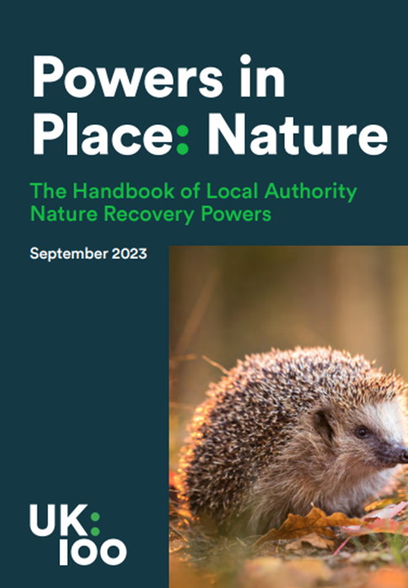
We are also facing a twin crises!
“We are facing twin crises - an ecological crisis that is exacerbated by, and exacerbates, the climate crisis.
Along with the transformative changes needed to tackle climate change and deliver Net Zero, transformative change is also needed to deliver Nature Recovery and this requires a mind-set shift for national government and local authorities.”
Addressing both together is a win win!
Source: UK100
Notes:
What is the link between climate and nature - addressing both together is a win win!
We are in the middle of a climate and nature emergency, and the two are inextricably linked. Climate change is driving nature’s decline, and the loss of wildlife and wild places leaves us ill-equipped to reduce carbon emissions and adapt to change.
One cannot be solved without the other.
When healthy, our natural habitats can reduce the risk of flooding, help prevent coastal erosion, improve people’s health and wellbeing, as well as maintain healthy soils, clean water and the pollinators needed for our crops – and therefore sustain us.

Slide 19
Environmental impacts affecting assets & services
Changing temperatures
Flooding
Access to good quality green space
Air and water quality
Biodiversity decline

Slide 20
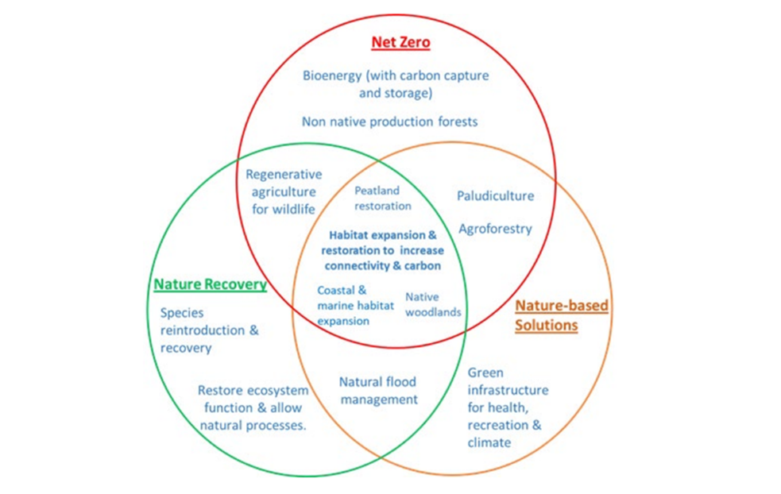
Linking policy agendas together
Supporting housing development
Sustainable transport
Better health and well being
Ensuring climate change adaptation and mitigation
Reducing flood risk
Improving air and water quality
Thriving biodiversity – including the pollinators on which we all depend
Source: UK100
Notes:
Although the nature and climate crises are inextricably linked the decline of nature can still be somewhat divorced from climate change and there is not enough to tie into wider priorities – environment, care, health, economy, housing
So how you pitch it is key so its about:
Supporting housing development – Embedding Green Infrastructure in new and existing housing will ensure high levels of quality of life and quality of place.
Enabling sustainable transport - Integration of green and grey transport infrastructure will be an essential element to facilitate truly sustainable growth
Better health & wellbeing - People enjoy access to natural green spaces for recreation, leisure, relaxation, inspiration and improved health and wellbeing.
Addressing the climate and biodiversity emergencies - Green Infrastructure will be part of our contribution to global efforts to reduce carbon emissions towards a zero-carbon future. This will include tree planting, habitat restoration and people walking and cycling instead of using fossil-fuel-based modes of transport
Reducing flood risk - Green Infrastructure will help to reduce the risk of both river and surface water flooding..
Improving air quality - Green Infrastructure will provide a cost-effective, adaptable and small-scale solution to improving air quality. This will improve people’s health and overall quality of life.
Thriving biodiversity - Networks of Green Infrastructure will provide great spaces for wildlife. They will contribute to a healthy natural environment.

Slide 21
How can nature and the government’s nature recovery reforms help address these?
How can nature help?
Valuing the benefits from nature
Legislative and policy requirements
Environment Act 2021

Slide 22

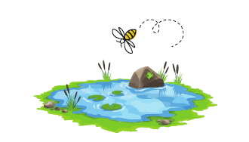
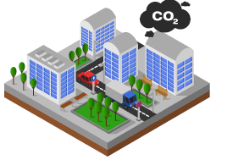

How can nature help?
“Our economies, livelihoods and well-being all depend on our most precious asset: Nature”
Dasgupta Review (2021):
Healthier, more resilient Places
Healthier, more resilient People
Healthier, more resilient Economy
Healthier, more resilient Nature
Notes:
nature’s a great multi-tasker. It can metaphorically rub its tummy and pat it’s head at the same time.
So there’s a logic chain here isn’t there - Healthier more resilient nature close to where people live, means healthier more resilient places - helping us adapt to and reduce climate change, leading to healthier more resilient people, and a healthier more resilient economy.
A healthy Nature Recovery Network can support biodiversity and connect people with nature - 82% of people say being in nature makes me happy!
Nature and green space is a place to have fun, relax, exercise, access nature – for people from all backgrounds. Local greenspace has been a lifeline for many during covid for physical and mental health and reducing isolation.
Climate resilient places – Trees store carbon and help to mitigate climate change and deliver net zero.
Green travel routes encourages low carbon active travel.
Green infrastructure reduces flood risk and increases water supply, by allowing water to permeate ground rather than overwhelm our drains. It reduces heat in towns – bringing down temperatures by several degrees; and it can filter particulates which is good for the air we breath. All are important for health!
For Communities and the economy benefit – nature/parks and green space make us proud of where we live and can be an important part of its DNA - greening towns can help to regenerate places, making them more investable and attractive to skilled workers and visitors.
Healthier more resilient nature close to where people live, means healthier more resilient people and places, which means people are fitter for work and a healthier more resilient economy.
Our economies, livelihoods and well-being all depend on our most precious asset: Nature
Dasgupta Review (2021)

Slide 23
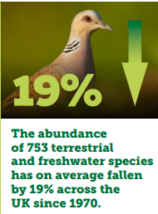
What’s the scale of the problem?
Climate and biodiversity crises – UK is bottom 10% globally and worst G7 nation for biodiversity loss. Nature is key to mitigating and adapting to climate change, and supporting health and wellbeing.
Health crisis: Annual loss to economy with mental health absence from est. £70 - £100bn.
Approach over past 70 years focus on nature conservation: preserving pockets of nature. Hasn’t stopped decline → need to move towards nature restoration and nature recovery
State of Nature 2023, the State of Nature partnership, Available at: www.stateofnature.org.uk
Notes:
UK is one of the most nature depleted countries in the world.
Species abundance and diversity is declining.
The current legislative system isn’t working.
Pressures on nature have continued to rise.
Climate change will amplify these pressures.
Nature will be less able to provide us with the benefits we need.
State of nature 2023 report showed that species across the UK are continuing to decline in both abundance (the numbers of them) – with numbers falling 19% since 1970….

Slide 24
Legislative and policy requirements
Lawton Report ‘Make Space for Nature’ (2010) - ‘Bigger, Better, More Joined up’
25 Year Environment Plan (2018) -
‘Be the first generation to leave the environment in a better state than we found it’.
Develop a Nature Recovery Network
Agriculture Act (2020) – public money for public goods
Environment Act (2021) – species and habitat targets, mandatory 10% BNG for developments, LNRS
30 by 30 Pledge (2020) – protect 30% of land/sea by 2030
Environmental Improvement Plan (2023) - builds on 25 Year Environment Plan and Environment Act 2021.
Green Infrastructure Framework (2023) – voluntary – 40% green cover in urban residential areas; 15 minutes to nature
NPPF updates
Levelling Up and Regeneration Bill
Land Use Framework?
Notes:
The UK governments 25 Year Environment Plan sets out what the UK will do to improve the environment, within a generation. By 2042, the ambition is to achieve high quality, accessible, natural spaces with increased biodiversity close to where people live and work, with a focus around the equal distribution of environmental benefits and resources to all.
Agriculture Act (2020) – public money for public goods
Environment Act (2021) – species and habitat targets, mandatory 10% BNG for developments, LNRS
30 by 30 Pledge (2020) – protect 30% of land/sea by 2030
Environmental Improvement Plan (2023) - builds on 25 Year Environment Plan and Environment Act 2021.
Green Infrastructure Framework (2023) – voluntary – 40% green cover in urban residential areas; 15 minutes to nature
Two key opportunities coming at the moment are:
Levelling Up and Regeneration Bill
NPPF updates
The Nature Recovery Network is a major commitment in the government’s 25 Year Environment Plan, enacted by the Environment Act 2021, and is the biggest nature restoration project in our nation’s history.

Slide 25
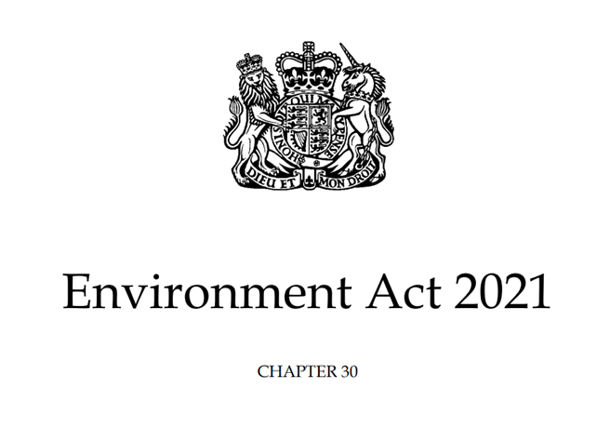
Environment Act 2021
Responsible authorities appointed by the Secretary of State (S105) to lead the Local Nature Recovery Strategy (LNRS), working with a broad range of stakeholders.
Enhanced duty for LAs to conserve and enhance biodiversity (S102) and report on their actions (S103)
LPAs will need to comply with the above duty and have regard to the Local Nature Recovery Strategy in local planning policy and decisions (S102).
All planning permissions granted in England (with a few exemptions) will have to deliver at least 10% biodiversity net gain from Nov 2023 (S98-101)
Notes:
The Environment Act 2021 introduced a number of new duties for local authorities which are of relevance to nature recovery and biodiversity including:
Responsible authorities appointed by the Secretary of State (S105) to lead the Local Nature Recovery Strategy (LNRS), working with a broad range of stakeholders.
Enhanced duty for LAs to conserve and enhance biodiversity (S102) and report on their actions (S103)
LPAs will need to comply with the above duty and have regard to the Local Nature Recovery Strategy in local planning policy and decisions (S102).
All planning permissions granted in England (with a few exemptions) will have to deliver at least 10% biodiversity net gain from Nov 2023 (S98-101)
An amendment to the Levelling Up & Regeneration Act changed the need for plan makers to 'have regard' to LNRS to 'take account’ of LNRS. This duty applies generally, and to specific elements of the LNRS, including the mapped proposals. This hasn't come into force yet but its important to flag.

Slide 26
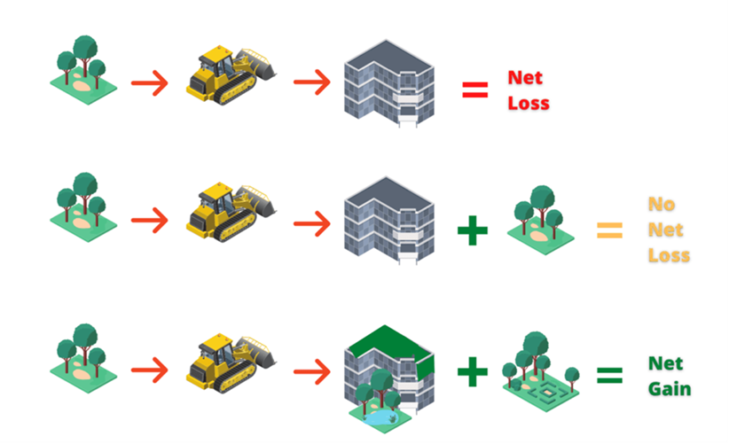
Mandatory Biodiversity Net Gain
England only and covers all (bar exempted) development under the Town & Country Planning Act (TCPA) – majors now, non-majors from 2 April - and (from 2025) 2008 Planning Act, i.e. NSIPs
Minimum 10% gain required and post-planning approval of biodiversity gain plan
Significant on-site and off-site habitat secured for at least 30 years
BNG hierarchy: on-site, off-site and last resort statutory biodiversity credits
Baseline and post-intervention unit values calculated using standardised biodiversity metric
National register for off-site net gain sites
Notes:
Under the Environment Act 2021, all planning permissions granted in England (with a few exemptions) except for small sites will have to deliver at least 10% biodiversity net gain from 12 February 2024.
This will be achieved by delivering habitat onsite or, if that is not possible, through buying off-site biodiversity units.
BNG will be required for small sites from 2 April 2024.
BNG will be measured using Defra’s biodiversity metric and all off-site and significant on-site habitats will need to be secured for at least 30 years.
Further information about mandatory BNG and the Environment Act is available on PAS’ Biodiversity net gain now and in the future page.

Slide 27
A strengthened biodiversity duty
Public authorities who operate in England must consider what they can do to conserve and enhance biodiversity in England. This is the strengthened ‘biodiversity duty’ that the Environment Act 2021 introduces.
This means that, as a public authority, you must:
Consider what you can do to conserve and enhance biodiversity.
Agree policies and specific objectives based on your consideration.
Act to deliver your policies and achieve your objectives.
Notes:
The existing Biodiversity Duty has been strengthened from original conception in the Environment Act. The Biodiversity Duty applies to Public Authorities who operate in England and requires them to consider what they can do to conserve and enhance biodiversity.
The Biodiversity Duty outlines that Public Authorities must do what they can to conserve and enhance biodiversity in England. It strengthens to duty outlined in the Environment Act 2021 and outlines that Public Authorities must:
a. Consider what they can do to conserve and enhance biodiversity
b. Agree policies and specific objectives based on our conservation
c. Act to deliver policies and achieve objectives
Public Authorities must complete their first consideration of what action to take by 1st January 2024 (this report) and then agree policies and objectives as soon as possible after this date. Public Authorities must also reconsider actions within 5 years of the first ones although can do it more frequently.
Relevant signposts and examples from local authorities completing their first consideration requirement are below:
https://www.essexwtrecords.org.uk/sites/default/files/planning_files/Local%20Authority%20Services%20and%20Biodiv%20report.pdf
https://assets.publishing.service.gov.uk/media/5a8178dde5274a2e8ab542d1/pb12584-la-guid-english-070510.pdf
https://www.gov.uk/guidance/complying-with-the-biodiversity-duty#actions-you-could-take
https://councildecisions.bury.gov.uk/documents/s37969/The%20Local%20Authority%20Biodiversity%20Duty%20First%20considerations%20requirement.pdf
https://democracy.derbyshiredales.gov.uk/documents/s9235/Public%20Sector%20Biodiversity%20Duty%20Update%20Report.pdf

Slide 28
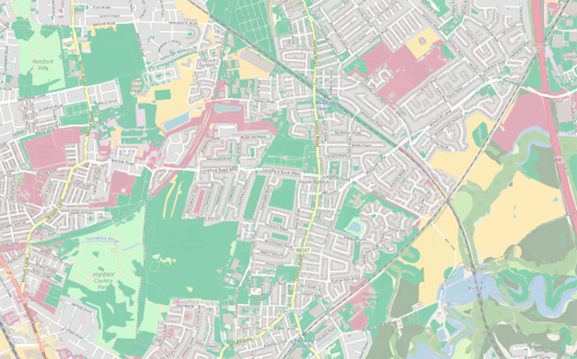
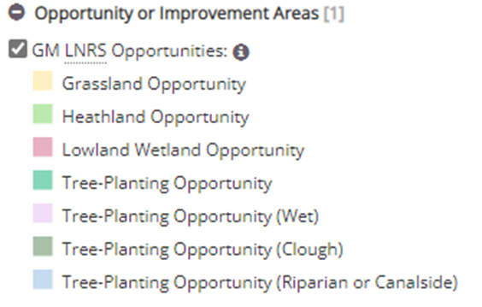
Local Nature Recovery Strategies
New system of locally led, transparent and collaborative spatial strategies for nature’s recovery covering the whole of England.
Each of the LNRS will be led by a responsible authority who are preparing them over the next 12-13 months, following regulations and guidance
Each strategy will:
Map the existing areas designated for biodiversity
Agree priorities for nature recovery
Map actions for delivering priorities in areas where they provide the best environmental outcomes
Local delivery will be through a variety of mechanisms including Biodiversity Net Gain and Environmental Land Management schemes.
Local Nature Recovery Strategy Opportunities map
(source Greater Manchester LNRS pilot)
Notes:
Recap what LNRS are
New system of locally led, transparent and collaborative spatial strategies for nature’s recovery covering the whole of England.
Each of the LNRS will be led by a responsible authority who are preparing them over the next 12-13 months, following regulations and guidance
Each strategy will:
Map the existing areas designated for biodiversity
Agree priorities for nature recovery
Map actions for delivering priorities in areas where they provide the best environmental outcomes
Local delivery will be through a variety of mechanisms including Biodiversity Net Gain and Environmental Land Management schemes.
Regs: https://www.legislation.gov.uk/uksi/2023/341/made
Stat guidance: https://www.gov.uk/government/publications/local-nature-recovery-strategy-what-to-include

Slide 29
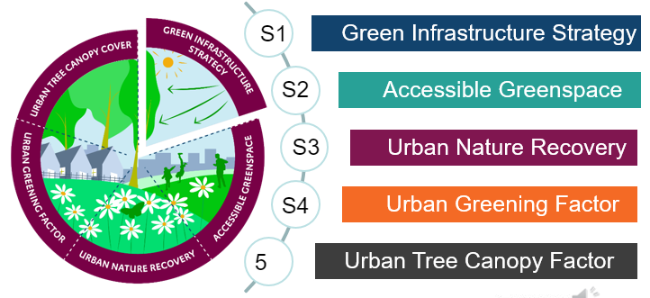
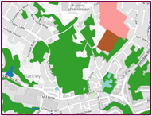
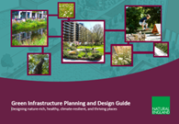
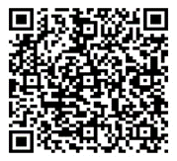
Green Infrastructure Framework
What is the Green Infrastructure Framework?
The Green Infrastructure Framework supports the greening of our towns and cities as part of the Nature Recovery Network. It sets out what good looks like for local planning authorities, developers, parks and greenspace managers and communities. It provides tools to help plan and design green infrastructure networks that deliver multiple benefits. The five main products in the Framework are:
Green Infrastructure Standards
National standards for green infrastructure quantity and quality.
Green Infrastructure Principles
Why, What and How of good green infrastructure
Green Infrastructure Mapping
Mapped datasets to support the standards
Why: 1. Nature 2. Health 3. Economy 4. Water 5. Climate
What: 1. Multifunctional 2. Varied 3. Connected 4. Accessible 5. Responds to Character
How: 1. Partnership and Vision 2. Evidence 3. Plan Strategically 4. Design 5. Manage, Value and Evaluate
Planning and Design Guide
How to design good quality green infrastructure
Process Journeys
How to apply the products in the Framework- Planners, Developers and Neighbourhood Planners
For more information scan the QR code or copy the link: https://designatedsites.naturalengland.org.uk/GreenInfrastructure/Home.aspx
Notes:
The Green Infrastructure Framework supports the greening of our towns and cities as part of the Nature Recovery Network. It sets out what good looks like for local planning authorities, developers, parks and greenspace managers and communities. It provides tools to help plan and design green infrastructure networks that deliver multiple benefits. The five main products in the Framework are
Green Infrastructure Principles - Why, What and How of good green infrastructure
Green Infrastructure Standards - National standards for green infrastructure quantity and quality.
Green Infrastructure Mapping - Mapped datasets to support the standards
Planning and Design Guide - How to design good quality green infrastructure
Process Journeys - How to apply the products in the Framework- Planners, Developers and Neighbourhood Planners

Slide 30
What is your council doing now to take full advantage of the new duties and requirements?
Notes:
So what’s going on elsewhere

Slide 31
An A-Z of quick wins
A - Use suppliers that have an ethical mission/framework.
B - Audit carbon/biodiversity offsetting claimed by third-party firms (avoid 'greenwashing').
C - Train new staff on nature-based solutions.
D - Audit projects that directly impact habitats/vegetation.
E - Assess impact of borough-wide procurement of products and services (e.g., lighting).
F - Check pension provider supports ethical investment.
G - Source food locally, avoiding palm oil.
H - Avoid peat-based products.
I - Identify mono-culture/single-use decisions/outcomes and explore if a multi functional approach could deliver better outcomes.
J - Design for bio-solar roofs rather than only solar.
K - Understand the council's policy of 60% native planting schemes.
L - Help people benefit from nature through increased direct experience.
M - Require an understanding of the climate and ecological crisis and evidence of personal action through the recruitment process.
N - Share best practice across teams.
O - Understand the biodiversity value of your assets/under your control.
P - Identify opportunities for habitat creation.
Q - Recognize and promote the health and wellbeing benefits of nature-rich places.
R - The value of holistic NHS delivery, through social prescribing, volunteering in green spaces, supporting community gardens.
S - Provide Nature/Biodiversity/climate courses at Sutton College.
T - Invest in local initiatives to reduce food miles and support local employment/expertise in food growing (e.g., Sutton Community Farm, ICR herb growing, High Down horticulture skills).
U - Ensure Nature's services are recognized as critical infrastructure in new development.
V - Be familiar with terms such as Nature-Based Solutions, Natural Capital, Biodiversity Net Gain, and what they mean to your service.
W - Write/approve policy, provide maps and tools to guide developers to see nature as essential/added value.
X - Implement a Kerbside Strategy - to get more nature-greening along roads and encourage active travel.
Y - When attenuation tanks are proposed, ask for further justification - green roofs and rain gardens should be the first choice.
Z - Think outside your role or service, help colleagues across the council.
Source: Sutton Council

Slide 32
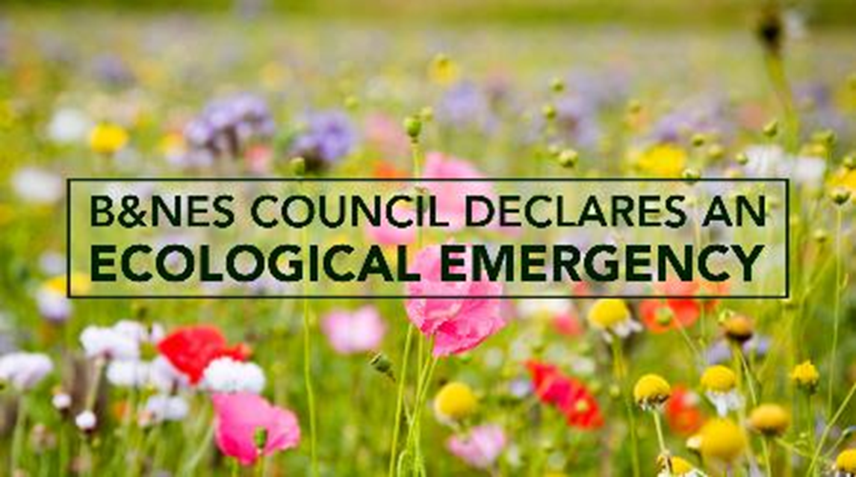
Corporate committments
Source: Dorset County Council
Notes:
So the first is from Bath & North East Somerset which covers the importance of meeting wider corporate priorities.​
Nature recovery is not one persons responsibility, this needs internal & external collaboration.​
There have been a number of key developments that have taken place in B&NES to support this including declaring a Climate and Ecological Emergency, establishing the role of a ‘Biodiversity Champion’ for an elected member and emphasising the environment within the Corporate Strategy.​
Ultimately this all led to the setting up of an environment team 18 months ago creating several new posts to support engagement, collaboration and delivery on Green Infrastructure, BNG and the LNRS.​
More recently the Councils new Economic Strategy will be adopted on feb 1st which sets out a new approach to local economic development and prioritises meeting the needs of residents and places whilst reducing impacts on the natural resources and environment.

Slide 33
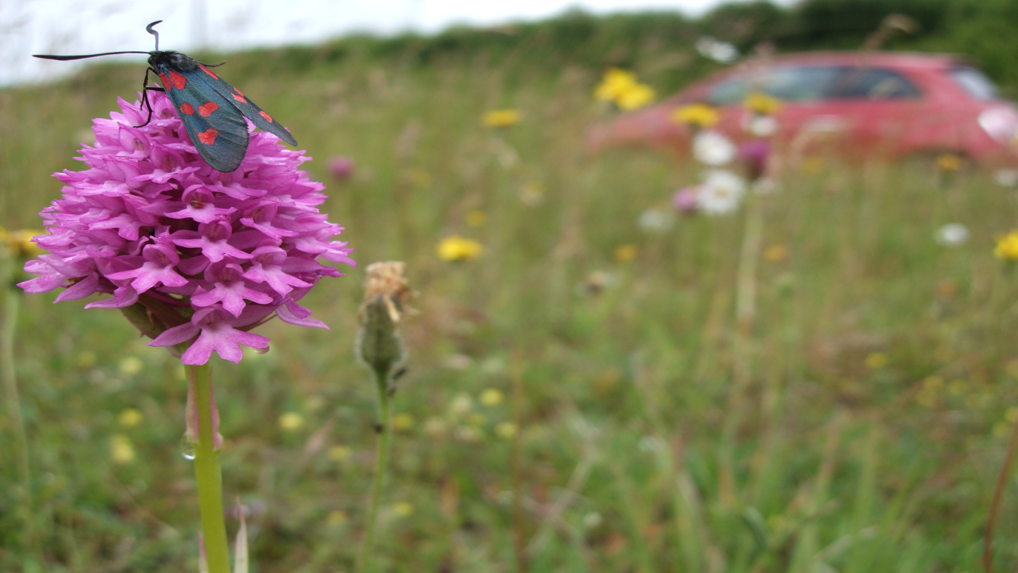
Changing maintenance regimes
Source: Dorset County Council
Notes:
Dorset Council – Cut and Collect
Dorset Council has implemented a cut-and–collect approach to urban mowing across the north of the county.
Removing the grass cuttings reduces soil fertility and prevents dominant grasses and herbs from suppressing wildflower growth.
As vegetation growth diminished each year with reducing fertility, it was possible to drastically reduce the frequency of cutting from 7 to 2 times per year leading to a 45% saving in mowing costs within 5 years.
This enabled the investment in new mowing machinery to be paid back within a viable timeframe.

Slide 34
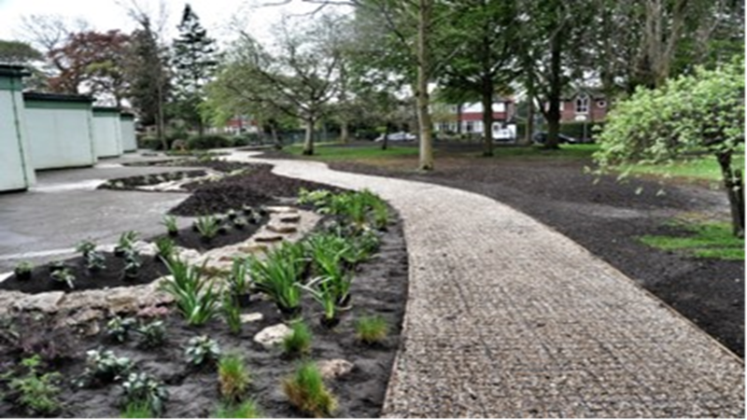
School raingardens
Source: The BITC Water Taskforce – Water Resilient Cities project
Notes:
The work at Moorlands Junior School includes a new rain garden filled with thirsty plants, which holds on to surface water during heavy downpours, allowing it to soak away slowly, and replacing tarmac and paths with permeable surfaces which water passes straight through instead of running into a drain.

Slide 35
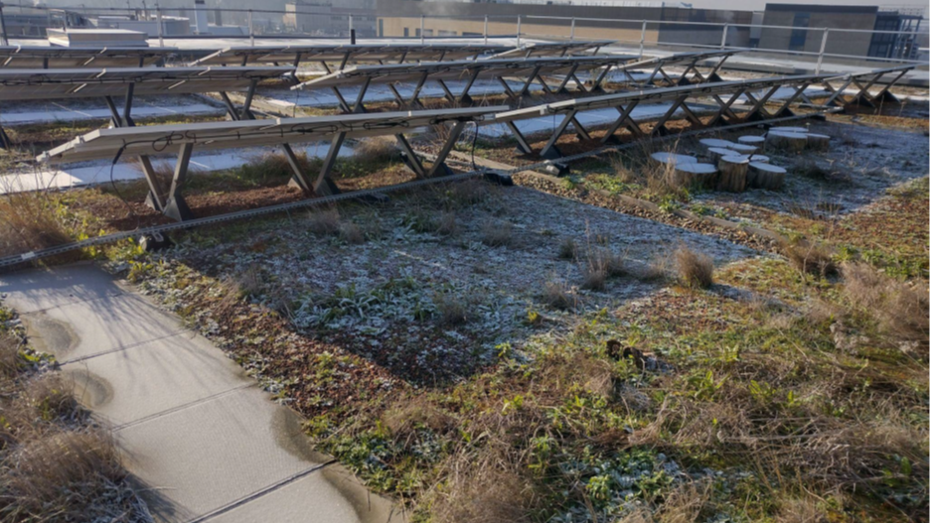
Low carbon & biosolar
Notes:
The Design Team and The Institute of Cancer Research (ICR) were keen to integrate the building into its landscape setting and minimise the impact on the site. Green roofs provide an undisturbed habitat and at the time were recommended within the London Plan to enhance the biodiversity of a site.
The green roof was an opportunity for ICR to provide a biodiversity enhancement, enable a solution to minimise any impact and to also create a space for locating PVs.
Much of the roof was seeded with a chalk grassland and wildflower mix, with the areas around the solar panels seeded with a biodiverse species mix designed specifically for use with solar panels. Log piles were also created for additional invertebrate habitat.

Slide 36
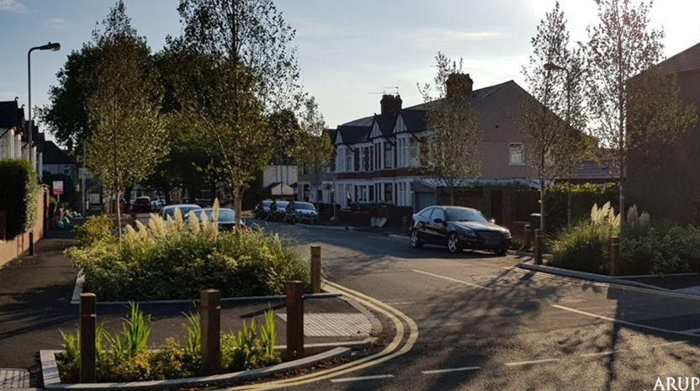
Resilient highways
Source: Arup
Notes:
In September 2019 an assessment of the wider benefits of the Greener Grangetown project was
undertaken, this was performed using a selection of available tools, including CIRIA’s Benefit
Estimation Tool (B£ST). It considered a variety of aspects including; health, recreation, air quality
improvements, carbon sequestration, amenity enhancements.
This assessment arrived at an
estimated benefit of over £8.4 million over a 30 year period from 2015 to 2045. This value includes a
reduction based on uncertainty around wider benefits and does not include; the increase in water
quality entering the river Taff, the value of a reduction in crime due to the enhancement of the area,
the impact of the reduction in vehicle traffic and the benefits of an increase in cycling and walking in
the area. As these are harder to measure without further studies or surveys which have not, to date,
been undertaken.
This suggests a maximum payback period of around 12 and a half years for the project and although
it must be said that there are inherently difficulties in quantifying the wider benefits, this project
delivers excellent value for money.

Slide 37
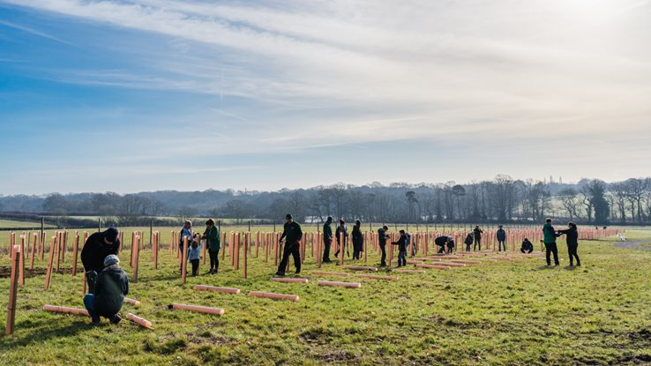
Carbon storage on estates
Source: Hampshire County Council
Notes:
Understanding the opportunities for use of council assets alongside funding and resources. Local authorities may have a land bank which may be appropriate for BNG or carbon etc.
Hampshire County Council completed a complex mapping project over two years from April 2020 to May 2022 which included developing the methodology and identifying areas where carbon was stored across the Council’s estate.
The mapping used habitat, land-type and land use data to estimate the current carbon storage of the Council’s landholdings, as well as estimate current levels of carbon dioxide sequestration. The data has been used to consider and understand Hampshire County Council’s potential to mitigate for climate change.
This work was carried out in partnership with the Hampshire Biodiversity Information Centre (HBIC). This mapping methodology is now being adopted by others and HBIC has been asked to map some of the District Council areas in Hampshire.

Slide 38
Thank you
Email pas@local.gov.uk
Web www.local.gov.uk/pas
Phone 020 7664 3000
Twitter @Pas_Team

Slide 39
PART 3

Slide 40
Discussion
What does all this this mean for your services and priorities?

Slide 41
Key questions to address
What are your service priorities and objectives?
What are the economic, environmental and social challenges affecting delivery?
How can nature and the government’s nature recovery reforms help address these?
What are the risks of doing nothing?

Slide 42
Break out session

Slide 43
Break out session
Split into groups and use the first part of the action template in the next slide to map out:
What opportunities are you currently delivering?
Challenges - What are the challenges affecting delivery?
Strengths - What are you doing well to address these?
Needs - What would you like to do better?
Opportunities - What can you do to improve and how?
Use the checklists and template to help inform the process.
From the discussions what are the ‘immediate’ opportunities you would like to consider further as part of Workshop #2?

Slide 44
Priorities & opportunities template
Service | Status quo | Strengths | Weaknesses | Opportunities
Education
Environmental health
Estates
Finance
Health and social care
Highways
Housing
Leisure and recreation
Planning
Transport
Waste

Slide 45
First part of the template
Notes:
Include first part of template

Slide 46
Now (Yellow notes) Capture what you are doing now: Existing examples – Reinventing the wheel is OK. Practice that is low risk, high acceptability and easy to implement. Solutions to fill existing gaps in processes. Focus on incremental benefits. | Strengths (Green notes) Capture whats worked well: Innovative breakthrough ideas. Practice that has high impact. Practice that is relatively easy to implement. ‘Wow’ ideas are those with potential for significant change and possible to implement within current reality.
Weaknesses (Pink notes) Capture whats not worked well: What currently challenges the “Now”? What risks are there to achieving the ambitions? What practice is currently impossible to implement (what are we waiting for and need to know?) | Opportunities (Orange notes) For each orange note capture what could be improved and/or what more could you do: What is within the councils discretion? How can you reduce the risk? What could government do to help? What can you do better? What can you stop doing? Remember each opportunity however big or small adds to the understanding of what is possible.

Slide 47
Feedback and review
Each group presents back on what they have discussed and the immediate opportunities identified.
All to discuss and agree on a short list of immediate opportunities to be explored in more detail as part of Session 2.

Slide 48
Further support and guidance

Slide 49
For more information
Environment Act 2021
Environmental Improvement Plan 2023
Understanding biodiversity net gain
Defra Complying with the biodiversity duty
Natural England’s Green Infrastructure Framework
PAS Environment webpages
UK100 Powers in Place: Nature Report
UKGBC Nature Recovery and Climate Resilience Playbook
Nature Scotland Nature Based Solutions for Local Authorities

Slide 50
Thank you
Email pas@local.gov.uk
Web www.local.gov.uk/pas
Phone 020 7664 3000
Twitter @Pas_Team

