Slide 1
Neighbourhood Planning
Local Authority Experience – The Cockermouth Neighbourhood Development Order
Kevin Kerrigan
Allerdale Borough Council
11 February 2015

Slide 2
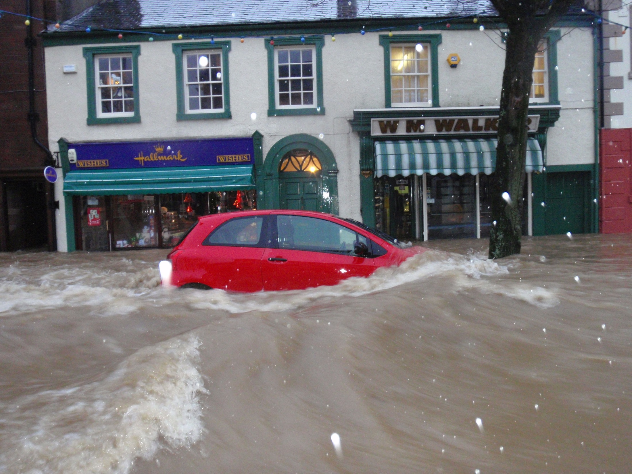

Slide 3
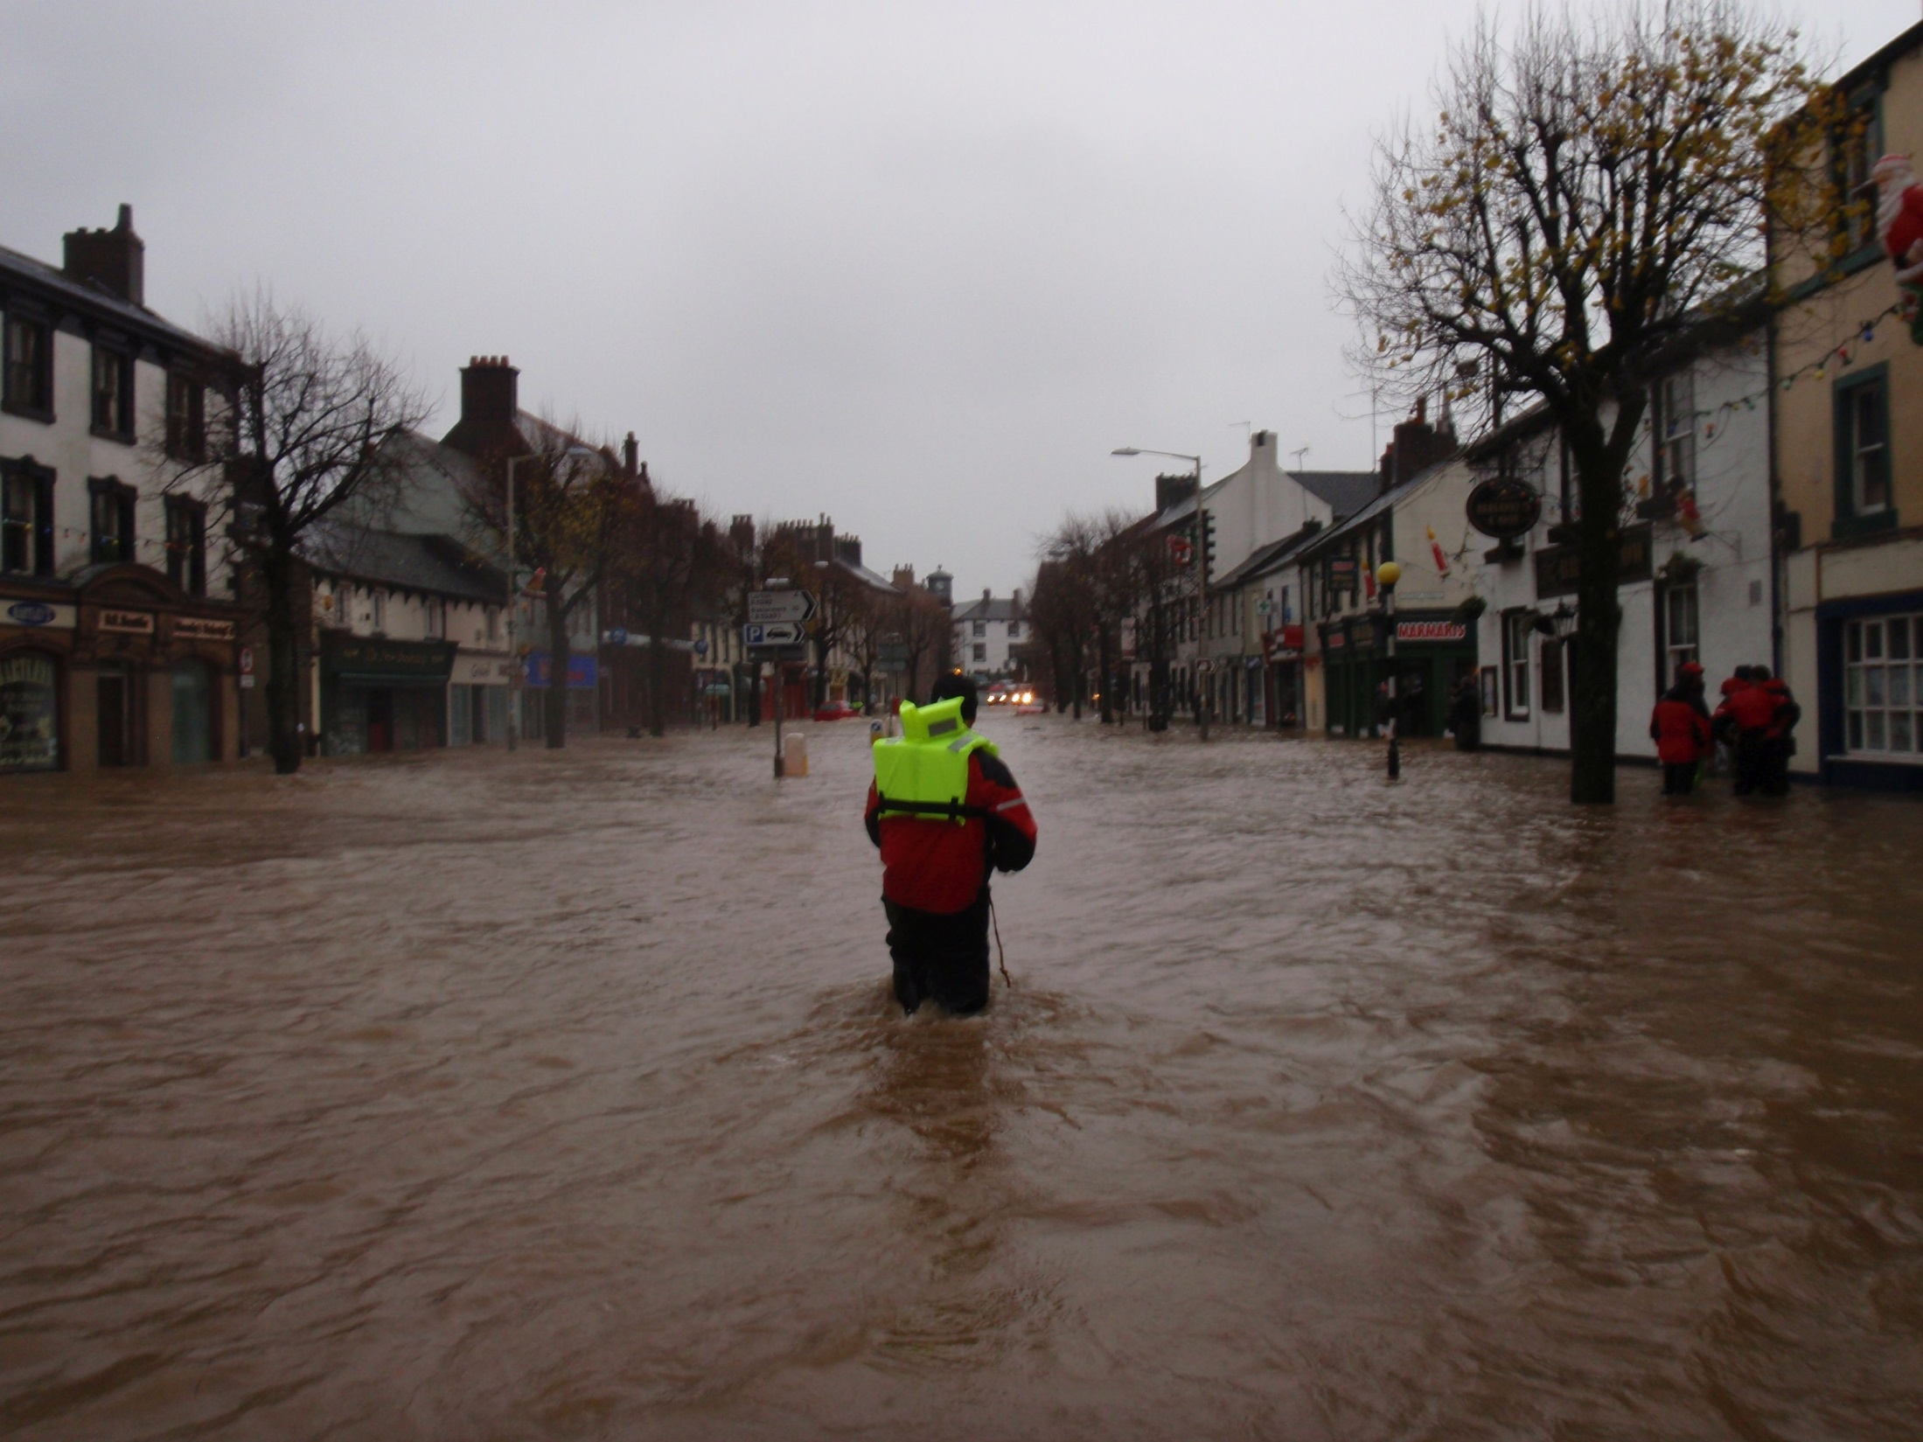

Slide 4
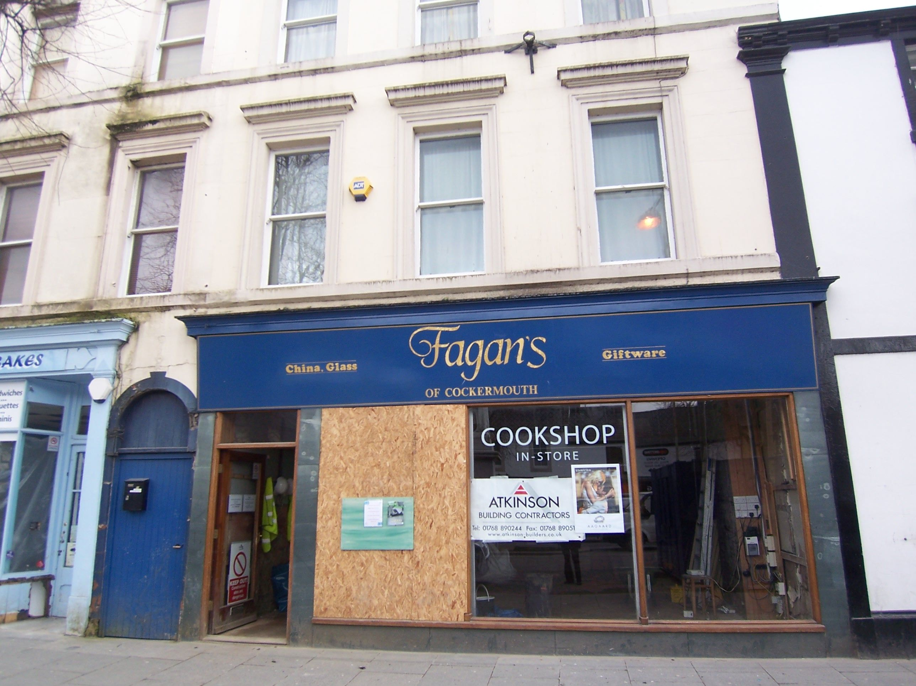

Slide 5
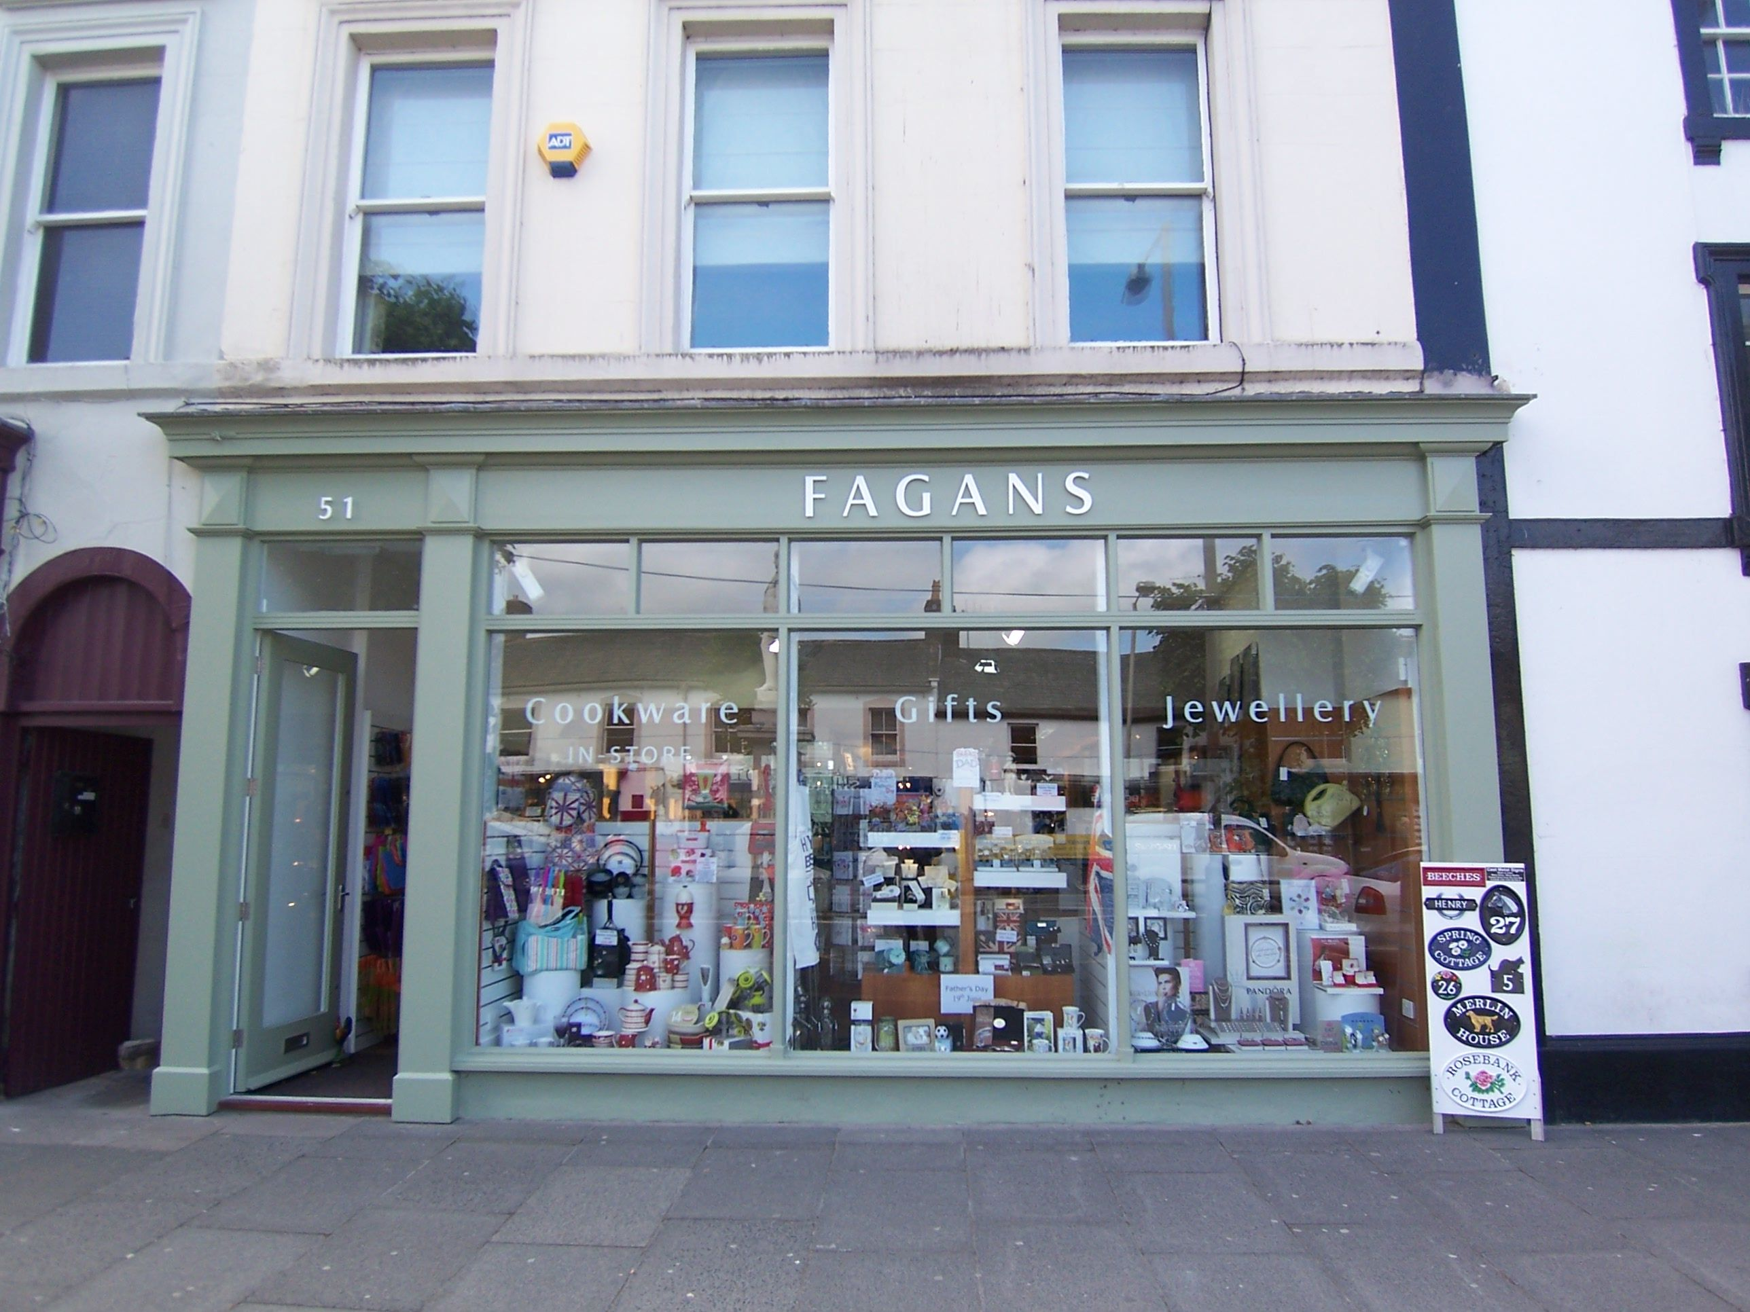

Slide 6
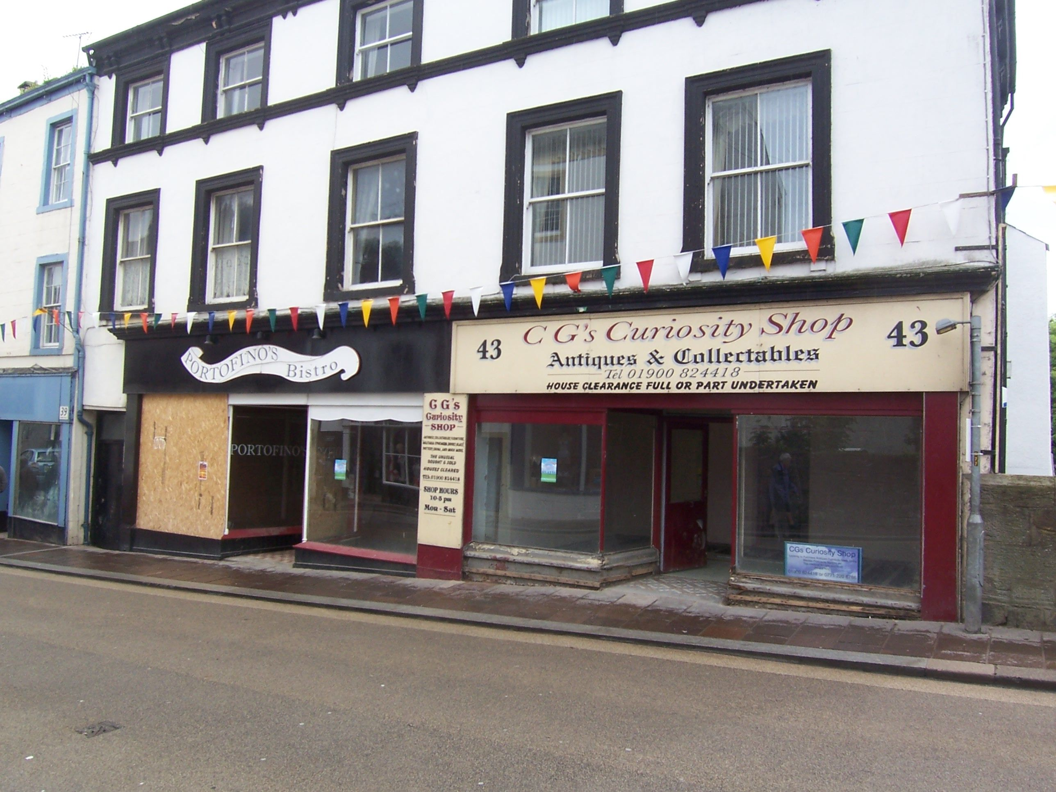

Slide 7
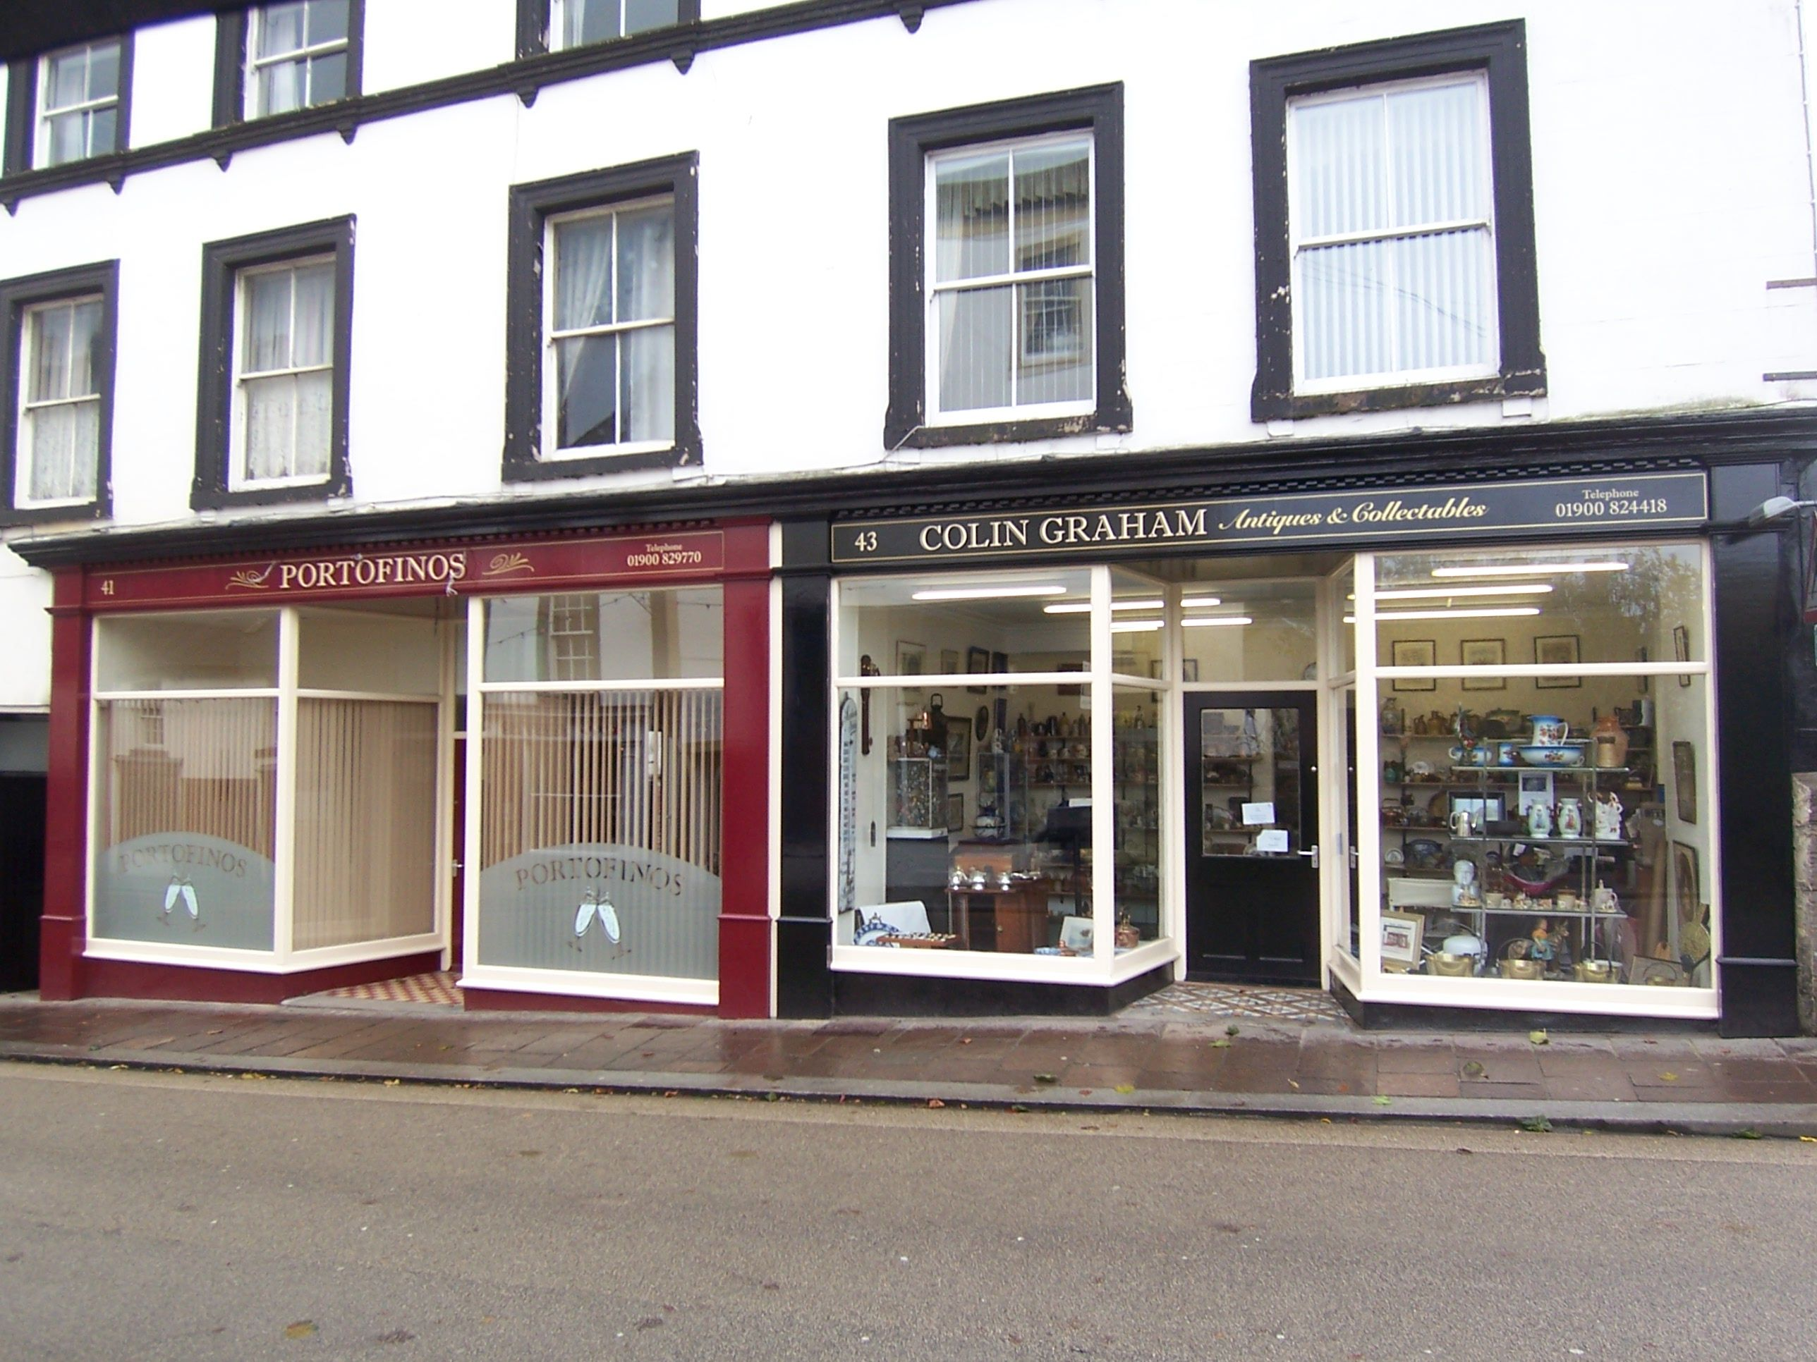

Slide 8
Neighbourhood Planning Front Runners Scheme
One of the first 17 front runners schemes confirmed by DCLG in March 2011.
The only Neighbourhood Development Order to be progressed in the first wave front runners scheme
The first Neighbourhood Development Order to be subject to referendum

Slide 9
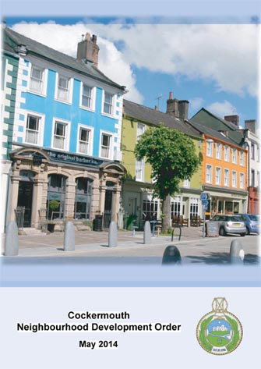
Cockermouth Neighbourhood Development Order

Slide 10
Cockermouth Neighbourhood Development Order
Part 1: Market Place
Aimed at developing a new role for Market Place as an area for leisure and entertainment.
Permits:
The change of use of ground floor commercial properties within Market Place to restaurants, cafes and bars
The change of use of designated land within the public highway on Market Place for the seated consumption of food and/or beverages

Slide 11
Cockermouth Neighbourhood Development Order
Part 2: Creation of flats above commercial premises
Aimed at creating new housing in the town centre
Permits the change of use of upper floors above shops and offices along the main shopping streets to create a maximum of four residential flats.

Slide 12
Cockermouth Neighbourhood Development Order
Part 3: Replacement shopfronts
Aimed at visually enhancing the primary shopping areas of the town.
Permits the replacement of shopfronts along Main Street and Station Street within the existing openings of commercial properties.
Has an associated design guide

Slide 13
Cockermouth Neighbourhood Development Order
Part 4: Modification of Article 4
Aimed at visually enhancing the conservation area of the town.
Permits the installation of replacement windows and front doors on houses located on designated streets with the town
Has an associated design guide

Slide 14
Cockermouth Neighbourhood Development Order
March – August 2011: Project initialisation - Set up steering group and draft Terms of Reference for the group
August 2011 – April 2013: Drafting the NDO - Scoping out issues, defining objectives, producing content
April – June 2013: Agreeing a consultation strategy Who and how – compliance with the requirements of the Consultation Statement
June - August 2013: Regulation 21 Consultation
November – December 2013: Regulation 23 Consultation

Slide 15
Cockermouth Neighbourhood Development Order
January 2014: Pre-examination check (NPIERS)
March 2014: Examination
July 2014: Referendum – 19.3 % turnout, 60.7% in support
September 2014: Full Council confirm NDO

Slide 16
Lessons learnt!
Commitment from steering group – ownership
Process can be complex and protracted
Availability of resource
Format – 1 vs 4 orders
Objection from English Heritage
Conditions
Referendum – timing and resources
Referendum – extent of referendum area
Need for clear communication strategy
Delegated powers

Slide 17
Any Questions?

