Slide 1


Community Infrastructure Levy
The fundamentals

Slide 2
Response to questions

Slide 3
The Basics
The Community Infrastructure Levy (CIL) was introduced in 2010.
It allows local authorities in England and Wales to raise funds from developers undertaking new building projects in their area.
The money can be used to fund a wide range of infrastructure that is needed to support the development of the area.
CIL will be charged through the Planning process
CIL is payable by the developer on commencement of development
A proportion of CIL raised in a neighbourhood will be reinvested in that neighbourhood
It was always envisaged that CIL largely but not completely replaces s106

Slide 4
 |  | Planning Obligations (Site specific negotiations) | Community Infrastructure Levy (Charging Schedule)
Scope | What Type of Infrastructure can it support? | Only items justifiable within the 3 legal tests: necessary to make the development acceptable in planning terms directly related to the development fairly and reasonably related in scale and kind to the development | All infrastructure necessary to support development of the area
 | Can it be used to secure Affordable Housing? | Yes - use to prescribe a proportion of affordable housing contributions | No
 | Geographic Application | Site specific impacts that may or may not reach beyond the ‘red line’ | Must cover whole Planning Authority Area with no exceptions (room for differential rates)
 | What types of development are eligible to pay CIL? | All development (but the time consuming nature of the process means only the largest are charged) | Any development over 100m² Building that people would normally go into. (some further exemptions existing for charities and social housing)
 | Eligibility of Capital & Revenue | Capital & Revenue both eligible (Revenue for maintenance & agreed revenue items) | Provision, improvement, replacement, operation or maintenance of new and existing infrastructure
 | Can the money be pooled? | Not for long. After April 2015 you will not be able to pool more than 5 obligations | CIL is effectively a pooling mechanism with complete flexibility over spending priorities
 | Once the money is collected how easy is to change what it is spent on? | Items agreed within the s106 Agreement (this is often inflexible). It cannot be spend on items identified for CIL investment | CIL can be spent on any infrastructure. Authorities need to set out the items they intend to fund using CIL in a Reg 123 list.
Setting Charging Levels | Is there a need to establish a list of Infrastructure requirements | The authority needs to justify s106 is necessary based on the 3 legal tests (as above). A Planning Obligations SPD is required (or as a position statement on their use for Examination) | Yes. Need costed infrastructure list to prove local need (there is no emphasis on prioritisation at the evidence gathering stage and explicit recognition that the list will change over time)
 | Setting differential rates | Negotiated proposal taking each development on its merits | Differences in rates should only relate to viability for different zones different uses scale of development
 | Charging Units | Flexible | Per m² of additional floor space only (all uses)
 | Testing Viability | Case by case basis (leaving room for negotiation during pre-application discussion) | Viability is tested at a borough-wide level at the evidence gather stage, then CIL payments are mandatory
Notes:
Set out the main differences between the two systems.
Note that we will come back to this later

Slide 5
What is Eligible to pay CIL
A development that creates net additional floor space, where the gross internal area of new build exceeds 100 square metres and new houses or flats
CIL will not be payable on:
most householder extensions
houses, flats, residential annexes and residential extensions which are built by ‘self builders’ (see Regulations 42A, 42B, 54A and 54B, inserted by the 2014 Regulations)
social housing that meets the relief criteria set out in Regulation 49 or 49A (as amended by the 2014 Regulations)
Notes:
The three key lessons identified from our work with councils across the country related to infrastructure planning are:
It is still a relatively minor component of a CIL examination – Whilst the regulations and guidance may have been updated to place a greater emphasis on the examiner still only tends to dedicate 2-3 paragraphs to the infrastructure planning in the examination report.
All councils have an infrastructure funding gap
Greater emphasis on CIL vs S106 – Settling on the correct approach between CIL and S106 remains the greatest challenge for councils

Slide 6
What is Eligible to pay CIL
CIL will not be payable on:
charitable development that meets the relief criteria set out in Regulations 43 to 48
buildings into which people do not normally go (see Regulation 5(2))
buildings into which people go only intermittently for the purpose of inspecting or maintaining fixed plant or machinery (see Regulation 5(2))
structures which are not buildings, such as pylons and wind turbines
specified types of development which the Council has decided should be subject to a ‘zero’ rate based on local viability evidence, and specified as such in this charging schedule
vacant buildings brought back into the same use (see Regulation 40 as amended by the 2014 Regulations)
Notes:
The three key lessons identified from our work with councils across the country related to infrastructure planning are:
It is still a relatively minor component of a CIL examination – Whilst the regulations and guidance may have been updated to place a greater emphasis on the examiner still only tends to dedicate 2-3 paragraphs to the infrastructure planning in the examination report.
All councils have an infrastructure funding gap
Greater emphasis on CIL vs S106 – Settling on the correct approach between CIL and S106 remains the greatest challenge for councils

Slide 7
What is Eligible to pay CIL
CIL will not be payable:
Where the levy liability is calculated to be less than £50, the chargeable amount is deemed to be zero so no levy is due.
On Mezzanine floors of less than 200 square metres, inserted into an existing building, are not liable for the levy unless they form part of a wider planning permission that seeks to provide other works as well.
Notes:
The three key lessons identified from our work with councils across the country related to infrastructure planning are:
It is still a relatively minor component of a CIL examination – Whilst the regulations and guidance may have been updated to place a greater emphasis on the examiner still only tends to dedicate 2-3 paragraphs to the infrastructure planning in the examination report.
All councils have an infrastructure funding gap
Greater emphasis on CIL vs S106 – Settling on the correct approach between CIL and S106 remains the greatest challenge for councils

Slide 8
Why CIL
CIL can increase funding for your local infrastructure priorities
CIL ensures the widest range of developers make a fair contribution
CIL helps with planning cash flow
CIL provide flexibility on spending priorities and timing
CIL’s transparency & speed of negotiations reduces developers’ risk and could encourage development in difficult economic conditions
Initial investment to create charging schedule can lead to reduced management costs for the Charging Authority going forward
Your ability to pool s106 will be severely limited from April 2015
Notes:
The three key lessons identified from our work with councils across the country related to infrastructure planning are:
It is still a relatively minor component of a CIL examination – Whilst the regulations and guidance may have been updated to place a greater emphasis on the examiner still only tends to dedicate 2-3 paragraphs to the infrastructure planning in the examination report.
All councils have an infrastructure funding gap
Greater emphasis on CIL vs S106 – Settling on the correct approach between CIL and S106 remains the greatest challenge for councils

Slide 9
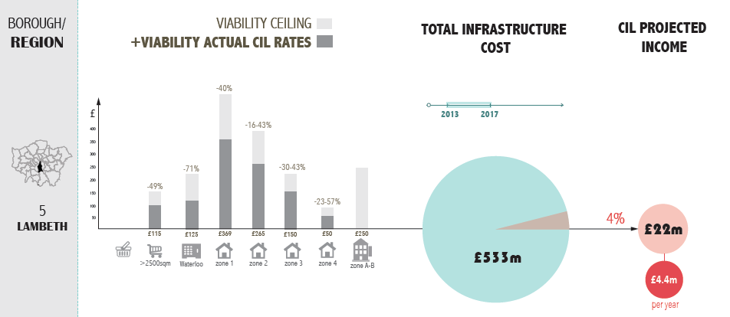
Examples from elsewhere
Notes:
The following four slides provide information on the infrastructure evidence that four councils have prepared to take them through a successful CIL examination.
On this slide you can see that Lambeth could demonstrate a total cost of infrastructure of £533m for the 5-year period 2013-2017 and were projecting £22m (or 4% of the total cost) income form CIL during the same period

Slide 10
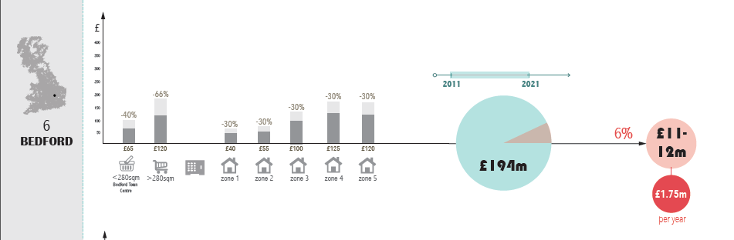
Examples from elsewhere
Notes:
On this slide you can see that Bedford could demonstrate a total cost of infrastructure of £194m for the 10-year period 2011-2021 and were projecting £12m (or 6% of the total cost) income form CIL during the same period

Slide 11
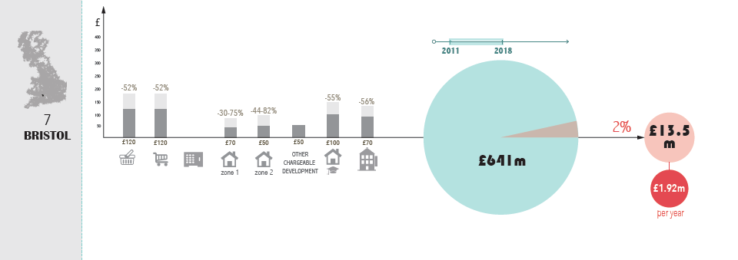
Examples from elsewhere
Notes:
On this slide you can see that Bristol could demonstrate a total cost of infrastructure of £641m for the 7-year period 2011-2018 and were projecting £13.5m (or 2% of the total cost) income form CIL during the same period

Slide 12
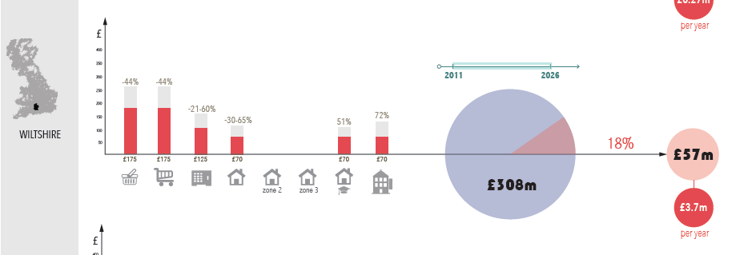
Examples from elsewhere
Notes:
On this slide you can see that Wiltshire could demonstrate a total cost of infrastructure of £308m for the 15-year period 2011-2026 and were projecting £57m (or 18% of the total cost) income form CIL during the same period

Slide 13
Regulations
The Planning Act 2008
Part 11 (sections 205-225)
Purposes of CIL – broad framework of CIL – plus some detail on charging schedule examination, charities, charging authorities...
The Localism Act 2011
Chapter 2 (sections 114-116b)
Approval of Charging schedules, Examiners comments, Use of CIL, Duty to pass to others, use of CIL outside of the charging area
The CIL Regulations 2010, 2011, 2012, 2014 regs
Scope of CIL – liable parties – collection – enforcement – definitions – monitoring – procedures – exemptions and exceptions – alterations to Section 106…
CLG Statutory Guidance 2014
(note the CIL overview document and CIL Relief document are non-statutory)

