Slide 1


Community Infrastructure Levy
Implementation
July 2014

Slide 2
Contents
process
instalments policy – discretionary
infrastructure in-kind contributions
phased payments
vacancy test
CIL spending

Slide 3
Community Infrastructure Levy
Process

Slide 4
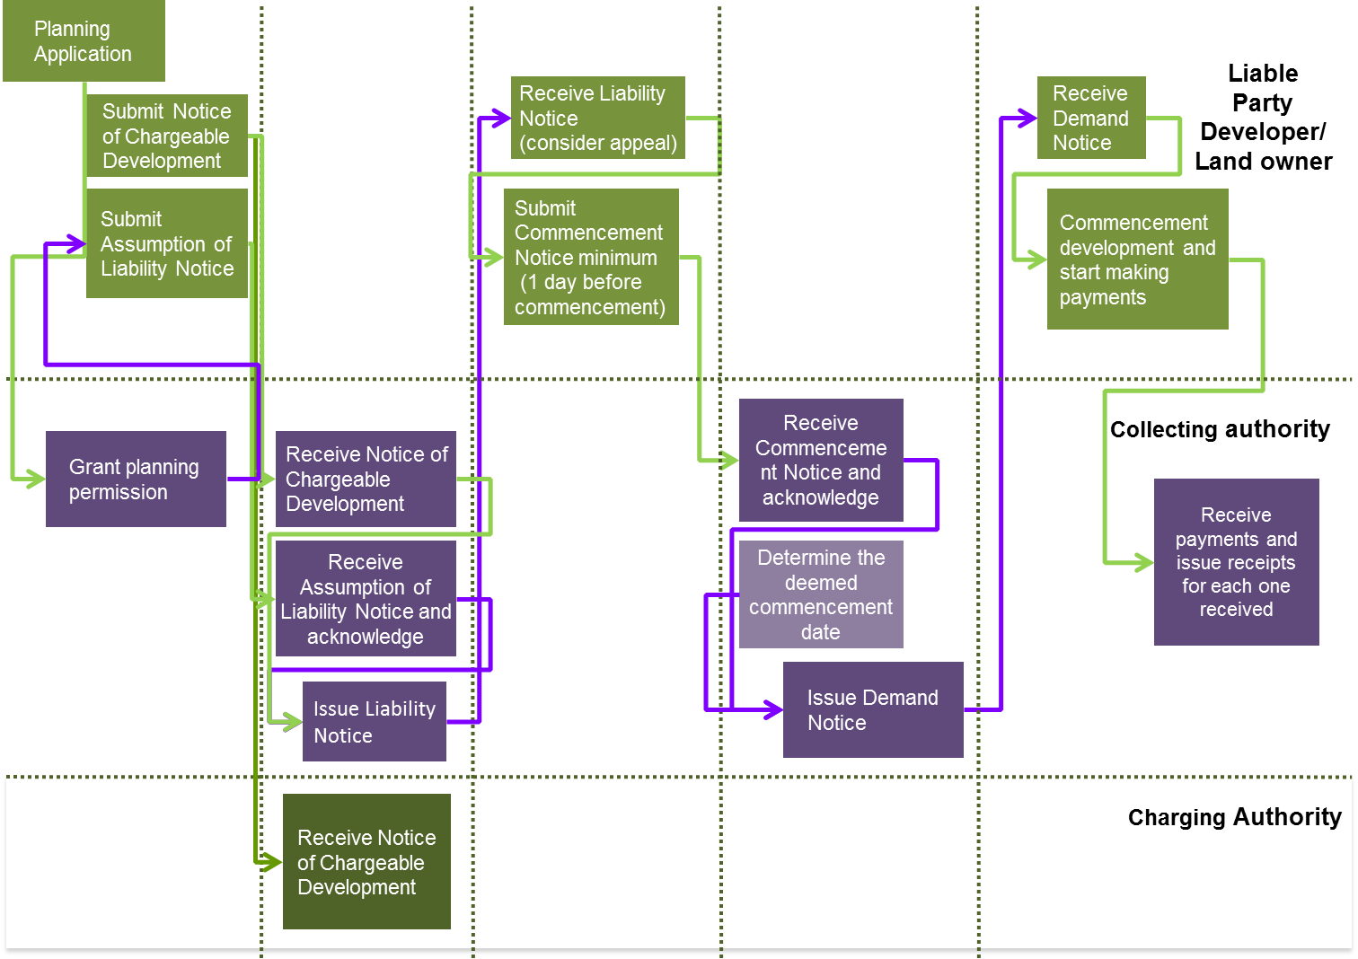
Collection Flow Chart

Slide 5
Collection - Notices
Notice of chargeable development
details of development size (net increase) and usage.
Assumption of Liability
  details of parties assuming liability for CIL charge.
  Withdrawal of Assumption of Liability
  Transfer of Assumed Liability
Claiming exemption or relief notice
  details of claim for relief or exemption.
Liability notice
  charge due and payment procedure.
Commencement notice
  sets out date of commencement.
Demand notice
  sets out payments due in line with payments schedule.

Slide 6
Enforcement – processes and notices
Schedule of surcharges
captured in regulations 80 to 86
late payment interest
warning notices
stop notices
  contravention carries a fine of up to £20,000 (or more on indictment).
Authority may apply to courts for an injunction
Liability reminder
  If no payment received within 7 days then authority may apply for a
  Liability order
  From magistrates court
Charging order
Local land charge
Prison…

Slide 7
Enforcement – appeals
Appeal against chargeable amount
within 28 days from date of liability notice
Calculation check undertaken by a person ‘more senior’ than the person who originally calculated the amount.
Appeal against apportioned liability
Appeal against surcharges
Appeal against deemed date of commencement
Appeal against a stop notice
Appeal for grievance against levy or attempt to levy to magistrates court

Slide 8
Community Infrastructure Levy
Instalments policy

Slide 9
Instalments Policy
Instalments policy constructed around the variables of:
number of payments
proportion of CIL due at each payment
time from commencement of development
threshold (s) when instalments apply.
Authority must publish an instalments policy to allow payment by instalments.
Where no instalments policy in place default is full payment at end of 60 days after development has started.
Threshold of CIL Charge | Proportion of CIL Charge | Time from start of development
£0 | 100% | 60 days

Slide 10
Instalments Policies
Havant
Threshold of CIL Charge | Proportion of CIL Charge | Time from start of development
£20k | 100% | 120 days
£20k to £100k | 25% | 60 days
 | 25% | 180 days
 | 50% | 240 days
£100k to £250k | 25% | 60 days
 | 25% | 180 days
 | 50% | 360 days
£250k to £750k | 25% | 60 days
 | 25% | 180 days
 | 25% | 240 days
 | 25% | 360 days
Above £750k | 25% | 90 days
 | 25% | 180 days
 | 25% | 360 days
 | 25% | 540 days

Slide 11
Instalments Policies
Wycombe
Threshold of CIL Charge | Proportion of CIL Charge | Time from start of development
£20k | 100% | 60 days
£20k to £100k | 25% | 60 days
 | 75% | 120 days
£100k to £300k | 15% | 60 days
 | 35% | 180 days
 | 50% | 360 days
Above £300k | 15% | 60 days
 | 35% | 360 days
 | 50% | 540 days

Slide 12
Instalments Policies
Huntingdonshire
Threshold of CIL Charge | Proportion of CIL Charge | Time from start of development
£16k | 100% | 120 days
£16k to £50k | 25% | 120 days
 | 50% | 210 days
 | 25% | 270 days
£50k to £100k | 25% | 120 days
 | 50% | 240 days
 | 25% | 365 days
£100k to £500k | 25% | 150 days
 | 50% | 300 days
 | 25% | 450 days
Above £500k | 25% | 180 days
 | 50% | 450 days
 | 25% | 720 days

Slide 13
Community Infrastructure Levy
Infrastructure in-kind contributions

Slide 14
Overview
Discretionary policy on both land and infrastructure
One or more infrastructure payments in satisfaction of the whole or part of the CIL
Infrastructure must support development of the CA area (maybe outside of area)
Must be relevant infrastructure
Must not be necessary to make the development acceptable in planning terms

Slide 15
Process
CA must have made infrastructure payments acceptable.
Liable party must issue an agreement in writing stating:
  Value of infrastructure
  Date by which infrastructure will be provided
  That the CIL cash amount + interest that will be paid if the infrastructure is not delivered by that date (or otherwise
The value of the infrastructure (including related design costs) is determined by an independent person (joint appointed and suitability qualified) on the day the valuation takes place.

Slide 16
Community Infrastructure Levy
Phased payments

Slide 17
Overview
Where a planning permission is phased, each phase of the development is treated as if it were a separate chargeable development for levy purposes (see Regulation 8(3A) as amended by 2014 Regulations). This may apply to schemes which have full planning permission as well as to outline permissions.

Slide 18
Process
Must be set out in the planning permission
Each phase treated as separate chargeable development

Slide 19
Community Infrastructure Levy
Vacancy test

Slide 20
Overview
Parts of an existing building that are to be demolished or retained can be taken into account when calculating the chargeable amount
Lawful use for continuous period of 6 months within past 3 years

Slide 21
Community Infrastructure Levy
Spending CIL

Slide 22
What the regulations say
CIL has to be spent on the provision, improvement, replacement, operation or maintenance of infrastructure
No provision for infrastructure prioritisation
Have to specify which infrastructure categories/ projects that S106 will not be sought for (reg 123 list)
15% is allocated for neighbourhood funding and can be spent on anything else that is concerned with addressing the demands that development places on an area’
Annual report on CIL spending required

Slide 23
What councils are doing
Linking regulation 123 list to capital spending priorities
Setting generic regulation 123 lists
Linking local CIL income to local infrastructure priorities

Slide 24
Community Infrastructure Levy
Approach

Slide 25
Implementation - Approach
Set it up as a defined project with a project manager, project sponsor, governance etc.
Define the existing resources, systems, processes and procedures that you have in place to collect and enforce development contributions.
Define the required systems, processes and procedures that you will require to implement an efficient CIL collection and administration regime.
Map the journey between the two.

Slide 26
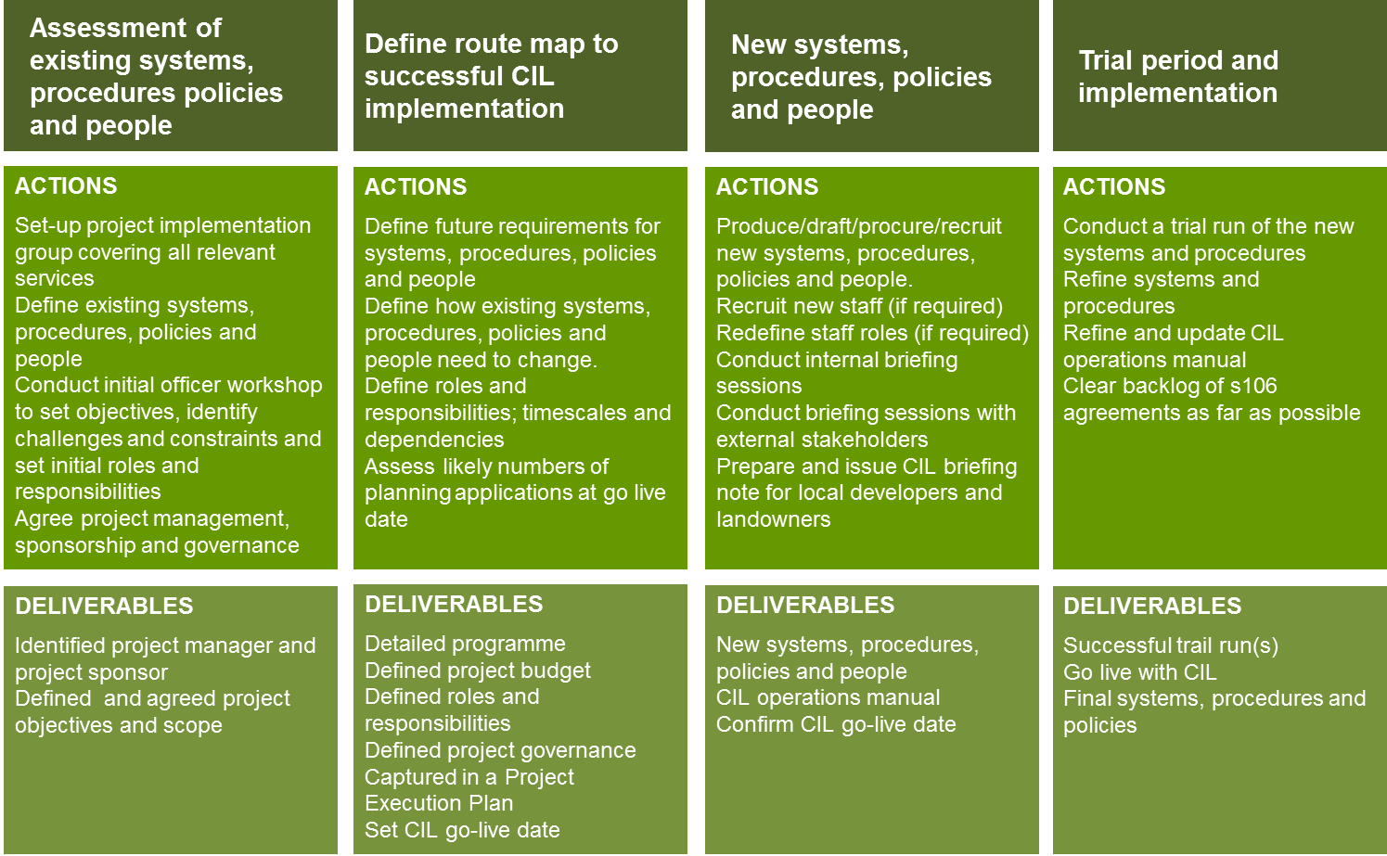
Stages, actions and deliverables

Slide 27
Summary
Start planning, and doing, now.
Use the good news story from CIL to energise the implementation process.
Make sure that the CIL income estimates you present always deduct an allowance for administration.

Slide 28


Questions
www.CILknowledge.com

