Slide 1

Local Development Order
Wellfield Road, Hatfield
Colin Haigh - Head of Planning

Slide 2
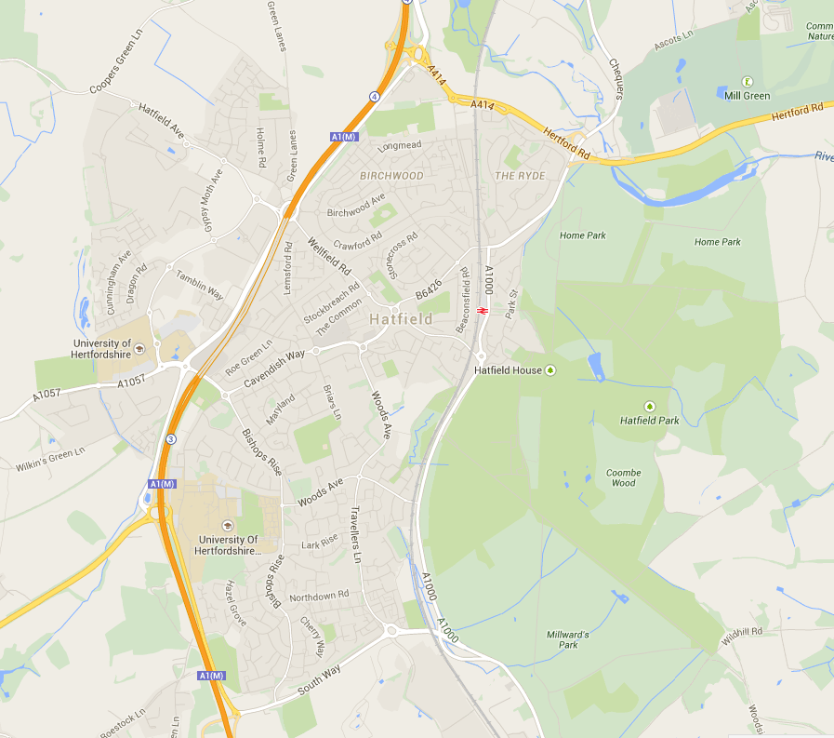
Hatfield
New Town
Good range of services but needs a bit of regeneration
Business Park
Railway station
Town centre
Galleria
Hatfield House
University

Slide 3
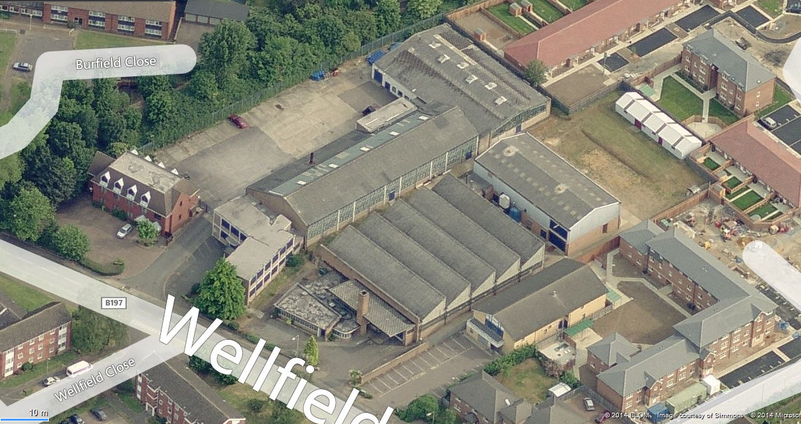

Slide 4
Wellfield Road site
0.9 hectare factory site
Makes cosmetics applicators for high-end companies
Identified as deliverable/developable in SHLAA
Promoted for about 90 dwellings
Lack of land use or environmental designations
Subject to positive pre-application discussions
Mix of local architectural styles = scope for range of masterplan, landscape, design approaches

Slide 5
Council mentality
New Director and Head of Planning in summer 2014
Strong emphasis on pre-application advice and PPAs
Local Plan raising challenging green belt issues
Desire to bring forward brownfield sites
Hatfield seen as bridesmaid to Welwyn Garden City
Chance to explore new development mechanism

Slide 6
Caressa Kahn / Wakelin Associates
Caressa Kahn in Hatfield for 50+ years
Specialist manufacturing, complicated to relocate
Ambition to grow but constrained by site size
Want to leave legacy on site once gone
Want to maximise value to cover relocation costs
Most evidence already exists to support plan app
Wakelin keen to explore new ways of working
But hesitant about working with others, particularly in respect of masterplanning/design issues

Slide 7
LDO Objectives
Quality – to deliver exemplar scheme and at least as good as through conventional plan app process
Speed – to adopt LDO within timescales and deliver scheme earlier than 2018, to demonstrate that LDOs can boost delivery and free-up officer time
Ease of replication – to gain experience of how best to prepare an LDO and establish standard structure

Slide 8
Governance
Political leadership = Executive Member for Planning
Project manager = Head of Planning
Project officers = from Policy and Dev Management
Input from Wakelin Associates
Input from URS on behalf of PAS
Regular updates to Cabinet Planning Panel, with expectation that LDO will be approved by DM Cmte in same way as normal planning application

Slide 9

Process
Sept 14 = Agreement with landowners and agents to submit nomination. Wakelin Associates enthusiastic.
Oct 2014 = Early preparation of clear project plan with agreed milestones
Nov 2014 = Initiation meeting and site
visit between Council, PAS, URS,
landowner, agents and ward cllrs.
First time all parties had met.

Slide 10
Process
Dec 2014 = Landowner/agent worried that LDO will be slower than plan app and ultimately less profit.
Jan 2015 = Council, PAS, landowner/agent meeting to offer reassurance. Agreement that indicative masterplan and LDO will be prepared
in parallel to reassure landowner of
most profitable scheme.

Slide 11
Process
Feb 2015 = Finalisation of clear project plan, agreed milestones and use of project funding
Feb 2015 = Council advise that LDO is far cheaper than plan app route, which would cost circa £3,000 pre-app advice plus £24,000 plan fee
Feb 2015 = Funding received from CLG
and project gets properly underway

Slide 12

Next steps
Complete technical contamination evidence (Feb)
Commission joint viability appraisal (Feb)
Jointly prepare indicative masterplan &LDO (March)
- Absolutes such as building heights, overlooking distances
- Parameters such as number of units, density
- Palettes such as design styles, construction materials
Informal local consultation (March)
Prepare and consult on draft LDO (April)
Agree final LDO at DM Cmte (June)

Slide 13
Timetable

Slide 14
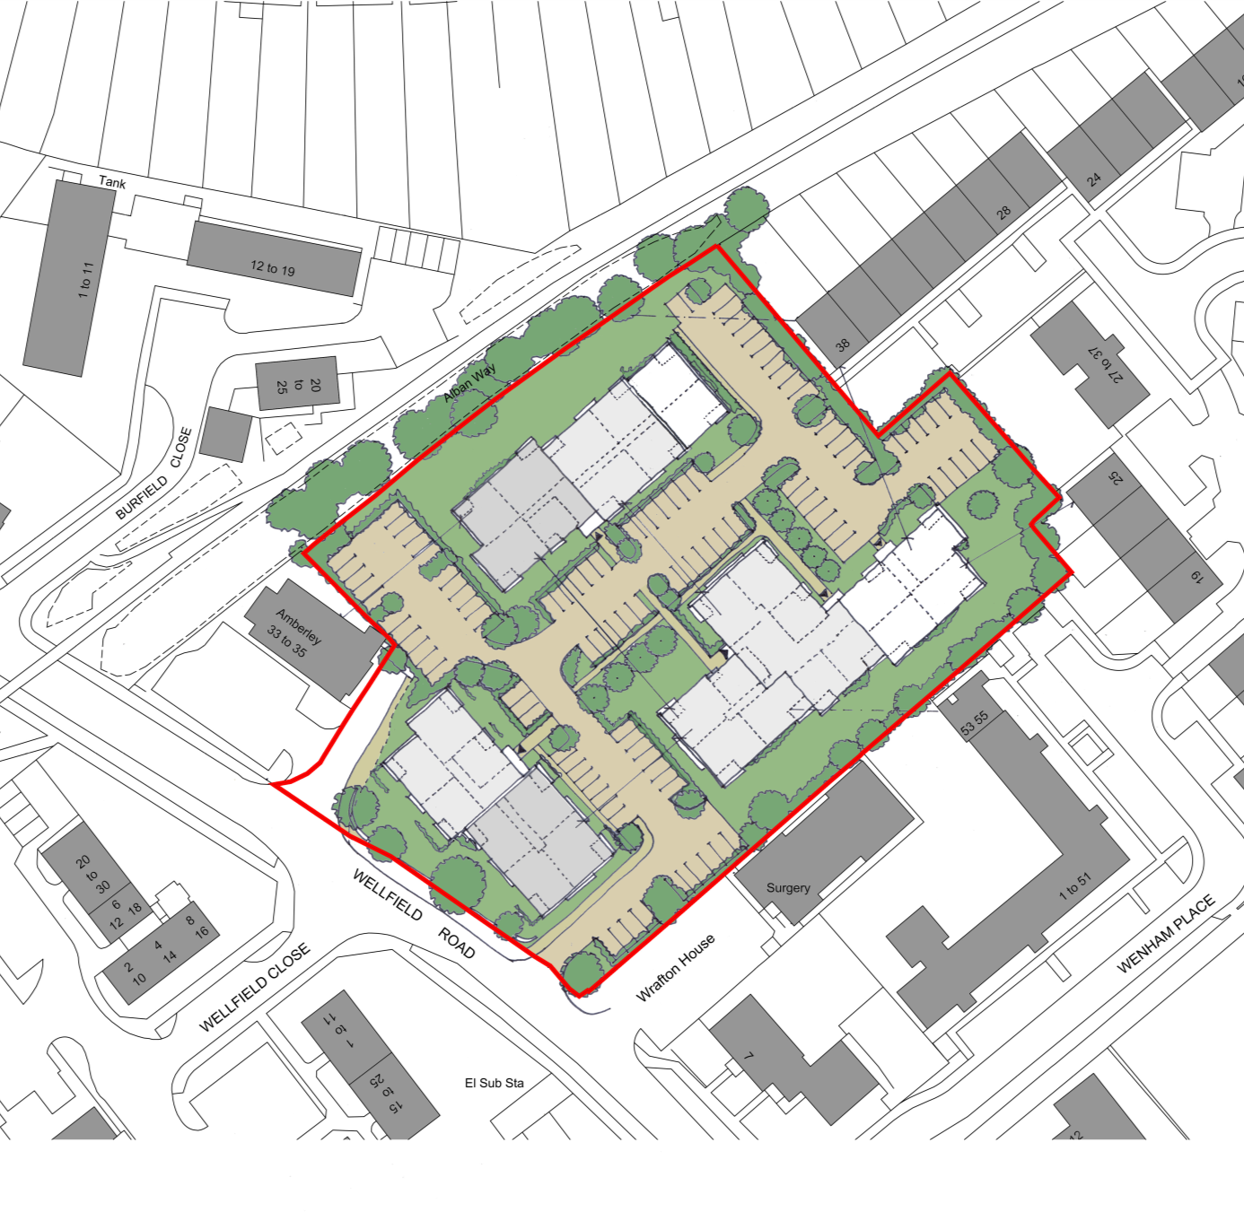
Scheme
Flatted blocks of 2, 3, 4 storeys
Modern architecture and flat roofs
Parking courtyards
Landscaping

Slide 15
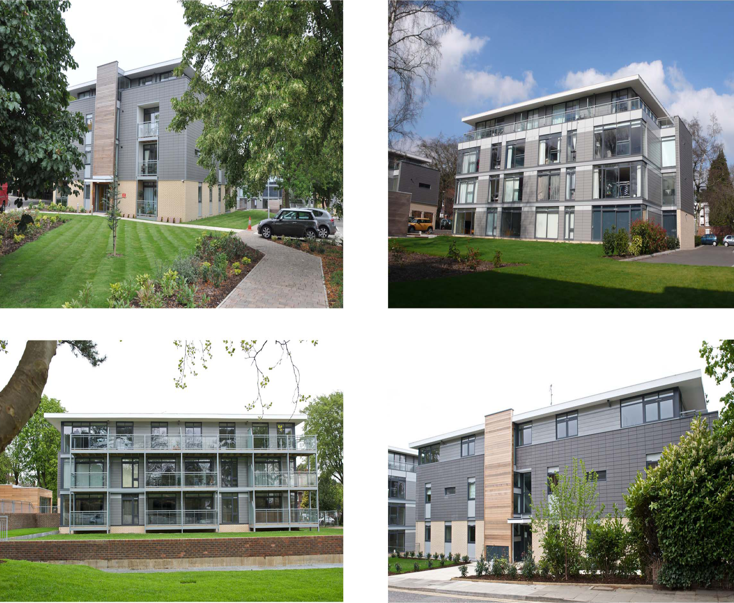

Slide 16

LDO Costs
£12,000 for joint viability appraisal
£1,500 for desktop contamination survey
£650 for newspaper adverts
£500 for letters to surrounding residents
£250 for consultation boards / material
£7,500 for graphic design work and more detailed contamination evidence if needed
Total £24,640 inc 10% contingency

Slide 17
Ambitions
Learning experience
Looking for transferable principles
Template format with standardised headings and text, so can be easily copied and re-applied to other brownfield and potentially green belt sites
Scope to be cheaper third alternative:
1) straight plan app = plan app fee
2) pre-app advice = pre-app fee + plan app fee
3) prepare LDO = joint work fee but free plan app

Slide 18
Risks
LDO results in inappropriate development
Difficult for supporters/objectors to comment on all aspects of scheme if LDO enables flexibility
LDO contains loopholes that are exploited
LDO is incorrect or ineffective
LDO preparation is delayed
LDO is not seen as giving residents a voice
Viability appraisal concludes that scheme does not deliver sufficient returns

