Slide 1
Focus on Enforcement
Adam Dodgshon – Principal Consultant
10th Nov - Birmingham
www.pas.gov.uk

Slide 2



Housekeeping and Introductions
Notes:
Graeme Duerden from Wychavon District Council
Nicola Hamilton from St Helens District Council
Neill Whittaker from Ivy Legal – Neill will do the POCA section
Housekeeping points:
Toilets
Turn phones to silent
Feel free to tweet
Fire procedures
Where will lunch/refreshments be
Evaluation forms

Slide 3
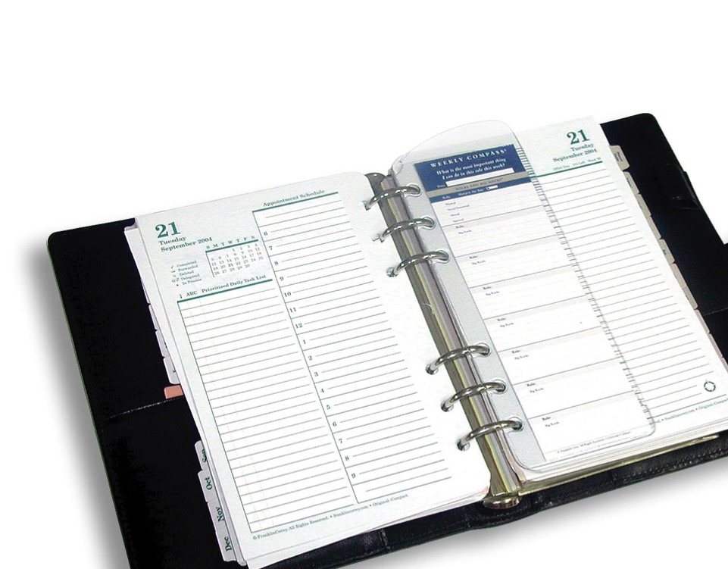
Agenda and Aims
Enforcement Plans
Proceeds of Crime
Act (POCA)
S215 Notices
Voluntary Start
Notices
Notes:
A greater understanding of what they are and how they can be used. Help you to explain to Members and the public.
Help be more proactive and not seen as the ‘last resort’ service.

Slide 4
What is Planning Advisory Service for?
“The Planning Advisory Service (PAS) is part of the Local Government Association. The purpose of PAS is to support local planning authorities to provide effective and efficient planning services, to drive improvement in those services and to respond to and deliver changes in the planning system”
(Grant offer letter for 2014-15)
Notes:
DCLG funded
Live within the LGA
Focus for past few years has been on plan led system (includes neighbourhood plans)
Expect that to continue, but also with an increased emphasis on supporting performance – in fact that is explicitly referenced in the consultation document – para 22.
4

Slide 5
The Planning Advisory Service
We
Are funded by £2m from DCLG to the LGA
Work for English Planning Authorities
Have been around ever since 2005 (Planning Act) and subsequent reform
Reduce cost, risk and delay through pilots, toolkits, Q&A
We are not
A thinktank, “experts”, a lobby group or researchers

Slide 6
Duty to Cooperate
Strategic planning
Plans in place
Pre-app, PPAs, conditions
Strategic issues
Enforcement
Essentials
Leadership
Delivery
Evidence
CIL & S106s
Energy & climate change
Committee training & peer review
Local plans
Viability
Viability Training
Project mgmt
Good decisions
Peer challenges
Successful
plan-making
Sustainability Appraisal
Housing needs
Improvement
Neighbourhood plans
Community engagement
Designation
Peer support
Resources
Events, toolkits and materials
Resource Review
Planning Quality Framework

Slide 7
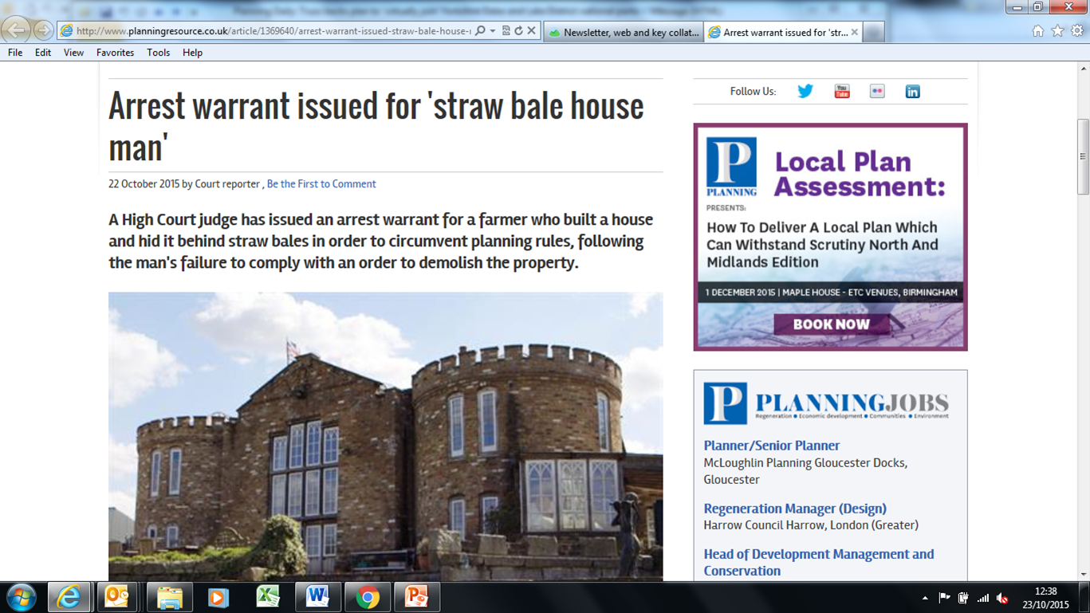
This just in….

Slide 8
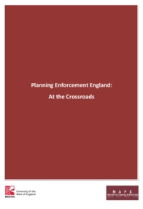
Enforcement work
Joint with NAPE
Need to build examples
4 ‘tools’ highlighted:
  Enforcement Plans
  Start Notices
  S215 Notices
  POCA
Notes:
Used the UWE/NAPE publication ‘Planning Enforcement England: At the crossroads’ from 2014. This highlighted that there are existing tools in the toolbox which are perhaps not being used as widely as they could be and suggested they would benefit from greater publicity and focus. We have picked this up for our advice note.
We do have examples when it comes to Enforcement Plans and also use of POCA but there can always be more.
So the purpose of today is also to get you sharing the work you have done, or sharing reasons why you haven’t been able to pick up these tools to date. If we understand the barriers we can improve the advice on how to overcome them.

Slide 9
Why have an Enforcement Plan?
Planning Enforcement is a statutory function of local government with a discretionary power to take formal action.
‘The Ombudsman would say failure to investigate was maladministration. The duty to investigate is, in my view, implicit in the law and explicit in policy’. (Local Government Ombudsman, 2014)
‘the duty to consider breaches of control is implicit in the Act… if you decide to enforce, you have to say why, and if you decide not to enforce, you have to say why too, because you have a general duty in public law to give reasons for all decisions’
(LGO in ‘Planning Enforcement England: At the Crossroads’, UWE/NAPE, 2014)

Slide 10
Enforcement Plans - Process
Link to Corporate Enforcement Policy and Local Plans
Member involvement
Engage with officers (and end users)
Adopt through appropriate Committee/Cabinet

Slide 11
Enforcement Plans - Content
Local Plan link –
support ‘themes’
Clear service standards
The need for compliance
Consider ‘Projects’ –
Member buy-in on pro-active enforcement
Consider chargeable services
Use appendices and glossaries
Notes:
Be clearly linked and explained in the Local Plan
Set out clear service standards for investigating alleged breaches including performance indicators, prioritisation and monitoring
Explicitly support the ‘themes’ of the Local Plan
Also include and be clear about the need for compliance
Consider having a section on ‘projects’ where there is member buy in on pro-active enforcement - this is likely to be reviewed regularly as priorities change
Consider whether some form of chargeable services could work or at least be clear that referral to a chargeable pre-app service is the policy for rectifying appropriate breaches and that the planning enforcement case officer will be in attendance
Contain appendices and glossaries to demystify service if necessary

Slide 12
The role of elected Members
Ultimately they fund your service
They make the calls on the cuts
They engage frontline with constituents
They can make your job easier and/or more difficult
Do they understand your service?! If not why not?!
Member Training
Personal Engagement
Newsletter
COMMUNICATION – not just an initial target

Slide 13
Planning Enforcement Fund
Introduced by DCLG in 2014 (runs to March 2016)
Reimburse up to 50% legal fees to max. £10,000
To qualify for consideration, your authority is must confirm it has adopted the enforcement best practice recommended in para 207 of the NPPF and published its plan to manage enforcement of breaches proactively. Your enforcement plan must have been published at least 3 months prior to applying for grant and you are required to confirm adherence to the recommendations of the NPPF of how your authority:
Monitors the implementation of planning permissions;
Investigates alleged breaches of planning control; and
Take enforcement action whenever it is expedient to do so.

Slide 14

Wychavon District Council’s previous Enforcement Policy
Previously the need for Councils to have a policy of Enforcement was set out in:
“A Charter Guide: Development Control”
– DoE in 1994
“Enforcing Planning Control: Good Practice Guide (1997)” – DoE
Then came:
The national “Enforcement Concordat”
(which still remains!) and
Our previous Enforcement Policy 2008-213

Slide 15

The Wychavon Way
At Wychavon we believe the first step in enforcement is to help prevent contravention of the law by raising awareness and promoting good practice.
The methods that the Council pursues to achieve this aim include the issuing of press releases, tweets, alerts, the production of webpages and other forms of written guidance as well as direct access to enforcement officers to provide proactive advice and assistance.
The Council use its best efforts to resolve any situations where the law may have been broken without intention without issuing formal notices, or referring the matter to the courts, subject to their statutory obligations.

Slide 16

National Planning Policy Framework
The National Planning Policy Framework was introduced in March 2012 (NPPF)
This revoked PPG18 ‘Enforcing Planning Control’ and replaced it with a single paragraph!
Paragraph 207 deals with Enforcement:
It states:
“Effective enforcement is important as a means of maintaining public confidence in the planning system. Enforcement action is discretionary, and local planning authorities should act proportionately in responding to suspected breaches of planning control. Local planning authorities should consider publishing a local enforcement plan to manage enforcement proactively, in a way that is appropriate to their area. This should set out how they will monitor the implementation of planning permissions, investigate alleged cases of unauthorised development and take action where it is appropriate to do so.”

Slide 17

The process/timetable
March 2012 Introduction of NPPF
February 2013 Report to Development Control Committee
June 2013
Reported draft Local Enforcement Plan to Executive Board
6 Week consultation period commenced with the Town Councils, Parish Councils and external organisations
November 2013
Final report taken to Executive Board following consultation period
December 2013
Final report to Full Council for formal adoption of Local Enforcement Plan
December 2013
Formally adopted

Slide 18

Proactive Compliance Role
Commenced 1 November 2013 – 0.5FTE
Main aims of the role:
To engage as soon as possible with developers to “build relations”
Ensure conditions discharged prior to works commencing on site
To monitor major developments during the construction phase and be a conduit between the interested parties
To date:
119 applications being monitored (and counting)
31 applications received
23 have been resolved and closed

Slide 19
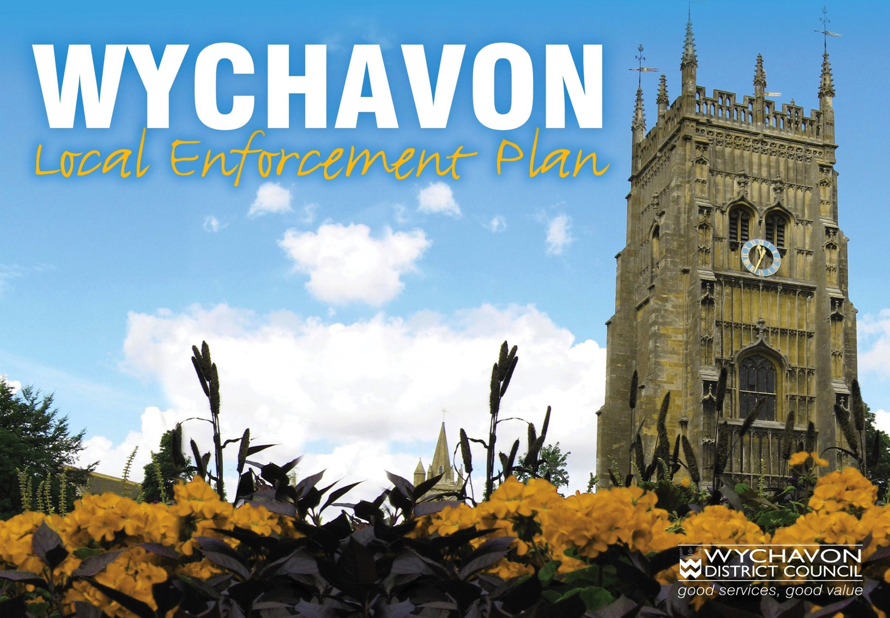

Slide 20
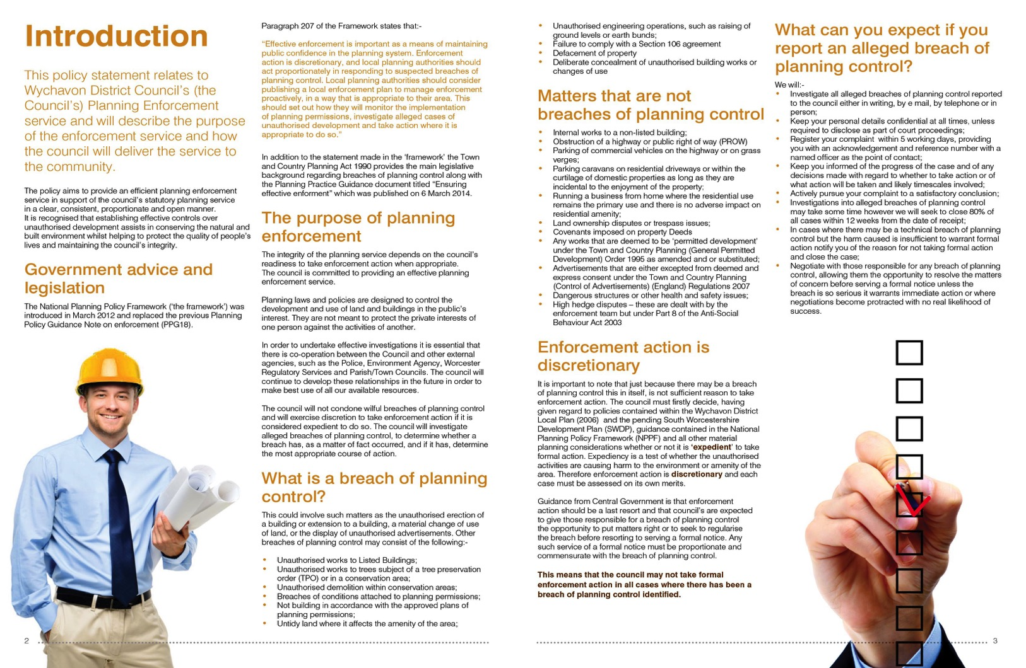

Slide 21
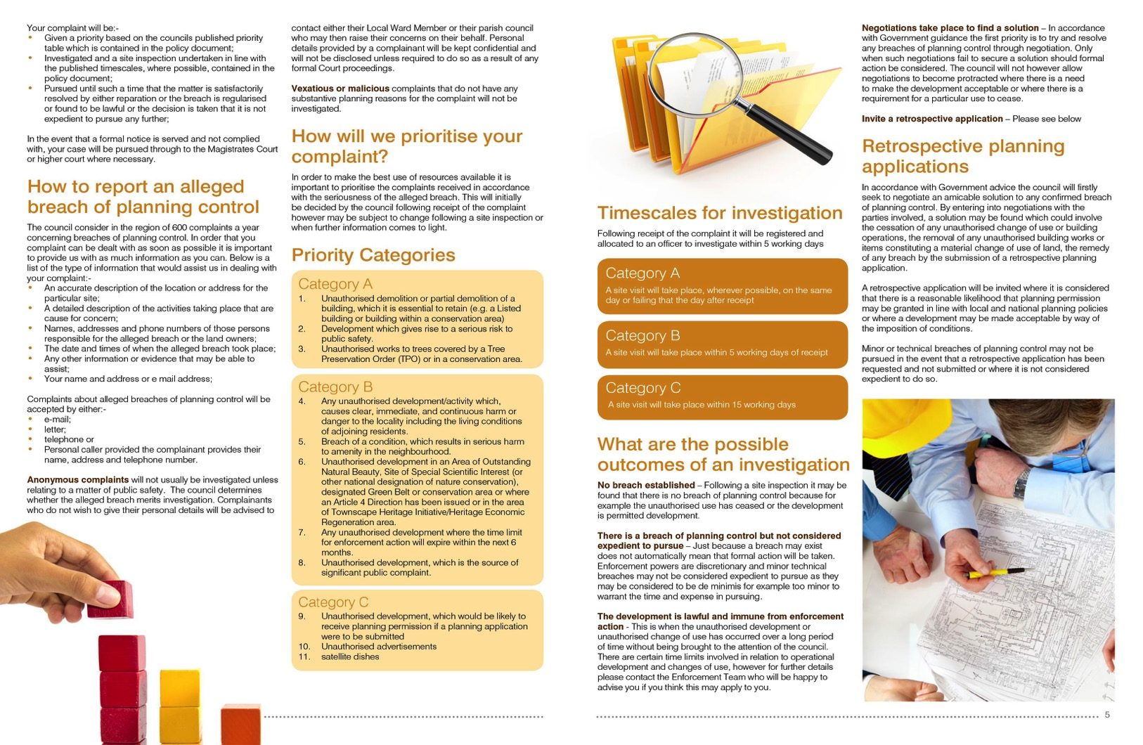

Slide 22
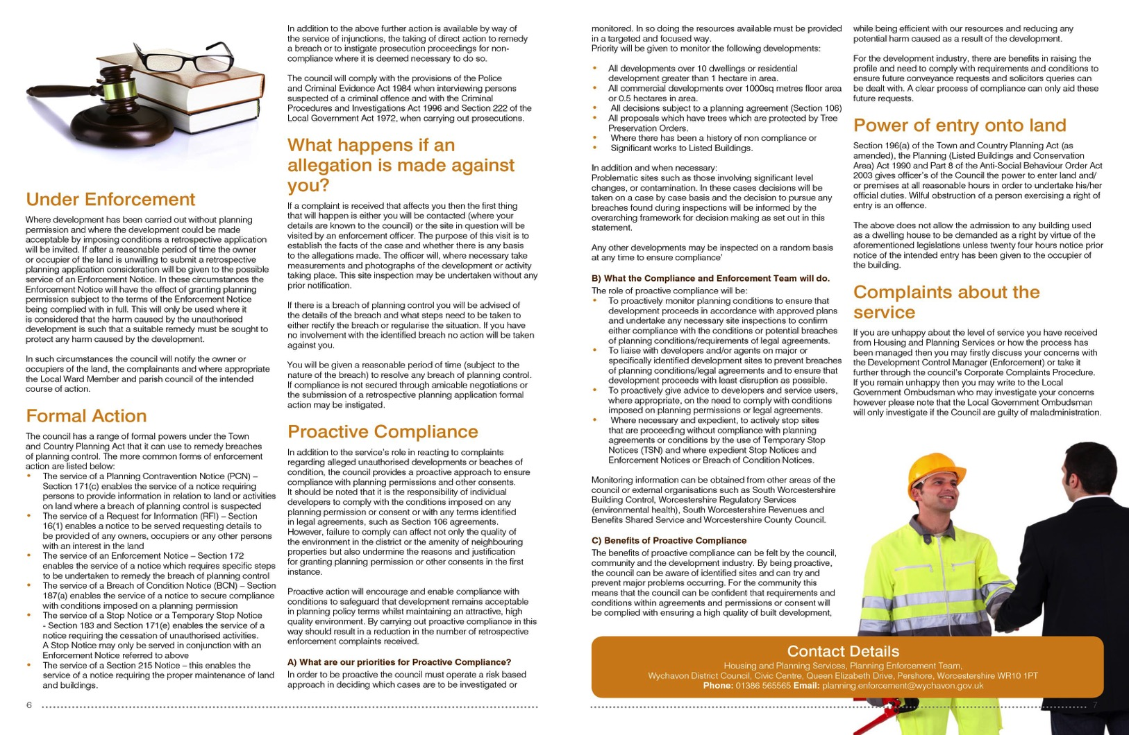

Slide 23

The benefits
Local Enforcement Plan referred in all communications – email/letters etc.
Available on web site in an
“easy to understand” format
Sets out what we expect and what people can expect from us
Sets out some of the limitations
Improves overall communication
Used as part of our programme of training for Members, Town and Parish Council’s

Slide 24

Enforcement Plans - Discussion
Who has a post-NPPF one?
Member involvement?
Local ‘projects’?
Advantages v disadvantages

Slide 25
POCA in Planning Enforcement
Introduction to POCA in Planning Enforcement
Applying POCA to Planning Enforcement Breaches
POCA procedure to secure confiscation
Examples of where LPAs have used POCA in Planning Enforcement

Slide 26
Introduction
“ The legislation is intended to deprive defendants of the benefit they have gained from relevant criminal conduct, whether or not they have retained such benefit, within the limits of their available means.”
House of Lords in R v May, Jennings v CPS and R v Green (2008)
Majority of cases involve offences of theft, dishonesty, drug dealing.
Planning Enforcement – underused, but increasingly better utilised.
Key advantages – profits forfeited and LPA receives portion of proceeds

Slide 27
Selected planning offences relevant for POCA
Town and Country Planning Act 1990
S179 - failure to comply with an enforcement notice
S194 – false or misleading statements on CLUED application
S210 – non-compliance with TPO
S224 – non-compliance with Town and Country Planning Control of Advertisement – (England) Regulations 2007
Planning (Listed Buildings and Conservation Areas) Act 1990
S9 – Carrying out works to a listed building without consent
S43(1) – non-compliance with Listed Buildings Enforcement Notice

Slide 28
POCA Procedure
Consider restraint as soon as criminal investigation is initiated
Conviction
Ask Crown Court to proceed with confiscation order – Section 6 POCA:
The Crown Court must proceed under this section if the following two conditions are satisfied
He is convicted of an offence or offences in proceeding before the Crown court; or is committed to the Crown Court for sentence AND
The Prosecutor asks the court to proceed under this section, the court believes that it is appropriate to do so.

Slide 29
POCA Procedure
Prosecutor to provide statement of information (S16)
Statement by Accredited Financial Investigator
Should include specifics set out in Rule 5(2) of the Crown Court (Confiscation, Restraint and Receivership) Rules 2003 (SI 2003 No. 421))
In practice, will paint a picture of defendant, history, assets etc.

Slide 30

POCA Procedure
Court identifies whether case is general or particular criminal conduct matter
General –sch. 2; course of criminal activity and / or offence committed over a period of 6 months and defendant has benefited
If general, 4 assumptions MUST be made (S10)

Slide 31
POCA Procedure
Defendant to reply to statement of information (S17)
Court may request further specified information from defendant (S18)
Court decides whether Defendant has benefited from criminal conduct
(Remember R v Waya (2012) UKSC 51)

Slide 32
POCA Procedure
Court determines the recoverable amount
Defendant may prove s/he can only pay available amount
Court makes confiscation order
When confiscation with incentivisation scheme

Slide 33
Asset Recovery Incentivisation Scheme
When paid, proceeds from confiscation orders split:
  Home Office 50%
  Prosecuting authority 18.75%
  Investigating authority 18.5%
  HM Court Service 12.5%
  Therefore, if LPA is prosecuting and investigating authority, it can receive 37.5% of proceeds

Slide 34
Enforcement of confiscation order
Payment due immediately
Time to pay of up to 3 months where assets need to be realised
Enforced as a fine
Default sentence up to 10 years
Enforcement Receiver can be appointed to realise assets

Slide 35
Examples of POCA in Planning
Confiscation orders obtained in 2010
Hounslow Council obtained an order for £180k – flat conversion
Bishop Stortford obtained an order for £760k – park and ride facility
Confiscation obtained orders in 2011
Bexley Council initially obtained an order for £180k for proceeds from the sale of cars from the defendants home but unfortunately the defendant was unable to pay and was ordered to pay £3k
Richmond Council obtained an order for £110k against thrice convicted defendant for flat conversion

Slide 36
Examples of POCA in Planning
Confiscation orders obtained in 2012
Brent and Harrow obtained an order for £1.4m –single house converted into flats
Runnymede obtained an order for £250k for using green belt land for commercial purposes
Confiscation orders obtained in 2013
South Bucks DC obtained an order for £33k for unlawful operation of a car park in the Green belt
Ealing council obtained a £11k order for illegal use of an outhouse building as rental property
Barnet Council obtained a £75k order for converting 2 houses into flats
Haringey Council obtained an order for £310k – landlord convicted of unauthorised changes of use of single residential dwellings

Slide 37

Summary
Introduction
Using POCA for specific breaches of planning control
POCA procedure
Examples

Slide 38

POCA Discussion
Any questions?
What opportunities in your area
Barriers to using POCA
Advantages v disadvantages

Slide 39
S215 TCPA
“If it appears to the local planning authority that the amenity of a part of their area, or of an adjoining area, is adversely affected by the condition of land in their area, they may serve on the owner and occupier of the land a notice under this section.”
Non-compliance- summary conviction & level 3 fine
Further non-compliance- fine 1/10th for every day

Slide 40
S215 appeal
28 days to appeal to Magistrates’ court
that the condition of the land does not adversely affect the amenity of the land;
that the condition of the land has resulted in the ordinary course of events from the lawful use of or operations on the land’
that the requirements of the notice exceed what is necessary for preventing the condition of the land from adversely affecting the amenity of the land;
that the period for compliance is too short
Further appeal to Crown Court possible
Problem for LPA
Wide scope
Magistrates often inexperienced in Planning law
Delays

Slide 41
S215 Direct Action
LPA may enter the land and take the steps required by notice & recover from owner expenses reasonably incurred in doing so.
Some LPAs use regularly for small sites
Can be uncomplicated & inexpensive

Slide 42
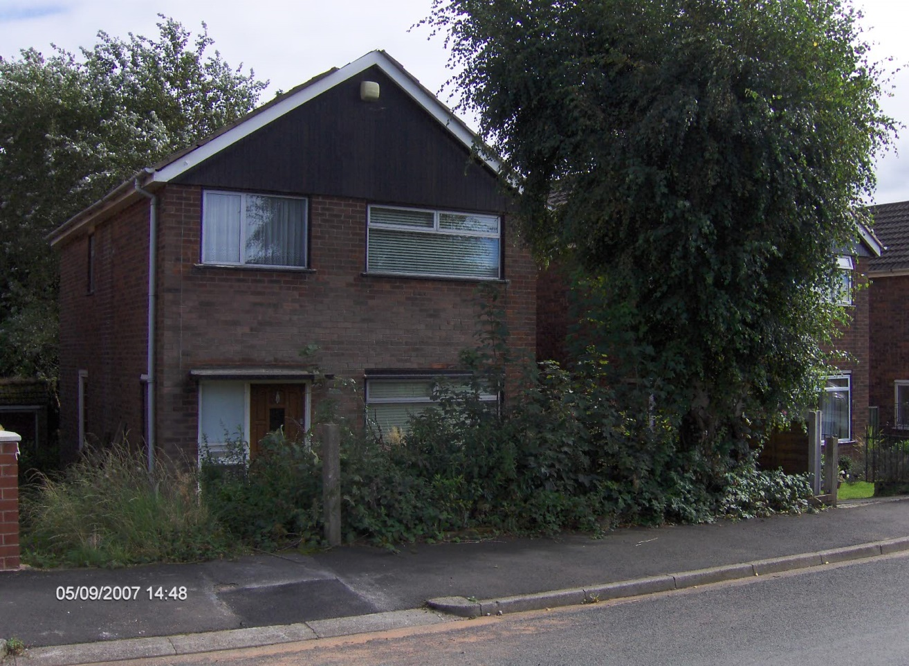
Conway Lane – Before (2007)

Slide 43
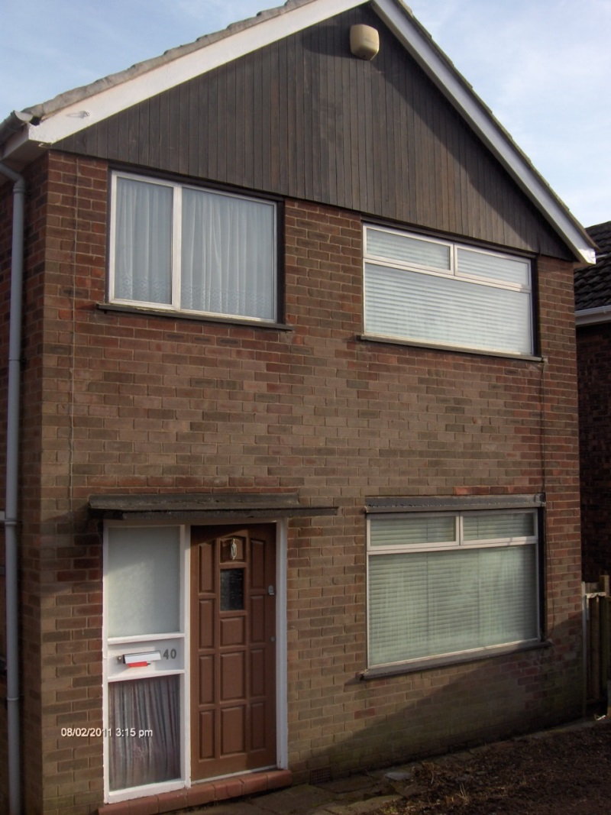
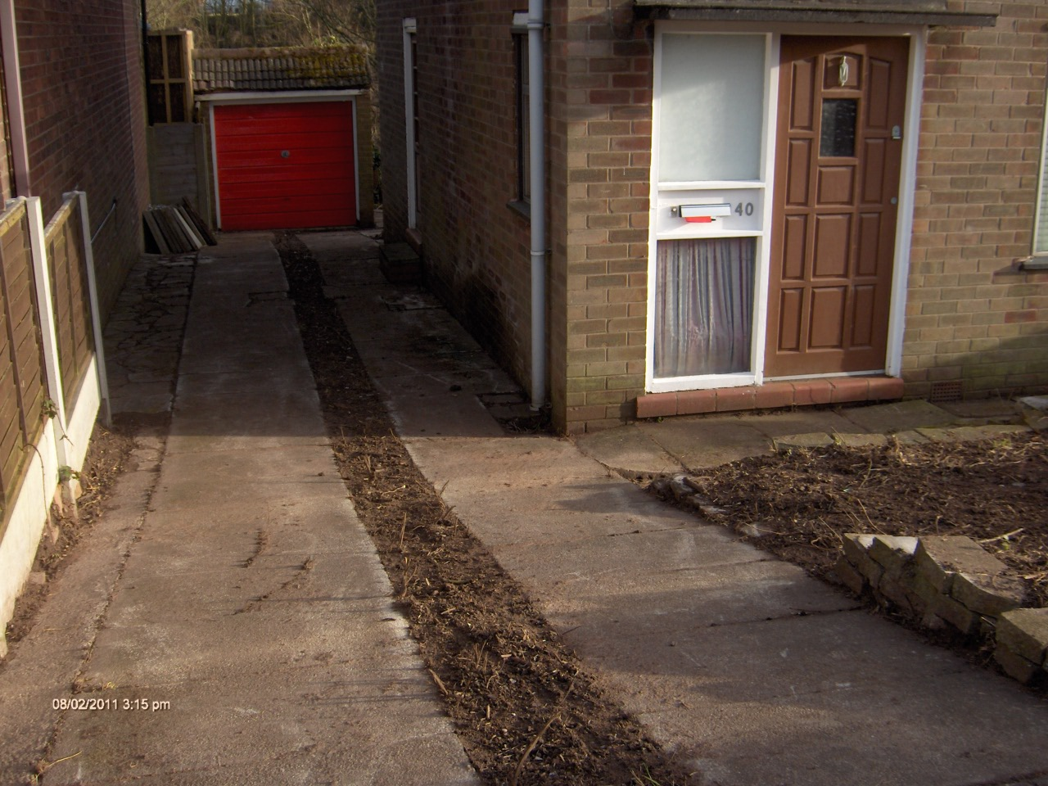
Conway Drive - After (2011)

Slide 44
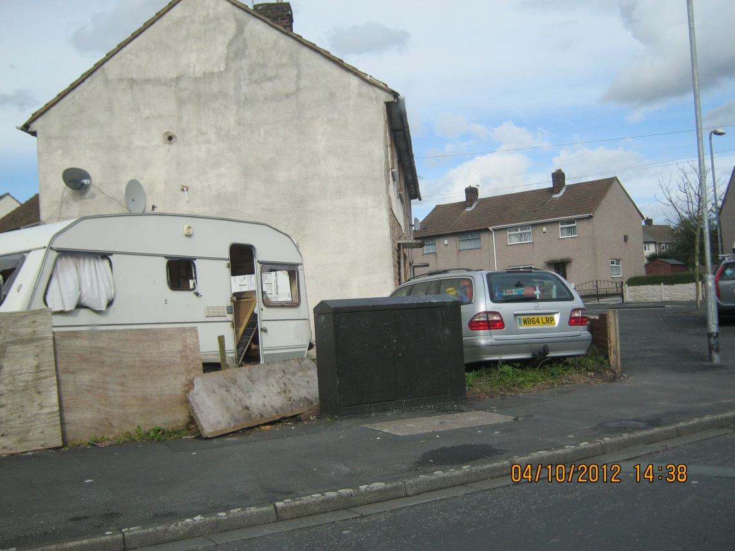
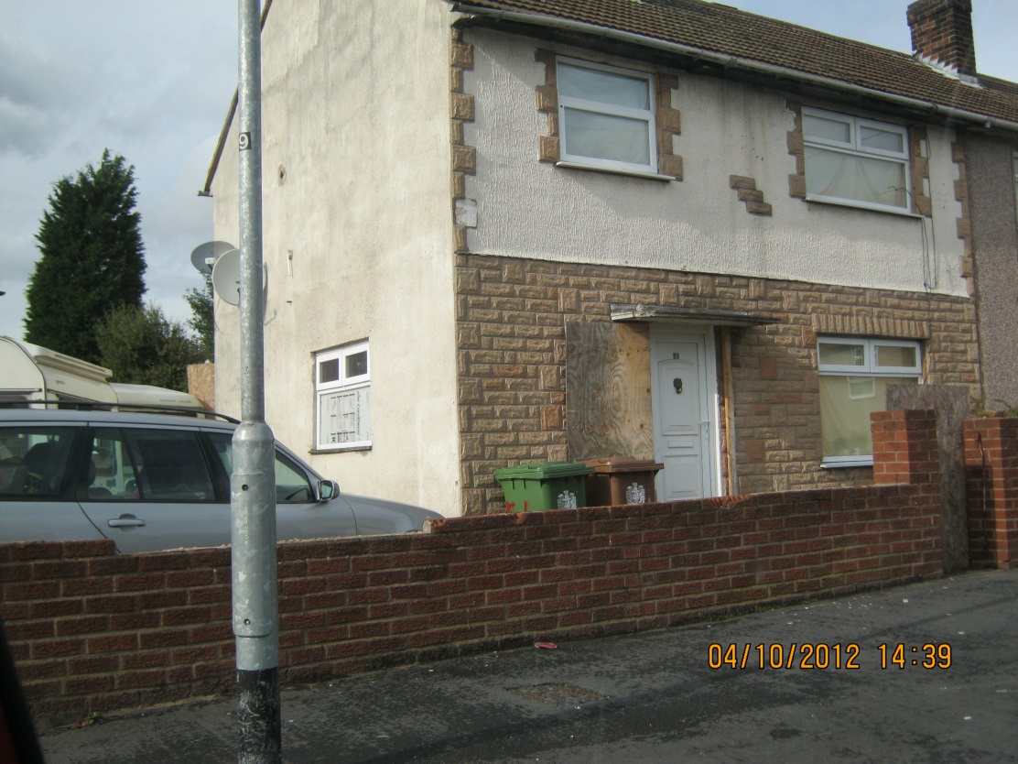
Brookway Lane – Before (2012)

Slide 45
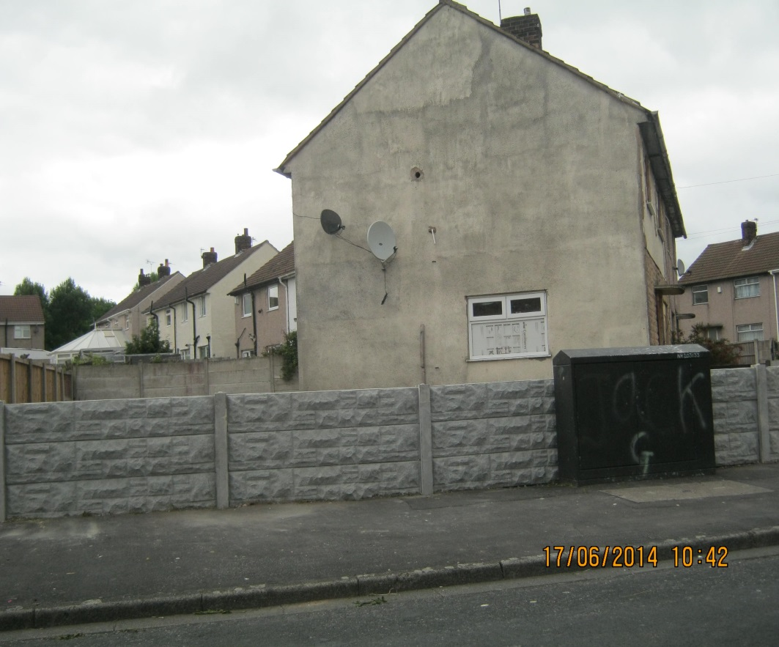
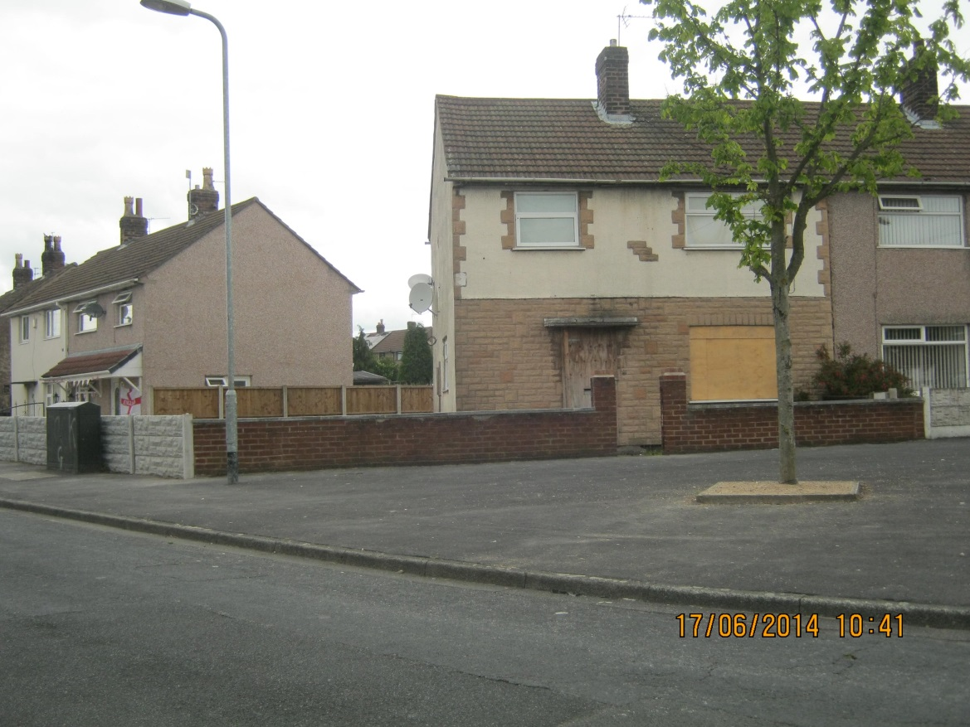
Brookway Lane – After (2014)

Slide 46
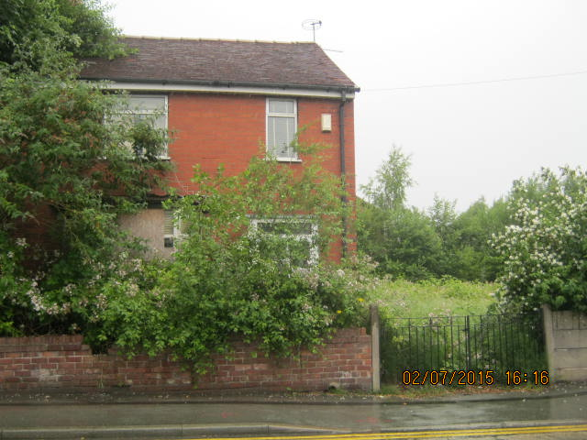
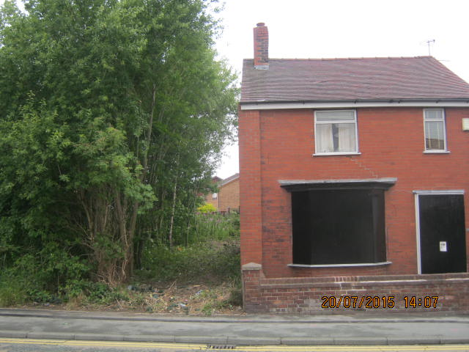
Mill Lane – Before and After (18 days)

Slide 47
S215 Notices
Do you use these and, if so, how regularly, and on what?
Is there a persistent local problem that use of S215 could help solve?
Are they widely understood in your council and if not, how will you ensure they are?
Advantages v disadvantages

Slide 48
Voluntary Start Notices
Compulsory in Scotland
Helps council proactively monitor development
Keep it simple – yields returns

Slide 49
Start Notices
Use in your area?
If not, why not? Resources?
Advantages v disadvantages

Slide 50

We need your feedback

Slide 51
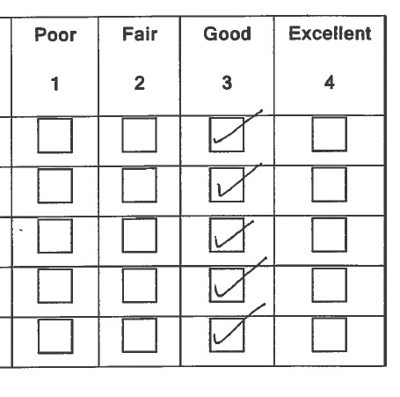
This is nice, but we want more
We need to know what you think
Comments triply welcome
We read all of them
We use your ideas to change what we do and how we do it

Slide 52
Follow-up evaluation
We employ Arup to follow-up on our work
  On reflection, was today actually useful?
  10 mins of feedback in return for £100’s of support
Our board use this to decide what we do with our grant. If we don’t get positive feedback we are unlikely to continue

Slide 53
Recent & forthcoming PAS activity
PAS Autumn Conference
Planning Decisions
Pre-Application Discussions

Slide 54
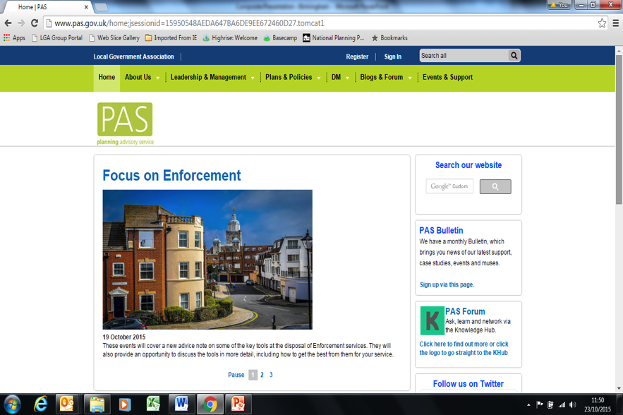
Three things to do before
10am tomorrow:
1
Sign up for the PAS Bulletin
2
Follow us on Twitter
3
Sign up to the Khub

Slide 55

Please leave your badges
The support doesn’t end now:

