Slide 1

PRE-APPLICATION SERVICE
COUNCILLOR & PUBLIC INVOLVEMENT
David Malcolm (Principal Planning Manager)
Cheshire East Council

Slide 2
Cheshire East Context
Facts & Figures
Pre-Application Service
  what we do and how
Councillor & Public Involvement
  Issues & resolutions
Example from Bunbury
Recent changes
Final Thoughts

Slide 3
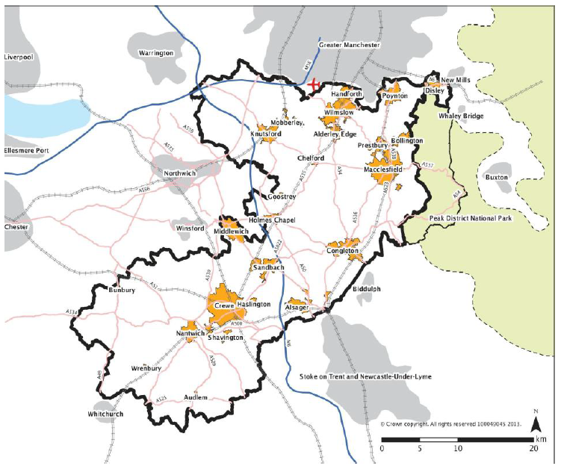
Context

Slide 4


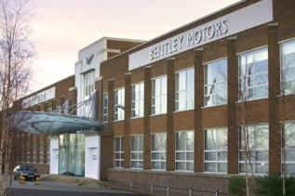
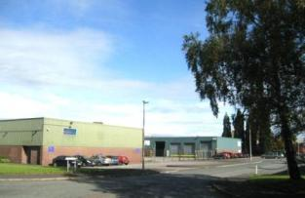
Economy
Excellent connectivity: M6, Manchester Airport, West Coast Mainline, HS2
Growing Industrial sectors: Automotive, manufacturing, life sciences, energy, R&D
High quality rural hinterland - over 16,000 businesses
Leisure and tourism – visitor economy worth £600M pa (10% of GVA)
Growth and jobs is CEC’s number one priority

Slide 5
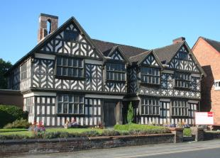
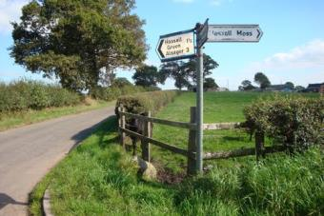
Environment
76 Conservation Areas, 47 Grade 1, 179 Grade 2*, 2,412 Grade 2 Listed Buildings
108 Scheduled Ancient Monuments; 17 Registered Parks and Gardens
Approximately 41000 ha of greenbelt (north & south east)
33 SSSI’s, 11 EU designations, 2 National & 8 Local Nature reserves
426 Sites of Biological Importance
1,210 Tree Preservation Orders

Slide 6



Population
Since 2001....
370,100 people – increase of 5.2%
159,400 households – increase of 8.7%
By 2021.....
26% increase in over 65s – up by 11,700
35% increase in over 85s – up by 2,500
18 year differential in healthy life expectancy from north to the south
...also have lots of soap stars and footballers!

Slide 7
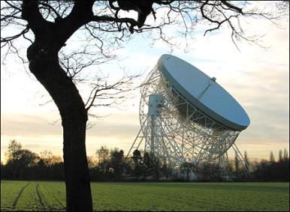
Democracy
82 Councillors in 52 Wards
10 Town Councils
97 Parish Councils
Planning
Very high profile
Over 4000 planning applications
178 Major Applications

Slide 8
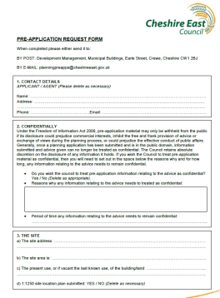
PRE-APPLICATION SERVICE
Introduced October 2011
Six levels of service
    Duty Planning Officer
    Householder
    Replacement Dwelling
    Minor Operations
    Pre-Application Meeting
    Development Team Service
Tiered Charging Structure: Free - £2000

Slide 9
COUNCILLOR INVOLVEMENT
Invitation to the pre-app meeting
To listen to the proposals
Add local context and information
Feel part of the process
Ability to influence
Awareness of application

Slide 10

PUBLIC INVOLVEMENT
No direct input into initial Pre-App meeting
Developers advised of SCI
Community engagement requirements
Consultation, exhibitions
SCI statement with the application

Slide 11



ISSUES....

Slide 12
RESOLUTIONS
Developer
  Advise/ask the developer!
  Two stage pre-app meeting
Councillor
  Remind of Code of Conduct
  Reassure not fettering / prejudging
The Public
  ...probably already know!

Slide 13
FACILITATE PUBLIC INVOLVEMENT
Get past the public suspicion
- Developers are paying for the pre-app
Signpost developers to key contacts
    - Organise and arrange meetings
    - Officers/Councillors attend public meetings
Parish / Town Council involvement
    - Let them do the work
    - Gives ‘independence’
Relies on good community organisation

Slide 14

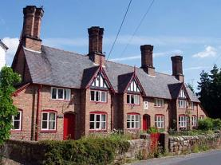
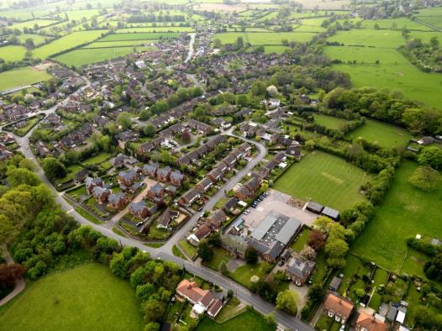
EXAMPLE
Active Parish Council and Ward Councillor
Locally engaged community
Village within Open Countryside
Two Conservation Areas
Local Service Centre likely to require approx 80 houses over next plan period
Under pressure from variety of small housing schemes

Slide 15
EXAMPLE
Initial presentations from developers to PC, Ward Cllr and Officer
Detailed discussions about main issues in local context
Formal Pre-App with Officers to identify specific planning issues
PC organised a ‘Developers Exhibition Day’ for local community
  - 7 developers all in one room!
  - Officers / Ward Councillor did not attend
Full Public Meeting to include feedback
  - Supported by Officers / Cllr
Applications now being submitted....

Slide 16
RECENT CHANGES
Formalise the Councillor involvement – more explicit
It is part of the pre-app process
Ward Members made aware of Pre-App on submission
Invitation to meeting will follow in normal way
Developers to be made aware of Cllr involvement
Assurances given on confidential matters
Website / forms to be updated

Slide 17
FINAL THOUGHTS
Pre-Application process has to be accepted by both developers and the public
Early engagement is the key to successful outcome
....but it doesn’t guarantee approval
Involving Councillors at an early stage should not be feared – it should help the developer
Proactive Parish/Town Council helps
Ultimately – its just common sense!

Slide 18
QUESTIONS?

