Slide 1
Development contributions –
S106 & CIL - update
Gilian Macinnes
March 2016
www.pas.gov.uk

Slide 2
Developer contributions - context
One of the Government’s pre-election manifesto commitments
“when new homes are granted planning permission, we will make sure local communities know up-front that necessary infrastructure such as schools and roads will be provided”.

Slide 3
Developer contributions
S106
CIL
S278
Other mechanisms?

Slide 4
s106 obligations can:
restrict the development or use of the land in any specified way
require specified operations or activities to be carried out in, on, under or over the land
require the land to be used in any specified way; or
require a sum or sums to be paid to the authority (or, to the Greater London Authority) on a specified date or dates or periodically.

Slide 5
S106 can:
be subject to conditions,
specify restrictions definitely or indefinitely,
And in terms of payments the timing of these can be specified in the obligation.
If the s106 is not complied with, it is enforceable against the person that entered into the obligation and any subsequent owner.
The s106 can be enforced by injunction.

Slide 6


S106 Obligations
Reality-post 2008:
  Times have changed – viability
  Times have changed - legislation
Ongoing changes since 2008
Notes:
Reality was that pre 2008 developers did not argue much about developer contributions/106 requests because the values and viability of their sites were generally rising. A big impact on viability was the time a development spent in planning – it was cheaper for them just to agree to the contributions/ s106 than spend time arguing.
Developers as we all know just stopped building in some areas because the viability just wasn’t there. Lowest level of housebuilding now for around 100 years
SO developers are less likely to accept unreasonable developer contribution requests as they are closer to the viability threshold in uncertain times. They will not bring the site forward – you will not be able to realise your local plan/core strategy.
In addition, the legislation has changed for s106’s, there are not only policy tests in the NPPF and the legal tests introduced by the CIL regs. There are more and more appeal decisions where s106’s are not considered reasonable.
So where does that leave you – you need to be able to evidence why a developer contribution through s106meet the tests. – see next slide

Slide 7
S106 – legal tests- CIL Regs
  If the development is capable of being charged CIL, the S106 obligation must meet these legal tests:
    NECESSARY to make the development acceptable in planning terms
    DIRECTLY RELATED to the development
    FAIRLY AND REASONABLY related in kind and scale to the development
Notes:
7
For development capable of being charged CIL for infrastructure capable of being in CIL – Not for other s106 obligations e.g. affordable housing, habitats except infrastructure for habitats ( visitor centre)
The Community Infrastructure Levy regulations 2010 (as amended):
Limitation on use of planning obligations
122.—(1) This regulation applies where a relevant determination is made which results in planning permission being granted for development.
(2) A planning obligation may only constitute a reason for granting planning permission for the development if the obligation is—
(A)NECESSARY TO MAKE THE DEVELOPMENT ACCEPTABLE IN PLANNING TERMS;
(B)DIRECTLY RELATED TO THE DEVELOPMENT; AND
(C)FAIRLY AND REASONABLY RELATED IN SCALE AND KIND TO THE DEVELOPMENT.
(1)
NPPF:
204. Planning obligations should only be sought where they meet all of the
following tests:
●necessary to make the development acceptable in planning terms;
● directly related to the development; and
● fairly and reasonably related in scale and kind to the development.
205. Where obligations are being sought or revised, local planning authorities
should take account of changes in market conditions over time and,
wherever appropriate, be sufficiently flexible to prevent planned development
being stalled.

Slide 8
S106 Policy tests - NPPF
204. Planning obligations should only be sought where they meet all of the following tests:
necessary to make the development acceptable in planning terms
directly related to the development; and
fairly and reasonably related in scale and kind to the development."
Notes:
PPG
Paragraph: 004 Reference ID: 23b-004-20150326
Does the local planning authority have to justify its requirements for planning obligations?
In all cases, including where tariff style charges are sought, the local planning authority must ensure that the obligation meets the relevant tests for planning obligations in that they are necessary to make the development acceptable in planning terms, directly related to the development, and fairly and reasonably related in scale and kind.
Planning obligations should not be sought where they are clearly not necessary to make the development acceptable in planning terms.
Planning obligations must be fully justified and evidenced. Where affordable housing contributions are being sought, planning obligations should not prevent development from going forward.
Revision date: 26 03 2015

Slide 9

S106 obligations
Site specific mitigation measures
Pooling issues –A planning obligation may not constitute a reason for granting planning permission..
if there are … 5 or more separate planning obligations within the area of the charging authority for project or type of infrastructure

Slide 10
S106 and policy making
Policies for seeking planning obligations should be set out in a
local plan,
neighbourhood plan
The London Plan
to enable fair and open testing of the policy at examination.

Slide 11
Supplementary planning documents
‘Supplementary planning documents should not be used to add unnecessarily to the financial burdens on development and should not be used to set rates or charges which have not been established through development plan policy.’
So should you have supplementary planning documents?

Slide 12

Delivery and viability of development
"Where obligations are being sought or revised, local planning authorities should take account of changes in market conditions over time and, wherever appropriate, be sufficiently flexible to prevent planned development being stalled.“
Paragraph 205- NPPF

Slide 13
Renegotiation of s106 A
Amended Regulation (Feb 2013) to set out a procedure for amending any planning obligations entered into between 28 March 2008 and before 6 April 2010.Section 106A of the Town and Country Planning Act 1990
where the s106 - "no longer serve a useful purpose" or "continues to serve a useful purpose equally well“
Sunset- April 2015- so back to 5 years
Notes:
The Town and Country Planning (Modification and Discharge of Planning Obligations) Regulations 1992 set out the procedure for making an application to amend planning obligations, including standard forms.
PPG - Paragraph: 009Reference ID: 23b-009-20140306
Can an agreed planning obligation be changed?
Planning obligations can be renegotiated at any point, where the local planning authority and developer wish to do so. Where there is no agreement to voluntarily renegotiate, and the planning obligation predates April 2010 or is over 5 years old, an application may be made to the local planning authority to change the obligation where it “no longer serves a useful purpose” or would continue to serve a useful purpose in a modified way (see Section 106A of the Town and Country Planning Act 1990).
In addition, Section 106BA of the 1990 Act (inserted by the Growth and Infrastructure Act 2013) allows applications to be made to modify the affordable housing requirements of any Section 106 agreement regardless of when it was signed. This review must be based on economic viability and cannot take into account other aspects of the planning consent. It addresses affordable housing requirements only. .
Paragraph: 011Reference ID: 23b-011-20140306
Can there be an appeal against a refusal to change a planning obligation (Section 106 agreement)?
Applications made to local planning authorities to modify a planning obligation, which pre dates April 2010 or is over 5 years old, may result in refusal or non-determination. If so, an appeal may be made. An appeal to the Planning Inspectorate under section106B of the Town and Country Planning Act (1990) must be made within 6 months of a decision by the local authority not to amend the obligation, or within 6 months starting at the 8 weeks from the date of request to amend if no decision is issued.
An appeal to the Planning Inspectorate on affordable housing viability under section 106BC of the 1990 Act must be made within 6 months of a decision by the local authority not to amend the obligation, or within 6 months commencing with the date which is 28 days (35 days if the Mayor of London is involved) from date of request to amend if no decision is issued. Further guidance can be found on Gov.uk titled “Section 106 affordable housing requirements: review and appeal.”

Slide 14
Renegotiation of s 106BA
Changes in the Growth and Infrastructure Act that require a council to renegotiate previously agreed affordable housing levels in a S106, and change the affordable housing requirement Section 106BA of the 1990 Act
viability of affordable housing requirements only
not reopen any other planning policy considerations or review the merits of the permitted scheme

Slide 15
Appeals
Under Section 106B of the Town and Country Planning Act 1990
Under section 106 BC- Appeal on affordable housing viability – revised level of Affordable housing for 3 years

Slide 16
S106 exceptions
Ministerial statement - Starter Homes – exception sites should not be required to make affordable housing or tariff style contributions.
Ministerial statement – Vacant Building Credit and Affordable Homes Threshold – Reading & West Berks case – 15-17th March 2016
Notes:
Paragraph: 031 Reference ID: 23b-031-20150814
Are there any circumstances where infrastructure contributions through planning obligations should not be sought from developers?
As set out in the Starter Homes Written Ministerial Statement of 2 March 2015, starter homes exception sites should not be required to make affordable housing or tariff-style section 106 contributions.
Revision date: 14 08 2015

Slide 17
Questions?

Slide 18

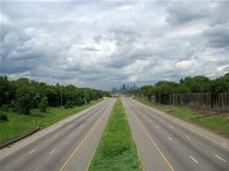
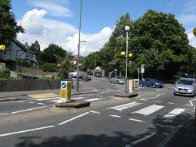
Highway agreements – s 278
Notes:
278 Agreements as to execution of works.E+W
(1)A highway authority may, if they are satisfied it will be of benefit to the public, enter into an agreement with any person—
(a)for the execution by the authority of any works which the authority are or may be authorised to execute, or
(b)for the execution by the authority of such works incorporating particular modifications, additions or features, or at a particular time or in a particular manner,
on terms that that person pays the whole or such part of the cost of the works as may be specified in or determined in accordance with the agreement.
(2)Without prejudice to the generality of the reference in subsection (1) to the cost of the works, that reference shall be taken to include—
(a)the whole of the costs incurred by the highway authority in or in connection with—
(i)the making of the agreement,
(ii)the making or confirmation of any scheme or order required for the purposes of the works,
(iii)the granting of any authorisation, permission or consent required for the purposes of the works, and
(iv)the acquisition by the authority of any land required for the purposes of the works; and
(b)all relevant administrative expenses of the highway authority, including an appropriate sum in respect of general staff costs and overheads.
(3)The agreement may also provide for the making to the highway authority of payments in respect of the maintenance of the works to which the agreement relates and may contain such incidental and consequential provisions as appear to the highway authority to be necessary or expedient for the purposes of the agreement.
(4)The fact that works are to be executed in pursuance of an agreement under this section does not affect the power of the authority to acquire land, by agreement or compulsorily, for the purposes of the works.
(5)If any amount due to a highway authority in pursuance of an agreement under this section is not paid in accordance with the agreement, the authority may—
(a)direct that any means of access or other facility afforded by the works to which the agreement relates shall not be used until that amount has been paid,
(b)recover that amount from any person having an estate or interest in any land for the benefit of which any such means of access or other facility is afforded, and
(c)declare that amount to be a charge on any such land (identifying it) and on all estates and interests therein.
(6)If it appears to the highway authority that a direction under subsection (5)(a) is not being complied with, the authority may execute such works as are necessary to stop up the means of access or deny the facility, as the case may be, and may for that purpose enter any land.
(7)Where a highway authority recovers an amount from a person by virtue of subsection (5)(b), he may in turn recover from any other person having an estate or interest in land for the benefit of which the means of access or other facility was afforded such contribution as may be found by the court to be just and equitable.
This does not affect the right of any of those persons to recover from the person liable under the agreement the amount which they are made to pay.
(8)The M1Local Land Charges Act 1975 applies in relation to a charge under subsection (5)(c) in favour of the Secretary of State as in relation to a charge in favour of a local authority.]

Slide 19
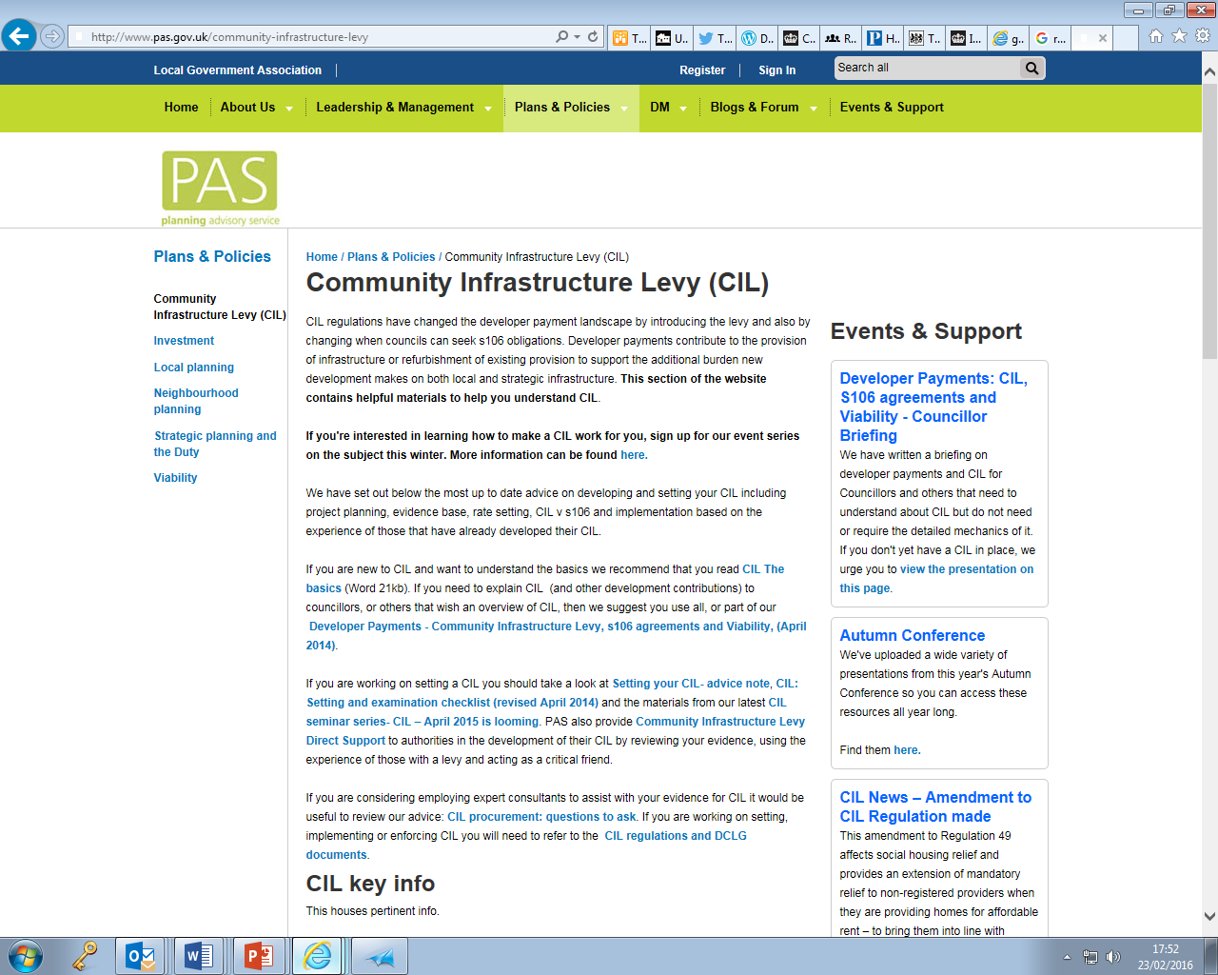
CIL

Slide 20

What is a CIL?
A mechanism for developer contributions
To contribute towards infrastructure needed to support the development of the area
A charge per square metre of floorspace
Not mandatory
Notes:
The aim is to allow local authorities to raise funds from developers to fund a wide range of infrastructure that is needed as a result of new development. Almost all development has some impact on the need for infrastructure, services and amenities, so it should contribute to the cost.
Planning Act says that authorities can only spend CIL on providing infrastructure to support the development of their areas:
“Infrastructure” legally includes (so the list in the Act is not exhaustive):
flood defence, open space, recreation and sport, roads and transport facilities, education and health facilities
CIL Regulations 2010 removed affordable housing, which will continue to be funded by S106s
Localism Act clarifies that CIL can be spent on the ongoing costs of providing infrastructure (Maintenance, Operational and Promotional);
Update: Act - 2008
CIL Regulations – April 2010
Last regulations update – Feb 2014
Statutory guidance now contained in NPPG - http://planningguidance.planningportal.gov.uk/blog/guidance/community-infrastructure-levy/
Localism Act 2011

Slide 21
What is CIL for?
To help pay for infrastructure needed to support new development
But not to remedy existing deficiencies unless the new scheme will make it worse
Councils must spend the income on infrastructure – but you can decide what (and that can change over time)
Notes:
NOTE:
Neighbourhood proportion- 15% or 25% where there is a neighbourhood plan – there are broader spending tests for neighbourhood proportion.

Slide 22
Charging CIL – some basics
£ per square metre on net additional (internal) floorspace
Rates can vary by geographic area, use or scale (or all)
Due when the development starts
It is index linked
The landowner is responsible for paying it
The local planning authority is the charging authority (& sets the CIL)
Notes:
CIL is charged on net additional floorspace – so any floorspace that has recently been in use ( 6 months use in the last 3 years prior to pp being granted)
Reg 40 11(2)contains a part that has been in lawful use for a continuous period of at least six months within the period of three years ending on the day planning permission first permits the chargeable development
Will be charged on most buildings that people use – not just housing.
Unlike floorspace calculations that are normally carried out in planning for CIL internal measurements are required
The definition of commencement of development is the same as already exists in planning legislation. Development is to be treated as commencing on the earliest date on which any material operation begins to be carried out on the relevant land.
The Index is the : The All- in tender price index of construction cost published by Building cost information service of the RICS
The collecting authority issue a liability notice setting out the requirements to pay the levy and encourages someone to assume liability – ultimately the owner of the land is liable – the liability transfers when the land is sold – the liability runs with the land.
Existing permissions will never be caught. Nor will any permission granted before a charging schedule is brought into effect locally

Slide 23
When does it apply?
To all development that involves ‘buildings that people normally go into’
Development over 100sqm gross internal floorspace
A single dwelling ( even under 100sqm) (but not subdivisions of dwellings)
Includes permitted development (it doesn’t have to follow a planning permission)
Once set, you can’t pick and choose which developments to charge
Exceptions including– self build: annexes and extension
Notes:
CIL will apply to all development that has been granted planning permission either through a planning application, permitted development, Local development order, neighbourhood development order, parliament etc.
It does not include development where planning permission is granted for a limited period.
All buildings that people normally go into over 100 sq m or single dwelling even if less than 100 sq m.
All measurement are internal.
A final net charge of £50 or less will not be collected.
CIL will apply to all developments in an area not just ones selected by the authority. However, it may be that the authority give some developments a zero rate which will have been justified by viability evidence.

Slide 24

Why set a CIL?
Money for infrastructure through charging nearly all new development -a little from almost everyone (so fairer)
There is a lack of government or other money
It is set out in a schedule based on evidence (so more transparent)
Developers have certainty
Changes to s106 – legal tests and pooling
Notes:
Tariffs and pooling inoperable from 6 April 2015 (but not re. Crossrail) to allow transitional arrangements ( although many tariffs have failed to meet the s106 tests since 2010 Regs introduced);
Existing permissions will never be caught. Nor will any permission granted before a charging schedule is brought into effect locally;
Under powers in the Planning Act, the CIL Regulations change the use of planning obligations (Section 106) by:
Making statutory the Circular 5/05 policy tests governing the use of planning obligations for permissions involving buildings, from April 2010 (Reg 122)
Preventing double charging via s106 for infrastructure to be funded from CIL, from the point at which CIL is introduced (Reg 123(2))
GPDO development liable from 6 April 2013;

Slide 25

CIL- positive economic effect
“By providing additional infrastructure to support development of an area, the levy is expected to have a positive economic effect on development across an area”
para. 8 - CIL Guidance – April. 2013

Slide 26

Setting a CIL
Identify the aggregate infrastructure funding gap- Is a CIL necessary?
What rate is viable to charge?
Check out the consequence of the rate on key uses
Make sure that the rate is backed by evidence
Consultation required
Independent examination
Notes:
Nearly all development - Net additional floor space of buildings that people use – exceptions, self build houses, annexes and extensions; social housing, charities and charity exceptions that you can decide whether to give (Investment state aid) Does not include changes of Use e.g. barn conversions. Buildings that exist and are being demolished are taken off the overall level of floor space.- This is limited to buildings that have been used for 6 months in the last 3 years (Reg 40, 11 (2))contains a part that has been in lawful use for a continuous period of at least six months within the period of three years ending on the day planning permission first permits the chargeable development.
You do not need to be specific about your infrastructure when you are setting your charging schedule although changes to the guidance seek to ensure that there is a clear thread running through from your plan, to your infrastructure evidence, to your draft CIL spending list ( REG 123) to your final list. You should have infrastructure planning from your core strategy/Local plan – this will be the basis of you calculating your Infrastructure gap. The guidance says that you should use your development plan to identify infrastructure and ultimately CIL spending.
The level of gap will be way above the viable level of setting the CIL.
You will need to look at the level of viability for all your uses – the temptation is to concentrate on housing – the level you then try to set may have some unintended consequences for other uses. You cannot just set a nil rate for uses because you don’t want to bother about them or you want to encourage them as this would look like state aid. You need to be able to justify your rate – it should be evidence based. The uses that you should concentrate on are the ones that are important for you to deliver as part of your plan
CIL gives developers certainty- they can build it in to their purchase price of land or sites ( however, a note of caution, there are sites with higher existing use values that might not come forward)

Slide 27
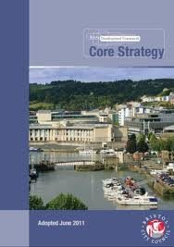
What you need to set a CIL?
Growth plan -preferably an up to date development plan
Evidence on infrastructure funding gap – aggregate gap
Evidence on viability
All evidence is ‘appropriate available evidence’
Rates should be consistent with viability evidence across the area
Notes:
This plan should identify the overall scale of development anticipated for the plan period; or you can work on a local plan and CIL in tandem.
The CIL examination is not expected to re-open the soundness of an adopted DPD or any infrastructure planning that underpins it :-
Paragraph: 016Reference ID: 25-016-20140612….
Information on the charging authority area’s infrastructure needs should be drawn from the infrastructure assessment that was undertaken as part of preparing the relevant Plan (the Local Plan in England, Local Development Plan in Wales, and the London Plan in London). .. The Community Infrastructure Levy examination should not re-open infrastructure planning issues that have already been considered in putting in place a sound relevant Plan.

Slide 28
Strike the Appropriate balance
Between
  the desirability of funding the infrastructure gap to support the development of the area from CIL
  and
  the potential effects (taken as a whole) of the imposition of CIL upon the economic viability of development across the area.
Notes:
DUTY to strike a balance
The desirability of funding from CIL (in whole or in part) the actual and expected total cost of infrastructure to support the development of the area…
…taking into account other actual and expected sources of funding for local infrastructure; and
The potential effects (taken as a whole) of the imposition of CIL upon the economic viability of development across its area.
London boroughs, in having regard to economic viability, must consider any approved Mayoral CIL.

Slide 29
Questions?

Slide 30

Developer contributions

Slide 31

CIL Review Panel

Slide 32
Pooling Restrictions
Impact on planning applications
Required planning obligations prohibited
Refusal stopping piecemeal approach resulting in infrastructure shortfall
Use of Grampian conditions
Obligation to deliver infrastructure
Notes:
Reg 123
(a) Obligation provides for funding or provision of infrastructure project or type of infrastructure;
(b)“five or more separate planning obligations that—
(i) relate to planning permissions granted for development within the area of the charging authority; and
(ii) which provide for the funding or provision of that project or provide for the funding or provision of that type of infrastructure,
have been entered into on or after 6th April 2010”.

Slide 33
S106 exceptions
Ministerial statement - Starter Homes – exception sites should not be required to make affordable housing or tariff style contributions.
Ministerial statement – Vacant Building Credit and Affordable Homes Threshold – Reading & West Berks case – 15-17th March 2016
Notes:
Paragraph: 031 Reference ID: 23b-031-20150814
Are there any circumstances where infrastructure contributions through planning obligations should not be sought from developers?
As set out in the Starter Homes Written Ministerial Statement of 2 March 2015, starter homes exception sites should not be required to make affordable housing or tariff-style section 106 contributions.
Revision date: 14 08 2015
Ministerial statement - https://www.gov.uk/government/speeches/starter-homes

Slide 34
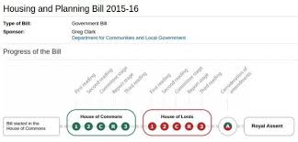
Housing and Planning Bill
Starter homes
Clause 143 – s106 - Affordable housing enforceability -
Clause 142 –s106 - Dispute Resolution

Slide 35
Starter homes
Starter Homes exempt from Community Infrastructure Levy and s106 affordable housing contributions
Proposed changes to NPPF:
  Expand ‘exception site’ policy to include other types of underused or unviable brownfield land – retail, leisure and institutional uses
  Expand definition of affordable housing to include Starter Homes
  Enable Neighbourhood Plans to designate land for Starter Homes
Source DCLG

Slide 36
Housing and Planning Bill – Starter Homes provisions
Bill progressing through Parliament- currently in House of Lords
Seven clauses:
  Legal definition for Starter Homes
  Define who can purchase
  Set price caps – and allow these to be varied by regulation
  Place duty on Local Authorities to promote Starter Homes in their area – including that Starter Homes are built on all ‘reasonably sized sites’ (details to be provided in secondary legislation)
  Require Local Authorities to report progress through Annual Monitoring
  Enable Government to issue ‘compliance direction’ where Local Authorities don’t meet their statutory duty
Source DCLG
Notes:
NPPF consultation closes 22 February – announce outcome later in 2016
Housing and Planning Bill now in the House of Lords – finalise by Summer
Publish consultation on secondary legislation on ‘reasonably sized sites’ threshold – March 2016
Publish Starter Homes Land Fund prospectus – March 2016
Ongoing engagement with lenders, house builders and Local Authorities to galvanise support and identify larger scale delivery and partnership working
Prepare and publicise ‘scheme designs’ for Lenders, Local Authorities and house builders – by Summer

Slide 37
Clause -143:
Enforceability of planning obligations regarding affordable housing
106ZB
Regs may impose restrictions or conditions on the enforceability of planning obligations entered into with regard to the provision of—
(a) affordable housing, or
(b) prescribed descriptions of affordable housing.
(2) Regulations under this section—
(a) may make consequential, supplementary, incidental,
transitional or saving provision;
(b) may impose different restrictions or conditions (or none)
depending on the size, scale or nature of the site or the proposed development to which any planning obligations would relate.
Notes:
Regulations made by the Secretary of State may impose restrictions or conditions on the enforceability of planning obligations entered into with regard to the provision of—
(a) affordable housing, or
(b) prescribed descriptions of affordable housing.
(2) Regulations under this section—
(a) may make consequential, supplementary, incidental,
transitional or saving provision;
(b) may impose different restrictions or conditions (or none)
depending on the size, scale or nature of the site or the proposed development to which any planning obligations would relate.
106ZB Enforceability of planning obligations regarding affordable housing
Paragraph (b) is without prejudice to the generality of section 333(2A).
(3) In this section “affordable housing” means new dwellings in England
that—
(a) are to be made available for people whose needs are not
adequately served by the commercial housing market, or
(b) are starter homes within the meaning of Chapter 1 of Part 1 of
the Housing and Planning Act 2016 (see section 2 of that Act).

Slide 38



S106 - Dispute resolution

Slide 39
Clause 142 of the Housing and Planning Act:
142 Resolution of disputes about planning obligations
(1) After section 106 of the Town and Country Planning Act 1990 (planning
obligations) insert—
“106ZA Resolution of disputes about planning obligations
Schedule 9A (resolution of disputes about planning obligations) has
effect.”
(2) After Schedule 9 to that Act insert, as Schedule 9A, the Schedule set out in
Schedule 13 to this Act.
(3) In section 106 of that Act, in subsection (1), for “and sections 106A to 106C”
substitute “, sections 106A to 106C and Schedule 9A.

Slide 40
Dispute Resolution
Decision Making Stage
All section 106 terms to be agreed within prescribed time - time period to be set in regulations but likely to reflect existing statutory timeframes for determining applications
Post-decision Stage
After prescribed time - if any outstanding section 106 planning obligations – LPA, applicant or other party prescribed in regulations, can write to the Secretary of State requesting that a person be appointed to help resolve outstanding issues.
The Secretary of State must be satisfied that LPA likely to grant permission.
Short “cooling-off” period during which other options could be pursued (e.g. resolve outstanding issues, LPA refuse application, applicant could appeal for non-determination.)

Slide 41
Dispute Resolution
Dispute Resolution – Appointed Person
Person appointed to deal with dispute - delivery body and qualifications of the appointed person to be determined through regulations.
LPA and applicant must engage in process – irrespective of who applied.
Appointed person can award costs for not engaging in process.
Appointed person to have a limited period to issue a report – to be set through regulations.
Appointed person to have reference to any section 106 template to be published by the DCLG.
Report to set out process undertaken, any agreed planning obligations, and recommendations for any matters that were still in dispute.
Report published by Local Planning Authority.

Slide 42
Dispute Resolution
Post-Dispute Resolution
Short additional period for completing any section 106 obligations - time period to be set out in regulations. Then:
  Where no obligations are entered into with a specified period – to be set out in regulations - the application must be refused.
  Where planning obligations are entered into in line with the report – or alternative terms are agreed - then the LPA must not refuse permission for reasons relating to the appropriateness of the planning obligations. Must be done within a specific period of time – to be set out in regulations.
  Regulations will set out restrictions on the LPAs ability to ask for additional obligations after the report is issued.
  Regulations will set out circumstances where the above will not apply e.g. extending the specified period to enable planning obligations to be agreed.

Slide 43
Regulations
The Secretary of State can make regulations setting out:
who, other than the local planning authority and applicant, could make a request for the appointment of a person;
the timing and form of requests;
that a person can be appointed if outstanding issues have not been resolved within set timeframes (regardless of whether there is a request);
further detail about appointments, including about when a request cannot be made and about when a request could be refused;
what qualifications or experience the appointed person must have; and
any fees payable.

Slide 44


Busy Summer
Housing and Planning Bill
NPPF changes
Local Plan Panel report
CIL panel report

Slide 45
Questions?

Slide 46

Contact us
email pas@local.gov.uk
web www.pas.gov.uk
phone 020 7664 3000

