Slide 1
The developers’ view of the government’s agenda
Andrew Whitaker MA MRTPI FRSA
Planning Director

Slide 2


Slide 3


Slide 4
Private sector share
1991-2014: 84%

Slide 7
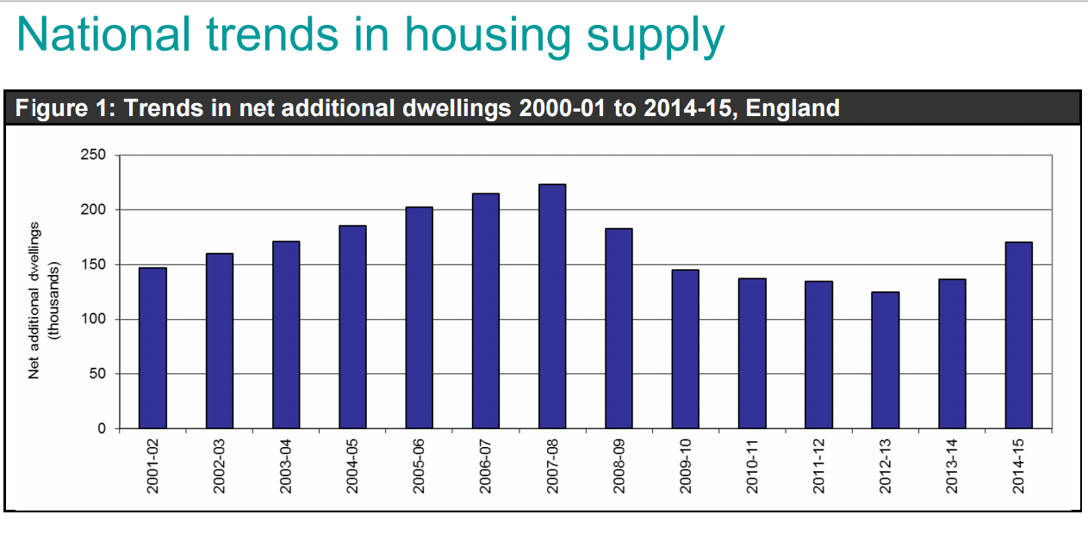
Source: ONS, Nov 2015

Slide 8
Net additions to housing stock 2014/15
TOTAL - 170,690
New Build - 155,080
Conversions - 4,950
Change of Use - 20,650
Other - 630
Losses - 10,620

Slide 9
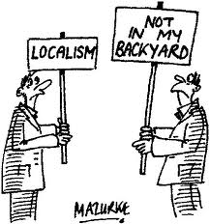

Slide 10


Slide 11
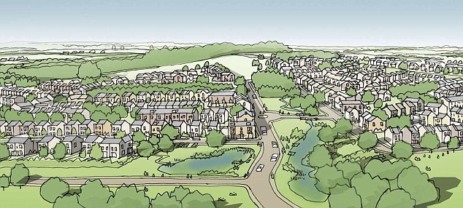

Slide 12
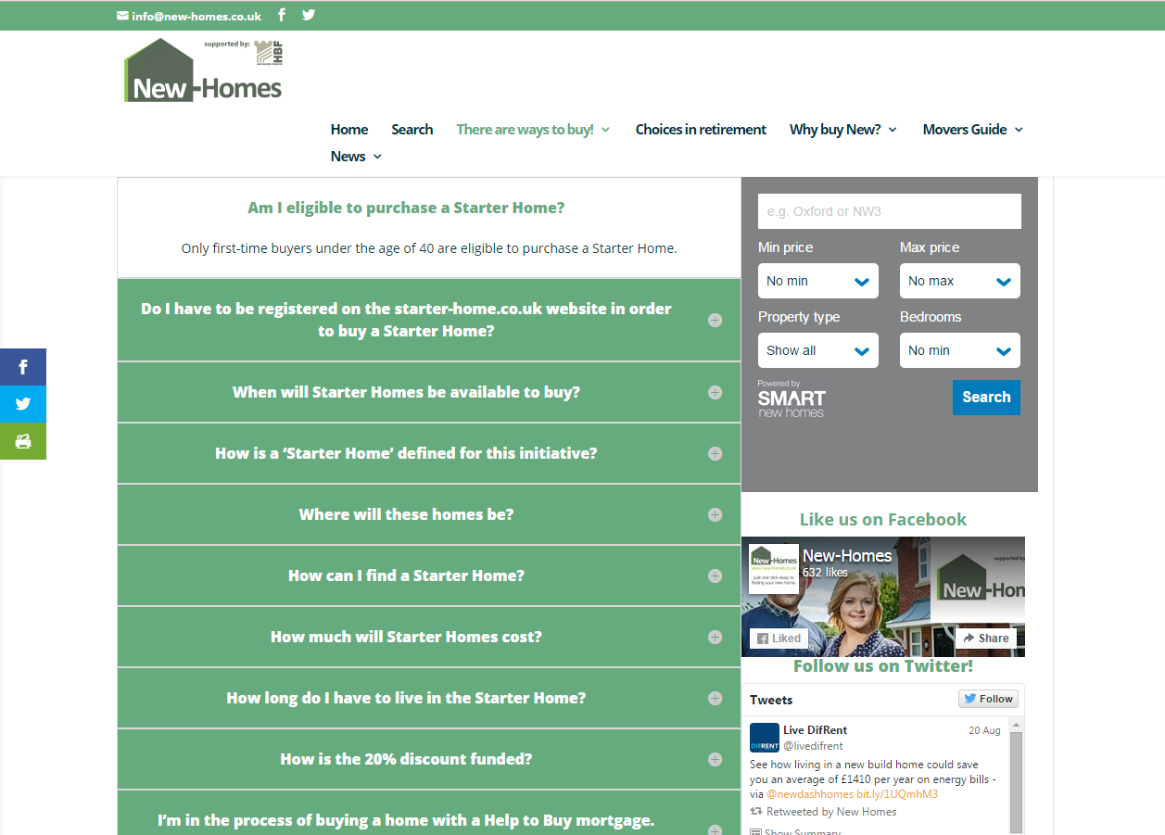

Slide 13


Slide 14


Slide 15
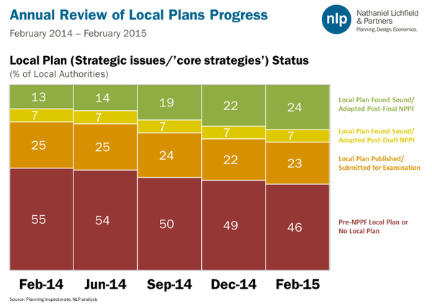

Slide 16


Slide 17
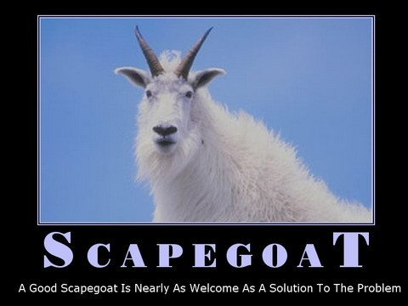

Slide 18
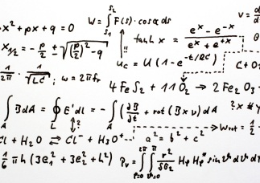

Slide 19


Slide 20
Think of a number
Subtract 1 from it
Multiply it by 3
Add 12 to the result
Divide by 3
Add 5 to the result
Take away the number you first thought of

Slide 21
8

Slide 22


Slide 23
Do the Maths
Plan period 2011 – 2026 (15 years)
Housing requirement = 1,200 net additional dwellings
Annual requirement = 1,200 / 15 = 80 dwellings per year
5 year housing supply = 80 x 5 = 400

Slide 24
5 Year Trajectory Plan

Slide 25


Slide 26


Slide 27
Build costs
Profit, overheads, interest
GDV
Cost of CIL & S106 inc. Affordable Housing
Land value (residual)
GDV = Gross Development Value

Slide 28
GDV
GDV
GDV = Gross Development Value

Slide 29
GDV
GDV
GDV = Gross Development Value

Slide 30
GDV
GDV
GDV = Gross Development Value

Slide 31
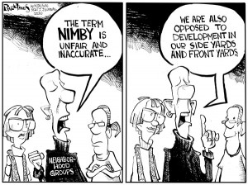

Slide 32
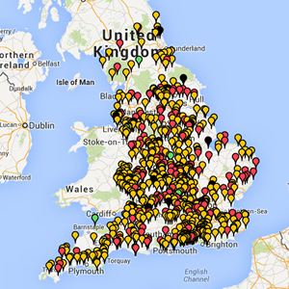

Slide 33


Slide 34


Slide 35


Slide 36


Slide 37
Planning fees and costs recovery

Slide 38


Slide 39


