Slide 1
PAS core training
Working with councillors
Richard Crawley
Jack Hopkins
October 2016
www.pas.gov.uk

Slide 2
Today
Introductions
Councillors
Place-making and policy
Planning committee
Easy life
So what?
Finish @ 16:30

Slide 3
Ground rules
Ask away – this is debate not one-way
Confidential
Safety
Phones
Others ?

Slide 4
Objectives
Understanding councillors
  Role
  People
Councillors and planning
How to improve (and have an easy life)
What to do next

Slide 5
Today
Introductions
Councillors
Place-making and policy
Planning committee
Easy life
So what?

Slide 6
1. Introductions
Have you brought your “homework” ?

Slide 7
Today
Introductions
Councillors
Place-making and policy
Planning committee
Easy life
So what?

Slide 8
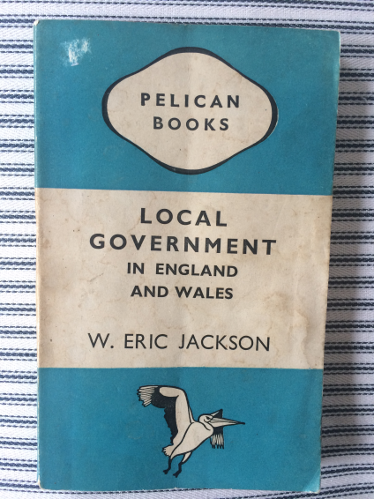
2. Councillors
With credit to …
From 1945

Slide 9
2. Councillors
“Some officials have been tempted to think that they could run their local services well enough without there being any elected members at all. [But] his usefulness is two-fold. The elected member is both lightening conductor and barometer.”
What do you think Mr Jackson meant?

Slide 10
2. Councillors
Lightening conductor:
“Any storms of public criticism are discharged upon the elected member. It is he who loses his seat at the next election if public opinion turns against his policy or actions. The official for the most part shelters behind the member.”

Slide 11
2. Councillors
Barometer:
“The action of legislators and governors must rest broadly on the support or sufferance of the people. There is a limit to public patience, beyond which the governor who wishes to avoid trouble must not go”
“It is the true function of the councillor to interpret public feeling and to enliven it with leadership”

Slide 12
2. Councillors
“The members settle the policy, that is, interpret and assess public feeling and public demands, and the official carries out his job in the light of the policy thus settled. If there were no elected members to interpret public feeling in this way, the official would have to do it for himself”
Is this still true ? In planning ?

Slide 13
2. Councillors
Councils are not businesses, but perhaps
  Shareholders = voters
  Directors = Councillors
  Staff = Officers
More difficult than business
  No profit & loss to measure
  Just “outcomes” as they relate to public taste and demand
  Change leads to pitchforks (sometimes)

Slide 14
2. Councillors
Councillors as people
  “mixed ability group”
Councillors in power / in opposition
Councillors in roles
  Back bencher / ward member
  Planning committee member
  Chair
  Cabinet member
  Leader

Slide 15
2. Councillors
What do you think they do ?
  How much time do they have ?
Some have back stories
  Stood on a planning issue ?
Different relationships with planning
  Boring ? Regulatory ? Quasi Judicial ? Scary ?
  Impact ! Legacy !
  Very public service / Newsworthy

Slide 16
2. Councillors
Have you ever wondered
  What lies behind member enquiries ?
  Where does trust come from ?

Slide 17
Today
Introductions
Councillors
Place-making and policy
Planning committee
Easy life
So what?
Finish @ 16:30

Slide 18
3. Place-making and policy
Planning has natural links to ward members
  Local issues
  Groups / civic societies
How to understand their principles / worries
  When making local policy
  When making infrastructure choices
  When allocating sites

Slide 19
3. Place-making and policy
How do you get political buy-in to a plan?
  Skin in the game ?
Over the lifetime of plan production
  Steps along the way?
  Cross-party = risk reduction

Slide 20
3. Place-making and policy
Make it interesting
  Planning for normal people
  Vision
Make it visible
  Steps along the way?
How do you do it ?

Slide 21
Today
Introductions
Councillors
Place-making and policy
Planning committee
Easy life
So what?
Finish @ 16:30

Slide 22
4. Planning committee
What is planning committee for ?
  Perception difference between officers & C’llrs?
    Rubber stamping <-> Posturing and soap opera
    Quasi judicial <-> representative democracy
  = culture of a committee (they are all different)
Who decides what goes up ?
  Scheme of delegation
  Pre-applications ?
  Risk profile

Slide 23
4. Planning committee
How to prepare
  Why do officers present ?
  Rehearsing / practising
  Low stakes (volunteer early)
Know your audience
  Members have “hot” issues
  You should be able to predict some questions
What about your committee ?

Slide 24
Today
Introductions
Councillors
Place-making and policy
Planning committee
Easy life
So what?

Slide 25
5. Easy life
This is a team game
  We all want an easy life !
Our advice and top tips
  Take it back to your council, and use it to ask questions that are difficult to ask ?
  Even if you are quite junior, you can find ways

Slide 26
5. Easy life
PAS top 5 for an easy life:
Communicate well
Build relationships
Be clear on roles
Work with what you’ve got
Develop the talent

Slide 27
5. Easy life: top 5 unpacked
Communicate well
  Email is great but …
    Once things are written down
    Sometimes the important point might not be clear
  Get in there early
  Think “goldilocks” level of information
    Don’t expect councillors to synthesise
    Give them what they need. Not too much; not too little
  Think appropriate levels of honesty

Slide 28
5. Easy life
Build relationships
  Informal works really well
    Eg Site visits
    Eg Come to a team meeting (?)
  Q&A
    What matters in the ward? On this scheme ?
  Be trust-worthy
  It can take time
    You won’t win them all

Slide 29
5. Easy life
Be clear on roles
  Remember what councillors are trying to do
  Think of the different pressures they are under
  Your role is to support and advise
    Professional context
    Do you work for the council or the RTPI ?

Slide 30
5. Easy life
Work with what you’ve got
  Councillors are individuals
    Don’t expect them all to behave the same
  Don’t play the Politics game
  Opposition members ?

Slide 31
5. Easy life
Develop the talent
  Planning is difficult ! And it keeps changing
  Councillors need general training to help them take good / robust decisions
  Backed up with specific support on key issues
    You will often find councillors have particular interests that can be developed (eg design)
  Celebrate (and revisit) successes
    Link policy and decisions to outcomes

Slide 32
5. Easy life
PAS top 5 for an easy life:
Communicate well
Build relationships
Be clear on roles
Work with what you’ve got
Develop the talent

Slide 33
5. Easy life
The prize is councillors acting as advocates
  Public meetings
  Difficult decisions

Slide 34
5. Easy life
Red flags ?
  Wilful misunderstanding
  Exposure
  Grandstanding
  “Bullying, rude, two-faced and manipulative”
What to do ?
  Seek help / advice
Your experiences?

Slide 36
6. To close
Problems ? Advice ?
What sort of thing might you try to do next ?
Most helpful thing we’ve said ?
How would you share this with your peers ?

Slide 37

Contact PAS
email pas@local.gov.uk
web www.pas.gov.uk
phone 020 7664 3000

