Slide 1
Housing needs assessment
Aligning jobs and housing

Slide 2
What not to do
Buy a job forecast
Translate the jobs into population into households & houses
  Assuming fixed commuting ratios
Infer number of dwellings ‘needed’
Why not?
  The forecast already assumes a given population
    And implicitly households and dwellings
  But not the same as you calculate at the end
    In economically buoyant areas usually fewer
  Because the forecaster’s jobs-to-population factors are different
  Especially commuting ratios are not fixed
    In real life commuting adjusts to supply-demand shifts
  Objectors have to ask just one question
    Show us the population figures behind your job forecast please
  And your numbers go in the bin

Slide 3
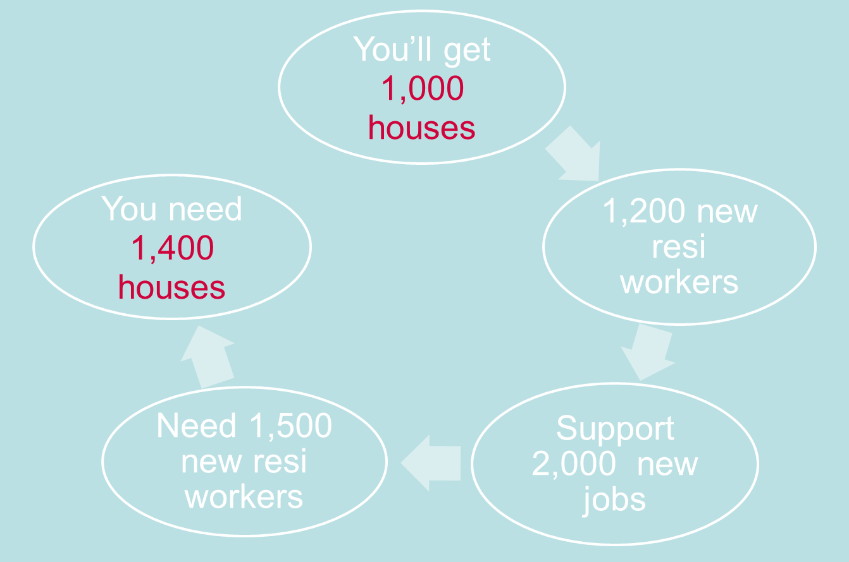

Slide 4

A real-life example
Experian forecasts 31,000 net new jobs in the plan period
They also shows population growth
  In small print at the bottom
  45,000 extra residents
  Taken from ONS 2010-based projections
The planners didn’t look at that
They calculate that 31,000 new jobs ‘needs’ 74,000 new residents
Hence (say) 32,000 new houses
Makes no sense
Happens all the time

Slide 5
What to do
Look at job forecasts
Assuming the correct population
  As per preferred demographic projection
Audit the forecasts
  Do you believe them?
  Are they consistent with policy aspirations?
  Are the commuting implications
    Credible?
    Acceptable / policy-friendly?

Slide 6

What to do continued
If Yes
  End of (almost)
  Make sure employment land policies use the same numbers
If No
  Produce new job numbers (demand)
  Make sure they’re reasonably realistic
    Don’t get carried away
    Show why you think the forecast is wrong
  Translate into resident population > housing
    Not necessarily fixed commuting ratios
    Take an intelligent view
    Ideally working with the forecaster
    Understand how their jobs-to-population relationship works
    The models vary
  If you don’t like the result
  Reconsider the job number

Slide 7
In short
Plan for enough housing to
  Support the number of jobs you are planning for
    Which may not equal latest (or any) forecasts
  Consistent with reasonable commuting patters
    Which may not be the same as today
In deciding how many jobs to plan for
  Don’t just pick up any old forecast
  Consider job forecasts critically
    Are their demographic numbers consistent with yours?
    Are they otherwise credible?
    Compatible with your objectives?
    If not, what can you realistically change?
Keep it simple

