Slide 1
CIL – a local authority perspective
Jeni Jackson, Woking BC

Slide 2
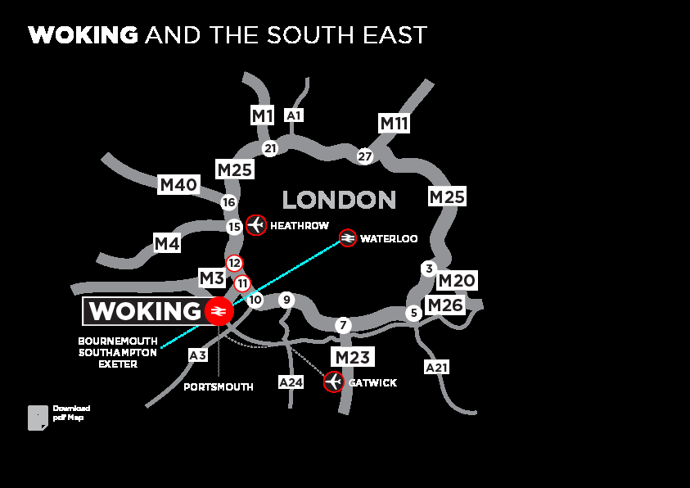
Where is Woking?

Slide 3
Woking: Vital Statistics
Population 99,198 in 2011
‘greying’ population
Net importer of workers
Need for school places

Slide 4
In Woking
Our Core Strategy was the first to be found sound post NPPF
We have an Infrastructure Delivery Plan which is informed by the quantum, type and location of development in the CS
Consultants conducted our Viability work for us

Slide 5
CIL Charging Schedule
Two rates
Type of development | Charging Schedule
Residential (Town Centre, Sheerwater and Maybury) | £75 per square metre
Residential (rest of the Borough) | £125 per square metre
Retail (all types) | £75 per square metre
All other commercial and non-residential uses | Nil (£0 per square metre)

Slide 7
In Woking
We submitted our CIL for examination, we didn’t have one …. No one wanted to appear!
We received a report from the Inspector on 9 July 2014 that it was sound
Council took a decision to adopt, implementation date 1 April 2015

Slide 8
Why April 2015?
The ‘drop dead’ date in the regulations
There is so much to do!

Slide 9
CIL Governance
Literature review
Other examples in Surrey
- Elmbridge Government Frontrunner 2011

Slide 10
CIL Governance
Two tier authority
Joint Committee

Slide 11
The political bit …
The role of Members
Level of understanding
The dichotomy of what is needed to support new development and what Members want …. It was ever thus!
Regulation 123 list

Slide 12
Woking’s Process
Planning services – planning application
Finance/Revs & Bens – collection
Delivery – corporate functions
Planning services - monitoring

Slide 13
Infrastructure Working Group
Political Members:
Portfolio Holder for Planning, WBC
WBC Member representative
SCC Member representative
(the above to include representation from both main political parties also)

Slide 14
Woking IWG Members
Head of Planning, Woking BC (Chair)
Planning Policy Manager, Woking BC
Promoting the Borough Manager, Woking BC
Corporate Policy Manager, Woking BC

Slide 15
Surrey CC IWG Members
For Surrey CC the following areas would be represented as required:
Spatial Planning
Transport Policy
Infrastructure Agreements
School Commissioning
Economic Development
Property Services

Slide 16
Aim of the IWG
To meet the challenge of aligning infrastructure delivery to development coming forward on the back of the Core Strategy,
To deliver the infrastructure requirements of the Core Strategy as amplified in the Infrastructure Delivery Plan.

Slide 17
Aim of IWG cont.
To facilitate delivery of the schemes identified in the CIL Regulation 123 list.
To coordinate with other infrastructure providers including utility companies.

Slide 18
IWG Objectives
to provide a co-ordinated and consistent response to delivery of the infrastructure set out in policies of the Core Strategy;
to ensure that overarching infrastructure delivery mechanisms are secured;
to advise the Joint Committee on the Reg 123 List schemes and their priority, in delivery terms, to ensure maximum benefit to the community

Slide 19
Categories of Infrastructure
 | Category | Description
1 | Critical | Infrastructure that must be provided to enable growth and without it development cannot be allowed to proceed e.g. major utilities infrastructure
2 | Essential | Infrastructure that is considered essential and necessary to support and/or mitigate the impact arising from development. The timing and phasing of these projects e.g. school places and public transport projects are usually linked to the occupation of development sites.
3 | Deliverable | Infrastructure that is required to support wider strategic objectives, to build sustainable communities and to make places. This type of infrastructure is influenced more by whether a person chooses to use the facility e.g. community facilities. The timing is not critical and is usually linked to completion of development.

Slide 20
Scheme Prioritisation
Criteria | Yes/No
Be included in the Infrastructure Delivery Plan
Be included in the Regulation 123 list
Deliver specific policies of the Core Strategy (and, in due course, the delivery DPD)
Contribute to the delivery of other approved Council strategies, e.g. open space
Contribute to the delivery of the Council’s Corporate Priorities
Contribute towards the delivery of infrastructure by a provider where it can be satisfactorily be demonstrated that the infrastructure would not otherwise be delivered i.e. that all other possible funding sources are insufficient
Address a specific impact of new development beyond that which has been secured through a section 106 obligation or a section 278 agreement
Lever in other funds that would not otherwise be available e.g. need to match or draw grant funding
Offer wider as well as local benefits
Be deliverable in the year that the funding is being programmed i.e. justified by
(i) a project plan including a timetable and resources available to meet the timetable
(ii) consultation summary report to indicate stakeholder support; and
(iii) arrangements for ongoing maintenance

Slide 21
The ‘meaningful proportion’
Woking – unlike other Surrey districts – has no parishes
We have a number of Neighbourhood Fora
We have had a ward boundary review
Patchwork quilt effect

Slide 22
Going forward
Site allocation work in delivery DPD
Green Belt & greenfield sites to be allocated 2022 – 2027
Finding other funding sources

Slide 23
Conclusion
Governance to be bespoke
Lessons learnt from other LPAs
Devil is in the detail
Need for corporate cross-working
Need to work in partnership at all levels
Need to be transparent

