Slide 1
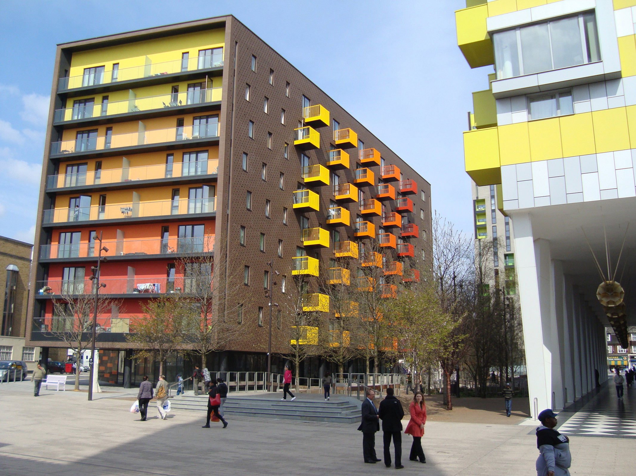
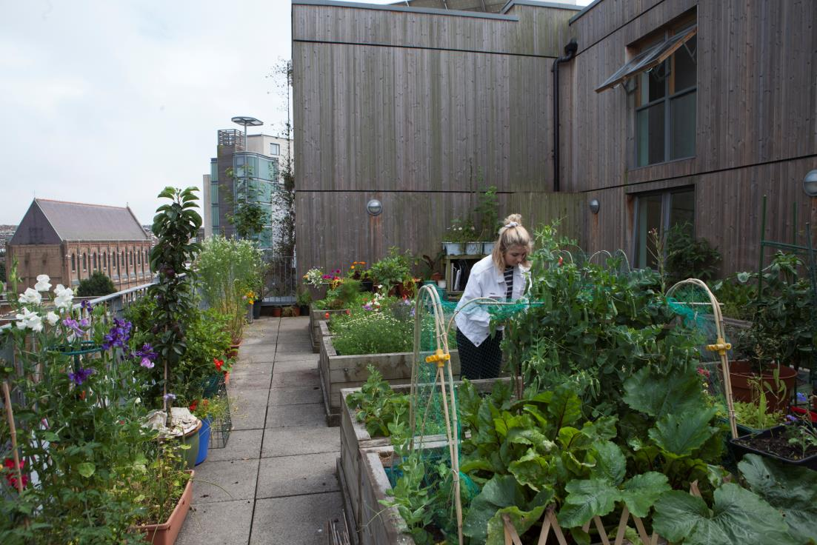

Delivering Quality Places in Challenging Times
Julia Wallace
CABE

Slide 2
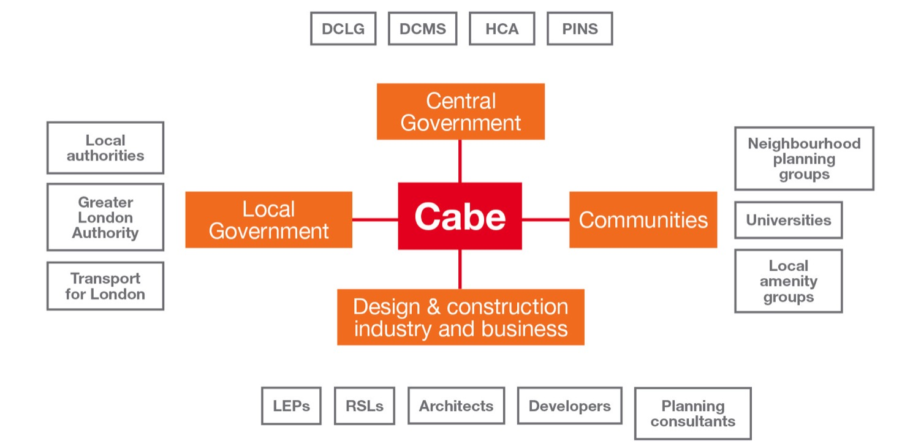
Design Council Cabe
networks

Slide 3

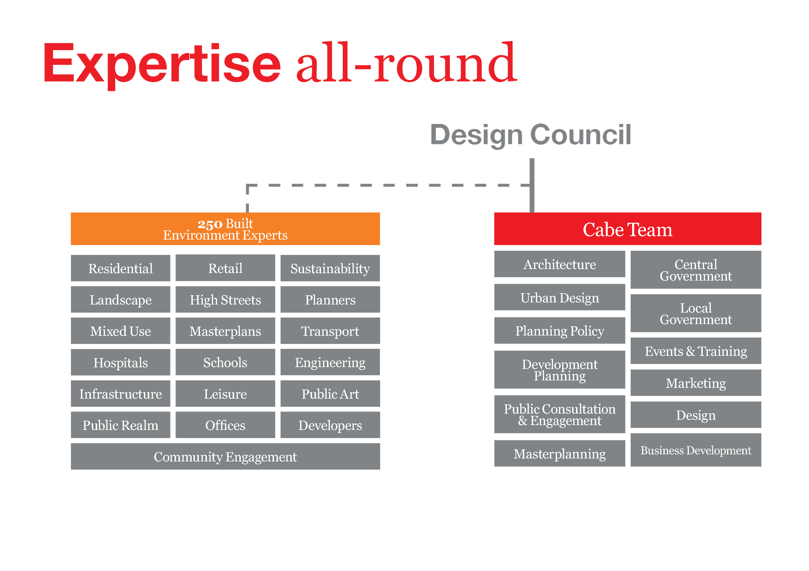

Slide 4
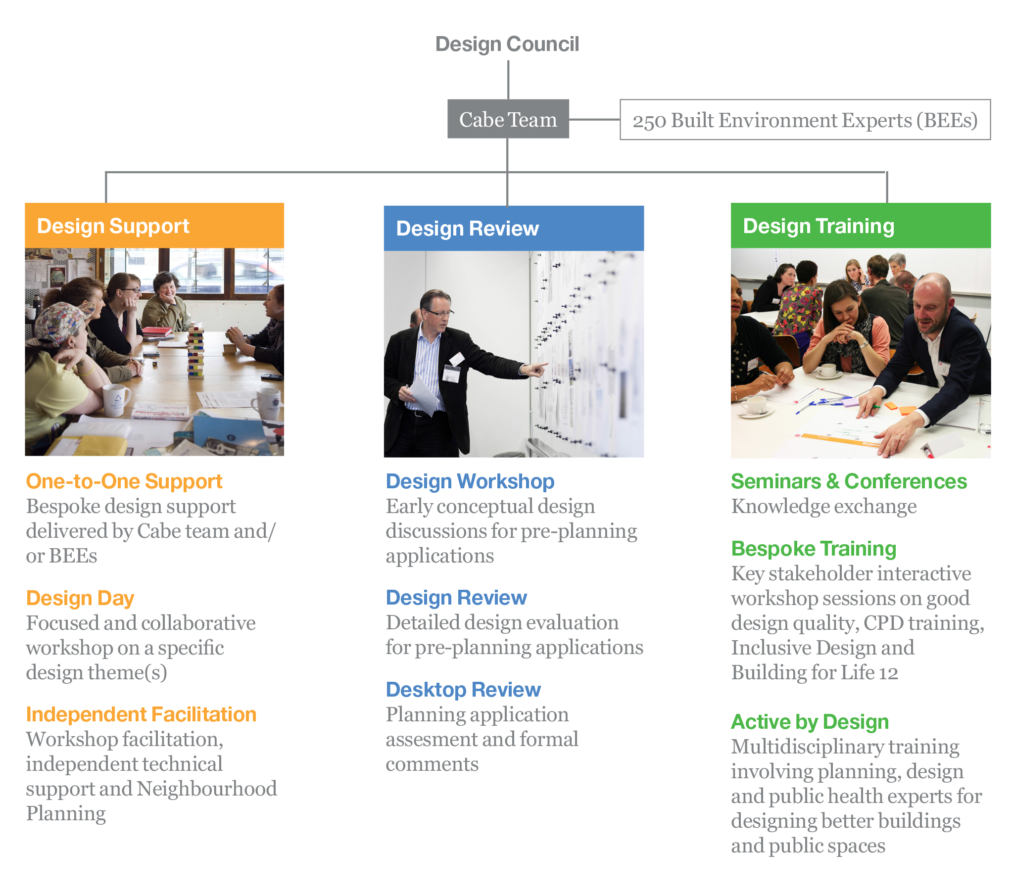
Cabe services

Slide 5
Design in planning

Slide 6
Design still matters
NPPF paragraph 56:
“The government attaches great importance to the design of the built environment. Good design is a key aspect of sustainable development, is indivisible from good planning and should contribute positively to making places better for people”.

Slide 7
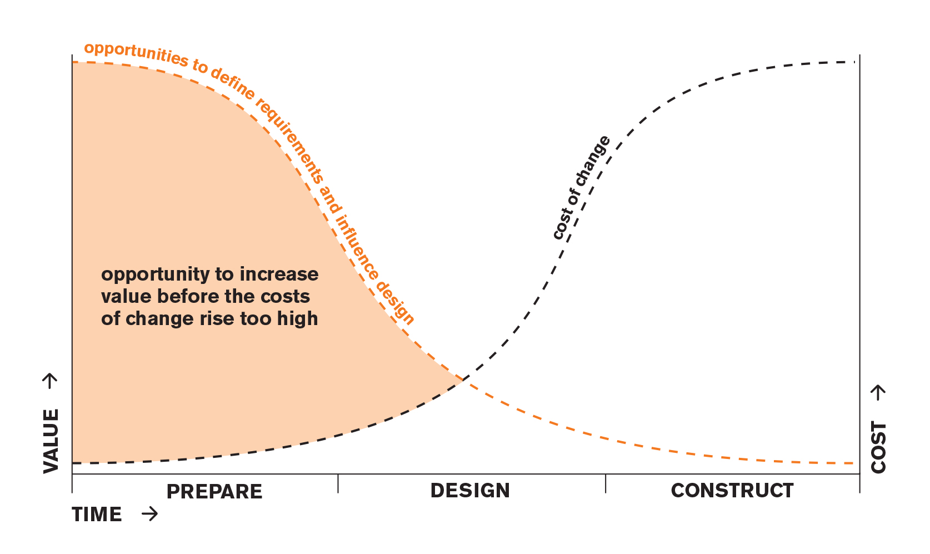
Design still matters

Slide 8
Your role in creating better places

Slide 9
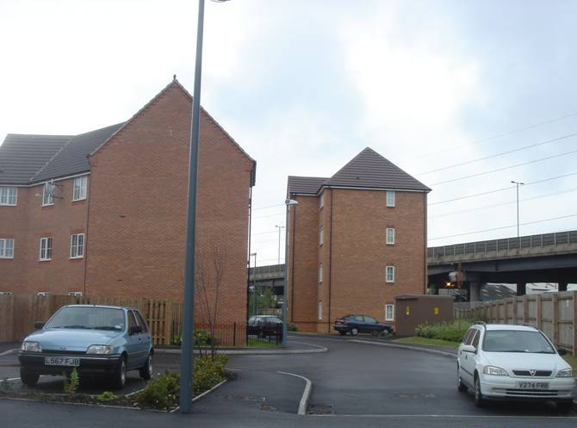
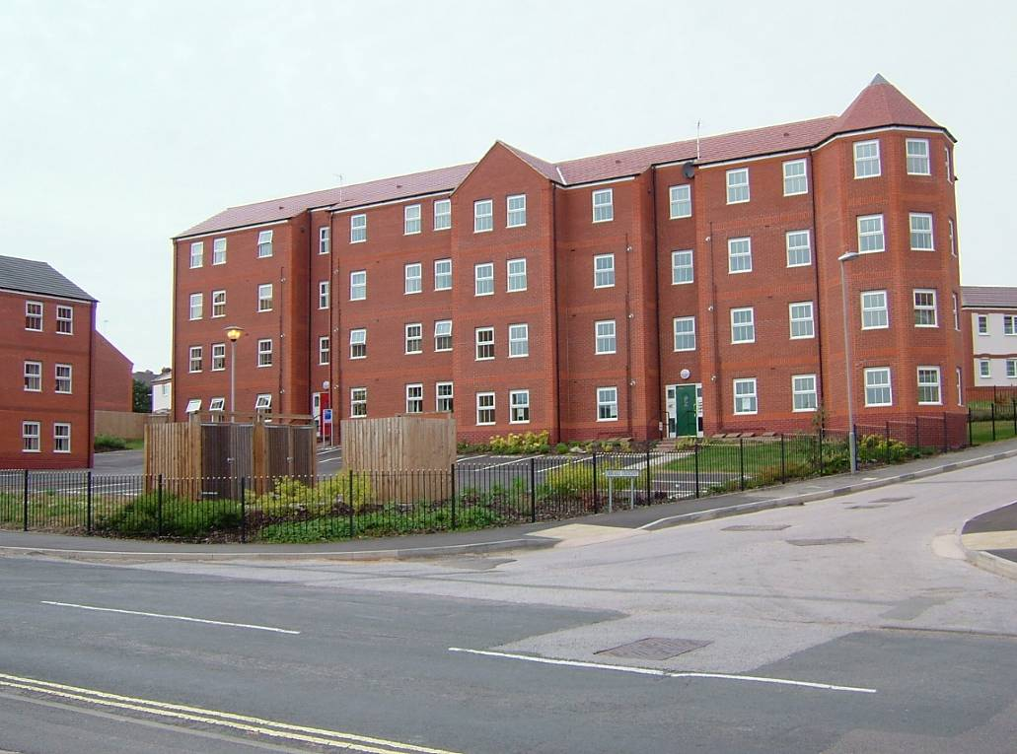
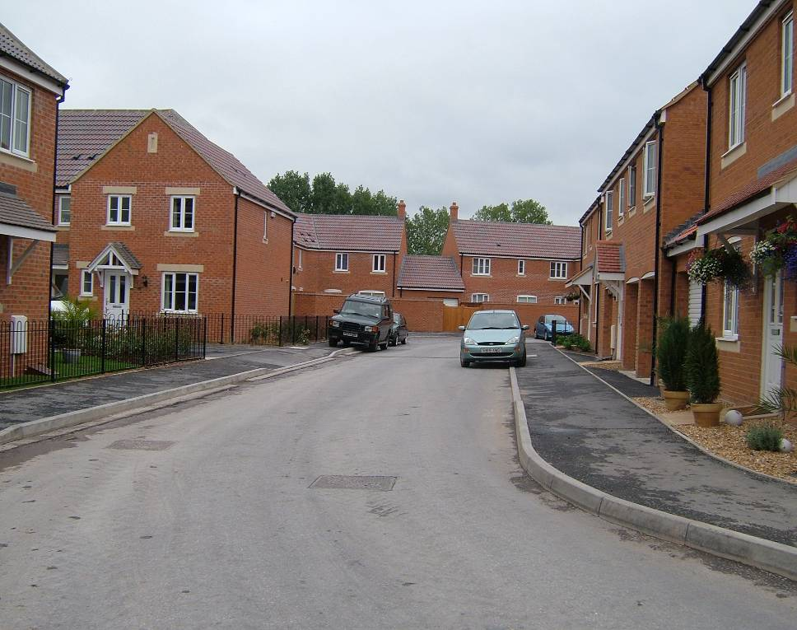
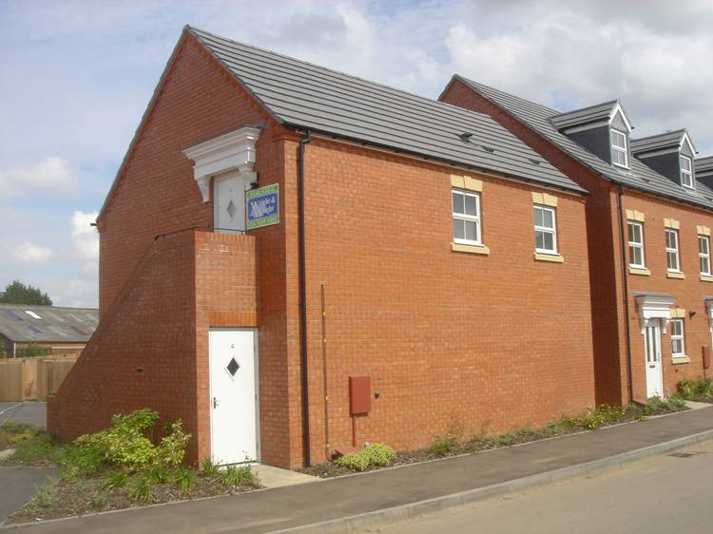

Slide 10

Gatekeepers

Slide 11

Thinkers

Slide 12
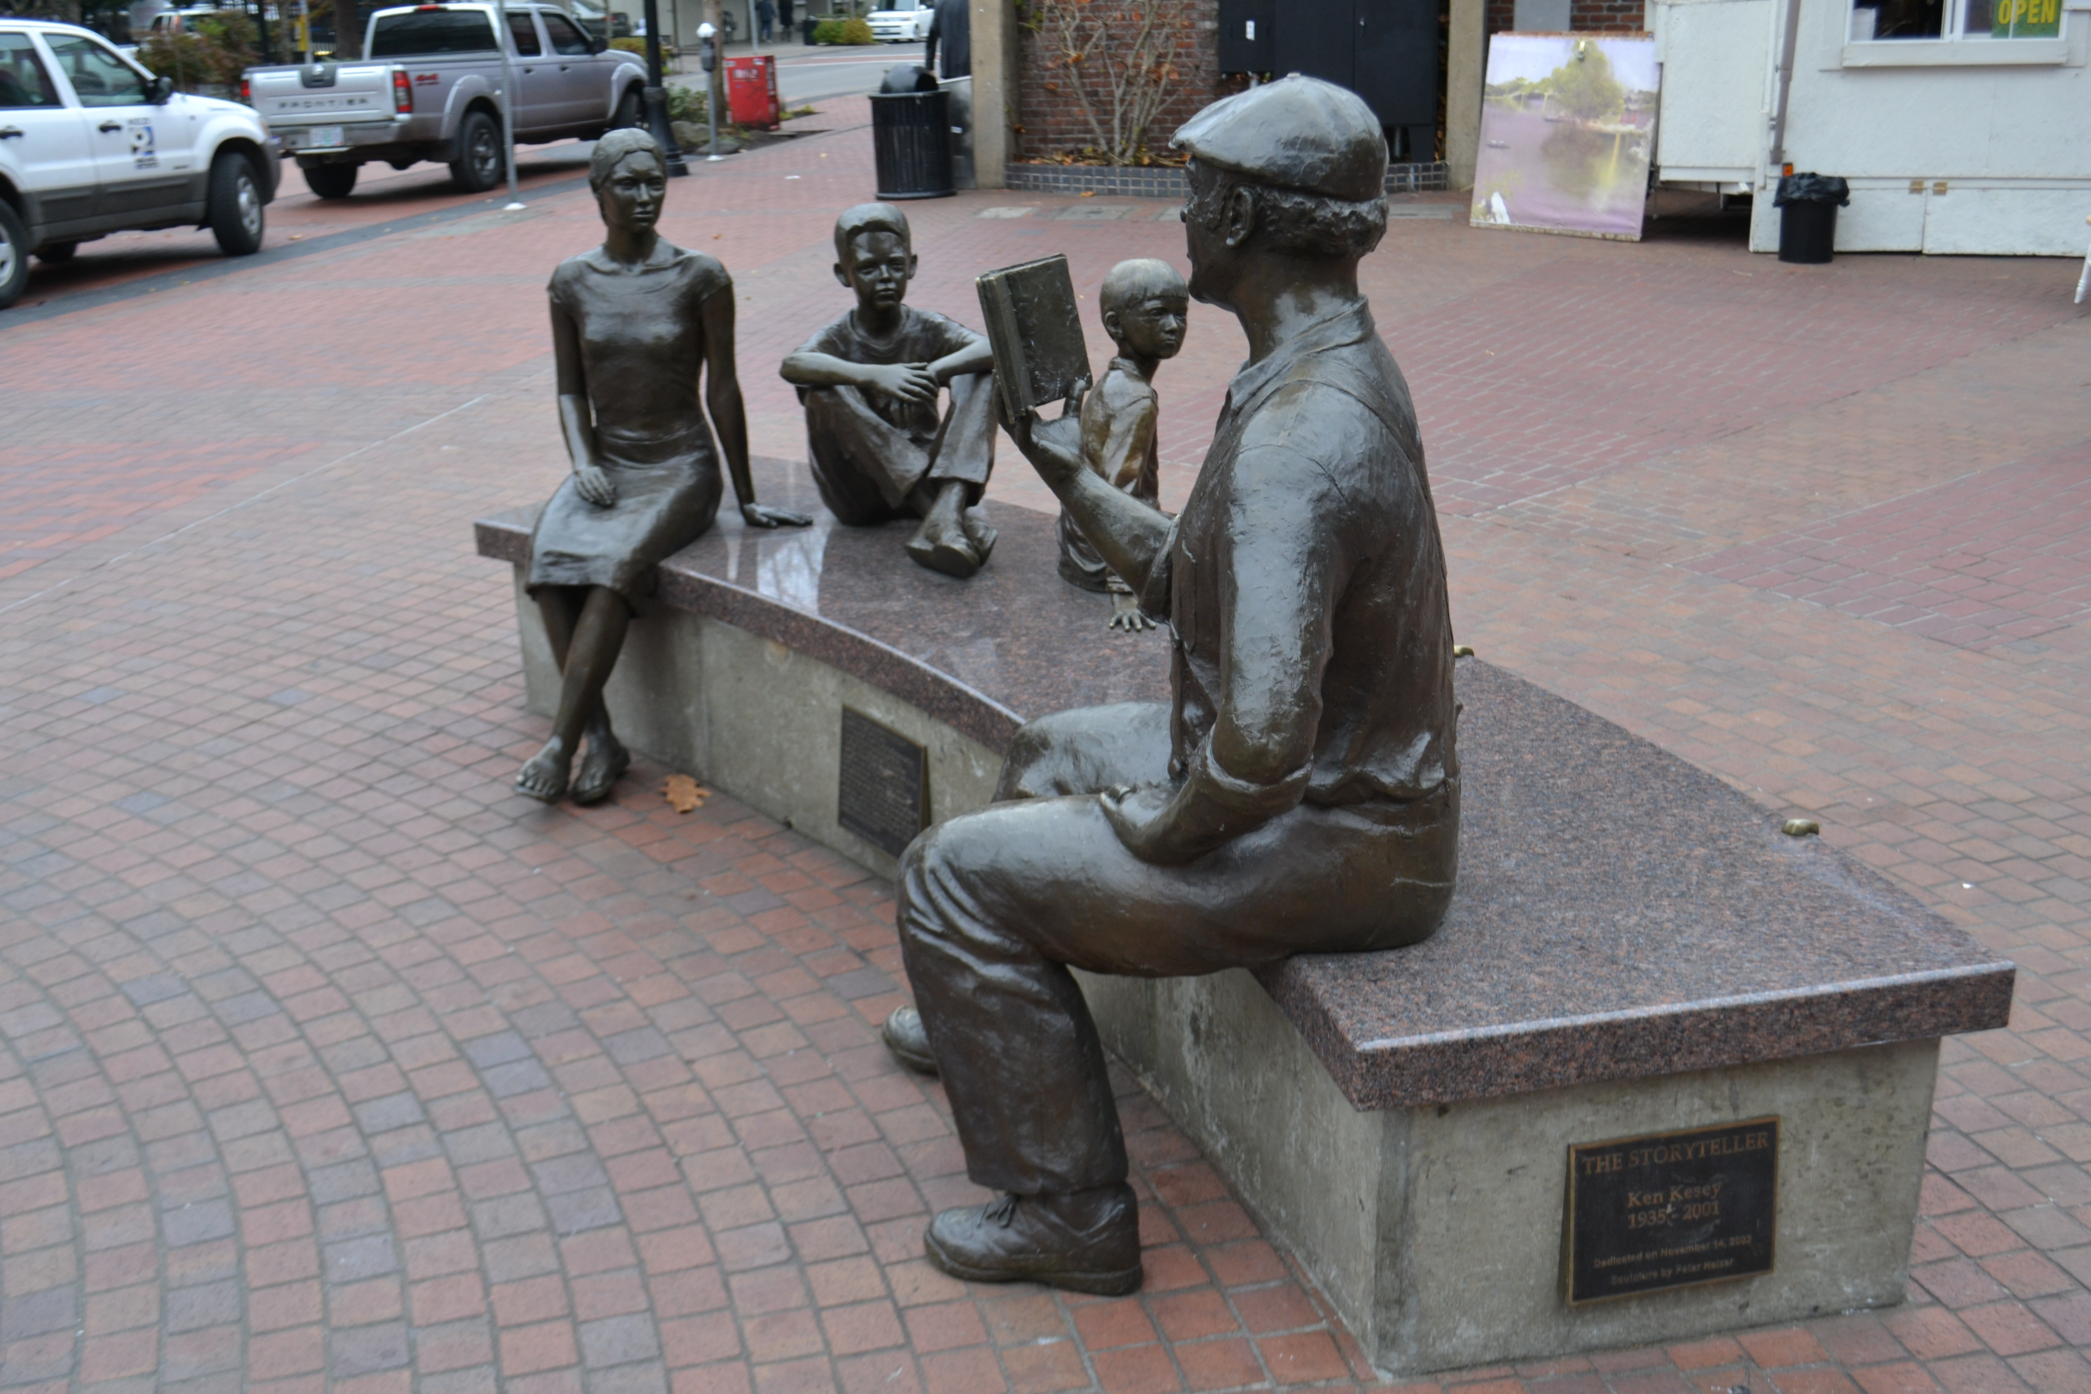
Scene-setters

Slide 13
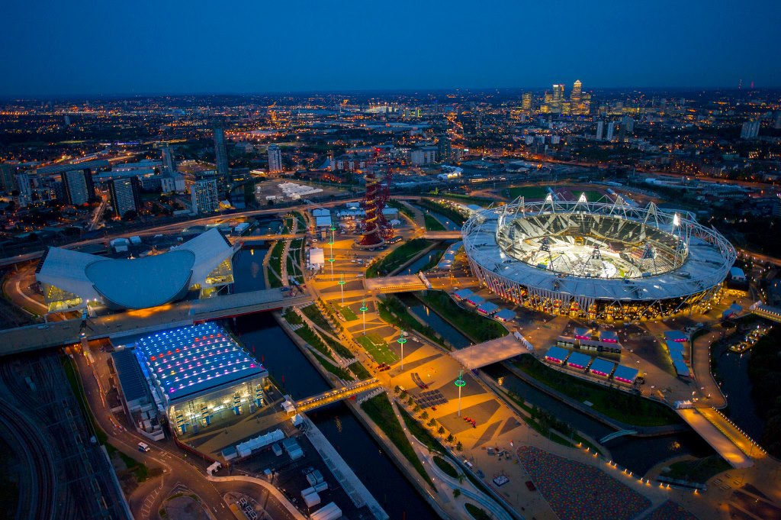
Legacy-makers

Slide 14
What makes a good place

Slide 15
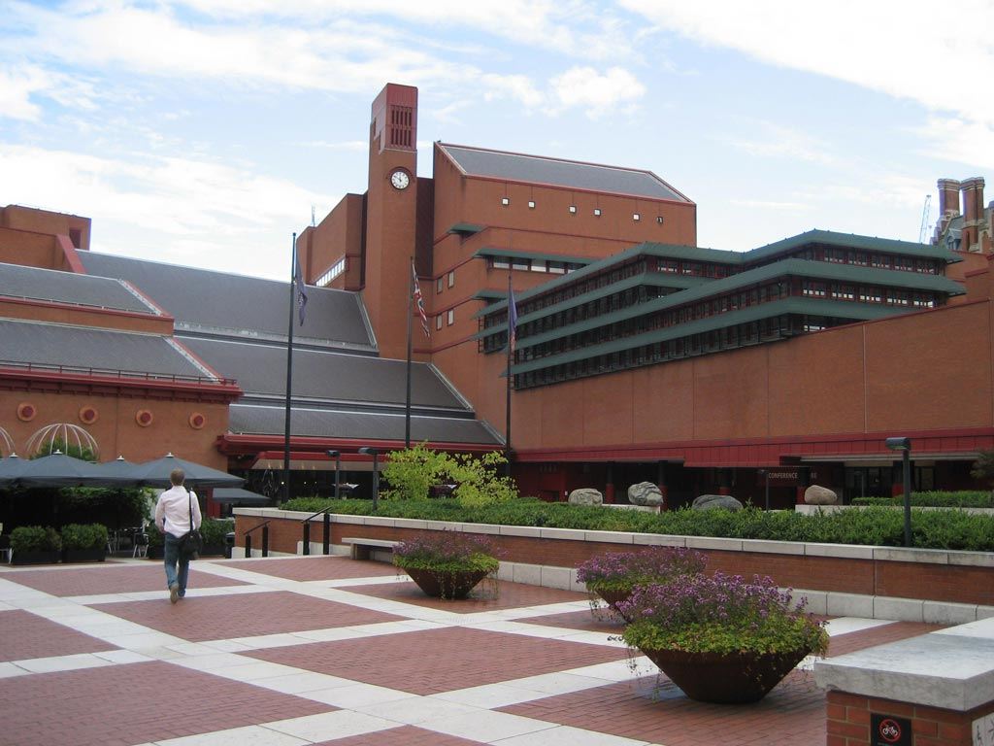
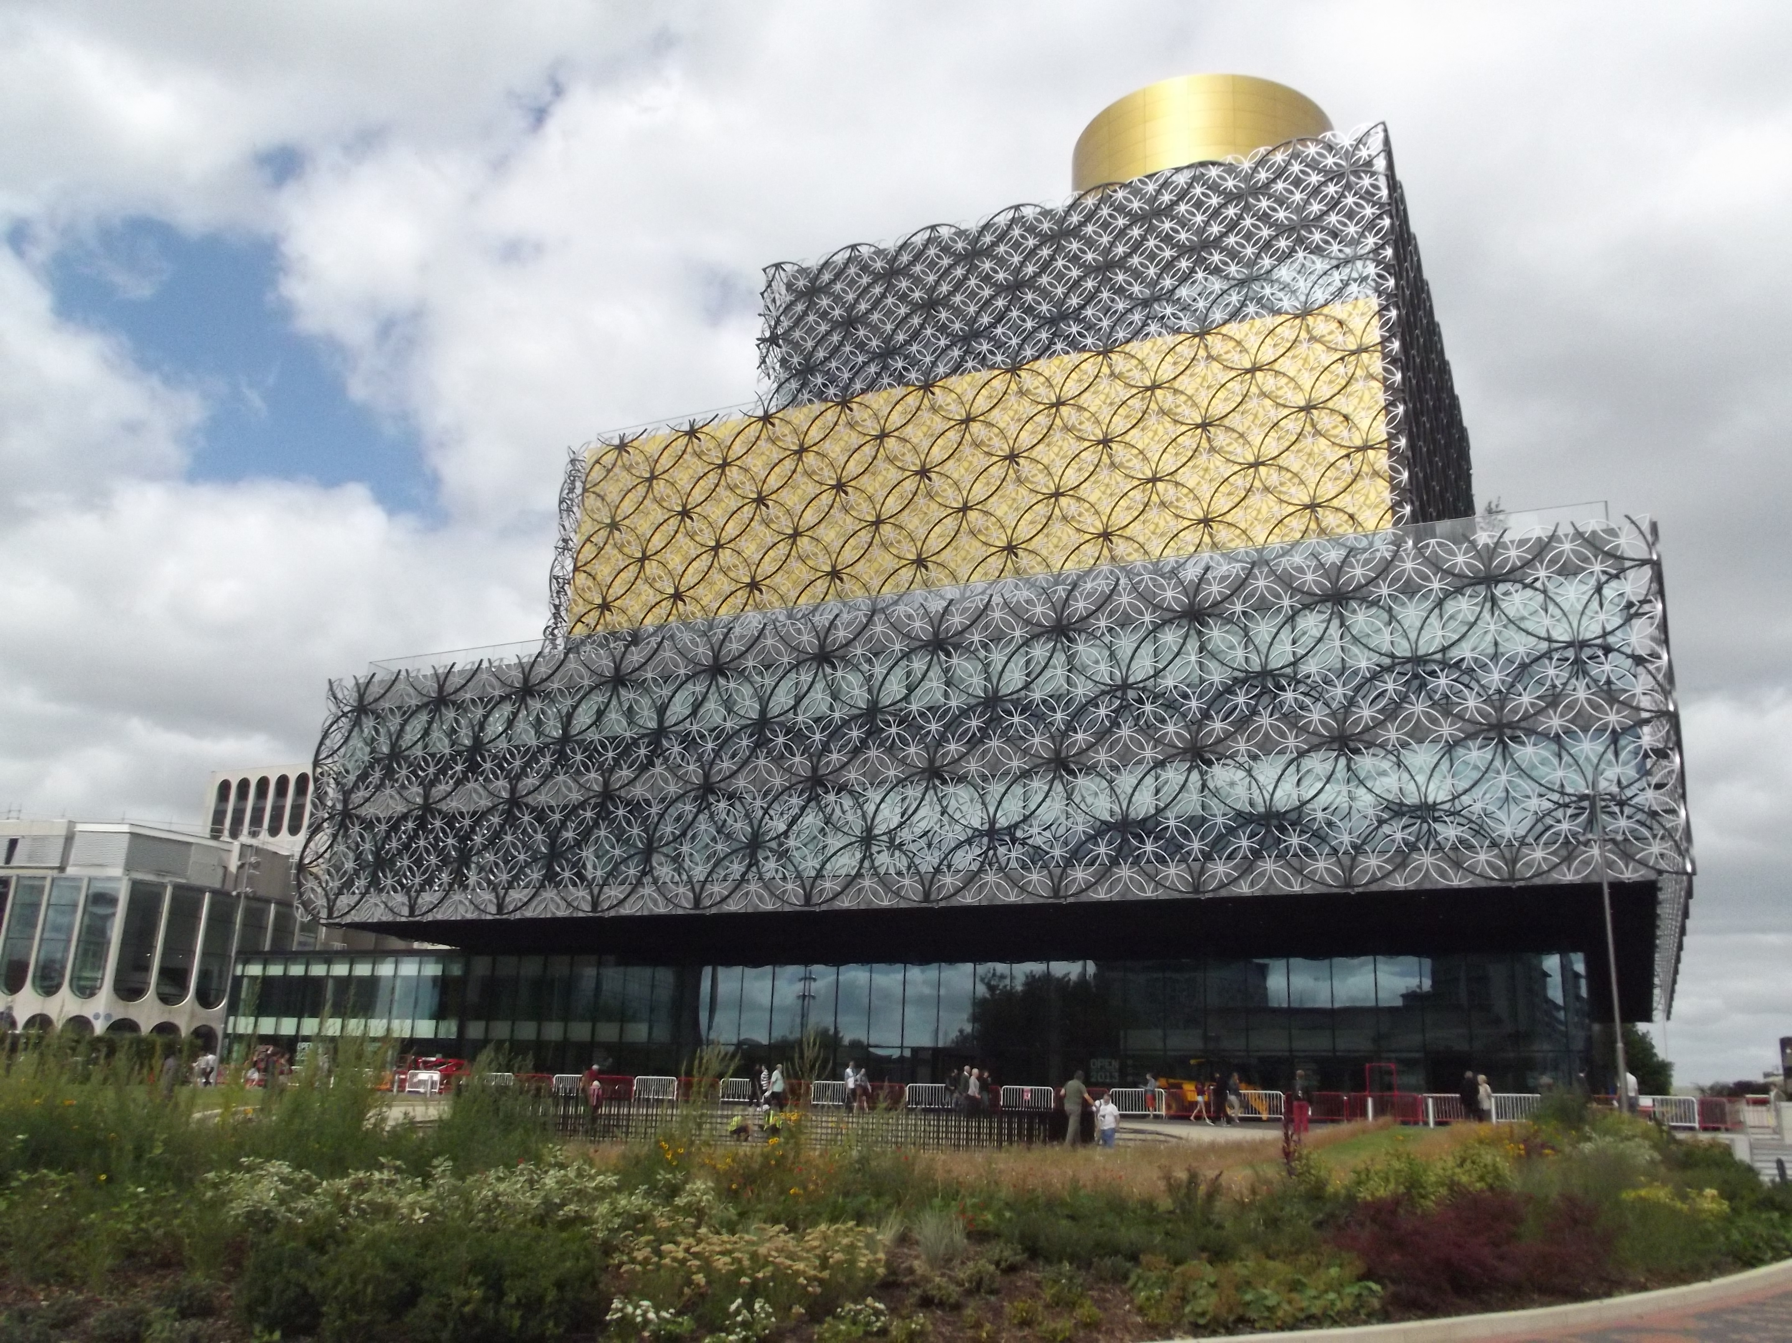
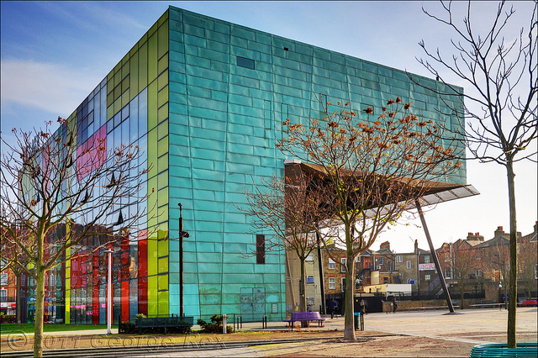
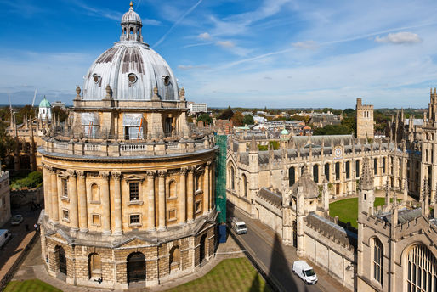
Character

Slide 16
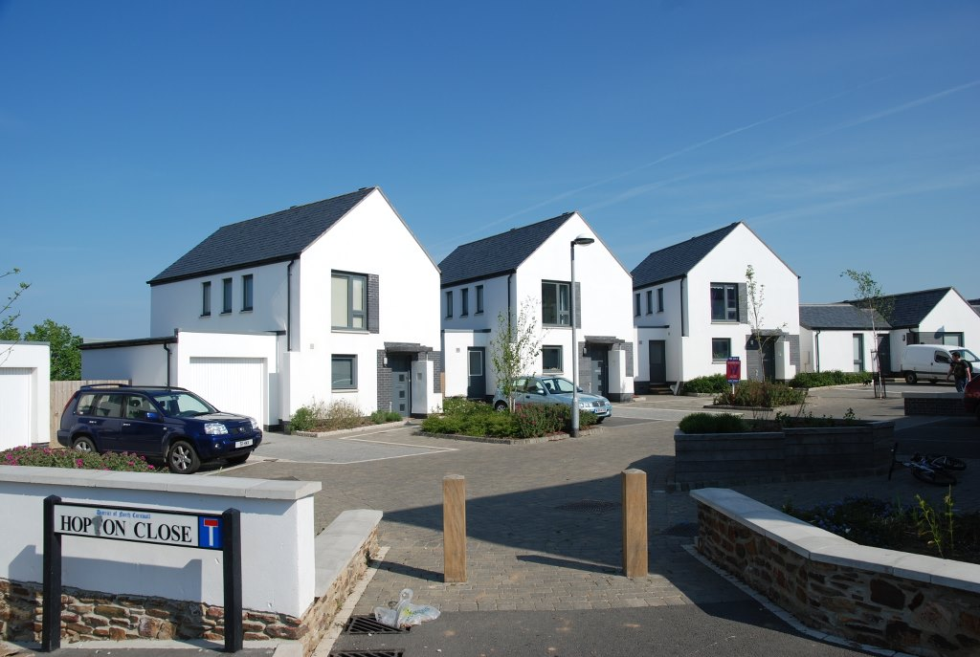

Slide 17
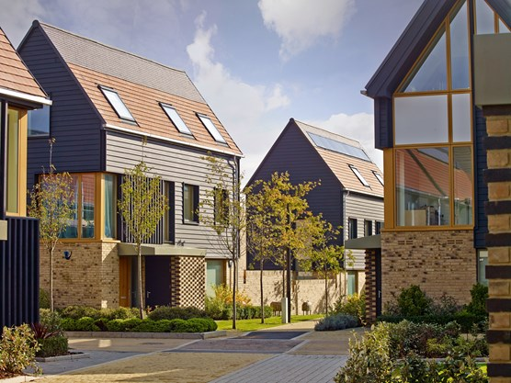

Slide 18
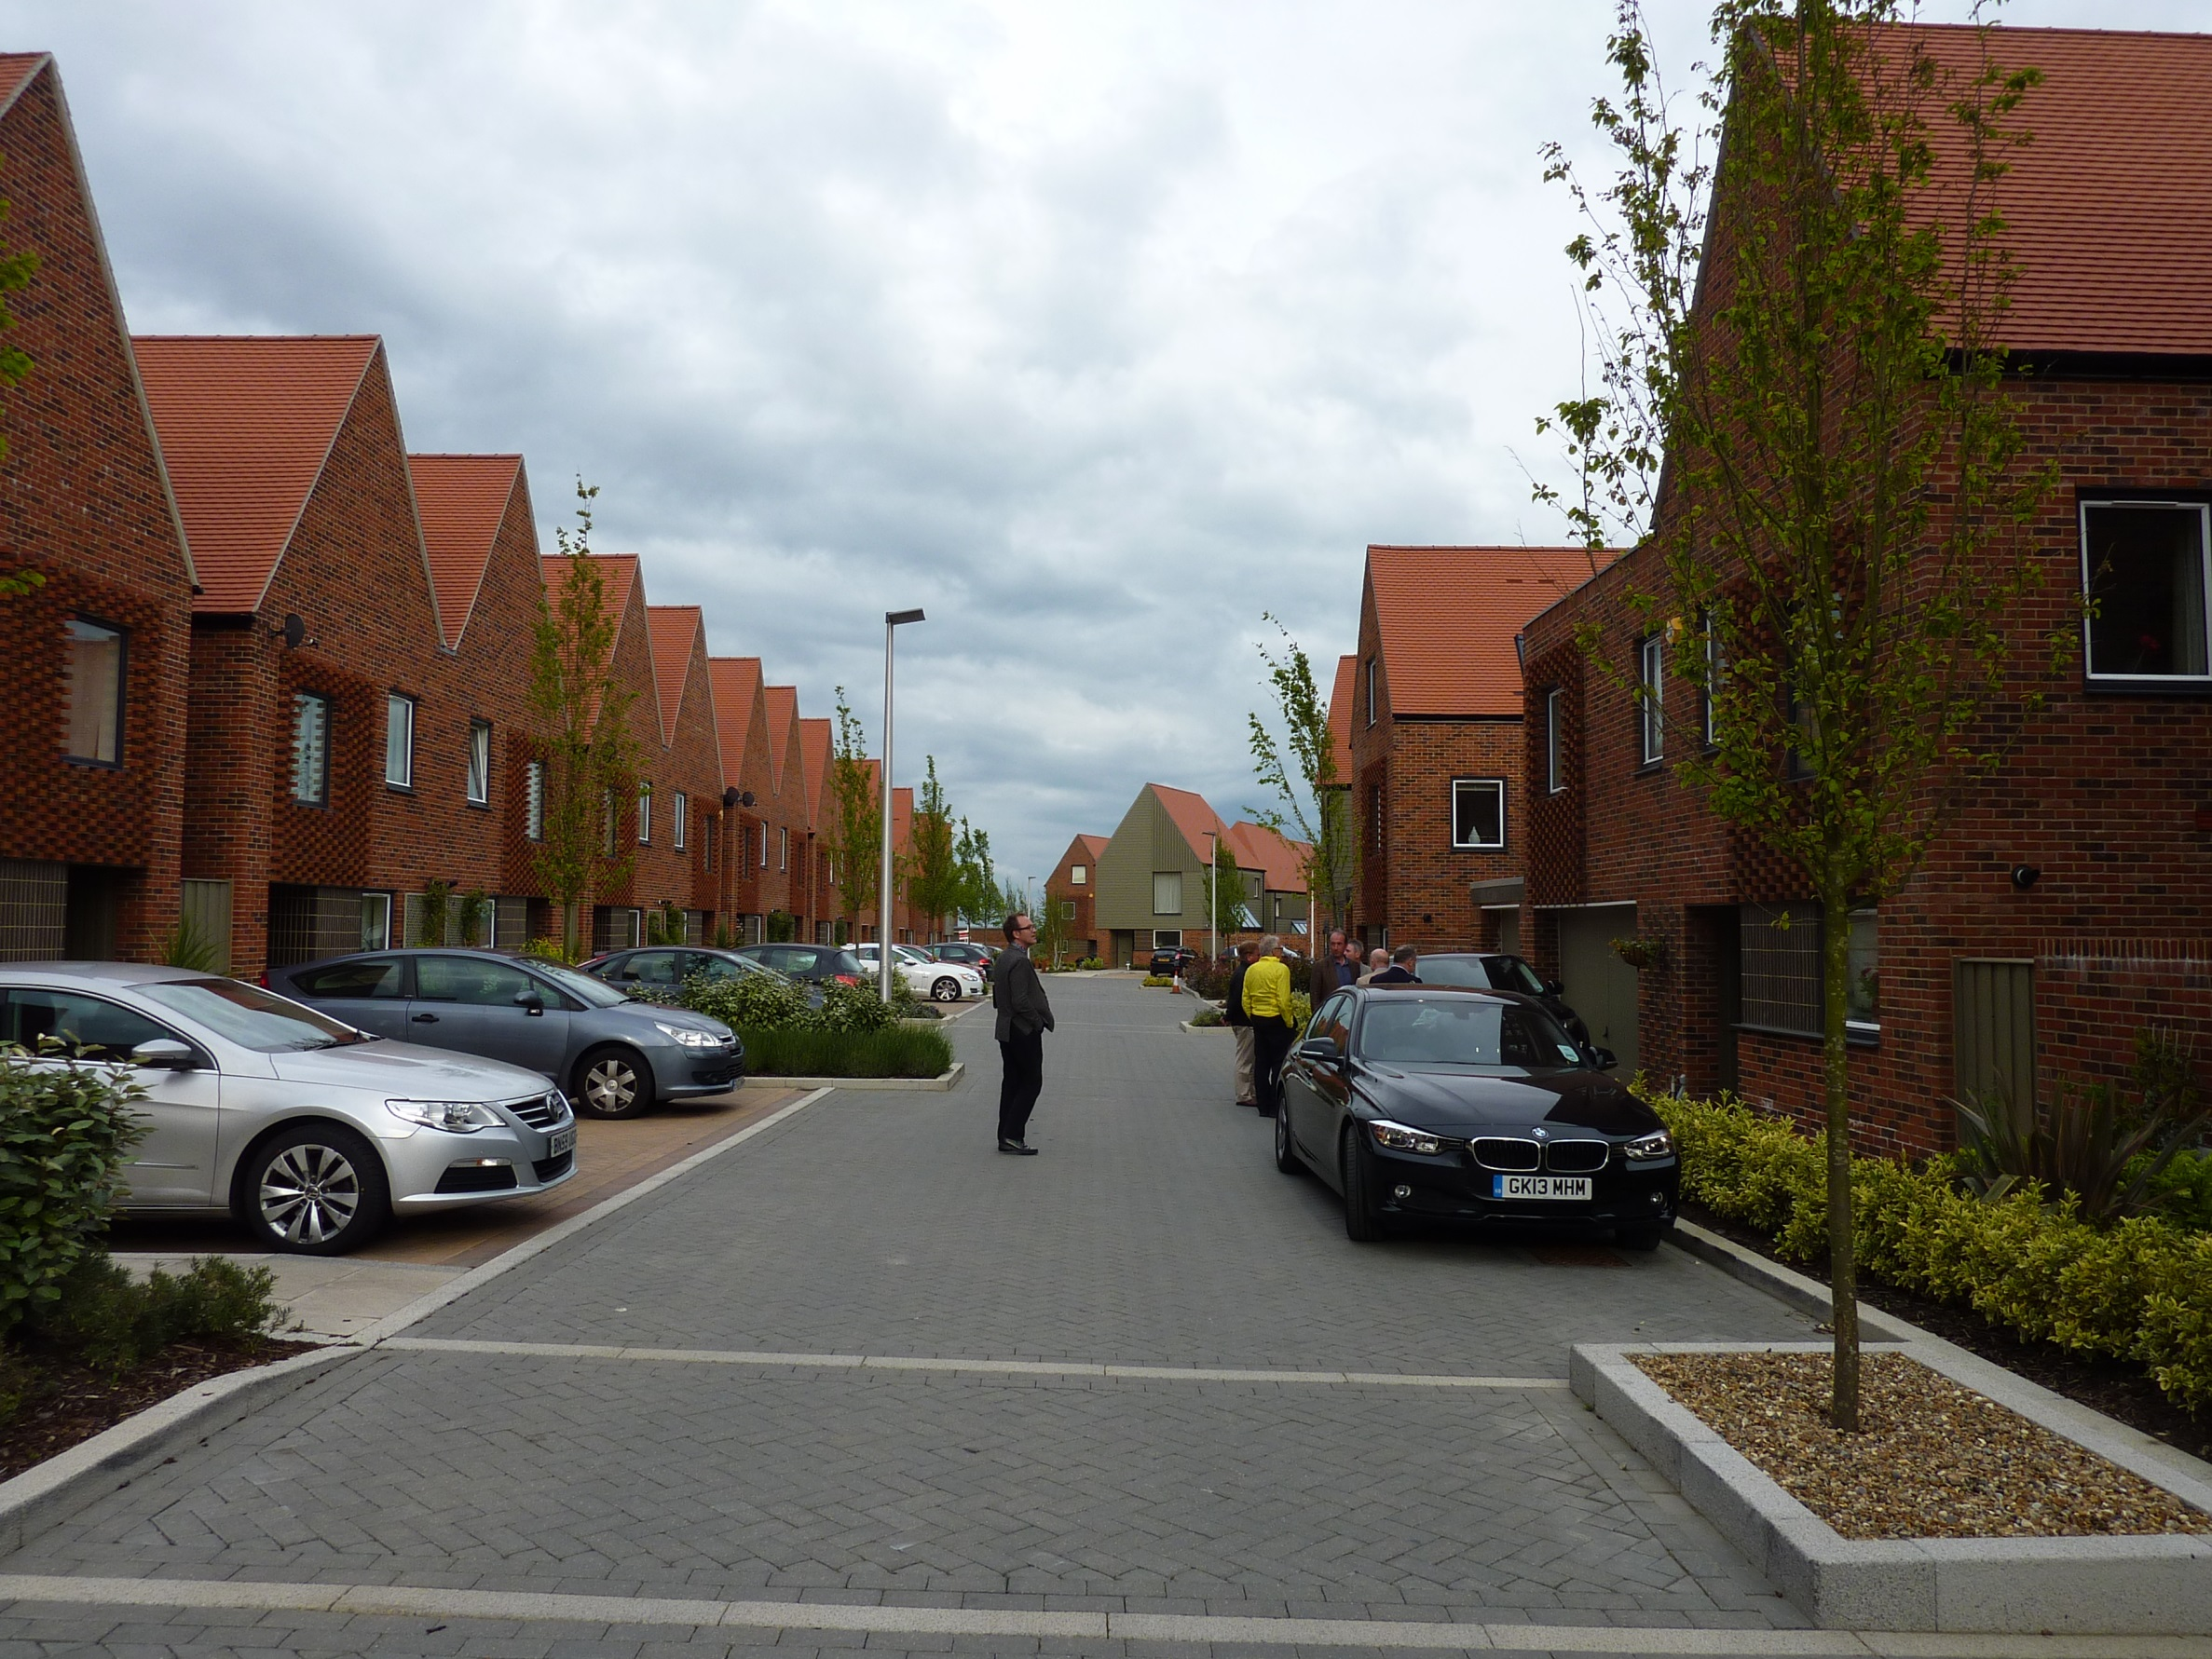
Notes:
Urban grain

Slide 19
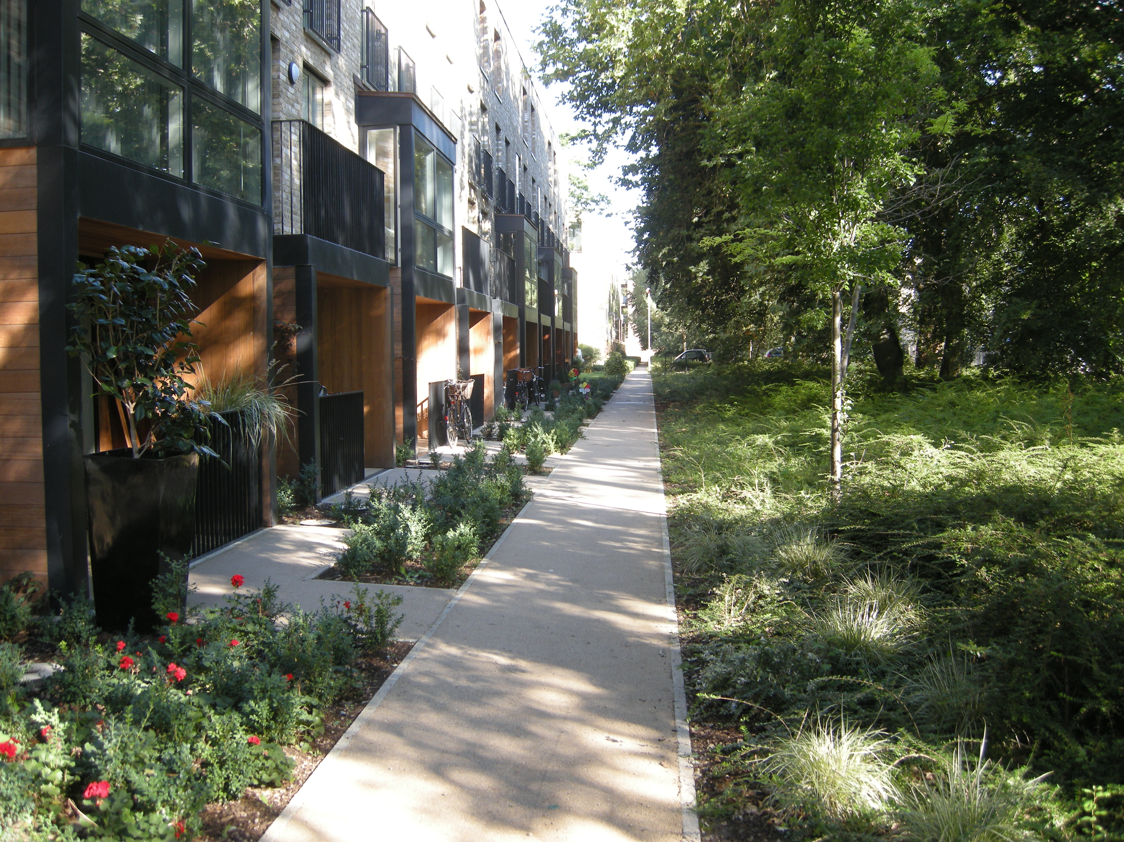
Character

Slide 20
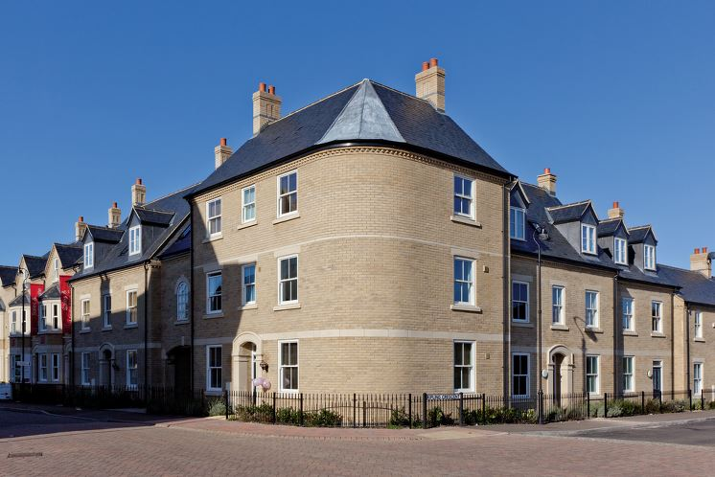
Continuity and enclosure

Slide 21
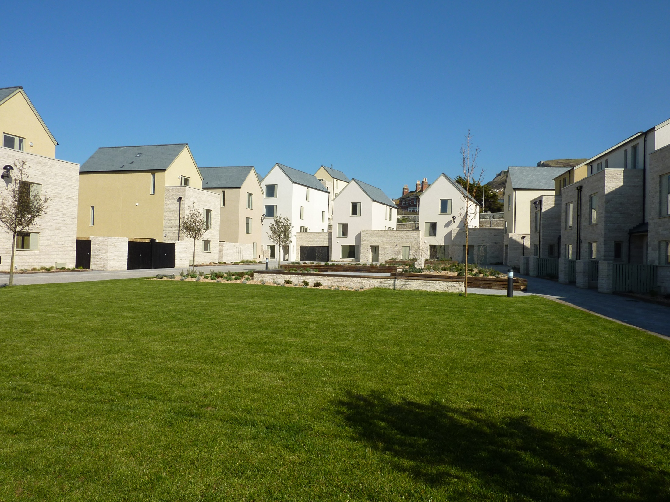
Continuity and enclosure

Slide 22
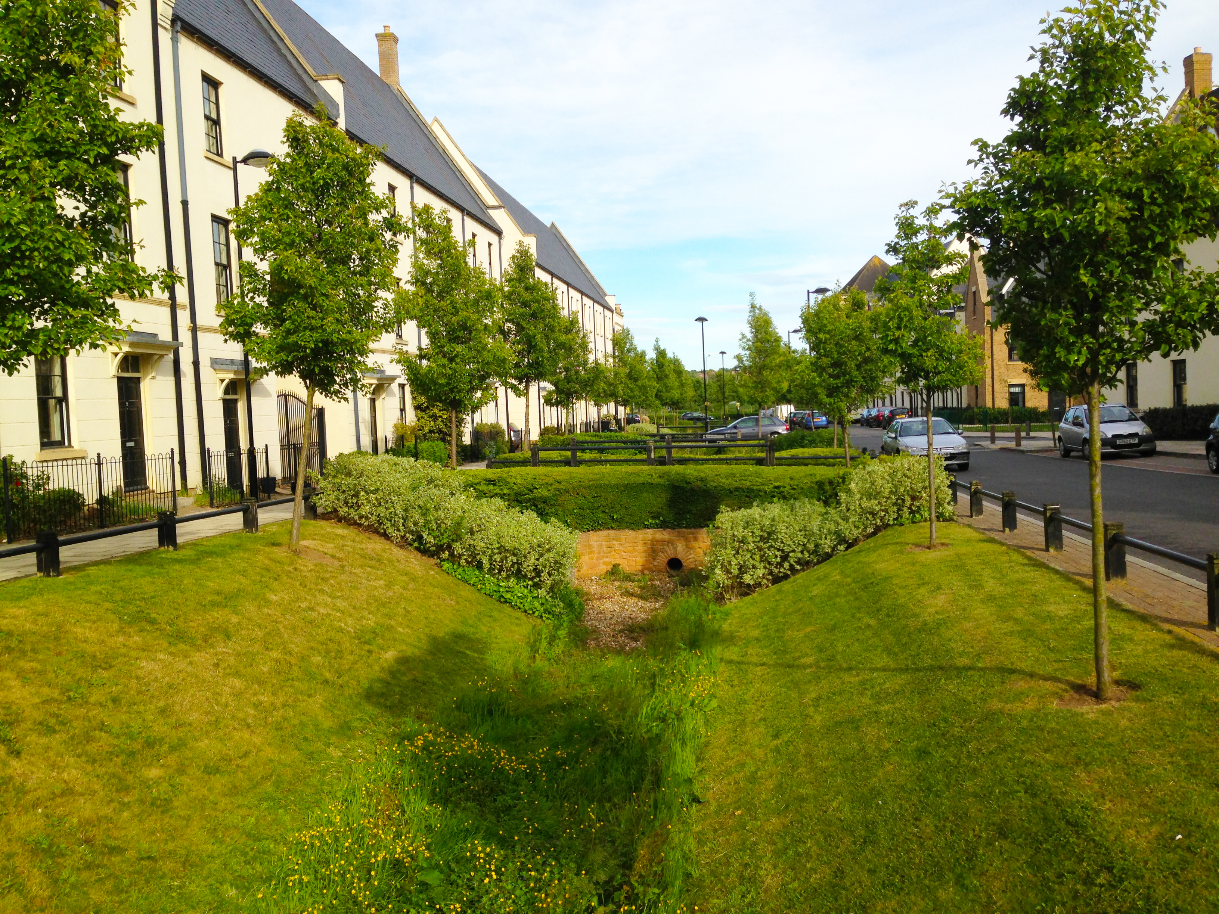
Quality of Public Realm

Slide 23
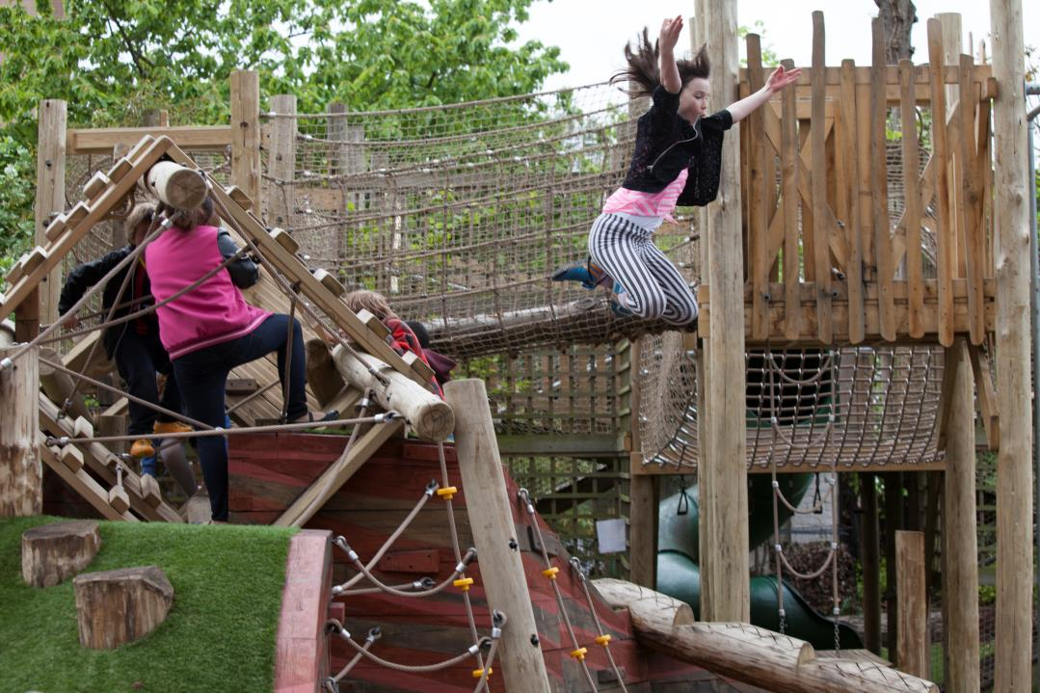

Slide 24
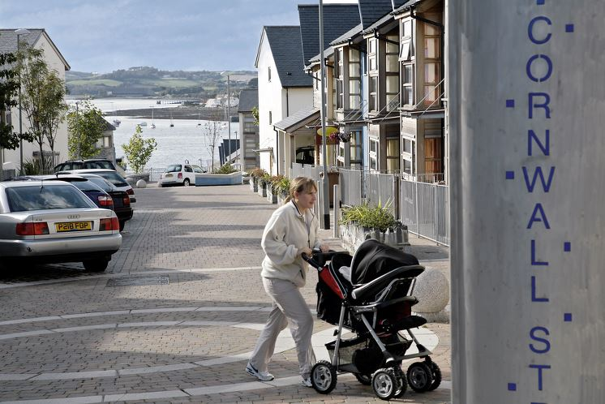
Ease of movement

Slide 25
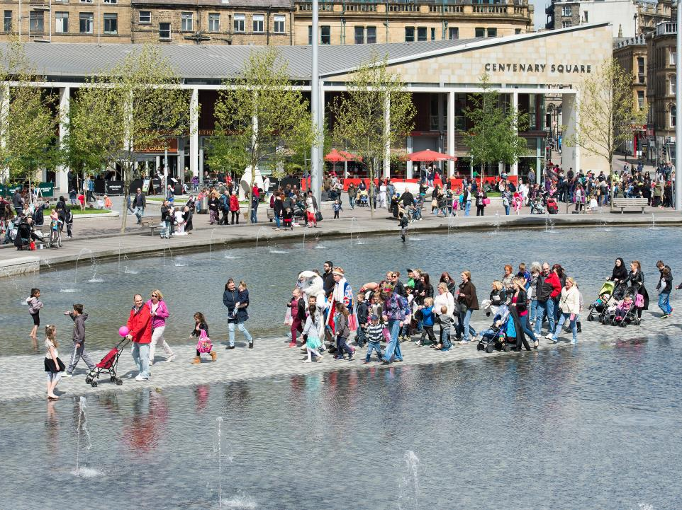
Ease of movement

Slide 26
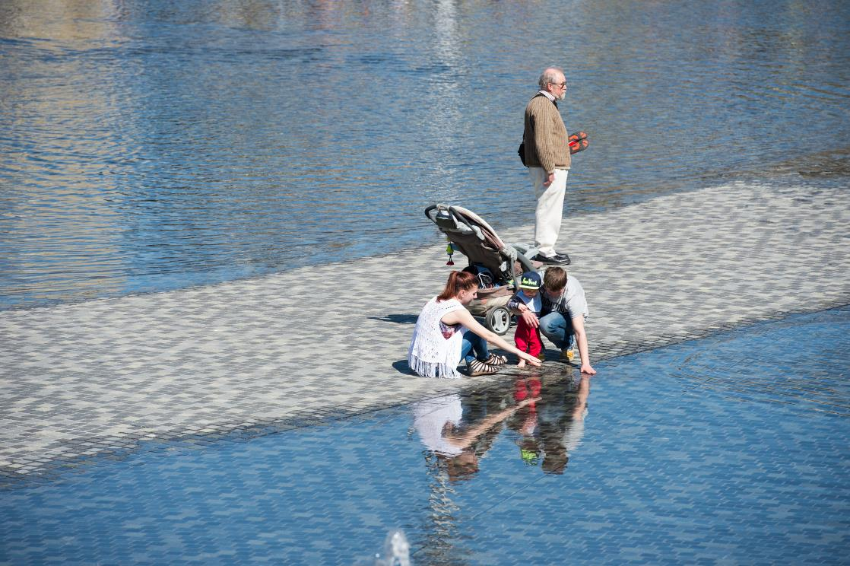

Slide 27
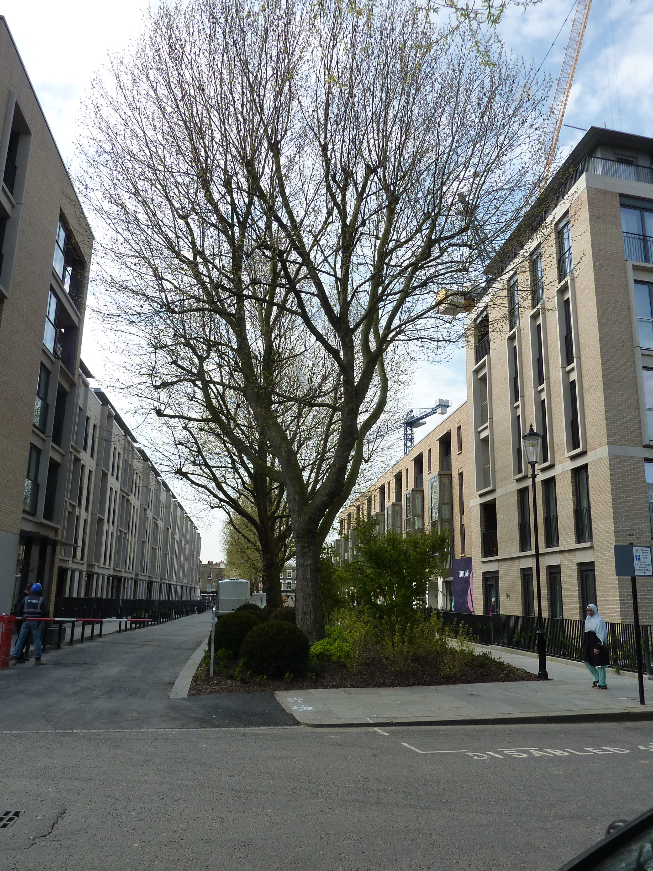
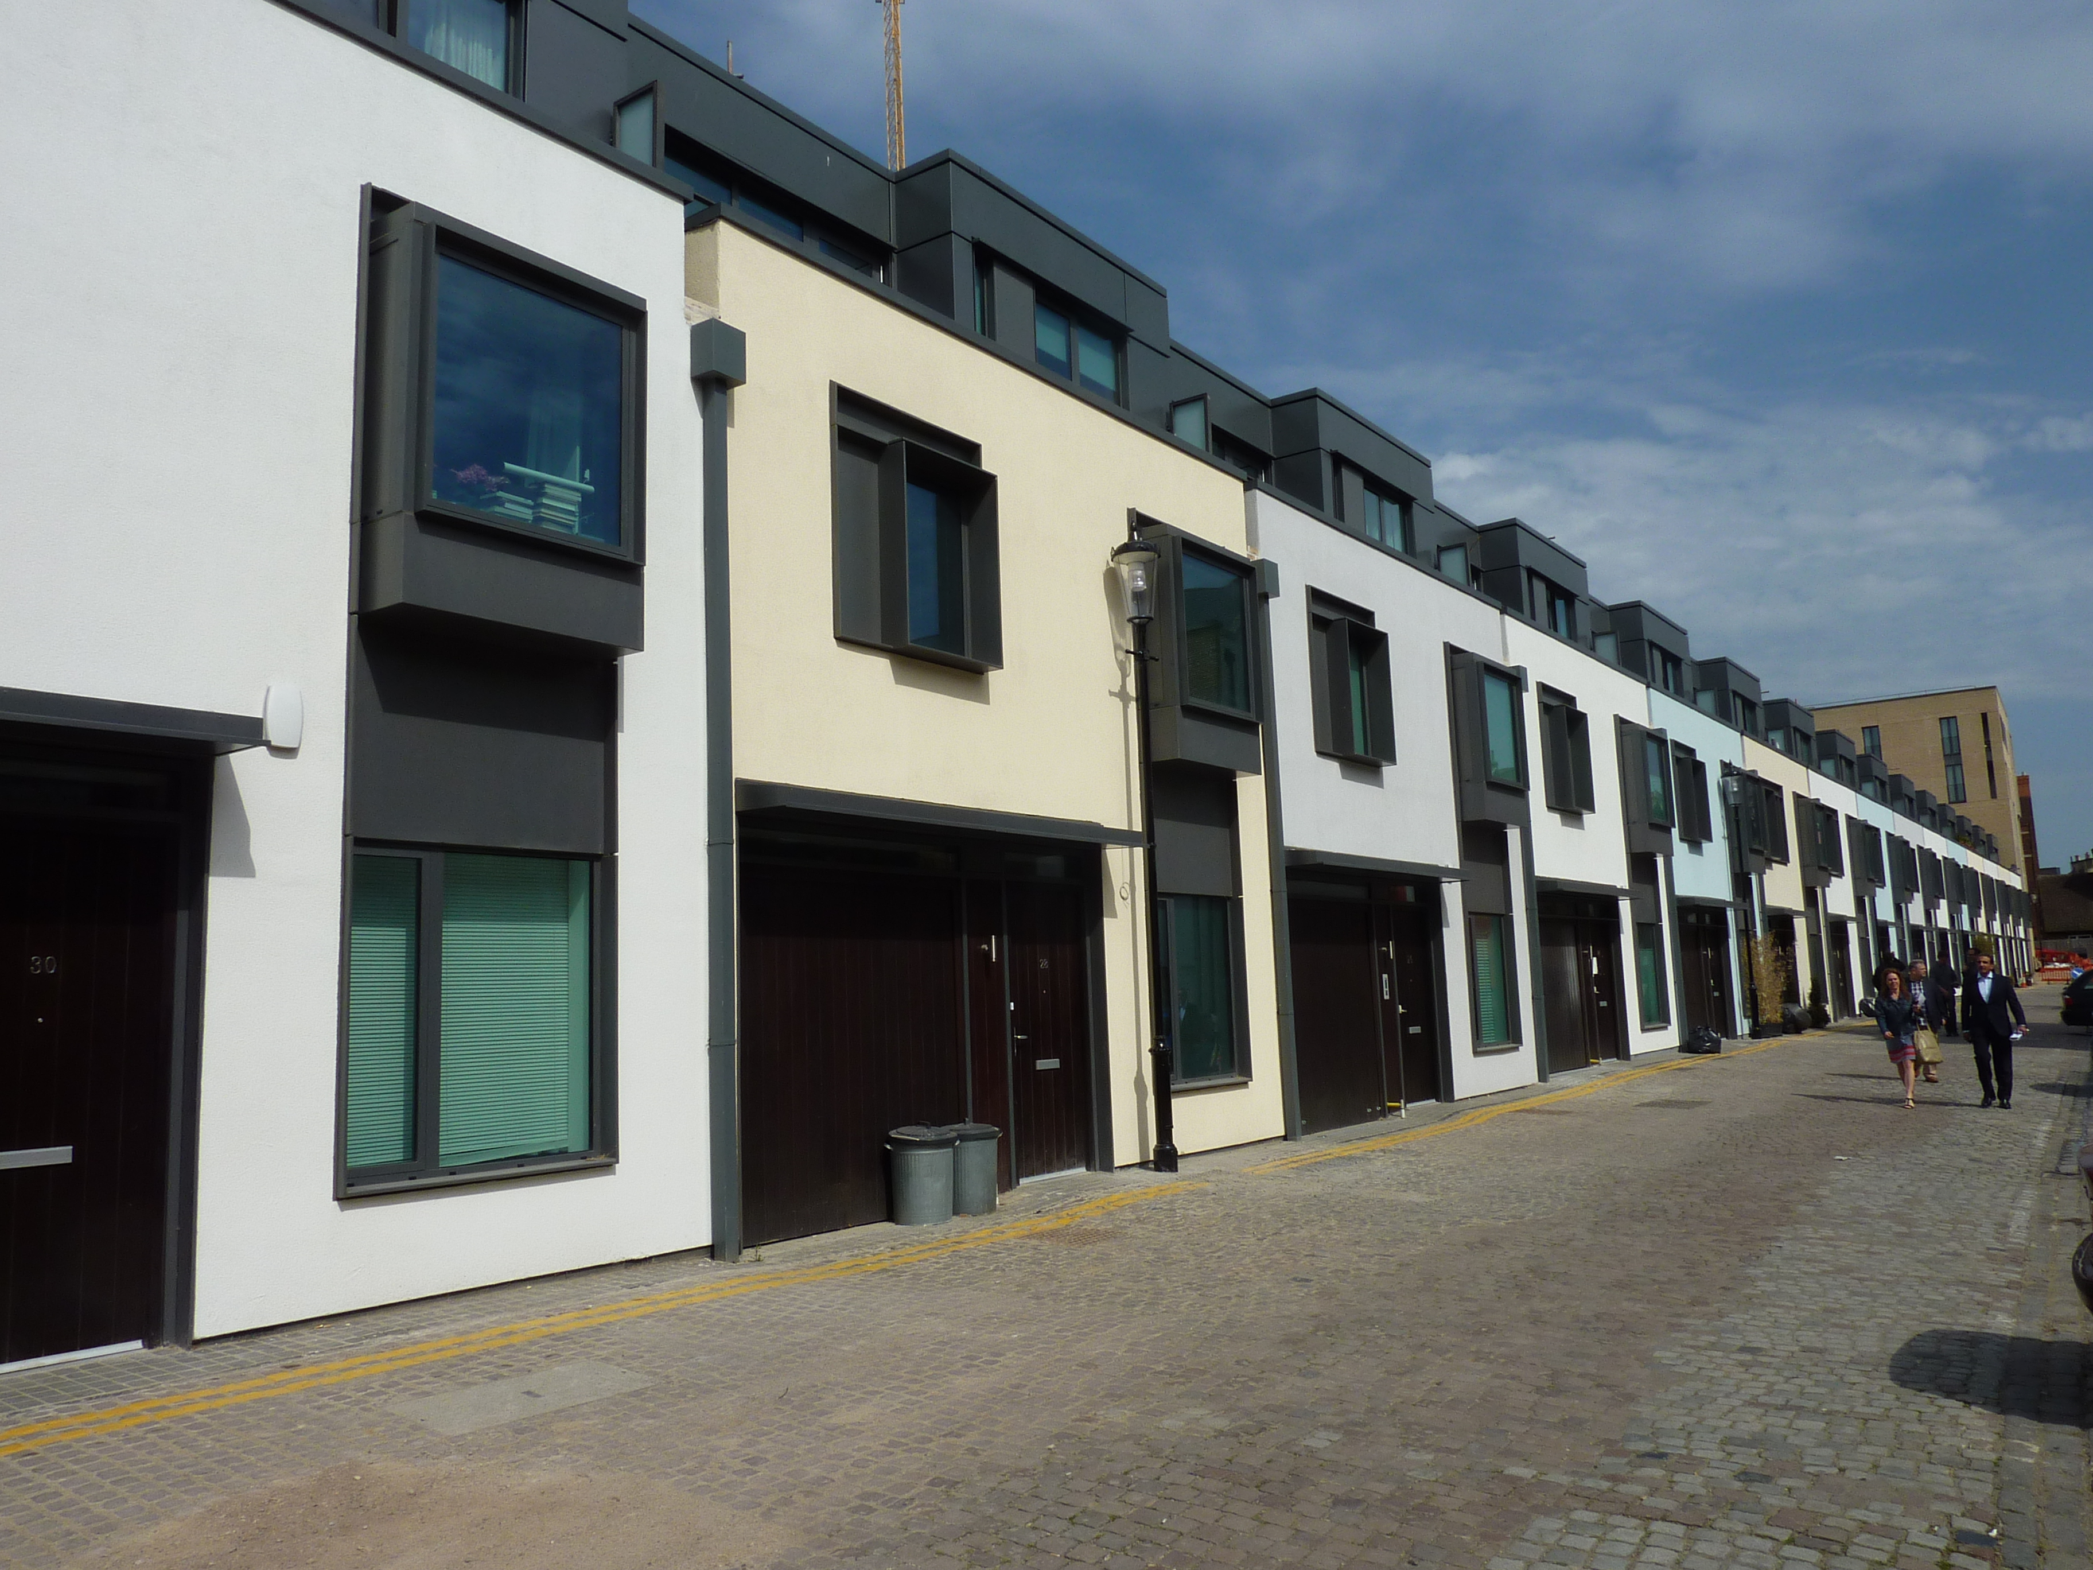
Legibility

Slide 28
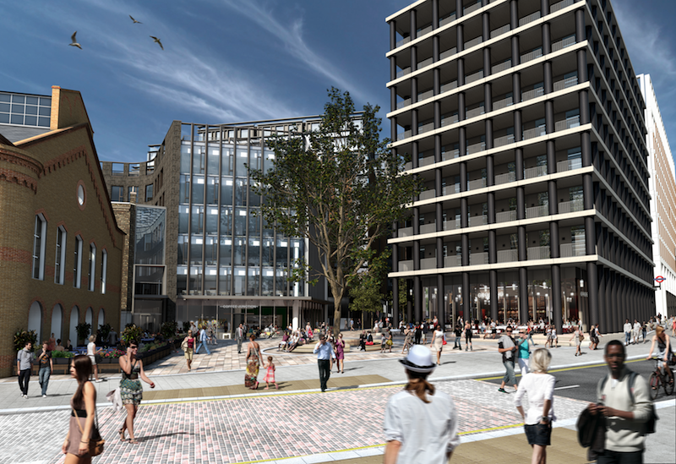
Adaptability

Slide 29
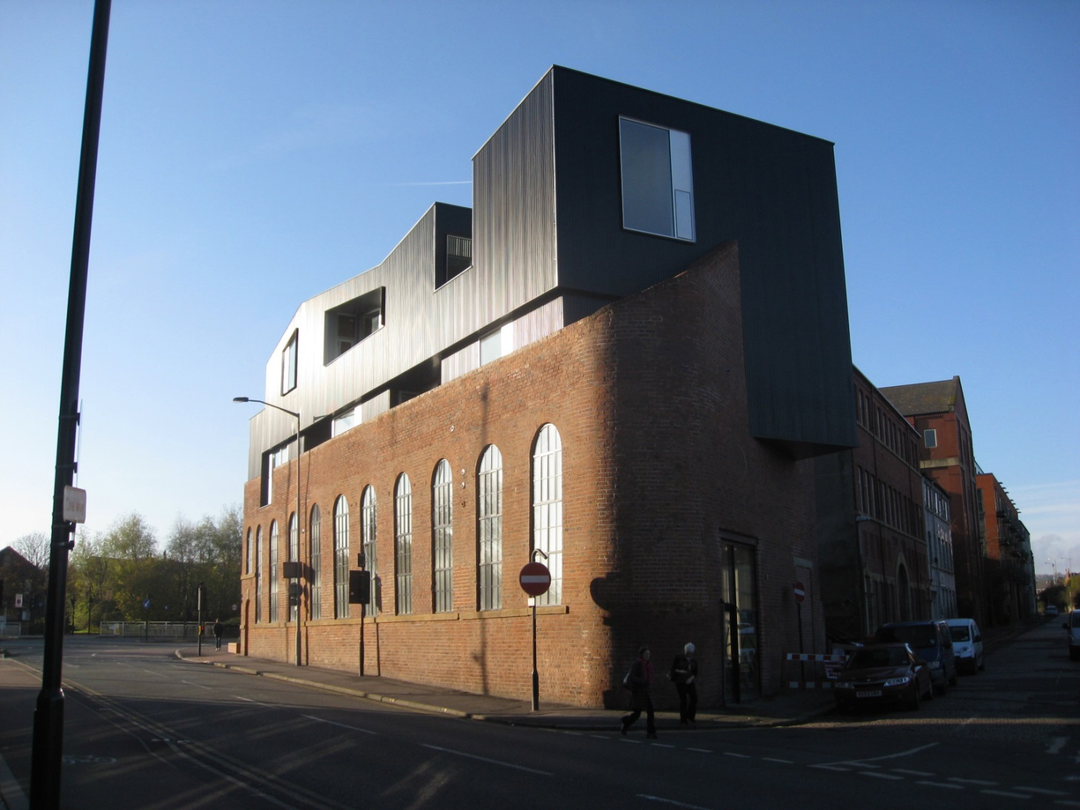
Adaptability

Slide 30
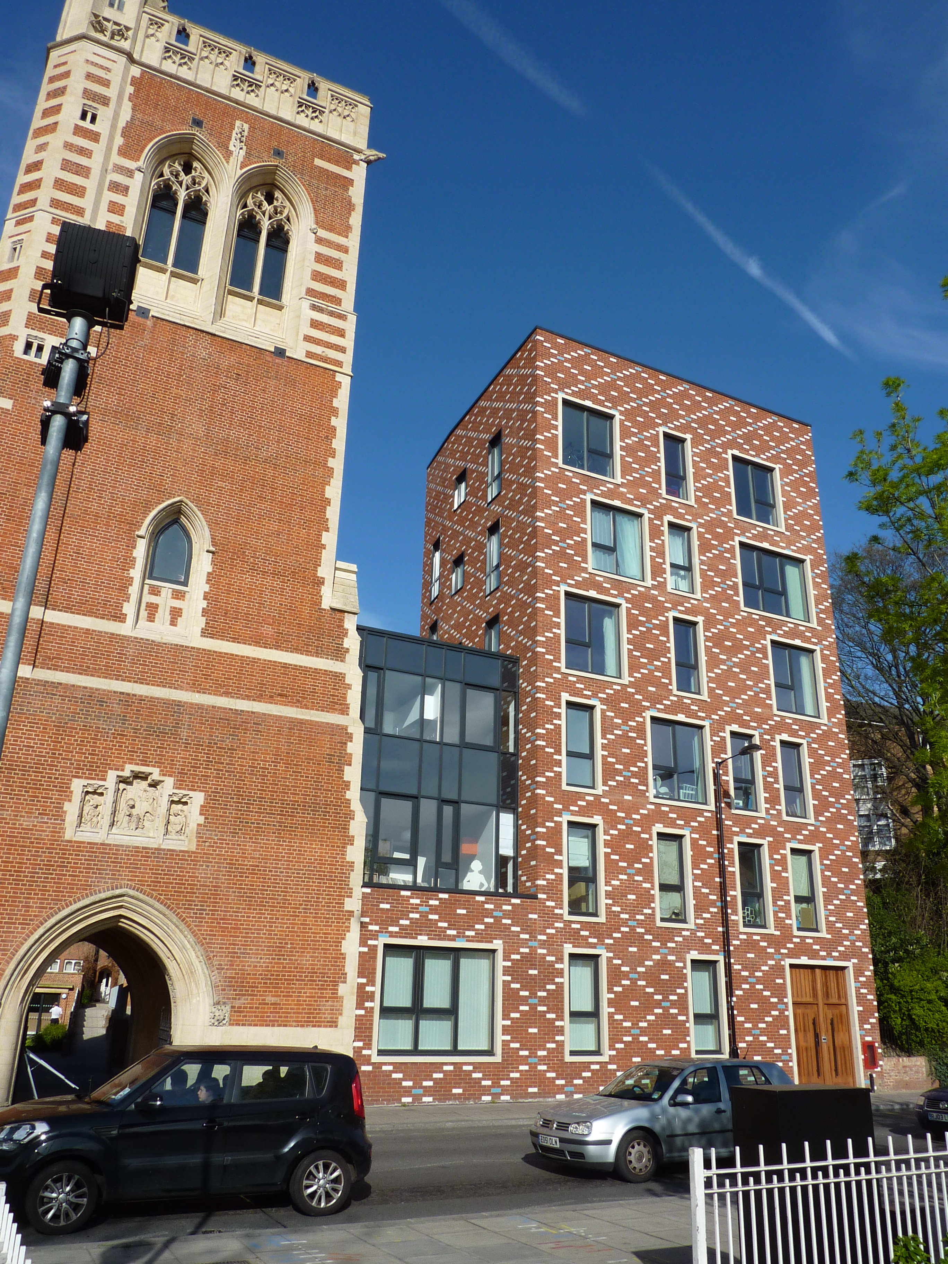
Diversity

Slide 31
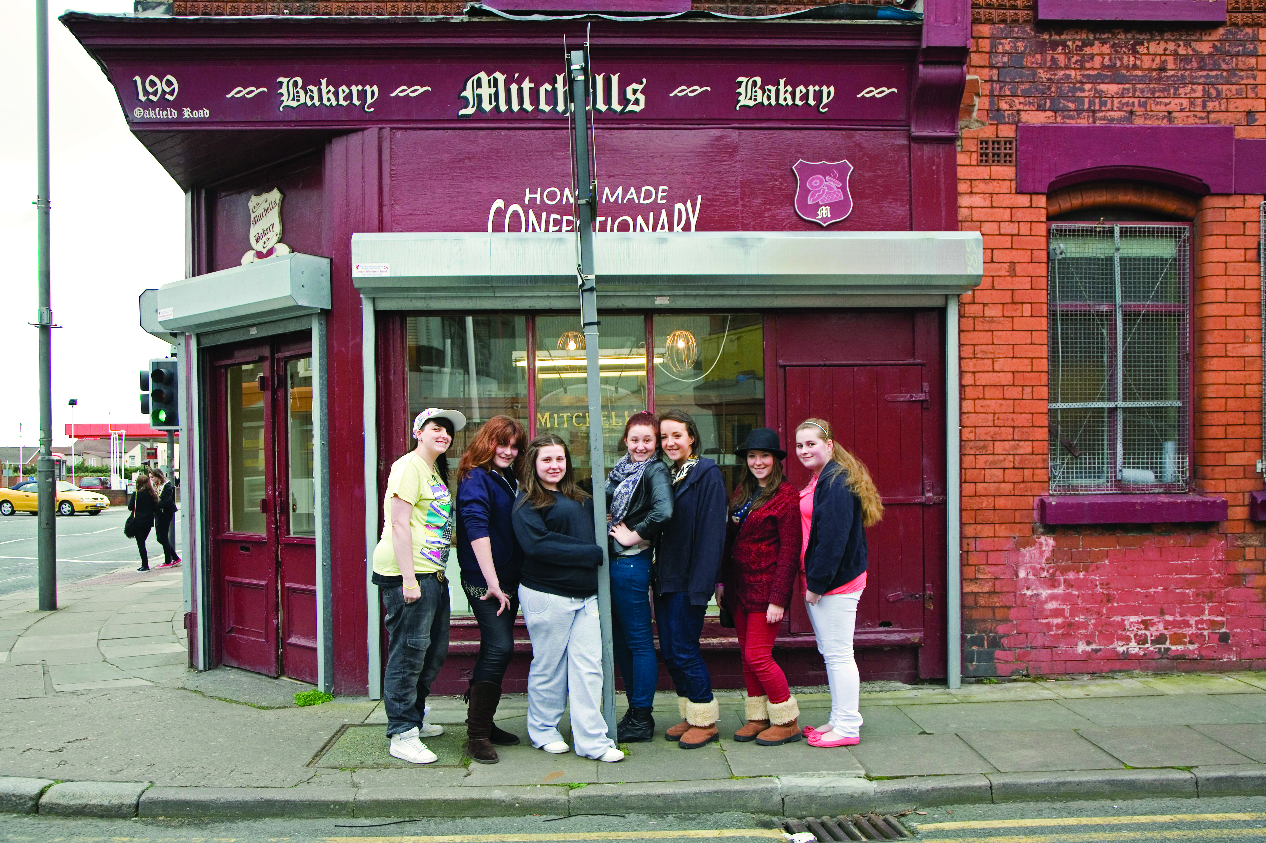
Diversity
Notes:
2up 2down – Mitchells bakery anfield

Slide 32
Tools

Slide 33

Building for Life

Slide 34
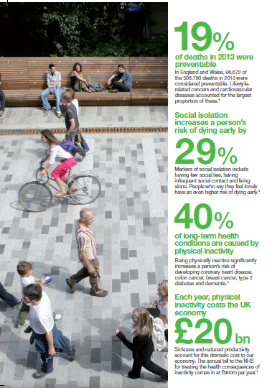

Design Council Cabe Programmes
Active by Design
Designing places for healthy lives
Rachel Toms

Slide 35
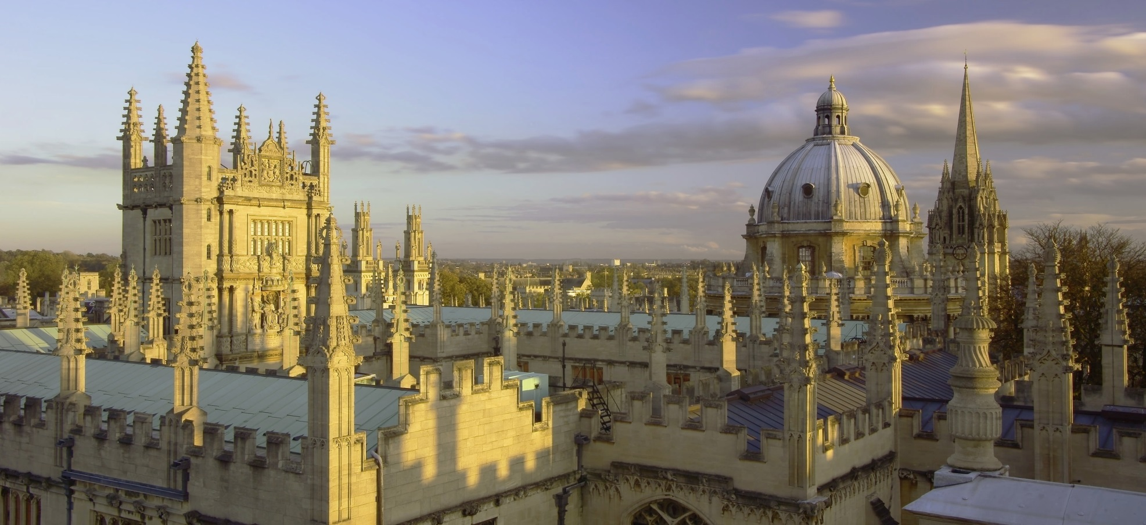
Oxford

Slide 36
Workshop

Slide 37
Championing great design to improve lives.
Julia.wallace@designcouncil.org.uk

