Slide 1

CIL Examination without a hearing
Dartford Borough Council

Slide 2
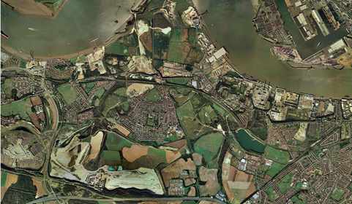
Dartford Development Context
Core Strategy 17,300 homes, 26,500 new jobs
Large strategic sites
South of the borough Green Belt

Slide 3
Dartford’s Rates
Zone | Development Type | CIL Rate (per square metre)
 | Residential development ª
A | All residential development | £200
B | Residential development of less than 15 homes, providing solely market housing | £200
B | Residential development of 15 homes or more, providing a housing mix which includes a proportion of affordable housing | £100
 | Retail development
D | All retail development above 500sq m ^{b} | £125
C | Supermarkets/superstores (above 500 sq. m)ª | £65
C and D | All other retail development | £0
 | Other Development Types
 | Office Industrial Hotel Leisure | £25
 | Any development types not identified elsewhere in the schedule. | £0

Slide 4
CIL timetable
Selection of viability consultant – Oct 2011
Agree test scenarios
Assumptions workshop - Dec 2011
PDCS consultation - Spring 2012
Updated viability - Summer 2012
DCS consultation - Jan 2013
Submission with modifications Aug 2013
Examination and report Autumn 2013
Adoption – December 2013
Implementation – April 2014

Slide 5
The lead up to examination
Update of Infrastructure Delivery Plan – Nov 2012
Overview document – updated
Issues raised in consultation
  Viability buffer
  Rates too high
  Impact on large strategic sites
  Retail
  Care Homes
  Other infrastructure should be considered
  Impact on other uses
Informal discussions

Slide 6
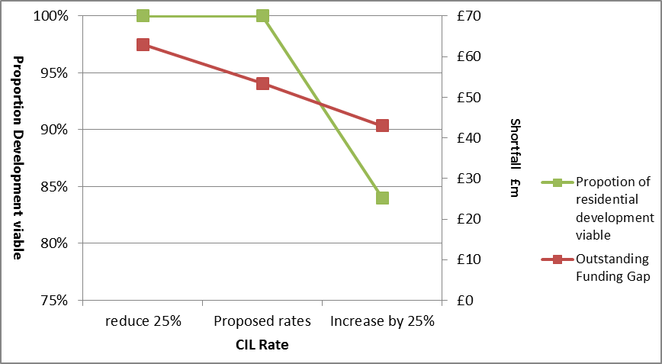
Demonstrating the balance

Slide 7
Examination
Written Reps
Evidence
Agreed with Council’s analysis of impact
Agreed with Council modifications
Considered impact on implementation of CS
Specified where objection not within remit of examination

Slide 8
Key points
Try to get broad agreement of baseline assumptions
Base viability on planned development profile
Update evidence – understand sensitivity testing
Be clear on viability impacting characteristics
Transparent – funding sources of infrastructure, instalment policy
Set out broad case – responding to objections
Informal discussion during preparation
Learn from others

