Slide 1
Section 106 - A Practical Approach
Michele Vas
11 March 2015

Slide 2
Section 106 - Context
Recent Developments
S106 - Basics
Regulation 122 and 123 - issues
S106 - Reducing Affordable Housing
S106 and Some Practical Examples
Death of S106?

Slide 3
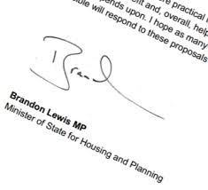
Section 106 - Recent Developments I
Update to the NPPG
  Common theme "incentivise" house building - Ministerial Statement
  Final push towards CIL?
  10 unit threshold (combined maximum gross floorspace of 1,000 sqm)
  5 units or less in designated rural areas
    No Affordable Housing
    No tariff style contribution
    Only commuted payments payable on completion of development for rural developments
  West Berkshire and Reading Councils - joint challenge

Slide 4
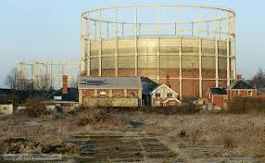
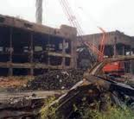
S106 - Recent Developments II
Vacant Building Credit
"Under national policy, where a vacant building is brought back into any lawful use, or is demolished to be replaced by a new building, the developer should be offered a financial credit equivalent to the existing gross floorspace of relevant vacant buildings when the local planning authority calculates any affordable housing contribution which will be sought. Affordable housing contributions would be required for any increase in floorspace"
Prioritise development on brownfield land
How to calculate?
  Swindon
  Southwark
Criticisms

Slide 5
S106 - Recent Developments III
Consultation Document on Speeding up S106 planning Obligations
  S106 Agreements to be concluded within the statutory timescale for determination
  greater use of standardised clauses
  dispute resolution procedure available to reduce delay of the negotiation process
  Oxfordshire CC v Secretary of State for Communities and Local Government and others - Monitoring Payments
Increased/more sophisticated use of Planning Performance Agreements (PPAs)?

Slide 6
S106 - Basics
Binding the land properly
  What type of interests?
  Mortgagee?
  Local authority owned land?
Use of condition where unable to bind all of the site
Implementation/Commencement
Negatively worded obligations offer the best means of enforcement
Sensible triggers to secure compliance
Reasonableness provisions
Third Party clauses
Release provisions

Slide 7
Section 106 - Regulation 122
Reg 122 compliance only required as a "reason for granting planning permission"
Decision making process/S106 confirmation
Policy support
"Other" obligations

Slide 8
Section 106 - Regulation 122 and Appeals
2 options
  Agreement
  Unilateral Undertaking
Justification for Obligations
Treatment in Section 106 Agreement
"If the person appointed to determine the Appeal states clearly in the decision granting Planning Permission that one or more of the planning obligations in this Deed are in whole or in part unnecessary or otherwise in whole or in part fail to meet the statutory tests set out in Regulation 122 of the Community Infrastructure Levy Regulations 2010 (as amended) then the said planning obligation or planning obligations (as may be identified) to that extent shall not take effect or bind the Site and shall not be enforceable by the Council."

Slide 9


S106 - Regulation 123
5th April 2015 - deadline
Reduces ability to "pool" funds - no more than 5 obligations
Reduces ability to "double dip"
Regulation 123 list

Slide 10

Section 106 - Reducing Affordable Housing I
Section 106 BA
  Apply to reduce, alter or remove the affordable housing requirement
  Temporary measures - Sunset provision - 30 April 2016
  Multiple applications
  No minimum period from the date of consent
  Developer must show the development is economically unviable
  Process is based solely on the issue of viability

Slide 11
Section 106 - Reducing Affordable Housing II
Minimising exposure to S106BA - flexible approach to securing affordable housing in S106?
  Viability review mechanisms
    Securing a minimum affordable housing provision
  "bounce back" provisions
  Cascade mechanisms
  Affordable Housing "holidays"
Disclosure of viability - Greenwich decision
Use of conditions to secure affordable housing?

Slide 12
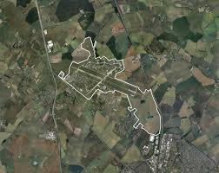
S106 - Practical Examples I
Alconbury Weald
  Master developer approach
  Site wide v development parcels obligations
  Clarity when obligations bound site and were released

Slide 13
Section 106 - Practical Examples II
Ref | Obligation | Land Bound | Event | Land Released | Release Event
1 | To pay the Temporary Health Facility Contribution to the District Council no later than Commencement of Development | The Site | Commencement of Development | The Site | Payment of the Temporary Health Facilities Contribution
 |  |  |  | Each Reserved Matters Area. | The Reserved Matters Start Date for the relevant Reserved Matters Area
 |  |  |  | Each Dwelling | The first date on which that Dwelling is acquired by a Beneficial Occupier
2 | Not to Commence Development until the Temporary Health Facility Contribution has been paid to the District Council | The Site | Commencement of Development | The Site | Payment of the Temporary Health Contribution
 |  |  |  | Each Reserved Matters Area (other than any Residential Reserved Matters Area) | The Reserved Matters Start Date for the relevant Reserved Matters Area
 |  |  |  | Each Residential Reserved Matters Area | The first date on which all of the Dwellings within the relevant Residential Reserved Matters Area shall have been Occupied
 |  |  |  | Each Exempt Unit | The first date on which that Exempt is acquired by a Beneficial Occupier

Slide 14
Section 106 - Practical Examples III
Croydon - Development of Whitgift Centre
Hierarchy of Enforcement
Developer
1
Council
2
Leaseholder
Landowner
3

Slide 15
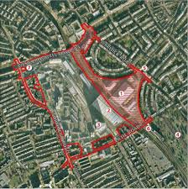
S106 - Practical Examples IV
Earls Court Redevelopment
Cessation of Obligations where works stall

Slide 16
S106 - Death of?
Still a role to play:
  On-site provision
  Large scale site where ought to be a CIL exemption/nil CIL
  Offer greater scope for flexibility/creativity/innovation

