Slide 1
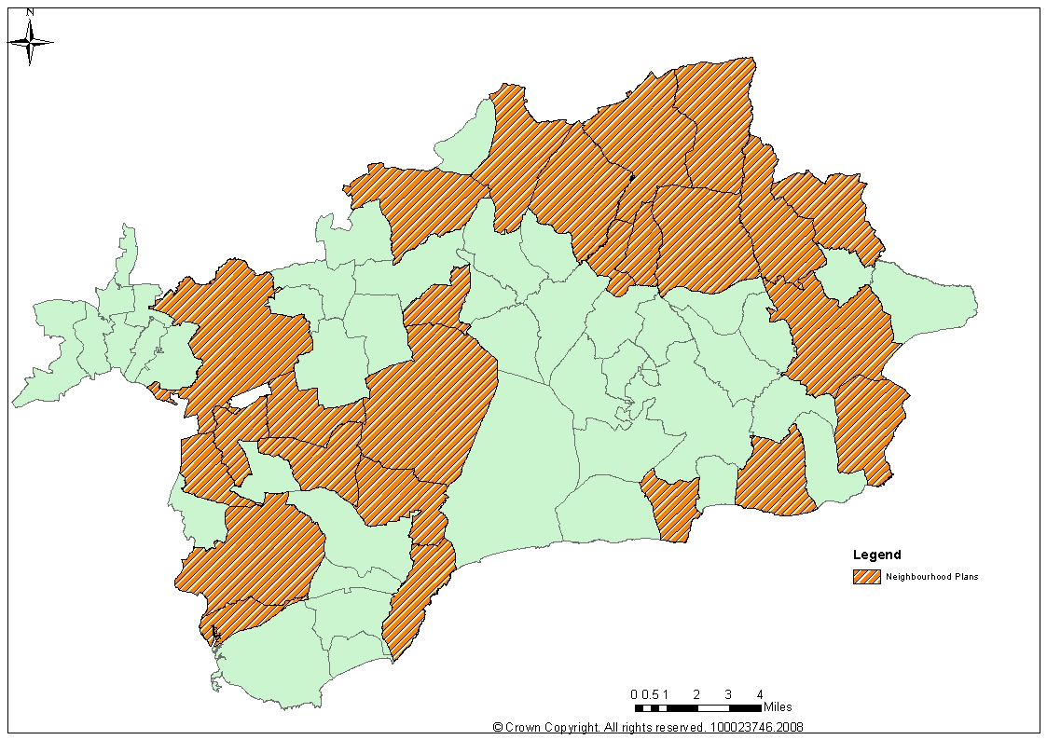

Neighbourhood Planning
East Devon Experience
Tim Spurway- Neighbourhood Planning Officer
Claire Rodway- Senior Planning Officer

Slide 2
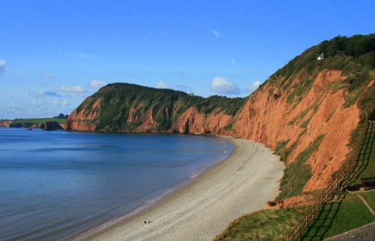
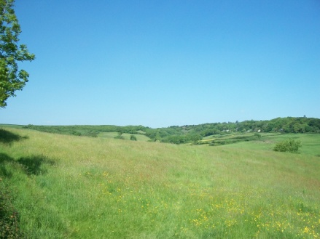
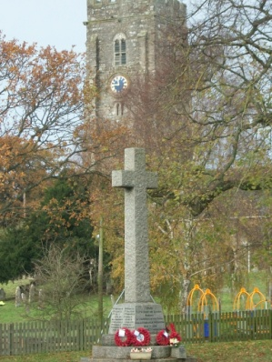
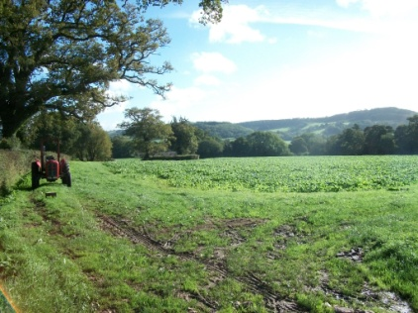
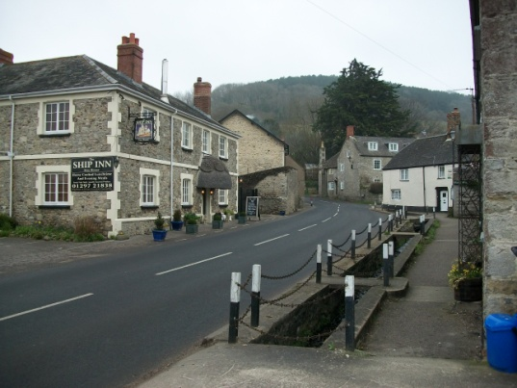
Neighbourhood Planning
East Devon Experience
About East Devon
Rich natural environment with 2/3 of the district being designated as Areas of Outstanding Natural Beauty and most of the coastline part of the Jurassic Coast.
Dispersed population emphasised by the low density of 1.6 persons per hectare (the English average is 4.1)
Typified by small rural villages with largest towns being Exmouth, Sidmouth, Honiton and Seaton.

Slide 3
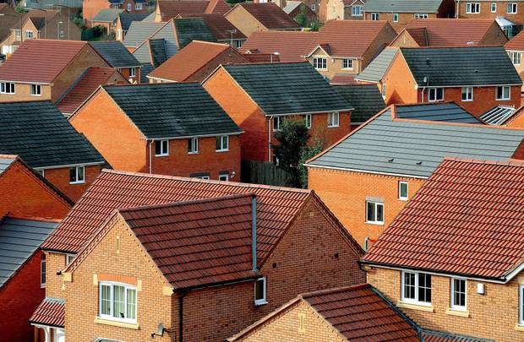
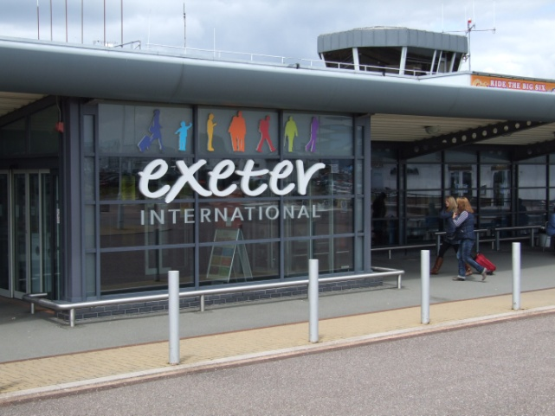
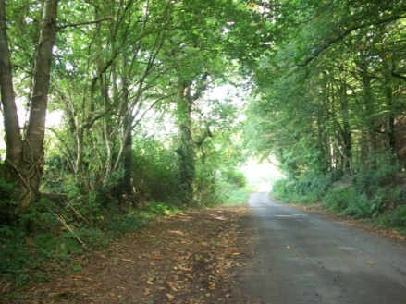
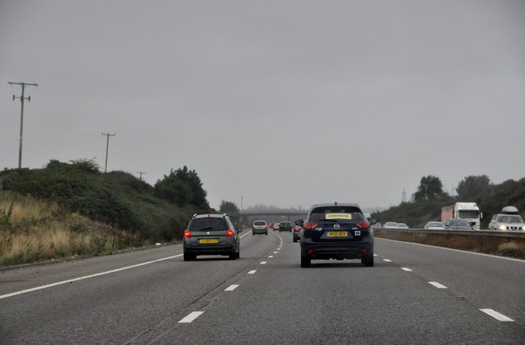
Neighbourhood Planning
East Devon Experience
About East Devon
Affordability of homes is a big issue- East Devon is in the top 25% of all Local Authority areas for house prices but one of the lowest nationally in terms of wages.
Good transport links in urban areas including Exeter International Airport and M5
Poor public transport in most rural areas. High levels of car ownership and a large out flow of workers leaving the district to work in places such as Exeter, Mid Devon and South Somerset.

Slide 4
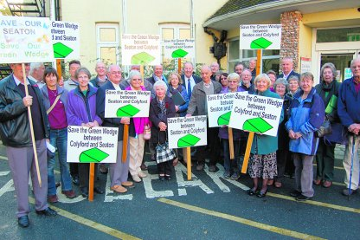
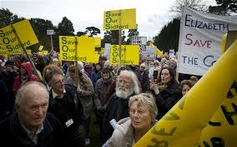
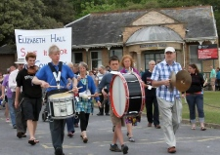
Neighbourhood Planning
East Devon Experience
About East Devon
The population of East Devon has an older age profile with the average age of its residents being 46.9 years (national average is 39.4 years).
Many residents have chosen to retire to East Devon because of its character and are resistant to change.
Planning applications are often controversial, anti-development campaigns are common

Slide 5
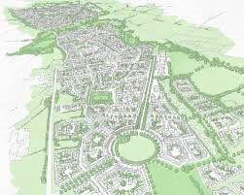
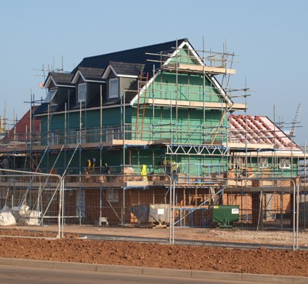
Neighbourhood Planning
East Devon Experience
About East Devon
Growth Agenda with large scale development planned in the West end of the district.
Cranbrook New Town- 7500 new homes.
Science Park
Skypark
Intermodal facility

Slide 6
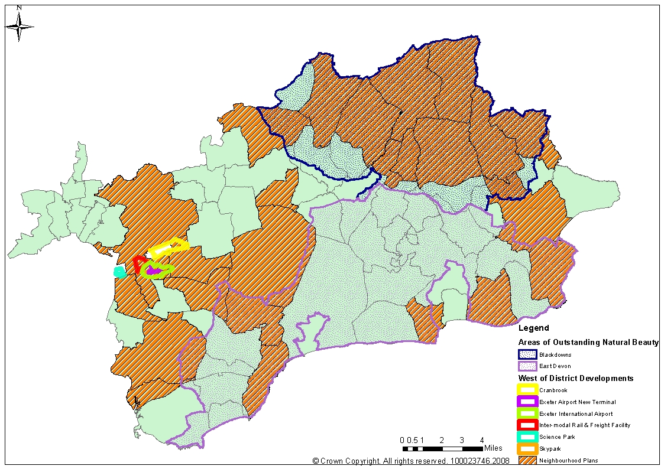
Neighbourhood Planning
East Devon Experience
Plans Across the District

Slide 7
Neighbourhood Planning
East Devon Experience
How we’re helping NP groups
  Producing bespoke guidance notes at various stages of the process (collecting evidence, engaging the community)
  £2000 funding
  Creating document templates including basic conditions statement, consultation statement.
  Always being available to offer advice to groups
  Providing introductory sessions to parishes interested in commencing a Neighbourhood Plan.
  Hiring a Neighbourhood Planning Officer
  Attending steering group sessions
  Regular newsletters
  Advice and guidance on Strategic Environmental Assessment/ Habitat Regulations assessment if necessary.
  Advising on any national updates
  Project plan template

Slide 8
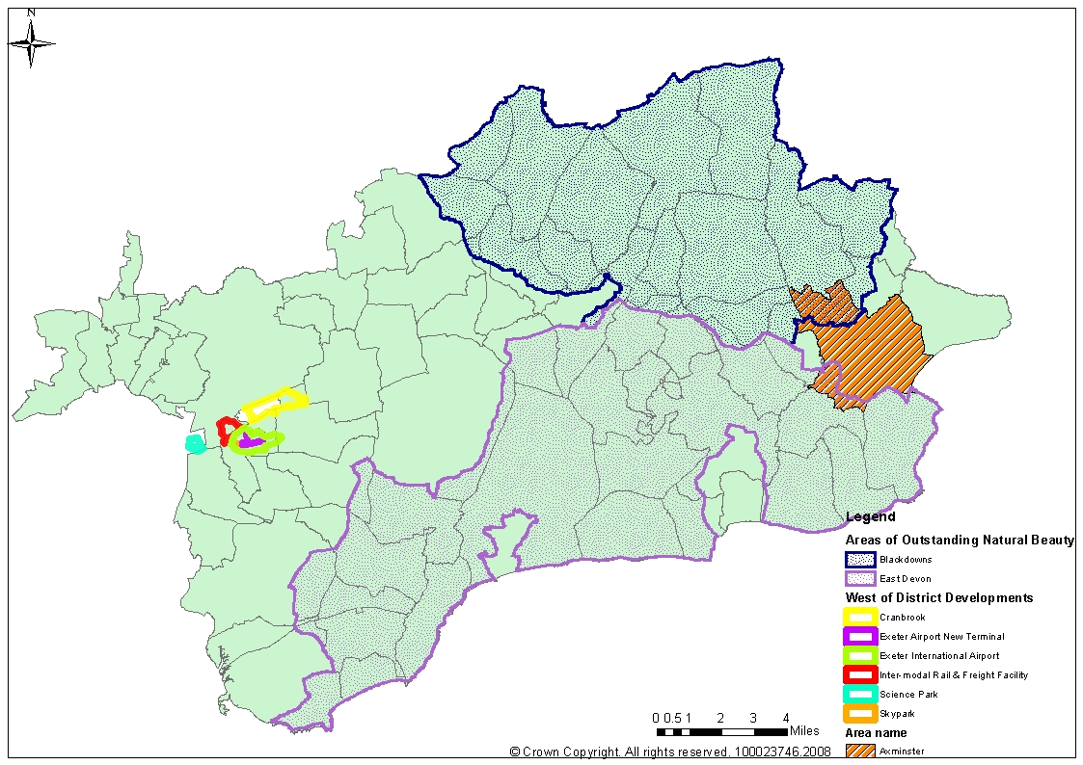
Neighbourhood Planning
East Devon Experience
Axminster

Slide 9
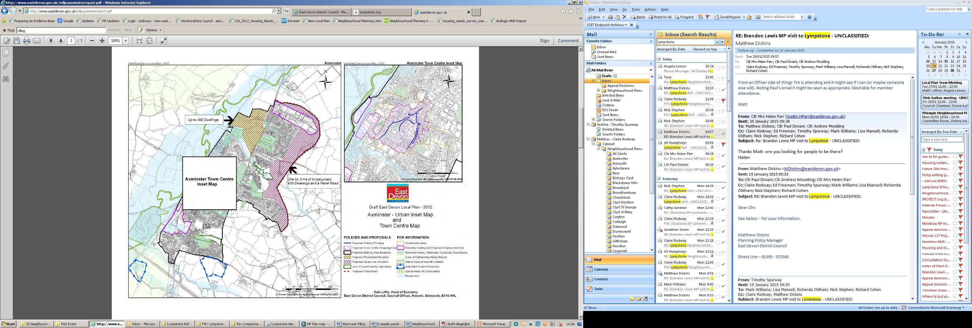
Neighbourhood Planning
East Devon Experience
Axminster

Slide 10
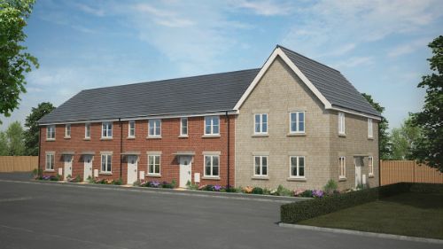
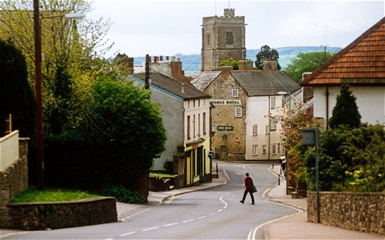
Neighbourhood Planning
East Devon Experience
Axminster
Small market town with good transport links including a regular train service.
Around 1000 new houses, new primary
school and employment land proposed.
These are supported locally as they will
deliver a distributor road/bypass.
Residents prepared to accept
more development for CIL
Using a planning consultant
to manage process

Slide 11
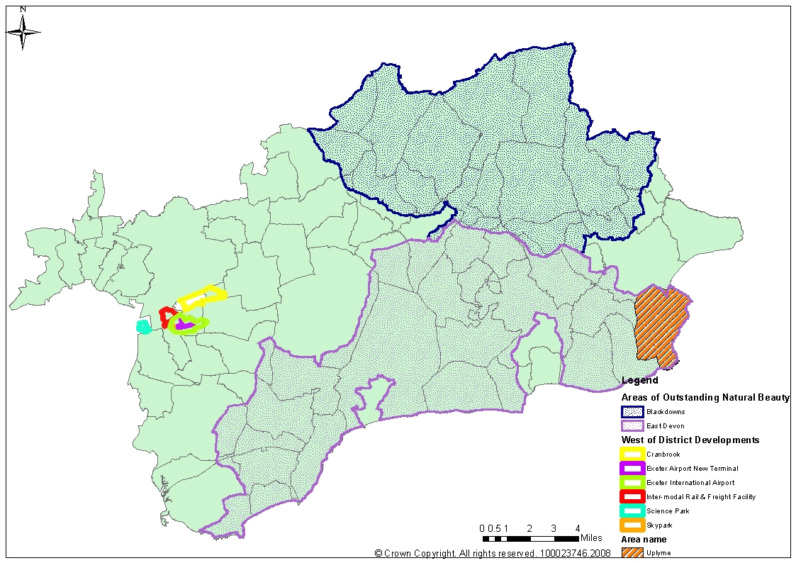
Neighbourhood Planning
East Devon Experience
Uplyme

Slide 12
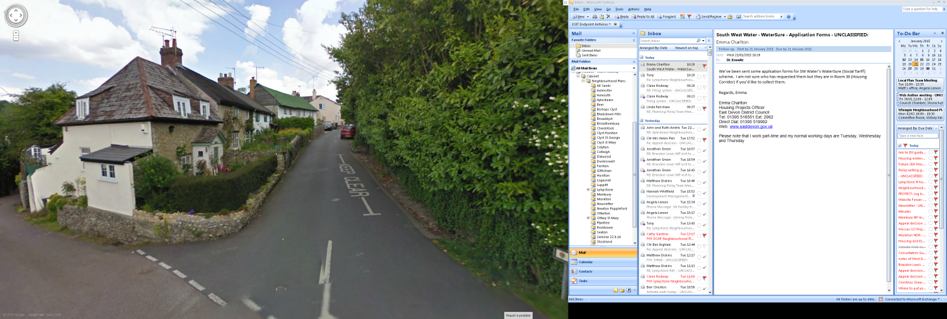
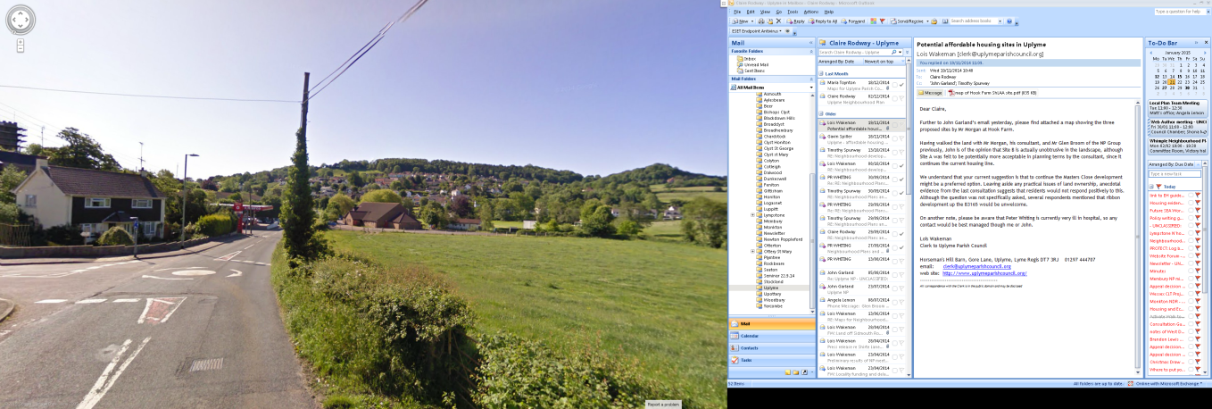
Neighbourhood Planning
East Devon Experience
Uplyme
Coastal parish with eclectic mix of housing,
steep sided valleys and coombes and
winding lanes.
Prominent in the AONB.
NP driven by concern that adjacent Lyme Regis can’t meet its need for housing and controversial proposals for 400 houses in Uplyme
Local Plan found no sites suitable for
development, NP supports several
small but visually prominent sites-
potential conflict with LPA
Support from Planning Aid

Slide 13
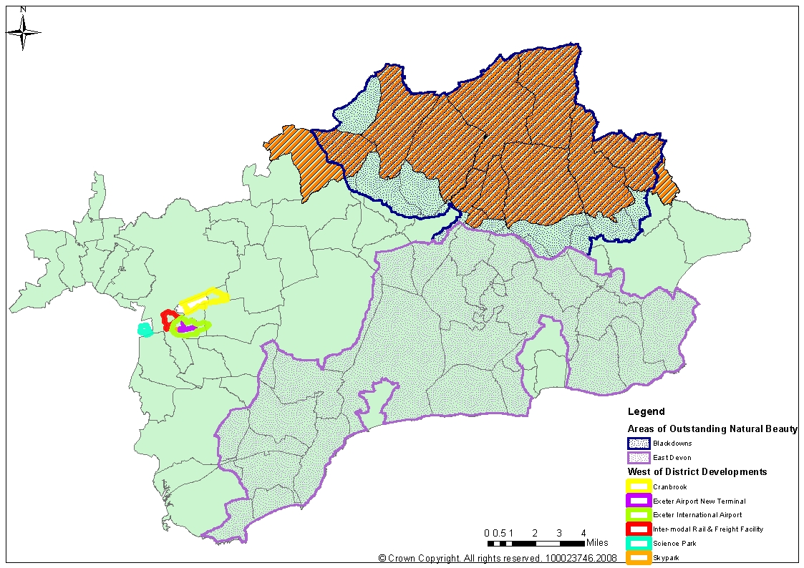
Neighbourhood Planning
East Devon Experience
The Blackdown Hills AONB Parishes

Slide 14

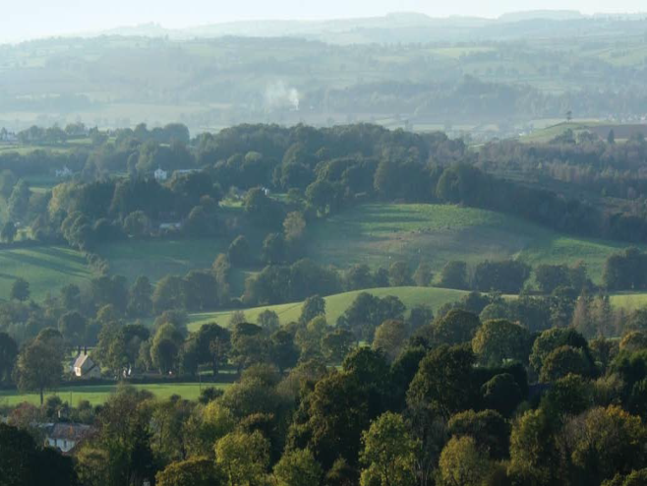
Neighbourhood Planning
East Devon Experience
The Blackdown Hills AONB Parishes
Group of 10 very rural parishes, driven by desire
to give formal status to the AONB design guide
Main issues - growth in open countryside (some want to define their own settlement boundaries, contrary to LP?)
Need for local retirement housing, lack of
facilities
              Using a planning consultant
              Standard approach and template
              Significant cost savings- approx £18-£20k per Plan individually? £7.5k when produced together

Slide 15
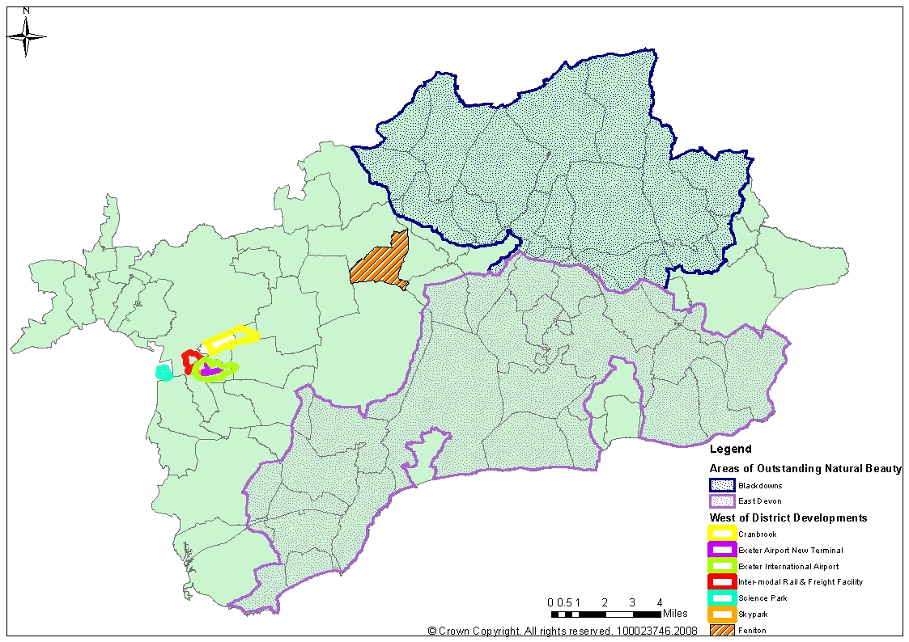
Neighbourhood Planning
East Devon Experience
Feniton

Slide 16
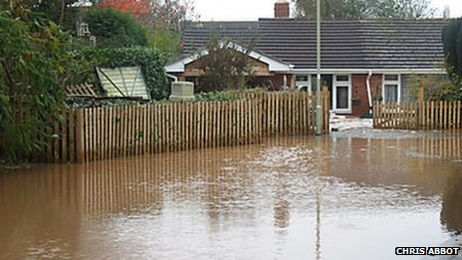
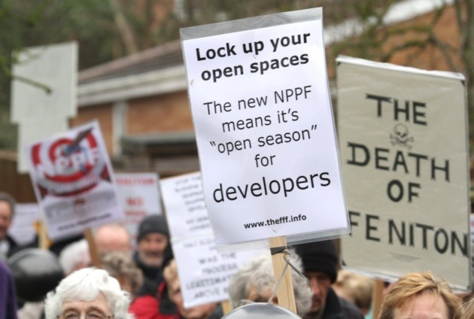
Neighbourhood Planning
East Devon Experience
Feniton
Rural village with basic everyday facilities and train station
Controversial development of 50 houses, won on appeal in 2013
Major flooding problems, accessed along winding country lanes
Last year saw a Super Inquiry against a total of 235 houses by three developers small 35 site allowed, others refused on sustainability grounds, interesting social sustainability reason
NP will support small scale growth on infill and brownfield sites

Slide 17
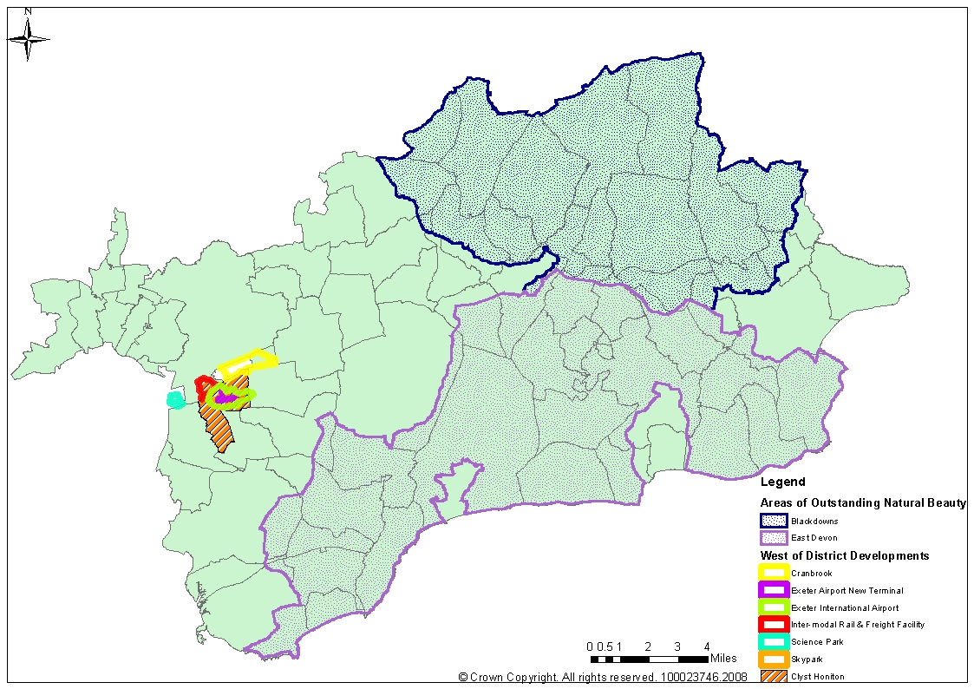
Neighbourhood Planning
East Devon Experience
Clyst Honiton

Slide 18
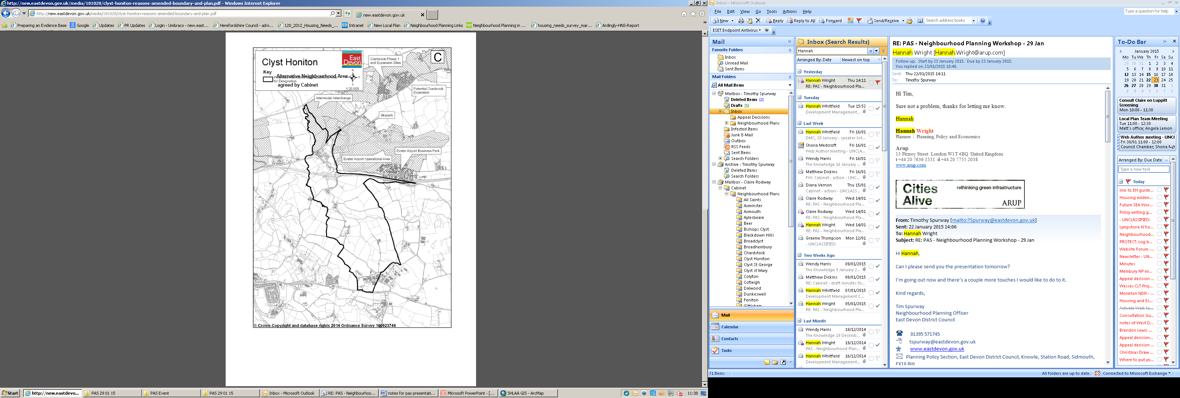
Neighbourhood Planning
East Devon Experience
Clyst Honiton
Historic village surrounded by strategic development- Cranbrook, Skypark, Science Park, intermodal freight facility, Exeter airport, bypass.
Original NA application was for whole parish but reduced through negotiation to exclude strategic areas
NP driven by need for community facilities, lost the School, sports facilities and meeting hall to Cranbrook
Would like mixed use scheme- 20-30 houses with site for a hall

Slide 19
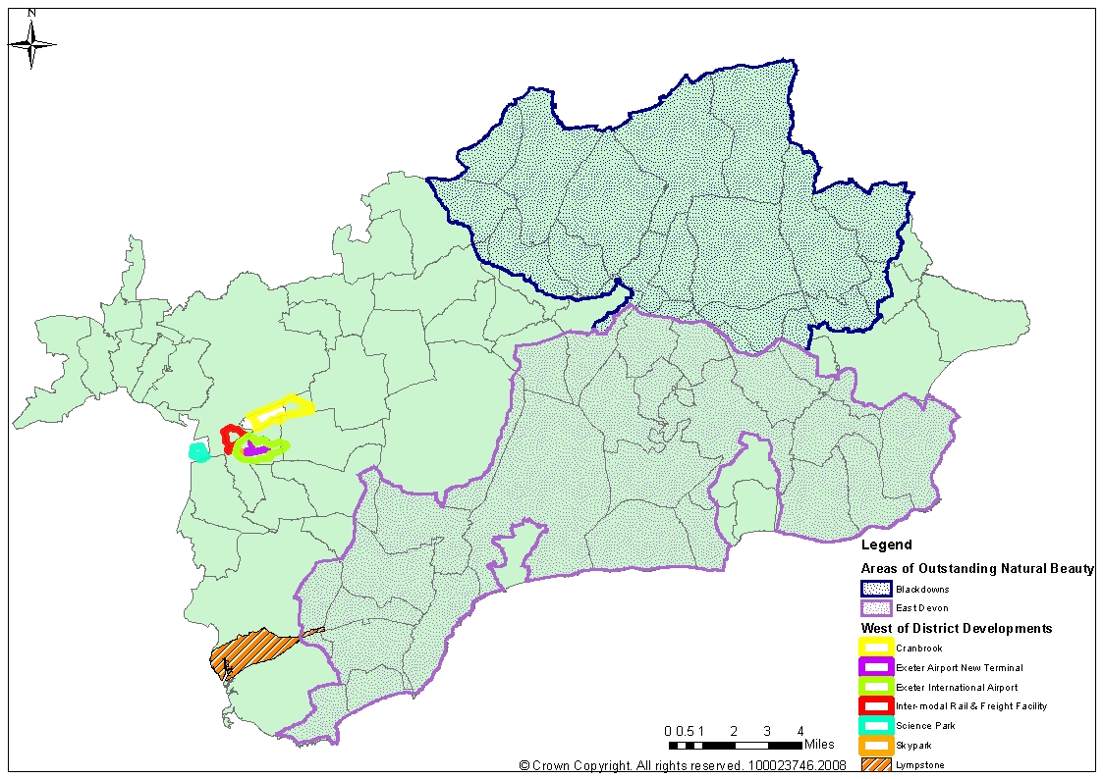
Neighbourhood Planning
East Devon Experience
Lympstone

Slide 20
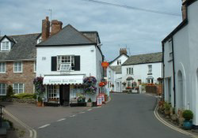
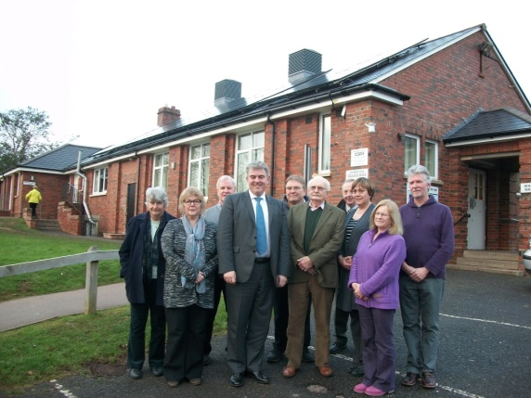
Neighbourhood Planning
East Devon Experience
Lympstone
Estuaryside historic village with infrastructure
and landscape constraints
NP driven by developer controversial major
(150 house) development scheme
SEA/HRA issues
Unusually, the NP was submitted twice to LPA as the LPA objected to it during the LPA’s first statutory consultation
‘Material Consideration’ in appeal in Oct 2014 (cited as reason for withdrawing appeal)
Examination by Nigel McGurk October 2014
Brandon Lewis MP visited 22 Jan 2015
Referendum on 26 March 2015

Slide 21
Neighbourhood Planning
East Devon Experience
Lympstone Examiner Comments
Confusion- need to clearly differentiate between planning policies and community actions
Imprecision- policies which aren’t absolutely clear will be deleted, the examiner rarely suggested alternative wording unless NPPF wording would apply
Overly restrictive- policies which were more restrictive than the NPPF eg. Defining acceptable employment types, were deleted
Detail- policies which added detail to the NPPF, eg defining ‘quality design’ were acceptable
Evidence- only examined in relation to specific objections, otherwise taken as read

Slide 22
Neighbourhood Planning
East Devon Experience
Points to Consider
Local Plan Issues
  Reluctance to pursue a Neighbourhood Plan without a Local Plan in place.
  Confusion over emerging policies (LP approach to rural housing provision changed several times)
  Where do we draw the ‘ general conformity’line?- eg can rural communities define their own BUAB’s to allow development in the countryside? Would a compliance checklist help?
  Will newly adopted LP’s supercede whole NP’s or only those parts in conflict?- can we have a statement of ‘saved NP policies’

Slide 23
Neighbourhood Planning
East Devon Experience
Points to Consider
Other Issues
  Reluctance to engage with LPA (and in some cases the community!!)
  Communities wanting high/er levels of housing in unsustainable locations
  Communities identifying development sites which the LPA wouldn’t choose
  Where is the line between Land Use and Community Actions
  Community Actions outside LPA/Examiner remit, but they can have significant implications
  What about the less popular land uses...

