Slide 1
Neighbourhood Plan Examinations
John Parmiter FRICS FRSA MRTPI
Independent Examiner
28 January 2015

Slide 2

Appointment
LPA appoints but with agreement of the QB
Source an examiner
Timing: pre-submission consultation stage
Brief: Give as much information as you can on the application form; are any specialist skills needed? What are the key issues in the Plan or Order? Site allocations?
Be realistic about programme, duration, level of risk etc.

Slide 3
Selection
NPIERS offers three Examiners (with CV)
Standard day rate for all
Procurement: make the process clear and transparent
Process: If interviewing consider telephone or Skype Conflicts very important to flush out
Independence absolutely essential
Limit questions to the process of examination and the examiner’s skills and experience – it is important that the merits of the Plan are not discussed
Try and provide feedback to the unsuccessful candidates
Agree contractual arrangements
PI issues include £limit

Slide 4
Working with the Examiner
Agree how LPA, QB and Examiner will work together
Useful to have one point of contact
The examination documents
How long will the examination take? Is there a deadline to meet?
Need for Public Hearing?
How will you keep in touch?

Slide 5
Preparing for a Public Hearing
Notice period for the hearing; publicity
Venue – keep it local
Timing and duration
Invitations to participants
Issues to be discussed – agenda and questions
Site visits
Note or record of the hearing
Seating, access and other practical issues

Slide 6
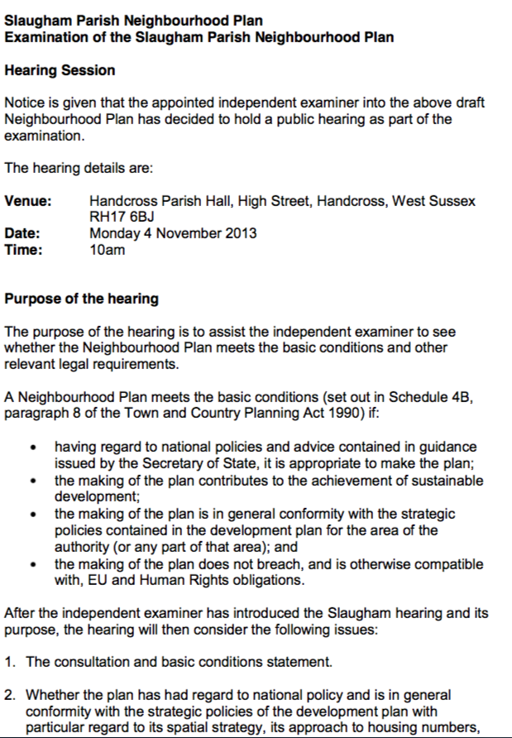
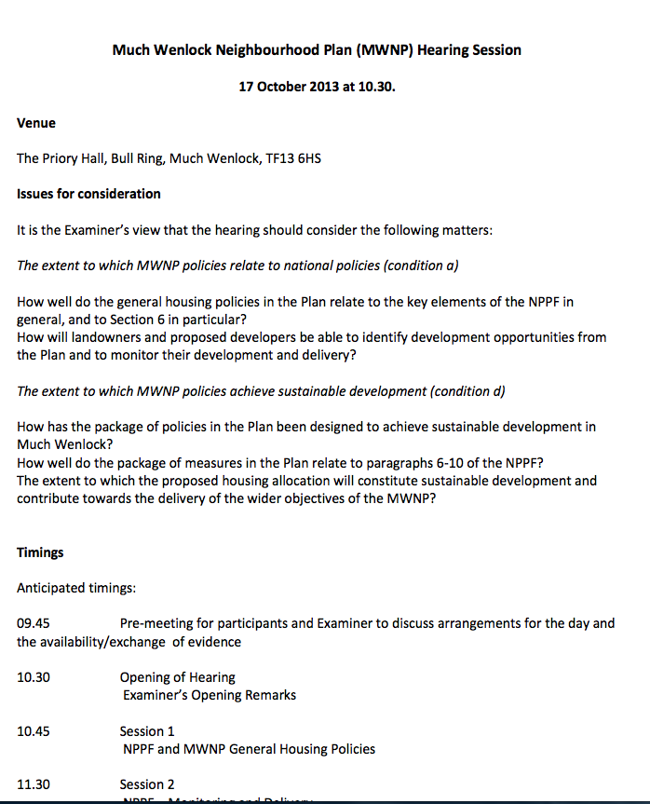

Slide 7
A public hearing
Tone – its not a public inquiry
Seating arrangements
Refreshments/facilities/equipment etc.
Social media
Recording proceedings and note taking
Press
Examiner in charge – managing expectations
Managing the participants

Slide 8
Dealing with representations
Process:
  Send copies to the examiner
  A summary sheet is a very helpful addition
  Dealing with late reps and ‘Ad hoc’ reps
  Dealing with the public in general
  Reps for or at the hearing
Considerations:
  Fairness, openness and transparency
  Basic Conditions and legal requirements
Key recommendations: Plan and Referendum
Overall: Light touch

Slide 9
Final comments
It’s about a light touch. Basic Conditions not soundness
All on a learning curve – including examiners!
Consistency desirable between plans in same LPA area?
Each examiner may have a different way of working
Liaise and keep in touch with the QB/LPA
Value of a public hearing
Process does not stop at Examination – but a sense of loss of control?
Questions?

Slide 10
Thank you
john@johnparmiter.com

