Slide 1
Phillipa Silcock
LDO’s Unpacked

Slide 2

LDOs unpacked
A grant of permission
Flexibility about mechanisms
  e.g. notifications or prior approvals
Unconditional permission or
  subject to conditions
Can permit any kind of
  Development
Can cover any area (but
  not across a LG boundary)
Time limited or permanent

Slide 3
More unpacking
Can’t effect a listed building or a European site
Doesn’t supersede any existing permission
Can still consider an application on the site
Can revoke or modify an LDO
Development may be liable for CIL
SoS can intervene in the LDO
MOST IMPORTANT – it’s a mechanism to simplify and speed up, so keep it as simple as possible

Slide 4
Summary of formal process
Prepare Draft Local Development Order
Prepare a statement or Reasons that includes:
  Description of the permitted development
  Define the area that it effects
Formal Consultation (list at art. 34 of DMPO)
Publicity
Consider representations
Decision to adopt
Notify the Secretary of State

Slide 5
Some good practice processes
Engage members early in the discussion
Work with the owners of the land – discuss collaboration and possible funding support
Don’t wait for formal consultation to engage the communities
Talk to stat cons early
Project planning is critical
Check your delegated agreement - think of your committee/ council dates
Think about your processes for post LDO.

Slide 6
Making a bid for funding
Sites are deliverable
There is a clear project plan in place for consulting on the draft local development order by the end of December 2015
The local planning authority has sufficient capacity to prepare and deliver the local development order, particularly staff resources
There is a clear commitment to timely discharge of conditions or the granting of prior approval
It is clear how the local planning authority intend to use the money and that it will be used in a cost effective way.

Slide 7
Remember
Deadline for applications is 11 March 2015

Slide 8
In our Council we are working towards…
Pre-app brand values
Trust
Cost
Time
Reliability

Slide 9
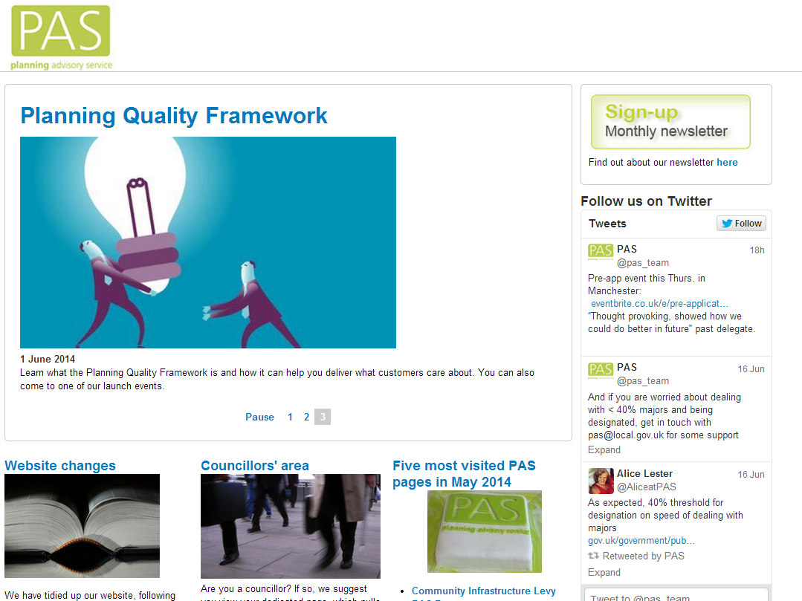
Notes:
Use our website, sign up for our newsletter, follow us on twitter

Slide 10

Contact PAS
email pas@local.gov.uk
web www.pas.gov.uk
phone 020 7664 3000

