Slide 1
Phillipa Silcock
Worthwhile pre-applications services

Slide 2

Pre-application services
Given: creating a chance to talk while the proposal is still fluid is ‘good’
But: it’s a discretionary part of the planning process
So: The discussion has to be worthwhile for people to be bothered doing it
Meaning: Create the something extra
Especially if you are charging for it
Notes:
There is a general agreement that some level of discussion before a development application is submitted is a good thing…
There are advantages to both the developer – who has more assurance that he /she is not wasting their time, or entering into a long drawnout process of considering the issues
For the councils there are also a range of benefits – savings and efficiencies - but even more – there is an opportunity to influence development so that it aligns to the goals of the councils and the needs of the community
But its discretionary - so developers will only use the process
When the advantages outweigh the additional costs – both money and time.
Councils need to recognise that its not just charges for pre-application services that put developers off – in fact not mainly this
It’s the uncertainty around the process.
For a prospective applicant to spend effort on preapplication discussions, it has to be worthwhile.
Hence the title of todays workshop

Slide 3
What pre-app should do
Faster route to planning permission
Chance to improve schemes
More sustainable development
Save abortive costs
Build community acceptance
Build in what the community wants
Mitigate problems
demonstrate political leadership
Notes:
A little reminder of the positive potential of good pre-application engagement between the council, the developer, the community

Slide 4
All the things that were wrong
Developers not bothering/not listening
Councils using charges as a cash generator
Just slows the system up
Inconsistent procedures
Still surprises - not everyone involved
No commitment to the advice given
And still too many conditions even if permission is granted
Notes:
But we also know that there are problems with the way that pre-application discussions are offered in councils
And that the government has been considering pre-applications among other options for reform of the planning system.
Specifically…. As it says on the slide.

Slide 5
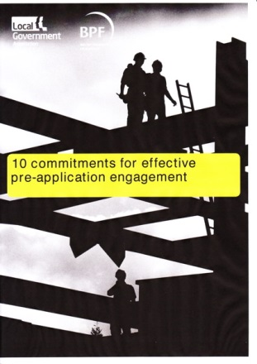

Worthwhile pre-application engagement

Slide 6

10 Commitments
A cross sector effort
- councils
- developer reps (HBF, BPF and FSB)
- statutory consultees ( big 5)
- community reps (Locality)
- RTPI and POS
Notes:
Late last year a group of representatives from across the sector got together to set out what the principles of good effective pre-application discussion should be

Slide 7
10 Commitments
Goal
To get our own houses in order, so that pre-application engagement will deliver……
“…high quality and appropriate development schemes being granted planning permission more quickly.”
“to shape better quality, more accepted schemes and ensure improved outcomes for the community.”
Notes:
Full text of the 10 Commitments if in the booklet in your delegate packs
Turn to section 1 of the workbook
These 10 commitments are intended to influence the behaviour of all parties – not just councils –
But in our PAS role the workshop and the workbook do inevitably concentrate on the offer from councils…

Slide 8

The commitments for LPAs
Quick, smooth process from proposal to completion
Choice and range of options
Help the developer
  to chose the most
  appropriate option
Notes:
For good sustainable development – opportunity to consider, discuss and shape – but avoid delays, duplication and repetition.
Not every one will require the same services – need for a range of options to suit smaller simpler, development ( and don’t loose sight of the fact that self service advice will suit many of your customers) but set out how you can help and support prospective applicants that need more advice and discussion because the proposals are larger scale, affect a wider community or embrace a lot of issues. ADVERTISE your services clearly – pre-apps is the front door to your service for investors coming to an area – don’t make it hard to find.
The choice of whether to have pre-app discussions at all, or which option to chose is up to the prospective applicant. As a LPA you will need to help them to make the best choice , but in the end the decision is up to the applicant. On the other side of the coin, if you gave the options of well managed efficient services, and a prospective applicant doesn’t take this up – for whatever reason – it will not be unreasonable to say that the options for discussion and modification during the formal application stage will be limited.

Slide 9
The commitments for LPAs
Demonstrate the good value of your service and meet the standards you promise
Co-operate to get the right people at the table
Promote an open exchange of information
Pre-app brand values
Trust
Cost
Time
Reliable
Notes:
4. Developers will only take up pre-application offers if they see value in doing so : not least because pre-app has a cost to it whether or not the LA is charging for the service. 2 aspects to what is good value – a) is it efficient or is it simply another hurdle on the path–b) is this going to improve the likelihood of a good outcome.
The council planning officers are most often the ring masters in pre-application discussions. They need to bring the right people to the table, or be able to speak for them. The discussions and advice given during pre-applications, while they don’t guarantee a positive planning application, should be reliable as indicators of the approach that will be taken further in the process – or its frankly a waste of time. Pre-apps should remove the surprises – so to avoid late emergence of problems, or to avoid someone’s solution creating a problem for someone else – the planning officer will need a weather eye and a welcoming approach.
The most productive discussions will come from having all the information on the table – but there needs to be a balance between the what stage the proposal is at and what information will be available. In the best situation - by the time the application is made, information to address all the issues should have been tabled and considered

Slide 10
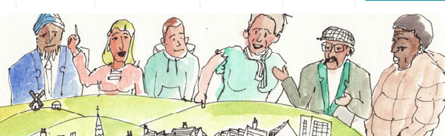
The commitments for LPAs
Be collaborative – consider everyone’s needs
Involve councillors in the discussion
Engage communities as early as possible
Record the information considered, advice given and agreements reached
Notes:
Although any planning discussion will inevitably start with a discussion of the development plan and the national policy framework – it’s a plan led system after all. Delivery of sustainable development also necessitates a full appreciation of the other factors that will determine whether a development proceeds successfully – financial constraints, market conditions, other regimes that kick in down the line, the needs of the local community, infrastructure etc By ensuring that pre-application discussions are collaborative increases the likelihood that delivery will be successful.
Involving the councillors of the local authority in discussions is part and parcel of the collaborative approach. It helps to de-risk of the development process ( and particularly the planning process) and is also a way for local leaders to influence development to achieve their wider goals for the area.
Similarly greater involvement of the community has a dividend in terms of better fit to local needs and greater opportunity for building support for a good development.
10. The three key words for this commitment - consistent/ advice/ transparent. For all three reasons there needs to be a shared record of the dicussions – or at least of the information shared, the advice given and any agreements that are made.

Slide 11

What makes a worthwhile pre-application discussion

Slide 12
The PAS pre-applications suite
1. The 10 commitments checklist
2. Pre-application services offer
3. Planning performance agreements
4. Engaging councillors and communities
5. Calculating the cost of pre-application services
6. Examples and templates from local authorities

Slide 13
Commitments for Development industry
Engage at the correct time and at the correct level
Have the correct people involved – that can make decisions/commitments
Be open and provide relevant information
Collaborative working – enter into a PPA
Engage with the local community

Slide 14
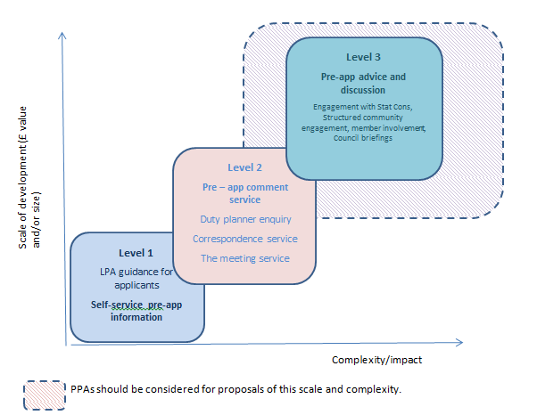
Offering a choice to the developer

Slide 15
Planning performance agreements
Pre-application
During the application
For discharge of conditions
Scale of development
Most suitable for major applications
Encourage for strategically important proposals or for particularly sensitive development

Slide 16
Planning performance agreements
Improves quality of planning process
Shared vision and policy objectives identified
An improved customer service (trust, collaboration and more certainty of timing)
Collaborative working (not just the Council’s needs)
Effective stakeholder involvement
Community empowerment and ownership
Better value in long term
Removes the 8/13 week constraint

Slide 17
Planning performance agreements
Facilitates workload planning
Discretionary pre-application advice paid for by those who benefit
Service can respond to development pressures
Core and ‘flexible workpool’ model

Slide 18
Planning performance agreements
Don’t have to be long and difficult
Some one page examples (pt 6)
Keep it proportionate
Base the agreement in discussion
Not just a document for the LPA’s convenience
Involve other parties (stat consultees and community for )

Slide 19

Cost versus value
The conundrum:
Can councils consistently provide a good value pre-app service without passing on costs?

