Slide 1
The experiences of local groups
Bob Keith
Planning Aid England

Slide 2
Contents
What has Planning Aid been doing with groups
How groups have coped with the different stages of plan preparation
What research amongst groups has indicated
What are the lessons to be learnt going forward

Slide 3
Planning Aid England
Part of the Royal Town Planning Institute
Provide free web based resource called Planning Aid Direct
Operate an advice service – offer limited amount of free, professional, general planning advice
Casework undertaken by volunteers for eligible groups
Further support and community engagement in planning – training for parish councils in Warwickshire on how to comment more effectively on planning applications
Support communities to deliver neighbourhood planning – part of Locality consortium funded by DCLG

Slide 4
Supporting Communities in Neighbourhood Planning 2013-2015
DCLG funded programme launched in April 2013
Two main aspects to support: grants and direct support
Also a shared learning element
There is one consortium delivering the programme comprising Locality, Planning Aid, Community Development Foundation, Eden Project and URS
New DCLG funded programme from April 2015
£22.5 million over three years to provide groups with expert advice, grants and technical assistance
Planning Aid won DCLG contract to develop suite of materials

Slide 5
Supporting Communities in Neighbourhood Planning
Examples of groups receiving direct support include:
Welford-upon-Avon, Wootton Wawen and Stratford Town (Stratford-on-Avon District)
Austrey and Fillongley (North Warwickshire District)
Longdon and Burntwood (Lichfield District)
Market Bosworth (Hinckley and Bosworth District)
Braunston, Brixworth and Kilsby (Daventry District)
Marchington (East Staffordshire District)

Slide 6
What has Planning Aid been doing with groups?

Slide 7

Support from Planning Aid takes many forms!

Slide 8
Direct support for communities
This might include:
Clarifying statutory process and preparing a project plan
Working with key partners, especially local planning authority
Evidence gathering including community engagement
Identifying key issues, creating a vision and objectives
Meeting the basic conditions e.g. conforming with local plan
Assessing sites for development
Drafting the plan and writing policies
Preparing a sustainability appraisal/SEA
Drafting engagement and basic condition statements

Slide 9
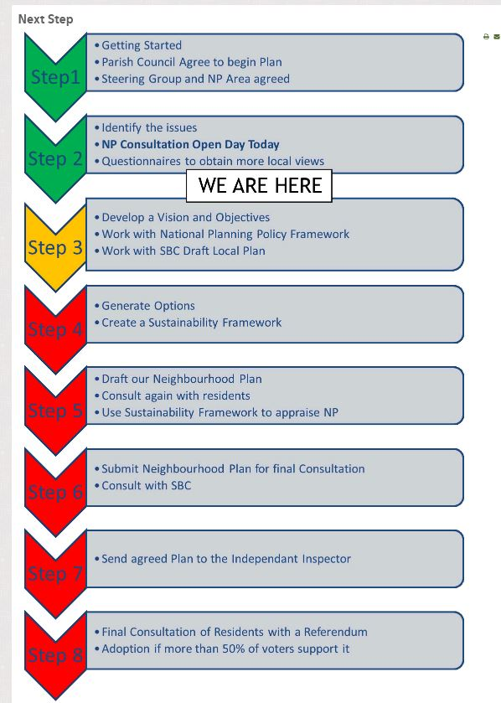
Project Planning
Groups have problems with this because they don’t understand the statutory process
They don’t know what they don’t know!
Not sure of time required for different tasks
A simple key tasks list with indicative dates should be drawn up early in process
Recommend PAS spreadsheet

Slide 10
Community engagement
Groups sometimes believe that the only evidence needed is local opinion, which is their understanding of localism
Have to explain that whilst important, community views may be anecdotal evidence that prompts further research
How representative are the Parish Council and Steering Group? Are the respondents representative?
Have to highlight need to be open minded and address issues arising over the entire plan period

Slide 11
Key principles of community engagement
Have to remind groups that consultation should:
be front loaded with an open mind
raise confidence and skills of the community
raise awareness of what the plan can and cannot do
manage expectations
be inclusive and accessible to all
adopt a systematic approach
consider a community engagement strategy
construct a profile of the community and key stakeholders
adopt creative techniques!

Slide 12
Understanding the need for evidence
A group will:
Need signposting to existing sources of information
Need help with bespoke surveys e.g. housing need
Often provide good information for context but don’t always apply it to policy justification e.g. local history
Sometimes worth undertaking an evidence review for groups

Slide 13
Assessing sites in a neighbourhood plan
Groups need to understand the implications of the adopted Local Plan and have regard to any housing requirement in emerging Local Plan
SHLAA often misunderstood – seen as allocations
Approach to allocating sites varies around country
Some groups have identified sites but need to understand they need a robust methodology dealing with suitability, availability, deliverability and viability
Others adopted criteria based policies
Need to agree housing requirement and approach with LPA
Could trigger need for SEA

Slide 14
Evidence gathering
Community engagement
Research and fact finding
Identify issues and options
Create vision
Objective
Objective
Objective
Policies and proposals
Policies and proposals
Policies and proposals
Reasoned justification
Reasoned justification
Reasoned justification

Slide 15
Key rules for writing policies
Explain to groups that policies should be:
appropriate for a neighbourhood planning document and relate to development and the use of land
consistent with the Framework and the local plan
positively written
viable
clear and unambiguous in plain English
capable of having the desired impact within the timescale covered by the neighbourhood plan
based on a robust evidence base

Slide 16
Policy Stance | Suitability | Is it in broad conformity? Does it replicate what is elsewhere? | Does it achieve sustainable development? | Does it have a robust evidence base?
What is the policy or proposal trying to achieve? | Appropriate for a neighbourhood development plan or aspirational project? Positively written? Clear and unambiguous? Capable of having the desired impact within the plan period? | National Planning Policy Framework? Planning Practice Guidance? Adopted Local Plan? Emerging Local Plan? | Does it have a positive or negative impact on economic factors? Does it have a positive or negative impact on social factors? Does it have a positive or negative impact on environmental factors? | What is the supporting justification? Source of evidence or research? Comments from community engagement?

Slide 17
Case studies
Holbeck: neighbourhood planning as tool for regeneration
Lawrence Weston: neighbourhood planning and community engagement
Friends of Fishwick and St Matthew's (FOFS): dealing with non-planning issues
Leeds: a case study about a local authority's role in neighbourhood planning
Peakirk: a case study about communicating your neighbourhood plan
Balsall Heath: a case study about the process and demands of consultation
Whitchurch: using traffic studies as part of the evidence base
Birdham: a case study about policy writing
Kirdford: a case study about neighbourhood planning examination
Ashurst Wood: a case study about site assessment
Headcorn: gathering evidence for your neighbourhood plan using surveys
Woodcote: how robust project management can help deliver a neighbourhood plan
Cringleford: a case study about neighbourhood planning in a growth area
Queen Camel: a case study of involving volunteers

Slide 18
What research amongst groups has indicated?

Slide 19
User Experience of Neighbourhood Planning Research (June 2014)
Drivers and motivations for preparing plans:
Reinvigorating the local area
Protecting the desirable characteristics of the area
Help shape a future vision for the neighbourhood
Greater say in planning and development in their area
Statutory weight a neighbourhood plan provides
Control over the process

Slide 20
User Experience of Neighbourhood Planning Research (June 2014)
Overall experience of neighbourhood planning:
55% thought process was what they expected
Over 90% felt it had gone well or okay
Majority had overcome difficulties, often with consultant or local authority support
Overall it was regarded as initiative with merit and further potential, although not without difficulties and opportunities

Slide 21
User Experience of Neighbourhood Planning Research (June 2014)
What would make it more attractive to communities?
Half wanted a better explanation of the process
44% wanted more face to face advice
39% felt faster process would make more attractive
Evidence strongly suggests that neighbourhood planning can be undertaken by most communities if effectively supported, especially by local authority

Slide 22
What are the lessons to be learnt?

Slide 23
Communities preparing neighbourhood plans
Groups engaged in neighbourhood planning include inner city areas, market towns and settlements in National Parks
Mix of Forum, Town Councils and Parish Councils
Most interest amongst rural communities, especially those with development pressures
Less interest in urban areas, especially deprived areas
The size, characteristics, issues and motivations vary
Rural areas often motivated because of development pressures – but then consider wider issues such as ageing population, affordable housing, loss of facilities
Urban areas more interested in regeneration

Slide 24
Local planning authority role
A key partner!
Agree neighbourhood area, organise examination, and arrange referendum
The duty to support might also include:
  technical advice and support on neighbourhood planning
  provide or direct group to background data/evidence
  identify key stakeholders and addresses
  advice on adopted and emerging Local Plan policies
  comment on initial drafts of neighbourhood plan
  screen for Strategic Environmental Assessment

Slide 25
What else can local authorities do to help?
Understanding difference between strategic policy and what can be developed at neighbourhood level
Determining patterns/extent of growth that the plan will need to respond to
Providing comments on early ideas for policy areas
Committing to attend number of group meetings
Keeping groups aware/enabling access to emerging new evidence if local plan is being reviewed.
Providing consistency and clarity throughout the process
Encourage Development Management Team to comment on emerging policy

Slide 26

We are all still learning!
Judicial Reviews
Some inconsistencies
What is proportionate evidence?
Implications of out of date Local Plan
Delays at Local Plan examination
Timing of submission

Slide 27

Some Lessons Learned
It’s not for everyone!
It’s not an easy or short process!
Raised understanding of planning system and empathy with LPA
Has made a tangible difference to decision making
  Planning applications
  Appeals
People are interested!
  Turnout often in excess of local elections
  Overwhelming YES votes

Slide 28
Contact Details
Robert.Keith@planningaid.rtpi.org.uk
PAE Advice Line: 0330 123 9244
E-mail: advice@planningaid.rtpi.org.uk
www.rtpi.org.uk/planningaid
To volunteer:
http://www.rtpi.org.uk/planning-aid/volunteering/how-to-apply/

