Slide 1


Planning Performance Agreements
in Islington
PAS Pre-Application Services Workshop
19th June 2014
Victoria Geoghegan
Head of Development Management & Building Control

Slide 2
Structure of Presentation
Why Islington using PPAs
When we encourage the use of PPAs
Islington’s service offer
Success so far
Examples
Survey
How Islington benefits?

Slide 3
Why Islington encourages PPA?
Lots of reasons……
Timeframes
Resources

Slide 4
Why Islington encourages PPA?
1: Improves quality of planning process
Shared vision and policy objectives identified
Effective stakeholder involvement
Collaborative working
Fosters strong and productive
partnerships
An improved customer service
Better value in long term
Removal of 13/16-week time constraint

Slide 5
Why Islington encourages PPA?
2: Facilitates well informed, robust decision making
Effective transparent community engagement
Community empowerment and ownership
Building trust
Less objection, more support
Certainty through Member involvement
Avoidance of refusal and lengthy appeals
More sustainable and higher quality developments

Slide 6
Why Islington encourages PPA?
3: Facilitates workload planning
Core and ‘flexible workpool’ model
Discretionary pre-application advice paid for by those who benefit
Service can respond to development pressures
Fixed term contracts for additional staff

Slide 7
What sort of PPAs do Islington offer?
Pre-application
Application stage
Post decision – AOD, s73
Significant clients who submit a number of applications and enquiries each year
One off PPA covering the end to end process

Slide 8
When do we encourage a PPA
Planning proposals that:
are strategic
require Environmental Impact Assessment
on larger sites that include a variety of land uses
have impact on strategic areas of environmental sensitivity
on sites with many constraints to be resolved
involve significant non-standard planning obligations
referable to GLA or Secretary of State;
significant impact on existing communities which require wide consultation/ involvement with stakeholders
unique to a local authority’s experience.

Slide 9
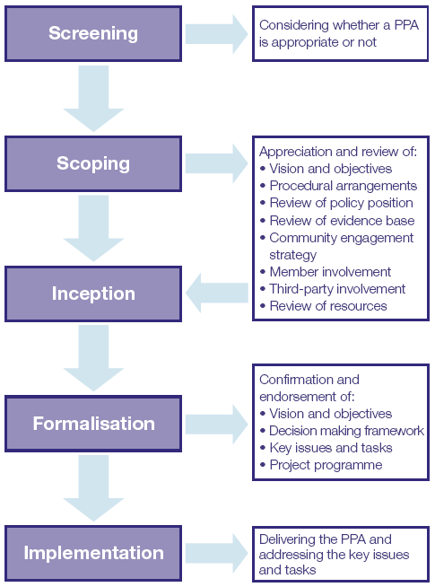
Islington’s
PPA process

Slide 10
Islington’s charges
Normal pre-application charging regimes
For a flat fee of £6000 we offer 2 types of PPA:
Pre-app and Application
Application phase only
Post decision fee of £1500 offer 1 type
1. AOD/s73
Also included as part of the PPA process:
Design Review Panel
Members’ Pre-application Forum

Slide 11
Success so far
Steady increase in use of PPA –
Pre-application Application Stage
2011: 0 0/52
2012: 8 2/33
2013: 19 17/40
2014 23 8/10
Some examples :
Mount Pleasant
City Forum
City University
Housing Service’s Major Applications
London Metropolitan University
Old street office development

Slide 12
Case Study: City Forum
Mixed use scheme comprising 995 flats, 190 bed hotel, B1 office and affordable workspace, town centre uses, crèche and open space. EIA development and referable to the GLA.
The application site has an extant permission
Screening: PPA was necessary. Funded an officer.
Scoping: Timetable of meetings agreed - including 2 x CABE DRP reviews, 2 x Pre-Application Members’ Forum.
Vision and objectives, key stakeholders, policy position, procedural arrangements and committee date all agreed.
Implementation: First of 50 agreed meetings April 2012 +. Extended
Key benefits: Member involvement allowed more certainty and understanding of a very complex proposal and ensured the applicant knew what the main issues were. Allowed key viability and design issues to be resolved – CABE DRP twice. Timeframe extended to accommodate negotiations.
Decision was to refuse under delegated
Call in by GLA

Slide 13
Case Study: City University
Redevelopment of part of the site for Graduate School.
Screening: PPA was necessary
Scoping: Timetable of meetings agreed - including 2 x DRP reviews, 1 x Pre-Application Members’ Forum.
Vision and objectives, key stakeholders, policy position, procedural arrangements and committee date all agreed.
Implementation: Nov 2012 onwards. Extended
Key benefits: Sensitive heritage area/switched on community.
Community /member involvement allowed more certainty and understanding of a very complex proposal and ensured the applicant knew what the main issues were.
Timeframe extended to accommodate negotiations.
Approved subject to a s106

Slide 14
PPA Survey 2012

Slide 15
Survey’s Positive Comments
Benefits both parties
Creates a positive working relationship
Accountability and focus on timescales
Provides results and dedicated offices makes a difference

Slide 16
Survey’s Neutral Comments
Doesn’t make a difference
Time consuming to put in place
When paying a fee they expect a certain level of service
Don’t always stick to targets
LPA use to justify longer determination period

Slide 17
Survey’s Negative Comments
Ignore timescales
Just another cost
Time consuming to negotiate

Slide 18
So for Islington a PPA is not just about removing the time constraints…
a PPA will:
limit bureaucratic approach
promote shared objectives , visions, goals
allows flexibility
build trust and strong partnerships
give genuine voice to local communities
establish transparency and more certainty
result in well informed and robust decision
Ensures staff resource is available for discretionary service

Slide 19

Questions?

