Slide 1


Planning Performance
Stuart Minty (Head of Development Management)

Slide 2

Our Story So Far
Pre 2013 - Traditional Target based culture (8/13 Weeks)
Benefits – Applications generally determined in timely manner
Problems – Targets dictated behaviour, too many checks/handovers, system not fully focused on our customers.
2013 - System Thinking Review
Benefits - Removal of traditional targets, focus on getting things right first time (fewer repeat applications), move to electronic working
Problems – Still to many checks/handovers, applications generally taking longer to determine, system based on risk rather than on efficiency and customer need.

Slide 3
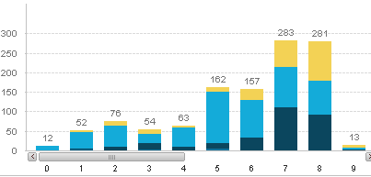
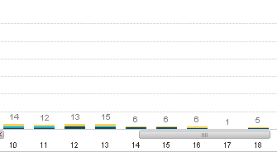
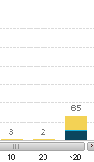
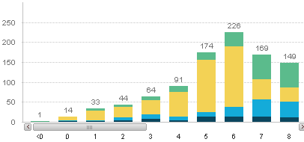
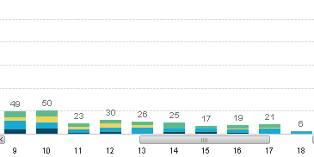
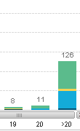
Time taken to decide applications: number of weeks from registered
Quarter 3 (October, November, December 2012)
Quarter 3 (October, November, December 2013)
Notes:
Reasons:
Pro:
Applications done in one go: historically withdrawn/ last minute refusal/ duplication of application- with no fee for 2nd application
Cons:
8 week target date removed- but no consistency in earlier decision making/ customer engagement- applications just taking longer for no justifiable reason/

Slide 4
Reflections – What we did next
Recognition that some parts of system not working for us, or our customers
Set up a trial team (Planning Solutions Team), designed new system for handling of applications (June 2014)
Focussed on less handovers, less checks, more efficiencies, and a better customer experience
Further roll in of staff in October 2014, and January 2015

Slide 5


What do our customers want ?
They told us two things:-
In most cases they wanted a timely decision
They wanted to communicate with the case officer

Slide 6

Translated into a service vision
Do things ‘right first time’
Focus on customer needs
Remove waste and inefficiencies
Focus on delivering customers a quality and value for money service
End-to-end responsibility within one team, working together to deliver positive outcomes

Slide 7

Highlights of change
Self Allocation - Take ONE AT A TIME, no historic caseload)
NOT DRIVEN BY TARGETS, more so the needs of customer.
ONE CASE OFFICER – No official validation stage process – no handovers
Approach to PROBLEM SOLVING FROM THE OUTSET
PROPORTIONATE APPROACH TO REPORT WRITING i.e. no objection, no report
CHANGE TO ROLE OF PLANNING TECHNICIAN

Slide 8
Timesheeting/Value Analysis
 | June 2013 | Nov 2014
Value Demand | 62% | 82%
Failure Demand | 38% | 18%
We have increased our ‘value demand’ from 62%
to 82% between June 2013 and Nov 2014.
Less time spent on dealing with failure demand i.e. progress chasing
More time to spend on adding value and helping customers
Dealing with applications in the same time as current system, however we are able to channel this time more effectively.
However, we are able to make decisions earlier with largely positive outcomes and happier customers (and officers).
Notes:
Failure demand = failure to do something or do something right for the customer i.e. progress chasing or complaints
Value demand = what the call centre exists to provide i.e. provide advice or guidance
By removing waste and not juggling tasks we are able to focus on spending more time getting the planning application
Moving forwards…
Transitional stage – likely time reduce further
Further reductions in failure demand

Slide 9


Key DM Measures
Performance So Far
Timeliness
Customer Satisfaction

Slide 10
Capability Chart – DM Service

Slide 11
Capability Chart – PST

Slide 12
Customer Satisfaction
Case officers phone applicants when decision is ready – complete online. Survey question focuses on:-
A) Case officer contact
B) Clear advice for officer reasoning
C) Speed of decision
D) Overall satisfaction
100% of PST Customers either satisfied or very satisfied overall, regardless of outcome of the application, 80% for DM Service
Strong correlation between speed, communication and overall satisfaction across the service.

Slide 13

Sample of Comments
“Genuinely surprised about how quickly it took to deal with the application”
“I thought it was a good service. Friendly, relatively quick and clear”
“The case officer who dealt with the application was very helpful and process went very well”
“Outstanding the best service I've had. You've set the bar for the rest”
“Very smooth and efficient planning process! Probably the best from all the LA's we have to deal with. Also, I quite like the accessibility of the planning officers.”
“It's a terrific improvement. I'm going to fall off my chair with surprise at how quickly you dealt with the application”
This new approach helps everyone in the development process. My client will be so happy and can get the builders on site asap.

Slide 14

Overview &
Challenges Ahead
Whole of DM service to be working in new way by May 2015
Number of options final roll in. Work out the final detail so this work for the service and our customers.
Transition Phase. One big team and embedding the culture change

Slide 15


