Slide 1


Community Infrastructure Levy
Project Planning and Infrastructure Evidence
July 2014

Slide 2
Project planning for CIL

Slide 3
What have we learnt so far?
You need a senior project sponsor and project manager
You need to sell the benefits of CIL
Keep focused; a CIL examination remains a relatively narrow affair

Slide 4
Setting the objectives, scope and deliverables
Team and resources
Timeline
Budget
Objectives, scope and deliverables
objectives, scope and deliverables
team and resources
timeline
budget.
What comes first?

Slide 5
Selling CIL
Members and executives
Fellow officers
Development market
Community
Regulations and timing
Regulations and timing
Regulations and timing
Regulations and timing
Regulations and timing
Regulations and timing
Regulations and timing
Likely increase in income
Support to strategic planning approach
Strategic infrastructure investment to support development
Community projects and reinvestment
Powerful tool to support growth
Easier to administer
Transparent, upfront cost
Greater involvement in priority setting

Slide 6
CIL Project Team and Resources
Project Management
Infrastructure planning and funding gap
Viability
Planning and regulatory compliance
Project
Sponsorship
Implementation - processes, procedures systems
Project Quality Assurance
Project direction and assurance
Project structure and components

Slide 7
Model Programme
 | 1 |  |  |  | 2 |  |  |  | 3 |  |  |  |  | 4 |  |  |  | 5 |  |  |  | 6 |  |  |  |  | 7 |  |  |  | 8 |  |  |  | 9
Mobilisation
Preparation of PDCS (min 6 weeks)
Consultation of PDCS
Preparation of draft Charging Schedule
Consultation on draft Charging Schedule and preparation for examination
Submission to examiner

Slide 8
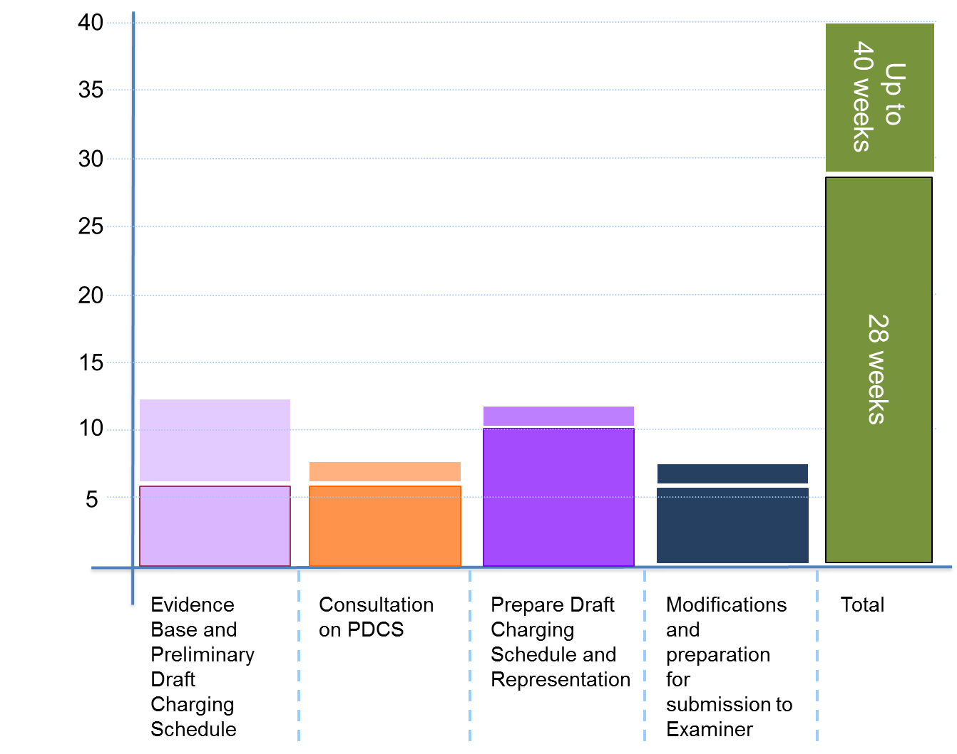
Programme - Building blocks

Slide 9
Programme – Stages, actions and deliverables
Evidence Base
Preliminary Draft Charging Schedule and Consultation
Draft Charging Schedule and Representation
Examination and adoption
ACTIONS
Collate infrastructure planning and cost evidence
Prepare funding schedule
Prepare development projections
Collate viability evidence
Prepare working hypothesis charging schedule
Assess evidence gaps
Fill gaps
Procure external support, if required.
ACTIONS
Finalise evidence base
Prepare consultation strategy
Prepare statement on
Installments
Finalise preliminary draft charging schedule
Undertake consultation for a minimum period of six weeks
Analyse consultation responses and, if necessary, refine evidence base and rates.
ACTIONS
Prepare draft charging schedule
Undertake representation for a minimum six week period
Analyse representations s and, if necessary, refine evidence base and rates.
Prepare statement of modifications, if required.
Prepare information for Examiner
ACTIONS
Procure a examiner
Issue information to examiner and set examination date
Undertake examination
Receive and review examiners report
Prepare adoption report for Full Council
Take report and charging schedule to Full Council and gain approval
DELIVERABLES
Infrastructure and funding analysis that demonstrates a funding gap
Development projections by usage (and potentially by area)
Working hypothesis charging schedule
Estimate of CIL income with sensitivity analysis
DELIVERABLES
Preliminary draft charging schedule
Supporting evidence base
Consultation report
Updated evidence base
DELIVERABLES
Draft charging schedule
Representation report
Statement of modifications (if required)
Information for examiner
DELIVERABLES
Examination
Examiners report
Report to Full Council

Slide 10
Consultation and representation strategy
Two elements:
  consultation on Preliminary Draft Charging Schedule
  representation on the Draft Charging Schedule.
Our recommendations are:
  to make the consultation as meaningful and comprehensive as possible whilst containing it within the specified time period and to interested parties; by conducting it in this manner you will draw out and address the significant issues in advance of representation
  you want the representation to be quick, efficient and contained leading up to the examination.

Slide 11
Typical Project Risks
Risks | Likelihood of becoming issue
Failure at examination due to insufficient evidence base | Unlikely
Failure at examination due to unreasonable interpretation of viability evidence | Unlikely
Failure at examination due to incorrect interpretation or application of the regulations | Unlikely
Discouraging development through poor engagement or inappropriate rate setting | Likely
Disruption to project timeline due to poor/ inappropriate engagement with members/ senior managers | Highly likely
Not having the procedures, processes and systems in place for implementation and collection | Highly likely

Slide 12
Five key points on successful CIL project delivery
CIL is a good news story; sell the project to make life easier.
Proper planning prevents poor performance.
Resource it properly with the correct expertise.
Know the regulations and guidance; there are no shortcuts.
Keep it simple and contained.

Slide 13
Infrastructure Planning

Slide 14
What have we learnt so far?
Still relatively minor component of examinations
All councils have an infrastructure funding gap
Greater emphasis on CIL vs S106 and ‘double dipping’

Slide 15
Infrastructure Funding Gap
total cost of infrastructure
funding from other sources
aggregate funding gap
projected CIL Income
residual funding gap
Aggregate
Funding Gap
Residual Funding Gap
Projected CIL Income/ CIL Target
Other
sources
Total Cost of Infrastructure
Funding
Funding

Slide 16
Golden thread
Relevant Plan Infrastructure Evidence
CIL Infrastructure Evidence
Regulation 123 List
Funding Gap
Project List
Drawn from infrastructure evidence that underpins the plan
Total cost of infrastructure for projects that are potential candidates for CIL funding
Regulation 123 list
Need to understand approach to S106 and S278

Slide 17
Waltham Forest Case Study 2 (1)
Context
Adopted Core Strategy in 2012
CS supported by SIP produced 2009
PDCS consultation based on SIP
Council commissioned update to support DCS consultation
Considerations
Should additional infrastructure planning be undertaken for CIL?
How to align plan making process to delivery?

Slide 18
Waltham Forest Case Study 2 (2)
Approach
additional infrastructure planning undertaken in 2013 to align IDP to spending priorities
work undertaken during a 12-week intense period.
update to viability work undertaken concurrently
Outcomes
Updated IDP that can inform capital programme
Successful CIL examination in spring 2014.

Slide 19
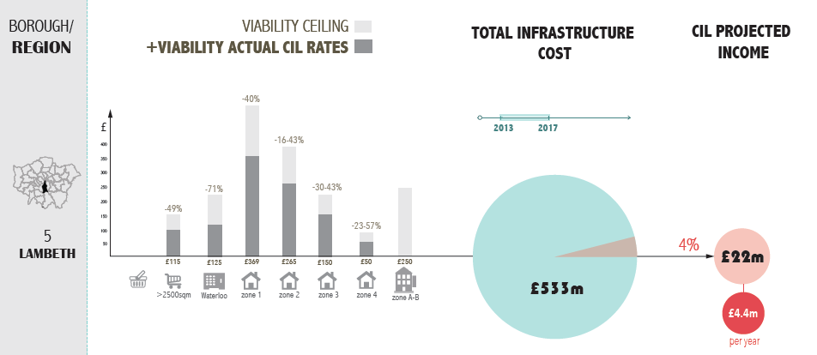
Approach by Councils

Slide 20
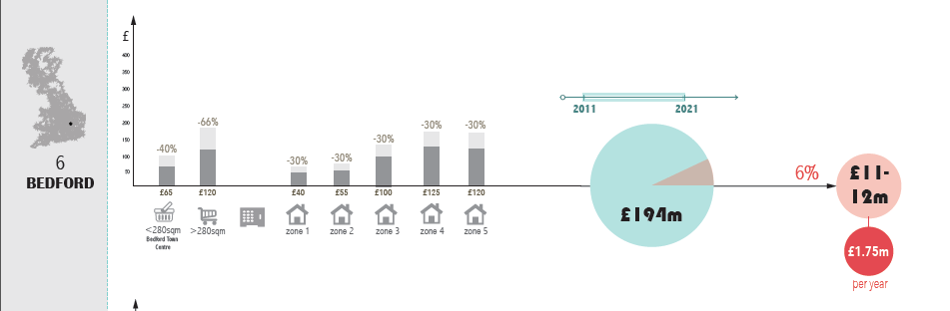
Approach by Councils

Slide 21
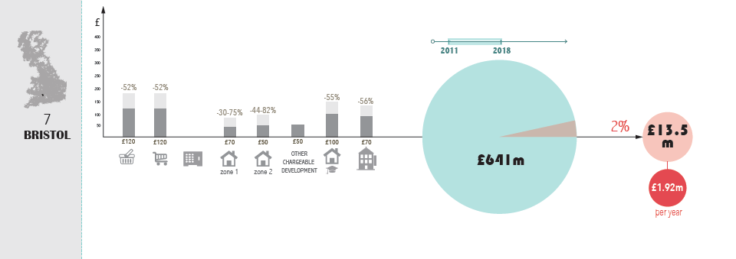
Approach by Councils

Slide 22
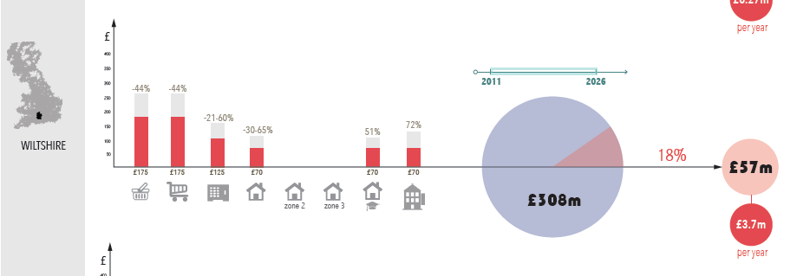
Approach by Councils

Slide 23
Feedback from examinations
Relatively minor part of CIL examinations to date (2-3 paragraphs in the examiners report)
Most authorities undertook additional bespoke infrastructure planning for CIL.

Slide 24
Infrastructure Evidence - Questions
Have you identified the total cost of infrastructure they wish to fund wholly or partly through the levy? (para.2:2:2:1)
In identifying your CIL target, have you considered what additional infrastructure is needed in your area to support development and what other funding sources are available? (para.2:2:2:1)
Is your information on infrastructure need directly related to the infrastructure assessment that underpins your plan (para.2:2:2:1)?

Slide 25


Questions
www.CILknowledge.com

