Slide 1

CIL Latest Research & Findings
Rebecca Housam, Planner

Slide 2
Overview- CIL PAS Event
Intro
National Overview
North Focus
Latest Research/Role of Viability
April 2015 & S. 106 Pooling Restriction
CIL – Lessons Learnt

Slide 3
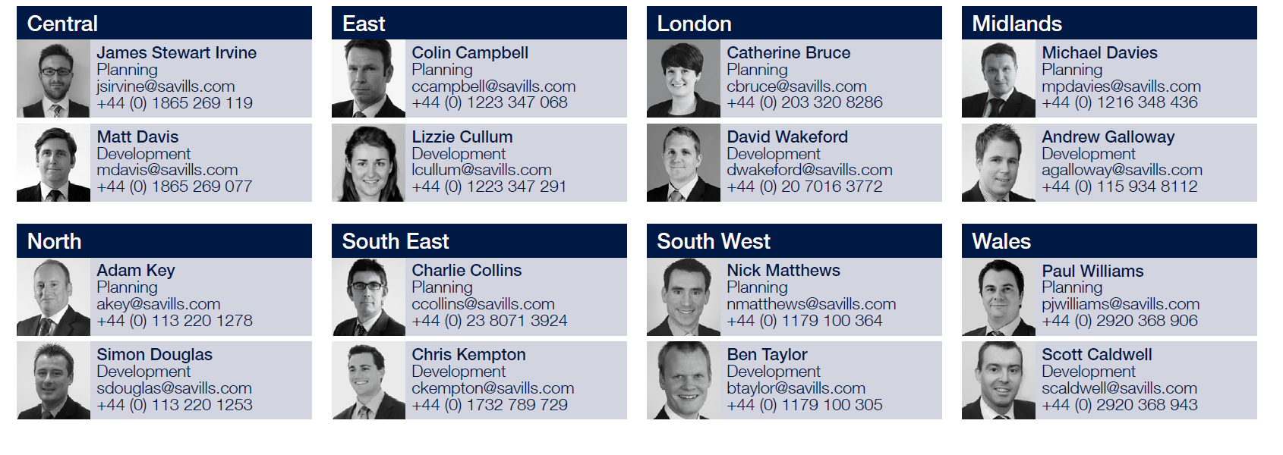
The Savills Team

Slide 4
CIL Progress
National Overview

Slide 5
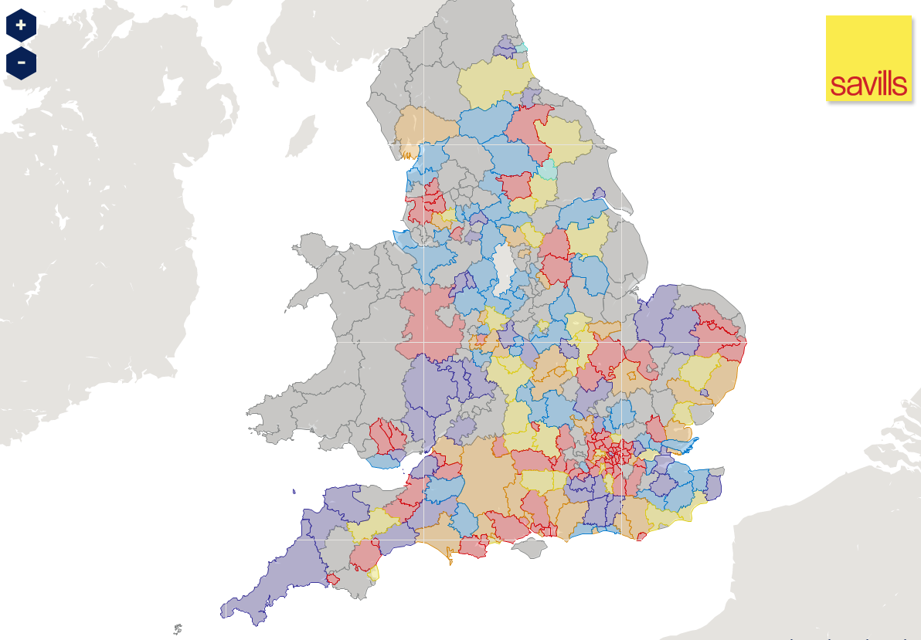
CIL Across England & Wales (All Stages)
Savills - http://www.savills.co.uk/promotions/cil-map.aspx

Slide 6
Progress on CIL Implementation (England & Wales)
Source: Savills (as at 23rd March 2015)

Slide 7
North of England

Slide 8
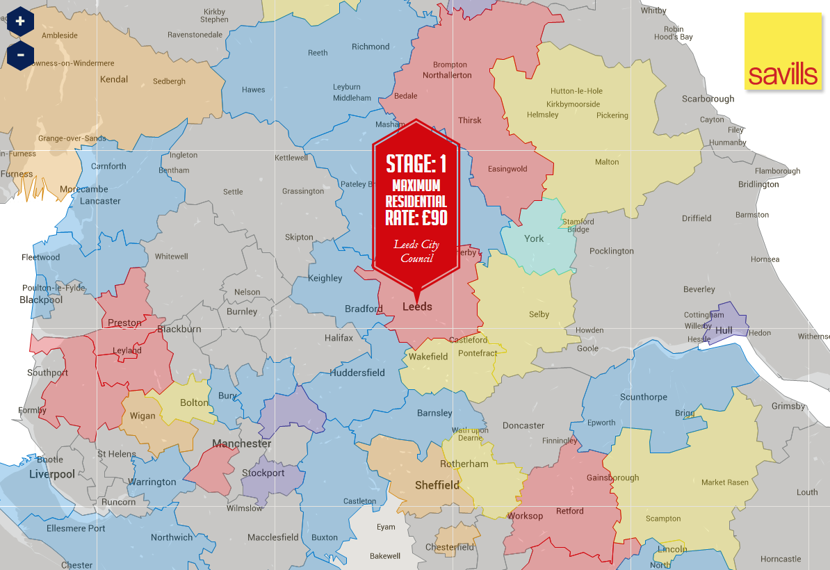
Northern England - CIL Progress Map

Slide 9
North England - CIL Progress In Numbers
8
Implemented
51% of Local Authorities engaged with CIL in the North of England
4
Submitted for Examination
4
Draft Consultation
Only 11 Northern LPAs Authorities anticipated to have implemented CIL by the end of 2015
7
Preliminary Draft Charging Schedule
14
Preparing Evidence
36
Not Started
Correct as of 29th June 2015

Slide 10
Latest Research

Slide 11
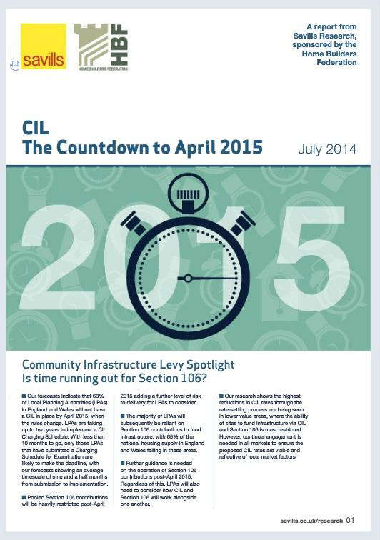
Research –Countdown to 2015 (July 2014)
Predicted that 68% of LPAs would not have CIL by April (actual 76%)
CIL production time average 24 months (note 8 months between PDCS and DCS)
Rates fall between PDCS and DCS

Slide 12
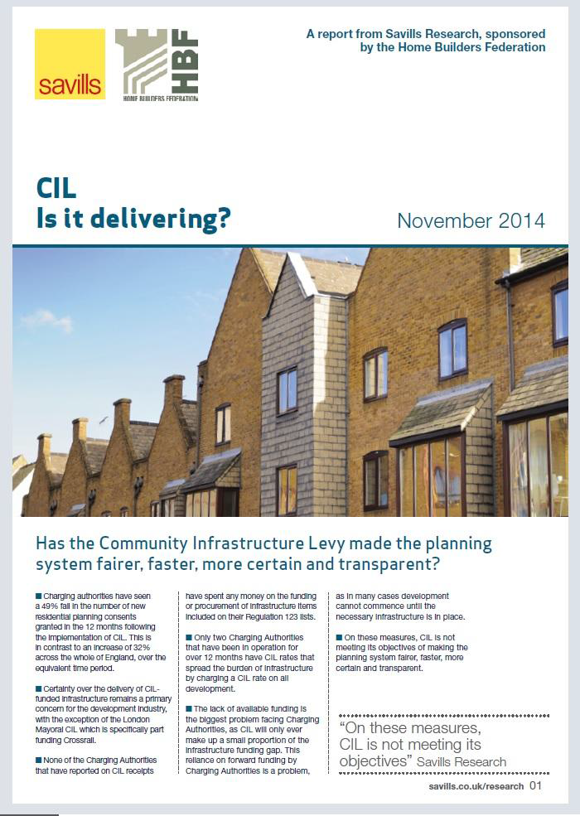
Research – CIL is it delivering? (November 2014)
Too early to draw conclusions (16 LPAs)
94% of CIL receipts towards Crossrail
100% of CILs charge Residential and Retail
Residential planning permissions drop post implementation of CIL
Over 30 LPAs have chosen to £zero rate one or more strategic sites or areas
LPAs as bankers. To operate effectively, forward funding is required

Slide 13

Research – CIL – Getting it right (January 2014)
Basics of viability for planners Trade off S.106 / Affordable Housing / CIL
CIL won’t work below £200 per sq ft
Gross site area/ value the best starting point Influences on Benchmark Land Value (BLV)
Updates on Savills assumptions on profit, build costs, abnormals, BLV etc.
Latest updates available in more recent
representations

Slide 14
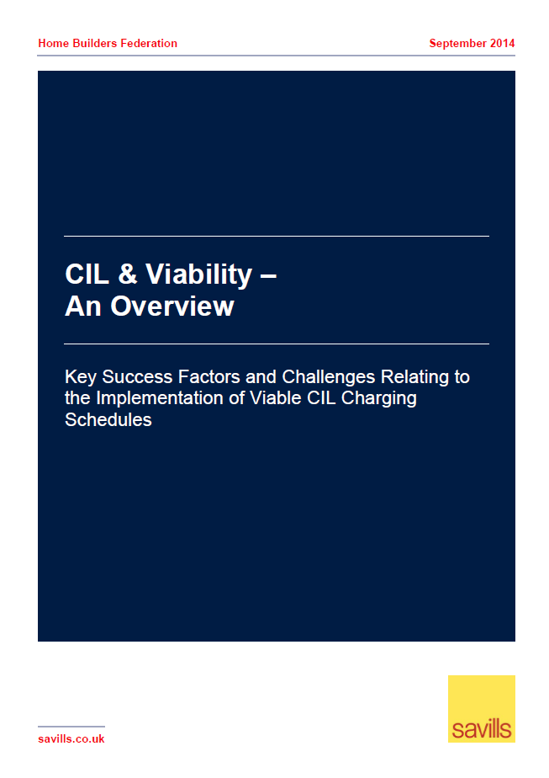
CIL Viability – An Overview
Savills was commissioned by the Home Builders Federation (HBF) to prepare a Briefing Note entitled ‘CIL & Viability – An Overview’ for PINS.
The purpose of the Briefing Note is to highlight
the important of understanding the key inputs
behind the viability evidence submitted to CIL
examinations and to emphasise those
components that have the greatest impact on
sites’ ability to support a CIL.

Slide 15
The Role of Viability

Slide 16

At the heart of CIL
Regulation 14
LPAs must strike an ‘appropriate balance’ between the desirability of funding infrastructure and the potential impact that CIL may have on the viability and delivery of development in the area
Tested at examination...

Slide 17
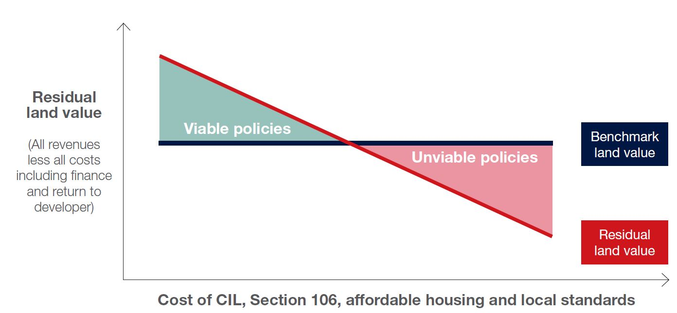
Why is this important?
Policy choices have a cumulative impact on viability resulting in a three-way trade off
Source: Savills

Slide 18
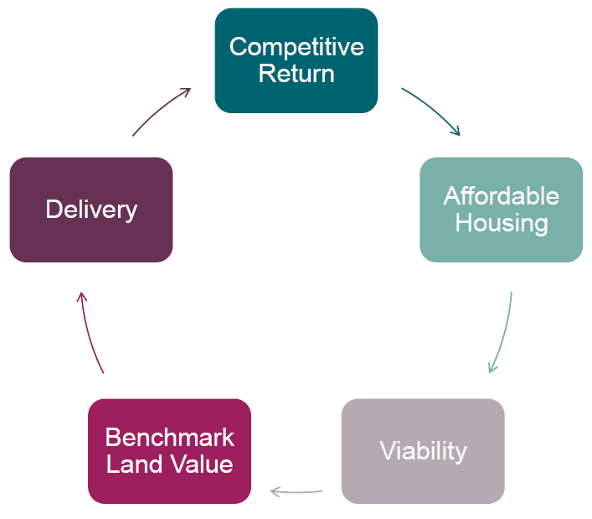
CIL 5 Key Challenges
General move towards consensus on standard inputs BUT key areas of disagreement remain
1
Benchmark Land Value & Net: to Gross
2
Affordable Housing
3
Residual Section 106
4
“Unviable” Sites & Nominal Rates
5
Viability Buffer
Difference between theory and reality!

Slide 19
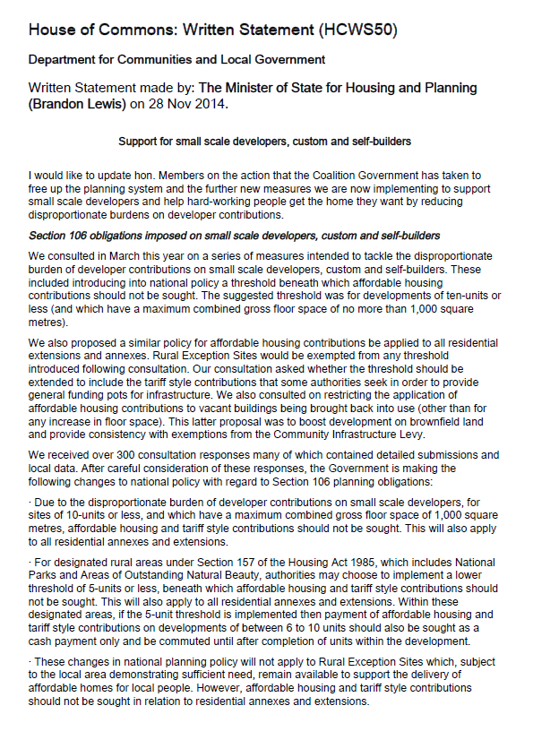
Complicated by changing policies!
Affordable housing thresholds
Space standards
Sustainability requirements
Vacant building credit
NB: Need to consider how this will impact CIL viability testing

Slide 20
April 2015 – Pooling Restriction

Slide 21
From 6th April – Section 106 lives on, but is restricted
Is a planning obligation related to ‘infrastructure’ a reason to grant planning permission ?
Infrastructure ‘type’ ‘i.e. transport, open spaces or education
Infrastructure ‘project’ i.e. Junction 1, the Pocket Park, Joe’s School
Restriction on number of obligations applies in areas with CIL already, and nationwide everywhere else from 6th April – regardless of whether a CIL is implemented
Otherwise known as the ‘pooling restriction’
Number of obligations entered into since April 2010, by type or project. Limit hit already ?
Has the Local Authority produced a Disclosure ? (i.e. outlining which infrastructure types and projects have hit the limit) - probably not
Infrastructure is defined by the 2008 Planning Act: As including: “Roads & Other Transport Facilities, Flood Defences, Schools & Other Educational Facilities, Medical Facilities, Sporting and Recreational Facilities and Open Spaces”

Slide 22
Projections on number of implemented CILs
Only 24% of LPAs anticipated to have a CIL in place by the end of April
Source: Savills (February 2015)

Slide 23
How to advise on this ?
CIL Charging Schedule in place BEFORE 6 April 2015?
YES
NO
25% of LPAs
75% of LPAs
‘Regulation 123 List’ outlines what types or projects Section 106 is restricted. This is not a commitment to spend CIL but will help to define types and projects. (Reg 123 (2))
Plus – need to be confident that the limit on the number of planning obligations has not yet been reached. (Reg 123 (3))
No List. Most if not all infrastructure obligations restricted ?
The test is the need to be confident that the limit on the number of planning obligations has not yet been reached. (Reg 123 (3))
In both cases. Regulation 122(2) tests will need to be satisfied for the planning obligation to be lawful

Slide 24
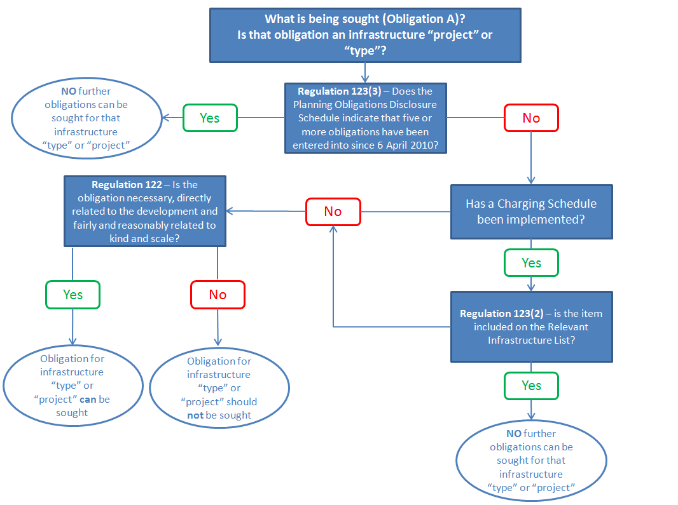


Slide 25
Implications?

Slide 26

What are the implications?
LPAs need to consider the impact of the April 2015 restrictions on the delivery of infrastructure in their area
Developers and housebuilders should work with LPAs to identify key pieces of infrastructure that are needed for the delivery of housing sites
Section 106 agreements should refer to specific named projects
Further guidance from Ministers is essential to ensure that LPAs have a sufficient Section 106 mechanism in place post-April 2015, as failure to do so will have a significant impact on the delivery of both infrastructure and housing.

Slide 27
From 6th April – Practical Implications
Some may argue that a planning obligation related to ‘infrastructure’ is not a reason to grant planning permission, and hence the pooling limit does not apply (Reg 123 (3)).
Where there is no CIL (i.e. 75% of LPAs) there is no legal mechanism to define infrastructure types or projects.
Savills is not aware that any Local Authority produced a form of Disclosure, and hence will not know if it has hit the pooling limit. Risk of delay.
Any planning obligation entered into as part of a planning permission counts (i.e. Including non implemented, part implemented and expired consents) – don’t forget County Council consents !

Slide 28
CIL Lessons Learnt

Slide 29
CIL Lessons Learnt
CIL operates most effectively when not set at the margins (i.e. Crossrail)
It will never replace Section 106 and hence...
real risk of ‘double dipping’ (Section 106 and CIL)
In practice the two mechanisms conflict
Thus, easier to address larger scale development or regeneration sites (say 150 units / 10,000 sq m plus) outside of CIL
The intention of CIL should be about identifying and delivering key strategic infrastructure not overtly capturing land value – otherwise growth will be stifled and development will not come forward

Slide 30

What’s next?
Reform seems inevitable?
Principle of CIL (clearer, faster & more transparent) wanted by all? But is that CIL?
DCLG commissioned research by University of Reading, Three Dragons & Smiths Gore
Report anticipated for Autumn 2015
Notes:
Examiner has limited scope at Examination.

Slide 31
Reform?
Inevitable
Do we all want the following system ?
Clearer
Faster
More transparent
Capture infrastructure / delivery
Is that CIL ?
Regulation Regulation Regulation !!
Some ideas, revoke Section 106 ? Or deduct from CIL ?
Apply CIL to smaller scale development only ?
Allow CIL to become negotiable ?
Set a national (or regional / sub-regional) standard rate ?
Abolish CIL and replace with ??????

Slide 32
Visit www.savills.co.uk/cil

