Slide 1
Richard Crawley
Calculating the cost

Slide 2
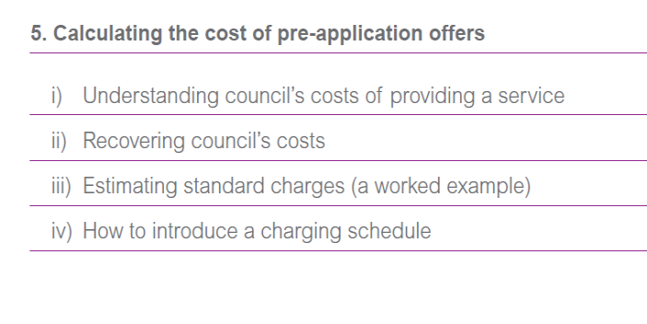
Costing / charging for pre-app
How hard can this be …

Slide 3
Before we begin
This is not a precise science, and there are several important stakeholders
  Finance director
  Staff providing the service
  Investors / Developers
  Place shapers
Don’t treat this just as a technical exercise
  Needs to be done right, for the right reasons, with political support
  And followed-through

Slide 4
The application process
Application
Post-App

Slide 5
Pre-application advice
Fee
Pre-App
Fee
Application
Post-App

Slide 6
Pre-application and PPA
PPA
Pre-App
Application
Post-App

Slide 7
Pre-application and PPA
PPA
Pre-App
Application
Post-App

Slide 8
Pre-application and PPA ?
PPA
Pre-App
Application
Post-App

Slide 9
Yellow bits = enhanced service ?
PPA
Pre-App
Application
Post-App

Slide 10
What we need is enough resource to do a good job
PPA
Pre-App
Application
Post-App

Slide 11
(i) Understanding councils costs
Even if you’re not going to charge, discretionary services need to be designed with cost in mind
Services are (mostly) provided by people
  Who,
  How long
  How much per unit
  ……….. Does it add value ?

Slide 12
(i) Understanding councils costs
To derive a “productive hourly rate” you need to wrangle three things:
Productive time
  How many hours are available for work ? (after holiday, supervision, training)
Cost of employment
  Salary, NIC
Overheads
  Light, heat, payroll, corporate, ICT

Slide 13
(i) Understanding councils costs
Productive hourly rate = cost / hours * overheads
See page 39
Consultation costs (ie within the council) are not always understood fully (and may not need to be)
[also note “opportunity cost” – planners working on pre-apps are not working on apps]

Slide 14
ii) Recovering costs
Recovery = recovery (only)
Method
  Standard charges
  Standard charges +/-
  Phased
Make life easy for yourself – standardise, average, communicate
Beware obvious mismatches

Slide 15
iii) Estimating standard charges
Understand your building blocks
  Eg hourly rate = £50
  Job = 4 hours
  Price = £200
Scaling

Slide 16
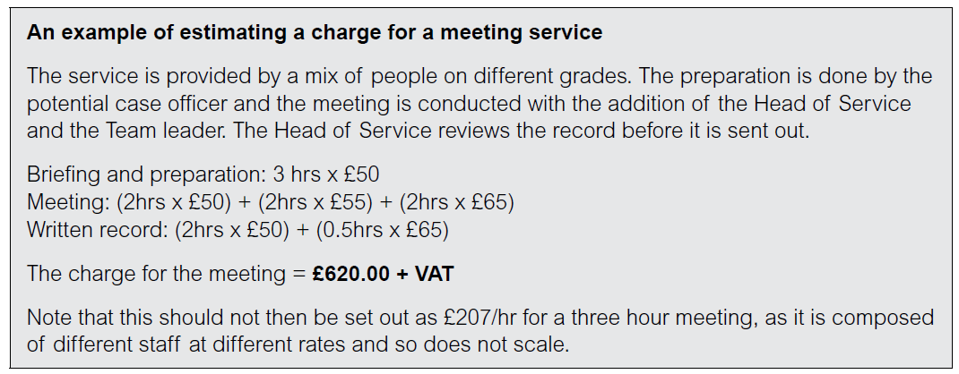
iii) Estimating standard charges
Page 40
What if they want another 2 hours ?

Slide 17
iv) Introducing a schedule
Think about monitoring
Think about capacity
  Core capacity and discretionary capacity ?
Talk to your neighbours
Be ready to learn
  A change of mindset ?
  An ability to negotiate

Slide 18
Your turn
For a few minutes each, consider these extracts from charging schedules [all downloaded on 5th June 2014]
Assume the role of buyer. What do you like / not like

Slide 19
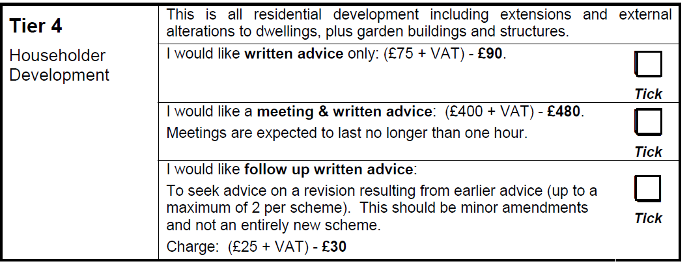
Notes:
Wycombe

Slide 20
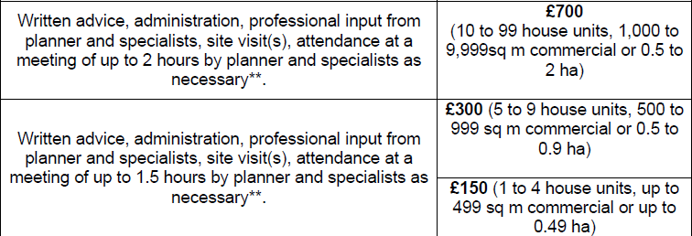
Notes:
Southhampton

Slide 21
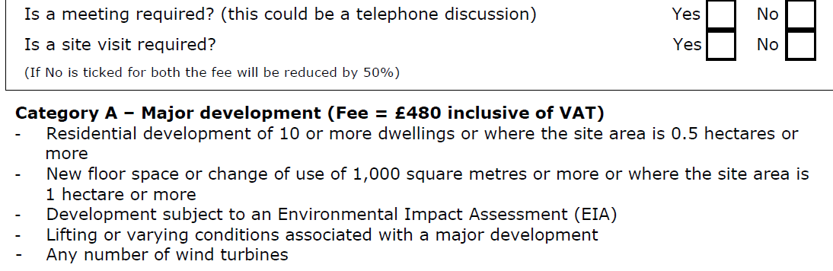
Notes:
Cornwall

Slide 22
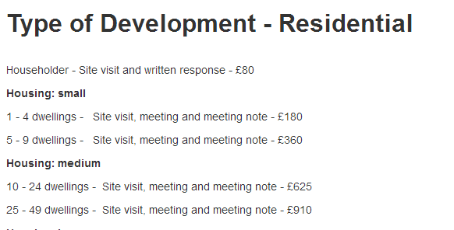

Slide 23
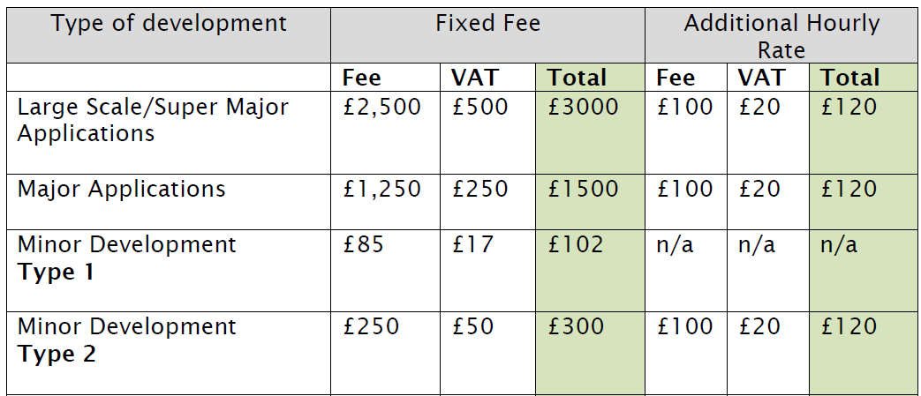
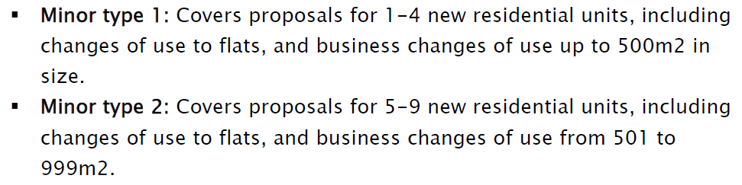

Slide 24
What do you think ?

Slide 25
Here’s what I think
Pegging charges to development categories (or planning fee) is understandable but illogical
Some of these things just don’t make sense
Offering choice is great (eg discount if …)
Fewer, broader categories
Where is the comfort ? Feedback ? Happy customers ? Amazon star ratings ?
You would not buy anything like this

Slide 26
The Planner [Dec/Jan 2014 p. 43]
“The RTPI’s experience is that most complaints about consultant’s fees occur when no agreement has been formalised between consultant and client. There should be no ambiguity. It is advisable to cover the following items”
Summary table of estimated costs; detailed tables of time costs; reimbursable expenses; subsistence and daily allowances; terms and schedule of payment.

Slide 27
Here’s what you must do
Support your staff
  This is not for everyone
Negotiate the freedom
  Beware corporate policies on headcount / savings
  More income = more resource requirement
  Don’t break your service promises
Corporate decision
  Approach to fees
Fail without a win-win
Great opportunity to project positivity !

Slide 28

Table exercise
Pre-application self assessment – this discussion is to help you to think about how the 10 Commitments to effective pre-application are implemented in your council.
We will use this discussion to find examples of good practice are implemented in your council.

