Slide 1
HEDNA and SHELAA
www.pas.gov.uk
Feb/March 2016

Slide 2
What is Planning Advisory Service for?
“The Planning Advisory Service (PAS) is part of the Local Government Association. The purpose of PAS is to support local planning authorities to provide effective and efficient planning services, to drive improvement in those services and to respond to and deliver changes in the planning system”
(Grant offer letter for 2014-15)
Notes:
DCLG funded
Live within the LGA
Focus for past few years has been on plan led system (includes neighbourhood plans)
Expect that to continue, but also with an increased emphasis on supporting performance – in fact that is explicitly referenced in the consultation document – para 22.
2

Slide 3

Agenda and Aims
Assessment of housing and economic needs
Understanding affordability
Looking at supply
Notes:
Is it one assessment or more?

Slide 4


Science or Art?
PPG tells us:
“Establishing future need for housing is not an exact science.”
It also says:
“No single approach will provide a definitive answer.”

Slide 5
Background
The NPPF says
  Planning should meet objectively assessed need (for land)
    So far as there is sustainable capacity to do so
      As defined by the Framework
For housing this means
  Prepare a Strategic Housing Market Assessment (SHMA)
    Working with neighbours when market areas cross admin boundaries
    To assess overall housing need
    Split it by size, mix and tenure
    Address affordable housing and ‘special needs’
For economic land uses (‘economic development’) it means
  Plan proactively to encourage sustainable economic growth
    Not act as an impediment to growth
  Understand changing business needs
    And identify and address barriers to investment
Planning should Integrate economic uses, housing & community facilities

Slide 6
Today’s agenda
So the planning authority needs evidence bases to cover
  Housing
    Overall need (the OAN)
    Housing mix and tenure
    Affordable housing need
  Economic uses
PAS has published advice on the housing OAN
  Technical advice note updated July 2015
  Not on today’s agenda
Two further notes are in draft
  Housing mix, tenure and affordable need
  Economic development
This morning you get a preview of each
  Your feedback will be gratefully received

Slide 7
Today’s agenda continued
We’ll package the notes as a trilogy
Technical advice on producing a HEDNA
  (Housing and Economic Development Needs Assessment)
But it doesn’t have to be in one bundle
  It would be pretty large!
Two (or three) separate studies is fine
But they must be mutually consistent
  Show the same future population
    Numbers and profile
  And future jobs
The OAN note discusses the links between
  Affordable and overall housing needs
  Population / housing and jobs

Slide 8

HDH Slides for PAS
Housing and Employment Needs Assessment (HEDNA) and Strategic Housing and Employment Land Availability Assessments (SHELAAs)
Viability and development economics
London
www.pas.gov.uk
Notes:
Set out objectives for the day and explain that after workshop 1 we can tailor the day to the LPAs needs
Many consultants involved in the development industry are paid by developers and so will have a view on viability
Today we shall discuss the trade off of different policy aspirations– CIL/CfSH and BREEAM/s106/Affordable Housing
For the purposes of this workshop we shall talk mainly about housing as it’s easier for a mixed audience to understand

Slide 9
Terminology
Objectively Assessed Need (OAN, overall need)
From CLG Household projections, tested / adjusted as per PPG 14 to 19. Disaggregated as per PPG 20.
Affordable Need
Need for affordable as per PPG 21 to 29
Specific Groups
Need for groups as per as per PPG 20
Housing Target (Requirement)
The housing planned for,
taking into account affordable need, specific groups, Duty to Cooperate, policy objectives and delivery constraints

Slide 10
Housing needs - mix, tenure and affordable housing
Why?
How?
So what?
See PAS Note

Slide 11
Why?
Because the NPPF tells us to
Because the PPG tells us to
- but why…?

Slide 12
NPPF
50. ….plan for a mix of housing based on current and future demographic trends, market trends and the needs of different groups in the community … the size, type, tenure and range of housing that is required in particular locations, reflecting local demand …
159. Local planning authorities should … prepare a Strategic Housing Market Assessment … identify the scale and mix of housing and the range of tenures that the local population is likely to need over the plan period which addresses the need for all types of housing, including affordable housing and the needs of different groups in the community..

Slide 13
PPG
2a-021-20150326 - Plan makers should therefore examine current and future trends of:
the proportion of the population of different age profile;
the types of household (eg singles, couples, families by age group, numbers of children and dependents);
the current housing stock size of dwellings (eg one, two+ bedrooms);
the tenure composition of housing.
This information should be drawn together to understand how age profile and household mix relate to each other, and how this may change in the future…..

Slide 14
But why?
2a-029-20140306 - The total affordable housing need should then be considered in the context of its likely delivery as a proportion of mixed market and affordable housing developments, given the probable percentage of affordable housing to be delivered by market housing led developments. An increase in the total housing figures included in the local plan should be considered where it could help deliver the required number of affordable homes.

Slide 15
So … (1)
Affordable Housing
  ‘Policy off’ assessment to consider uplift
Families with Children
  A disaggregation of OAN to assist mix
Housing for Older People
  A disaggregation of OAN to assist mix (Specialist Housing)
  The need for institutional not in OAN

Slide 16
… so … (2)
Households with Specific Needs
  A disaggregation of OAN to assist mix (Specialist Housing)
  The need for institutional not in OAN
People Wishing to Build Their Own Homes
  Policy off assessment to consider specific provision / policy

Slide 17
… so … (3)
Student Housing
  Policy off assessment to consider uplift
  Understanding of supply to meet OAN
Private Rented Sector (PRS)
    A disaggregation of OAN to assist mix

Slide 18
… and not mentioned
Starter Homes
  Can starter homes meet affordable need (will impact on level of uplift)?
  Relationship with PRS
  A disaggregation of OAN to assist mix

Slide 19
True or False?
Is the Affordable Need is a component of the OAN?
NO (and cannot be)
Different methodologies
  OAN based on past trends
  OAN already includes adjustment for affordability market signal
  Affordable Need based on PPG method
Different Outputs
  OAN a total requirement (single figure)
  Affordable Need is an annual flow (units per year)
Different purposes
  OAN starting point for housing target
  Affordable need to consider increasing housing target to ‘help deliver’

Slide 20
Confirmed by …
2a-021-20150326 - How should the needs for all types of housing be addressed? Once an overall housing figure has been identified, plan makers will need to break this down by tenure, household type (singles, couples and families) and household size. Plan makers should therefore examine current and future trends of……
KLWN v SoS for CLG & Elm Park Holdings

Slide 21
How? – 3 outputs
Disaggregation of OAN
  No specified methodology
Affordable Need
  Specified methodology
Specific Groups
  Suggested data sources

Slide 22
How – Affordable Need
As per 22 to 29 of PPG
Secondary data (not surveys)
Use of waiting list
Consultants or in-house

Slide 23
4 steps
  Stage 1: Current unmet gross need for affordable housing (PPG 023 and 024). The amount of affordable housing that is needed by existing households.
  Stage 2: Newly arising affordable housing need (PPG 025). The need for affordable housing of households that will form in the future.
  Stage 3: Current affordable housing supply (PPG 026). The affordable housing that is available at the time of the assessment.
  Stage 4: Future housing supply of affordable rented re-lets and intermediate affordable housing (PPG 027). How much affordable housing will be available in the future.

Slide 24
Key checks
Access levels (cost of entry level housing)
  Should it be lower quartile?
Affordability Test (proportion of income spent on housing)
  How is market functioning (policy off)
Impact of benefit and housing reforms
  Benefit caps – particularly single person households under 35
  Starter homes
  Role of PRS and Local Housing Allowance

Slide 25
How – Specific Groups
As per 21 of PPG
Secondary data (not surveys)
Primary data from council records
In house data
Ask stakeholders (MOD, Universities etc)

Slide 26
How – Overall Mix
A disaggregation of OAN
No specified method
Much can be taken from OAN

Slide 27
Key components
Understanding of current stock and how it is used – including ‘inefficiencies’
Model houses to adequately house households with OAN – modelling out or correcting inadequate housing (over crowding etc), but accepting inefficiencies continue.
Difference is requirement (2 minus 1) – when adjusted for vacancies

Slide 28
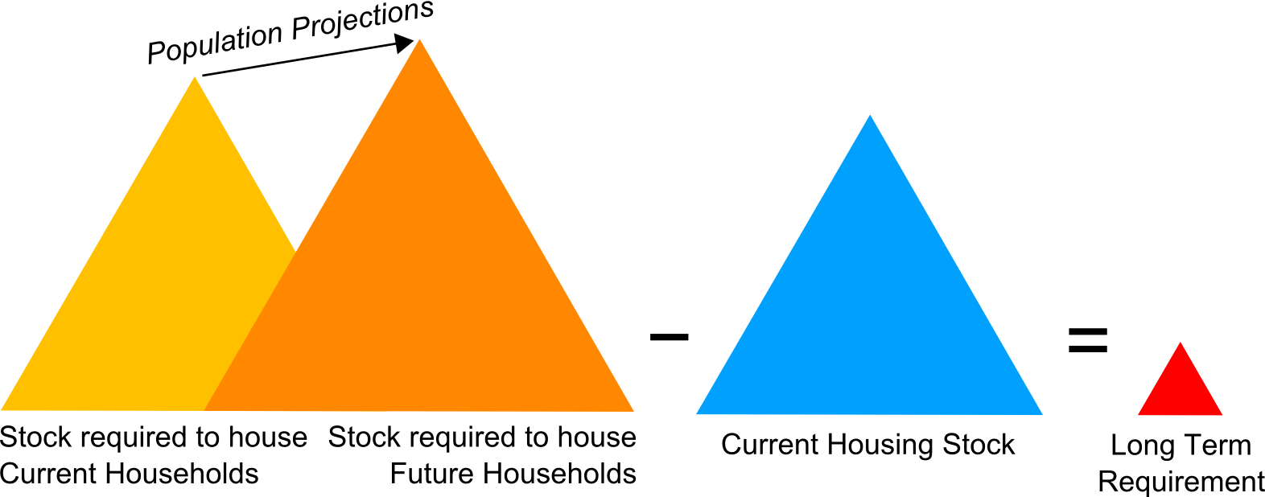
A Model

Slide 29
So what?
Should the housing target be increased to help deliver affordable housing?
Should housing target be adjusted to reflect growth of specific groups (e.g. service families or students)?
Should specific provision be made for specific groups (e.g. older people)?
Should ‘mix’ policies be developed of market and affordable housing?
Amount of Starter Homes?

Slide 30
BUT….
Must evidence decisions / use
Just one element of the evidence base
Must be considered with OAN
May impact (positively or negatively) on viability
Must consider the whole plan and real world of delivery
Consider consultation / stakeholder input

Slide 31

Contact Details
Simon Drummond-Hay
HDH Planning and Development Ltd
Clapham Woods Farm
Keasden
Nr Clapham
Lancaster
LA2 8ET
simon@HDHplanning.co.uk
015242 51831 / 07989 975 977

Slide 32
Economic Development Needs Assessment
February 2016

Slide 33
Overview

Slide 34
The NPPF
­Plans should be supported by an evidence base that
  ­Assesses needs for land and floorspace
    Both quantitative and qualitative
    For all foreseeable types of economic activity over plan period ­
  Reflects a clear understanding of business needs
  ­Is based on close work with the business community
    To understand their needs
    Also identify and address barriers to investment,
      Including lack of housing, infrastructure or viability
  [Comment
    In practice it’s mainly about the property industry]
Authorities should co-operate
  With neighbouring authorities and County Councils
  And LEPs

Slide 35
The PPG
The needs assessment should ignore supply constraints
  E.g. land availability, infrastructure, environmental impact
  Constraints bear on policy targets but not on ‘need’
Assessments should cover market areas
  For economic uses these are FEMAs
  For main town centre uses they are trade draw areas
    [We thought main town centre uses were economic uses?
    Don’t worry, I’ll come back to this]
  Where joint studies aren’t practical
    Due to plan timetables
    Single-authority evidence bases are OK just this once
      In future you should co-ordinate timetables
Paras 030-034 is headed ‘methodology’
  There’s no beginning-to-end narrative
  A long shopping list of bullet points
  Our step-by-step method (below) aims to satisfy them all

Slide 36
Definitions
Better name the parts before we start
What is ‘need’?
  It’s got to mean ‘effective demand’
  The land that would be developed and occupied for economic uses
  If planning did not restrict development
  The land will be developed only if floorspace is
    In demand (occupiers want it)
    Financially viable (developers and landowners want to provide it)
  That’s why property market assessment is so important
    Looking at property values and viability
    A huge part of the needs assessment
    [The PPG says ignore viability
    As a supply constraint
    I think we can ignore that?]

Slide 37
Definitions continued
What is ‘economic development?’
  The PPG is not consistent
  But the NPPF is clear
It’s construction and change of use for economic end uses
Which comprise
  B-class uses
    AKA ‘employment, ‘business’
    Offices, industry & warehousing, R&D
  Main town centre uses
    Retail
    Leisure and culture
    (B1 offices = overlap with the B class)
  The rest
    E.g. health & education, energy & infrastructure

Slide 38
Structure of the study
Here is a suggestion
Part A The whole economy
  An overview of the economy
  To help inform the plan’s vision and strategy
  Include a view of future jobs
Part B The B-class (‘employment’) uses
  Formerly known as employment land review
  Full assessment of demand for land
  To help inform provision targets
  And other planning policies and decisions
(Other economic land uses are planned for in other ways
  Retail and leisure assessments
    A separate subject not covered here
  Land for schools etc is provided as part of housing schemes
  Hospitals, universities etc are planned for individually)

Slide 39
Part A The whole economy

Slide 40
The whole economy
Job growth over the plan period
  Start from formal economic forecasts
  Test against historical experience and policy aspiration
  But the plan must be realistic as well as ambitious
  Do not overstate future jobs
    Think of the implications for housing
The balance of jobs and workers
  Reconcile the economy and housing evidence bases
  See the technical note on OAN and housing targets
Formal assessments of retail and leisure needs
  There is no guidance on this
  Follow established good practice
Overview of other economic land uses
  Identify major opportunities
  And resulting need for land over the plan period
  Focus on large one-off projects
    E.g. universities, major hospitals, tourism, culture

Slide 41
Part B The employment land review

Slide 42
Defining the FEMA
The CLG Economic Note (2010) explains what it’s about
FEMAs are (mainly) sub-regional labour markets
Defined by commuting containment
Start from official Travel-to-Work Areas (TTWAs)
  Updated last year from the 2011 Census
But they don’t always fit local authority boundaries
  Not even roughly
The alternative
  Make a separate containment calculation
  Using Census commuting data
  And TTWA thresholds
  75% or 66.7% depending on size
Also talk to the property industry
  What do they think the sub-regional market is?

Slide 43
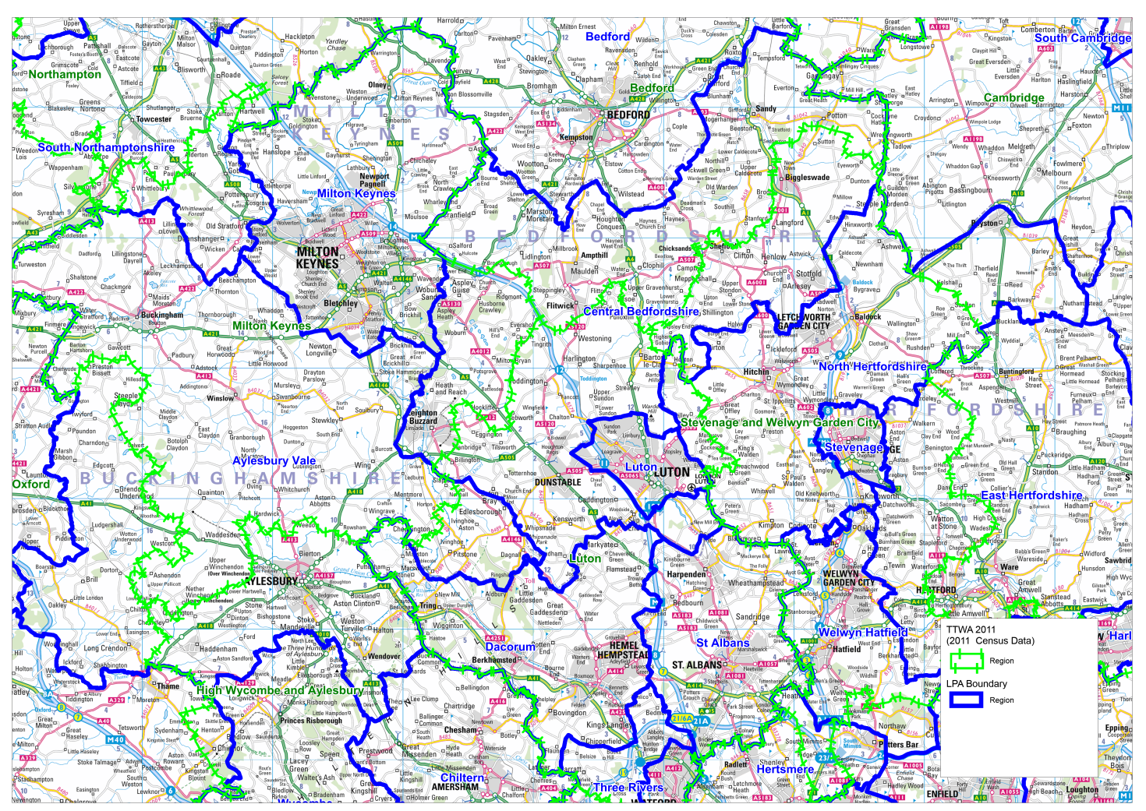

Slide 44
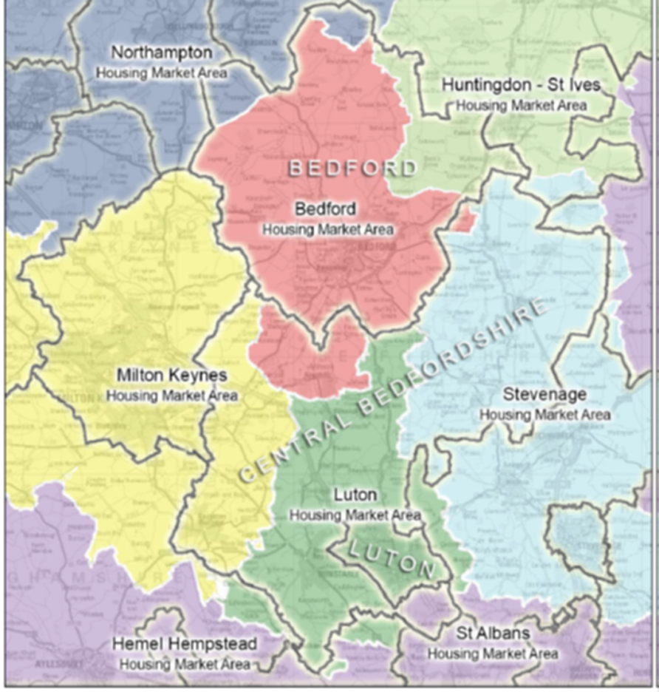

Slide 46
The logic

Slide 47
Property market profile - analysis
Best done by a property consultant
Split between land uses
  Offices, industry / warehousing
  And maybe more finely sliced
  E.g. media, R&D, strategic warehousing
Demand
  Floorspace take-up
  Who are the occupiers?
  What are they looking for?
  Can they get it?
  Drivers of change
Supply and market balance
  Floorspace availability and pipeline
  Vacancy rate and years supply ratio
  Development in recent years – how successful?
  Rents and values
    What, where, is viable to develop?
    And to maintain?

Slide 48
Property market profile - conclusions
Opportunities for development / redevelopment
  For whom? Occupier activities / profiles
  What and where?
Existing employment sites surplus to requirements
  What and where?
  Why can’t be viably maintained or redeveloped?
Implications
  Where is the demand for development land?
  Where are existing sites surplus to requirements?
    The Framework says don’t safeguard land for employment
    If it has no realistic prospect of being occupied for that use
Now you should probably hold a stakeholder workshop
  To stress-test these answers
  It’s usually an eye-opener
But still you’ll only have half the answer
  The market doesn’t look beyond next week or next year
  That’s why we do a separate analysis on the long term

Slide 49
Sites inventory and appraisal
Still keep different land uses separate
Quantity and qualitative appraisal
Cover
  Existing employment sites
  Commitments
    Permissions and allocations
    Positive and negative
  Potential sites
    Proposed or under consideration for B-class development
Mixed use is important and difficult
Qualitative assessment is about market potential
  Existing sites
    Is it in demand and viable to maintain?
  Development redevelopment sites
    If offered to the market will it be developed and occupied?
The property market profile tells you what you’re looking for

Slide 50


Slide 51
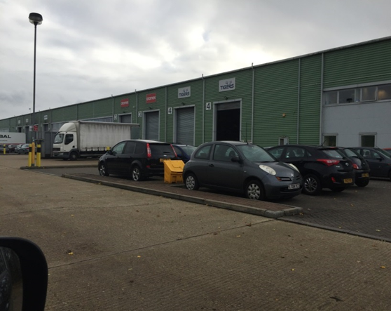

Slide 52


Slide 53
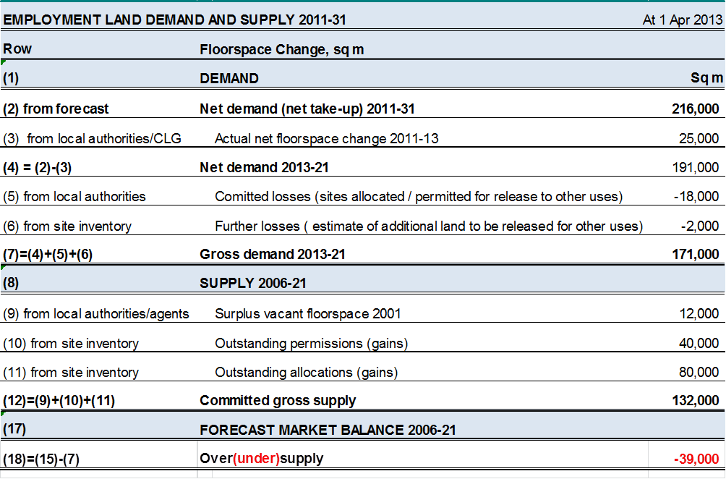
Demand and supply in the long term

Slide 54
Demand and supply in the long term continued
Key points and pitfalls
  Employment forecasts
  Matching jobs and housing numbers
  Sector to land use
  Employment densities
    HCA Guide
    Yorkshire and the Humber study
  Gross and net change
  Dealing with mixed use
  Dealing with Permitted development rights
  Blending in the market analysis

Slide 55
Conclusions and policy implications
The quantity
  The total land provision that the area should aim for
  By land use, district and time period (net change)
For a multi-authority HMA
  The allocation of that total between districts
Site-specific policies / allocations
  Existing employment sites
  Committed development sites
  New sites to be allocated for employment
Criteria-driven policies
  To cover those sites which will not be identified individually in the plan;
  Other policies
    Positive policy intervention?

Slide 56
Optional addendum
Aligning housing and jobs

Slide 57
What you’re meant to do
The PPG and Inspectors say
You should check the ‘starting point’ demographic projection
To see if it would provide enough workers
  (Labour supply)
To meet future numbers of jobs
  (Labour demand)
If not
  You should lift the population
    Until it does provide enough workers
  (Or improve the infrastructure
    So workers can go to where the jobs are)
In short
  Plan for enough housing
  To support the jobs you are expecting and planning for

Slide 58
A bad method
Buy an economic forecast off the shelf
Take future jobs over the plan period
  This is labour demand
Use a demographic model (PopGroup) to translate
  Workplace jobs into resident workers
    Using assumptions about commuting
  Resident workers into population
    Using assumed economic activity rates
    And unemployment
  Population into homes ‘needed’
    Using assumed housing formation rates
    And % of unoccupied homes
  This is the job-led housing need
    (Demand for homes)
  If it’s above the demographic number
    (Supply)
    Increase that number so supply matches demand

Slide 59
What’s wrong with it?
The forecasts are produced by integrated models
That already include demographic figures
So if you put in your own figures
The calculation will be inconsistent
So can’t be right
  E.g. Experian starts from SNPP 2012 population
    So if your calculation produces a different population
    It’s inconsistent
    If it produces the same population
    It’s circular
  Oxford Economics makes its own population forecast
    Job-led
    Just like the PopGroup one
    Shows the population needed to meet job demand
    Re-working it backwards makes no sense
  Cambridge Econometrics uses different models at different times

Slide 60
The problem with activity rates
Some of the inconsistencies can be minor
But one of them has a large impact
It relates to economic activity rates
The % of the population that is part of the labour force
  In each age x sex group
People take different views of future activity rates
  We know they’re increasing for older people
    Due to rising State Pension Age and life expectancy
  How fast is a matter of judgment
But everyone agrees on one thing
  Local activity rates follow the national trend

Slide 61
Activity rates continued
Many people take a conservative view of activity rates
Expect less growth in rates than the economic forecasters
So they say to match a given job demand
Needs more people in your district than the forecasters think
And hence more homes in your district
Fair enough
But if rates are lower than the forecaster expects
There will also be fewer jobs in the UK than they expect
  Many fewer, because the population is ageing fast
And hence lower job demand in each local area
  Because local growth is driven by the national total
  That’s how reality and all forecasting models work
So the job number you started from must change
People forget that half of the calculation
Result: vastly overstated housing need
  Often twice what it should be

Slide 63
A good method
Look at the economic forecast as a whole
  Not just future jobs
  But also population, activity rates etc
If you want to test different assumptions
  Do so through the forecaster’s economic model
  So the whole thing stays consistent
Or, if you want to use a demographic model
  Such as PopGroup
Use consistent assumptions across the two models
  National (macro) as well as local
  Especially national activity rates
It’s much less complicated that it sounds
  We have developed a good method with Experian
    Supported by Inspectors in Birmingham, Dorset, Swale
  Similar approaches work with the other forecasters
    See for example NMSS evidence for Gloucester, Cheltenham & Tewkesbury

Slide 64
Thank you
Questions? Comments?

Slide 65



Strategic Housing and Employment Land Availability Assessments (SHELAAs)
Jo Lee
Peter Brett Associates
1 March 2016

Slide 66


National context
NPPF requires local planning authorities to:
have an adequate, up to date and relevant evidence base
to ensure that these assessments for housing and employment supply are integrated.
establish realistic assumptions about availability, suitability and economic viability
Notes:
National Planning Policy Framework (NPPF) para 161
It follows on from the HEDNA by look at the supply….
The NPPG provides comprehsnive methodology – we will look at that in a minute
Most of it is not new and you have been doing this – want to help provide an advice note which is useful – concentrates on the more difficult areas
We want your help to inform this and identify good practice, useful approaches and techniques

Slide 67
Landuses
Assess sites are available, suitable and achievable:
Employment;
Housing, including:
  - Residential
  - Student Accommodation
  - Older person accommodation
  - Caravans for Non-Travelling Romany Gypsies and Irish Travellers
  - Caravans for Travelling Gypsies and Travellers and Travelling Showpeople

Slide 68
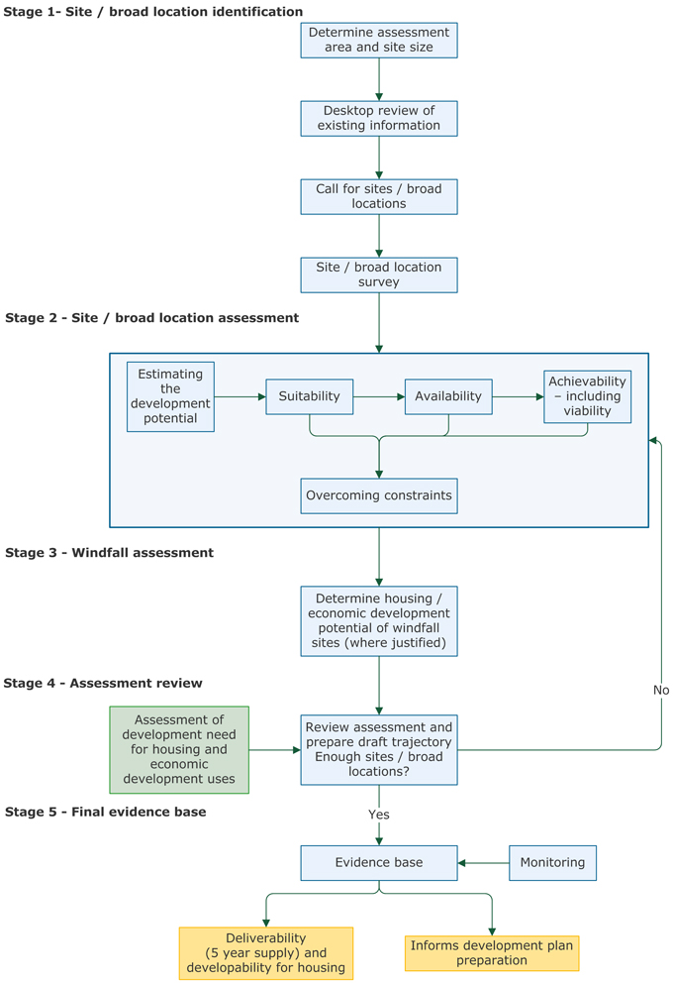
NPPG Method
Notes:
NPPG provides guidance on how to undertake a SHELAA.
Firstly understand your area and site size, then undertake desktop review
As part of this you Do a call for sites and investigate all sources of possible sites and survey these
Secondly is the site assessment – this is the fundamental and most important element where consideration is made of where sites are suitable, available and achievable and where development potential is estimated and constraints considered
Thirdly is the consideration of windfalls – primarily in relation to housing
Fourthly is the final review process where you consider the assessment and if there is not enough sites to meet the need you consider whether criteria within assessment should be amended to identify more sites
Lastly is the evidence base – ie the trajectory and list of sites which could be allocated and which make up your five year supply/
Improtant this is an evidence base – it tells you what is possible – should be set up to tell you the options available and used to make adjustments, but does not decide about which sites – that is for the next stage as part of plan making and options

Slide 69
Method – Stage 1
Where
  Is the geographical area the same as HEDNA?
Who
  Do you need to work together?
  Who needs to be involved?
  How will you involve them – Panel?
What
  Site size thresholds
Notes:
Is your HEDNA and SHELAA covering the same geographical area?
Would it be beneficial to work with neighbouring local authorities?
How does your method compare with other authorities?
What are the key standard assumptions that you are going to apply?
What bodies and groups already exist and have you already used?
How can you best harness knowledge and information?
Who do you want to be involved? What do you want from them?
Do you need specific representation from any particular groups such as Universities, Care Homes, Gypsy and Travellers?
All sites or just 0.25ha and above or 500m for economic pland

Slide 70
Method – Stage 1
Site identification process
What has changed?
What sites might be suitable from emerging evidence / plan making?
What do you know about already?
What might members know/find out?
How will sites for employment, caravans, older people, students be identified?
Notes:
Important to understand what your evidence is saying – where might you want areas to develop – are there sites there?
The aim is to identify as wide a range as possible of sites and broad locations for development. One starting point is a desk based assessment, utilising local knowledge of the area and identifying as many sites as possible for the whole range of potential uses. All potential sources of sites should be explored. Brainstorming maps, photos, local knowledge – can involve members in this – opportunity to understand the opportunities in their areas
Desk based assessment – lots of sources of informationAs the PG identifies data sources can include development starts and completion records or planning application records, use local authority ownership records and national register of public sector land, empty property register, English House Condition Survey, national land use database, commercial property databases, valuation office databases. Ordnance Survey maps, aerial photography, planning applications, pre application inquiries, village plan and neighbourhood planning documents and local information are also good sources of information.
For Gypsy and Traveller and Travelling Showpeople sites this would include extension and intensification of existing sites; public owned land; land owned by the local/county councils; Call for Sites; and any other sites promoted for this use.
What information do you already have about potential sites and what do you need?
How will you fill any gaps in information and knowledge?
What sites are coming forward from the plan and evidence reviews which you need to test?
How will you engage with public sector bodies and statutory undertakers to effectively gather information about sites?
How will you identify sites for employment use?
Will you consider all existing employment sites?
What has changed since you last considered sites which mean more sites may be available?

Slide 71
Method – Stage 1
Call for sites
Using a comprehensive form to capture all the relevant information:
  ownership, history, investigations, constraints, viability, possible uses, yield, timing
Survey process
Designing an effective database to record data
Undertaking a desk based assessment
Notes:
How are you going to do your call for sites?
How will you make it comprehensive and involve those not normally familiar with process?
Where and how will you advertise the process?
How can you most effectively work with established groups such as Parish Councils and neighbourhood forums, landowners, developers, businesses, relevant local interest groups and Gypsy and Traveller communities?
Have you set up a well-designed GIS and database adequate for the purpose to log all submissions?
Useful to Provide guidance and links to relevant information to assist people in completing the form – as for as much information as possible
In surveying the site need to consider infromation as set out in PG and where sites are outside settlement boundary additional issues such as impact on landscape, greenbelt and accessibility issues
Mapping and seiving process to exclude sites which could be due to
Size;
In the open countryside not adjacent a sustainable settlement;
Current employment sites – unless come through ELR;
Sites in Green Belt;
Within functional flood plain;
SSSI;
SAC and SPA;
Scheduled Ancient Monument and Ancient Woodlands;
Allocated for another use.
Then detailed consideration of sites that are available and suitable

Slide 72
Method – Stage 2
Is the site available?
Is the site suitable?
Is the site achievable and viable?
Methods include:
  Panel approach
  Broad testing of typologies
  Broad testing of all sites
  Hybrid – broad testing of sites or typologies plus detailed testing of strategic sites
Notes:
Confirmation from landowner and involvement of a developer – unencumbered by constraints. Useful to sense check with what they may have delivered in the past and will need to be clearly recorded and presented.
Is the site truly available? Do you have enough information to make this judgement?
Who owns the site? Will they sell to a developer? Can a developer develop it freely? Can any problems/restrictions be overcome?
What evidence will you require to demonstrate this?
Past record of performance by owners and developers inside your area or in other areas?
Which type of development is the site being promoted for example:
Housing and/or employment?
Travelling Gypsy and Traveller and/or Travelling Showpeople uses?
Are existing residents Travelling Gypsy and Travellers?
Are existing residents Non-Travelling Romany Gypsy or Irish Travellers?
Existing G&T sites: room to intensify or expand existing sites?
Existing Travelling Showpeople sites: room to intensify or expand existing sites?
In relation to suitability the issue is following the survey work and elimination of inappropriate sites – further assessment against policy, consideration of impacts and constraints – environment, physical limitations, objectives, alternative land uses,
for economic development additionally consider – access, existing employment, commercial attractiveness, broadband access and speeds, amenity issues
Viability – is very important and is likley to be questioned in any S78 appeals so will need to assess market, cost and delivery factors and extent to which they limit development potential – need to prove there is a reasonable prospect
Four approaches
Use a panel of local development experts ( could be SHELAA panel) to review sites and comment on how likely to come forward in next 5 years – meeting to go through each site – timeconsuming or review a batch each and share discuss findings
This tests a range of sites that are representative of the types that have been put forward – uses a residual valuation method to ascertain whether sites could come forward under current market conditions, can be sensitivity tested and then applied to broadly similar sites to identify how much of the suply is viable and therefore likely to be achievable
This is more robust but time and resource intensive, as above it applies assumptions using a residual approach and reports on whether sites are likley to be viable, marginal or not and is used to demonstrate whether each site is achievable
This approach is useful if you are reliant on a large supply from strategic sites, it enables more detailed consideration of infrastructure, construction and timing issues and can be used to provide assurance that the initial development strategy is achieveable. Other sites are tested either individually as above or using a typology approach.
Worth noting that making a judgement about employment land is more difficult and speculative development may be unviable now, but not in 5 years time

Slide 73
Method – Stage 2
Calculating the development potential
Using realistic lead in times and build out rates
  Inspectors critical of over optimistic rates
  Assumptions based on transparent and robust local evidence
  Use SHELAA panel to explore rates, test rates against past performance and comparable schemes, monitor what is delivered
  Implications for a future delivery test
Notes:
This is about bringing together all the information to understand what is the most appropriate amount and most realistic options. It factors in any constraints and needs to feed back into the viability so that different suitable options can be tested
Inspectors critical of over optimistic rates so it is very important to use realisitc assumptions based on local evidence and local market factors which can withstand scrutiny.
Ideally consider site specific issues which may require a deviation from standard rates, but if standard assumptions are used these need to be discussed, agreed, tested and monitored to see whether they are being achieved and if not – understand why not
Cotswold set out a useful list of sources that they have used in deriving reasonable estimates
Important to understand that supply does not equal delivery – there are many factors at play in this translation – and the Government has perhaps not grappled with this. Interested to hear what you think about a delivery test, how it might work and what it will achieve and have chance to consider this in the workshop discussions

Slide 74
Method – Stage 3 & 4
Including realistic windfall allowance
Assessment Review
  Trajectory – how much housing and employment land provided and when
  Are discounts necessary and appropriate?
  Do you have enough sites to meet your need?
  Is there evidence to defend a stepped trajectory?
Notes:
The test for including windfall sites is whether there is robust and compelling evidence – ie good quality accurate date from past trends over reasonable time frame with no double counting
Key questions are:
What has your windfall rate been?
Has everything been excluded that need to be in terms of policy changes?
Does this constitute compelling evidence?
For a broad location – what evidence do you have that windfall rates have been coming forward in similar locations, at what rate and over what timescale?
A trajectory will illustrate how much land will be provided and when. It illustrates what is possible and if done properly in a database can be easily adjusted and updated to provide different options
it is important to remember that sites may be suitable for a number of different uses.
Therefore perhaps useful to deal with land for employment, students, older people, caravans and any other specialist needs separately in the trajectory.
May be necessary to consider whether you need to apply any discounts – examples of 10% used by Inspectors – but suggest this should be considered on your own local evidence and only for sites which you havent considered individually
If you don’t have enough sites identified to meet your needs you should to rerun the database with different options and uses for sites to increase the number, and or visit the assessment and assumptions used to see if more development potential could be released. For example could you adjust your density assumptions overall or on some sites? And what would the implications be of this?
A stepped trajectory have been considered by some authorities – with only limited success the most recent being in East Staffs – but it must be set out and justifed in the plan and by the spatial strategy, and be a proper response to the evidence, and not just to manipulate supply and circumvent provision. Also set heavily in context of need to boost housing supply and meet needs as soon as possible– which is counter to any deferral of provision.

Slide 75
Method – Stage 5
Final evidence base – outputs
  Table of sites/broad locations and maps
  Assessment of suitability, availability and achievability
  Type, quantity and timescale of development
Monitoring
  Rolling review of sites and identification of change
  Check status, assumptions and timescales
  Have you deviated from projections – why?
Notes:
Can take various forms but need to be Publically accessible and suitable level of detail with clear link to trajectory and maps through dynamic use of database to allow updating and adjustment, can use filters to identify sites which meet different criteria and interrogate the information and set up different options.
Once got a list of sites you can consider them to help identify and evaluate reasonable options which can then be further tested and assessed through sustainability appraisal and feed into other evidence base to identify preferred options for the local plan.
Key questions for monitoring is are you where you thought you would be
What progress has been made with delivery of development on allocated and sites with planning permission?
What new planning applications have been submitted or approved on sites and broad locations identified by the assessment?
What progress that has been made in removing constraints on development and are there any sites which are now considered to be deliverable or developable?
Are there any unforeseen constraints that have emerged which now mean a site is no longer deliverable or developable, and how these could be addressed?
Is the windfall allowance coming forward as expected, or should it be adjusted?
Are the lead in times used still accurate? Have sites taken longer or shorter time to get permission, and be completed than anticipated, and if so why? Do figures need updating?
Are the build out rates used still accurate? Are sites coming forward with different rates and is there difference between types and size of site? Should any variation be reflected and figures updated?

Slide 76
Specialist Accommodation
Housing for older people
Housing for students
Caravans for Non-Travelling Romany Gypsies and Irish Travellers
Caravans for Travelling Gypsies and Travellers and Travelling Showpeople
Notes:
The five year land supply uses the information within SHELAA and the outputs in terms of the trajectory. The robust nature of the information will determine the reliability of the 5yls.
Heard how HEDNA will identify the need for specialist accomodation and if it is a significant issue in your area you will need to consider how to meet this need and specifically what your supply is.
Consequenlty you may need to set out a methodology for counting this source of housing within your supply calculations and also wish to identify sites. Need to understand what a self contained units it and how much housing it will free up in your area. This is likley to require survey work to understand how many previously lived alone and where which can be used to identify how many rooms in a nursing/care home realisitcally equates to 1 dwelling.
In relation to students the key thing is to understant the number of students, tyopes of accodation, and current stock, number of bedrooms in a typical cluster flat and whether new build has realy released units into general market, or whether just continue to be taken up by students. Exeter have considered this in detail and show it is important to avoid double counting and properly understand how the local market works and what the existing supply and demand is. Working with educational establishments is crucial to get robust information.
What is the need for older person accommodation in your area?
Is it included in your HEDNA and are you clear about the number and implications?
Do you have robust local evidence about how many houses are freed up through the creation of C2 uses?
What is the most effective way of gathering this information?
Have you contacted care home providers?
Do you need to undertake a survey of residents in existing institutions to identify where they have moved from and what type and size of accommodation they have left?
How will you monitor and update this information?
Caravans may also be an important issue – if this has been incorporated into your HEDNA for non travelling and from GTAA for travelling . This will need to distinguish between travelling (as now defined) and non travelling which require specialist accomdation. There is a requirement to provide a five year land supply of sites to meet the needs that exist – if this is an issue a methodology is required to identify sites and assess them – this is best done through the SHELAA but will require consideration of local evidence, existing pitches and understanding ethnicity, as well as a wider search for sites than the usual sources.

Slide 77
Other Issues
Empty housing and buildings
  Is it making a significant contribution?
Brownfield Register
  How best to use the SHELAA process to identify and assess sites?
Project management and skills required
  Identifying key issues
  Filling the gaps
Notes:
Most be over the usual local vaccancy rate and evidence that successfully delivering housing and that these are not counted elsewhere as windfalls
Must understand you levels, compare with other local, HMA, regional, national rates, what is your strategy and what you have achieved. Inspectors often concerned about the lack of evidence to include a figure. (Pendle)
The SHELAA process is probably the most appropriate approach to use for assessing sites and considering their inclusion onto the register and we need to think about how best this can be done and what the implications are – we will be discussing this in the workshop and collecting ideas about this.
While you will all be familiar with doing a SHLAA and assessing sites, the difference now is that it pulls together a range of landuses which wil require different methods particualrly in identifying sites, assessing them and engageing with the stakeholders – depending on the needs.
So some of questions we are going to discuss in workshops include :
Who is going to project manage the HELAA?
Who is going to run the engagement with stakeholders for housing; employment; Gypsy and Traveller sites; older person housing; student accommodation?
Who has the skill to design a methodology and assess the sites for the full set of landuses?
Who has the skills to test the viability, achievability of sites?
Who has the skills to work with developers/agents to assess when sites are realistically going to be delivered, to inform the 5 year land supply?
Are there any skill gaps and who can fill them? If go out to tender on this – need to work with your consultants to ensure it is bespoke, links to your area and evidence, involves right local stakeholders, sets up a database that you can update and utilises your local knowledge as effectively as possible.

