Slide 1
Beyond the Duty to Co-operate…
…and towards strategic planning
Welcome!
8th March 2016
www.pas.gov.uk

Slide 2
Introduction
Andrew Pritchard
PAS Principal Consultant
Notes:
2

Slide 3
The Story So Far…
Keith Holland
Former PINS Assistant Director

Slide 4

Beyond the Duty to Co-operate…
…and towards effective strategic planning
www.pas.gov.uk

Slide 5
Background
Research into the Duty to Cooperate conducted by Shared Intelligence (Si) in 2015.
Involving interviews with over 100 planning officers, chief executives, lead members, leaders, and industry professionals.
Aiming to understand what concerns authorities have regarding the duty, and their current and future support needs.

Slide 6
Mixed views about the Duty
Research unearthed a wide mix of views about the Duty
From hostility from some who saw it as a “half measure” in the absence of “proper strategic planning”
To a cautious welcome as a locally-led alternative to the old “top down way of doing things”
Introduction of the Duty – “dropped in…at the last moment” - had created considerable confusion
Common view that it would not survive after the May election…

Slide 7
Learning curve
In that context, authorities had been on a steep learning curve
Initial perception that the Duty was a narrow process requirement
Replaced by an understanding that the Duty was a “pretty fundamental test”
Many officers faced an internal task of raising awareness amongst senior officers and elected members

Slide 8
Learning curve
“They thought regional officers had been abolished. It wasn’t – it was delegated”.
“The removal of top-down planning, whatever you thought of it, created a void”.
“Most now appreciate that the Duty is a pretty fundamental test”.
“We thought we were doing everything right. Up until the point we failed”.

Slide 9
Local context
The response to the Duty was shaped by local context
For areas with a history of cooperation and a shared / emerging vision, the Duty was a continuation of business as normal
“We have a strong bond [with neighbours]. The Duty just gives us another reason for talking at that strategic level, for seeing out inter-relationships”.

Slide 10
Local context
The response to the Duty was shaped by local context
For areas with a history of cooperation and a shared / emerging vision, the Duty was a continuation of business as normal.
For areas with little or such history and / or conflicting planning goals, the Duty raised issues that were not being answered – or even addressed
“We have a strong bond [with neighbours]. The Duty just gives us another reason for talking at that strategic level, for seeing out inter-relationships”.

Slide 11
Top 5 challenges
We asked interviewees to rate the main challenges facing their authority in terms of compliance:
“Agreeing a distribution of housing / employment land with neighbouring authorities”
“Doing effective cross-boundary strategic planning at the local authority level”
“Political differences”
“Lack of alignment with neighbouring areas in terms of local plan development”
“Capacity in the authority”

Slide 12
Reflections on the challenges
“If you have an uncooperative partner, and they’re prepared to put up with the consequences and blame the government, there is no real sanction.”
“It’s a hard duty to carry out effectively…The level of collaboration is a bit pick and mix as we’re all at different stages.”
“The difficulty is selling it to members.”

Slide 13
Support
We also asked interviewees to identify the features of a support package:
Bringing authorities together to focus on strategic, cross-boundary issues
Engaging elected member and senior managers
Providing a review / critical friend function
Illustrating examples of joint working arrangements
Working with individual authorities to develop capacity and raise awareness

Slide 14
Changing context
Devolution:
  operating at a level larger than and across strategic housing markets
  Delivering powers and resources that should enable faster delivery of planned homes
  Ramping up pressure for more housing to match ambitious growth plans
Mayoral corporations

Slide 15
That was then…
To what extent are those issues and concerns still relevant today?
What do we need to do to address them?
What other support needs remain?

Slide 16
Beyond the Duty to Co-operate…
Strategic Planning under Devolution
Rob Murfin
Director, Planning Officers Society
Head of Planning, Derbyshire County Council

Slide 17
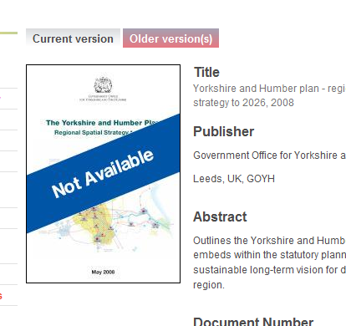
Emergence of the devolution agenda with new local governance models means opportunities for new forms of strategic planning?

Slide 18
Lessons from…
Talking to council leaders, CEs & planners
Discussions with CLG & PINS
Looking at current plan fails/DtC issues
Housing supply issue putting planning in panic mode, inherently unstrategic and unsustainable
Experience on strategic evidence issues
DTC: “sustained joint working with concrete actions and outcomes” is unlikely to be met alone by “an exchange of correspondence, conversations or consultations”

Slide 19
Keep in mind..
Localism Act - false hope for locally set housing targets to reflect political-public ‘anti RSS housing growth’ agenda?
Post RSS but pre Devo era – What is working? Gap analysis to inform future?
Local Plans and local decisions space
Government housing priority/Lyons
How LPAs best navigate DtC and Devo
The next 12 months, and beyond?

Slide 20


Slide 21
New strategic planning emerging -
Spatial framework or vision
Unambiguously built on local plan work
Implied uplift included to deliver Gainshare, SEPs, supported by SIPs
Tail wagging dog or some other description?
Delivery tools including mayor planning powers/consultee role
Possibility of SPD on back of vision
Direct delivery powers to fill housing shortfall

Slide 22
Economics, SEPs, SIPs and Frameworks
PPG: LPAs expected to “work together constructively from the outset of plan preparation to maximise the effectiveness of strategic policies”
Need to show really and meaningfully got head round interplay of issues – growth, infrastructure need and economic activity rate…or others will
Failing of first round RPG/RSS – chapter based approach

Slide 23
The Future of PLACES
Housing
Additional
Infrastructure
SPATIAL CHOKE FACTORS
LATENT DEMAND
EXPRESSED
DEMAND

Slide 24
Additional
Infrastructure
Housing
ACTIVITY RATE ?
GVA or FTE
TARGET
JOB MOVE &
COMMUTER RECAPTURE ?
NEW RESIDENT ?

Slide 25
Devo governance and DTC #1
Working arrangements need to avoid significant additional overall resource
Reflect roles/desires of all constituent authorities and not constrain decisions
Maintaining ongoing / live DtC resource will be valuable asset if working across many LPAs (and in particular) multiple HMAs
DO NOT reopen HMA working, but may need to reality check boundary assumptions if not done since RSS

Slide 26
Devo governance and DTC #2
Keeping arrangements under review* can be simpler under devo, particularly if CLG follow through on allowing mayor power to produce CA wide SPD
Easier to ensure political accountability*, leadership, and wider corporate ownership
But – no obvious or consistent wider stakeholder input route
*Golden rule issue

Slide 27
Pause - cautionary thoughts
Philosophical change - economic need v economic potential. ‘Don’t spread jam too thinly’
Selective use of available city evidence, ignores evidence on market towns/rural productivity
Planning was intended to address inequality and deliver SD. Re-emergence of economic growth v sustainability false dichotomy
Needs care in handling aspirational targets and spatial choke factors – inc skills

Slide 28
Example of approach
Extensive, fast broadband infrastructure
Access to high quality mobile communications*
Improved transport connectivity
High quality education and training
Expanded apprenticeships
New Enterprise Zones
Better regulation and streamlined planning
More housing

Slide 29

Key lessons from Devo Experience
…and some observations

Slide 30
Rule #1 Simple is transparent
“On the Method of Theoretical Physics” the Herbert Spencer Lecture, Oxford, June 10, 1933
“everything should be as simple as possible, but not simpler”

Slide 31
Rule #2 Evidence is not policy
But effective policy can be extrapolated at any stage of joint work if not anchored into clear spatial scope
Starting/joining a process is accepting logical results. Will be seen as agreeing to latent and expressed demand drivers beyond SEP sign up
Alignment of evidence and plan phases key, avoids long term aspiration impact too early in plan cycle
Structure work to avoid aspirational growth being selectively interpreted on non-strategic basis

Slide 32
Rule #3 Avoid Framework creep
Strong evolutionary tendency – strategic working abhors a perceived policy vacuum
Leave local space for everything but tight issues rooted in strategic spatial evidence issues
Not RSS “do everything” (32-314), Pt 1 UDP or SP
BUT
Agile SPD for issues between plan review cycles? SPD needs to be tied to a plan…. not just evidence?

Slide 33
Rule #4 Remember this will be semi-voluntary
Inspectors/challenges will look for gaps in decision making process. Ongoing member involvement vital
Power in marriage: City Region drivers, MCR message success
If this work is to direct our plans, is Devo/LEP work spatial enough - could it “pass” SA/SEA?
Not RSS “Table” which bedevilled Regional experiment
Risk of non-polycentric urban economic focus because of the Gainshare issue?

Slide 34
Conclusions #1
Many statements in this presentation end in ?
Comparative rural advantage = stunning view
Green belt & strategic reviews - perhaps start working on scope of consistent methodology now.
Economic growth is a delivery mechanism for spatial planning, if harnessed properly.
Fundamental tensions with localism
Non polycentric, language of urbanising impacts

Slide 35
Conclusions #2
Political ownership far more important than vehicle
Understanding economics, econometrics + infrastructure
Key difference between constraint based strategy and objective SEP aspiration/latent needs assessment
Gov planning changes seem to be heading towards as yet unstated goals including hybrid zonal
Looming gap: non core stakeholders

Slide 36
Is it Spatial Planning rediscovered?
Thank You

Slide 37
Invest to save to invest
Area-Wide Strategic Planning and Investment
Presentation by
Lawrence Revill
Partner
David Lock Associates
3rd and 8th March 2016

Slide 38
In the UK in 2016 area-wide, strategic planning is as rare as hen’s teeth.

Slide 39
That is because we don’t really do “planning” anymore: most plans are just “advance development control”…..

Slide 40
.....that means that we fail to exploit big infrastructure investment effectively.....

Slide 41
…..and we struggle to get local infrastructure investment right, in scale and timing.....

Slide 42
.....because it’s hard to delivery strategically if you dont have a strategy!

Slide 43
Why is that so?
Few plans set out to predict the future and to “design” their area
Few plans explicitly link development, strategic infrastructure and economic development
Instead, plans start with some numbers and a “call for sites”
Those sites are already carrying expectations and costs
Politicians are reluctant to deal with “someone else’s problem”
Notes:
Expectations in terms of land values
Costs in terms of options and purchases already concluded

Slide 44
And yet…..
We have more data about our places than ever before
We need to be smart about how we collect, analyse and synthesise
There is great virtue to planning for “functional geographical areas” rather than feudal administrative/political areas…..
.....but politics can get in the way
We have the biggest programme of roads investment for more than 20 years
We have major rail projects in the offing
Both can change the geography of place and the propitious locations for development
Notes:
The power to interpret

Slide 45
Area-wide strategic plans remain a powerful catalyst for good things to happen!
Localism does not remove the obligation to plan strategically – just the terms and conditions change.
Notes:
Bottom-up means a willingness to cooperate (this is beyond “Duty”) to resolve wider than local issues
Incentive is maximising beneficial impacts at minimum cost – more bangs for your buck!

Slide 46
Some Recent History
RPG9A Thames Gateway – a strategy for area-wide regeneration
Led to the Kent Thameside Partnership
HS1 (CTRL) and Javelin – Ebbsfleet Station
Notes:
Expectations in terms of land values
Costs in terms of options and purchases already concluded

Slide 47
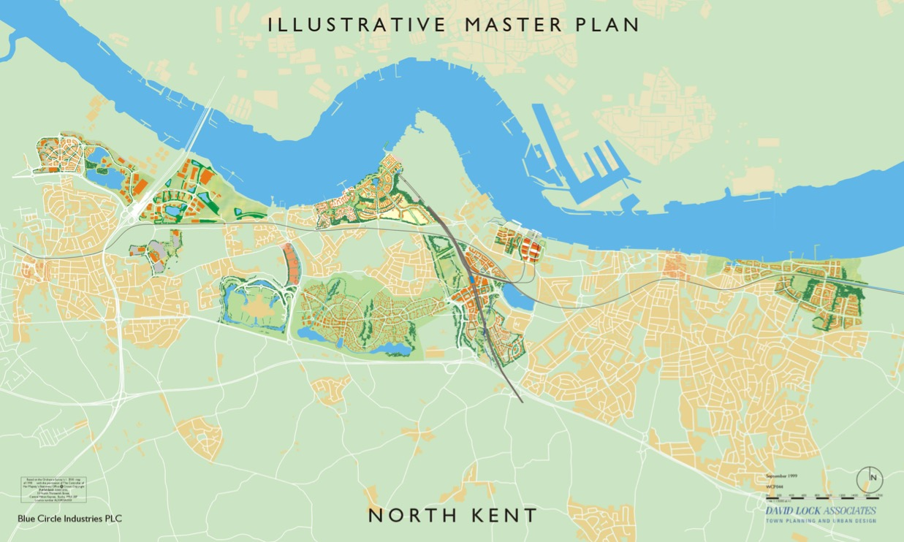
Thinking Big:
A Compelling Diagram and a Regional Plan
13km
2 x 17km BRT Circuit or “10 mile lasso”
Dartford – Ebbsfleet – Gravesend

Slide 48
Some Recent History
RPG9A Thames Gateway – a strategy for area-wide regeneration
Led to the Kent Thameside Partnership
HS1 (CTRL) and Javelin – Ebbsfleet Station
”Fast-Track”
Notes:
Expectations in terms of land values
Costs in terms of options and purchases already concluded

Slide 49
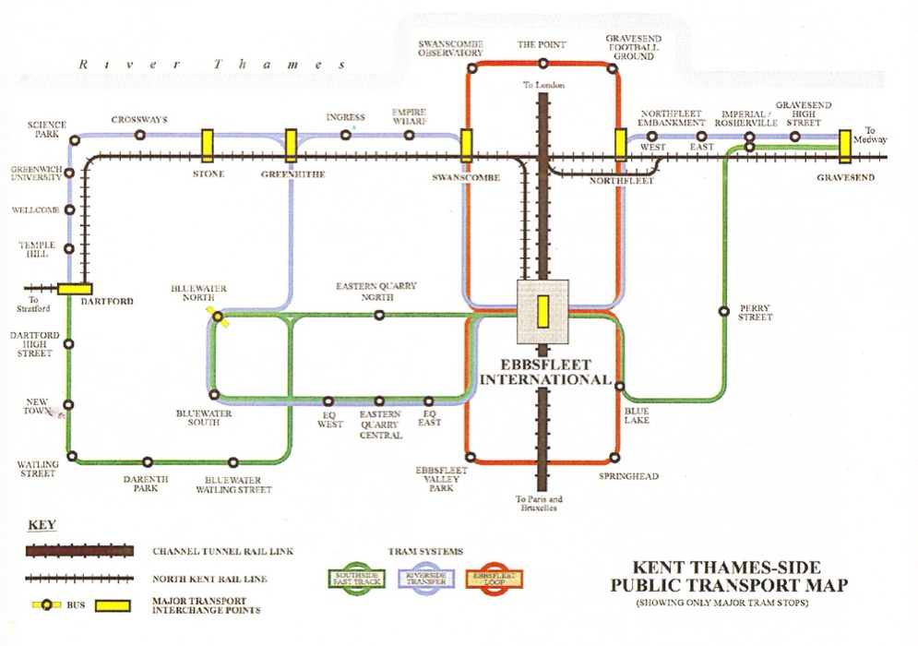


Thinking Big:
A Compelling Diagram and a Regional Plan
Notes:
1995

Slide 50
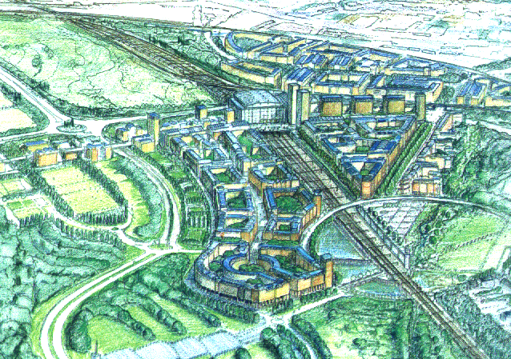
Ebbsfleet Planning Application 1995

Slide 51
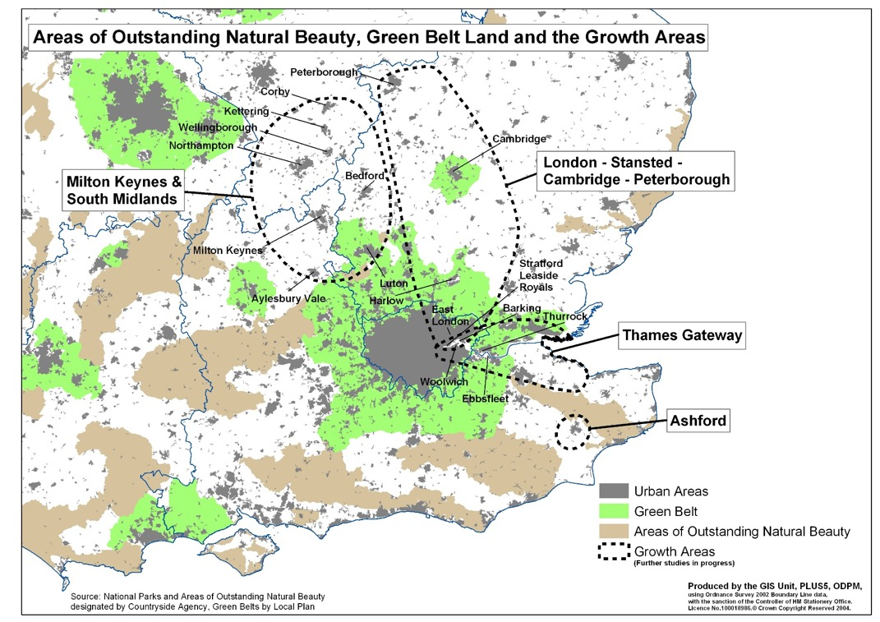
Multi Modal Studies and the Growth Areas Plan

Slide 52
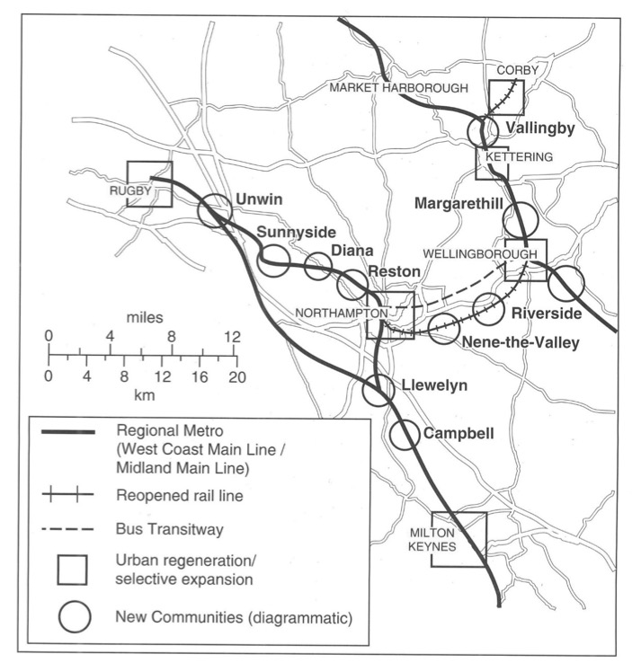
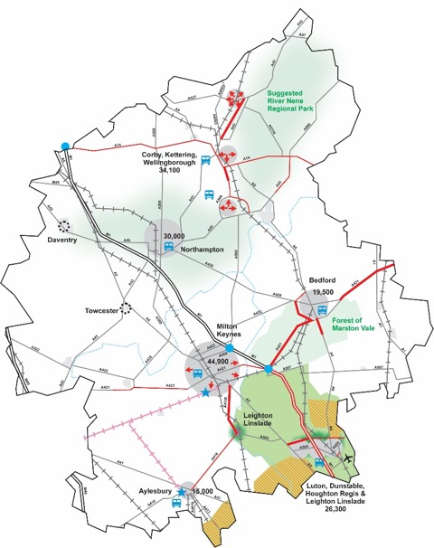

A Regional Strategy – Sustainable Communities Plan
MKSM
Sustainable Communities Plan
2003

Slide 53
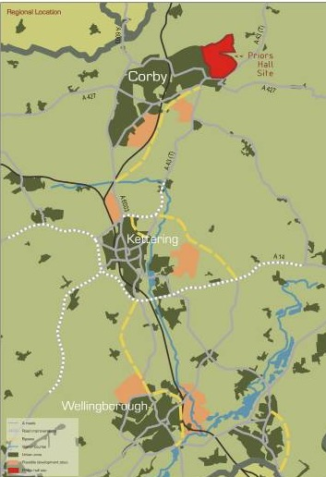
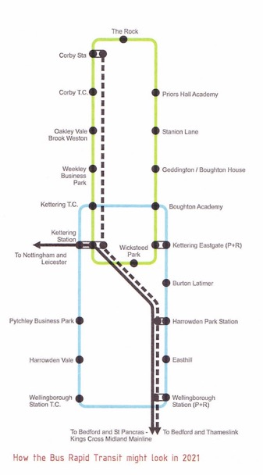
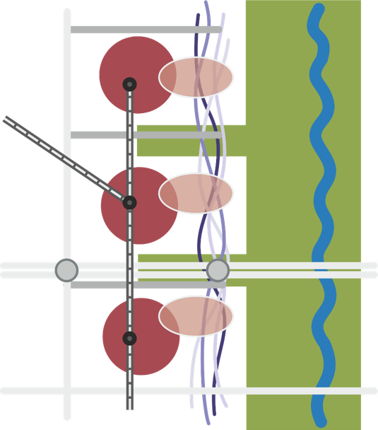



An Area-Wide Strategy: The Principles Applied in North Northamptonshire

Slide 54
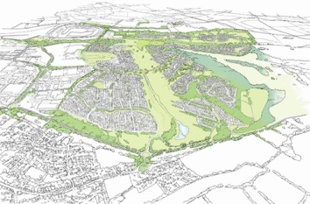

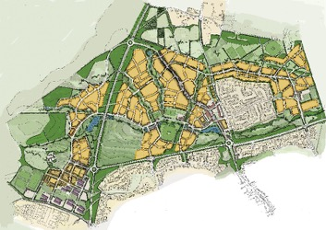
An Area-Wide Strategy: The Principles Applied in North Northamptonshire
Priors Hall 5100 homes
East Kettering 5500 homes
North Wellingborough 3000 homes

Slide 55
Current Thinking
Think Big.....
.....act small
Notes:
Big - Embracing major infrastructure investments
Small - Planning the local context to optimise the positive impacts

Slide 56
Current Thinking HS2: lessons from the Independent Transport Commission
No one builds terminus stations anymore
Move from a “line” mentality to a “network” mentality
Integrate local PT planning from the beginning
HSR stations change geographies
HSR stations should be in city centre locations
Development catalysed by the station should be undertaken in partnership
Decisions of regional or national significance need a regional or national plan
Plan for HS freight from the beginning
Leaving airports off the HSR network is not an option

Slide 57
Current Thinking HS2:
The Spatial Impacts of High-Speed Rail

Slide 58
Current Thinking:
Drive for new Settlements
Can we keep “edge blobbing”?
New settlement proposals must have local support

Slide 59
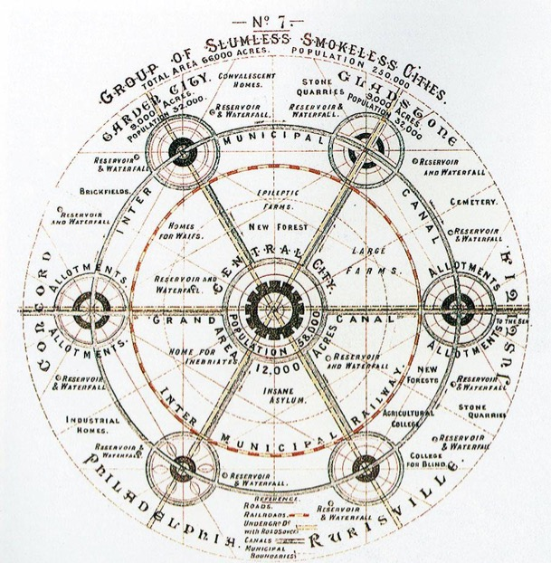
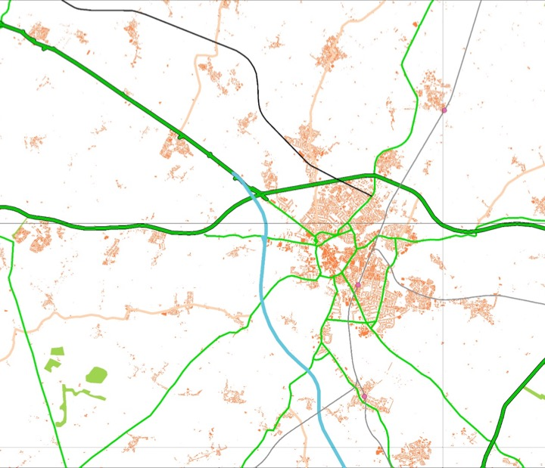
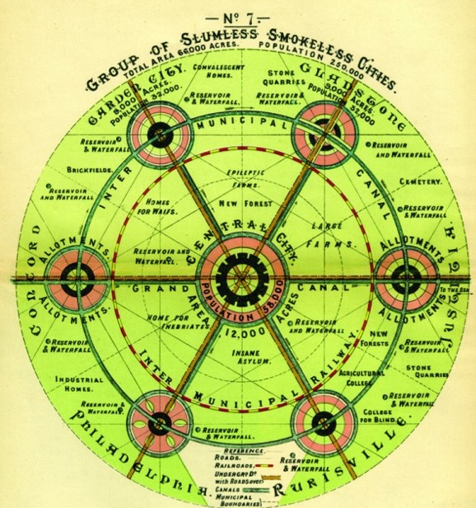
Thinking Big:
The Power of a Compelling Diagram
66,000 acres/26,710 Ha
Total population 250,000
104,200 homes
Central City
12,000 acres/4,860 Ha
58,000 population
24,200 homes
Satellite Town
9,000 acres/3642 Ha
32000 population
13,300 homes
The Social City Region

Slide 60
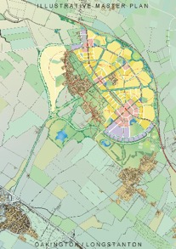
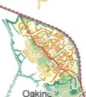
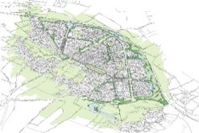
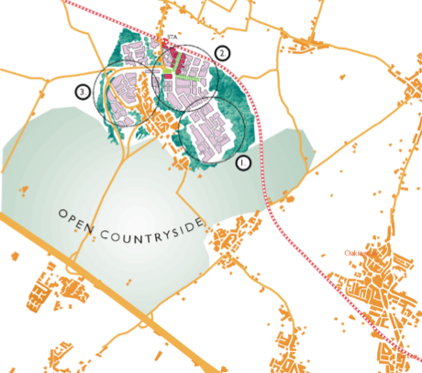
Thinking Big:
The Power of a Compelling Diagram
Longstanton-Oakington
Cambridge
The Social City Region in Cambridge

Slide 61
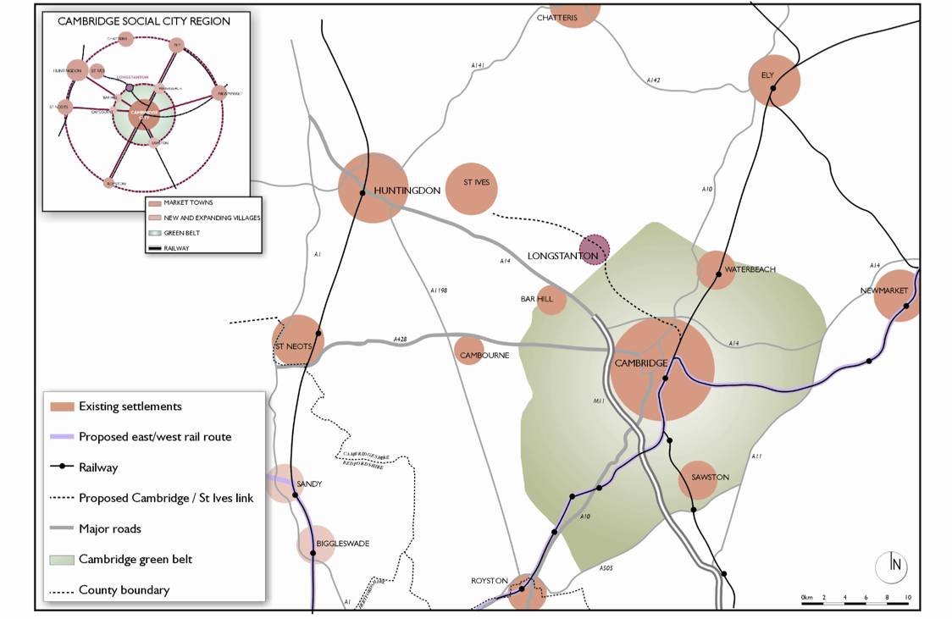
Thinking Big:
A Compelling Diagram and a Regional Plan
Notes:
Concept plan for what was to become Northstowe published 1998 copyright

Slide 62
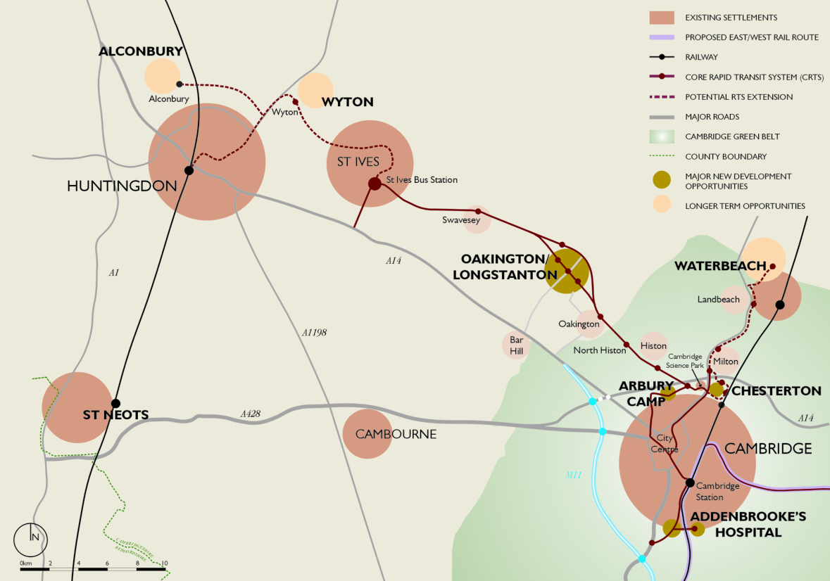
Thinking Big:
A Compelling Diagram and a Regional Plan

Slide 63
Current Thinking:
Drive for new Settlements
Can we keep “edge blobbing”?
New settlement proposals must have local support
Leeds

Slide 64
…..and what of Yorkshire?

Slide 65
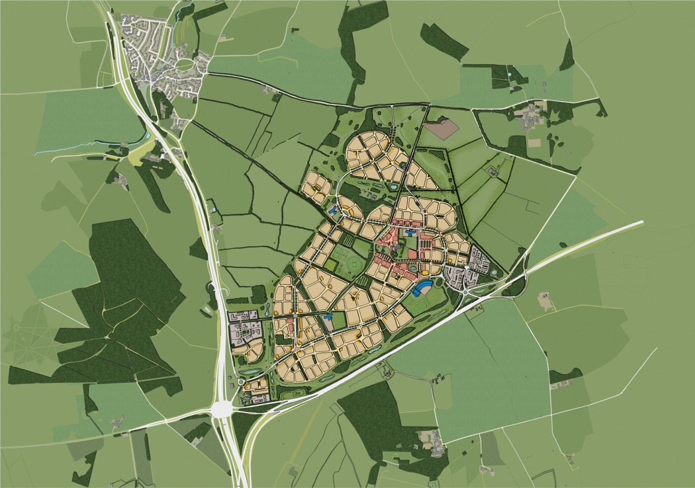
Headley - A New Yorkshire Town

Slide 66
Becca Hall- A New Yorkshire Town

Slide 67
Potential Savings
Data collection, collation and analysis
Optimum staffing to forward plan, inc specialist inputs
Minimised cost of plan publication and consultation
Fewer, simplified EiPs
Better and quicker reviews
Effective S106 and CIL negotiations related to strategic needs
Optimised investment:
  Infrastructure
  Services
Influencing strategic projects to maximise positive local impacts
Notes:
Big - Embracing major infrastructure investments
Small - Planning the local context to optimise the positive impacts

Slide 68
Likely Pitfalls
Skills and perspective and the will to plan at scale and to negotiate
Not relying on a “call for sites”
The distribution of consequential development and politics
Dealing with controversy and its resolution
Maintaining planning objectivity
Clarity of CIL related to a delivery plan
Not realising potential
Notes:
Just as LPAs naively cannot understand why developers are reluctant to enter into equalisation agreements, so councils are averse to taking more than their “fair share” of development

Slide 69
Invest to save to invest
Area-Wide Strategic Planning and Investment
Thank You

Slide 70
Panel Q & A

Slide 71
Where can I get some help?
Andrew Pritchard
PAS Principal Consultant

Slide 72
For More information…
www.pas.gov.uk

