Slide 1
S106 agreements
Issues and approaches

Slide 2
S106 agreements - Issues and approaches
Policy
CIL
Financial viability
Clauses and approaches
Soft options post-CIL
Boilerplate issues
Managing planning obligations

Slide 3

Policy
Development Plan
What does the development plan say?
What standards/requirements are set?
What happens if standards/requirements are not met?
Neighbourhood plan
Other Guidance
NPPF
NPPG
SPD

Slide 4
Policy
Case Study
Mid Devon Council
The Council's development plan set an affordable housing requirement of 35%
In its draft charging schedule in 2013, the Council used an affordable housing proportion of 22.5% to calculate CIL rates, arguing it was the average amount currently being achieved
The inspector was very critical of this approach, stating the resulting CIL rate was so high it was a ‘serious risk to affordable housing provision’
He ordered the Council to slash the charge for dwelling houses from £90 to £40 per sq m (which the Council acknowledged was a viable CIL rate if 35% affordable housing provision was assumed)

Slide 5
Policy
Case Study
Contrast with Exeter Council
The Council's policy also had a target to affordable housing provision of 35% subject to viability
The Council decided to use a 25% affordable housing percentage from a SPD to calculate its CIL rate, resulting in £80 per sq m
Initially the inspector said it would 'not be appropriate' for her to accept a CIL rate based on the SPD rather than the adopted core strategy and asked the Council to review the implications of 35% affordable housing for site viability
The inspector decided that the Council's subsequent calculations suggested there would be sufficient development value to support 35% affordable housing and a residential CIL rate of £80 per sq m

Slide 6

CIL
CIL Regulations
CIL should be a residual figure after development plan requirements are met
Charging schedules
  by area
  by intended use
  by size
Regulation 123 lists

Slide 7

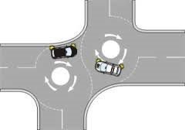
CIL: Regulation 122/123 tests
Regulation 122
Regulation 122 compliance required where obligation is a "reason for granting planning permission"
Decision making process/S106 confirmation
Regulation 123
Reduces ability to "pool" funds - no more than 5 obligations
Seeks to prevent no "fake tariffs"
Reduces ability to "double dip" by reference to "relevant infrastructure"

Slide 8
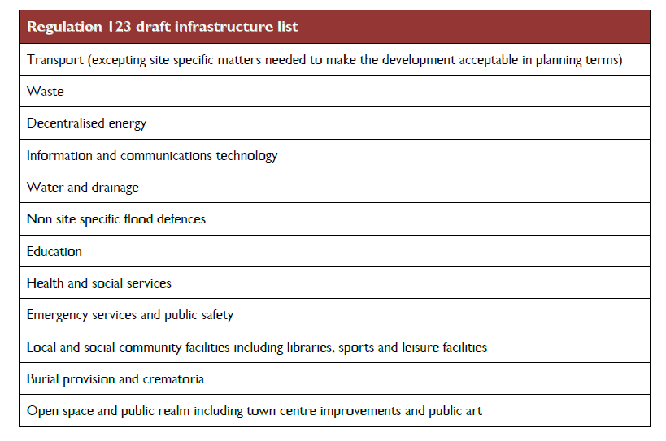
CIL Case study
Greenwich Regulation 123 list

Slide 9

CIL Regulation 123 list
How detailed should the list be?
The more you include, the harder it is to craft residual s106 obligations

Slide 10
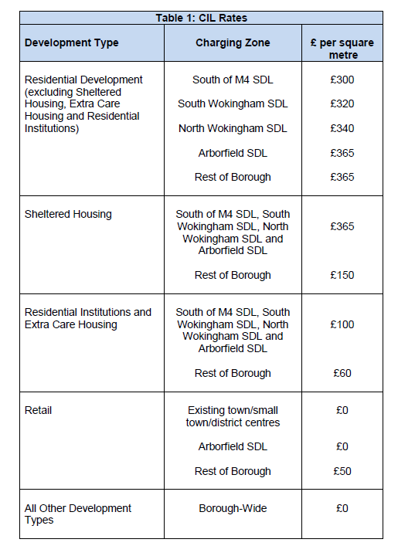
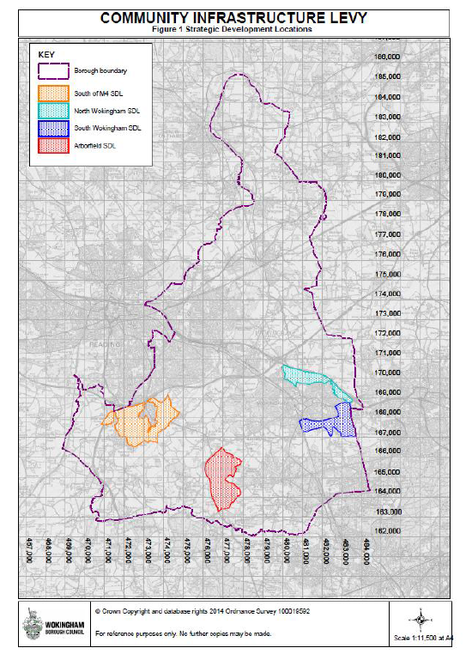
CIL Case study
Wokingham CIL charging schedule

Slide 11
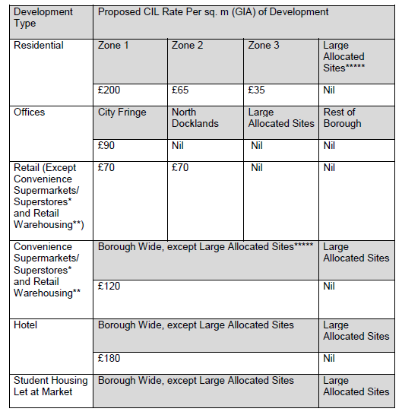

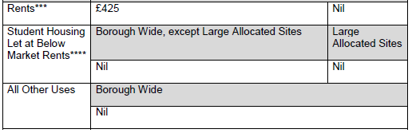
CIL Case Study
Tower Hamlets CIL charging schedule
Nil rate zone around Canary Wharf

Slide 12

CIL QUIZ
Is it lawful?
Roundabout to serve 10 equally sized development sites
Scenario 1: Developer 1 gives obligation to pay for it all
Scenario 2: Developers 1-5 pay 10% each, developer 6 gives planning obligation to pay 10%
Scenario 3: Developer 1 wants to provide less affordable housing because of cost of roundabout

Slide 13
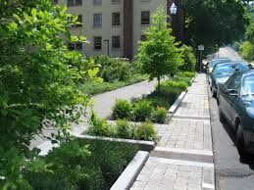


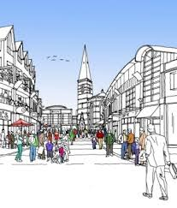
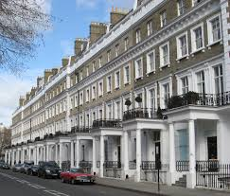
CIL QUIZ
Is it infrastructure?
Green infrastructure?
Public art?
Town centre managers?
Voluntary sector?
Historic environment?

Slide 14
CIL QUIZ
Is it infrastructure?
Definition in s216(2) Planning Act 2008, though not exhaustive:
“infrastructure” includes—
(a) roads and other transport facilities,
(b) flood defences,
(c) schools and other educational facilities,
(d) medical facilities,
(e) sporting and recreational facilities, and
(f) open spaces
[affordable housing?].

Slide 15
Financial Viability
  Development plan policies assumed viable through development cycle
  Viability only relevant if departure from development plan policy
  What justification needs to be given to LPA?
  What justification needs to be given to Councillors?
  What information needs to be available to the public?
  What information needs to be given to the Secretary of State?

Slide 16
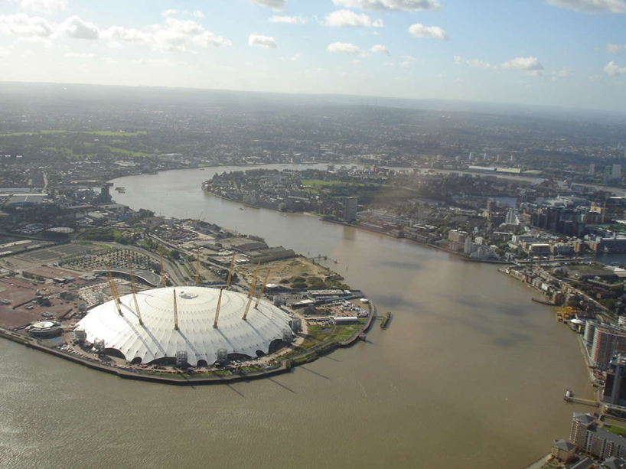
Case study
Greenwich

Slide 17
Case study
Greenwich
The Council's affordable housing target is currently set at 35%
If a developer's proposal does not meet this target, the developer has to produce a viability report, which they can request to stay confidential
In May 2015, the Council published a consultation document proposing that this viability report should be included in the proposed new local information requirements list for planning applications (local list)
If the applicant does not provide the information specified, the application will be considered "invalid and will delay the processing of the application until the information is supplied."

Slide 18
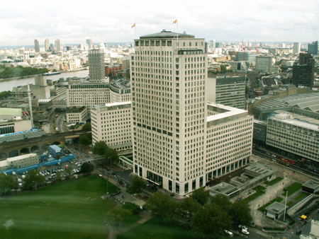
Case study
Shell Centre

Slide 19
Case study
Shell Centre
Local resident, George Turner, mounted a legal challenge against the Shell Centre redevelopment
Turner argued that the planning inspector had failed to properly consider the viability of the proposed scheme and the level of affordable housing in coming to his recommendation
He claimed that the inspector should have insisted that a confidential viability report was disclosed to the inquiry, rather than relying on a review of the report produced for the Council
In June 2015 the Court of Appeal refused to quash permission

Slide 20

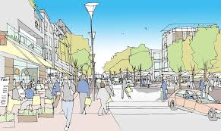
Clauses and approaches
Primary obligations
Affordable Housing
Transport
Education
Public Realm

Slide 21

Affordable Housing
Standard
Delayed
Clawed back
Clawed back cash
Payments in lieu
s106BA applications
s106BC appeals

Slide 22
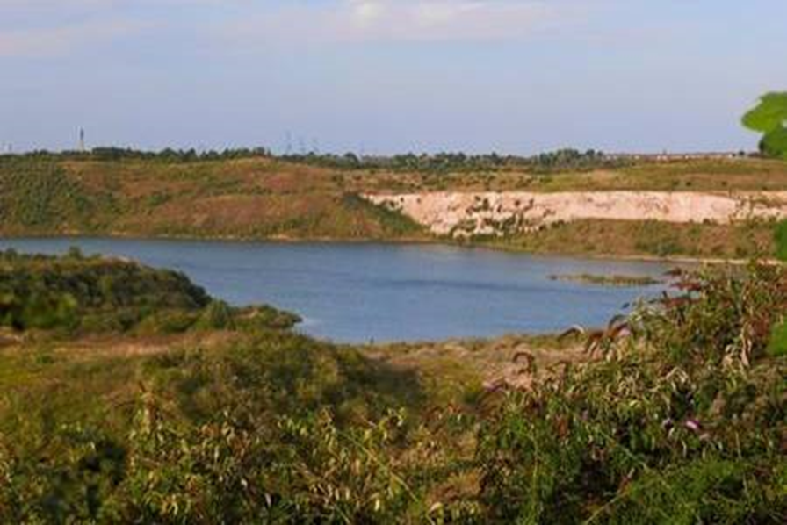
Case study
Eastern Quarry, Kent

Slide 23
Clauses and approaches: Eastern Quarry
Transport
  £40m towards strategic transport
  transit routes
  connection fees
Education
  school provision
  option to commute and KCC to build
  payment by Council towards spare capacity, including land
  co-location
Public Realm
  management companies
  service charges
Affordable

Slide 24


Public Realm and Long term maintenance
Public/private maintenance
Controls on access
Quality
Use

Slide 25
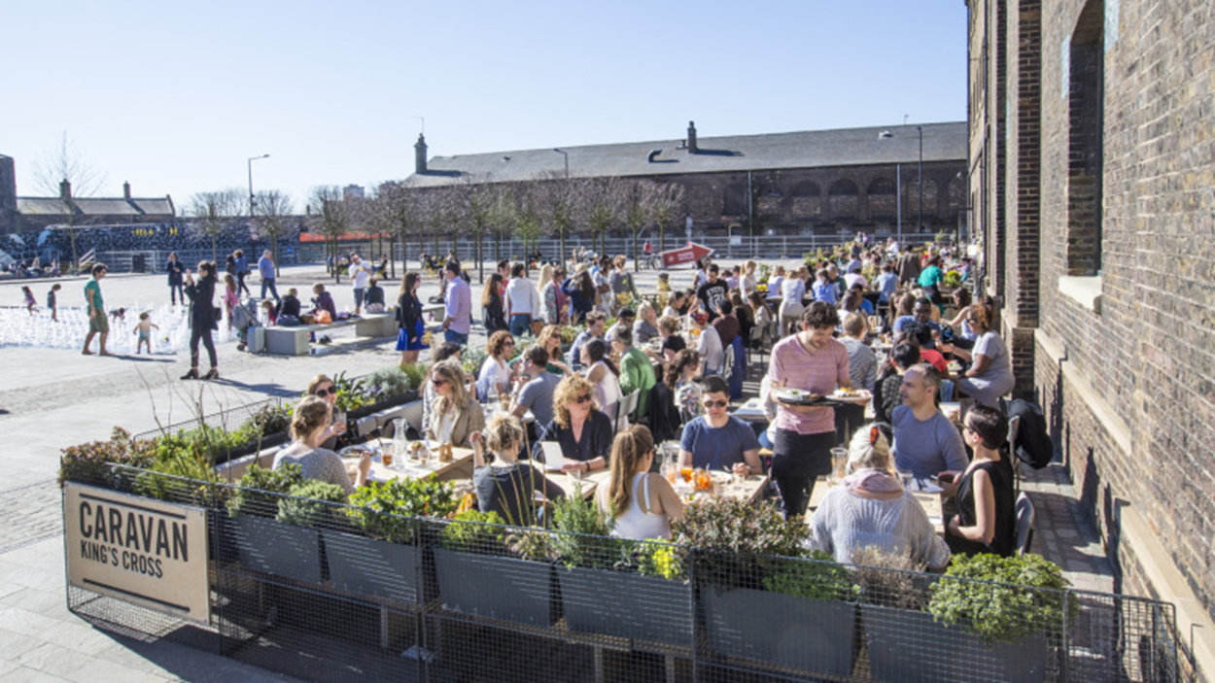
Case study
Granary Square, Kings Cross

Slide 26



Growth of non-infrastructure obligations
Local labour
Sustainability
Apprenticeships

Slide 27



Boilerplate issues
Interest
Indexation
Repayments
Use of money
Enforcement

Slide 28

Enforcement protocols/
Section 106 - Practical Examples III
Croydon - Development of Whitgift Centre
Hierarchy of Enforcement
Developer
1
Council
2
Leaseholder
Landowner
3

Slide 29
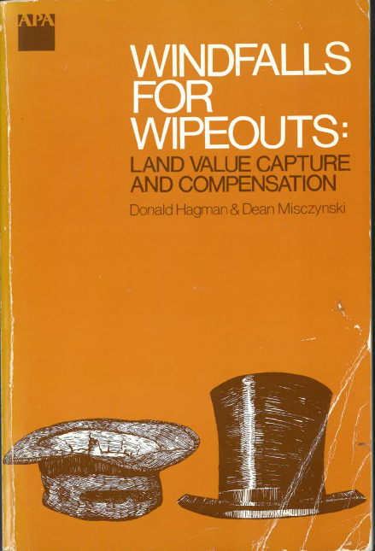
Conclusions and Reminders
Land values

Slide 30
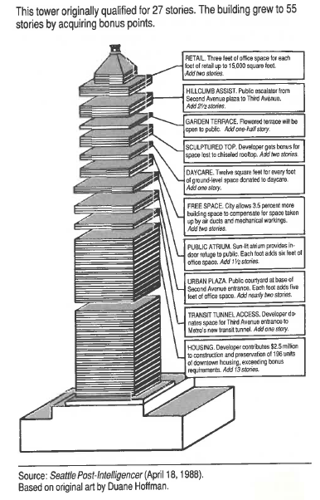
Conclusions and Reminders
Planning not viability

Slide 31
Questions?

