Slide 1


Slide 2

Steve Midgley
  Original background
    Supply to Construction industry
    Timber then Kitchens

Slide 3
Steve Midgley
  1989 joined a Family housebuilder in Lincolnshire
    Didn’t survive that recession

Slide 4
Steve Midgley
  1995 formed Fairgrove Homes with wife, Chris
    Currently Chairman of HBF Small Developers Group
    Past Chairman HBF Midlands region

Slide 5
Fairgrove Homes Ltd
  Based in East Midlands
  Family business
    Steve & Chris Midgley
    Now sons Simon & James

Slide 6
Fairgrove Homes Ltd
  20 years in business
    30 sites
    270 homes

Slide 7
Fairgrove Homes Ltd
  2006/2007 approaching 50 per annum
  2010 dropped to 6
  2015 target 36 & back upto 50 by 2017
  That's a 10 year set back by the recession!

Slide 8
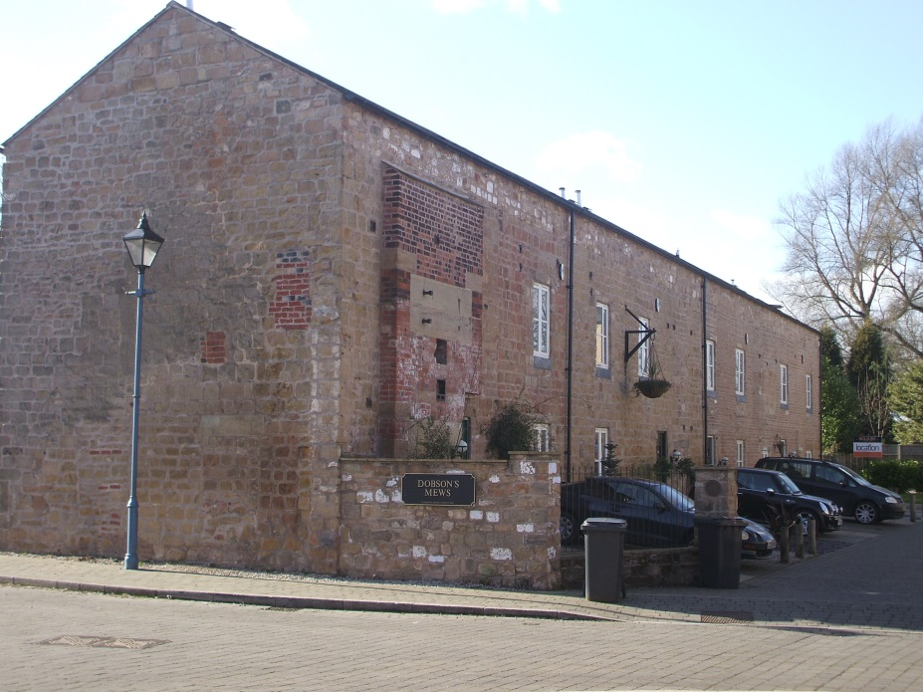
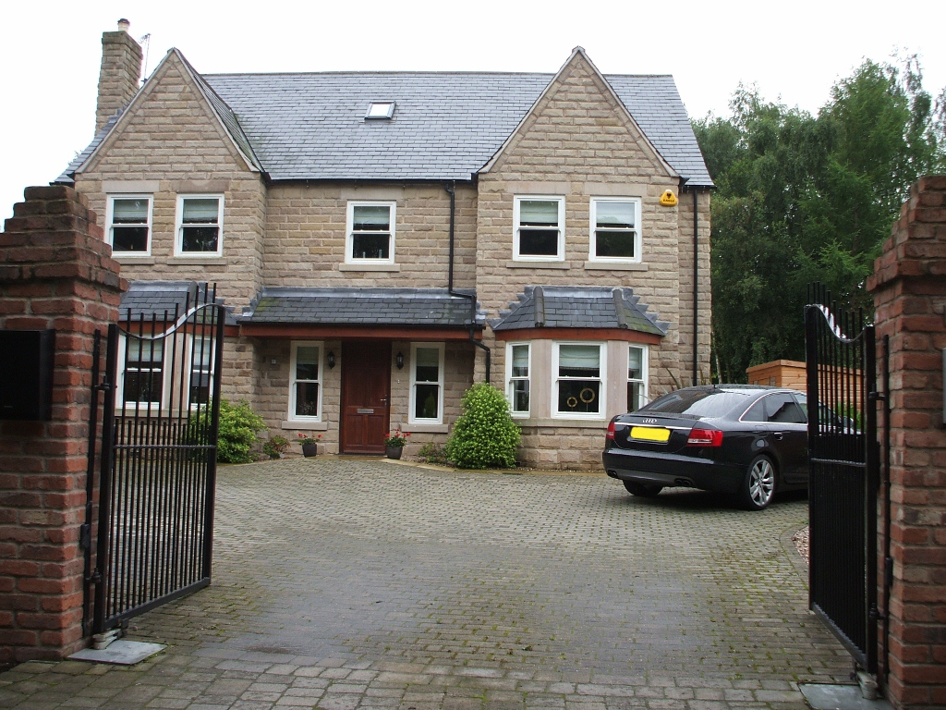

Previous Developments
School Woods Close, Shipley
Dobson’s Mill, Sutton in Ashfield

Slide 9
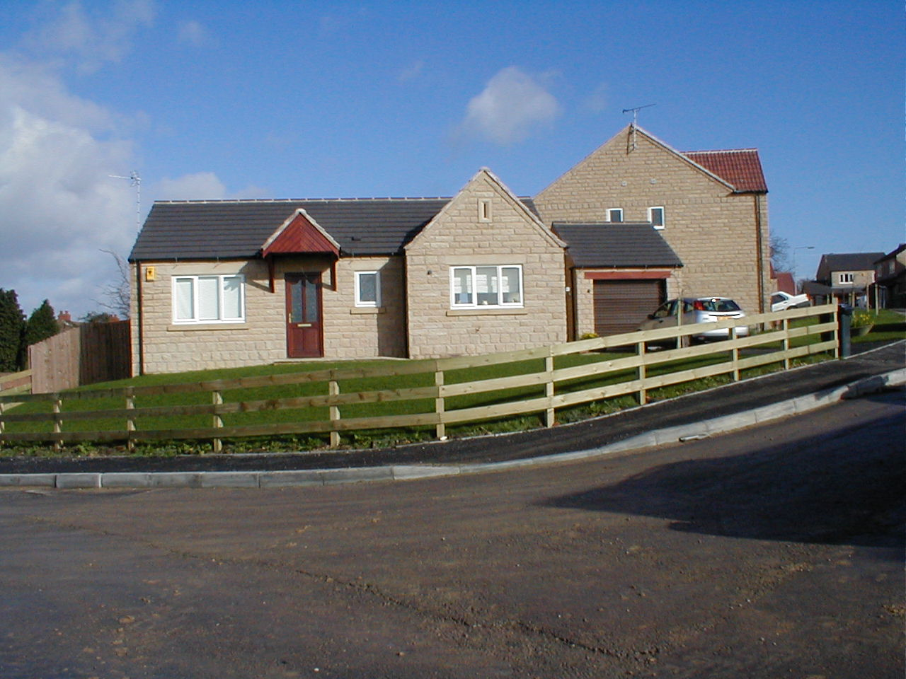
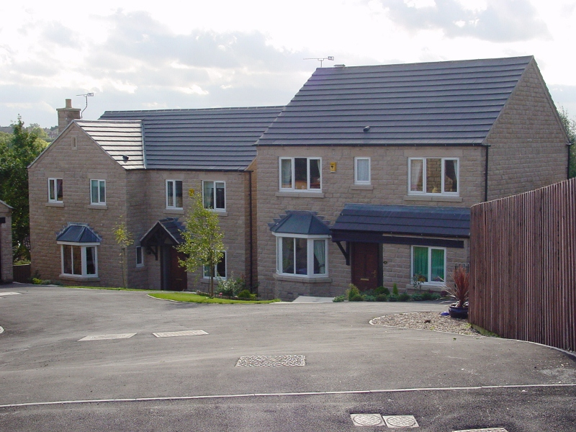
Previous Developments
Rock House Close, Tibshelf
St Michael’s View, Selston

Slide 10
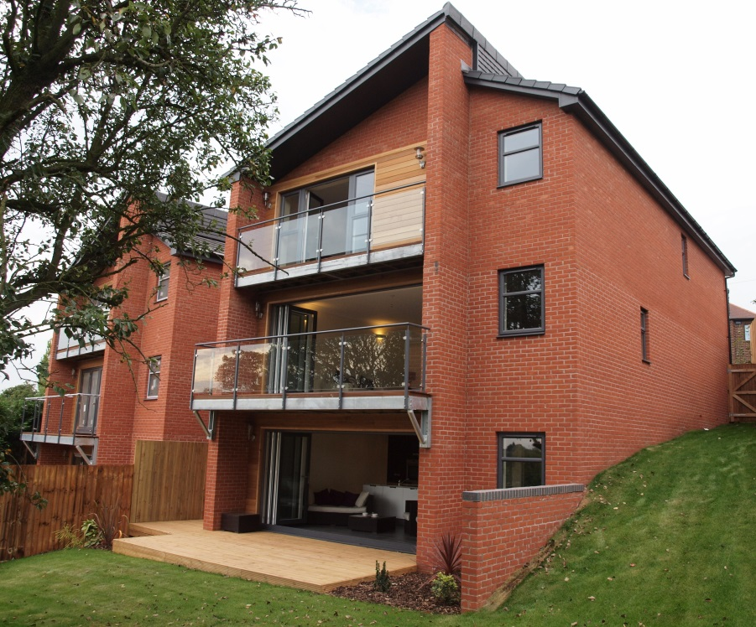
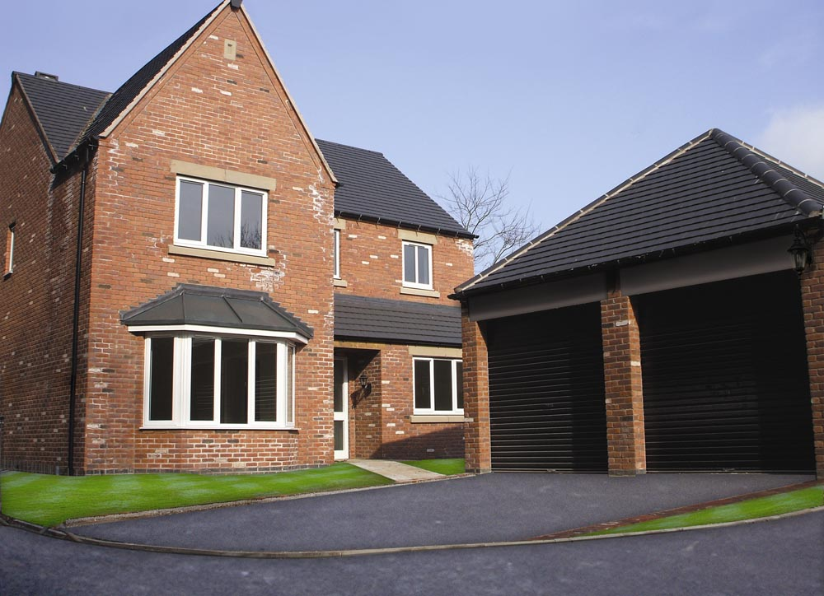
Previous Developments
De Buseli Fields, Gedling
Ashworth Heights, Mapperley

Slide 11
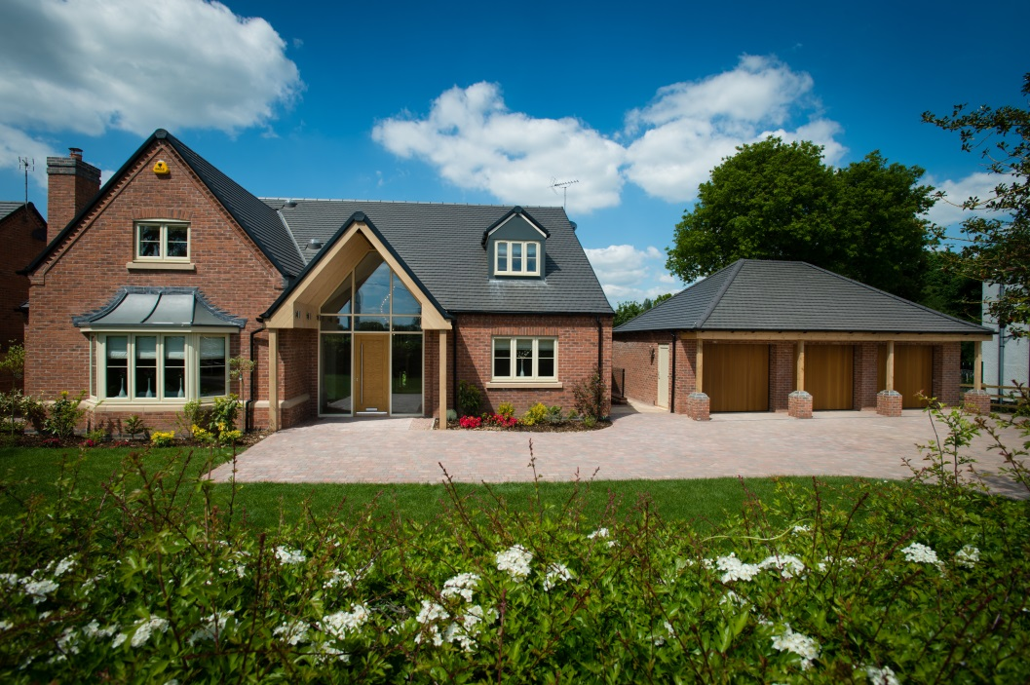
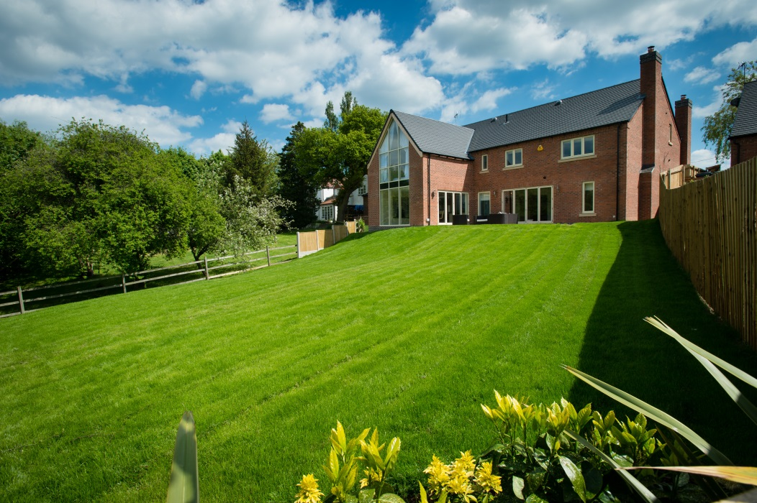
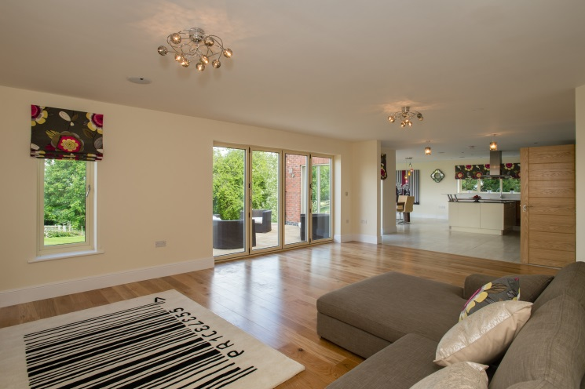
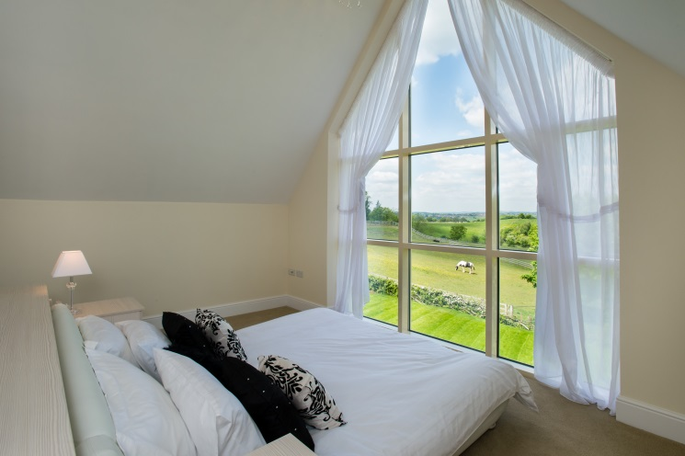
Previous Developments
Meadow View, Cloves Hill, Morley

Slide 12
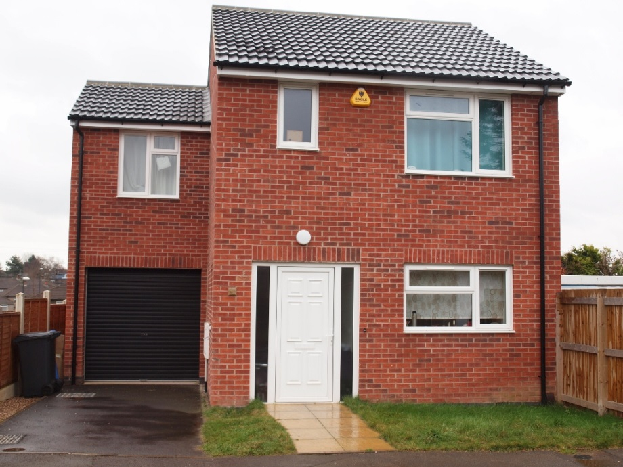
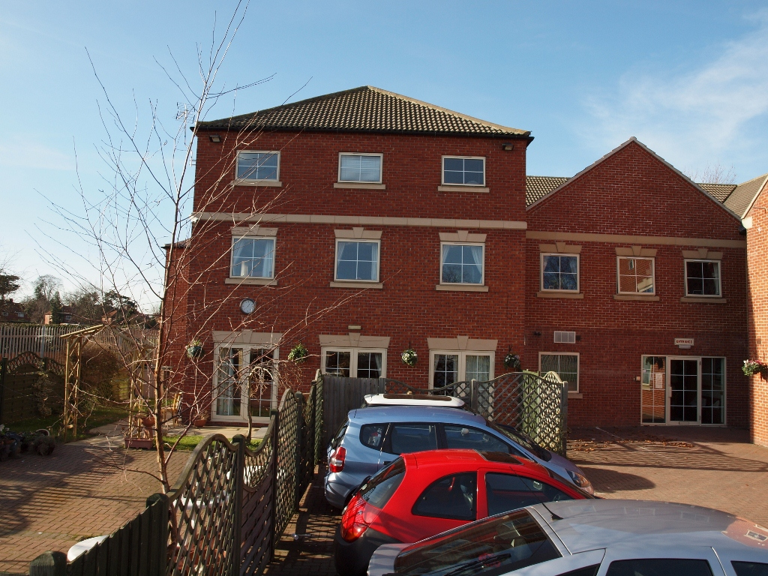
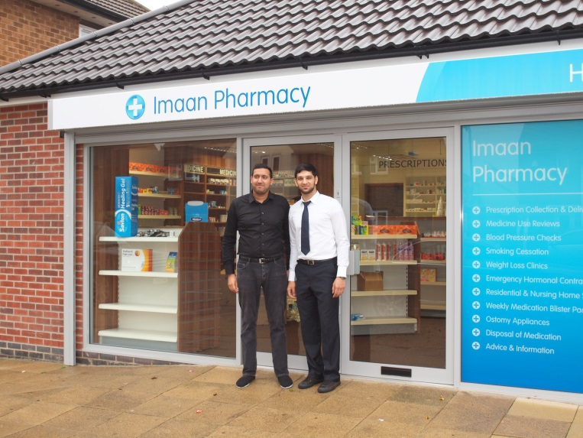
Commercial Projects

Slide 13

Self Build With Clean Hands!

Slide 14
CHOOSE YOUR PLOT…
CHOOSE YOUR DESIGN…
CHOOSE YOUR PRICE…

Slide 15
WATERTIGHT…
BASIC BUILD REGULATIONS…
BRONZE…
SILVER…
GOLD…

Slide 16
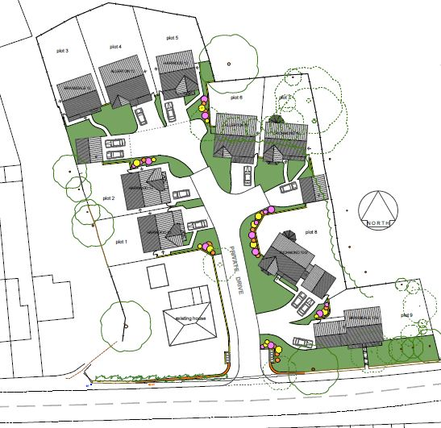
The Orchard, Morton, Derbyshire

Slide 17
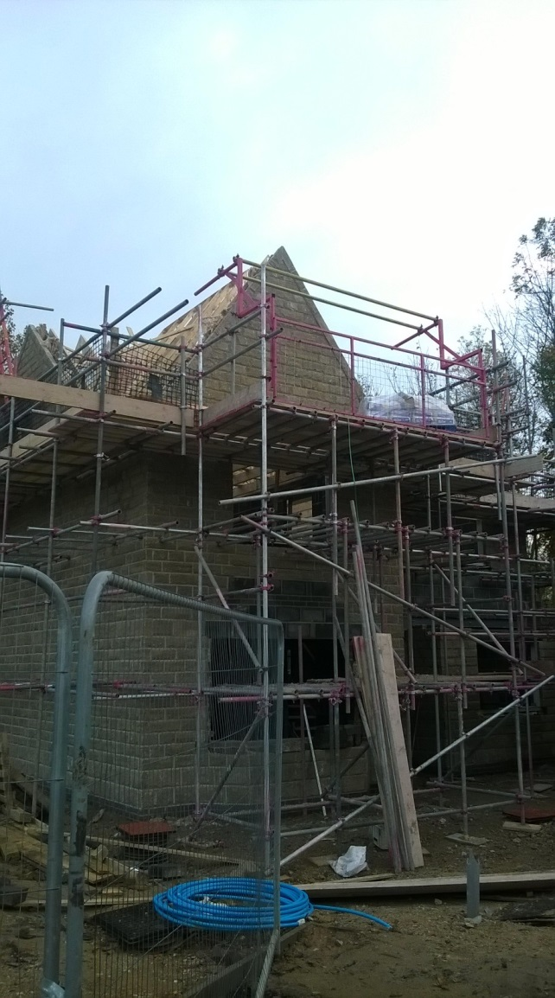
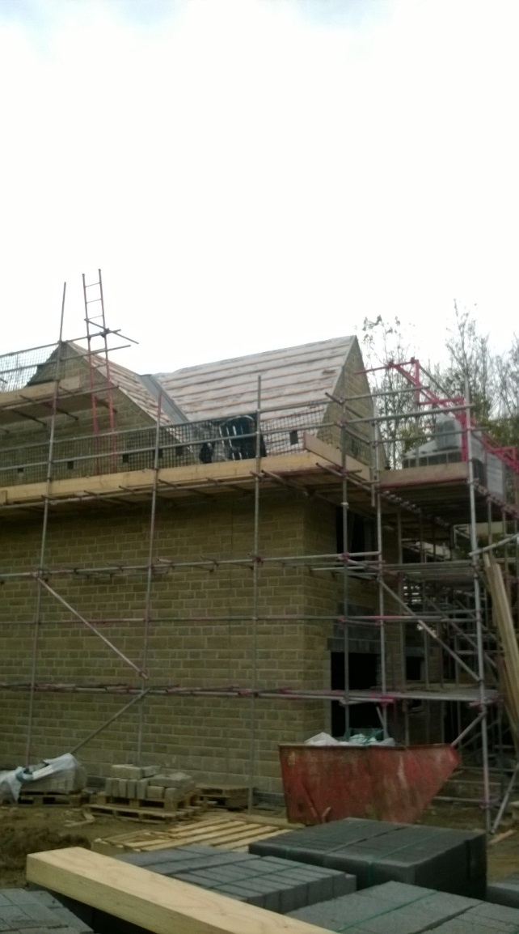
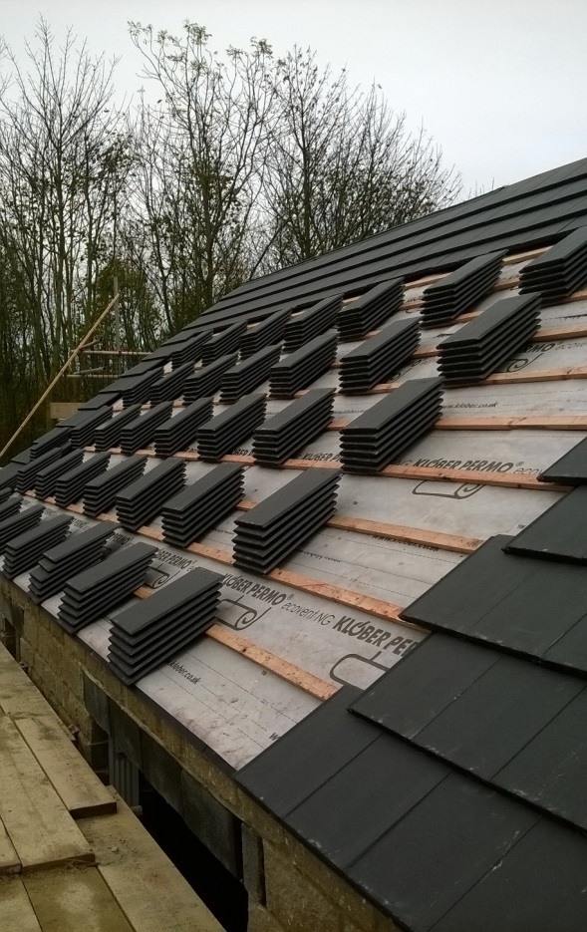
The Orchard, Morton – Richmond Design Currently under construction

Slide 18
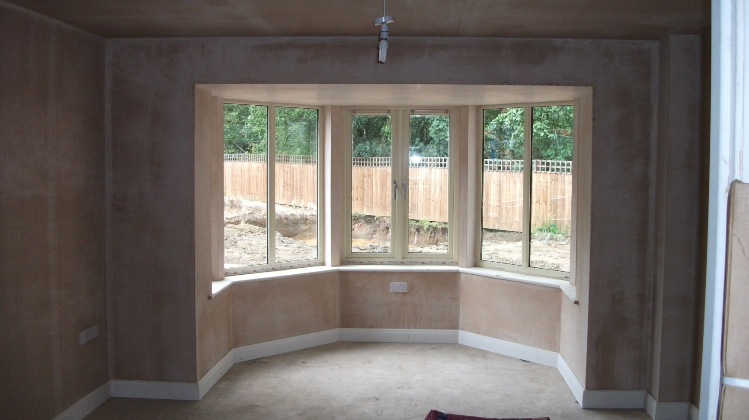
The Orchard, Morton – Richmond Design
Clients now moved in

Slide 19
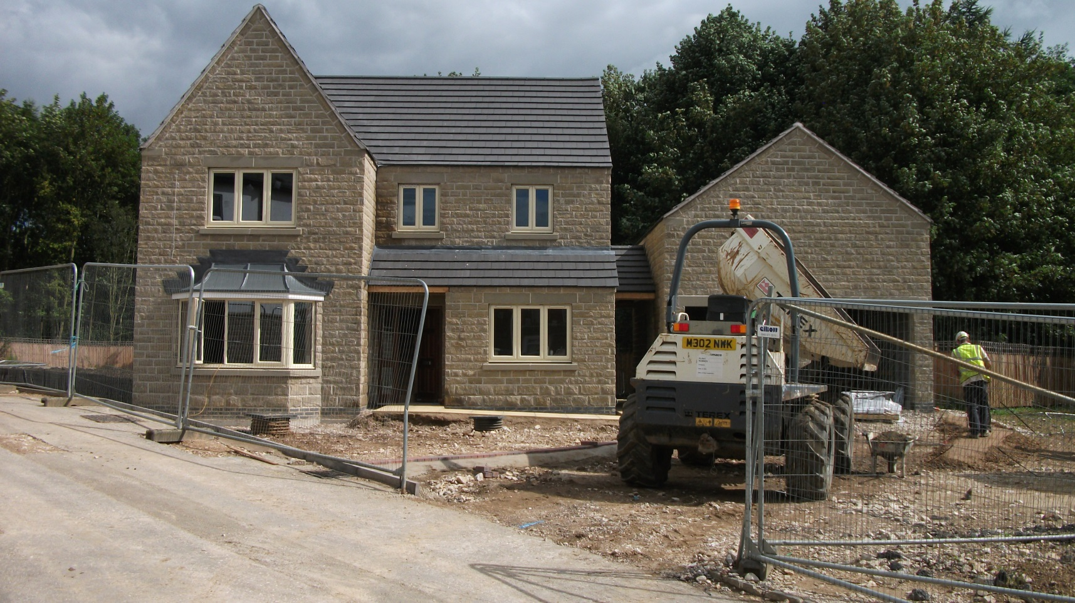
The Orchard, Morton – Richmond Design
Clients now moved in

Slide 20
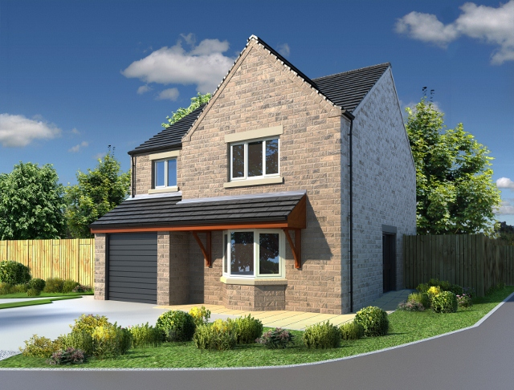
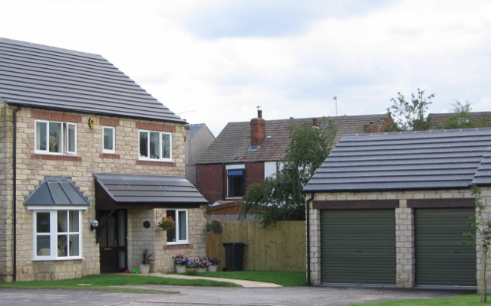
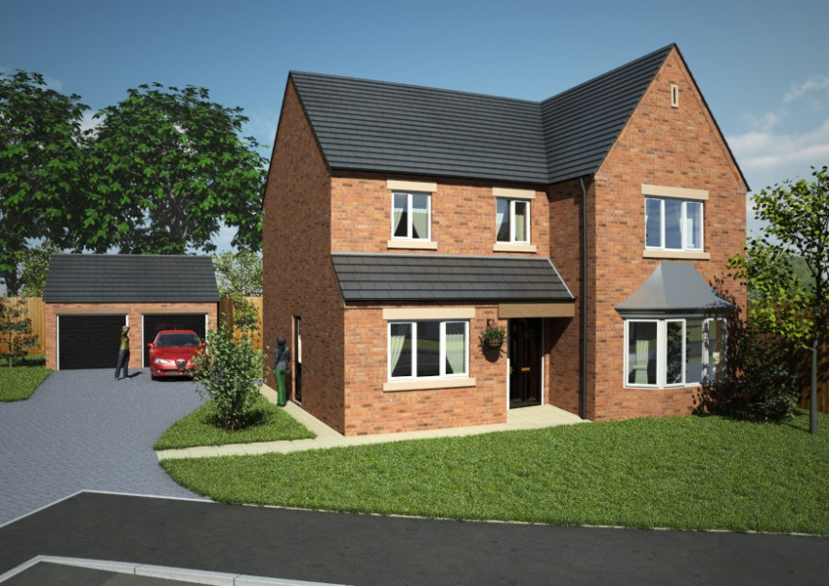
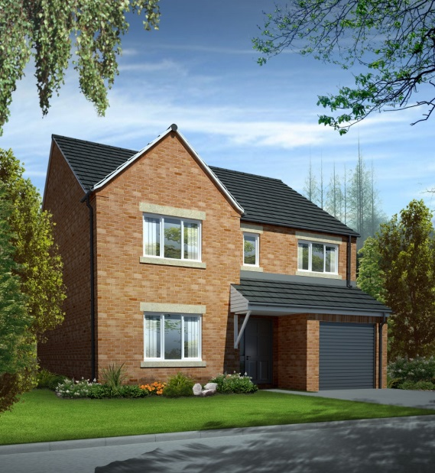
The Orchard, Morton – Available Designs

Slide 21
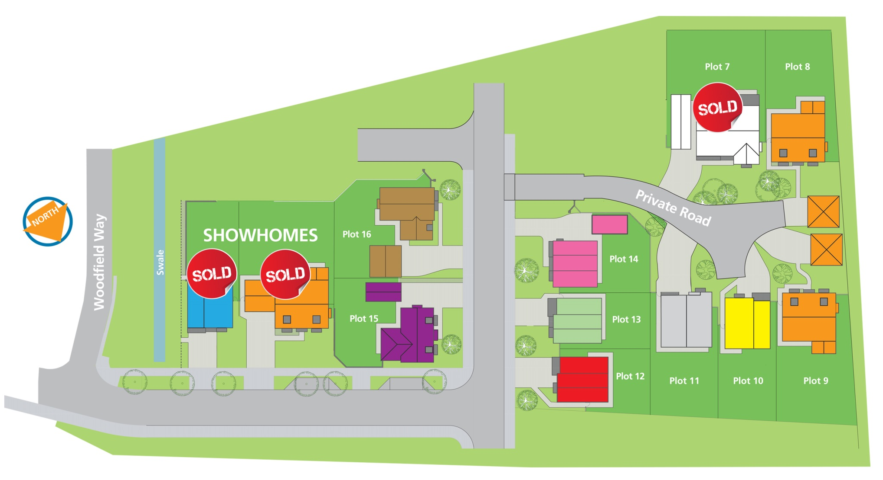
Dominion, Balby, Doncaster

Slide 22
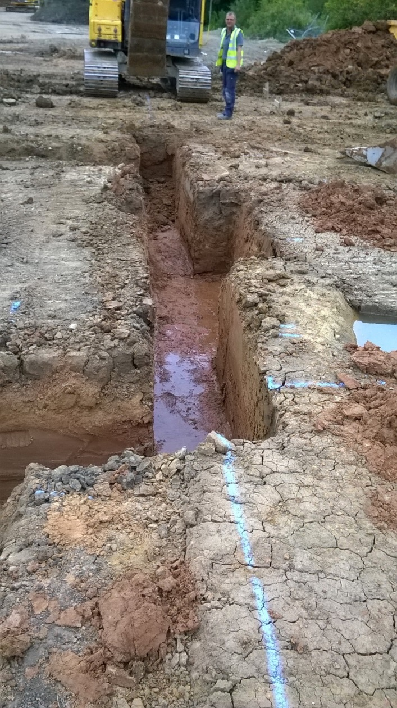
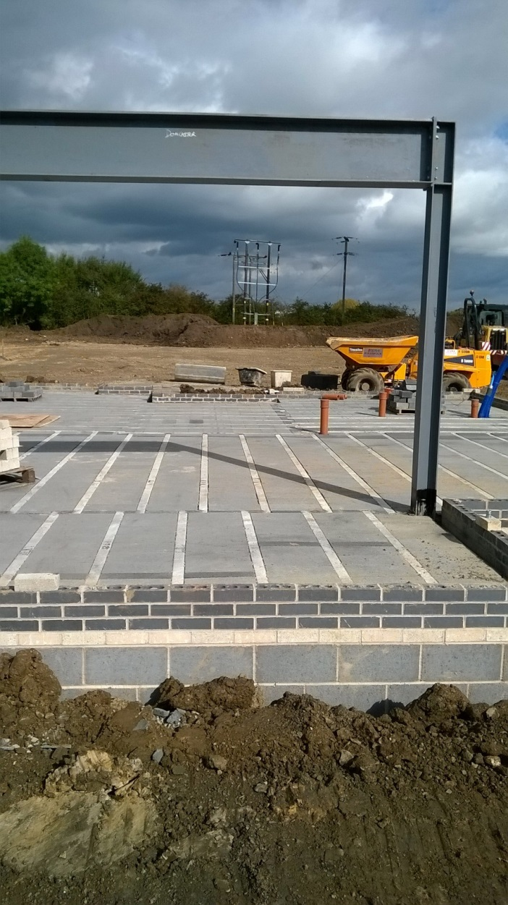
Dominion, Doncaster – Brompton Design Currently under construction

Slide 23
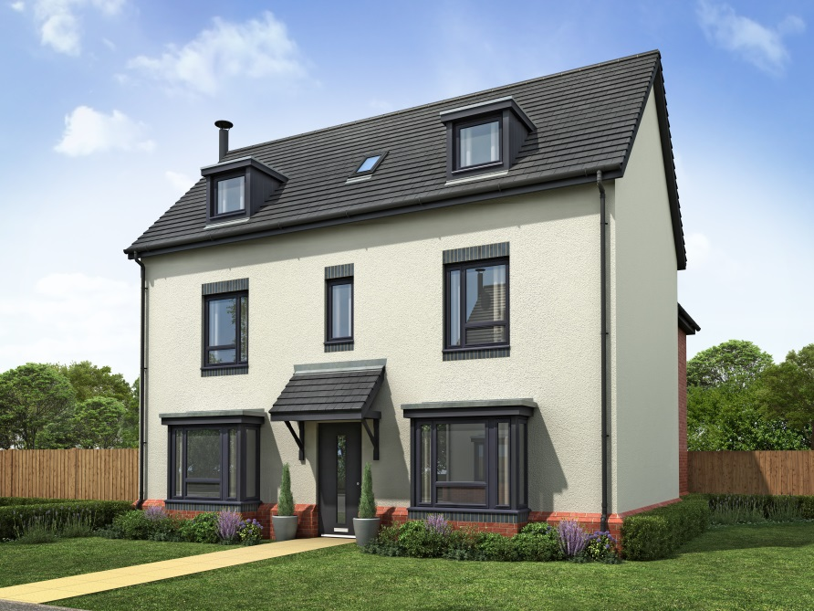
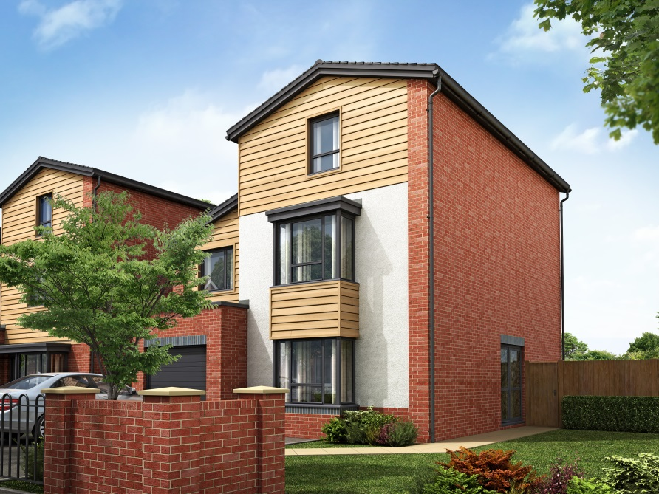
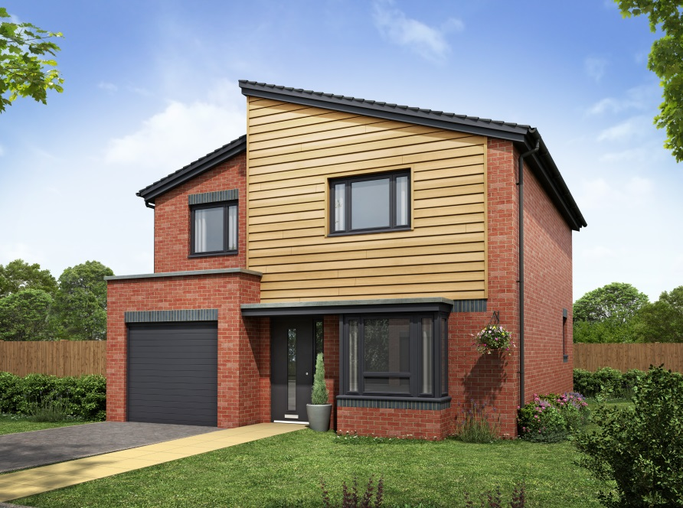
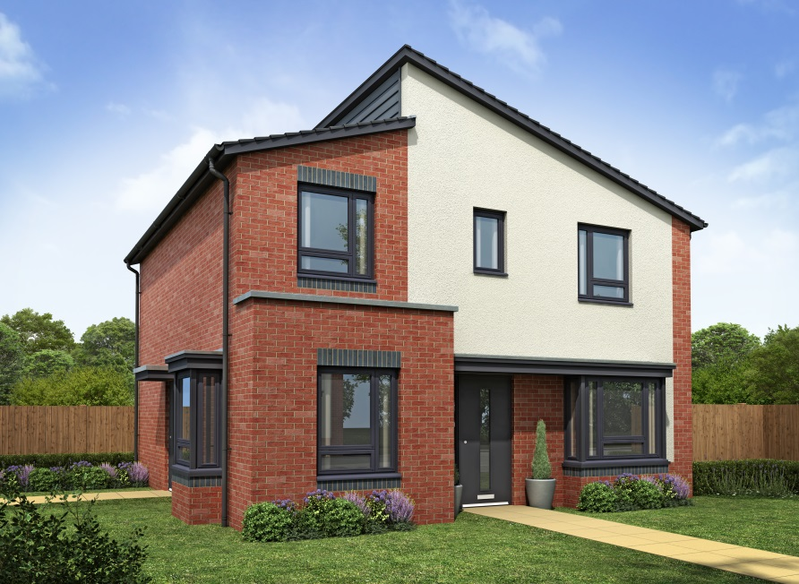
Dominion, Doncaster – Available Designs

