Slide 1
Suggestions based upon Experience of Examination
PAS Neighbourhood Planning Workshop 3rd February 2015 Birmingham
Presented By Tim Jones,
Barrister, NDP & NDO Examiner
(with thanks to fellow examiner Chris Collinson for substantial input into this presentation)

Slide 2

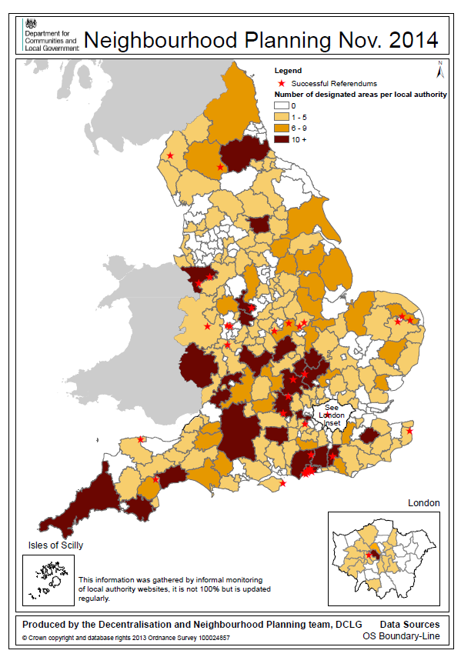
The state of play…
This data was informally gathered from internet monitoring and is being constantly updated

Slide 3
Meeting need & supporting growth

Slide 4
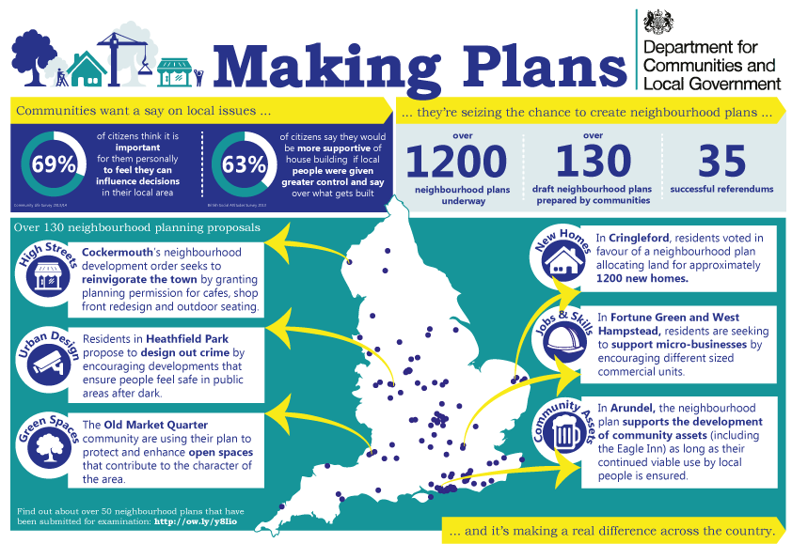

Slide 5
Collaborate
LPA’s specialist input to a NDP’s/NDO’s production e.g. SEA expertise, development management’s review of policies
LPA should help ensure basic conditions and other requirements are met before the examination
Try to resolve any differences between the LPA & QB before submission plan stage – the examiner’s power to modify is limited to meeting the basic conditions and Convention rights
Co-ordinate LPA and QB publicity/websites
Collaboration with other principle players – the worst problem at Cringleford was an unnecessarily late intervention by the highway authority

Slide 6
Early Preparation
Benefits an independent ‘health check’ – usually undertaken in a few days
Look at other examiner’s reports
Ensure that the issues are clear
Help QB if its English is poor or its use or terminology wrong or ambiguous
Consider if a NDP or NDO can help achieve an aspiration that the LPA has not had the resources to fulfil (e.g. a locally listed buildings, improving take-up of employment land)
Warn of problems (e.g. local green space designation of land not used by the community).

Slide 7
Health Check
An independent desk-based review undertaken by a qualified examiner
Should be at pre-submission stage
To identifies issues that may cause delay or rejection at examination
Considers problems in meeting the basic conditions and other requirements
Provides general advice on changes that need to be made
May comment on drafting

Slide 8
Appointment of Examiner
begin search after pre-submission consultation
LPA’s appointment - but QB’s consent required
the LPA/QB should complete the request form together
highlight key issues and particular areas of expertise required – e.g. housing, rural, heritage
indicate timing of examination - assists checking the examiner’s availability
consider level of professional indemnity insurance required & tell potential examiners this
Give enough information to enable any conflict of interest to be ascertained (including the identity of possible house-builder objectors)
Give LPA/QB view on whether hearing and/or SV required.

Slide 9
Selecting the Examiner
Applications should be sufficient to appoint provided you have said what you want - NPIERS provide CV, photo, and suitability statement from 3 potential examiners
if questions - consider email or phone
if interview essential - LPA and QB should be represented- deal with process, skills and experience - not the merits of the plan
try to feedback to unsuccessful candidates

Slide 10
Preparation for the examination
LPA and examiner contract directly
agree invoicing arrangements with Examiner (or relevant employee, e.g. barrister’s clerk)
nominate a single LPA point of contact
agree means of communication
agree anticipated timeline
examiner will usually (but not necessarily) visit the area – may be accompanied or unaccompanied - consider access
LPA and QB should provide a list of relevant documents –identify relevant parts of lengthy documents (e.g. the following policies only of the LP together with the supporting text & proposals map).
These documents should be provided.

Slide 11
Written Representations only or hearing
Examination by written representations is the general rule
LPA should issue guidance (or ask the Examiner to do so) - representations to address the basic conditions and other tests
late representations are not normally considered
However a hearing may be required because of:
(1) complexity;
(2) lack of literacy on the part of appropriate participants.

Slide 12
Hearing
If examiner decides a hearing is necessary LPA and examiner must agree roles
Examiner role’s - identify topic(s) for consideration, parties to speak in addition to LPA and QB, take charge of proceedings including recording, social media rules
LPA role - notice, venue, invitations, also consider accessibility, parking, toilets, refreshments, PA equipment, interpreters
Examiner may request the LPA to note take

Slide 13
Final stages
The Examiner may ask for fact-checking of a confidential draft
Electoral services will be involved
The Examiner may have recommended a referendum area that extends beyond the neighbourhood
Consider relevant meeting cycles of both LPA and QB (subject to delegated powers)
Notify participants, (NPIERS), DCLG
Press and publicity

Slide 14
Contact
Tim Jones
No 5 Chambers
tj@no5.com
www.no5.com
0845 210 5555
Paul Taylor
NPIERS Product Manager
ptaylor@rics.org
02076 951735

Slide 15
Suggestions based upon Experience of Examination
PAS Neighbourhood Planning Workshop 3rd February 2015 Birmingham
Presented By Tim Jones,
Barrister, NDP & NDO Examiner
(with thanks to fellow examiner Chris Collinson for substantial input into this presentation)

