Slide 1
Better Lives for People in Leeds
The Time of Our Lives: Making Leeds
the Best City in the UK to Grow Old
Mick Ward
Head of Commissioning
Adult Social Care
Leeds City Council
(Co-Chair. Leeds Ageing Well Board)

Slide 2
Support Across Partnerships in Leeds
Identified as a priority area by older people in Leeds
Specific priorities and work plan co-produced with members of Health and Well Being Board, Older People, Third Sector and others
Work now led by Ageing Well Board
Agreed as a Cross Council/Partners Priority

Slide 3
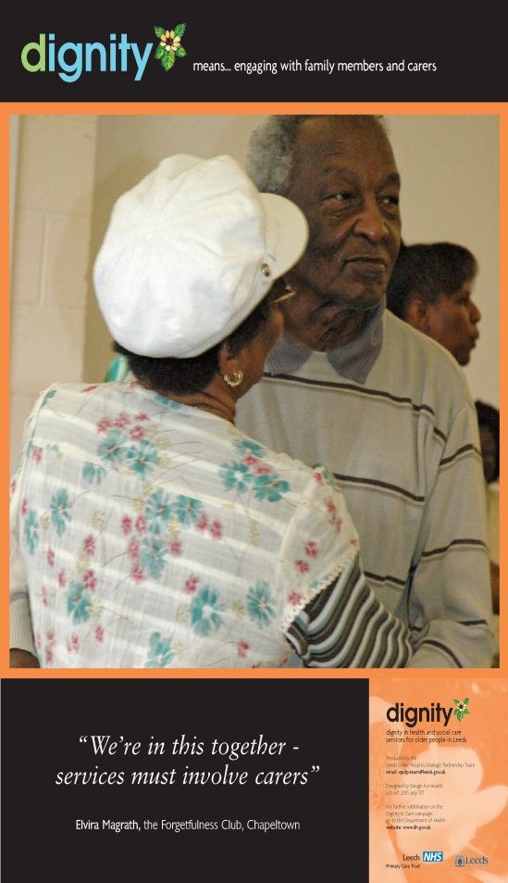
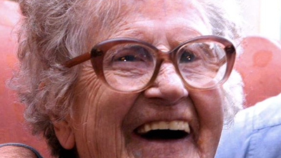
The Leeds Demographics 2

Slide 4
Inequalities in later life
Mean walking speed and wealth,
people aged 60+
English Longitudinal Study of Ageing

Slide 5
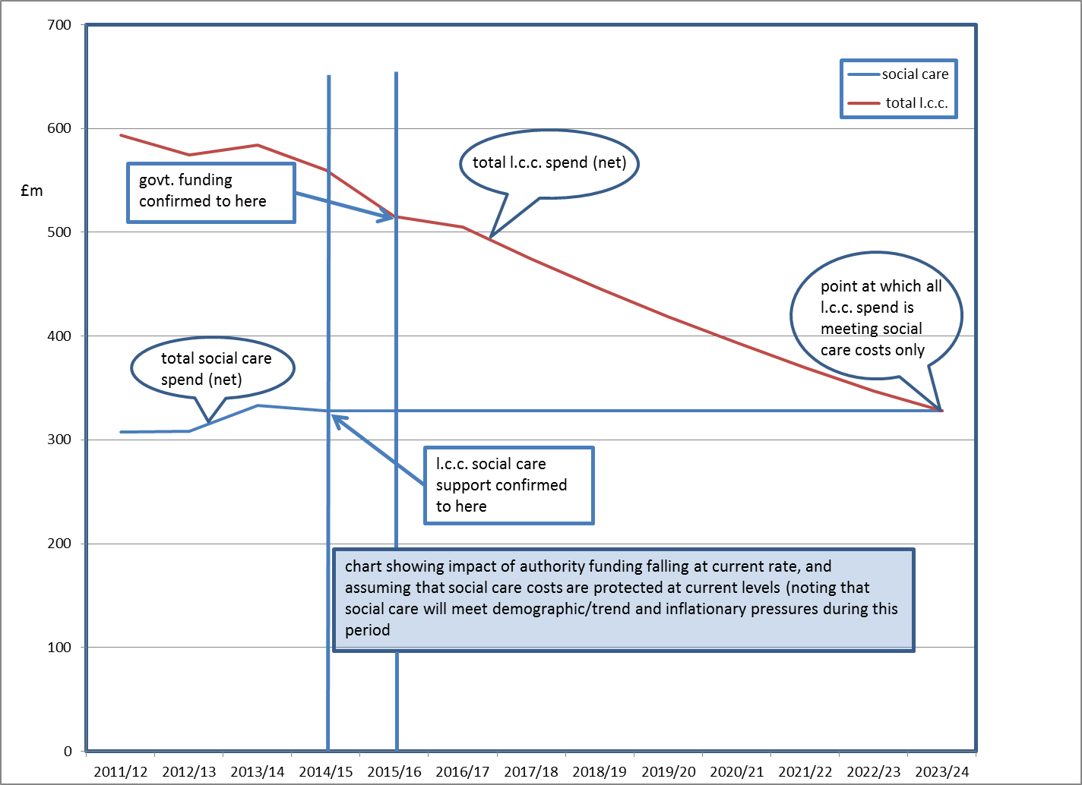
Social Care Projections

Slide 6
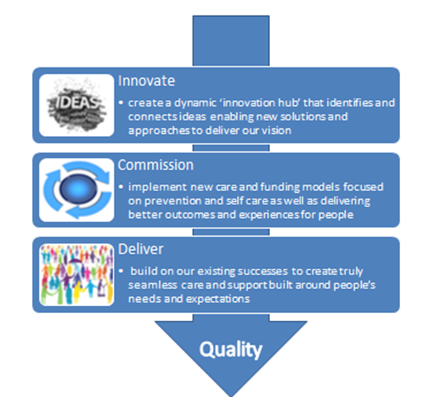
Bringing health and care together

Slide 7
Citizenship-based policy approach
Source: P.McGarry/MCC 2013
Medical | Care | Citizenship
Patient | Customer | Citizen
Focus on individual | Focus on individual, family and informal networks | Focus on neighbourhood and city
Clinical interventions | Care interventions | Promoting social capital and participation
Commission for ‘frail elderly’ | Commission for vulnerable people | Age-proofing universal services
Prevention of entry to hospital | Prevention to delay entry to care system | Reducing social exclusion
Health (and care system) | Whole system | Changing social structure and attitudes
Notes:
I want to start the discussion with this table, which sets out what we call the ‘citizenship approach’ to ageing , contrasting it to ‘medical’ and ‘care service’ approaches that are commonplace in ageing narratives and services.
These narratives tend to describe older people in terms of dependency and deficit, defining older people in relationship to the health and care system rather focusing on the wider aspects of ageing.
Of course we need high-quality medical and care services, but we also need to address the issues in the right-hand column – what we might call the wider determinants of ageing – if we are to have an impact on the pressures grouped around the red dotted line – the health and social care interface.
Source: Valuing Older People, MCC 2012

Slide 8
Leeds – A World Health Organisation
Age Friendly City
1. outdoor spaces and buildings;
2. transportation;
3. housing;
4. social participation;
5. respect and social inclusion;
6. civic participation and employment;
7. communication and information; and
8. community support and health services.

Slide 9
The Time of Our Lives: Implementation
(some examples of priority work areas)
Tackling Loneliness and Social Isolation
Preventing Excess Winter Deaths
Intergenerational Work
Healthy and Active Lives (Exercise, Nutrition)
Information (Inc. Digital Inclusion)
City Centre Management
Employment (Inc. Work, Retirement, Volunteering)
Transport
Cultural Offer
Leeds – A Dementia Friendly City
Asset Based Community Development

