Slide 1
Session 4: You have viability evidence – so what?

Slide 2
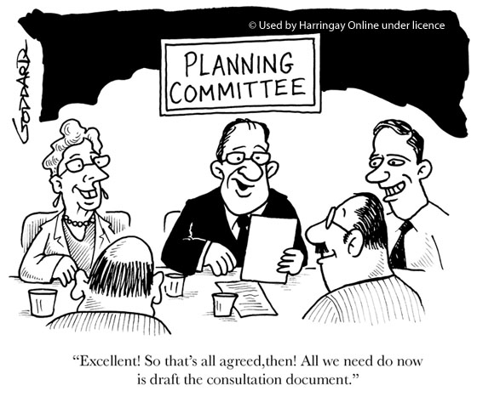
Consultation
Why
Who with
When
So what and what do you do with the results?

Slide 3
Consultations Engagement
A fundamental part of plan making and a requirement of NPPF, CIL Regs, Harman Guidance
Don’t be afraid to ask the developers
  For some evidence to support figures
  To explain / for detail
Record process and comments METICULOUSLY
What have you actually asked and is it in the context of delivering the development plan
Notes:
Engagement not consultation, you need to be pro-active (positively prepared as per the NPPF) and keep detailed notes of all discussions for audit purposes for when it gets to EiP e.g. record the justification for your methodology. Meticulous record keeping is very important to give sufficient weight in documents
Don’t be afraid to ask the developers for information, it can hep mitigate the risk of arguments happening at EiP. Highlight any examples you have where this has occurred.
Harman guidance essentially says that if you can’t get your evidence agreed you need to set out why you don’t agree. Need to get developers to think about the bigger strategic picture vs. minute details in the model

Slide 4
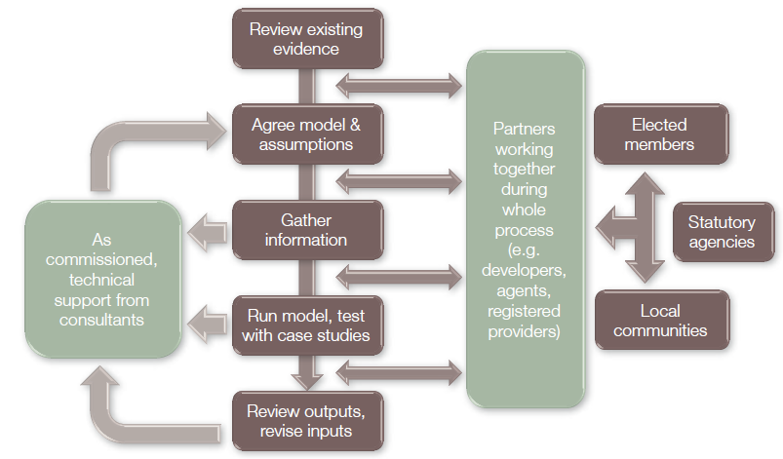
Engagement Phases
Delay at your peril
Two or three stages
Notes:
Avoid circular process and agree assumptions upfront (before modelling) to save time and money.
Don’t worry about not understanding CIL as there are only 7 charging schedules active nationwide so far, don’t be scared of change.
Durham HBF appointed Savills as it is easier to discuss issues professionally.

Slide 5
Stage 1 Engagement
Background and why
  Methodology
  Viability test
  Appraisal assumptions
Not results
Certainly not policy
Stage 1 includes establishing agreement on methodology and assumptions (build costs, sale prices etc.) Does not include workings.
Notes:
You cannot talk about how much a developer will pay in CIL until you agree methodology/assumption/inputs. Therefore sign off methodology and assumptions first.

Slide 6
Stage 2 Engagement
Changes made from first consultation (or not)
  Methodology
  Viability test
  Appraisal assumptions
Draft Results
Emerging conclusions
Still not policy
Notes:
What sites/type of sites are viable? At this stage you’re not yet drawing out policy. This stage is all about getting local plan evidence signed off before you get into the political dimension.
LPAs should seek to get cross party participation from Cllrs. Possibly highlight a politically informed decision you’re aware of here e.g. lots of market housing due to low AH target.

Slide 7
Stage 3 Engagement
Results
Factors other than viability to consider
Emerging and developing policy
Changes to existing policy
Approve now or hang on?
Notes:
Inevitably there will be some retro fitting based on the timing of your local plan formulation. The question is do you hang back if there is unpalatable evidence that you may need re-consult on? Overall scheme viability is hypersensitive to changes in the inputs e.g. prices. An increase of 1% can make a massive difference to viability.
LPAs should be engaging with developers on key sites one to one if they go to the heart of the plans deliverability – you’ll need mutual cooperation. You need to ask developers to provide their own data if they disagree with your figures. If you have audit that you requested justifications to assist you through the process and they’re not forthcoming with information and then raise objections at EiP you will have the upper hand.
Who will your objectors be? Are they trying to get Green Belt allocated? Are there NIMBYs? Your emphasis has to be on deliverability.

Slide 8
WPV & plans found sound in 2014
Local Authority | Developer’s Profit | Threshold Land Value
Barbergh | 17% | £370,000/ha
Cannock Chase | 20% on GDV | £100,000-£400,000/ha
Christchurch & East Dorset | 20% on GDC | £308,000/ha (un-serviced) £1,235,000/ha (serviced)
East Hampshire | 20% market/6% Affordable | £450,000/ha
Erewash | 17% | £300,000/ha
Fenland | 15-20% | £1-2m/ha (serviced)
GNDP | 20% market/17.5% large sites/6% Affordable | £370,000-£430,000/ha
Reigate & Banstead | 17.5% market/6% Affordable | £500,000/ha
Stafford | 20% (comprising 5% for internal overheads). | £250,000/ha
Staffordshire Moorlands | 17.5% market/6% Affordable | £1.26-£1.41m/ha (serviced)
Warrington | 17.5% | £100,000-£300,000/ha

Slide 9
Confidentiality
FOI Act 2000 (Sections 41 and 43(2))
Environmental Information Regulations 12(5)(e)
R (English) v East Staffordshire Borough Council and Anor (2010 EWHC 2744
Heygate Decision (2014)
Recent ICO Decisions (2012-2014)
RICS GN – Paragraph 4.3
“This viability report is provided on a confidential basis to the Council. We therefore request that the report should not be disclosed to any third parties (other than consultants instructed by the Council to review this report) under the Freedom of Information Act 2000 (sections 41 and 43(2)) or under the Environmental Information Regulations.” (para 4.3.3)
Planning Performance Agreements

Slide 10
Case study: South Worcestershire

Slide 11
Case Study – South Worcestershire Local Plan
Notes:
South Worcestershire Local Plan is a Joint Local Plan (Malvern Hills, Worcester City and Wychavon)
This is work produced by HDH Planning and Development in order to demonstrate how the cumulative impacts of policy can impact viability
For this case study will shall examine a profile of sites that have been appraised. We shall add cumulative policy costs to ‘no additional requirements’ baseline example to show you what happens once Affordable Housing, Density, Code for Sustainable Home level 4, Onsite Energy Generation are factored in. This example does not include CIL, CIL should be factored into your forthcoming work as the ‘cake’ is not limitless and all costs need to be factored in for your appraisals.

Slide 12
No additional requirements
No affordable housing
Built to Building Regulations (Part L)
Density informed by consultation with officers and developers – lower than policy to reflect current delivery (targets assume high content of flats etc)
Greenfield sites over 1 hectare have 40% open space
No CIL or s106
All other requirements over high quality and locally distinctive design and safe design remain

Slide 13
No additional requirements

Slide 14
Build Standards
Code for Sustainable Homes Level 4 from April 2013
  Add 6% to cost of house
SWLP 26 Renewable and Low Carbon Energy
(a) All new developments will be required to incorporate the generation of energy…by at least 10%.
All new development (as part of the major developments) will be required to incorporate the generation of energy…by at least 20%.
      Add 2.5% to cost of house (+/- £2,500 /dwelling)
NOT JUST REDUCING USE – ACTUALLY ABOUT GENERATION
NO EVIDENCE OF ANY PRICE BENEFIT FROM REDUCED ENERGY BILLS

Slide 15
CfSH Level 4 + Onsite Generation

Slide 16
Affordable Housing
15 or more 40%
10 – 14 30%
5 – 9 20%
As social rented, affordable rented and intermediate tenure and provided on site
NOT TESTED Less than 5, a financial contribution will be required.

Slide 17
Affordable Housing

Slide 18
Density
Density informed by consultation – lower than policy
Greenfield sites over 1 hectare have 40% open space
Brownfield sites NO Public Open Space
Greenfield sites less than 1ha but more than 5 units 20% open space

Slide 19
Affordable Housing, Density, CfSH4, Onsite Generation, ‘No’ CIL

Slide 20
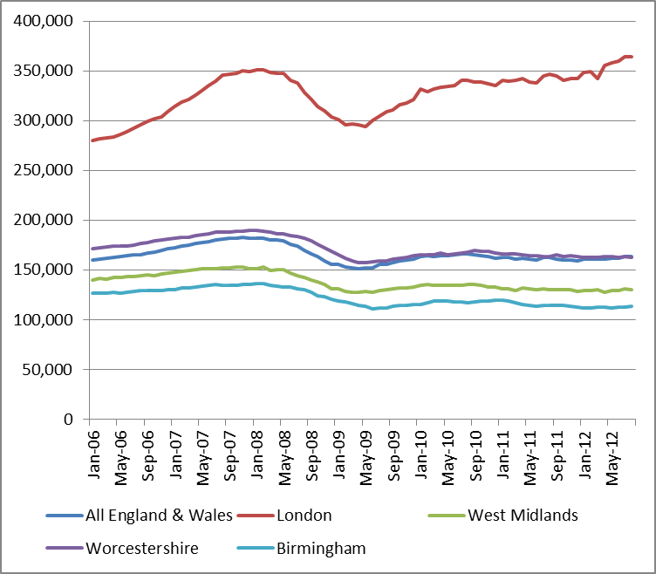
Uncertain Market
Average Prices
Notes:
The next two slides show the average prices and indexed turnover in Worcestershire set against the national average, London average, Birmingham average and West Midlands average

Slide 21
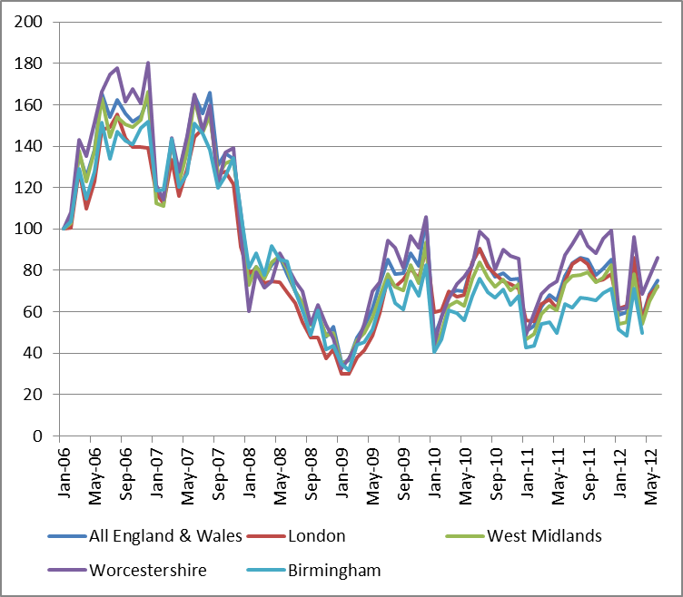
Uncertain Market
Indexed turn over (from January 2006)

Slide 22
5% fall in prices

Slide 23
Cumulative Impact of Policies Affordable Housing, Density, CfSH4, Onsite Generation
Notes:
This slide summarises the cumulative impact of Local Plan policies and includes a column showing a 5% drop in prices
It may be useful if your forthcoming study adopts a similar presentation in order to clearly show the impact of your policies on your site allocations and it may be helpful to review your Core Strategy retrospectively

Slide 24
So what?
You have a residual value – how to assess viability
  Competitive returns
  Harman (EUV Plus) v RICS (Market Value)
  Cushion
EUV Plus – reality checked against the market
Set it out – explain what you have done – don’t jump to a conclusion
Notes:
You’ve done your appraisals, you’ve thought about residuals/competitive retunes, you’ve considered the guidance. You know which sites are viable/unviable. Now what!?
NPPF/Guidance provide huge weight to carrying out effective consultation.

Slide 25
Appraisal considerations
Future considerations and viability over time
Scenario testing
Big impacts of little changes – hypersensitive model
Cumulative impact of policy
Pitfalls and preparing for the EiP

Slide 26
Potential Pitfalls
Out of date Local Plan adopted prior to NPPF
Robust housing target and up to date SHMA
Lack of 5 year supply
5% or 20% additional buffer on 5 year supply
Onerous discretionary policies
Approach to viability out of sync with RICS/Harman/Draft DCLG guidance website
Notes:
Set out your experiences of plans falling down on viability grounds

Slide 27
Context and Conundrum
Informing plan making process
v
retrofitting evidence to policy
Can you proceed
Goes to the heart of soundness
Cumulative impact
Don’t get into endless cycle of consultation, evidence, consultation, doubt, evidence, consultation….
Notes:
In determining whether or not you need to re-consult you need to judge whether or not a change in circumstances goes to the heart of the plans soundness (deliverability)
At some point you need to draw a line under your evidence collection.
Do not got too hung up on viability, as long as the majority of sites are broadly deliverable and you have a good audit and explanation of approach with record of good consultation you should be fine.
Other factors need to be balanced against viability e.g. building a community, tackling deprivation, encouraging growth over the whole plan period etc.
Changes to market conditions/grant funding/phasing should be considered. Monitor costs/values/need. Balance evidence base and market segmentation v schemes.

Slide 28
Preparing for the EiP
Examination Statements
PAS NPPF conformity toolkit
Participation Statement
Duty to Cooperate Memorandum of Understanding
Statement of Common Ground
Evidence Base Technical Note
Notes:
Set out how best to approach a memorandum of understanding/statement of common ground.
Examination statements are useful tools for bringing all the threads of argument together clearly and in one place. Do not repeat evidence, merely reference where the Inspector can find it.

Slide 29
Viability checklist
Would the approach to developer contributions/CIL have an unacceptably adverse impact on the economic viability of development, particularly when seen in the context of other future requirements?
Have you worked together with stakeholders to understand existing business needs and likely changes in economic markets operating in and across your area?
Are there enough sufficient sites, that are viable, to deliver the plan’s housing requirements over the plan period?

Slide 30
Viability checklist
Are your assessments of and strategies for housing, employment and other uses integrated, and do they take full account of relevant market and economic signals?
Have you assessed the likely cumulative impacts on development in your area?
Have you discussed viability with your key stakeholders, under the duty to cooperate, particularly with regard to those strategic priorities set out in paragraph 156 of the NPPF?

Slide 31
Viability checklist
Are affordable housing targets, thresholds and proportions fully justified and supported by an informed assessment of their economic viability; and will sufficient affordable housing be delivered to meet needs?
Do you have an understanding of changing needs and have you addressed barriers to investment in the Local Plan, including a lack of housing, infrastructure or viability?
Can you demonstrate that district-wide development/infrastructure costs have been considered alongside production of your Local Plan?

