Slide 1
Neighbourhood Planning
Examination and Referendum
A Local Planning Authority Perspective
3rd February 2015

Slide 2
Introduction
Where we are now
Examination:
  Purpose
  Process
  Appointing an Examiner
  Examiner’s Report
Referendum
  Arrangements
  Electorate

Slide 3
Where Are We Now? - Nationally
Over 1,300 communities have begun the Neighbourhood Planning process
44 successful referendums with five planned in January and February.
Many more plans are at or nearing examination

Slide 4
Where Are We Now - Locally
Plans at Publication Stage?
Plans at Examination Stage?
Plans at Referendum Stage?

Slide 5
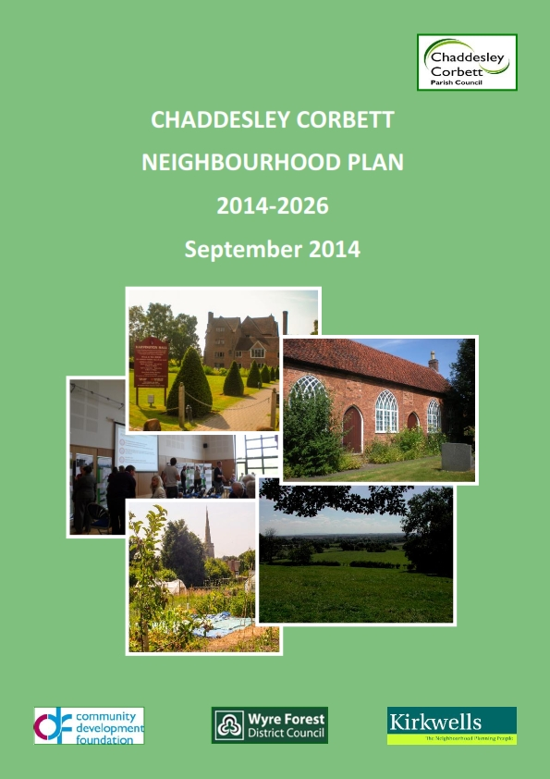
Wyre Forest District Council
Chaddesley Corbett Neighbourhood Plan – Made September 2014
Churchill and Blakedown Neighbourhood Plan – Regulation 14 consultation expected Sumer 2015
Early discussions with Bewdley Town Council

Slide 6
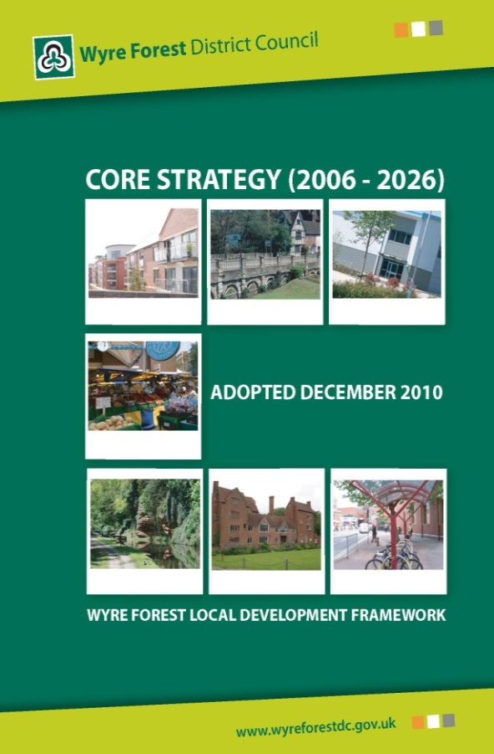
Wyre Forest District Council Policy Context
Adopted Core Strategy (December 2011)
Publication Site Allocations and Policies and Kidderminster Central Area Action Plan DPDs (July 2012)

Slide 7
Submission
LPA must satisfy itself that the submitted Plan complies with all statutory requirements before presenting it for examination.
LPA does not make a judgement as to whether the Plan meets the Basic Conditions until after the Examiner’s Report has been received.
Publicise Plan for six weeks

Slide 8
The Examination
The examinations tests the Plan against the Basic Conditions.
No ‘test of soundness’
No other material considerations are examined.

Slide 9
The Examination Process
Written representations
Can be a public hearing but this is unlikely
The Basic Conditions Statement is important in demonstrating how the Basic Conditions have been met.
Representations submitted during the Publication period will be considered during the Examination.

Slide 10
The Examiner
The examiner can be anyone who meets the criteria in The Localism Act 2011:
  (a)is independent of the qualifying body and the authority,
  (b) does not have an interest in any land that may be affected by the draft order, and
  (c) has appropriate qualifications and experience.
Suitable candidates will often be planning consultants or other planning professionals, employees of another LPA or planning inspectors.

Slide 11
NPIERS Referral Service
Application form
3 CVs provided – tailored to plan and examiner availability
Qualifying Body and LPA must agree appointment
Contract is between LPA and Examiner, NPIERS set daily rate

Slide 12
Appointing The Examiner - Issues
Timescales
Agreement between LPA and Qualifying Body
Sole practitioners – PII may be lower than what is usually required by LPA – weigh up the risk.
Expenses are additional to daily rate

Slide 13
The Examiner’s Report
The examiner will determine whether or not the plan meets the Basic Conditions
The report may set out recommendations which are required to be addressed and other recommendations.
Will make recommendations on the referendum area

Slide 14
Chaddesley Corbett Examiner’s Report
Set out required changes as well as advisory changes
Recommendations were discussed with the Parish Council
Recommended that the Neighbourhood Plan area was the boundary for the Referendum area

Slide 15
Decision Statement
LPA are required to publish a Decision Statement following receipt of Examiner’s Report.
Statement should set out whether or not the Plan will proceed to referendum.
If the Plan is to proceed to referendum, the date of the referendum should be included.

Slide 16
The Referendum
Organised and funded by the ‘relevant Council’
New Burdens funding
Must be conducted in accordance with:
  Neighbourhood Planning referendum Regulations 2012, as amended by the Neighbourhood Planning (Referendum) (Amendment) Regulations 2013
  Neighbourhood Planning (Prescribed Dates) Regulations 2012
Combined Polls

Slide 17
Who Votes?
Any person within the Referendum area who meets the criteria to vote in a local election.
In designated business areas businesses get to vote:
  Two polls
  If results differ LPA decides
  Much longer lead in time

Slide 18
The Poll
No minimum turn-out
Considerable variation in turn-outs to date
Simple majority
Yes vote – Plan ‘made’
No vote – ‘Plan can not be ‘made’

Slide 19

Chaddesley Corbett
Turn out – 27.8%
81% in favour, 19% against
No active campaign for or against the Plan

Slide 20
Poll Results and Decision Statement
Poll results were published in accordance with the Regulations.
A decision statement was approved at September Council and the Plan was formally ‘made’

Slide 21

Costs
Examination – estimated £3K
Referendum – expenditure – estimated £3.5K excluding officer time

Slide 22
Conclusions and Top Tips
Maintain a continuous working relationship with the Qualifying Body where possible
Think about the examination as early as you can
Work with the elections team at the earliest opportunity.
Ensure that the Qualifying Body understand and promote the importance of the referendum throughout the Neighbourhood Planning process.

Slide 23
Questions?

